Slide 1

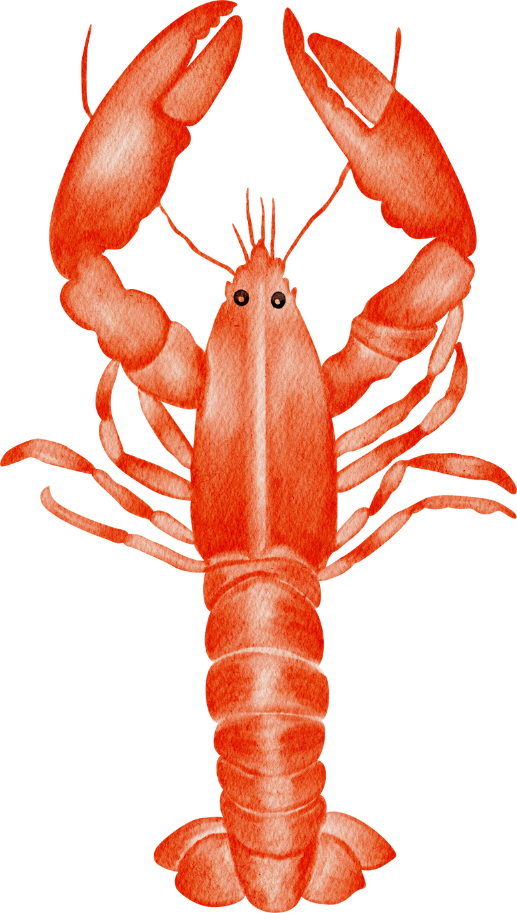

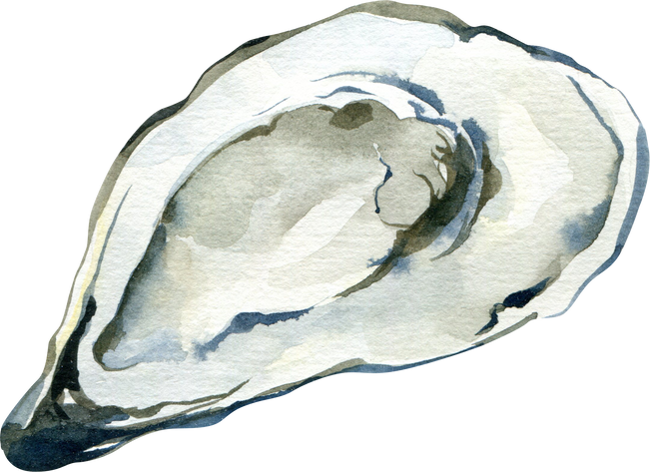
Guide the
Tides:
An Introduction to
Sustainable Seafood
PREPARED BY MADISON SEARS
Image/Graphic Sources: Canva
Notes:
Introduce the topic and scientist to the class

Slide 2
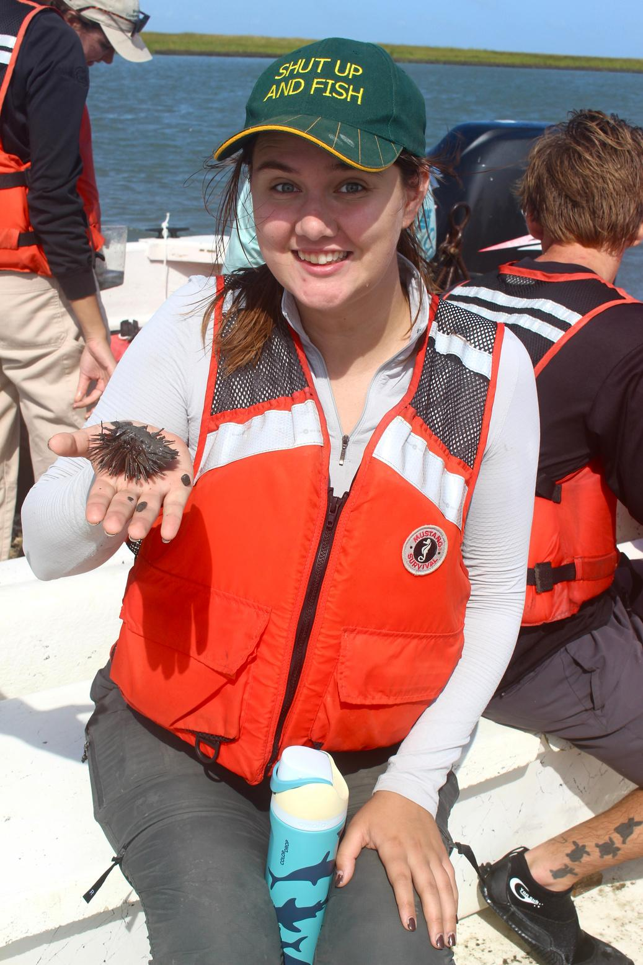
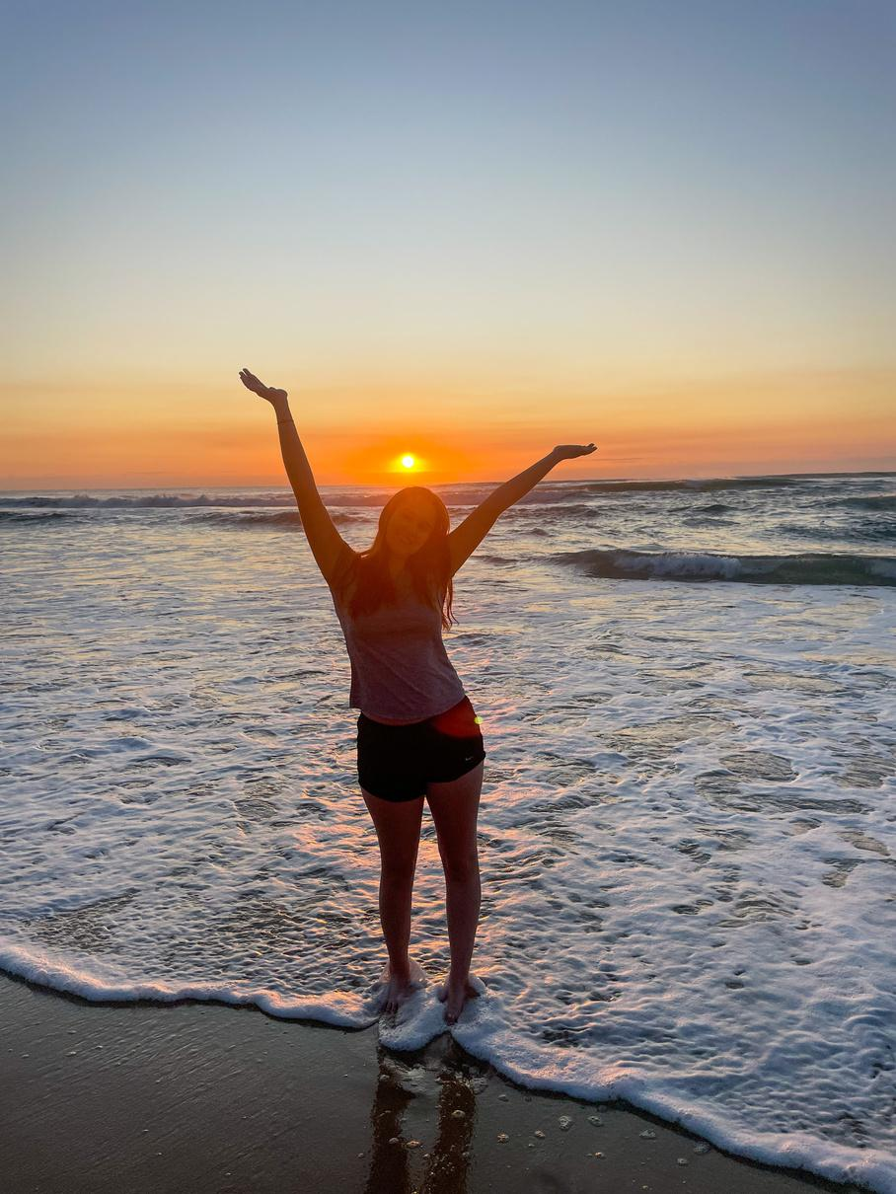
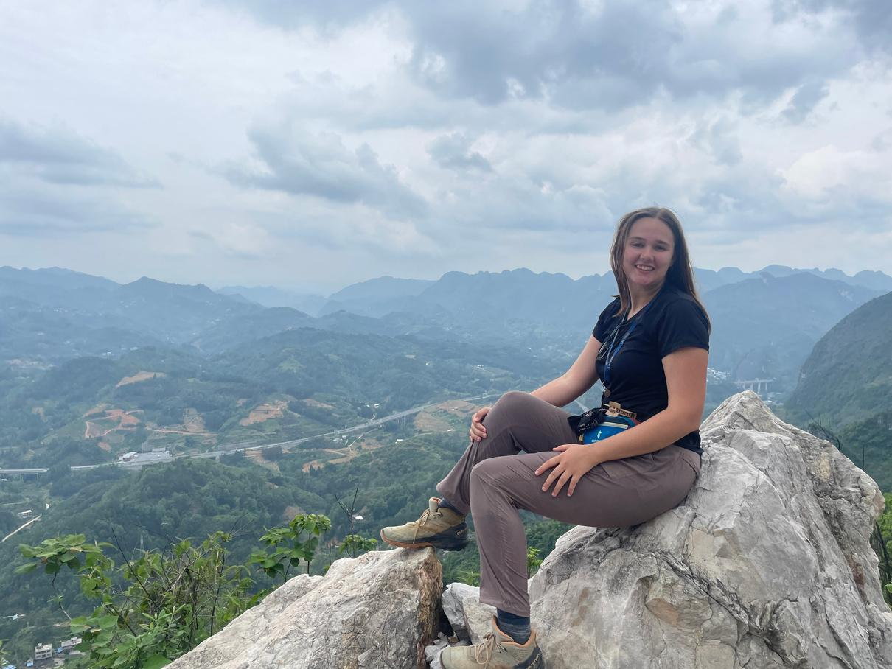
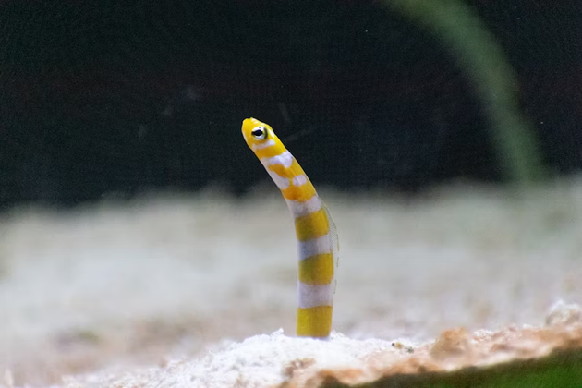
Meet the Scientist:
Hi, my name is Madison Sears! I study fisheries and seafood at the Virginia Institute of Marine Science! I am from Houston, TX and my favorite animal is a garden eel.
I recently worked at the Virginia Aquarium teaching visitors about seafood, and I am excited for you to learn too!
Image/Graphic Sources: Madison Sears, Unsplash, Canva
Notes:
Introduce the topic and scientist to the class

Slide 3
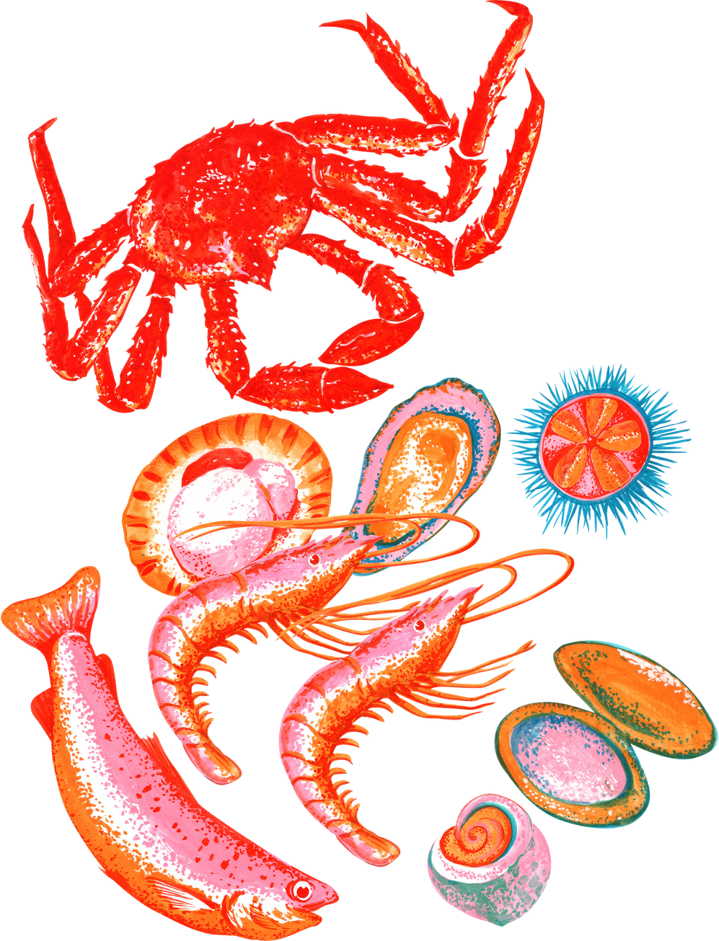
Raise your hand if you eat seafood!
What’s your favorite seafood?
Image/Graphic Sources: Canva
Notes:
Ask the students to raise their hands if they eat seafood, and then ask students with their hands raised what their favorite seafood to eat is. If not, do your family/friends eat seafood?

Slide 4
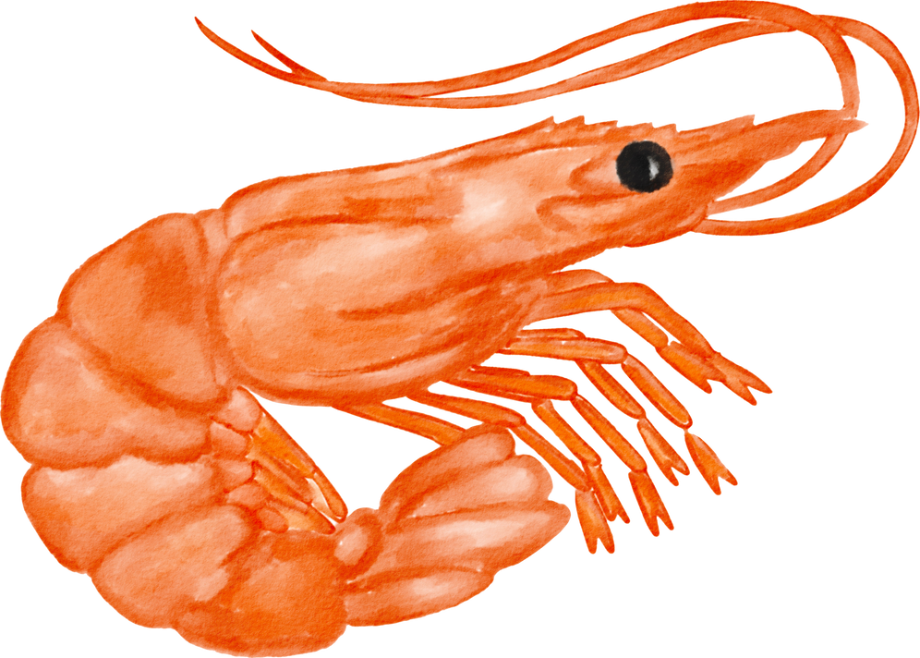
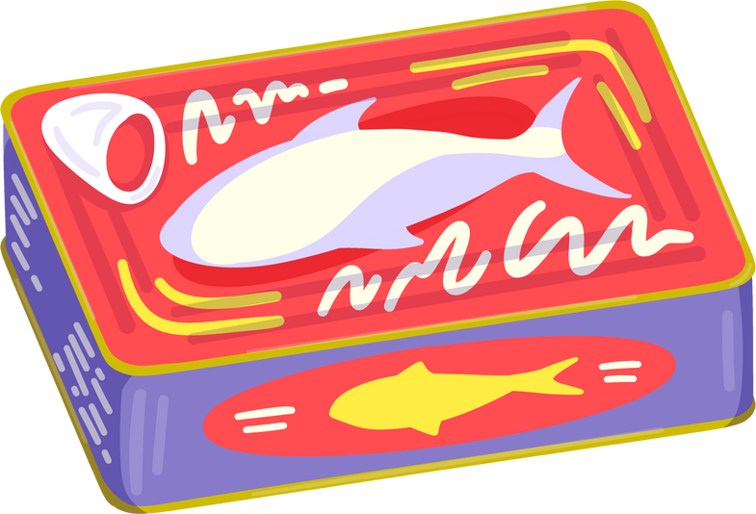
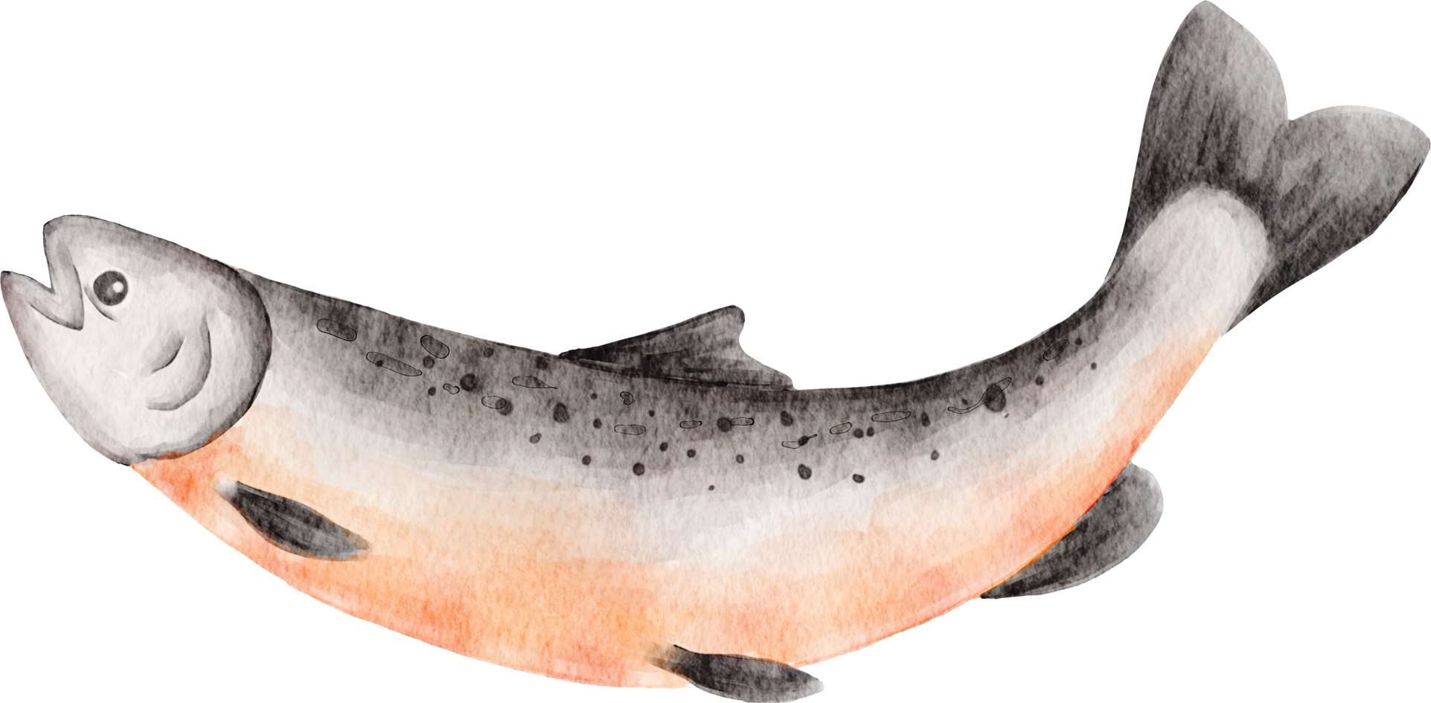
Most popular seafood in the United States:
  Shrimp: ~ 5.5 pounds per person every
year
  Salmon: ~ 3.22 pounds per person every year
  Canned Tuna: ~ 2.2 pounds per person every year
Image/Graphic Sources: Canva
Notes:
Introduce statistics on popular seafood in the United States, as well as global fish consumption. Introduce the topic of seafood being a resource that is extremely important to people everywhere

Slide 5
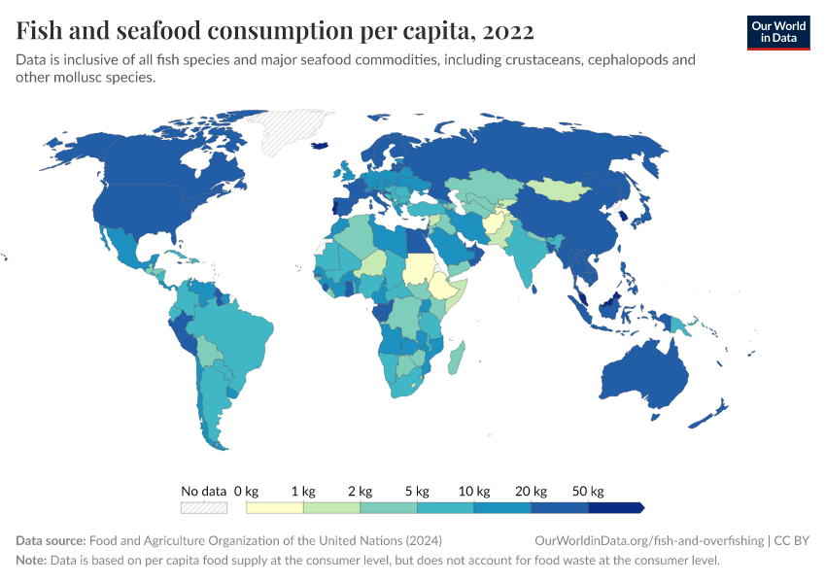
Per capita = per person
Image/Graphic Sources: Canva, FAO
Notes:
Introduce statistics on popular seafood in the United States, as well as global fish consumption. Introduce the topic of seafood being a resource that is extremely important to people everywhere

Slide 6
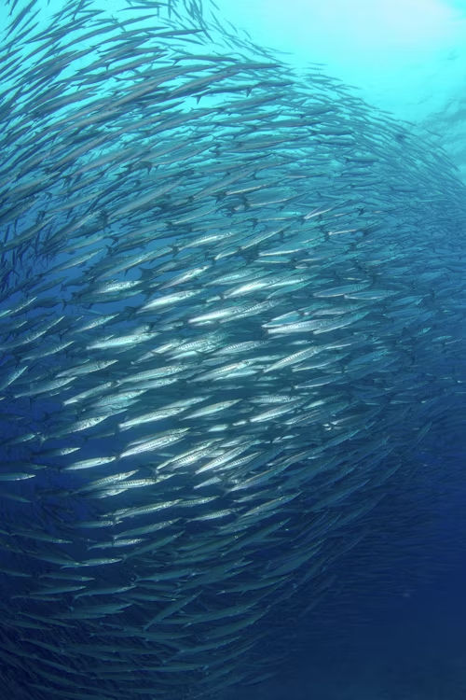
Commercial Fisheries
Commercial fishing: the activity of catching fish and other seafood for commercial sale and profit, mostly from wild fisheries.
Commercial fisheries provide millions of people around the world with food and jobs.
Commercial fisheries are different than subsistence fisheries, which are fishermen that practice harvesting marine or freshwater resources for personal food, shelter, local sale, etc.
Image/Graphic Sources: Canva, Unsplash
Notes:
Define commercial fishing and emphasize its importance again, as a food source and to the economy. Distinguish commercial fisheries from subsistence fisheries.

Slide 7
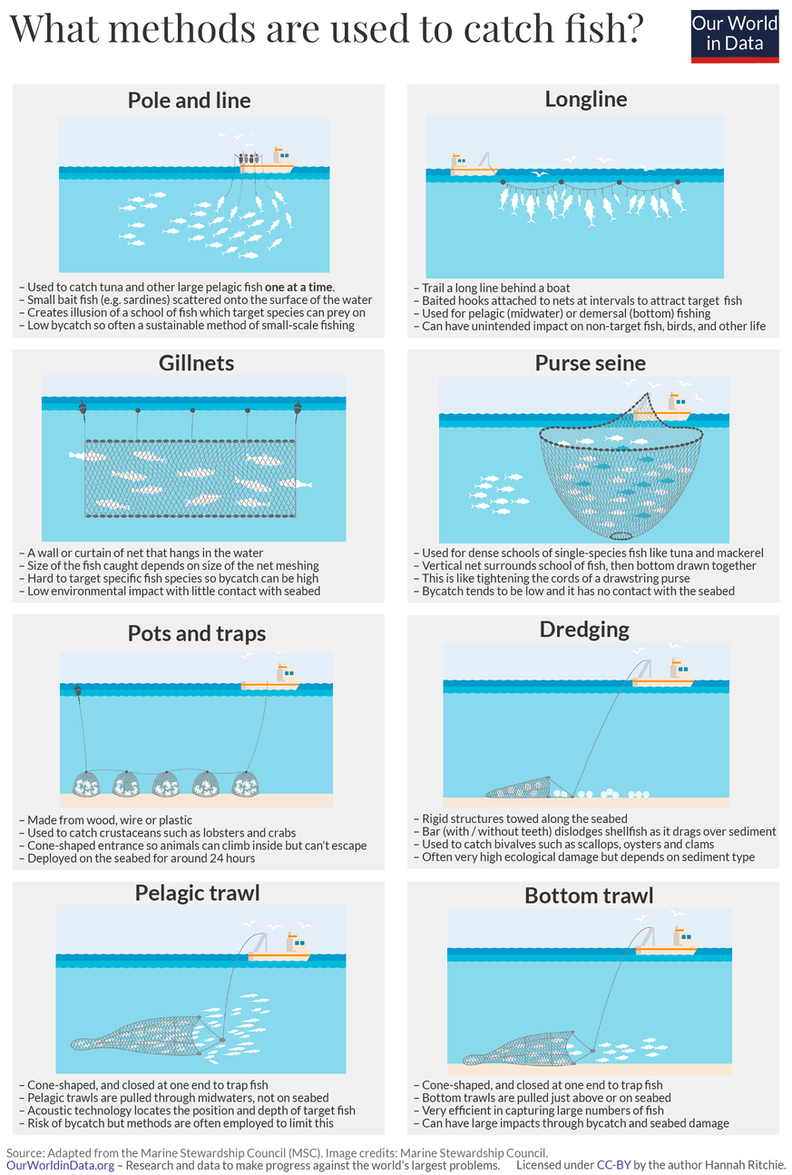
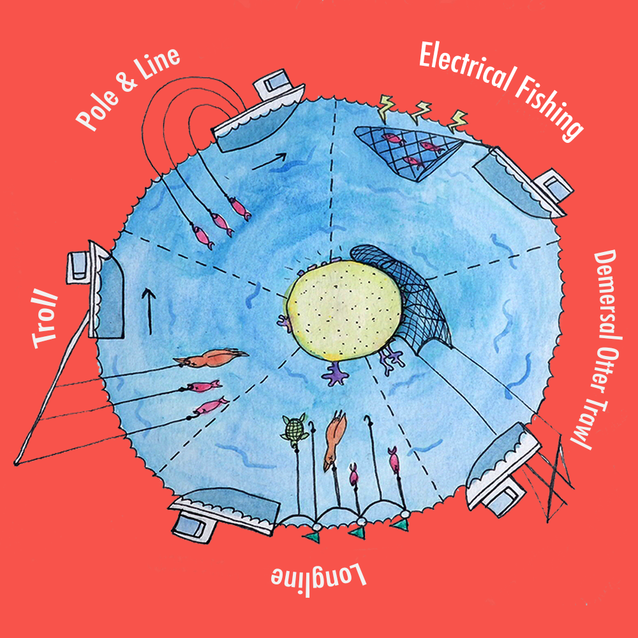
Commercial Fisheries
Fishermen use many types of gear to catch as many fish as possible
Image/Graphic Sources: Canva, MSC, Best Fish Forward
Notes:
Introduce the figure showing different types of fishing gear used by commercial fishermen without going into major detail, but mentioning that fishing technology has been optimized to bring in as much food and economic value as possible for growing populations.

Slide 8
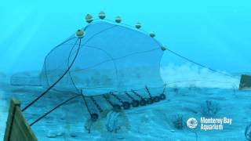
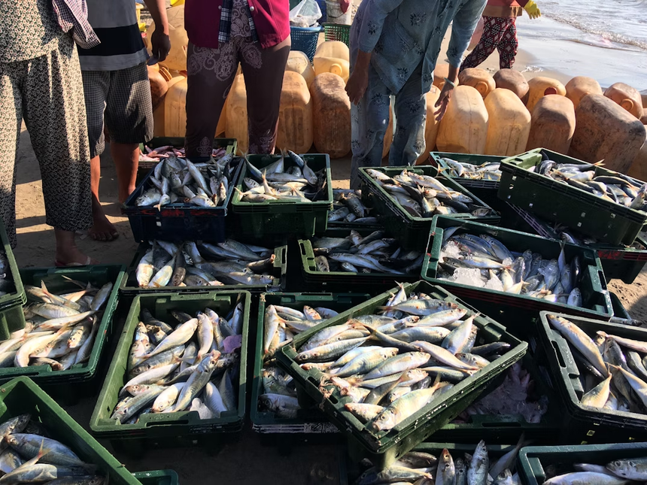
Environmental Impact
How fishing impacts ocean ecosystems:
Direct impacts:
  Overfishing → catching too many fish does not allow populations time to replenish
  Bycatch → accidentally catching and harming non-target species like sharks and sea turtles
  Destructive fishing gear → can damage ocean habitats like coral reefs
Indirect impacts
  Food web disruptions → Catching too many prey species will not leave any food for predators
  Genetic changes → Harvesting all of the large fish will cause future generations to be smaller in size
Image/Graphic Sources: Canva, Unsplash
Notes:
Introducing the environmental impacts that commercial fisheries have on the environment, mentioning that subsistence fisheries often do not have as many environmental impacts because they are being practiced at a smaller scale.
Overfishing occurs when more fish are being harvested at a faster speed than they can reproduce and replace the fish that are being removed
Bycatch is the harvest of fish or shellfish other than the species for which the fishing gear intended to catch. Oftentimes, larger marine animals will get stuck in fishing nets and are accidentally brought onto fishing boats. These animals are thrown back into the water, but are often already injured or dead.
Destructive fishing gear damages many ocean habitats across the globe. Play video on slideshow about bottom trawl net
Food web disruptions: harvesting too many individuals at a certain level in the food web can have impacts on other parts of the food web. If too many prey animals are harvested, then predators have no food. If too many predators are harvested, the prey species population becomes way too big and faces increased competition for resources.
Genetic changes occur when fishermen target all of the largest fish of a species (because that is the most valuable for consumption). This leaves only the smallest individuals to remain in the ocean and reproduce with each other, producing smaller offspring.

Slide 9
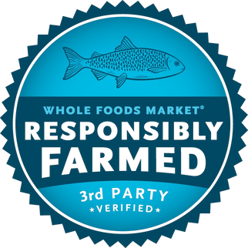
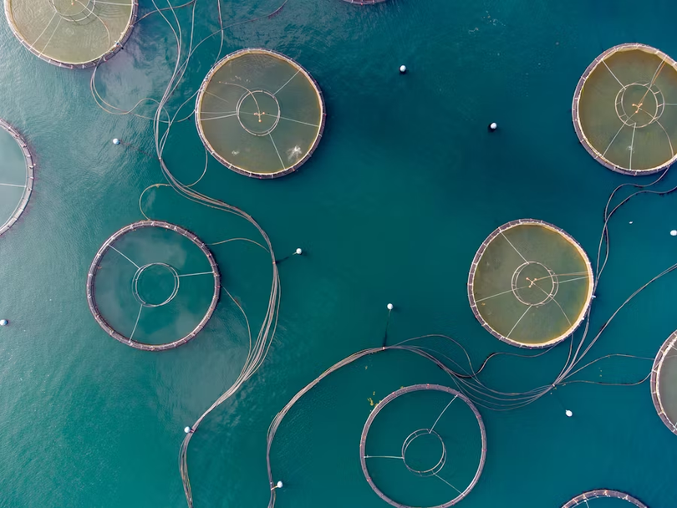
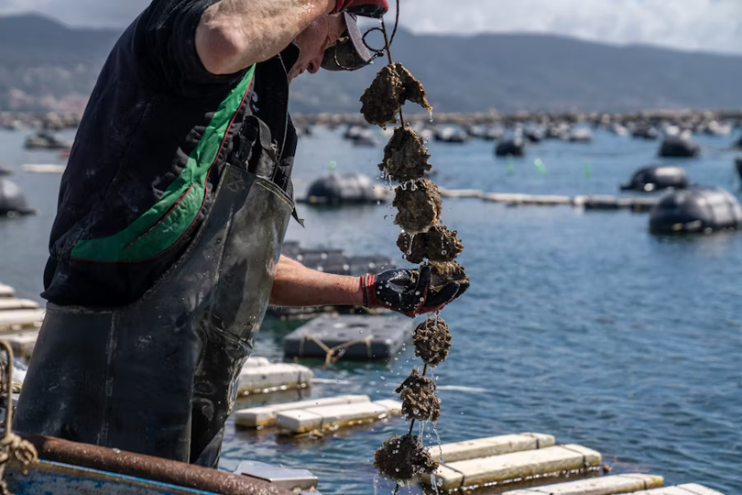
Aquaculture
Aquaculture is the raising of fish or shellfish under some controls. Feed and ponds, pens, tanks, or other containers may be used.
Also known as fish “farming”
Can have a variety of positive and negative environmental and health impacts
Image/Graphic Sources: Unsplash, Canva, Whole Foods
Notes:
Aquaculture is an alternative way that we can harvest fish for consumption. Also known as “fish farming”, fish or shellfish are raised under human control in a variety of different settings. They can have a variety of different impacts on the environment and health that can be both positive and negative. In the image on the top right, fish are being raised in pens in the open ocean. On the bottom right, shellfish are being grown in cages on the coast.
(Slide 10) Oyster aquaculture is a cool way to farm seafood while still having a positive environmental impact. Oysters are filter feeding organisms, meaning that they get their food by filtering water through their bodies and extracting small bits of food and nutrients. This results in cleaner water due to removal of many nutrients by the oyster. (Emphasize graphic top right to help students understand the full cycle) This is possible with many other types of shellfish, which make them a sustainable seafood choice in many places

Slide 10
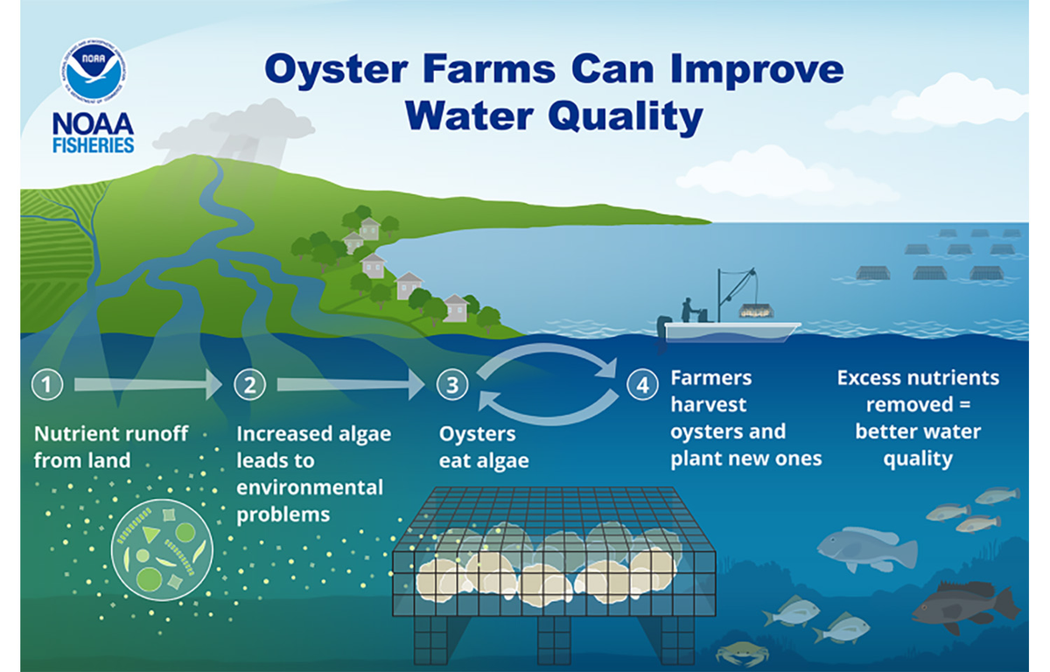
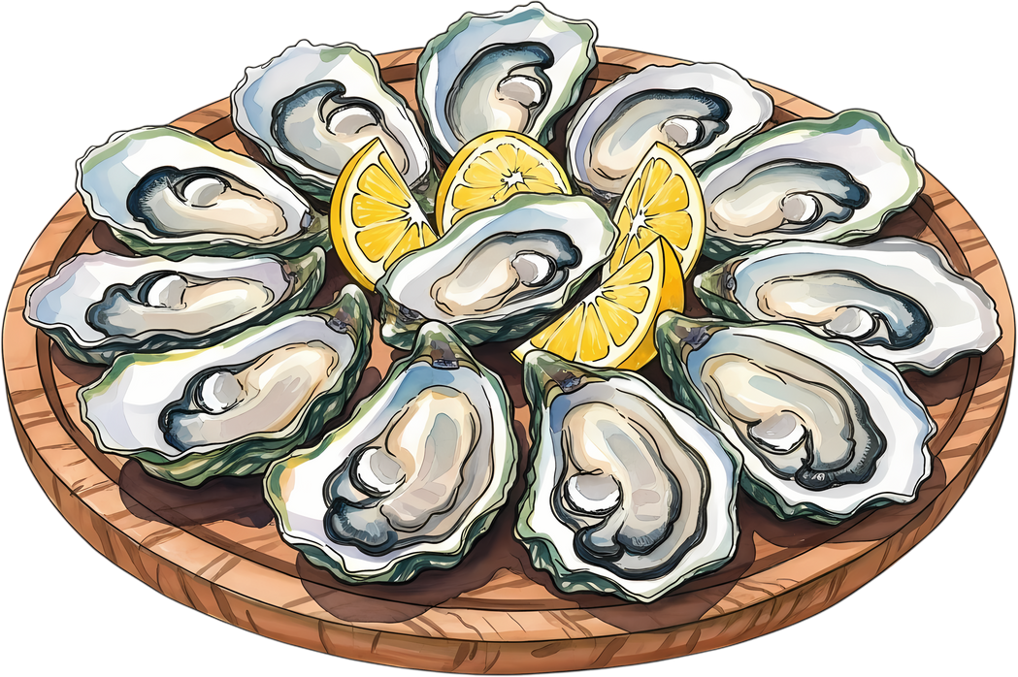
Example: Oyster Aquaculture
While aquaculture or farmed fish may have a bad reputation, it can also be better for our environment!
Oyster farms provide a sustainable source of protein and clean up the local environment at the same time
Most shellfish can be farmed like this, which makes them a sustainable seafood choice in many regions
Image/Graphic Sources: Canva, NOAA Fisheries
Notes:
Oyster aquaculture is a cool way to farm seafood while still having a positive environmental impact. Oysters are filter feeding organisms, meaning that they get their food by filtering water through their bodies and extracting small bits of food and nutrients. This results in cleaner water due to removal of many nutrients by the oyster. (Emphasize graphic top right to help students understand the full cycle) This is possible with many other types of shellfish, which make them a sustainable seafood choice in many places

Slide 11
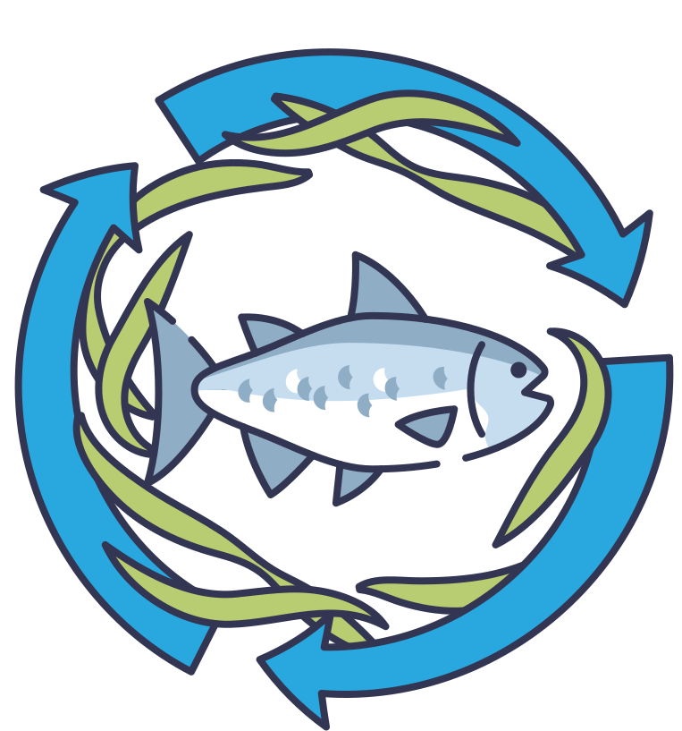
What are sustainable fisheries?
A sustainable fishery is a fishery that is harvested at a rate that will meet the needs of humans without harming the environment or preventing future generations from having the same access to that seafood
A sustainable fishery will have fish populations that remain relatively stable or continue to grow
Image/Graphic Sources: Canva
Notes:
First, ask students what they think makes a fishery sustainable, or to define sustainable fisheries.
A sustainable fishery is a fishery that is harvested at a rate that will meet the needs of the present without harming the environment or preventing future generations from having the same access to the fishery.
Populations in the wild will remain relatively stable or grow to larger numbers while still being harvested by humans

Slide 12
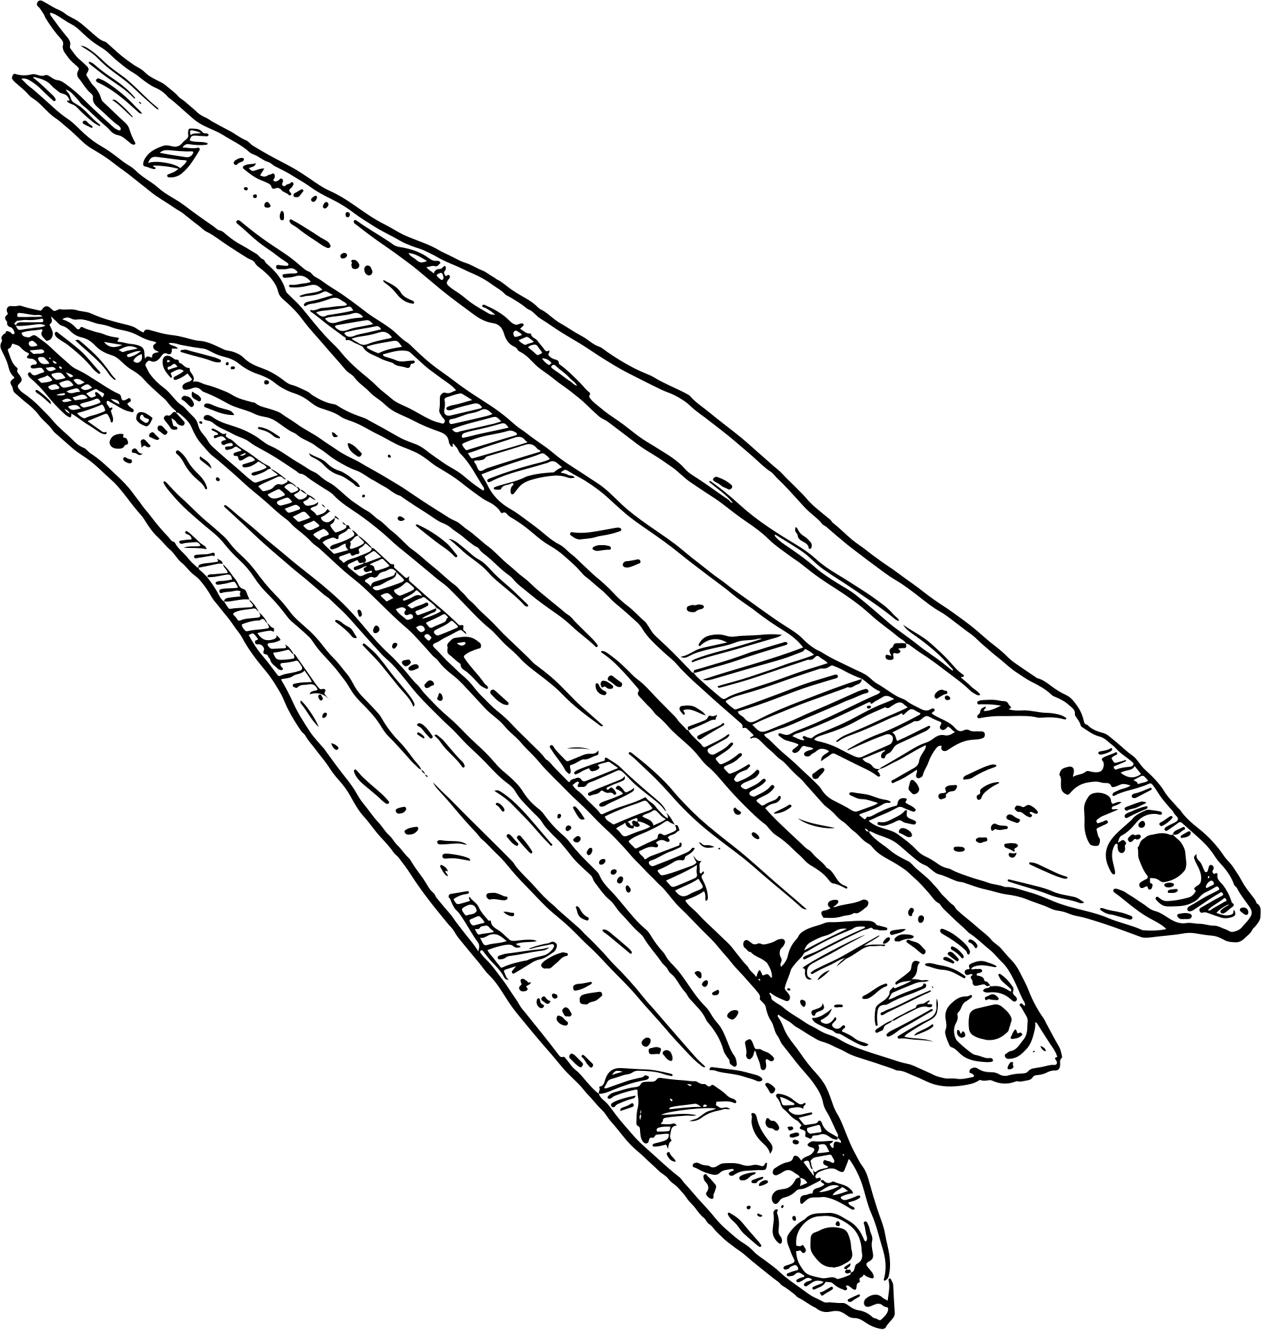
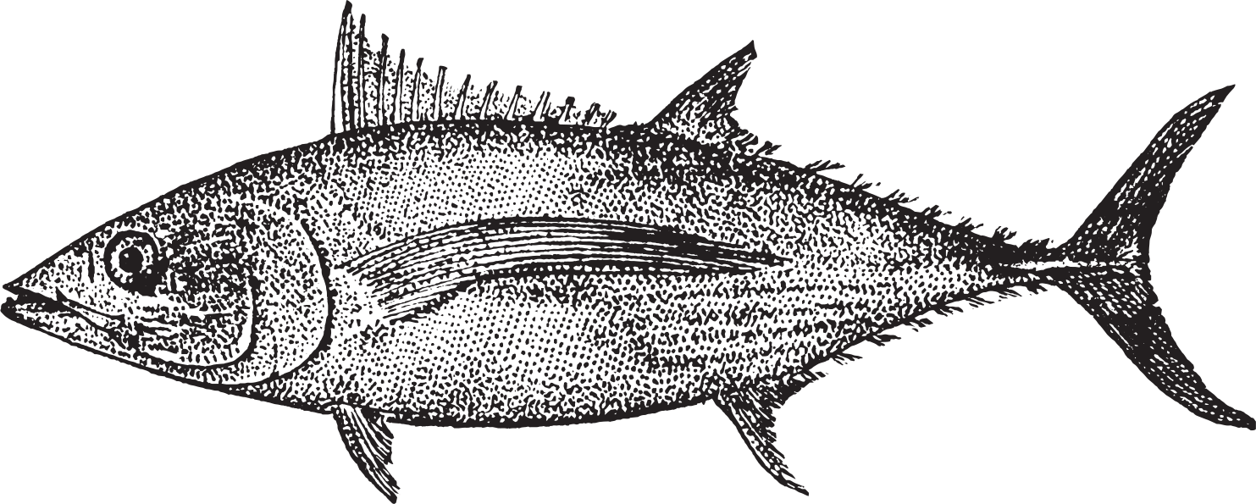
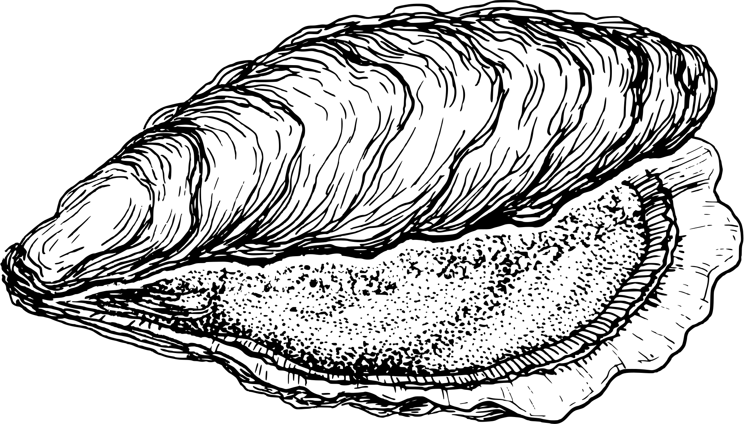
What makes a species “sustainable”?
  Size/growth rate → Organisms that grow quickly take less time to replace in the environment
  Spawning frequency → Organisms that lay eggs/reproduce more often are being replaced in the environment faster
  High fecundity → Organisms that lay a lot of eggs at a time are contributing more offspring to the population
  Shorter lifespan → Short lifespans often mean they reach maturity very quickly, so they can reproduce earlier
  Low on the food chain → “Prey” species often have larger population sizes and are more resilient to pressure
Image/Graphic Sources: Canva
Notes:
Some species have traits that make them more “sustainable” than others and by looking at these characteristics, scientists can manage species more efficiently.
Size/growth rate- organisms that grow quickly reach maturity faster and replace themselves faster in the environment
Spawning frequency- organisms that lay eggs more often are adding more individuals to a population, allowing the population to increase
High fecundity- fecundity refers to the amount of offspring an individual can produce. Higher fecundity means they are laying more eggs, allowing for faster population growth.
Short lifespan- often means that individuals reach maturity very fast. It takes less time for new organisms to be added to the population
Low on the food chain- organisms that are lower on the food chain usually have higher population sizes and are more resilient to pressure from predators, including fishermen

Slide 13
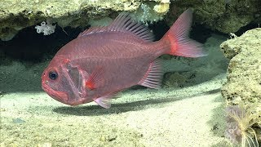
Example: Orange Roughy
Image/Graphic Sources: Canva
Notes:
Play video about the orange roughy - a case study on poor fisheries management and biological characteristics that can lead to the downfall of a fishery

Slide 14

Why was it so easy for the orange roughy to be wiped out by fisheries?
Image/Graphic Sources: Canva
Notes:
Ask students why it was so easy for the orange roughy populations to be depleted by fishing pressures?

Slide 15
Why was it so easy for the orange roughy to be wiped out by fisheries?
  Long lived species (~150 years)
  Slow growing (~1 inch per year)
  Late reproductive age (first spawning at age 20)
  Low fecundity - females did not produce very many eggs per year
Biological characteristics play an important role in determining how to manage a fishery!
Image/Graphic Sources: Canva
Notes:
Review characteristics talked about on slide 11 that apply to orange roughy

Slide 16
How could you manage the orange roughy fishery to make it more sustainable?
Image/Graphic Sources: Canva
Notes:
Ask students why it was so easy for the orange roughy populations to be depleted by fishing pressures?

Slide 17
How could you manage the orange roughy fishery to make it more sustainable?
  Size limit (for example, only fish over 12 inches long can be harvested
  Catch limits (fishermen can only harvest 25 fish per day)​
  Protected habitat areas
There is no right answer when it comes to fisheries management because it is always changing, but these are all great ideas!
Image/Graphic Sources: Canva
Notes:
Ask students why it was so easy for the orange roughy populations to be depleted by fishing pressures?

Slide 18
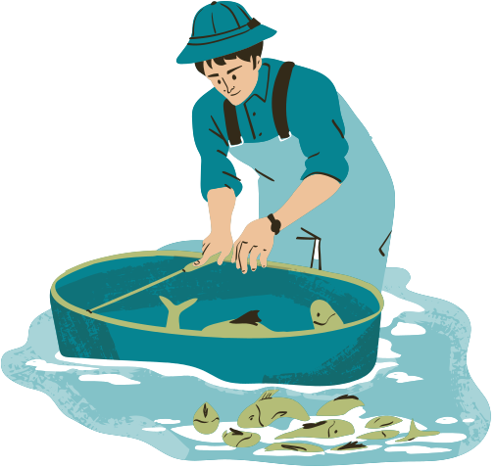
Who decides what is sustainable?
Fisheries scientists are constantly collecting data on wild fish populations and their health to see how human activity is impacting them.
In the United States, fisheries are managed by local government organizations that work with scientists to develop management plans and keep our fisheries sustainable
  NOAA Fisheries
  US Fish and Wildlife Service
  States may also have their own management agencies
Image/Graphic Sources: Canva
Notes:
Brief overview on how fisheries management is related to sustainability and who makes the decisions. Scientists are constantly working alongside governmental organizations to make decisions on how to best manage fisheries and decide what is sustainable and what is not. NOAA Fisheries manages many of the fisheries we have in the United States, and is where we will get all of the data for our activity today!

Slide 19
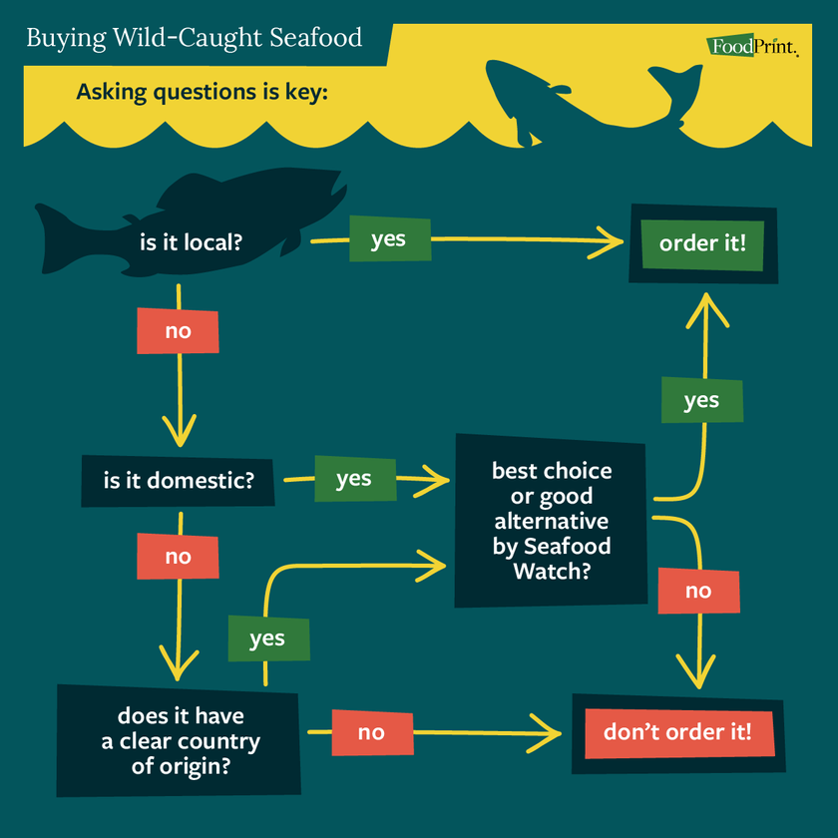
How can scientists protect fish populations?
Science communication is an important skill that scientists learn - it helps them to tell the public about their research and keep them informed on important things happening in Earth’s ecosystems.
By communicating findings about the status of commercial fisheries, scientists can help the public make more informed decisions on the seafood that they purchase or consume
Image/Graphic Sources: Canva, Foodprint
Notes:
Science communication is a skill that is extremely important for scientists to learn, because it helps them inform the public about the work that they do. If science communication is done properly, society has a better understanding of the world around them and the impacts that they have. If fisheries scientists communicate their findings about the health of seafood species, the public can be more informed when making decisions about buying or eating seafood

Slide 20
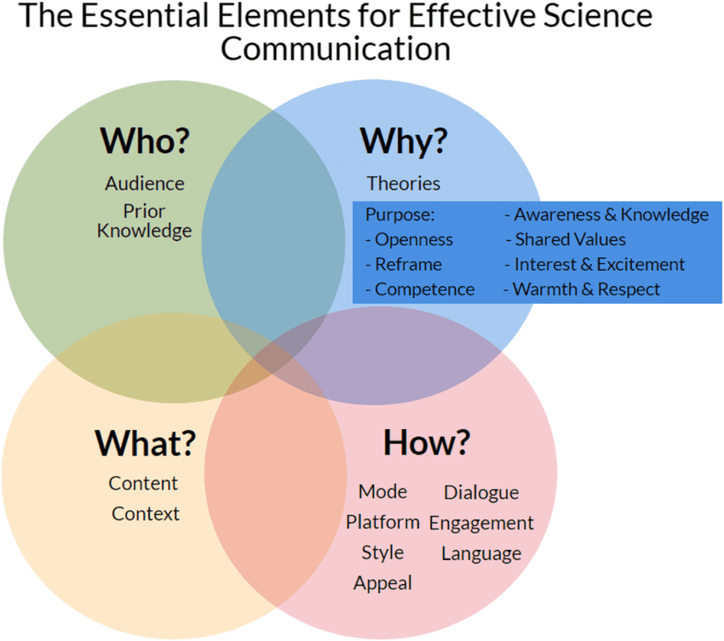
How can we effectively communicate science?
Science communication is when scientists teach the public about the results of their research and experiments
Scientists need to ensure that this information is easy for anyone to understand, is important and relatable to their audience, and focused on the big picture
Image/Graphic Sources: Canva, Activate Learning
Notes:
Science communication is a skill that is extremely important for scientists to learn, because it helps them inform the public about the work that they do. If science communication is done properly, society has a better understanding of the world around them and the impacts that they have. If fisheries scientists communicate their findings about the health of seafood species, the public can be more informed when making decisions about buying or eating seafood

Slide 21
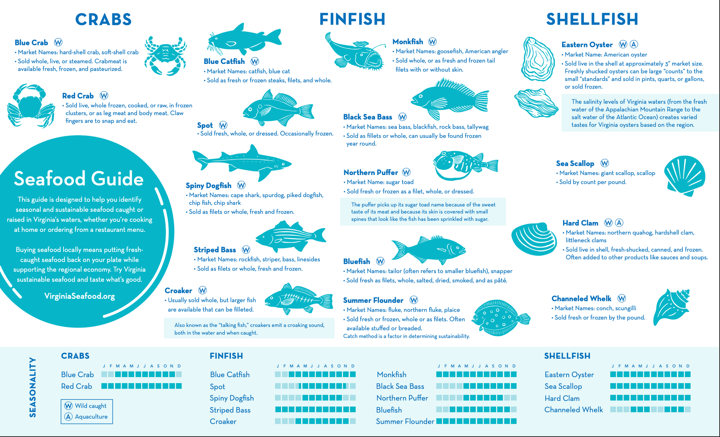
Image/Graphic Sources: Canva
Notes:
One way that this can be done is through the use of seafood guides- this example is from the Virginia Aquarium. State the importance of communicating the science in a way that is easy to read, understand, and use for day-to-day decision-making.

Slide 22
Activity: Classroom Seafood Guide
Let’s practice being science communicators, and make our own seafood guide to use!
Students:
  Divide into groups of 2-3, with at least one laptop per group
  Open the class google slides template
  Choose a seafood species to create a seafood card for
  Fill in all of the required information using the NOAA Fisheries Sustainable Seafood Species Directory
  Categorize the species based on the information you find and what you learned today about sustainable seafood
Image/Graphic Sources: Canva
Notes:
Students will split into groups of 2-3 (either self assigned or teacher assigned) with at least one laptop/tablet with internet access per group
Instructor will open the classroom seafood guide template and share access with student groups so that they can edit the slides
Students will follow the instructions given in the slides to select a species in their region
Navigate to NOAA Fisheries Sustainable Seafood Species Directory
Under region, select the region that you are in/are closest to
Students may then select their species from this list (with approval from teacher so that no species are repeated)
Students must navigate through the species page to fill in required information on the seafood card
While students are completing this activity, instructor can walk around or watch collaborative slides to check on student progress and answer questions
Once all information is filled in, students will decide if they think the species is sustainable or not based on the information they found by selecting Best Choice, Alternative, or Avoid
Students will add a picture of their species to the full seafood guide at beginning of template in the correct category
If time allows, students may research multiple species (dependent on class size/speed). If students do not finish within the allotted time, it can be finished as homework and reviewed at the beginning of next class.
After all groups have finished, the seafood guide is complete! Feel free to upload completed seafood guide here (drive link) and look through other seafood guides completed by classrooms

Slide 23
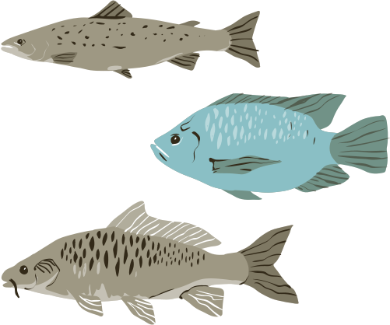
Review: Sustainable Seafood
What did we learn?
  Commercial fisheries harvest aquatic resources for sale and consumption
  They have a variety of environmental impacts but contribute a lot to society and the economy
  Sustainable fisheries are fisheries that are harvested at a rate that keeps populations healthy
  Many biological factors contribute to the health and sustainability of a population
  Fisheries are managed by government organizations that work with scientists to keep fish populations healthy
  Science communication is an important skill we can use to inform the public about scientific findings
Image/Graphic Sources: Canva
Notes:
Review major themes from the lesson, ask students what they learned that surprised them. Encourage students to practice science communication and use/share their sustainable seafood guides!

Slide 24
Conclusion Questions
What is something new that you learned today?
What is something that you're excited to learn more about from today's activities?
What are some other ways we can practice science communication?
How will you use what you learned from today's activity?
Image/Graphic Sources: Canva
Notes:
Review major themes from the lesson, ask students what they learned that surprised them. Encourage students to practice science communication and use/share their sustainable seafood guides!

