Slide 1

Where in the Water is the Atlantic Sturgeon?
Kelly Gonzalez
Notes:
Image Credit:
UMCES IAN image library

Slide 2
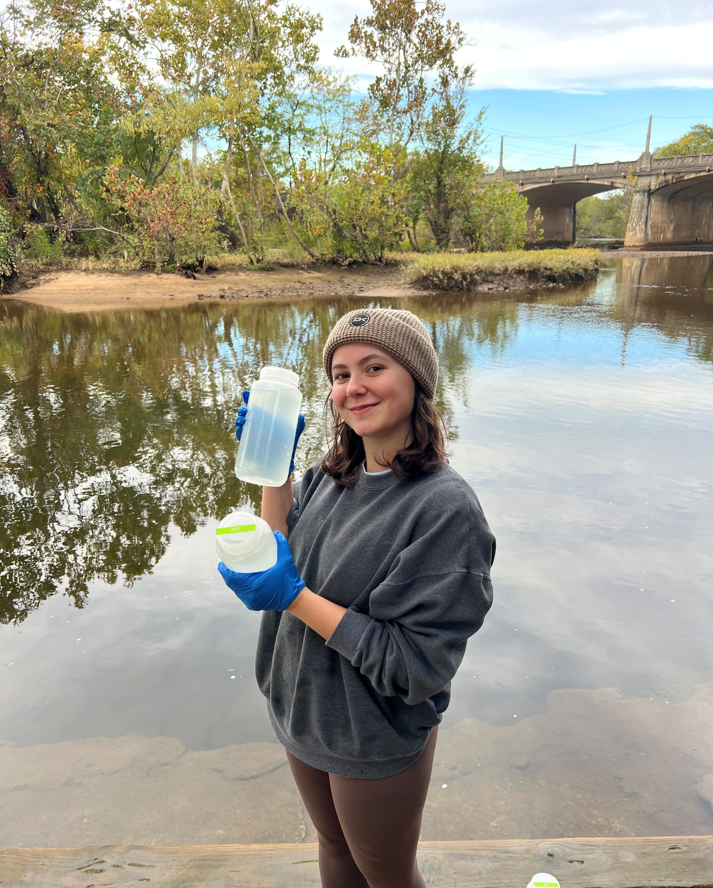
Meet the Researcher:
Hello, my name is Kelly Gonzalez, and I am a Master’s student interested in Atlantic sturgeon population success.
I have created this lesson plan based on the work I do for my thesis. I am so excited to share my work with you on arguably one of the coolest fish in the Atlantic!

Slide 3
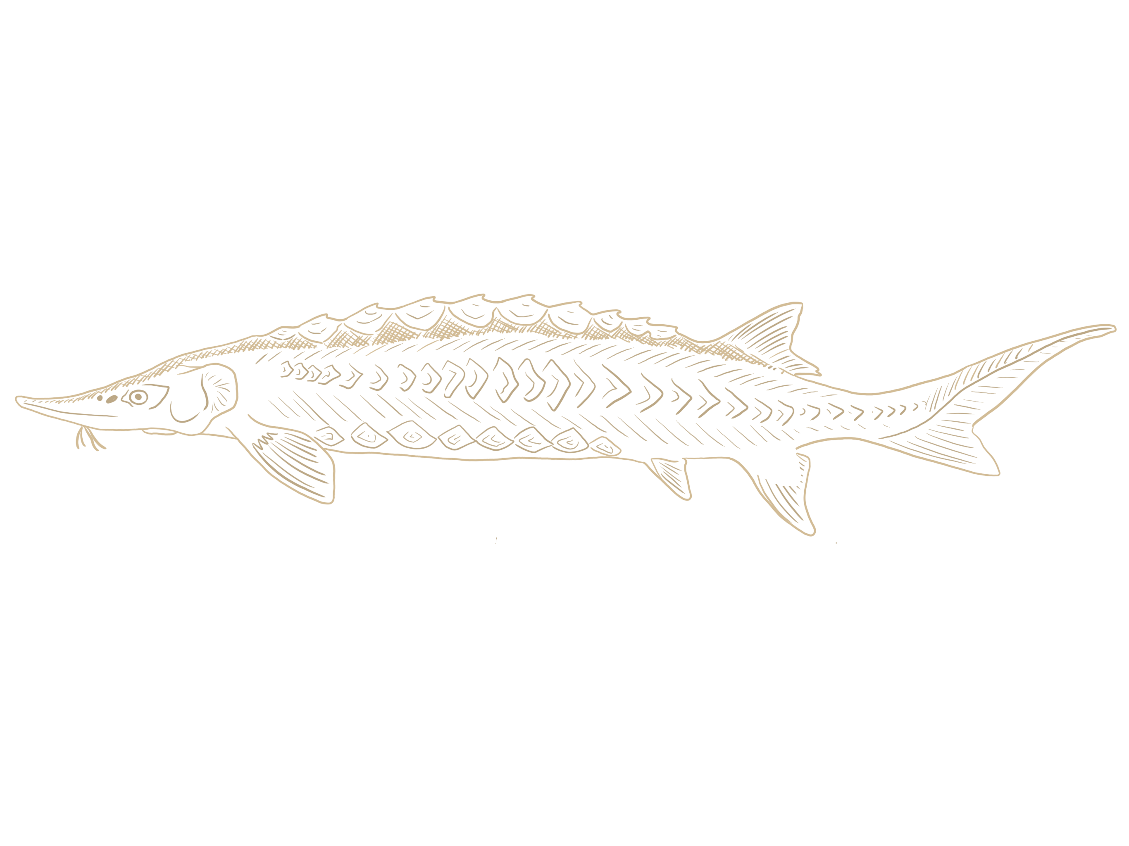
WANTED: Have you seen this fish?
?
Notes:
Ask students if they’ve ever seen an Atlantic sturgeon and where have they seen one?
Image Credit:
Illustration by Kelly Gonzalez, based on image from U.S. Fish & Wildlife Service

Slide 4
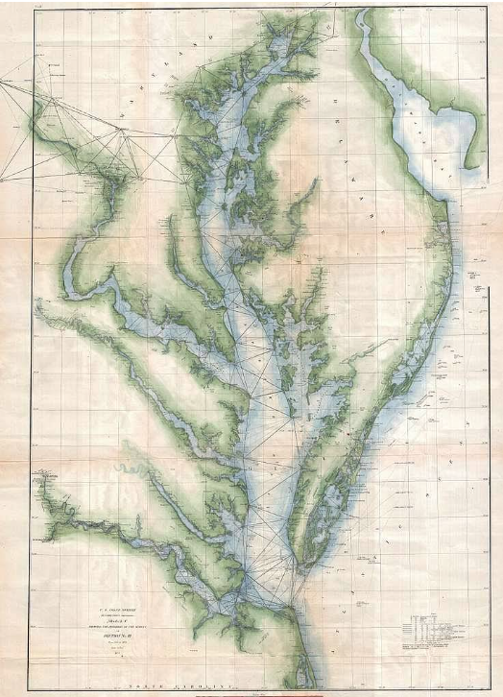
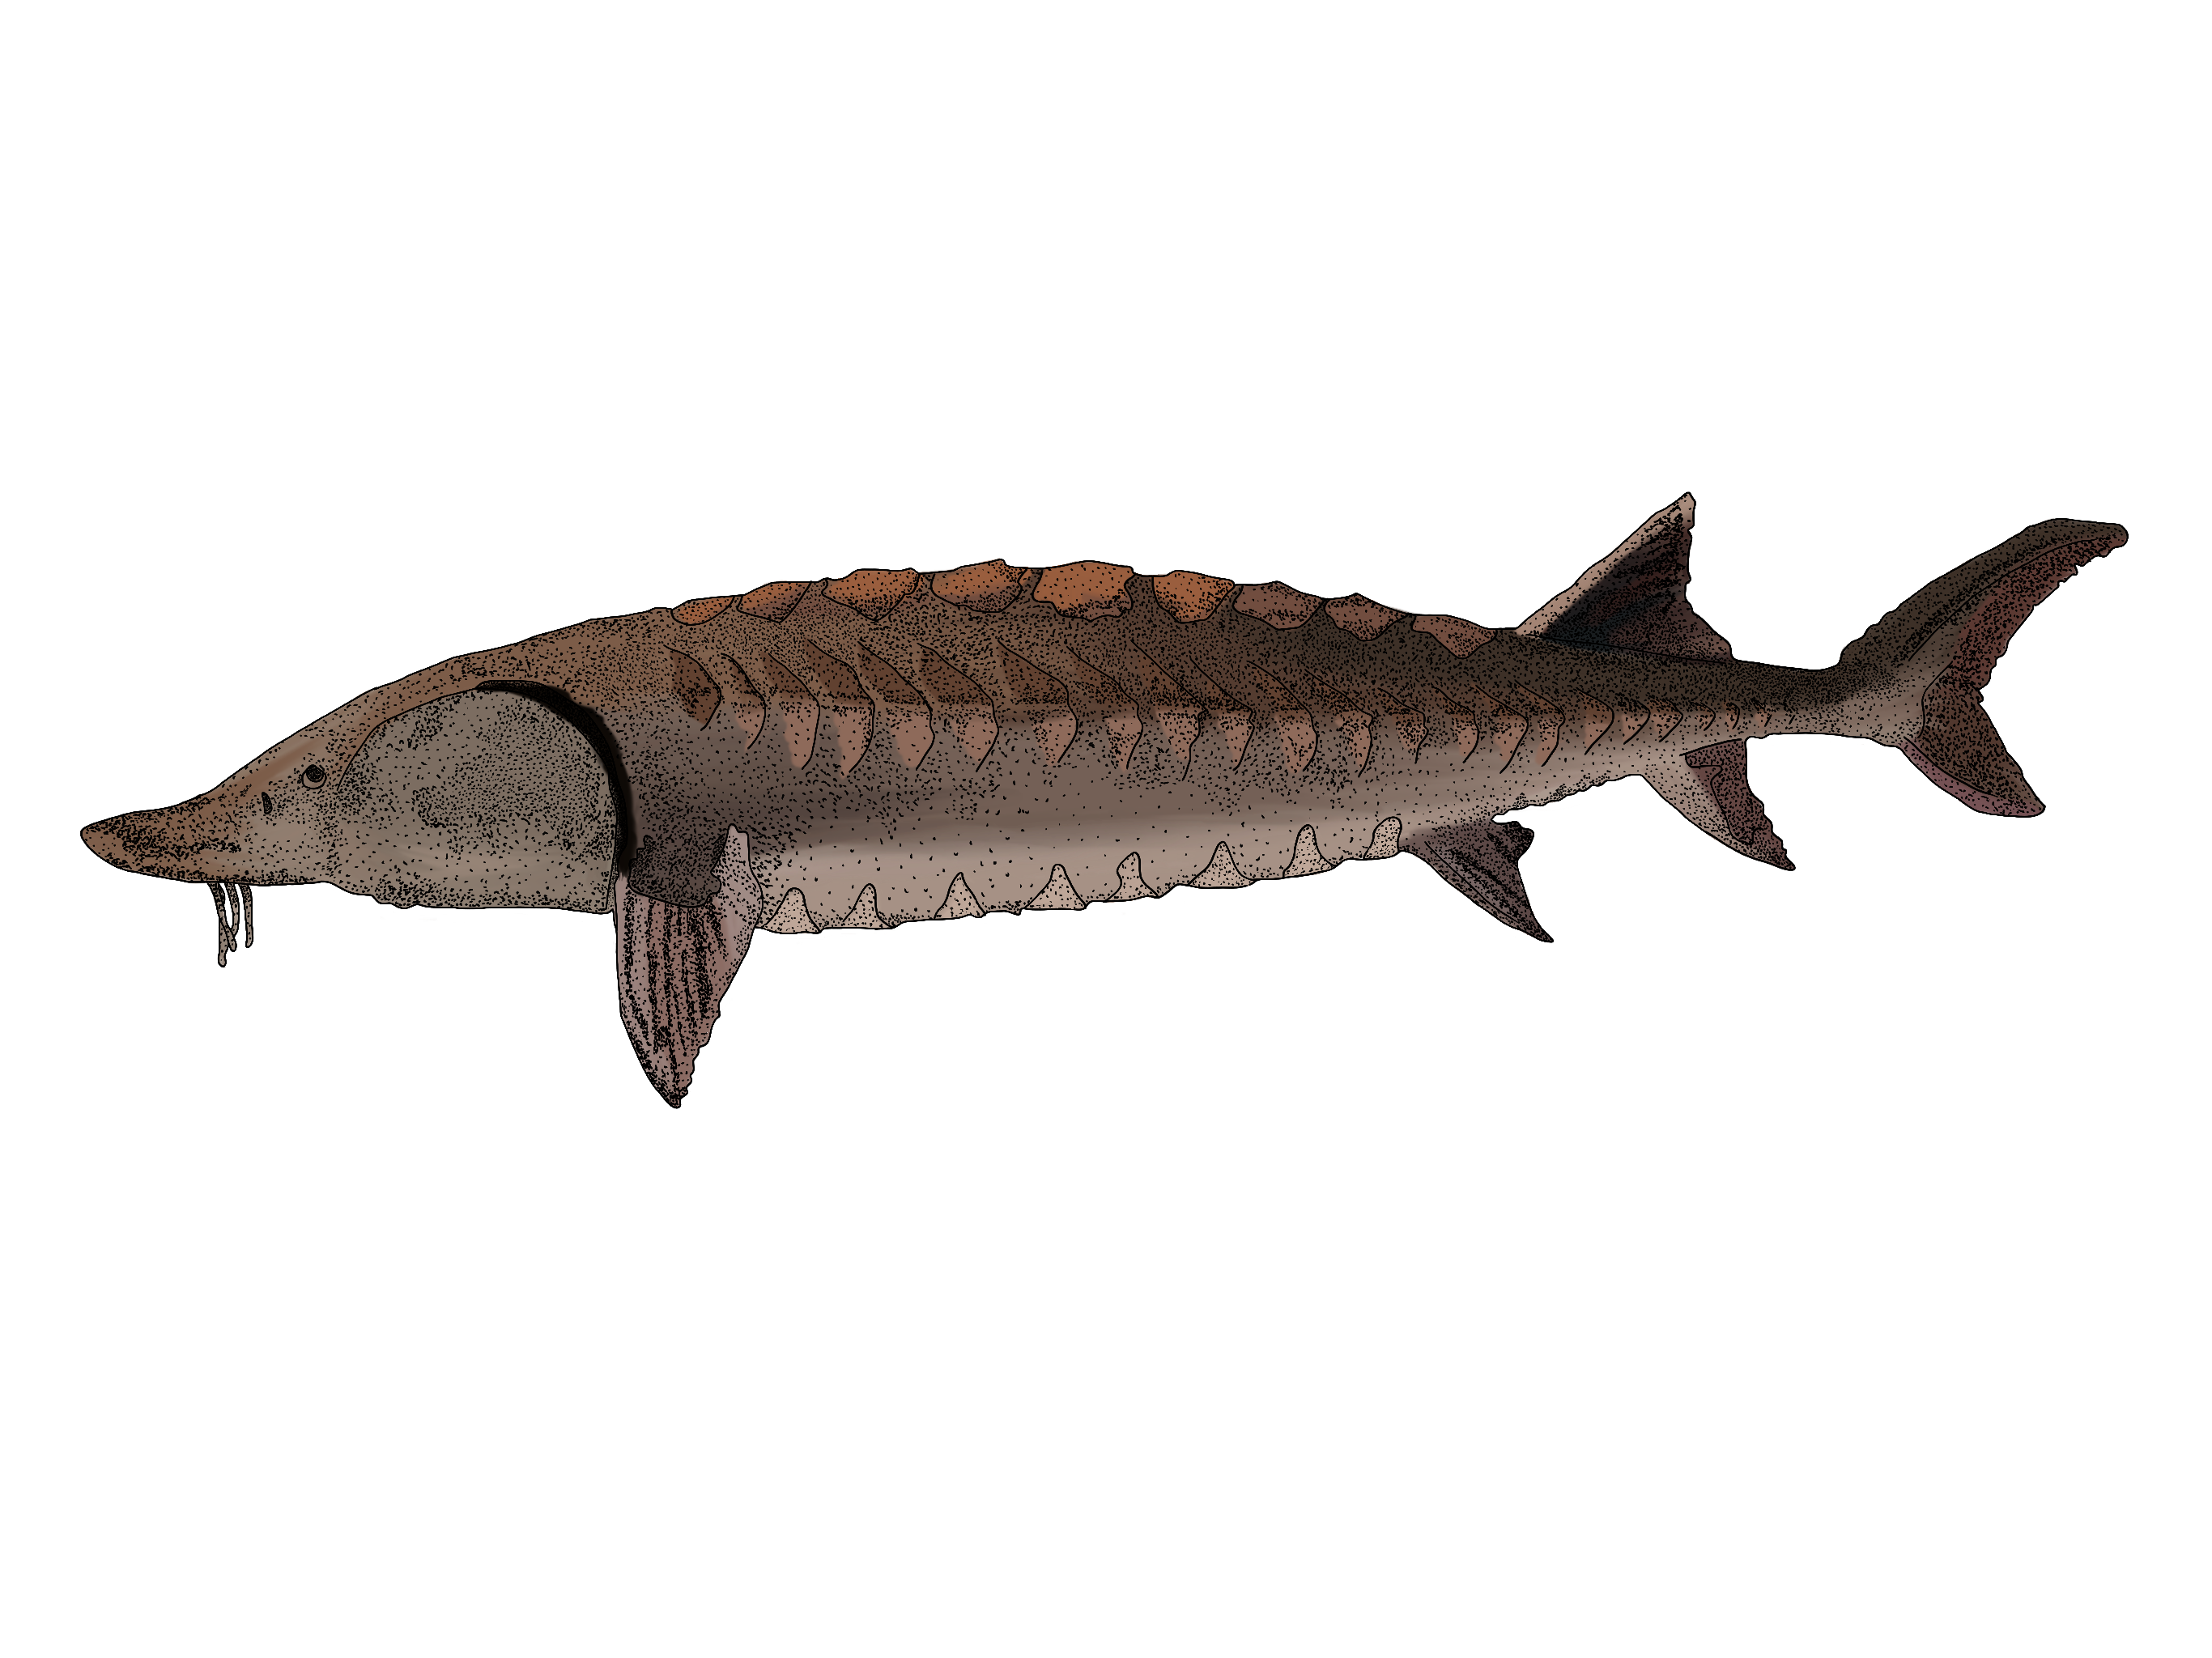
WANTED: The Atlantic Sturgeon
Acipenser oxyrinchus
Who?
An ancient fish that can get over 10 feet long and live for 60 years.
Where?
Chesapeake Bay and it’s major tributaries.
When?
Appear in the Spring or the Fall for spawning.
Why?
Endangered due to overfishing.
Notes:
Go over who, where, when and why.
Image Credits:
- Kelly Gonzalez illustration based on photograph from NOAA fisheries
- Geographicus Rare Antique Maps
https://www.geographicus.com/

Slide 5

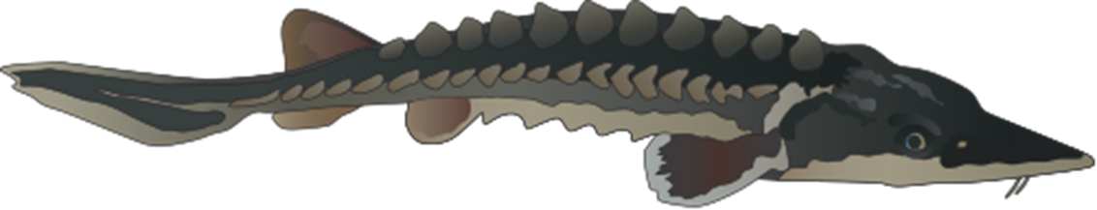
Life Cycle
Overfishing
Live majority of life in the ocean as adults.
Return to an estuary or bay for feeding in summer months.
Then travel further up-river to freshwater to spawn in the fall.
Overfished heavily in the late 1800’s.
Fishery very quickly collapsed.
Officially put under protection of the Endangered Species Act in 2012.
Notes:
Click through animations.
Image Credit:
- Geographicus Rare Antique Maps
https://www.geographicus.com/
- UMCES IAN Image Library

Slide 6

So why are we looking for them?
Atlantic sturgeon populations, although being protected, are still not booming like we’d expect.
If fishing has been reduced, what else could be holding them back?
_______________________________________________________________
Notes:
After clicking through the animations, ask students what factors they think may be holding back a population from thriving.
Image Credit:
UCMES IAN image library

Slide 7
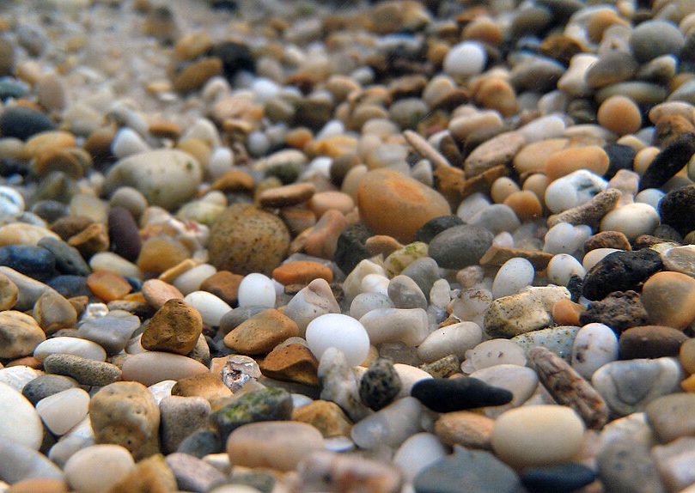

If fishing has been reduced, what else could be holding them back?
Fish can be vulnerable to changes in climate if it is out of their optimal range or what they’re used to.
  Abiotic factors that we see changing: temperature, oxygen and a lot more!
Atlantic sturgeon favor hard substrates in rivers to lay eggs on.
O₂
Notes:
Image Credit:
Wikimedia Commons

Slide 8
Changing Abiotic Factors
O₂
Temperature
Climate change has shown hotter, more frequent, and longer lasting heat wave events.
An important factor that affects fish just like people. No one wants to walk around baking in the sun all day!
Dissolved Oxygen
Levels of oxygen in the water should be at 100% but when water warms up, oxygen molecules have the energy to escape leaving levels less than 100%.
Notes:
After reading the information provided on the slide, emphasize that the way temperature affects dissolved oxygen is important to understand because in the real world, environmental stressors very rarely happen in isolation from one another. This is a rationale for why researchers should begin to focus on co-stressor experiments.

Slide 9


So why are we looking for them?
Atlantic sturgeon populations, although being protected, are still not booming like we’d expect.
If fishing has been reduced, what else could be holding them back?
_______________________________________________________________
With Atlantic sturgeon being endangered and highly migratory, they can be hard to find.
What would be a simple, fast, and cost-effective way to find sturgeon?
Notes:
After clicking through the animations, ask students if they have any ideas of ways to find sturgeon.

Slide 10

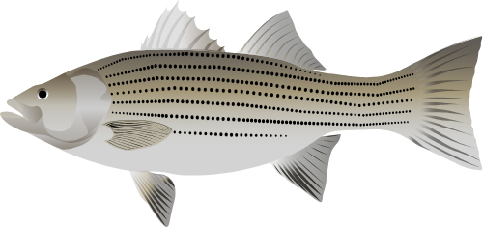
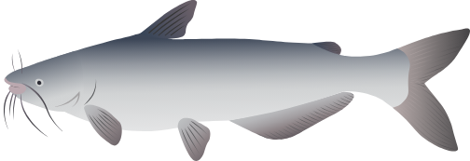
What would be a simple, fast, and cost-effective way to find sturgeon?
Environmental DNA (eDNA) is a new way of estimating a relative abundance of the target species.
Living things like fish shed DNA when they lose scales or skin cells, use the bathroom, or spawn.
Water is a soup filled with lots of DNA, and by taking samples from the environment you can test it for a specific strand of DNA.
Notes:
- eDNA is an alternative to the traditional methods of catch and release and tagging.
- eDNA can be a faster and more simple way to understand the population in relative terms
If you want to take it a step further:
- A sample can contain millions of strands of DNA from lots of organisms, but there are special tools like primers that are designed in a lab to help target a specific type of DNA fragment, in our case our target is Atlantic sturgoen
Image Credit:
UMCES IAN image library

Slide 11
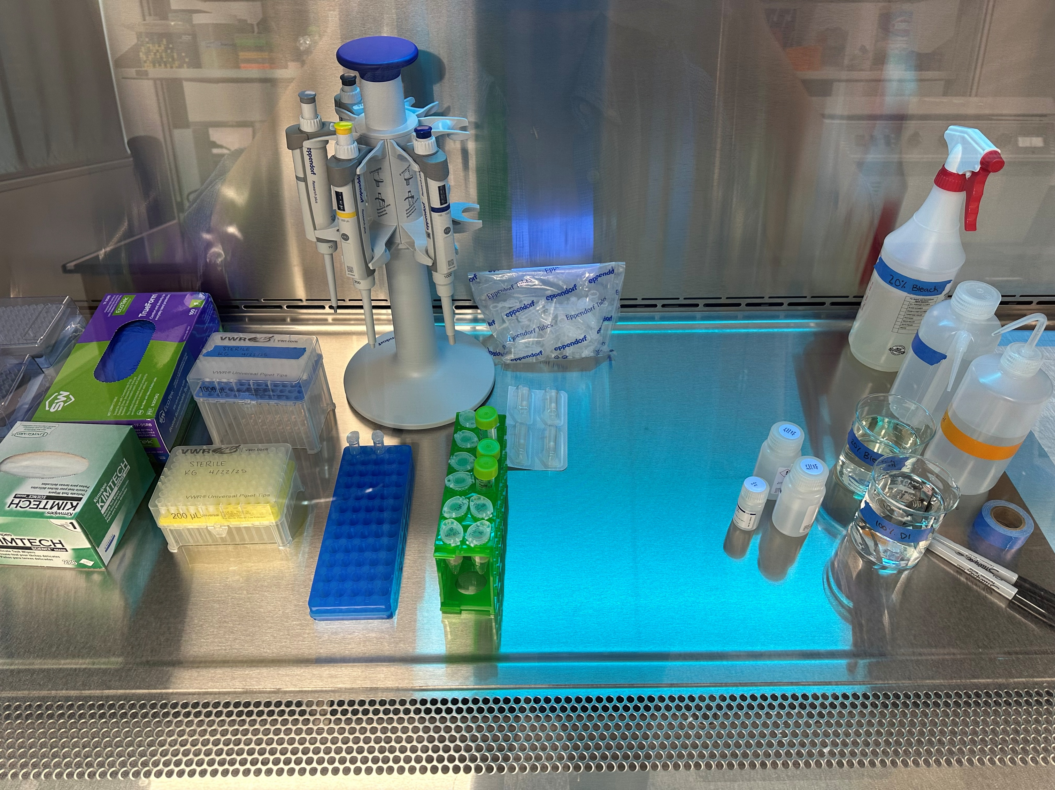
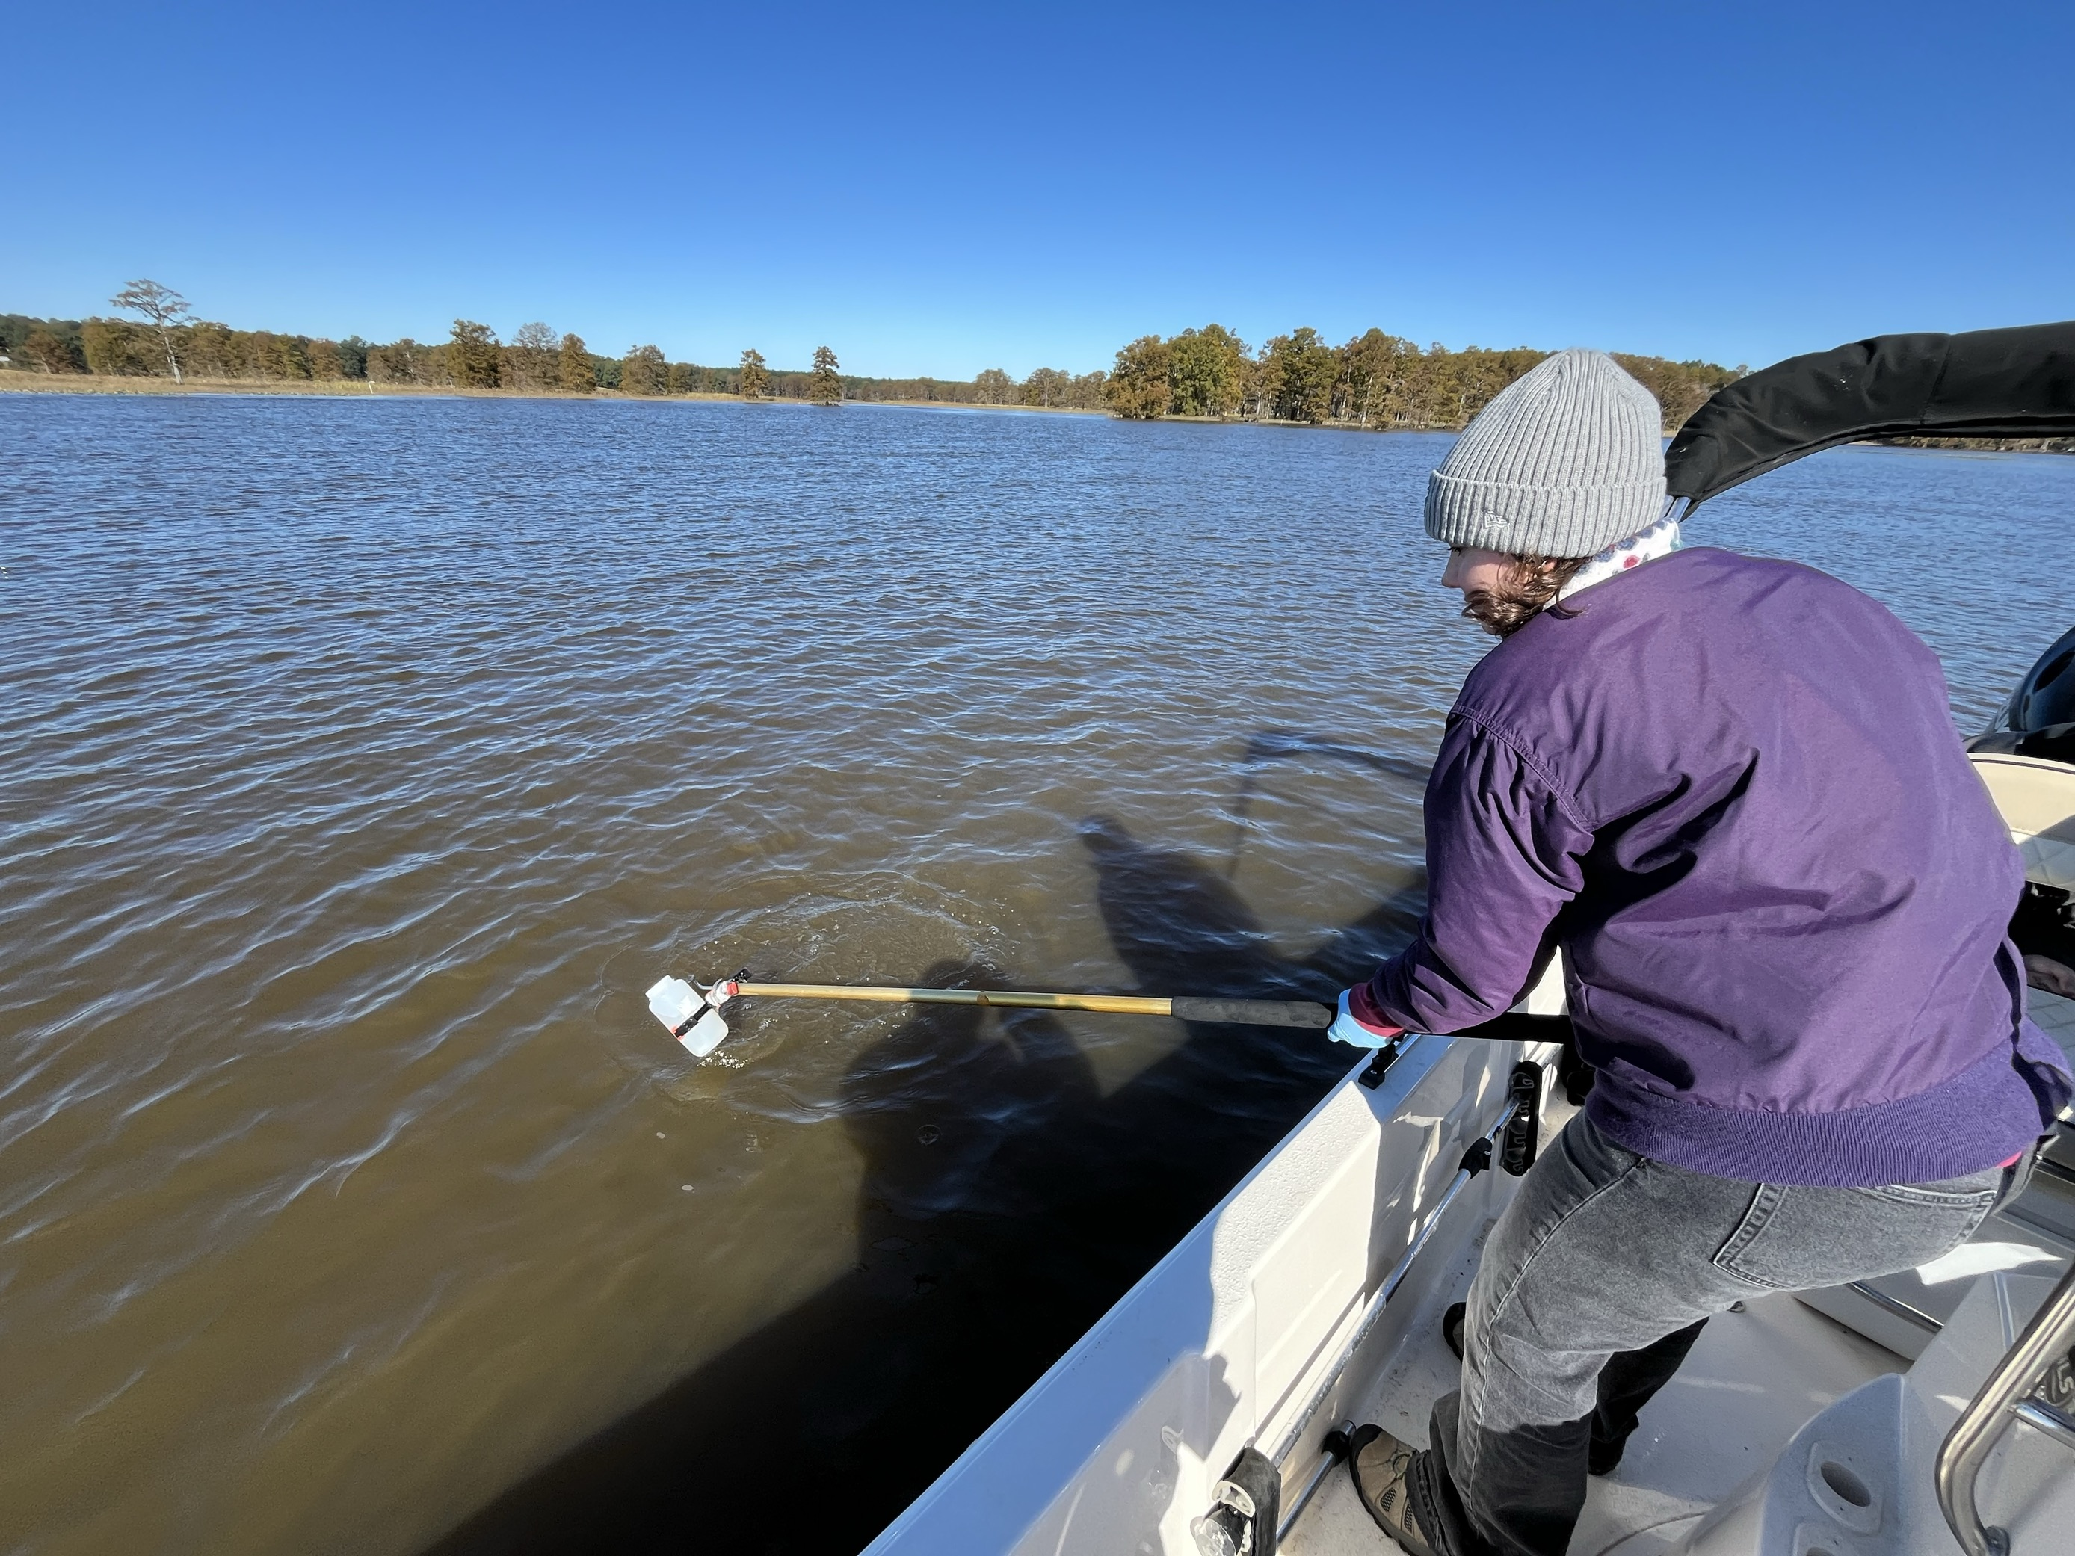
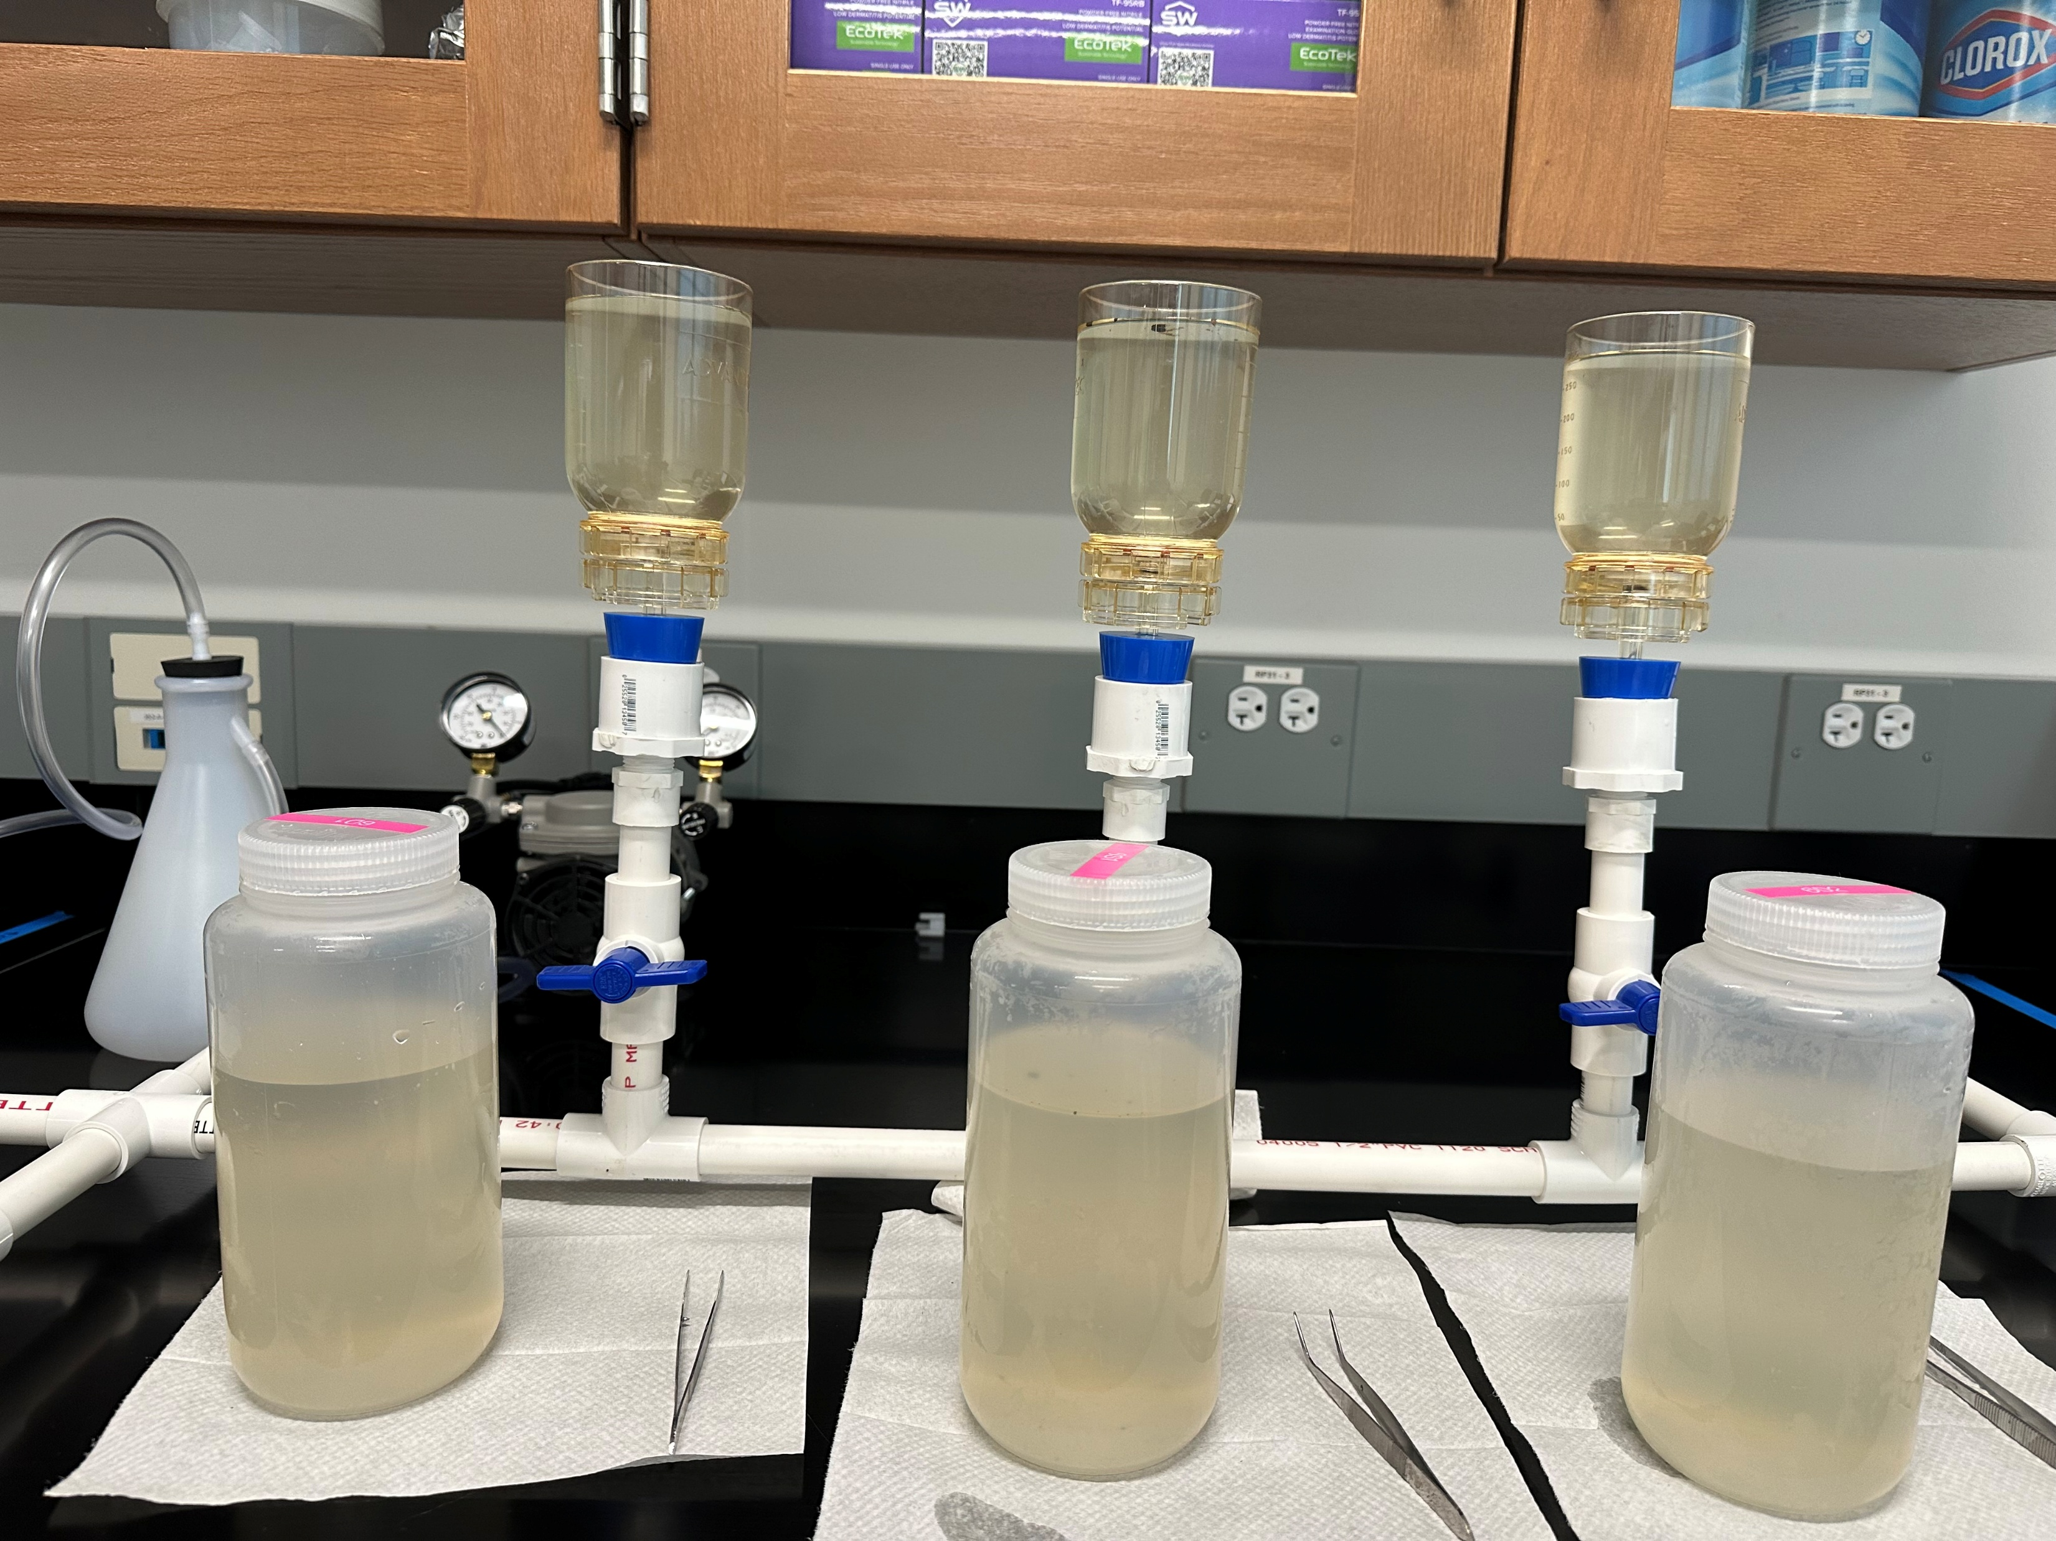
eDNA Steps
Gather samples from the environment (water or sediment) and water quality measurements
Filter samples
Extract DNA using specialized kits
Perform quantitative PCR (qPCR) to get a relative number of DNA in the given water sample
Notes:
Read the following with the numbered points for more context:
1. Explain that eDNA involves gathering samples from the environment, can be water or sediment, but in our case we take water samples. We also take water quality measurements to understand the environmental conditions at the time we collect our samples to use later for drawing conclusions. Water quality would involve things like water temperature, dissolved oxygen, salinity, and pH.
2. We then take our samples back to the lab to filter them, the filter will catch any DNA in the sample.
3. After filtering they are stored in a freezer until they can be extracted using special kits.
4. The end product you get from extraction is a small amount of liquid that contains DNA, that you will then run through a process called qPCR. This is a way to see a relative abundance of DNA strands in our sample. - From that relative abundance we can make assumptions about how abundant sturgeon are in that area.
Photo Credits:
Angelina Dichiera
Kelly Gonzalez

Slide 12
In the classroom…
Researchers need your help processing all these samples! We’ve gathered eight samples from and near the James River. Similar to how we do in the lab, follow these steps:
Each sample should be poured over a filter (make sure to use a different filter every time, we don’t want to cross contaminate our samples!) over a strainer.
From each sample extract the Atlantic sturgeon DNA.
Count and record how much DNA you find from each sample (make sure to take notes of environmental measurements provided on the field data sheet).

Slide 13
References
Atlantic Sturgeon. Atlantic States Marine Fisheries Commission. (2025, February 11). https://asmfc.org/species/atlantic-sturgeon/
Bemis, W. E., & Kynard, B. (1997). Sturgeon rivers: an introduction to acipenseriform biogeography and life history. Environmental Biology of Fishes, 48, 167-183.
Breitburg, D. et al. Declining oxygen in the global ocean and coastal waters. Science 359, eaam7240 (2018).
IPCC. Climate Change 2023: Synthesis Report. A Report of the Intergovernmental Panel on Climate Change. Contribution of Working Groups I, II and III to the Sixth Assessment Report of the Intergovernmental Panel on Climate Change. Core Writ. Team H Lee J 595 Romero Eds IPCC, Geneva, Switzerland, (2023).
Merriam-Webster. (n.d.). Thesaurus by Merriam-Webster: Find synonyms, similar words, and Antonyms. Merriam-Webster. https://www.merriam-webster.com/thesaurus
NOAA Fisheries (2024, November 19). Atlantic Sturgeon. https://www.fisheries.noaa.gov/species/atlantic-sturgeon#:~:text=Today%2C%20all%20five%20U.S.%20Atlantic,the%20U.S.%20Endangered%20Species%20Act.
Wang, S., Yan, Z., Hänfling, B., Zheng, X., Wang, P., Fan, J., & Li, J. (2021). Methodology of fish eDNA and its applications in ecology and environment. Science of the Total Environment, 755, 142622.

