Slide 1
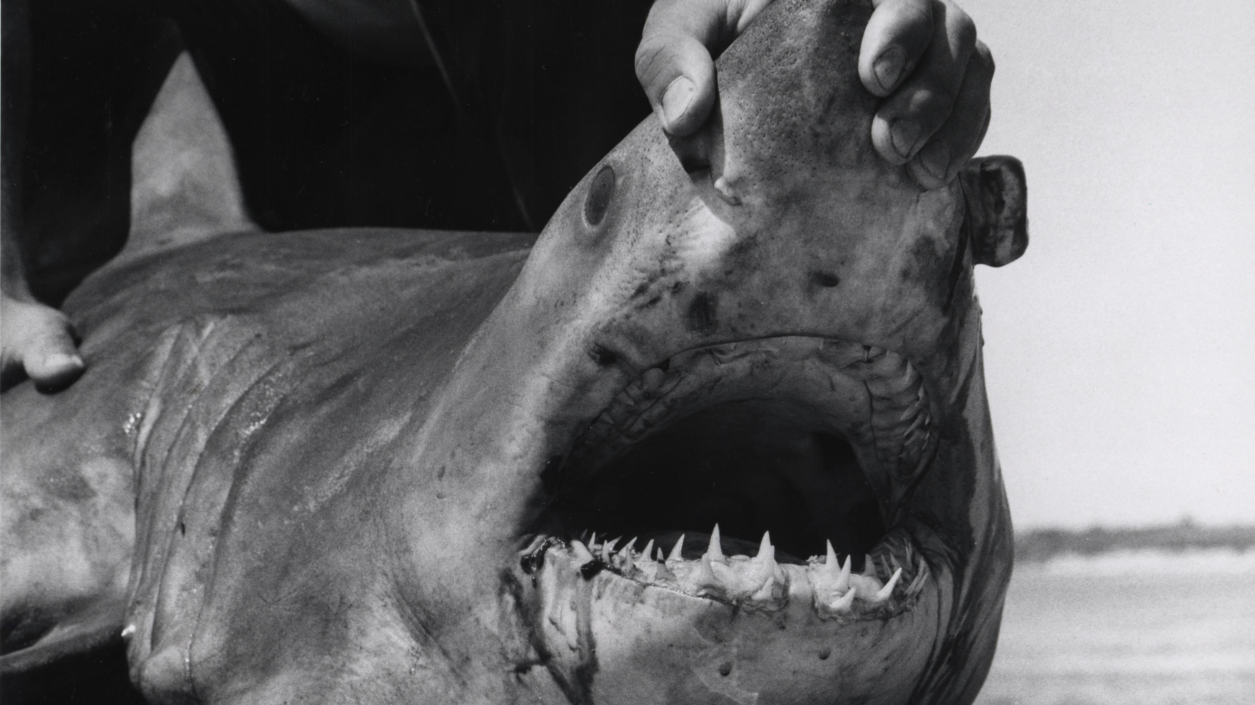
Quantifying Stress: Using Blood Biomarkers to Study Sharks
Shyane Masters
Image by NOAA Central Library Historical Fisheries Collection

Slide 2
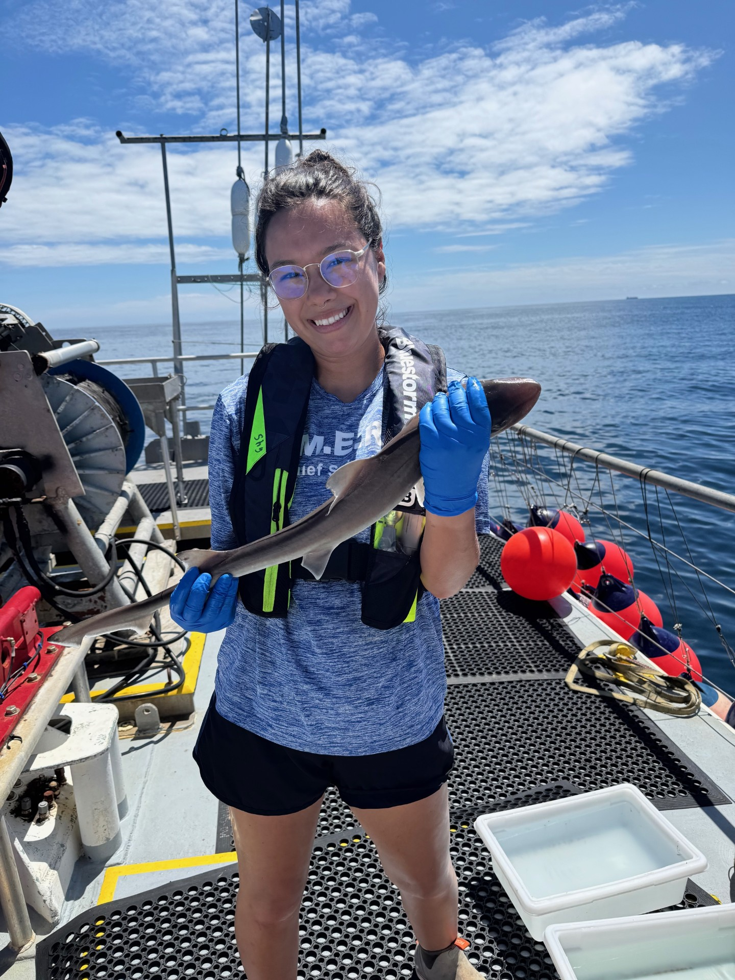
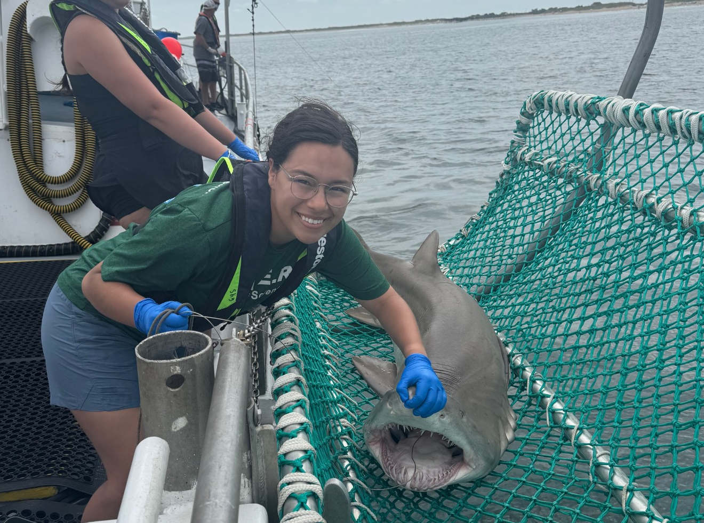
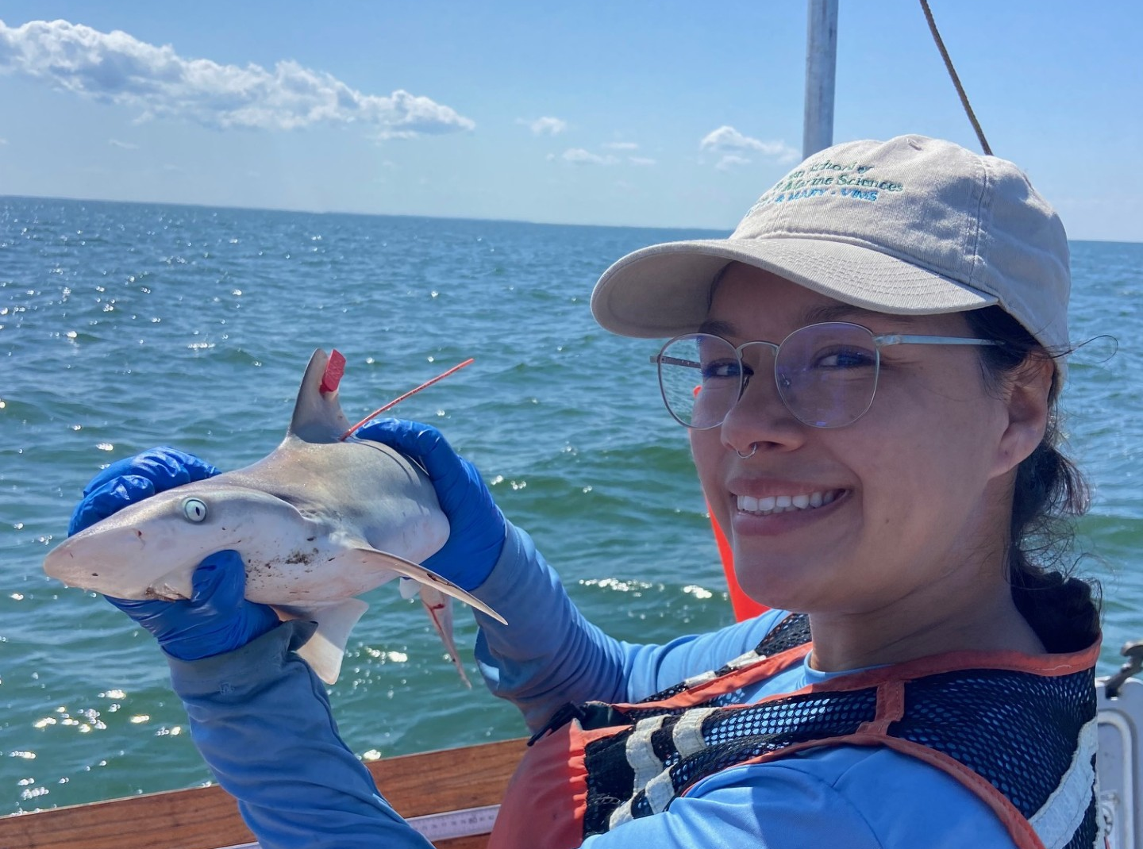
Meet the Scientist
Hi,
I’m Shyane and I am a scientist at the Virginia Institute of Marine Science.
I study how sharks recover from stressful events such as being hooked, caught in a net, heatwaves, and low oxygen availability.
I mainly do this by taking blood samples to see if there is an increase in stress chemicals which tells me how stressed the shark was after the event.
Images by Shyane Masters

Slide 3
Vocabulary
Physiology: The study of how living organisms and their body systems work.
Stress: A response that happens when an organism is exposed to difficult or harmful conditions in its environment.
Biomarker: A substance found in blood that scientists measure to learn about an organism’s health or stress level.
Salinity: The amount of salt dissolved in water.
Young-of-Year (YOY): A fish or shark that is less than 1 year old.
Juvenile: A young organism that is older than 1 year but not an adult.
Variable: Any factor in an experiment that can change, be controlled, or be measured.
Environmental Stressor: A condition in the environment, such as high temperatures, low oxygen levels, or pollution, that makes it harder for an organism to survive.

Slide 4
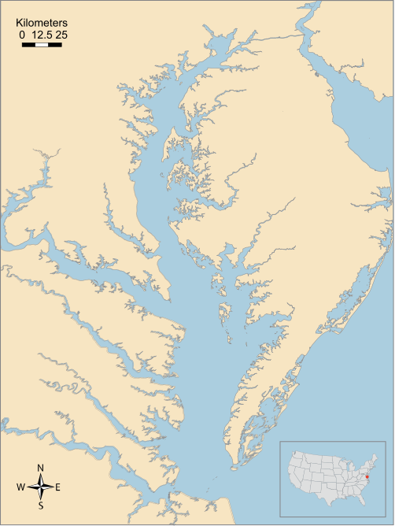
Chesapeake Bay
Large estuarine bay in the Mid-Atlantic coast of USA
  Spans two states!
Lots of freshwater input from rivers
Opens to the ocean
Important nursery habitat for fishes and crustaceans
Largely susceptible to effects of climate change
  Low dissolved oxygen in the water
  Heatwaves
  Pollution
UMCES Media Library

Slide 5
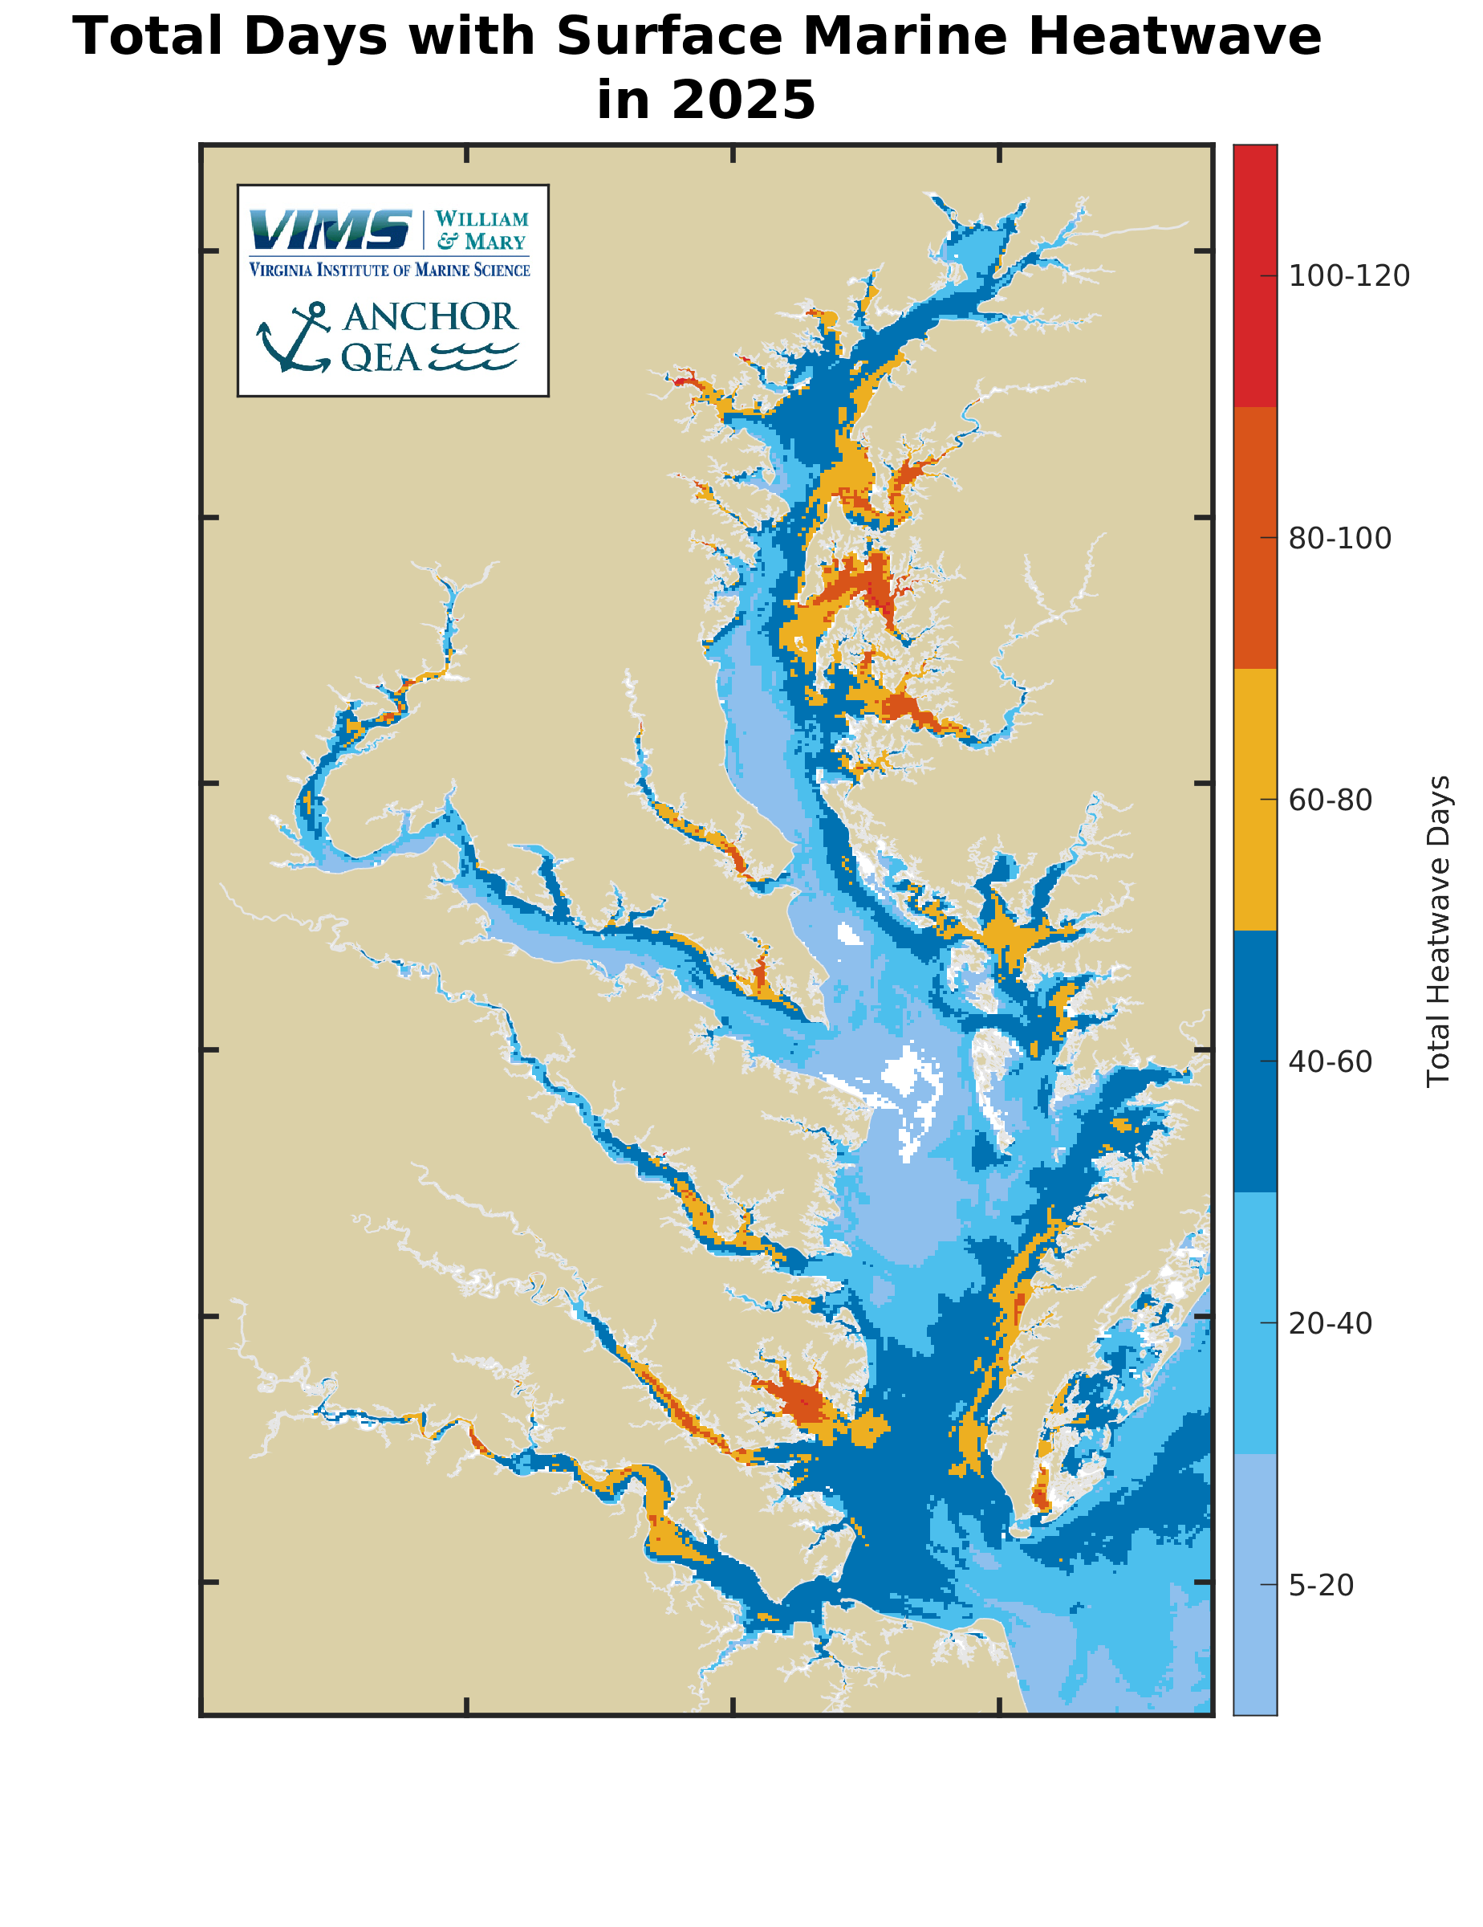
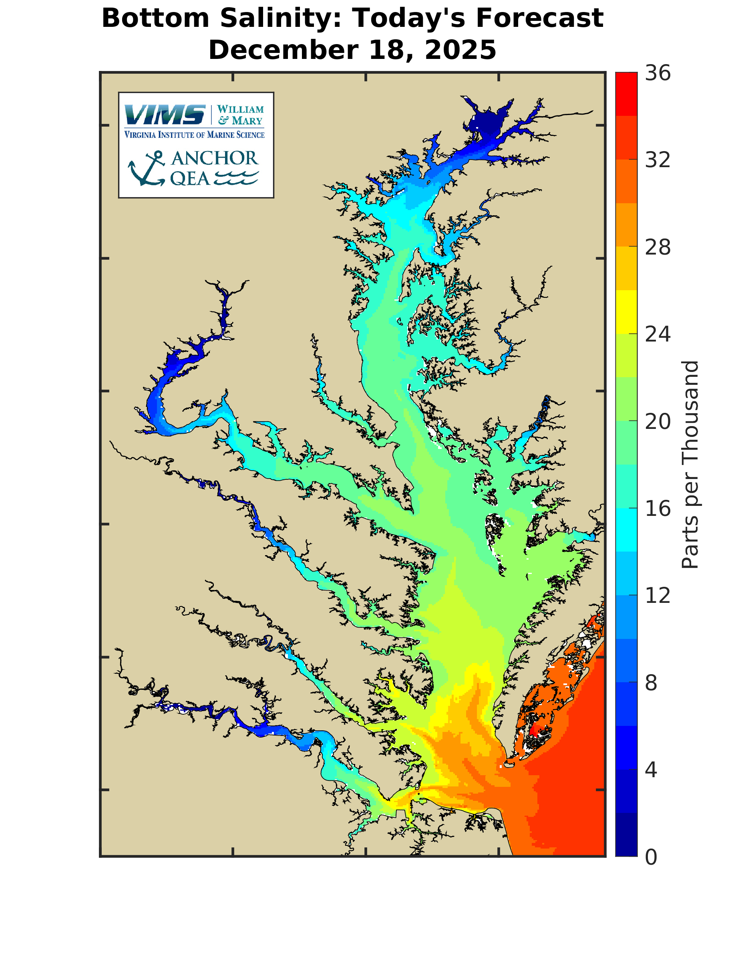
Climate Change in Chesapeake Bay
Heatwaves are becoming more common
Oxygen-dead zones are getting larger
  Areas with little to no oxygen where animals cannot survive
Pollution from large cities and commercial industries
  Oil spills, sewage leaks etc.
Images by the Virginia Institute of Marine Science
Notes:
These are some examples as to how different parts of the Chesapeake Bay experience vastly different temperatures, heatwaves, and levels of salinity.

Slide 6
Climate Change and Fishes in Chesapeake Bay
Fish live in waters that have good temperatures for them and have enough oxygen to breath
When temperatures and oxygen are not ideal, they will try and move
If they cannot move, they may get stressed
If temperature increases too fast or oxygen is gone from their habitat, they could die
Notes:
These are some examples as to how different parts of the Chesapeake Bay experience vastly different temperatures, heatwaves, and levels of salinity.

Slide 7
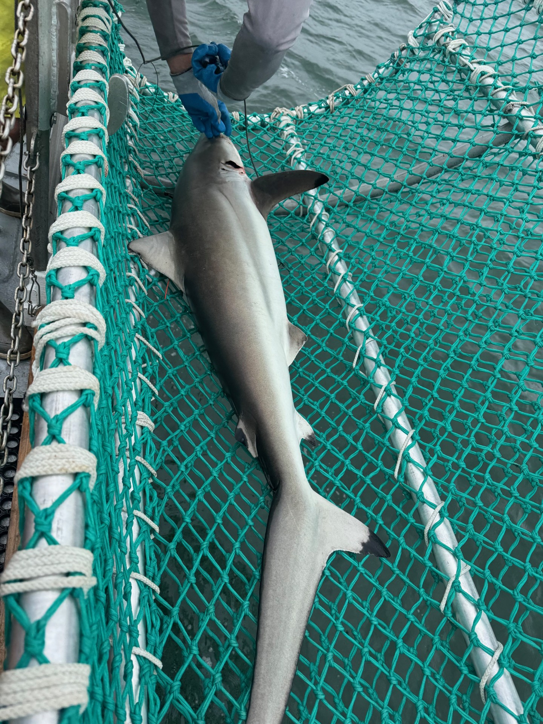
What is stress?
Stress in fishes are when their bodies are no longer in homeostasis.
  It can be visual, for example:
    A change in skin color
    More rapid breathing
    Deformed fins
    Unusual swimming patterns
  Most of the time it is internal, for example:
    Their blood pH can be too high or too low
    They might not have enough oxygen for their organs to work
    They may be dehydrated
    They might have a decreased hormone and immune function
Image by Shyane Masters
Notes:
These are some examples as to how different parts of the Chesapeake Bay experience vastly different temperatures, heatwaves, and levels of salinity.

Slide 8
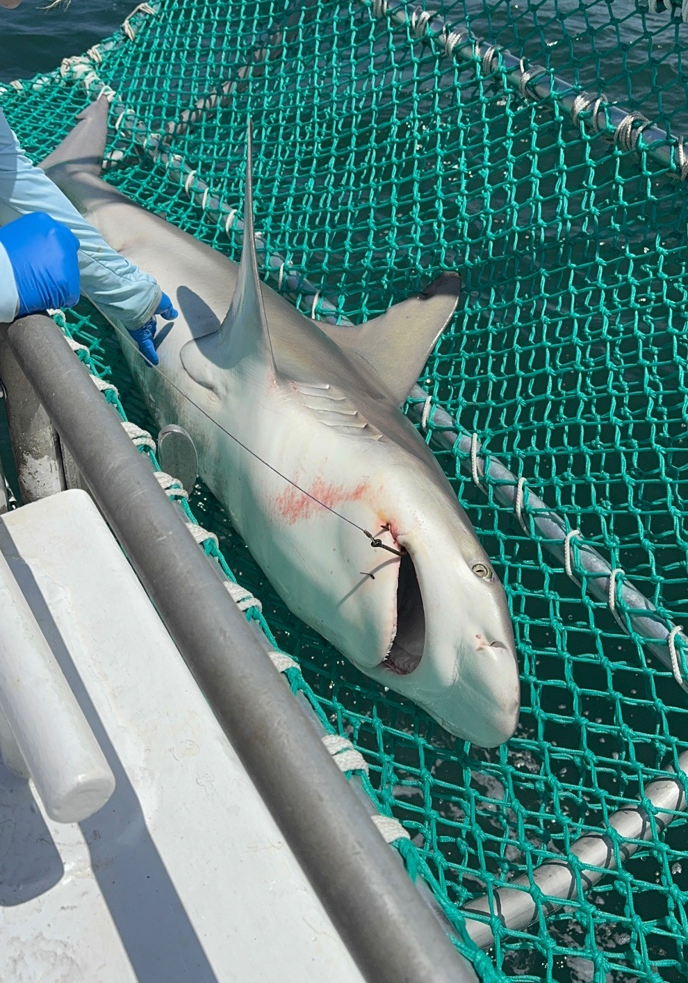
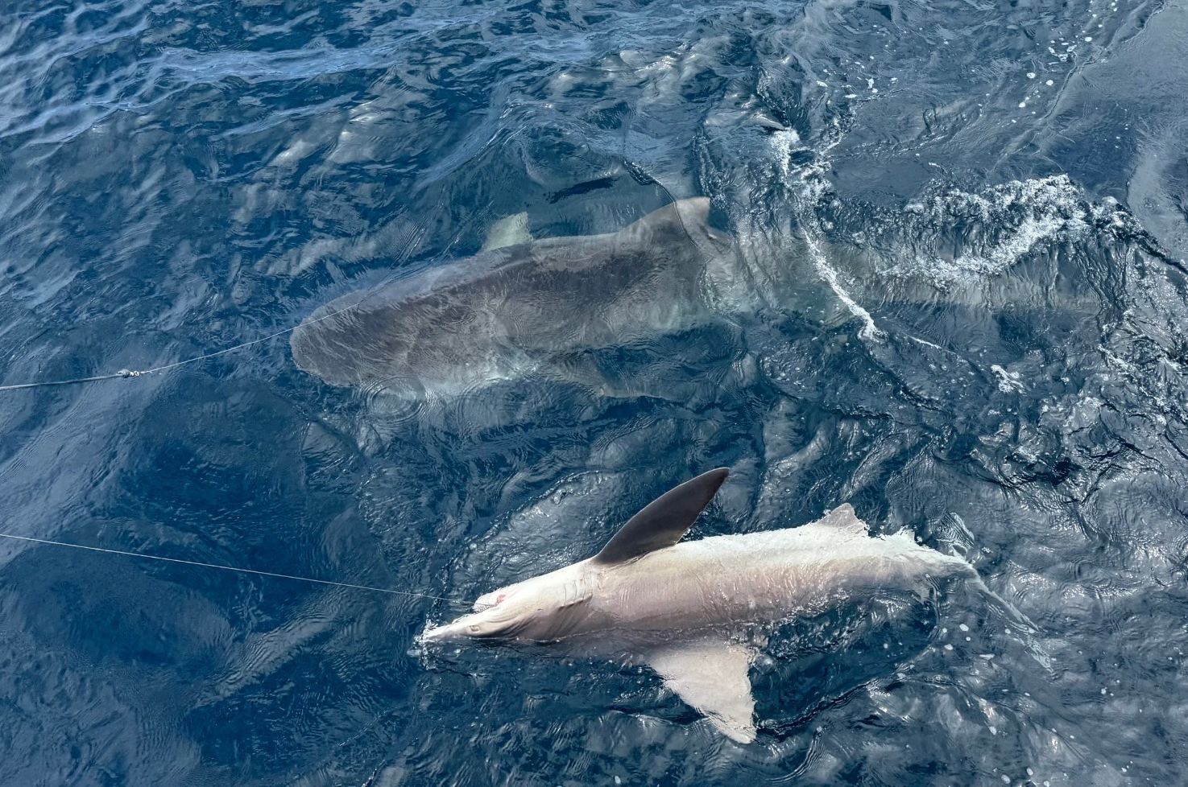
Are they stressed?
Images by Shyane Masters
Notes:
These sharks are a tiger shark (upper left) and the two others are sandbar sharks. All captured off the coast of Virginia. Have students make some observations as to whether or not they think they can tell if these sharks are stressed out.

Slide 9
We can’t tell!
Images by Shyane Masters
Notes:
The correct answer is that we cannot tell! Sharks can’t tell us how they feel so they only way to find out is to take blood samples.

Slide 10
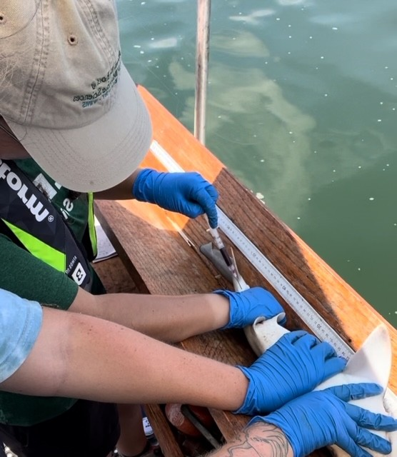
How can we find out? Blood Samples!
Scientist Shyane takes a blood sample of a Young-of-Year sandbar shark in the Chesapeake Bay.
Blood samples are taken from the bottom of the shark's tail.
There is an easily accessible vein there, similar to where doctors take blood from your arm.
Images by Shyane Masters
Notes:
The shark here is upside down in a v-shaped board. One person holds the mouth shut for safety while the other scientist is taking a blood sample.

Slide 11
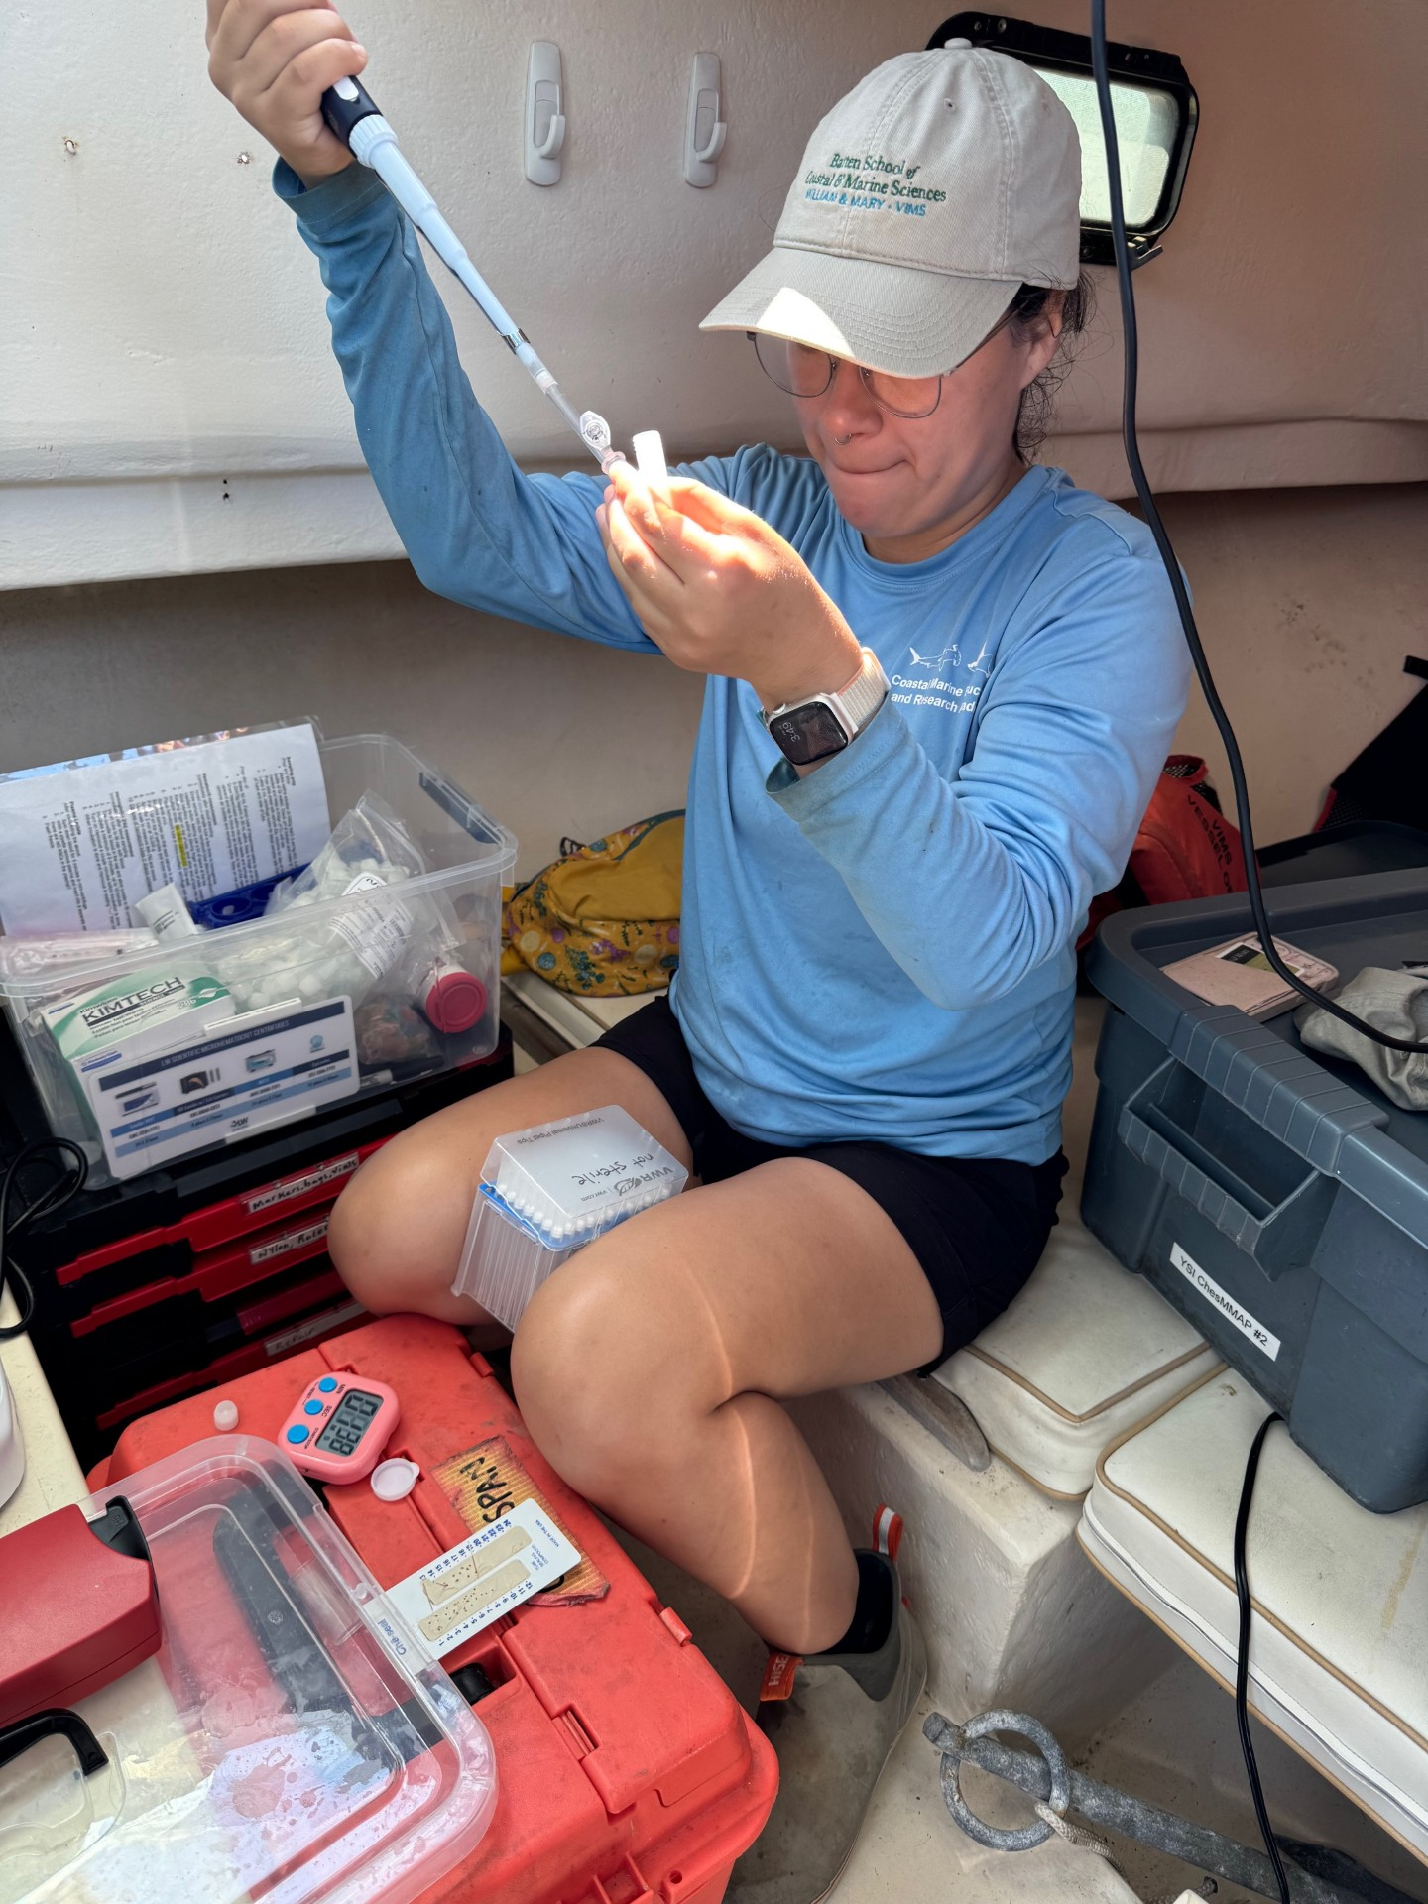
Processing samples on the boat
The scientist is separating the blood sample into three tubes!
This is how we get replicates to ensure that any measurements of biomarkers are as accurate as possible.
Sometime science looks like this!
  It is not always in a fancy while sterile laboratory.
  This science is happening on a small boat with all my materials packed up in a storage container, and I process sample sitting on the floor.
Images by Shyane Masters

Slide 12
Importance of Replication
Replication helps us ensure that a result is real and trustworthy and not a one-time accident.
Bodies can vary a lot, so replication helps:
Reduce mistakes
Handle natural variation
Increase confidence in results
Strongly support conclusions
Replication turns a single observation into real scientific evidence

Slide 13
What are we looking at in the blood?
Biomarkers
  Chemicals in the blood that can give us a "report card" on how an animal is doing internally
    We can look at their health with just a single blood sample
Three important biomarkers:
  Hemoglobin is a protein in red blood cells that carries oxygen.
    If hemoglobin is high, the blood can carry more oxygen
    If it’s low, the body might not be getting enough oxygen
    Tells us how well an animal is can deliver oxygen throughout their body
  Hematocrit is the percentage of blood that is made up of red blood cells.
    Higher hematocrit = more red blood cells
    Lower hematocrit = fewer red blood cells
    This tells us how much oxygen the body can hold, and how hydrated the body is
  Lactate is a chemical produced when the body makes energy without enough oxygen (like during intense exercise or stress).
    High lactate = the body is under stress or working really hard
    Low lactate = normal, relaxed conditions
    This is the same as the lactate in humans when you exercise really hard and muscle start to burn, the burning sensation is the lactate. This can tell us how hard a body is working and if the body is stressed.

Slide 14
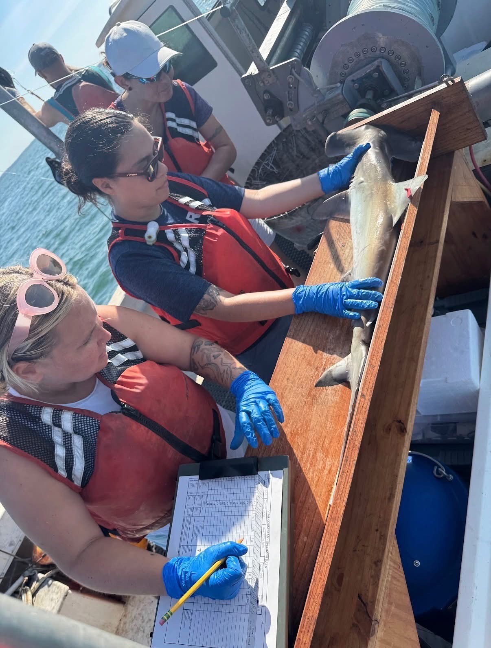
Importance of
Collaborative Science
There are 22 people in the shark lab!!
  A typical lab has about 5 people, so we have a very large team.
  A large team is needed to do shark research because there is a lot that goes into catching the sharks, sampling their blood, tagging them, recorded data, and analyzing data.
  Teamwork is super important; I could not do my research without my team because:
    I can’t drive a boat! Someone needs to drive the boat!
    It take at least 5 people to put out hooks, lines, and bait into the water!
    It takes 2-4 people to hold a shark, measure, weigh, and tag them!
    It takes 2 people to make the replicate blood samples before we get to the next station to catch more sharks!
    It takes more than 5 people to analyze all the data!
    It takes a lot more people in between each step to make sure than everything moves swiftly and, most importantly, safely.
Image by Shyane Masters

