Slide 1
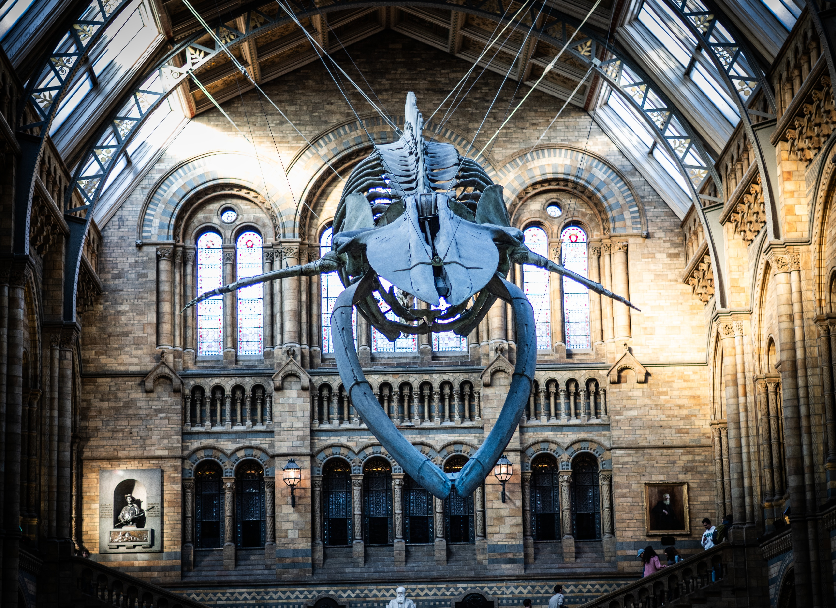
Learning about nature through
museum collections

Slide 2
What are museums?
They are places that store objects that are important to humans.
Can you think of objects that are important to you?

Slide 3
How about natural history museums?
These museums store and take care of objects that represent our natural world.
Can you name some items that would belong in a natural history museum?

Slide 4
A museum with rocks?
Yes! Natural history museums often keep rocks and minerals in their collections. Even some from outer space, like meteorites!

Slide 5
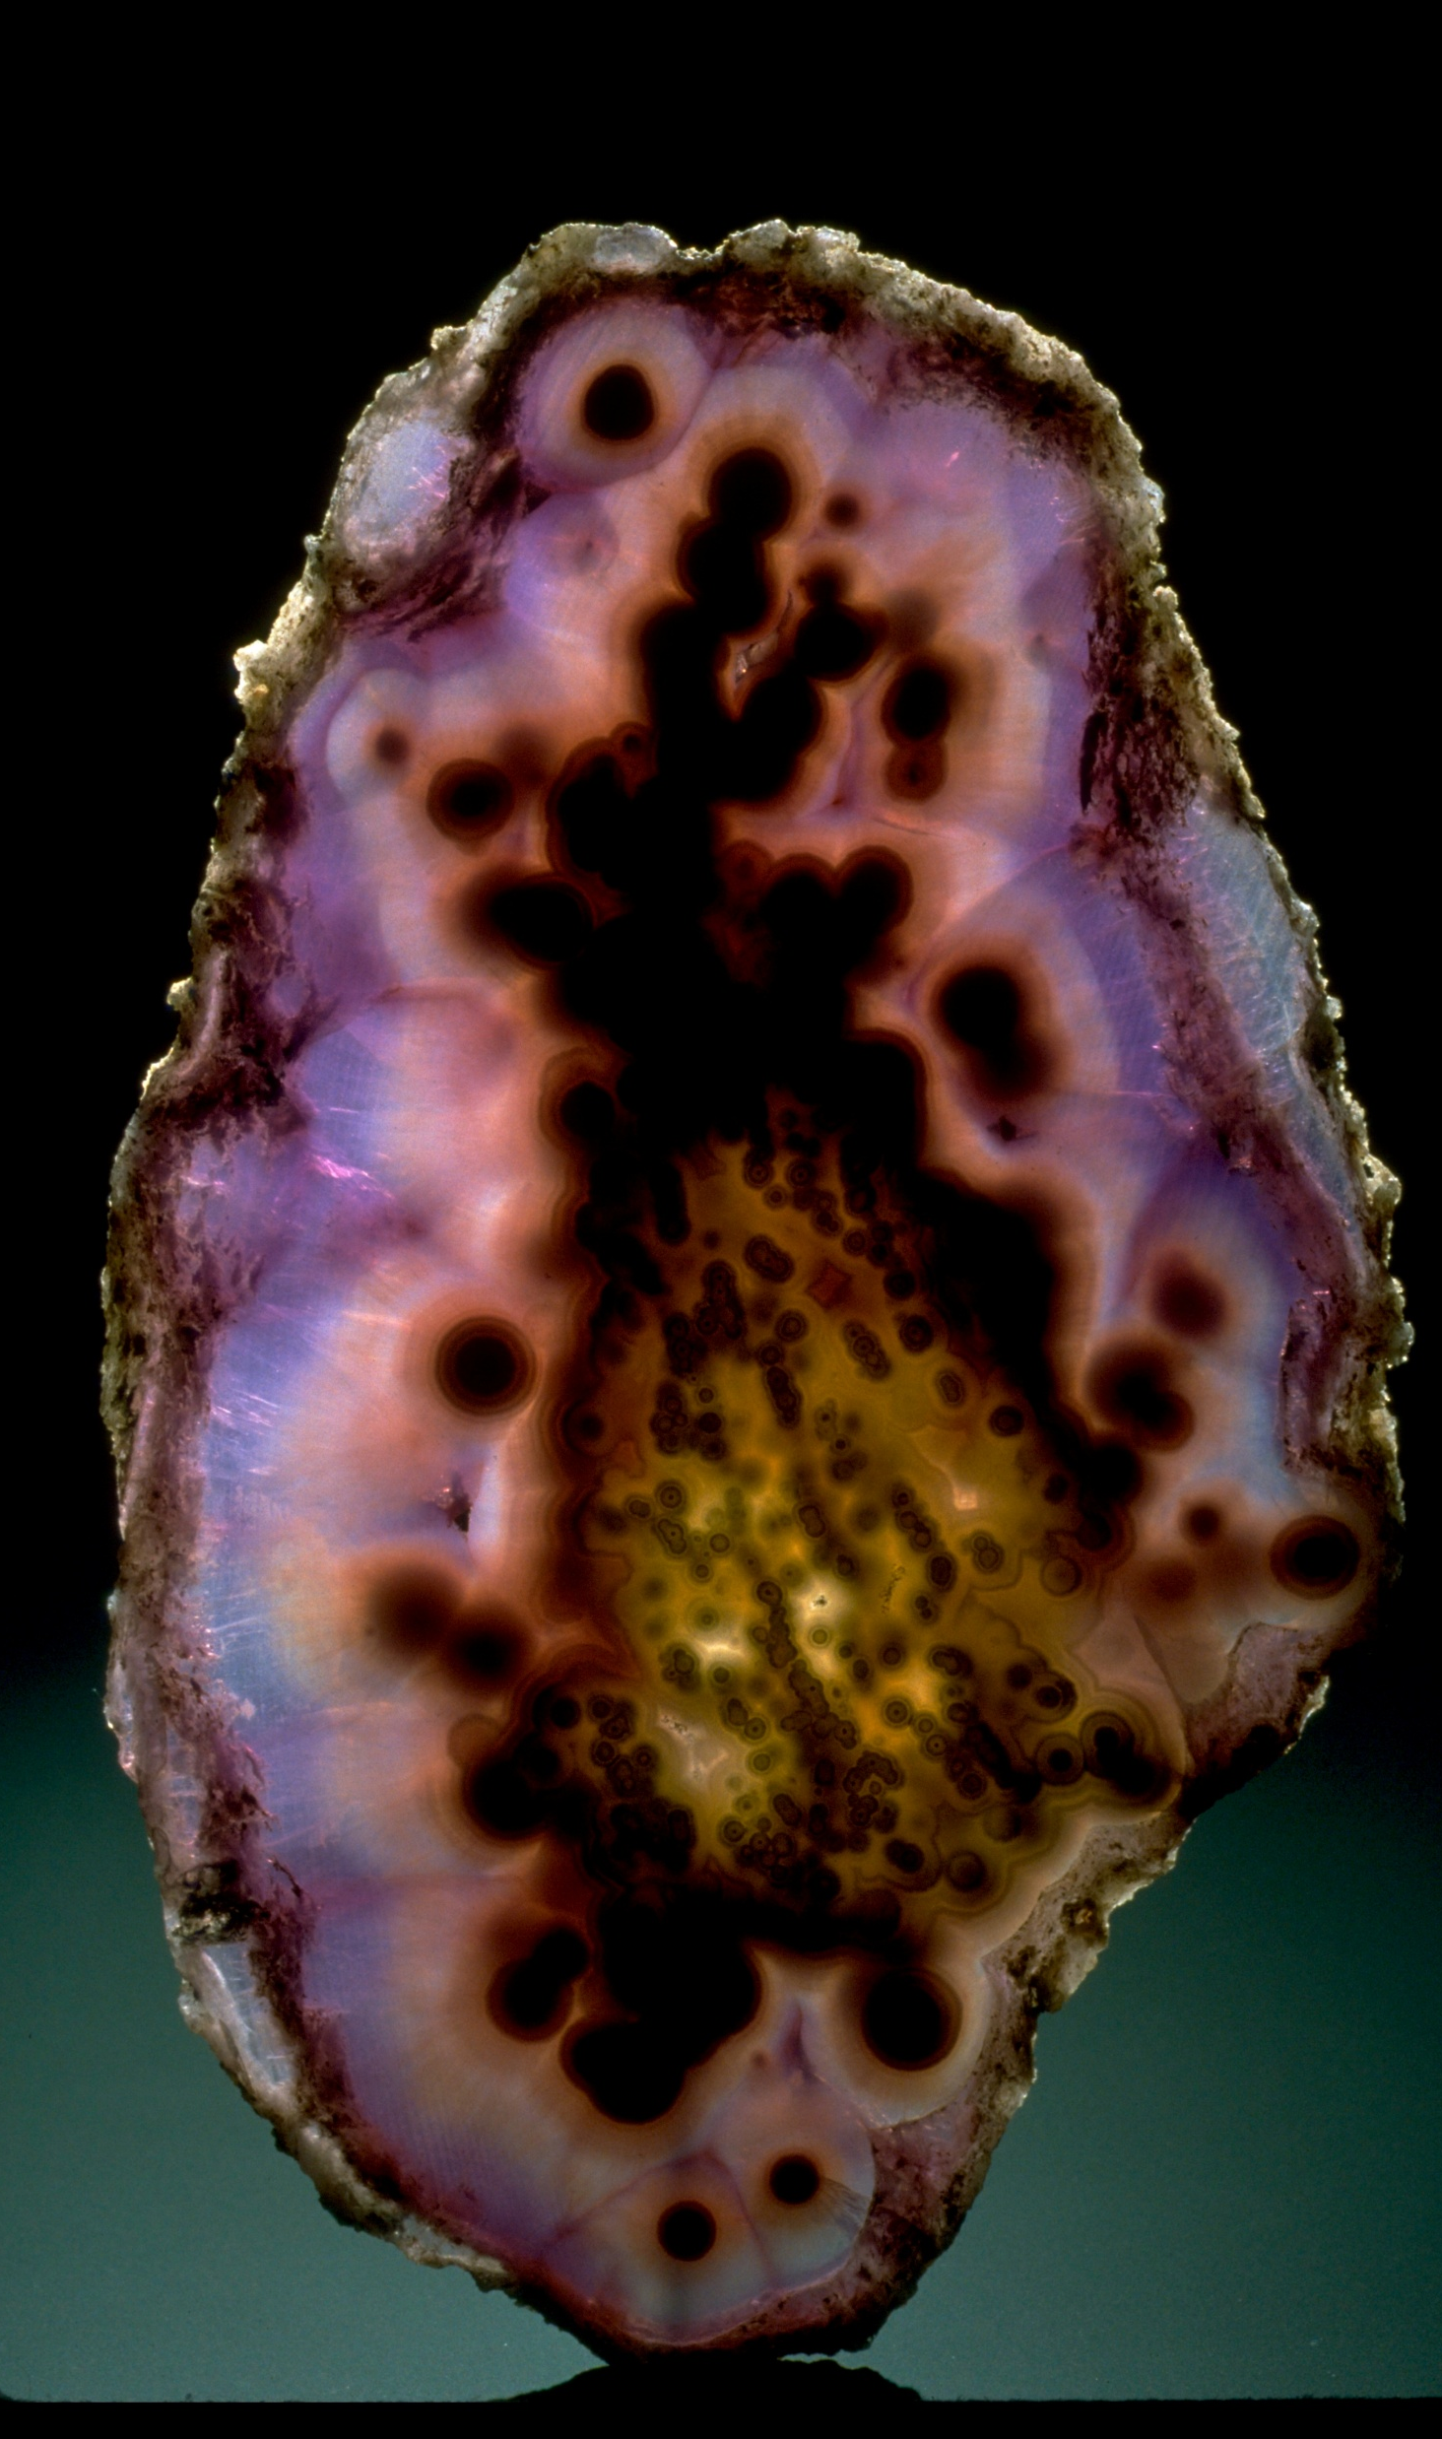
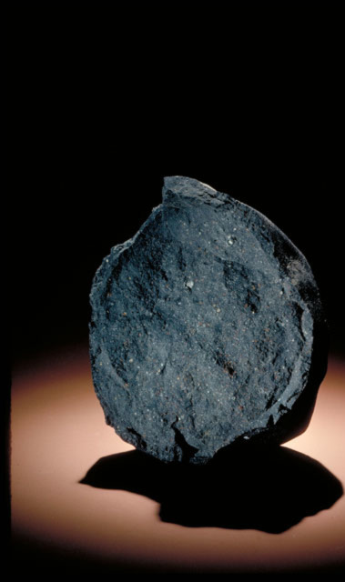
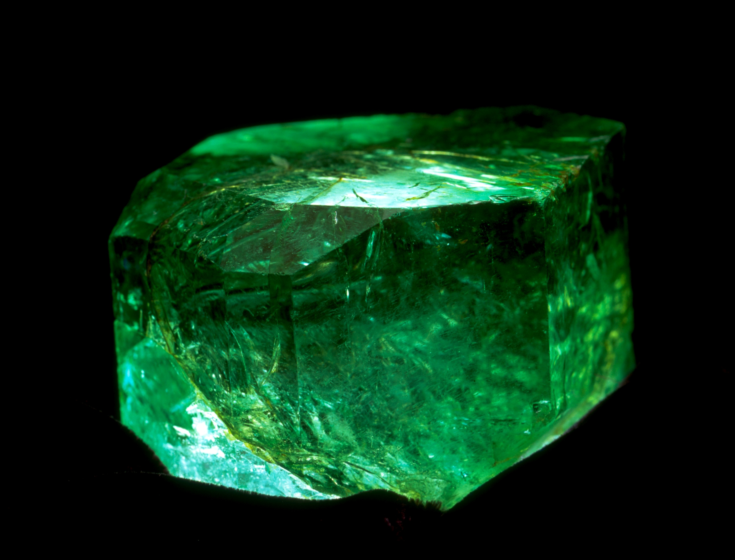
Notes:
These are all items from the Smithsonian collection:
Piece of agate
Piece of the Murchison meteorite that fell in Australia in 1969. Some of its minerals are the oldest materials found to date on Earth, aged to 7 billion years old. 2.5 billion years older than the Solar System
Gachala emerald. This is a very large emerald from Colombia. It was found in 1967 and weights more than a third of a pound!

Slide 6
How about fishes?
Yes! They are called ichthyological collections. “Ichthyo” comes from the Greek “ichthys” which means fish.

Slide 7
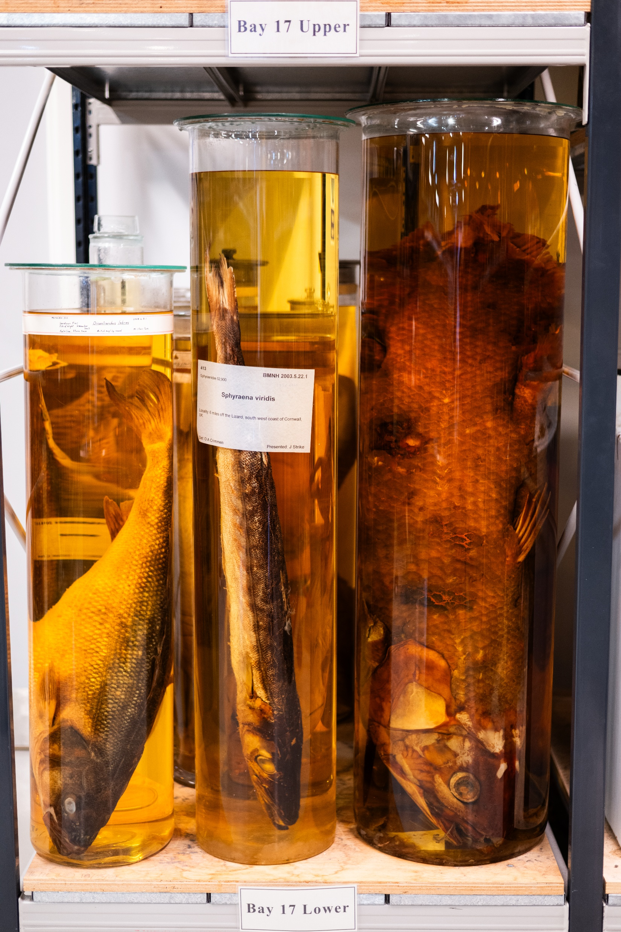
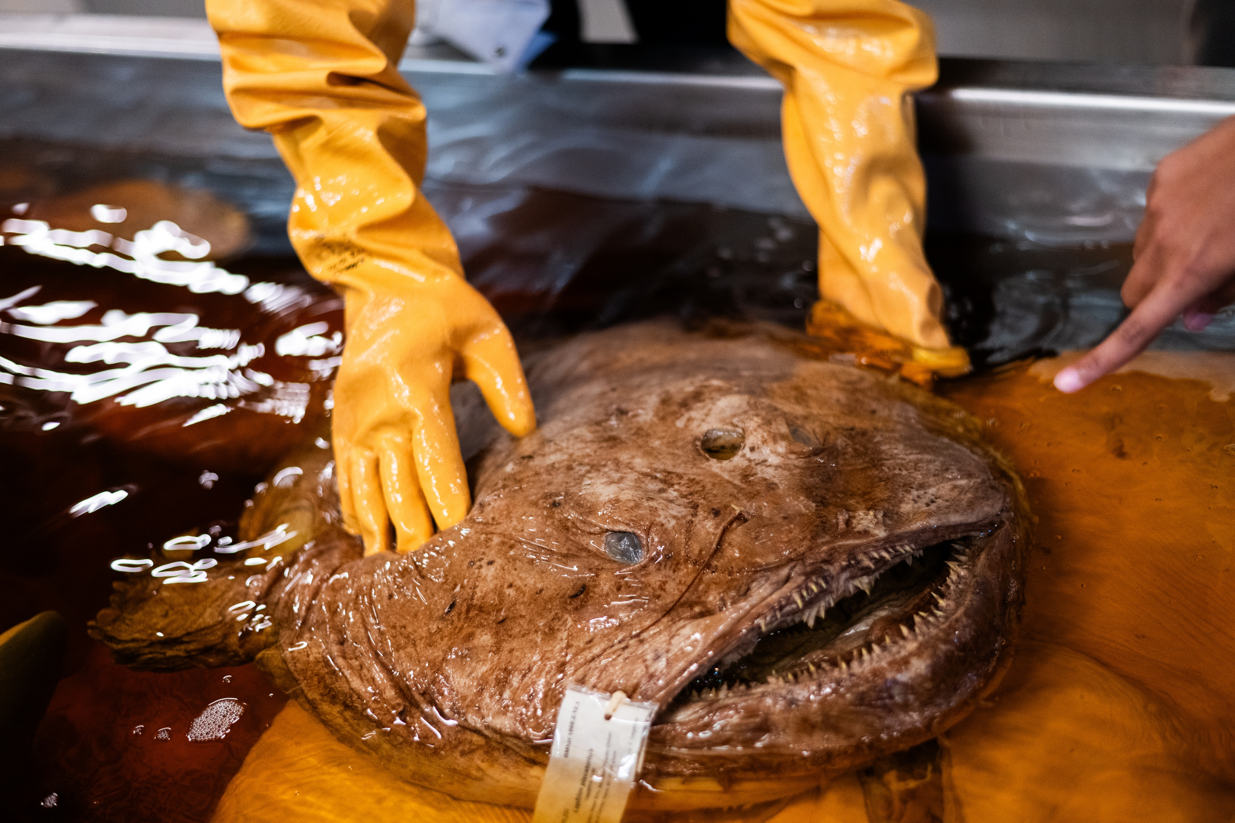
Notes:
Left: Large fishes stored in jars at the Museum of Natural History, London
Right: A large Angler Fish stored in a tank at the Museum of Natural History, London

Slide 8
And plants?
Also, yes! Plants are usually kept in collections that are called herbaria, where they are stored flat between pieces of paper.

Slide 9
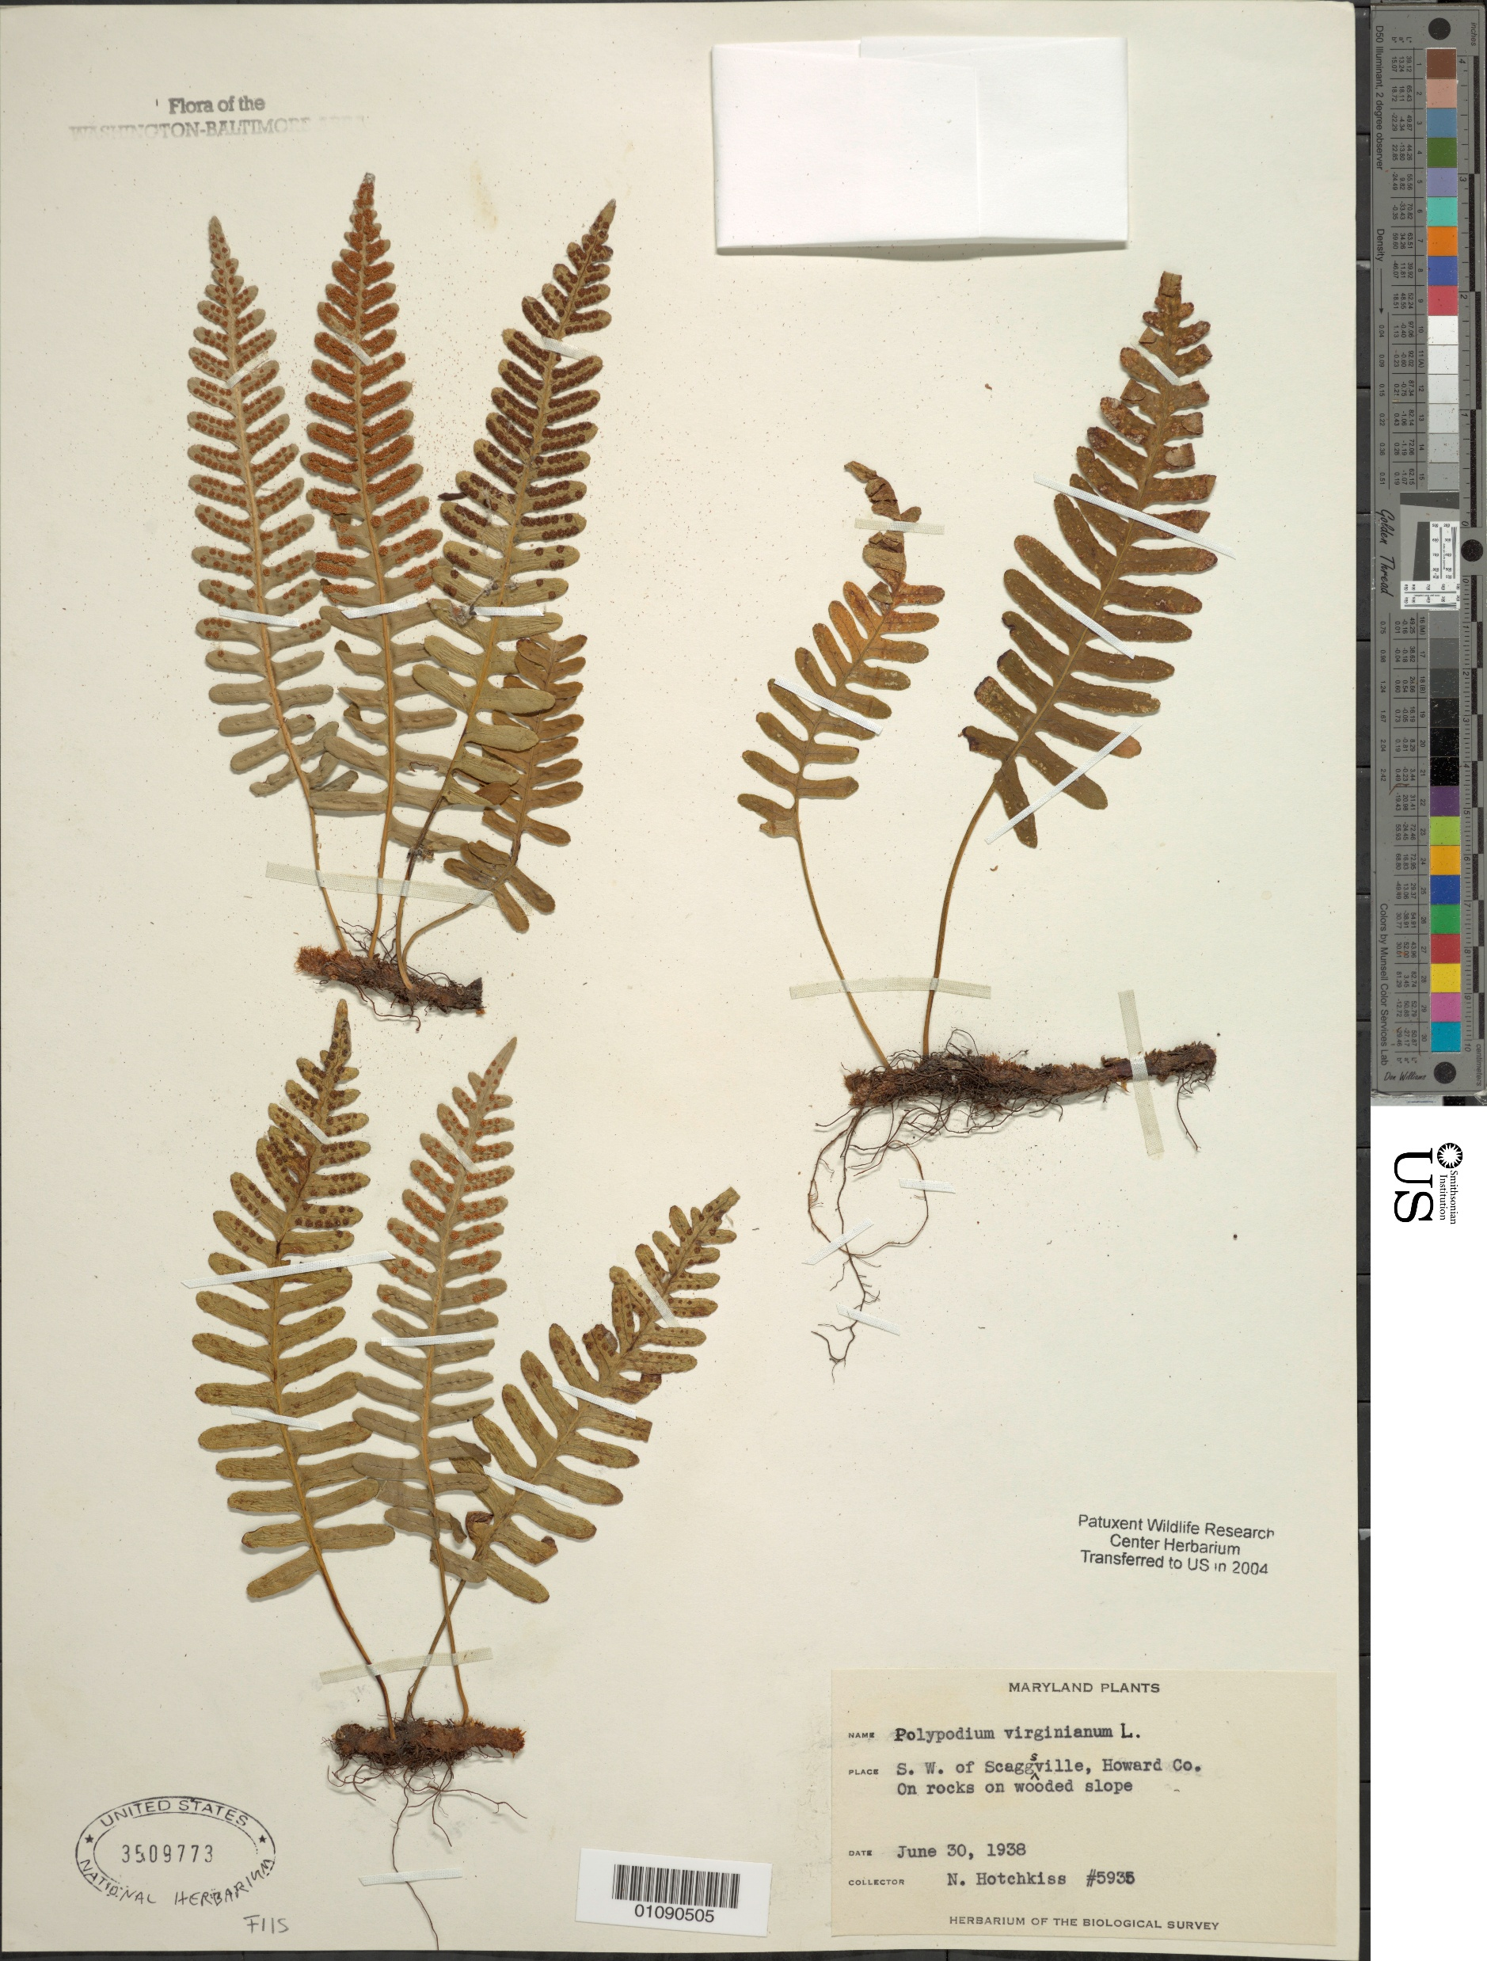
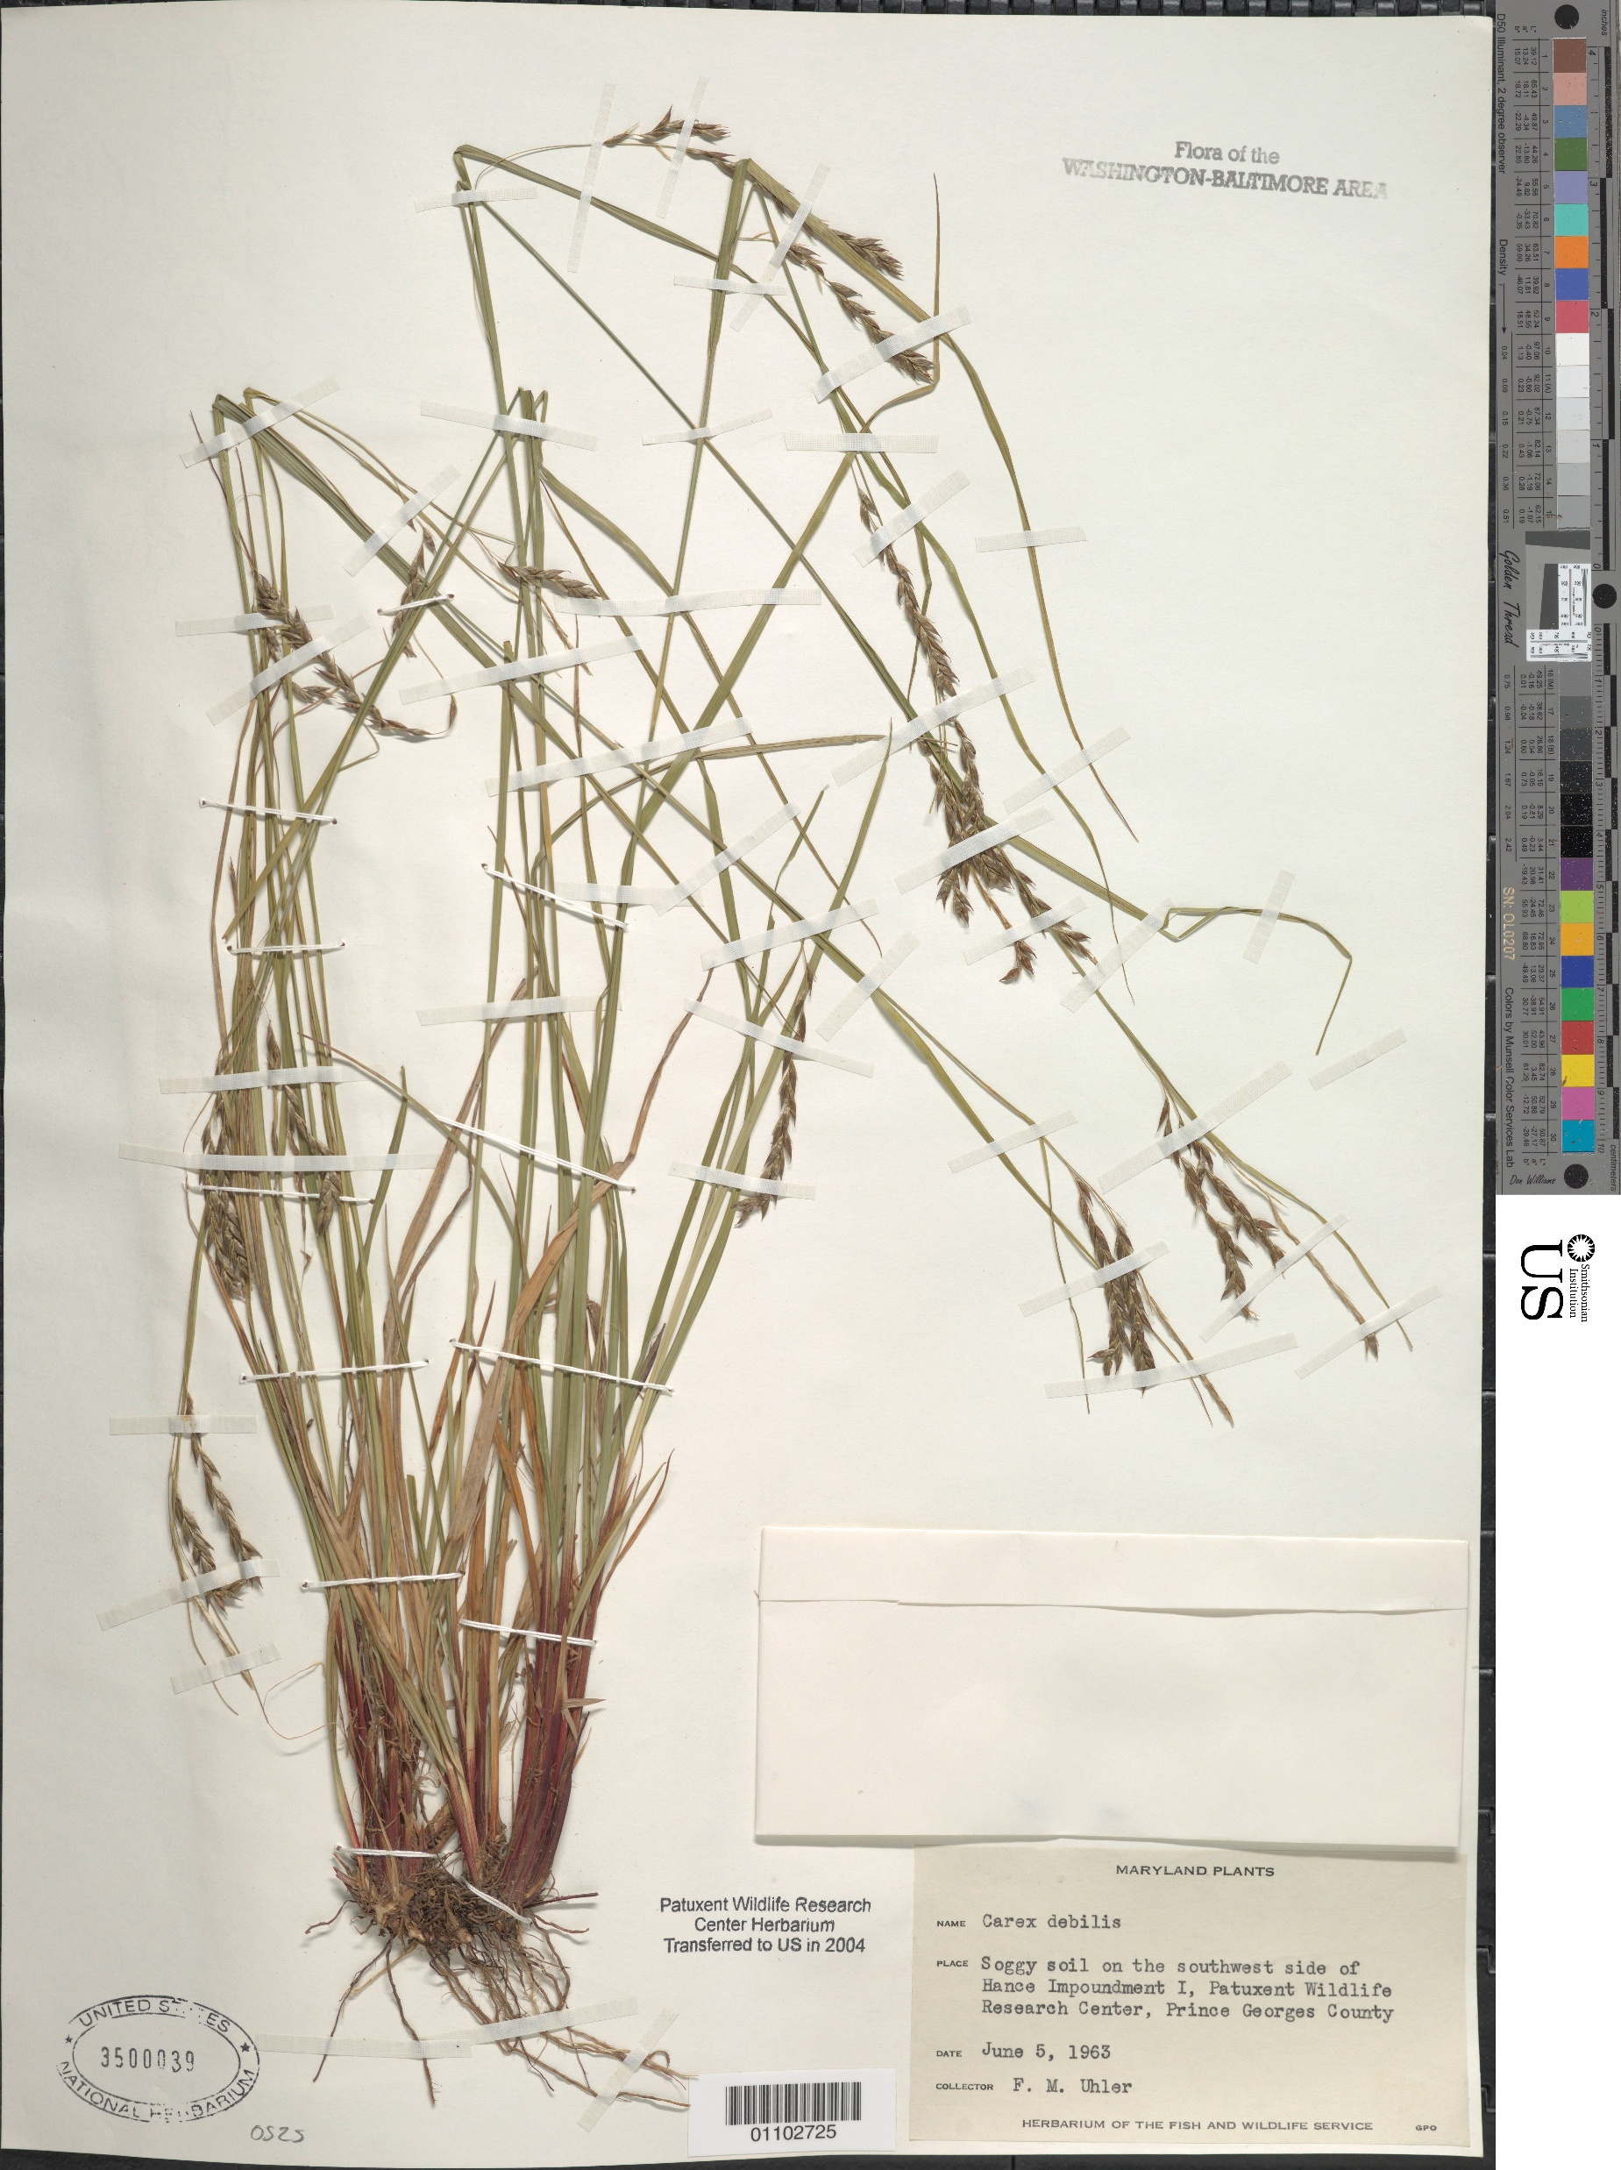
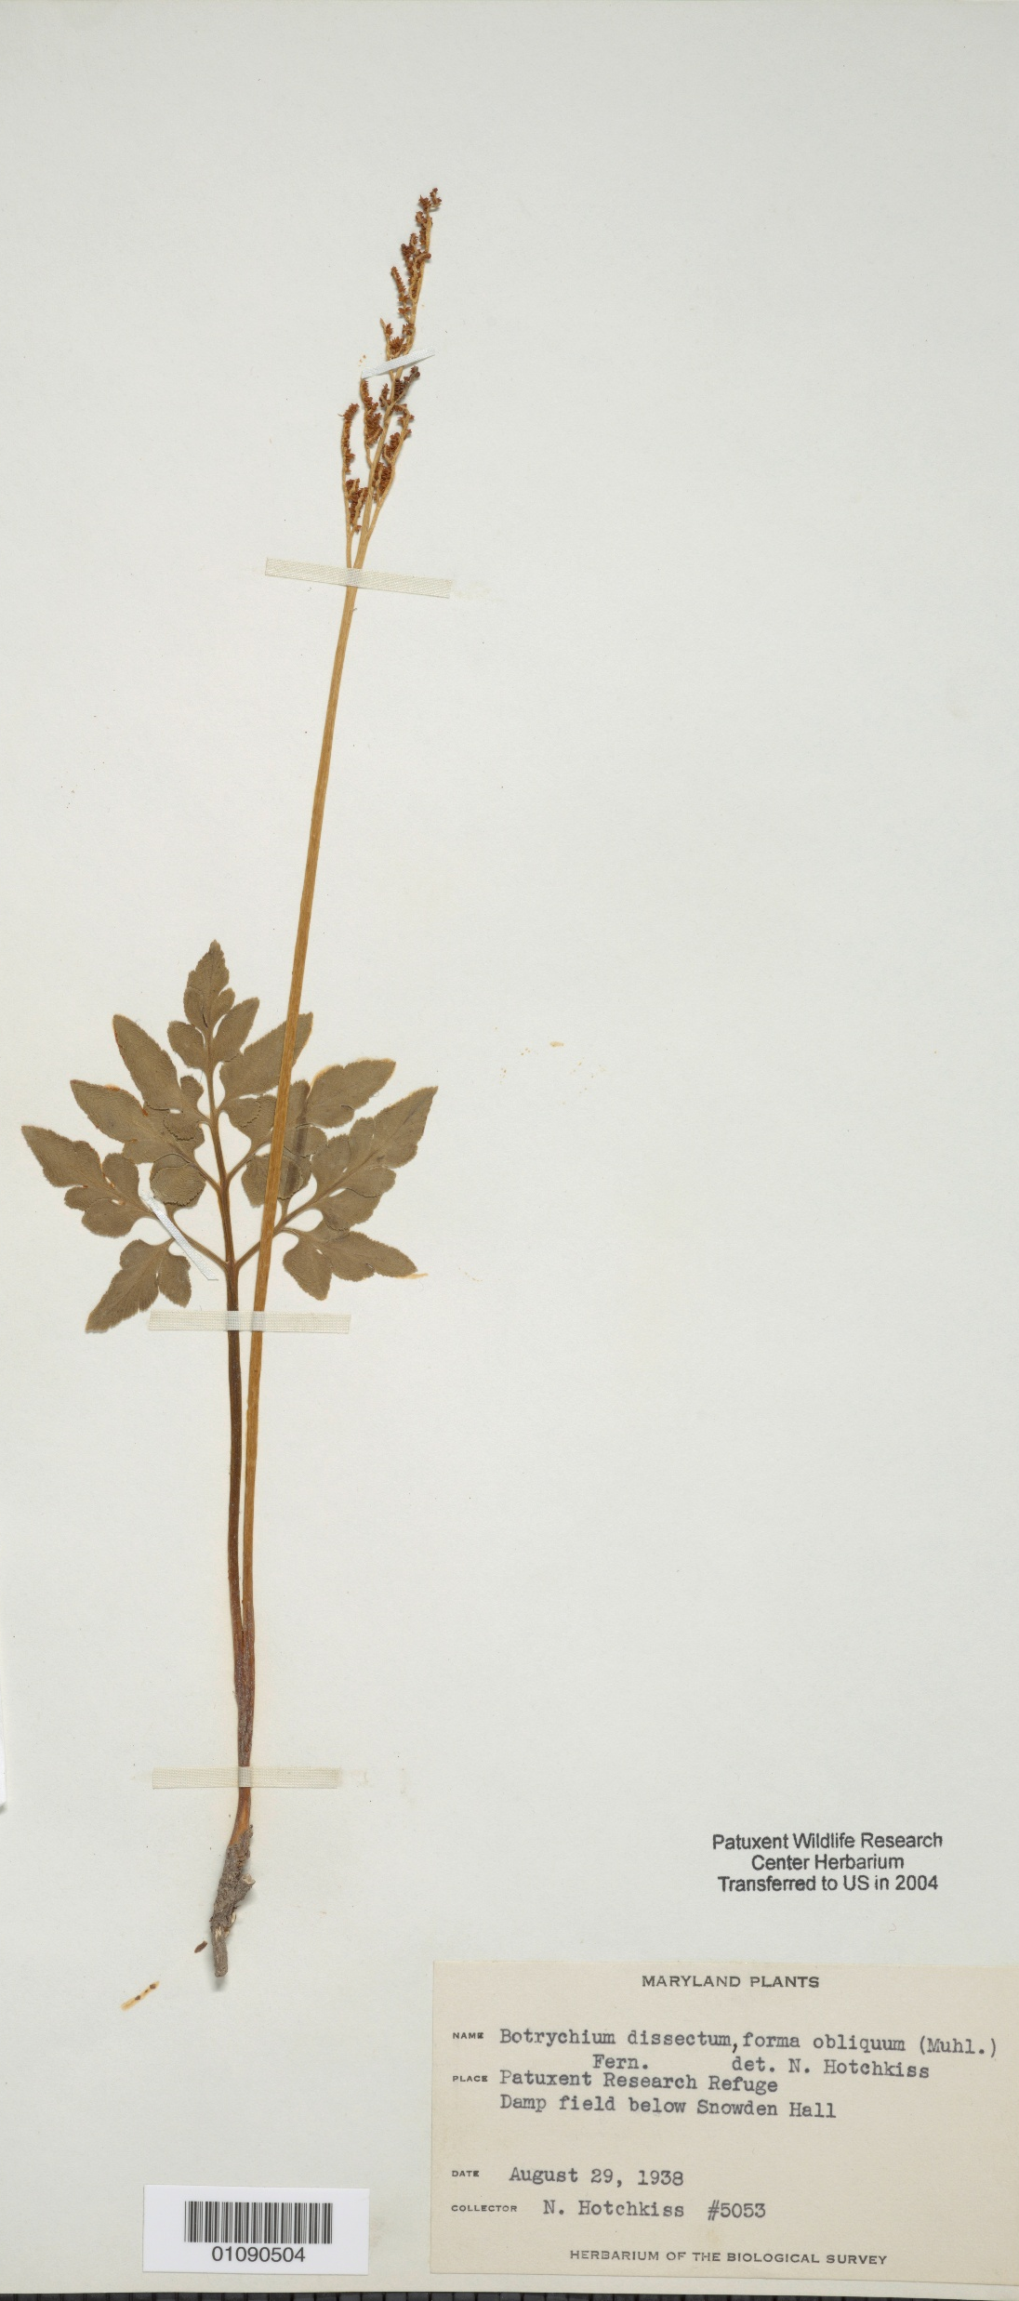

Slide 10
Let’s collect some specimens!
Follow your instructor’s guidelines on what specimens to collect.
Remember: be kind to your environment and watch out for your surroundings!

