Slide 1

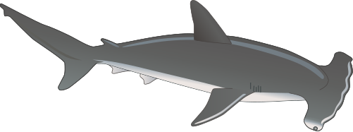
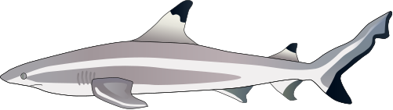


FINDING A HOME FOR SHARKS
Emily Echevarria

Slide 2
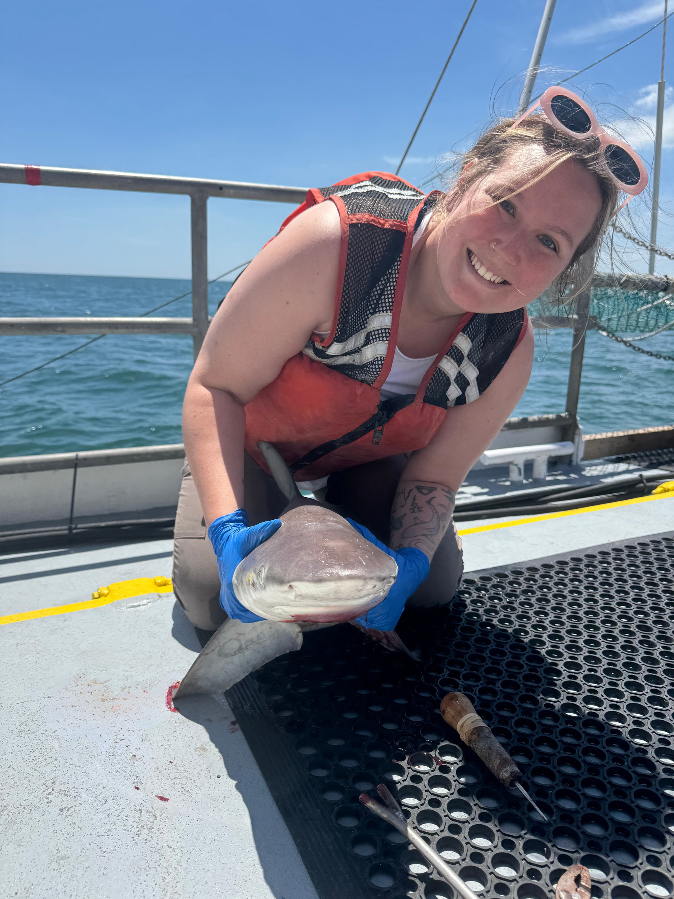
Emily Echevarria
Hi, my name is Emily and I am a Marine Biologist!
I study baby sharks and what their life is like in the first few years of their life.
I’m like to learn about all the different places that sharks can live and what makes them happy!

Slide 3
Have you ever seen a shark?

Slide 4
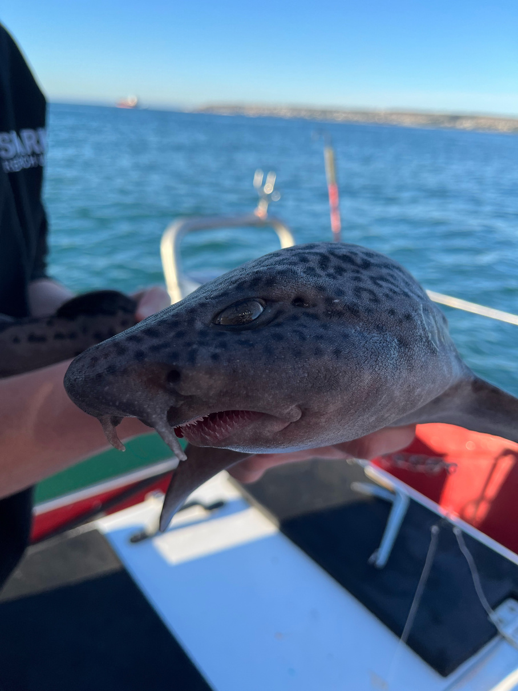
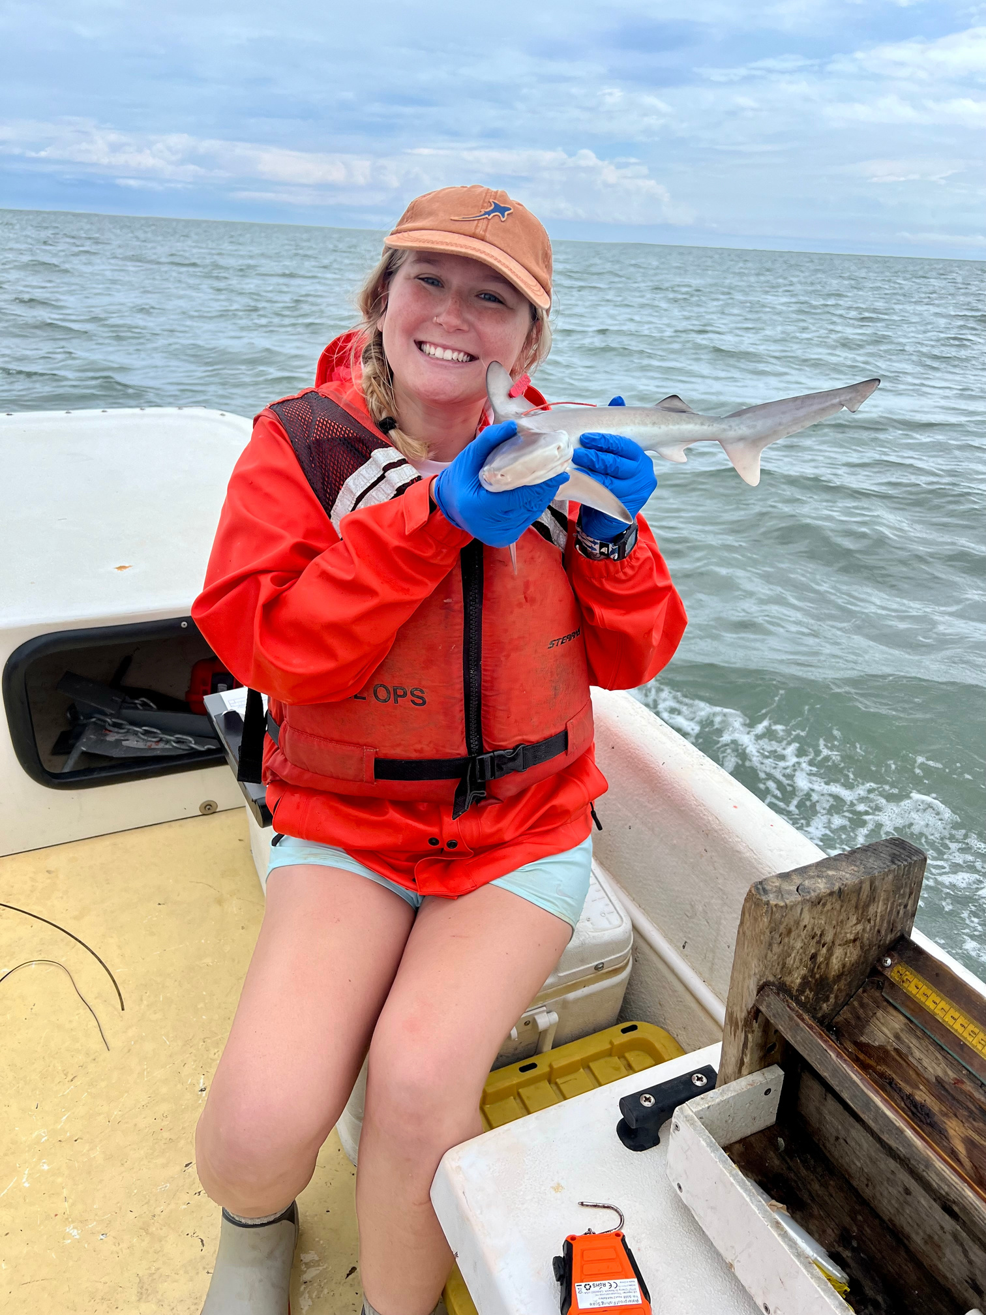
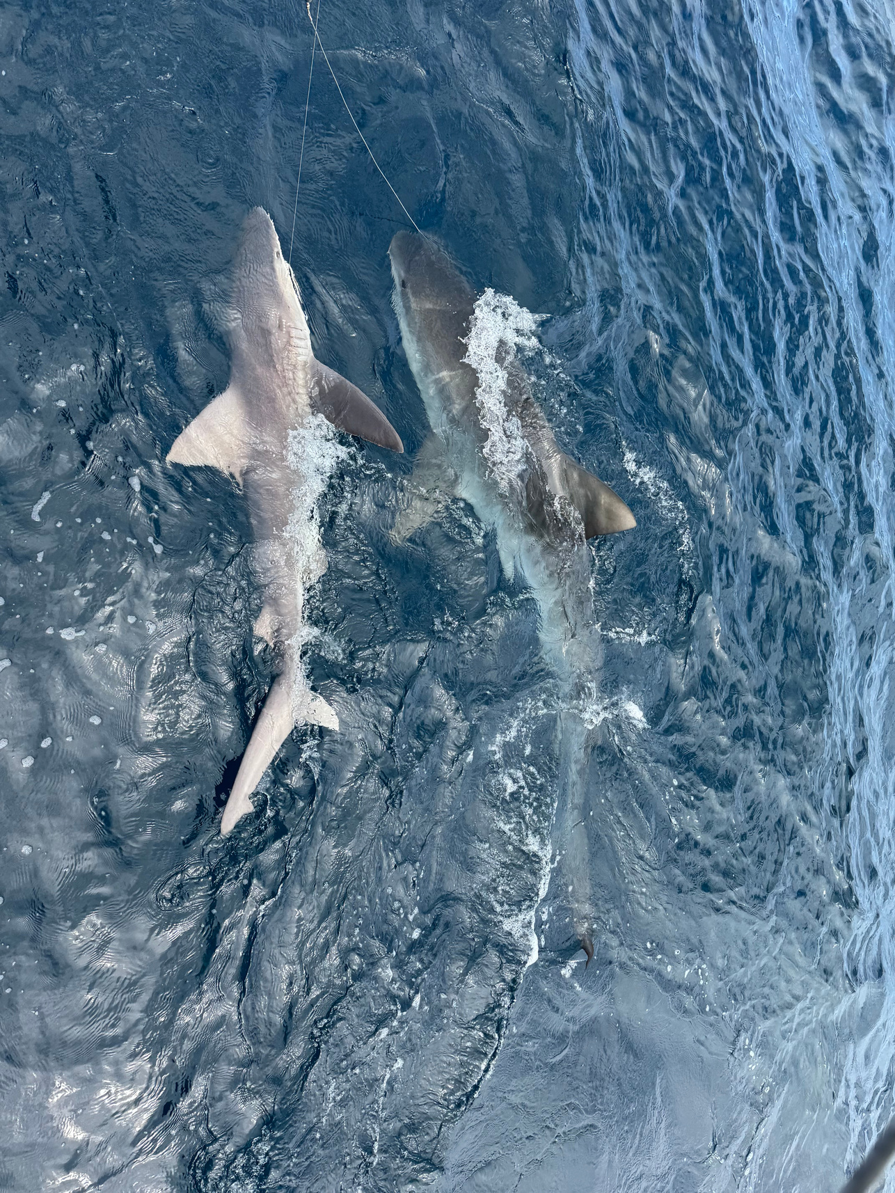
Have you ever seen a shark?
Leopard Catshark
Photo by Emily Echevarria
Juvenile sandbar shark
Photo by Emily Echevarria
Sandbar shark and tiger shark
Photo by Emily Echevarria

Slide 5
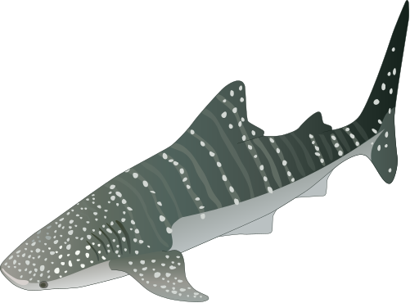

There are over 500 species of sharks!
They come in all shapes and sizes.
Some are as small as 8 inches long, and some get as big as 60 feet long!

Slide 6
Where do sharks live?
Sharks live in oceans all around the world, from warm, shallow waters near the shore to deep, cold parts of the sea. Some even swim into bays and rivers where fresh and salty water mix!

Slide 7
Where do sharks live?
Vocabulary:
  Habitat: The place where an animal lives and finds everything it needs to grow and survive. This is their home.
  Suitability: How well a habitat meets an animal’s needs. A suitable habitat has the right food, temperature, and shelter for that animal to live safely.

Slide 8
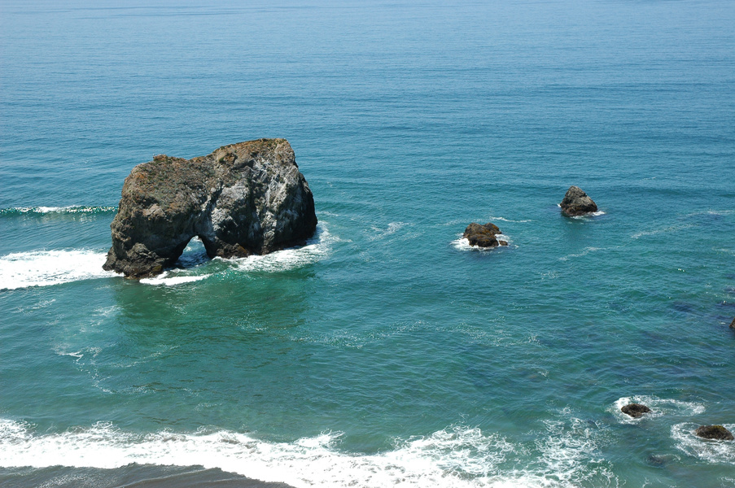


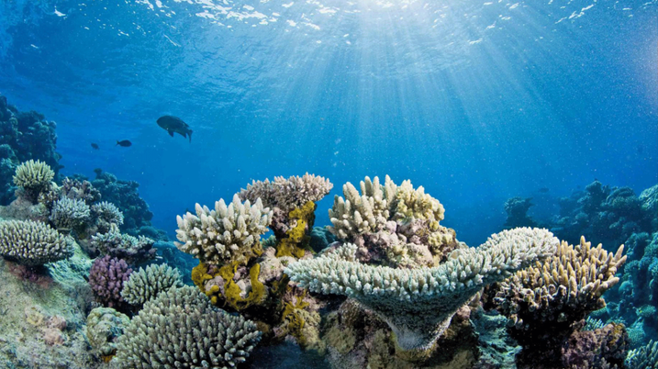
  Salinity
How much salt is in the water.
PARTS OF OCEAN HABITATS
Notes:
Salinity is how much salt is in the water, and we measure it in parts per thousand.
The saltiest part of the ocean has a salinity of 35 PPT (lots of salt!)
Freshwater has a salinity close to 0 PPT (no salt!)
Most places in the ocean have a salinity somewhere in between 0 and 35.
Sharks need a specific level of salt in their habitat to stay healthy.

Slide 9
  Salinity
How much salt is in the water.
PARTS OF OCEAN HABITATS
PARTS OF OCEAN HABITATS
  Temperature
Sharks are very picky about the temperature of the water.
Notes:
In science, we measure temperature with degrees Celsius.
Sharks are very picky about the temperature of the water.
It is easier for some sharks to survive in warmer water, and easier for some sharks to survive in colder water.

Slide 10
  Salinity
  Diet
How much salt is in the water.
It is important that a shark’s habitat has the right kind of food for it to eat.
PARTS OF OCEAN HABITATS
PARTS OF OCEAN HABITATS
  Temperature
Sharks are very picky about the temperature of the water.
Notes:
Different species of sharks eat different things. The items they eat are called prey. Sharks are called predators.
Some sharks eat plankton (tiny plants and animals that float in the water).Other sharks eat things like crabs, seals, or fish.
Some sharks eat anything they can find!
It is important that a shark’s habitat has the right kind of food for it to eat.

Slide 11
  Salinity
  Diet
How much salt is in the water.
It is important that a shark’s habitat has the right kind of food for it to eat.
PARTS OF OCEAN HABITATS
PARTS OF OCEAN HABITATS
  Temperature
  Pollution
Sharks are very picky about the temperature of the water.
Sharks need healthy oceans to survive!
Notes:
Humans can change ocean habitats with pollution. We can add trash and plastic, dangerous chemicals, and other things to the water that make sharks sick. We can also catch sharks when we go fishing or change where they want to live by adding noise and construction.
Sharks need healthy oceans to survive!

Slide 12

NO HABITAT IS PERFECT!
Sharks have to make choices, and there are downsides.
A downside is a negative, or not-so-good, part of a choice. A shark may pick a habitat that has lots of food.... but is too cold for them!

Slide 13
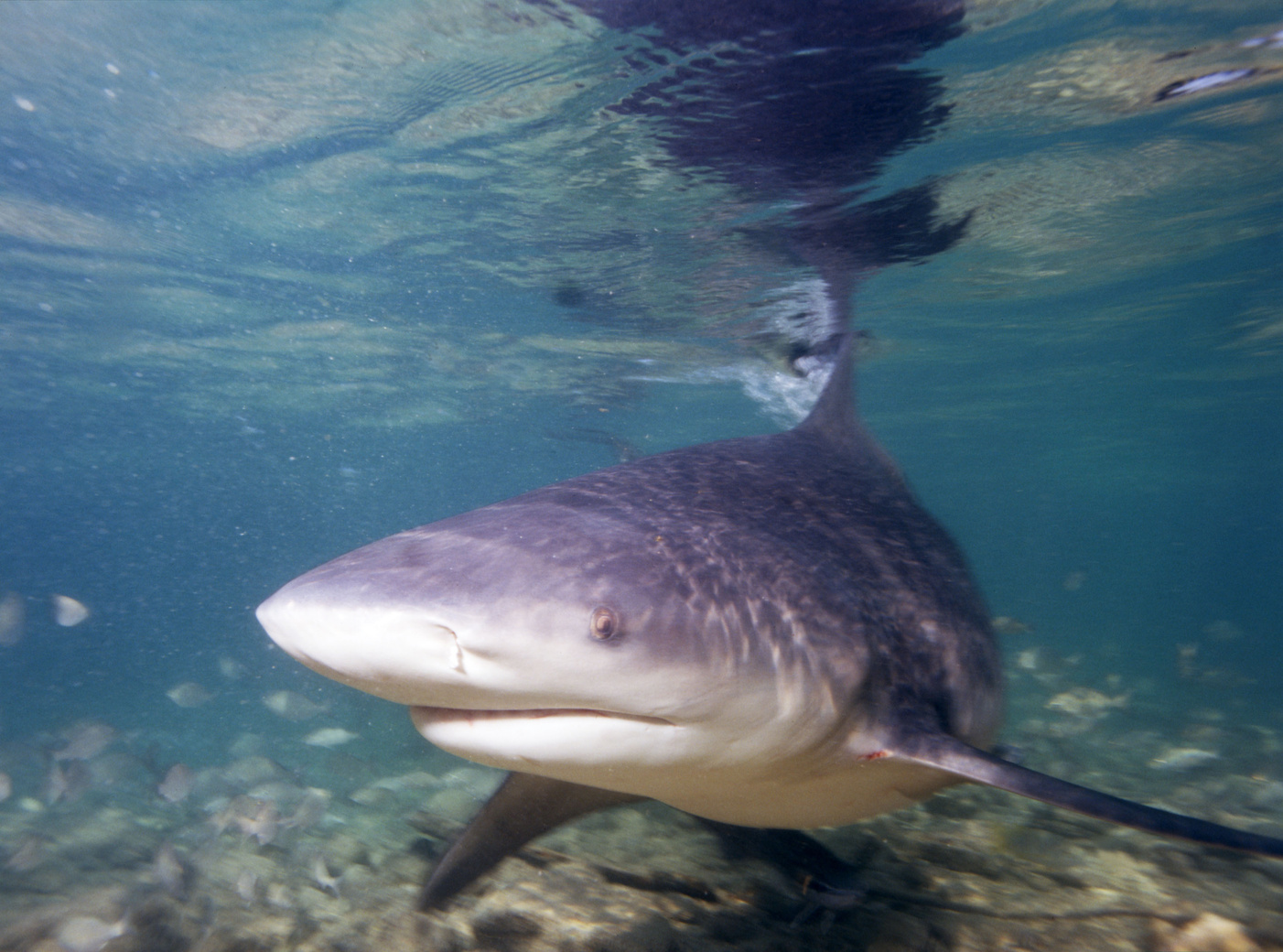
I have some shark friends that are looking for new homes!
Billy Bull Shark

Slide 14
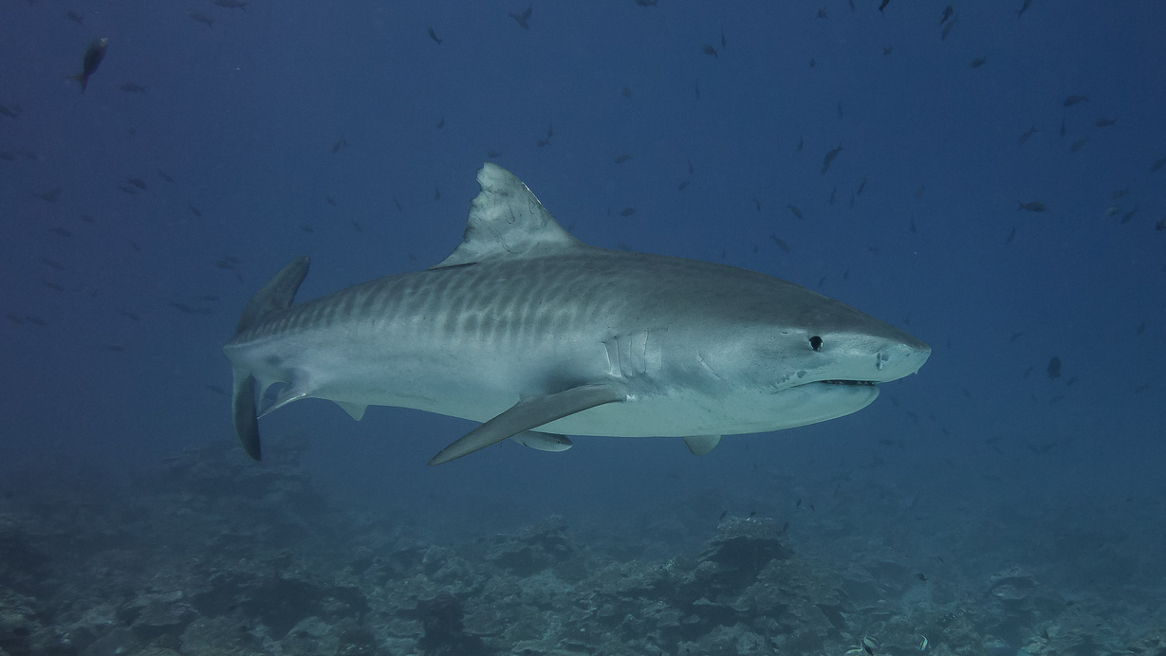
I have some shark friends that are looking for new homes!
Tara Tiger Shark

Slide 15
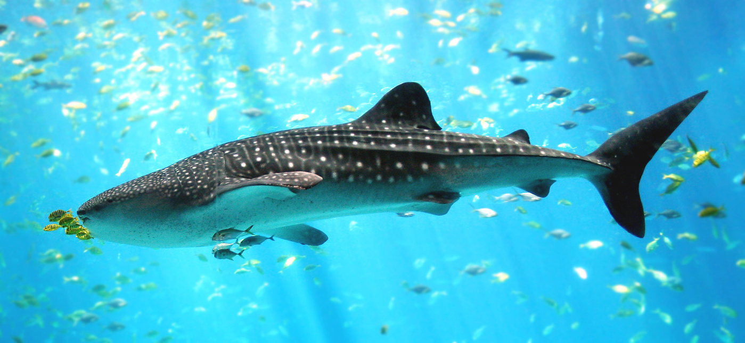
I have some shark friends that are looking for new homes!
Will Whale Shark

Slide 16
As a team, you will get information on your shark and what kind of habitat they need.
Each shark has 4 houses they are thinking about living in. Help them find the most suitable habitat!
Remember that important parts of a habitat are: Salinity, Temperature, Diet, and Pollution

Slide 17
Step 1: Get into groups and learn about your shark.
Step 2: Work through 3 stations to learn about the homes your shark wants to live in.
Step 3: Think about what you learned about each home and decide which home is best for your shark.

