Slide 1
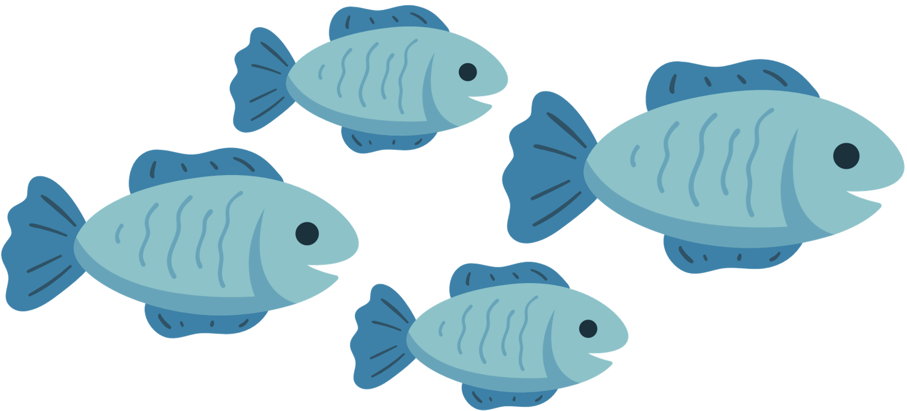


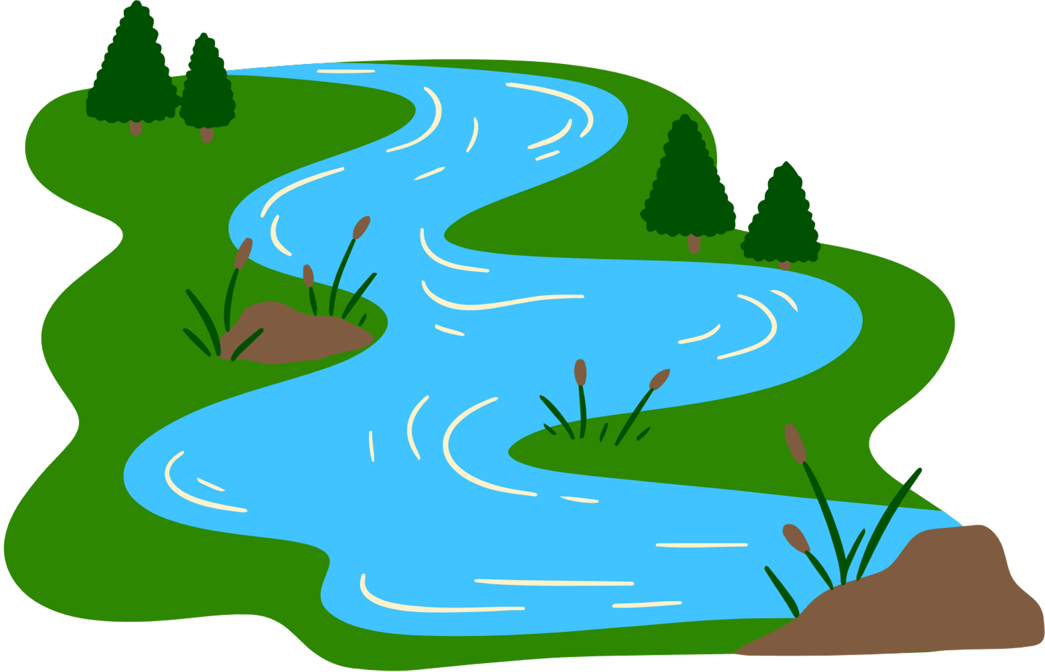

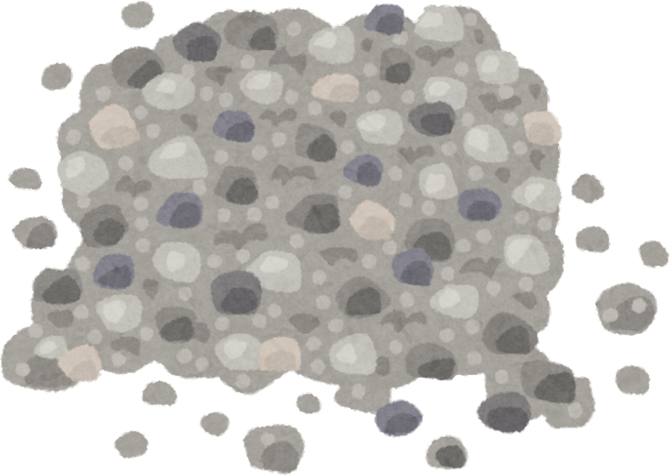

Fish Engineering: Building homes & Habitats
Prepared by Madeline Pitsenbarger

Slide 2
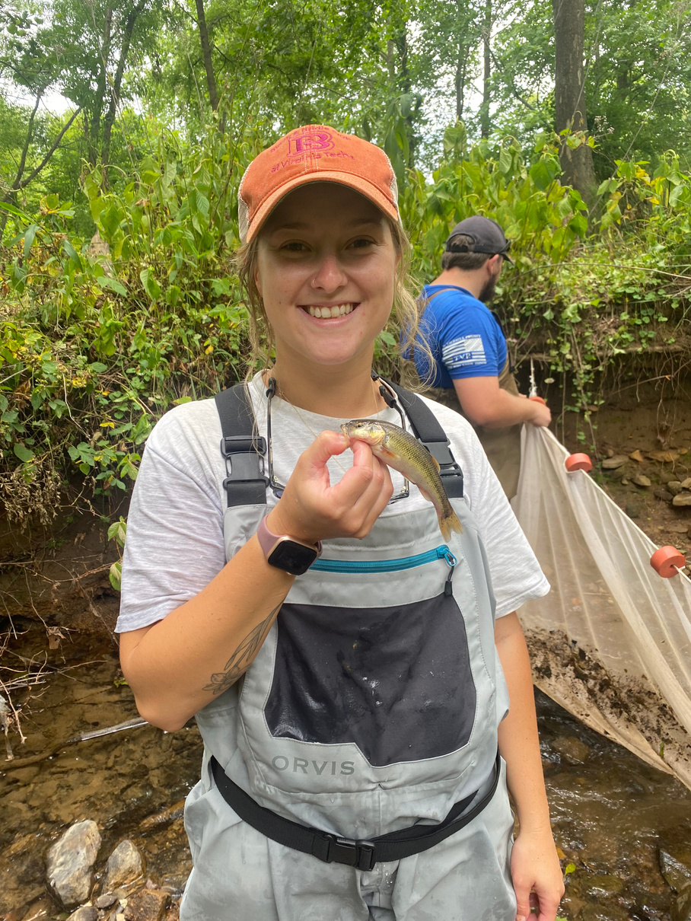
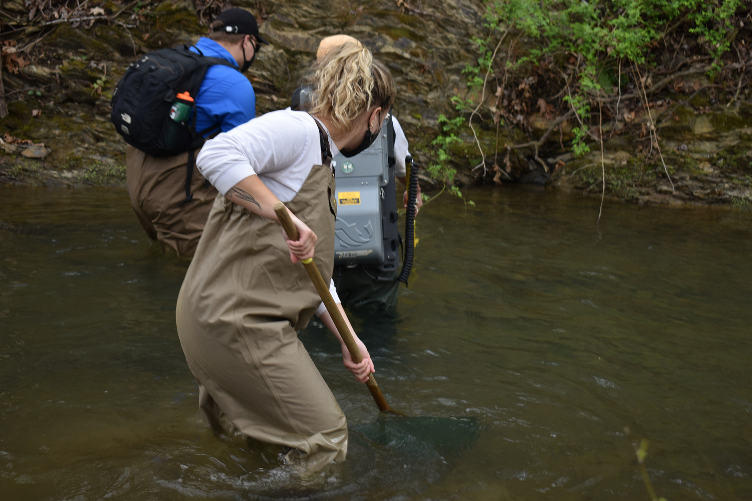
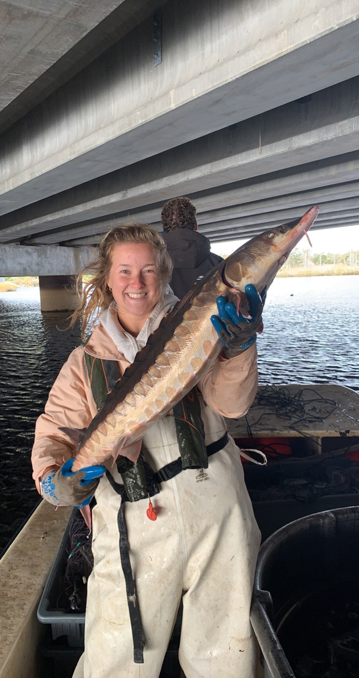
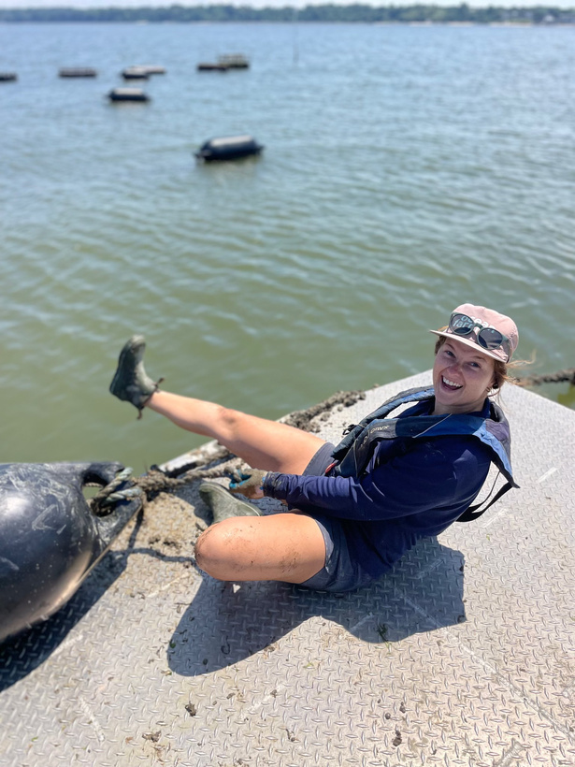
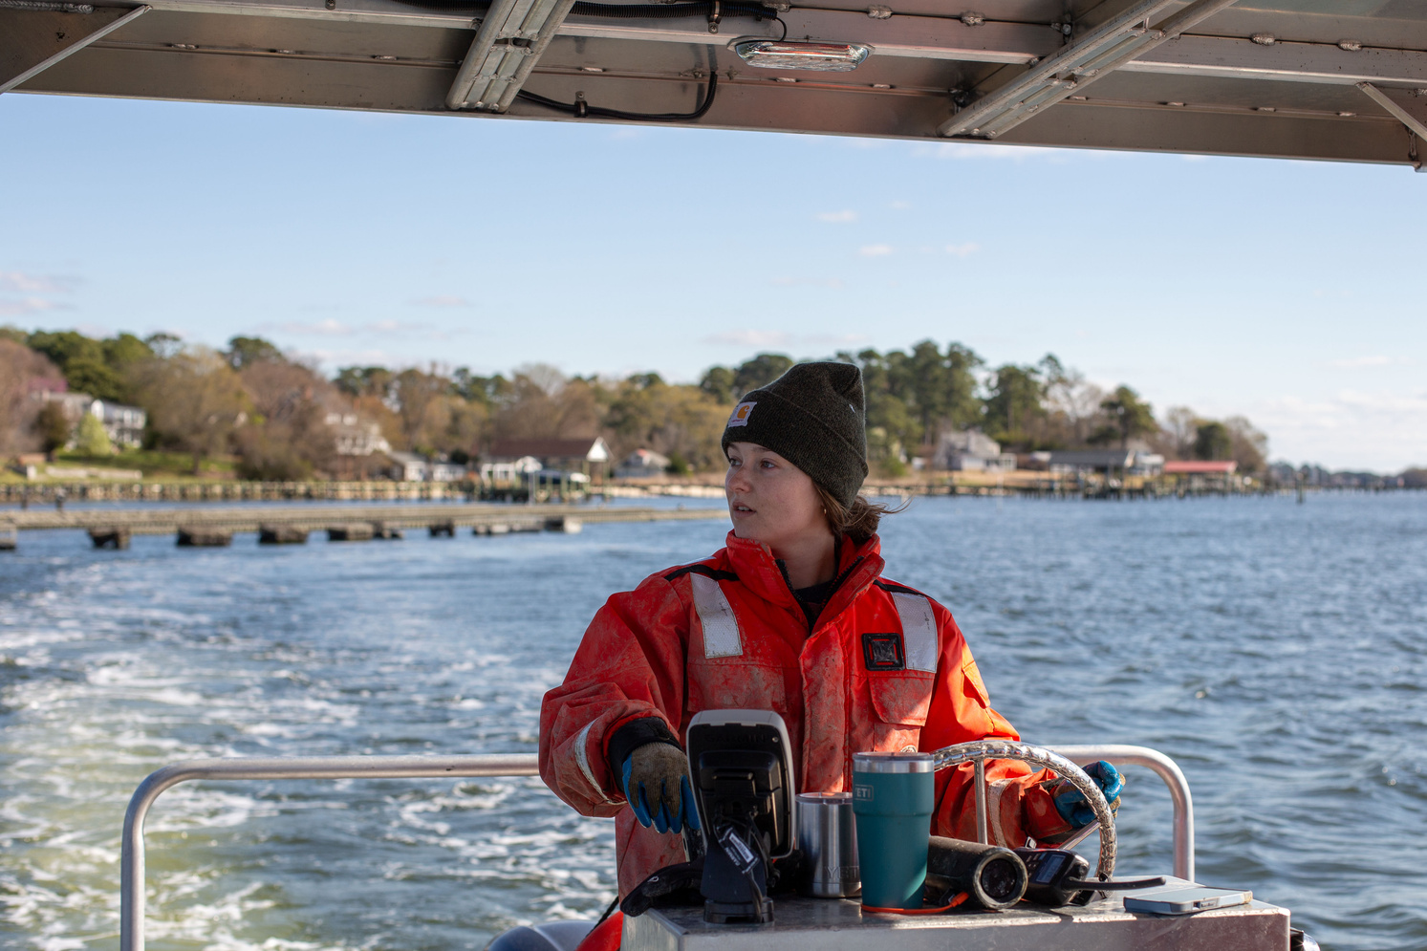
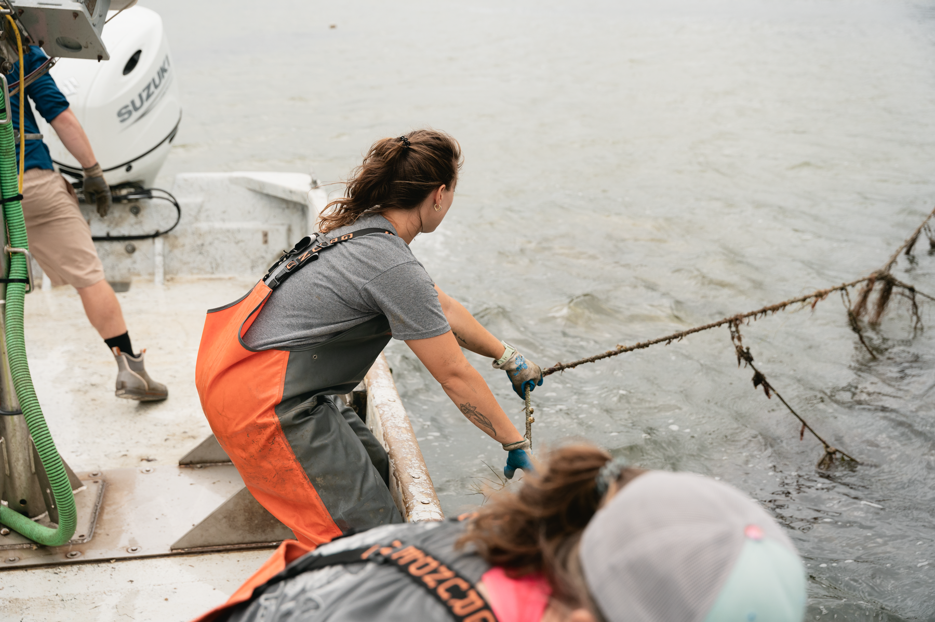
Meet the scientist!
Hi! My name is Madeline and I am a marine scientist.
Before I started studying animals in the ocean, I studied fish in the rivers of southwest Virginia!
I am excited to share my love for the water and knowledge of the animals that live in it with you!
Notes:
In case the kids ask...
The fish to the left is a white fish (freshwater) from southwest Virginia.
The fish to the right is an endangered Atlantic sturgeon (brackish/saltwater fish) caught in Wilmington, North Carolina for tagging to track their movement patterns.
The top middle picture is electrofishing to catch and release fish species to identify population abundances – to see how many and what types of fish there are in that river.
The bottom pictures are working on an oyster farm (my job now) for research!

Slide 3
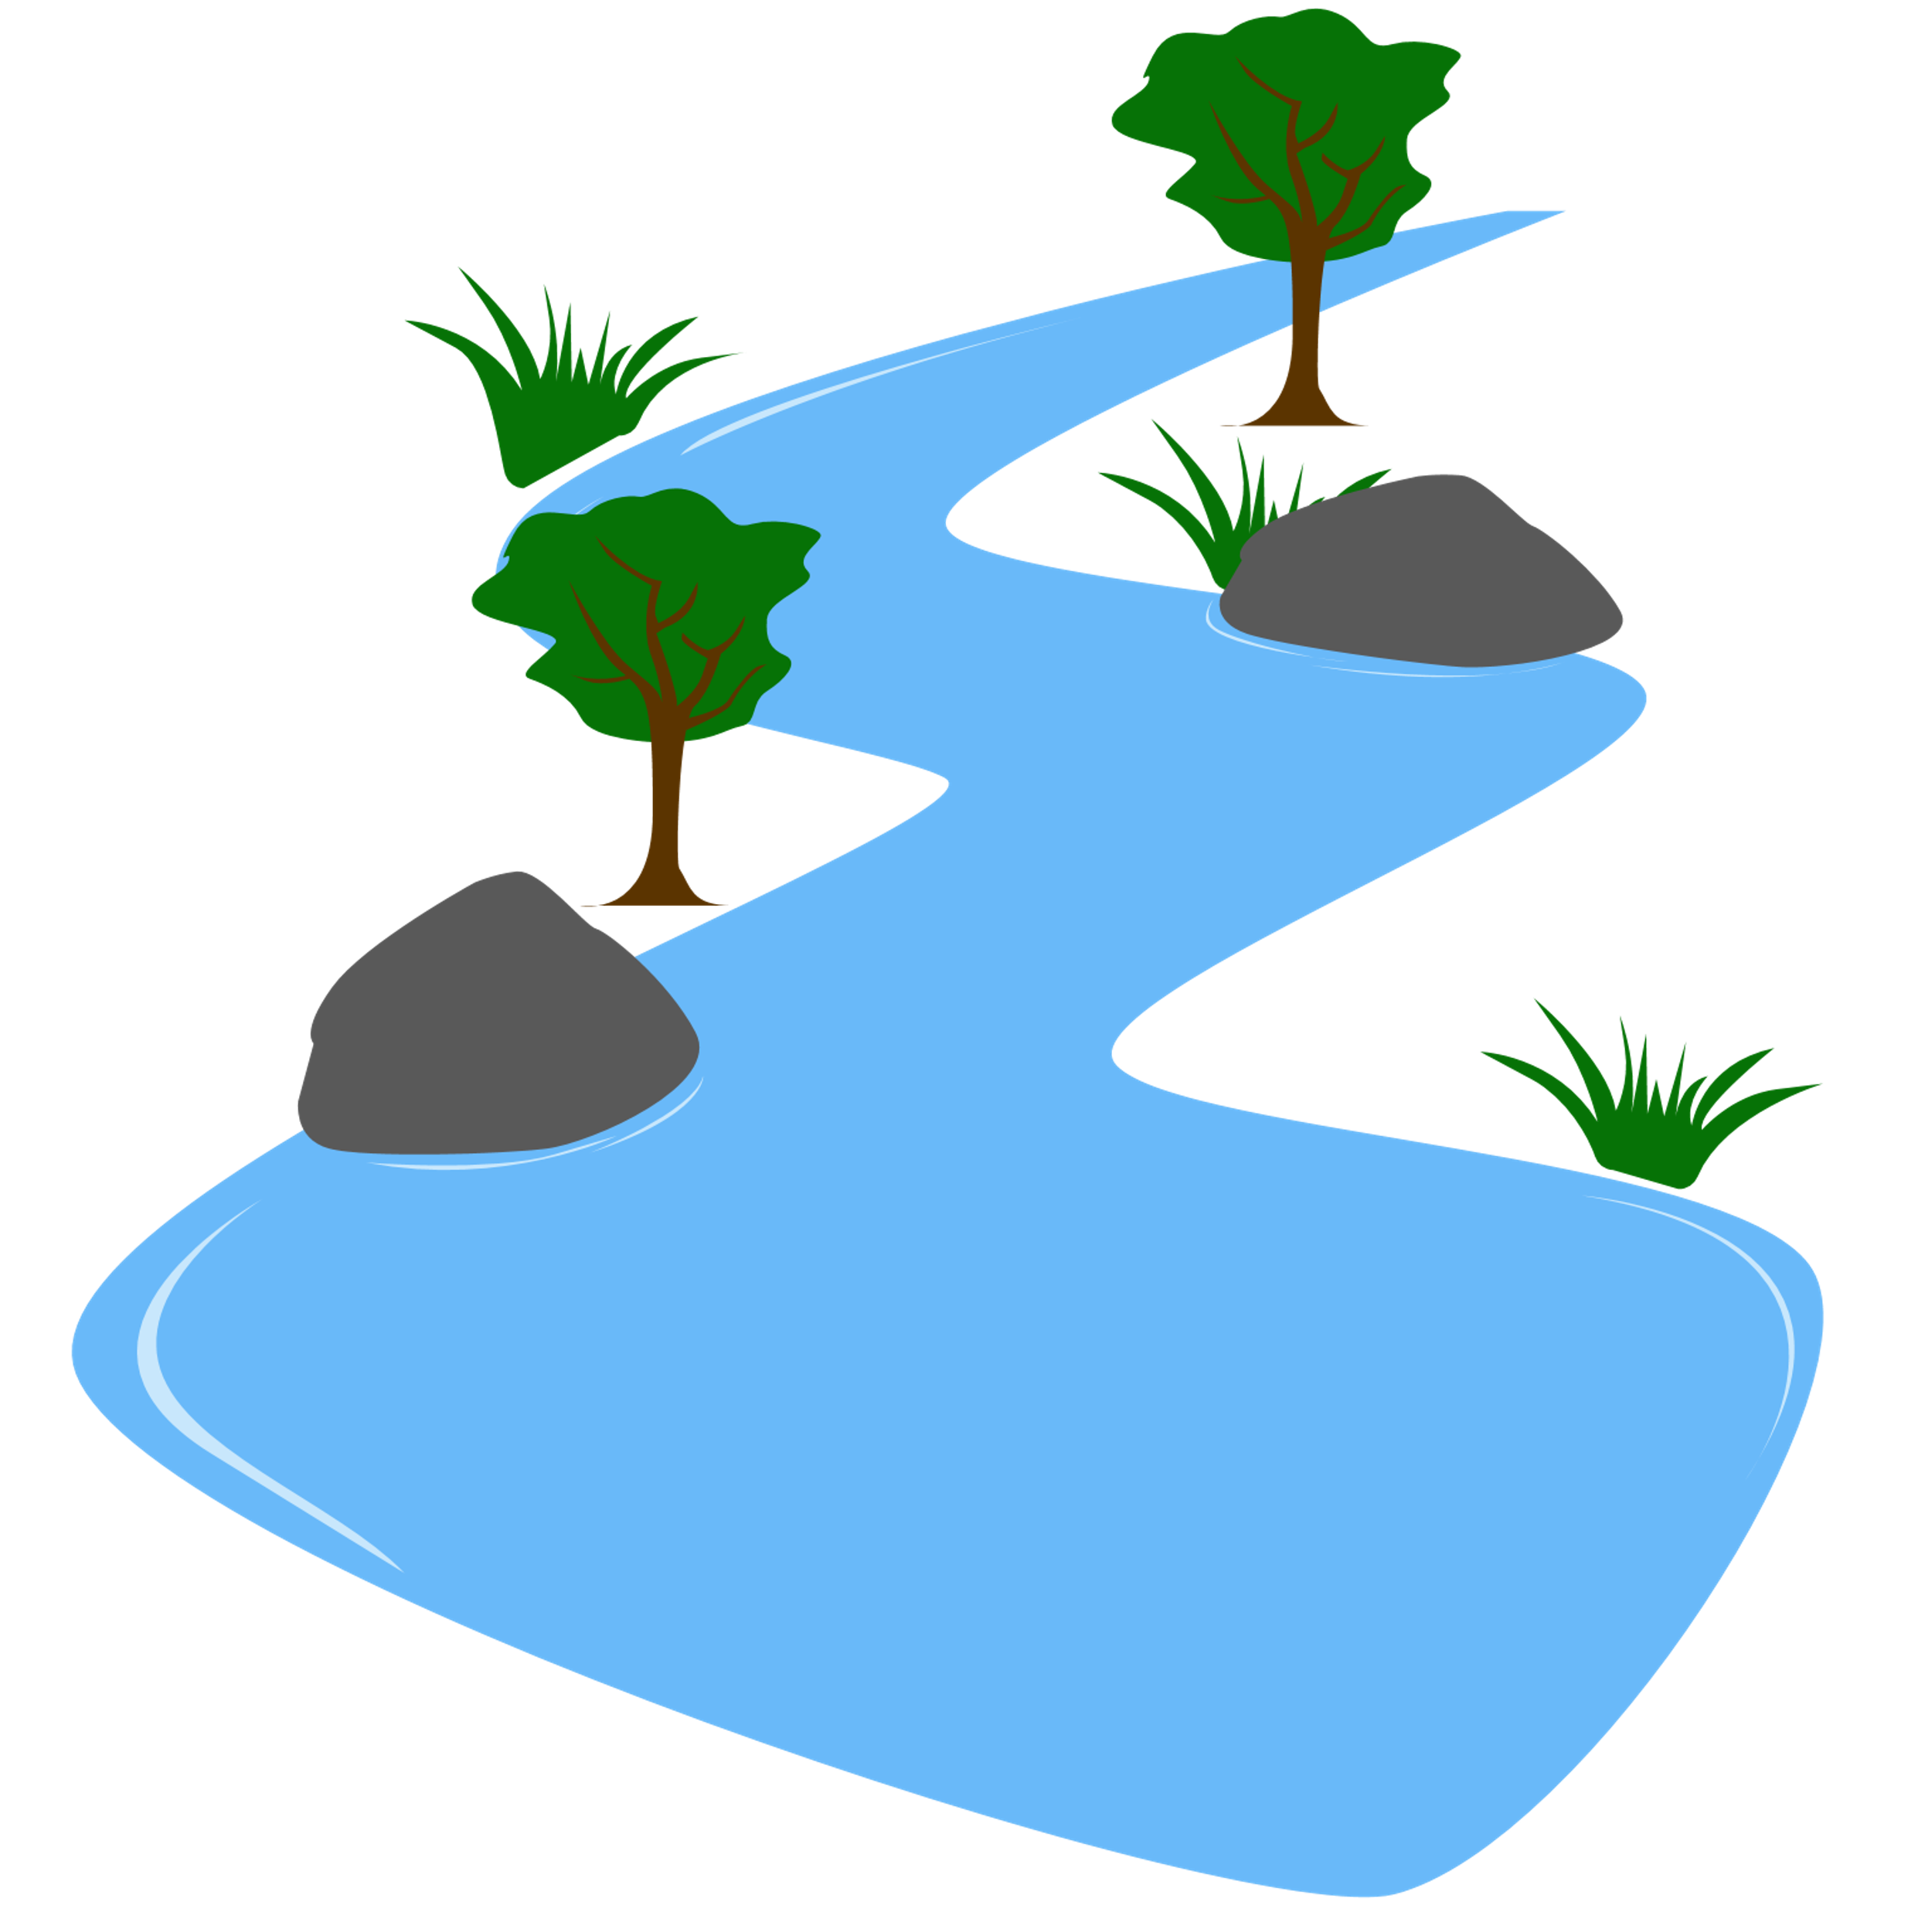
Many different fish species live in the rivers and creeks! These fish and other organisms help make up the ecosystem.
Can you think of any organisms that live in a creek or river?
Notes:
Have the students name out different species in a rive or creek. Next slide shows examples.

Slide 4
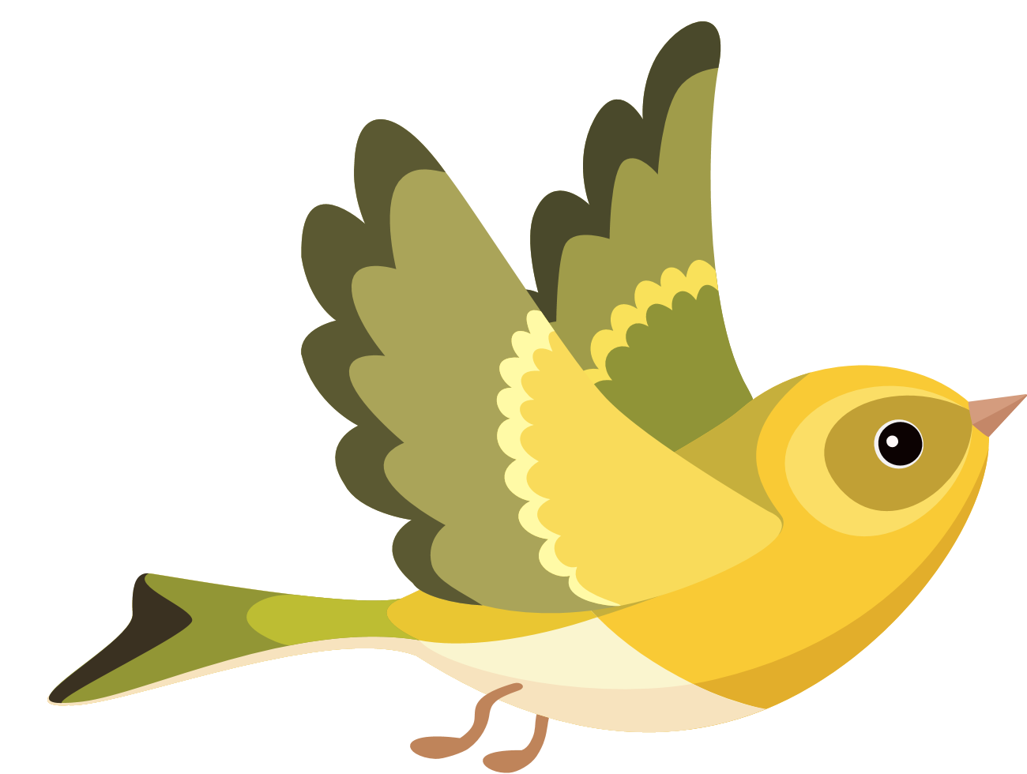
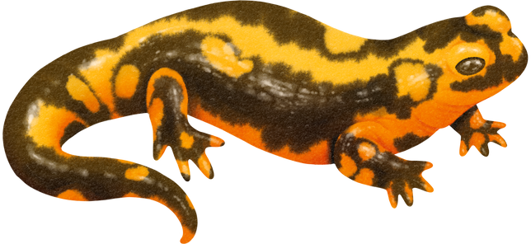
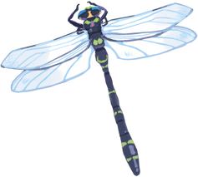
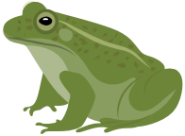
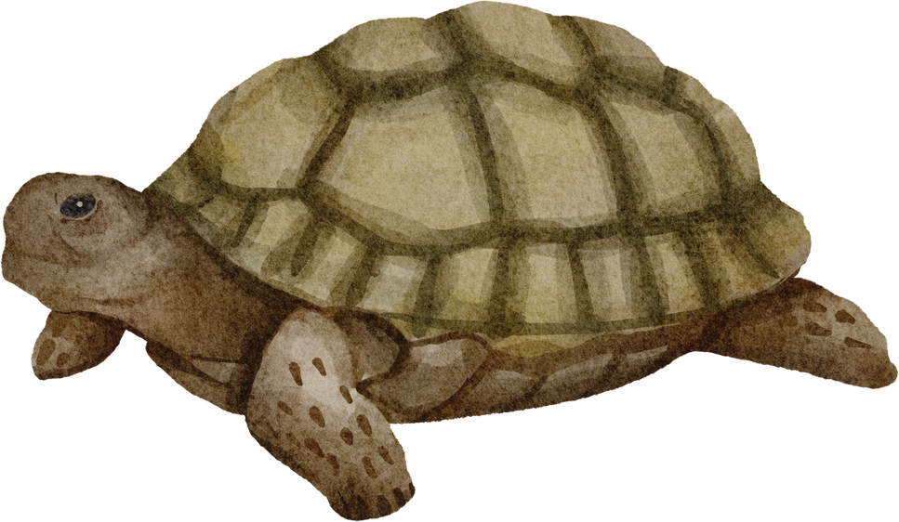
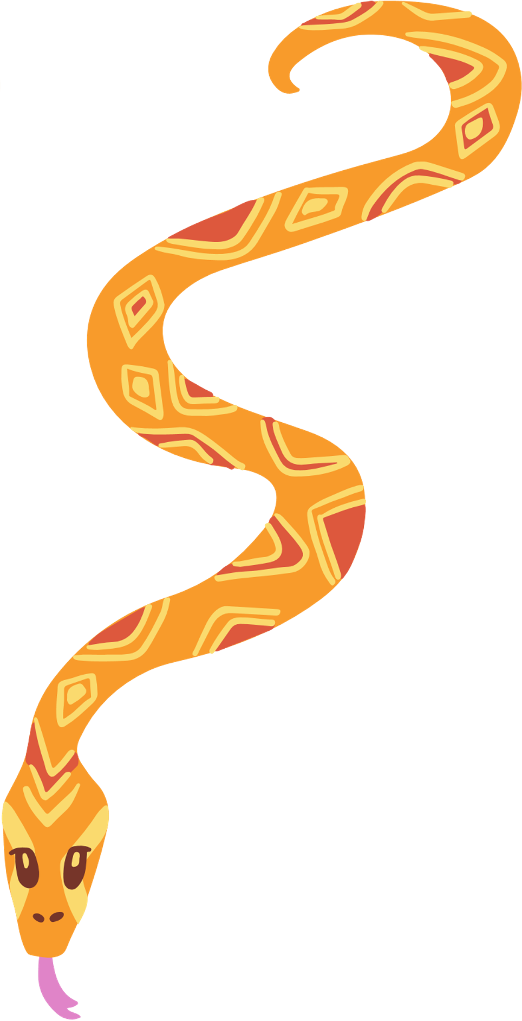
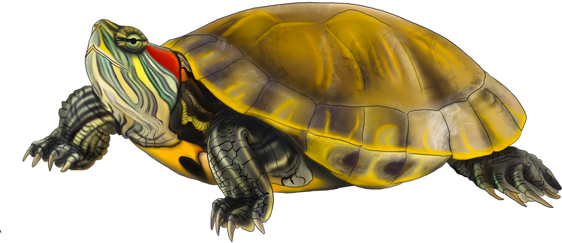
Many different fish species live in the rivers and creeks! These fish and other organisms help make up the ecosystem.
Can you think of any organisms that live in rivers?
These species interact with each other and count on each other for survival.
Notes:
Emphasize the importance of having a balanced ecosystem and how organisms need one another to survive (think food chain, population control, etc.)

Slide 5
Some organisms play a bigger role in the ecosystem than others. For examples ...
Keystone Species are species that have a huge effect on their environment.
Ecosystem Engineers are species that change or create habitat for others.
Can you think of any examples of keystone species or ecosystem engineers?
Notes:
Explain to the student the difference between keystone species and ecosystem engineers! (an animal can be both)
Examples:
Engineers
Beavers, beavers cut down trees to create dams
Elephants, elephants tear down trees and brush to make pathways and even can dig wells for water
Keystone species
sea otters, sea otters maintaining sea urchin populations, without sea otters, the urchin population rapidly expands and eats all the kelp, which is a habitat for lots of species
Bees, bees support the pollination of 90% of flowering plants, without bees many flowering plants would struggle to exist

Slide 6
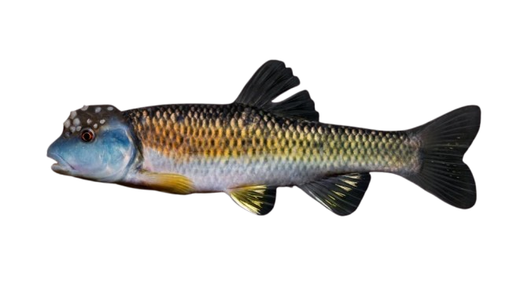
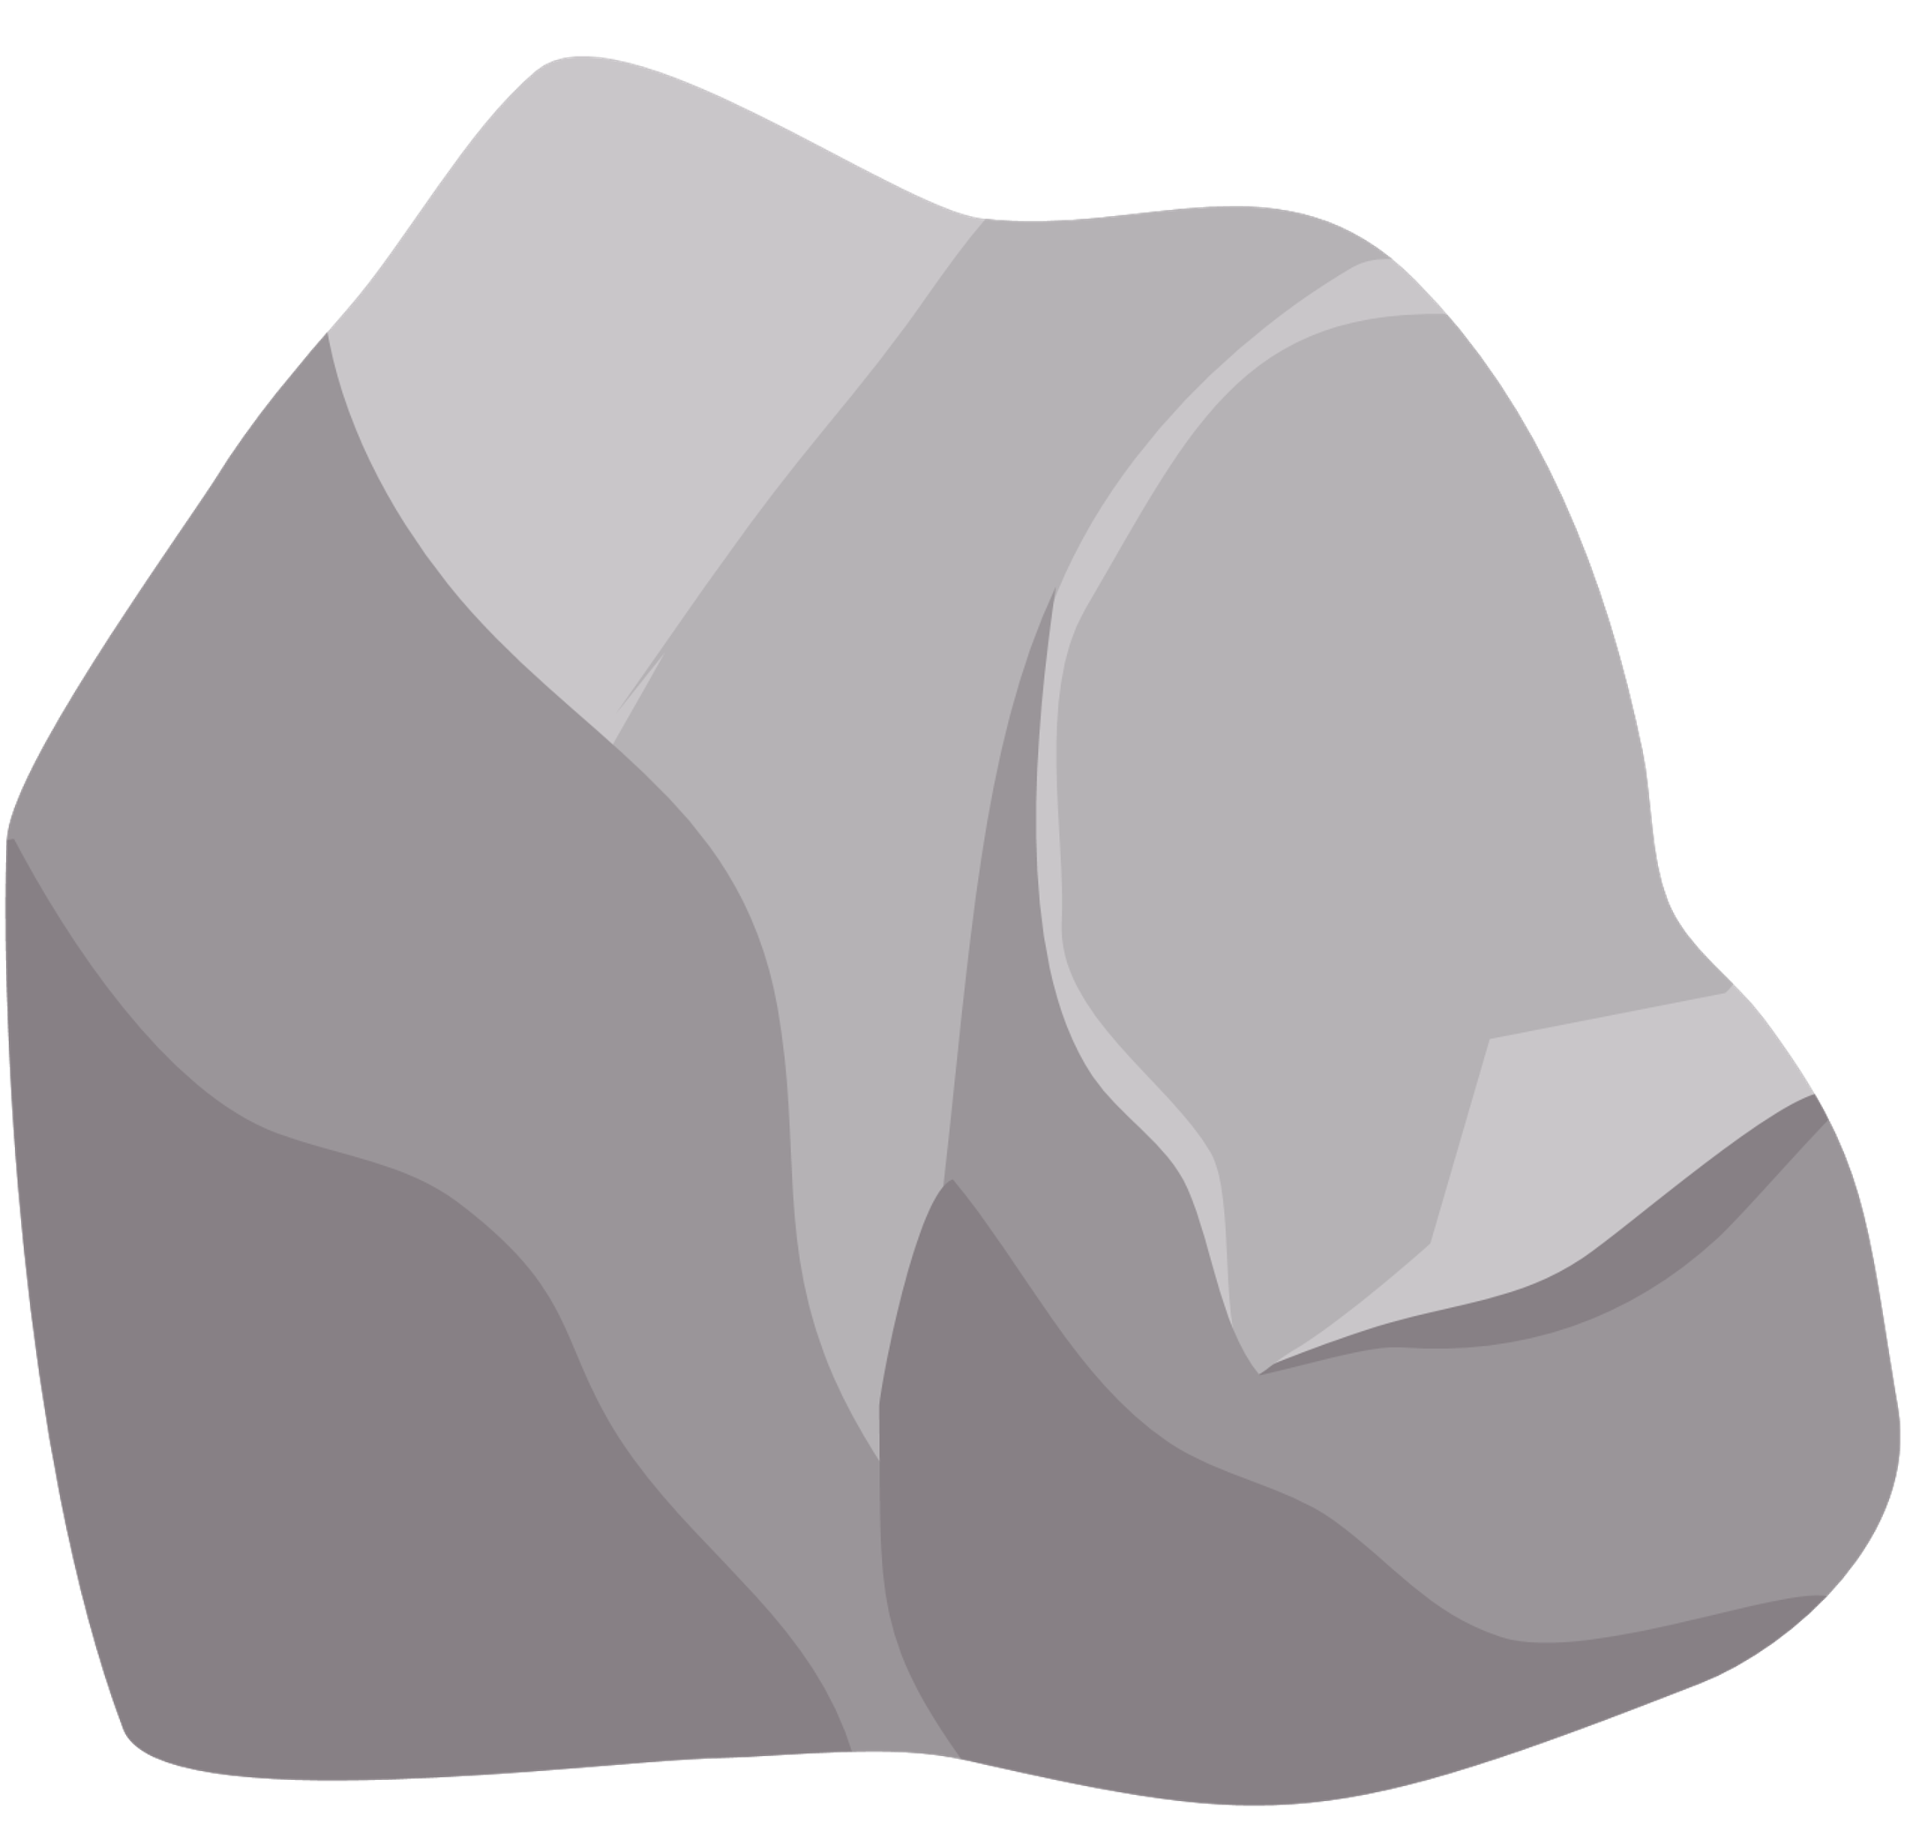
Fish Engineers!
Scientist think they have found a fish that may be BOTH an ecosystem engineer and a keystone speices!
The bluehead chub is an ecosystem engineer that lives in the rivers and creeks of southwest Virginia.
The males build nests by picking up pebbles with their mouths! They use these nests as a safe place to lay eggs.

Slide 7
Fish Engineers!
However they’ve noticed other fish species using the nests to lay their own eggs!
This relationship is mutualistic, both fish species benefit and neither are harmed.
This leads scientist to think lots of fish species depend on these nests to survive.
We need to find out if bluehead chubs are helping other fish populations!
Notes:
Optional video to play after this slide: https://www.youtube.com/watch?v=5500PjlqfgI

Slide 8
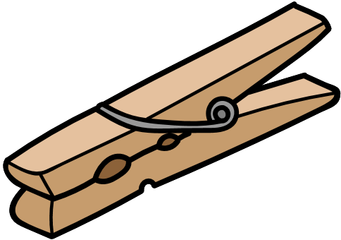
Build your own fish engineer!
Bluehead chubs have....
  a blue head (with white spots)!
  a dark green and orange body
  big lips to help carry rocks!
Notes:
Have the students color their clothespin to looks like bluehead chubs. Googly eyes are optional. Eyes can be colored in with colored pencils or markers.

Slide 9
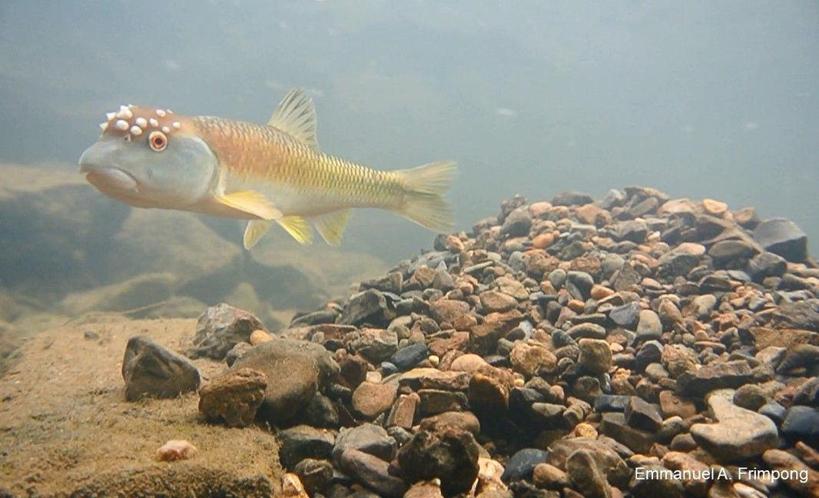
Build a chub nest!
Ready, set, go! Use your bluehead chubs mouth to pick up the pebbles and build a nest
Notes:
Time the students (~ 60 seconds worked best when I practiced with a group) to build a nest by picking up the pebbles (pompoms) with their fish's mouth (clothespin).
Fun Facts:
They can transport up to 7,000 stones, each as large as their head, from up to 23 meters away in a single day

Slide 10

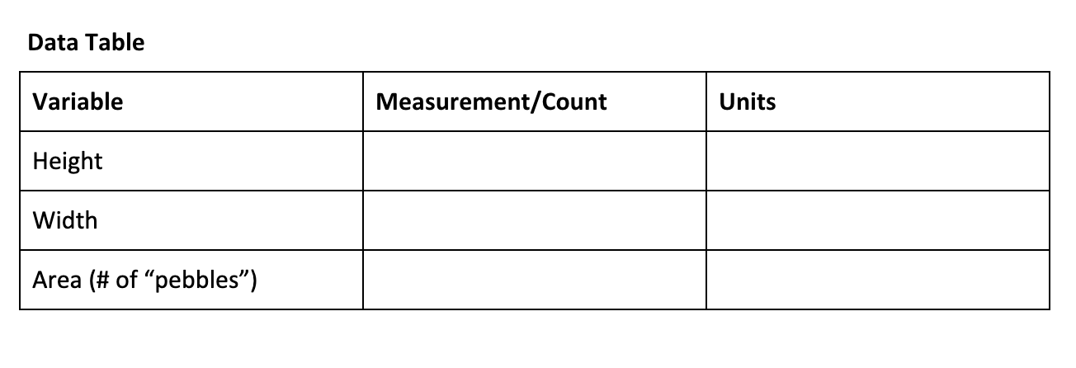

Nest Data Worksheet
Collecting & Graphing Data
Directions: Measure and record data on your nest using a ruler. Fill in the data table. Do not forget to right down the units of measurement.
Notes:
Leave this slide up while completing the Nest Data Worksheet. If done on a smart board, feel free to fill in the chart above as an example for the class.

Slide 11

Nest Data Worksheet
Collecting & Graphing Data
Directions: Measure and record data on your nest using a ruler. Fill in the data table. Do not forget to write down the units of measurement.
Let’s make a histogram using our data!
Notes:
Leave this slide up if the students are filling out the Histogram Handout individually. If the histogram is being done as a class, go to slide 12 to fill the histogram out on a smart board or draw the histogram template on a white board/chalk board.

Slide 12
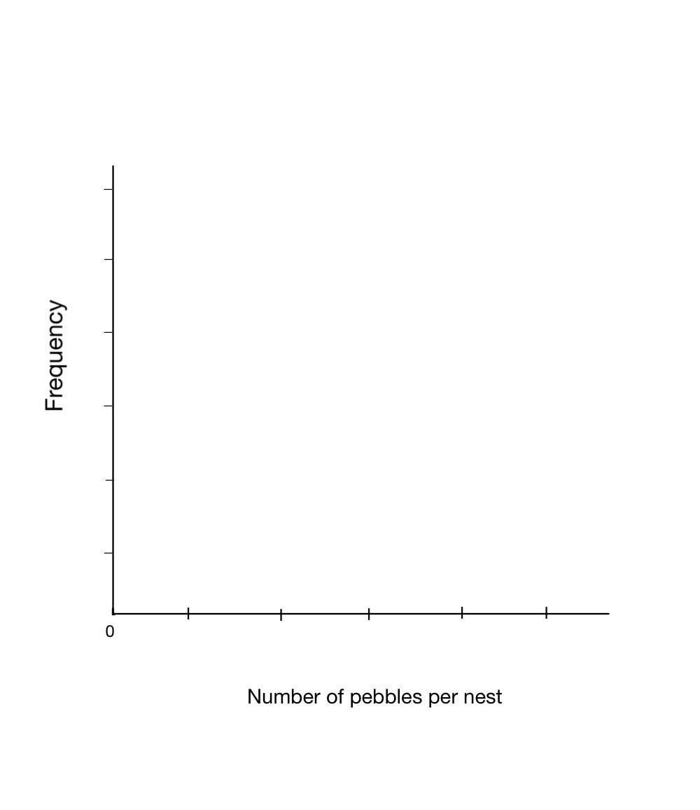
Notes:
Do not forget to add a title at the top and the units of measurement on the X and Y axis! If the class has time, feel free to make histograms for length and width of nests as well!
Drumroll please! This is where you can make it fun. Award the student who had the most “pebbles”(pompoms), tallest nest, etc. Using the Nest Data Outcomes sheet, tell the class the number of species that would be in each size range of nests using the guide. This chart does not use real data but is proportional to real data sets. Feel free to adjust “number of pebbles” as needed for your class’s data, it should reflect the x-axis ranges in the histogram. ~ 15 minutes

Slide 13
Nest Data Outcomes
Discussion Questions
1. What do you think will happen to the number of species on the nest as the nest size increases? What if it decreases?
2. Do you think bluehead chubs affect other fish populations? Why or why not?
3. Do you think bluehead chubs are keystone species? Why or why not?
Notes:
After working on the handout and drawing the histogram(s), talk through these questions! Questions are also on the Nest Data Worksheet if you would like students to answer individually.

