Slide 1
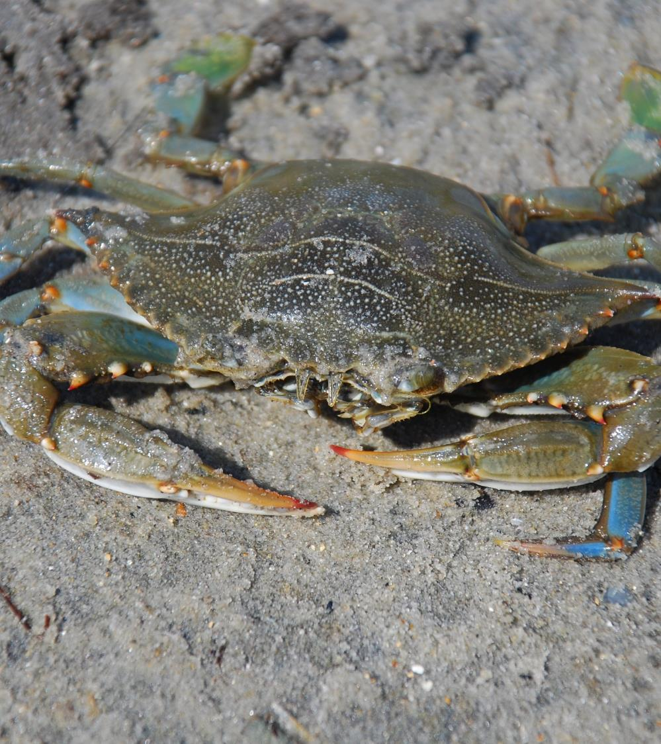


Blue Crabs and Cannibalism
Nihal Guennouni
This Photo by Unknown Author is licensed under CC BY-SA
Notes:
This Photo by Unknown Author is licensed under CC BY-SA

Slide 2
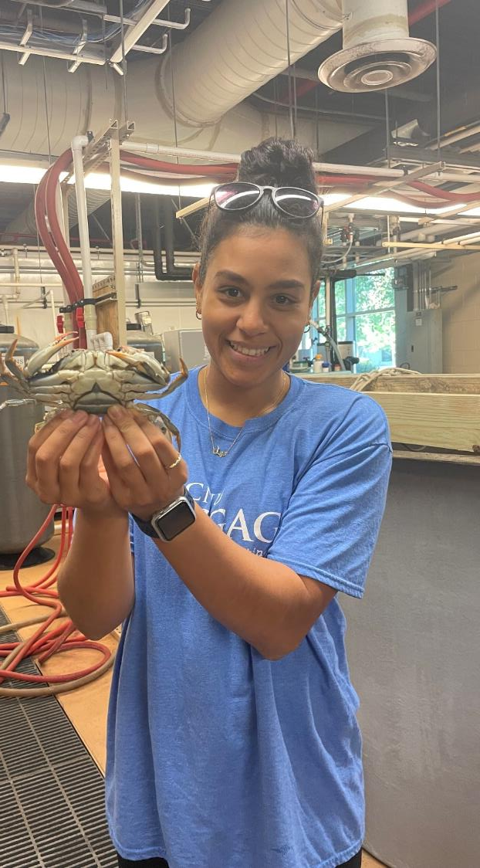
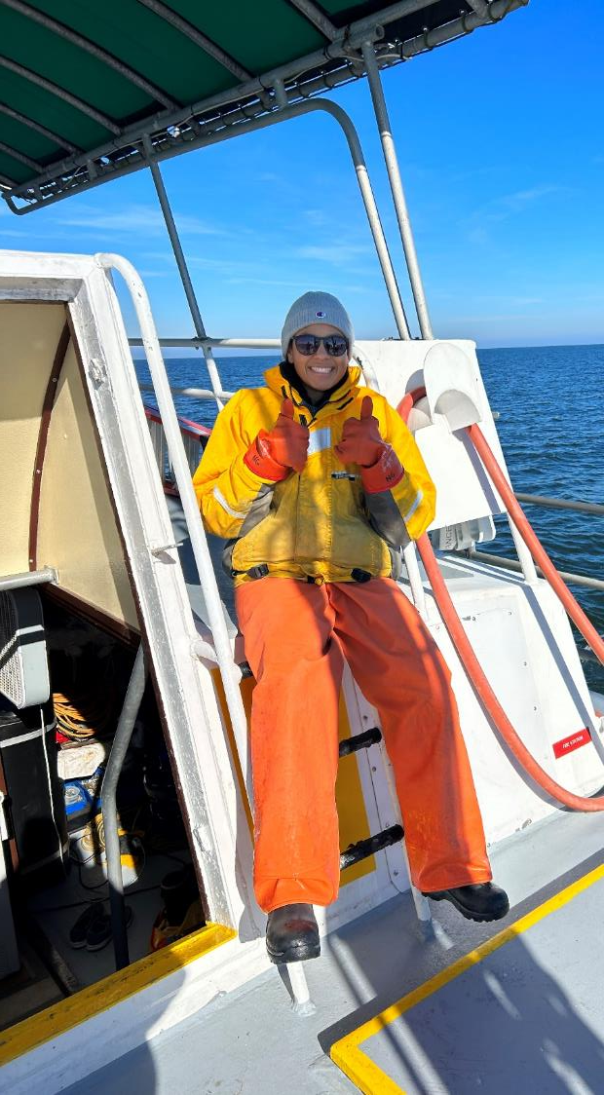
Nihal Guennouni
I am a graduate student at the Virginia Institute of Marine Science (VIMS)
As a fisheries ecologist, I study how blue crabs live together in their natural habitats by exploring how predators and prey interact with each other! I like to specifically understand how the rates of predation (in the form of cannibalism) change across different densities of blue crabs.
Nihal Guennouni

Slide 3
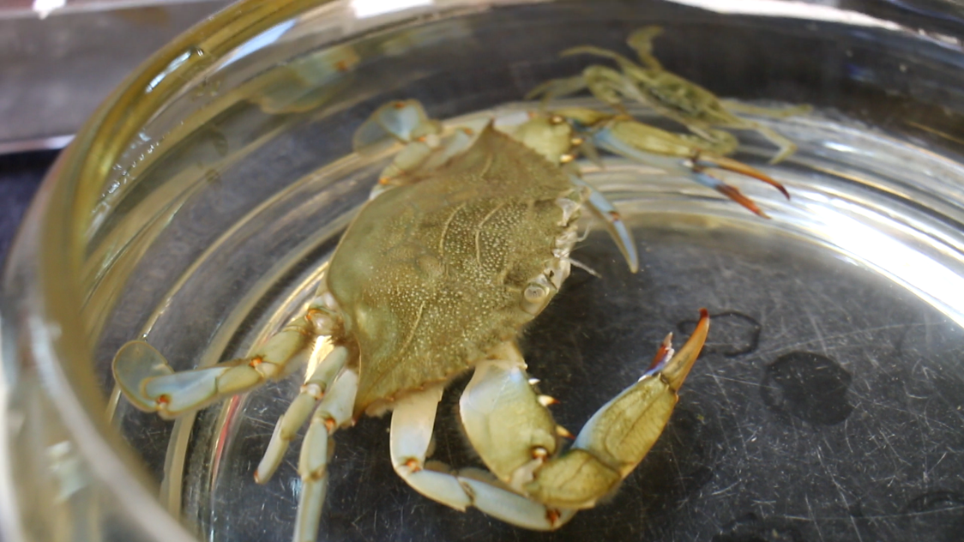
Gabby Saluta
Notes:
Observe this video of a blue crab cannibalizing another smaller blue crab. Feel free to play only a part of the video or the full thing. It is about 3.5 minutes long.

Slide 4
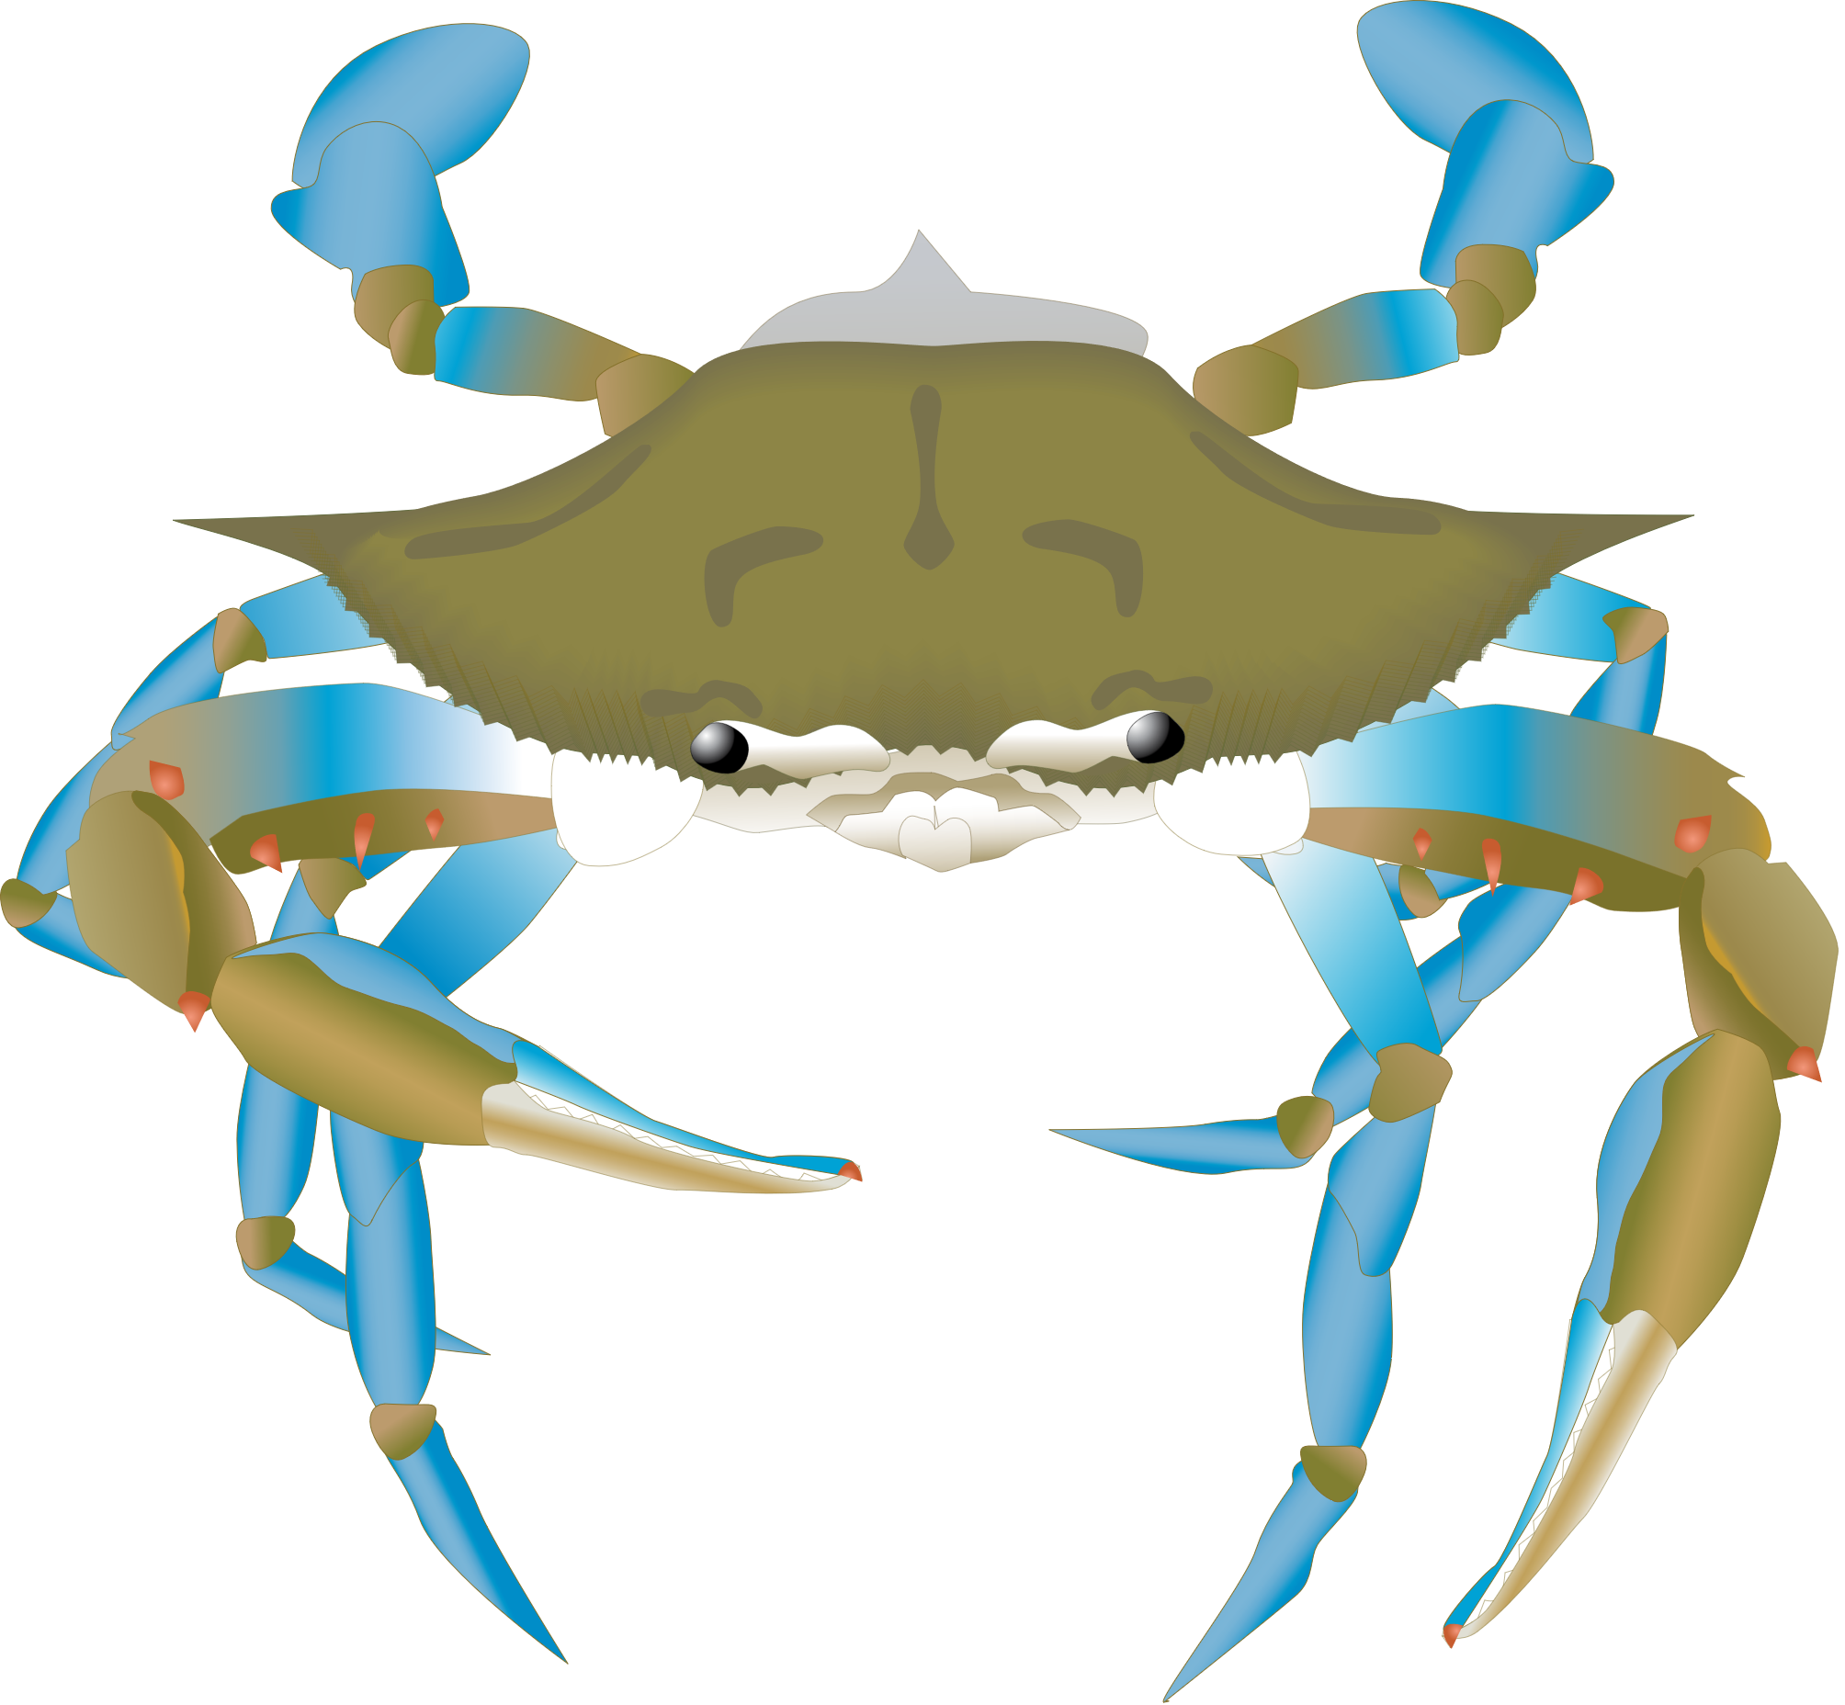
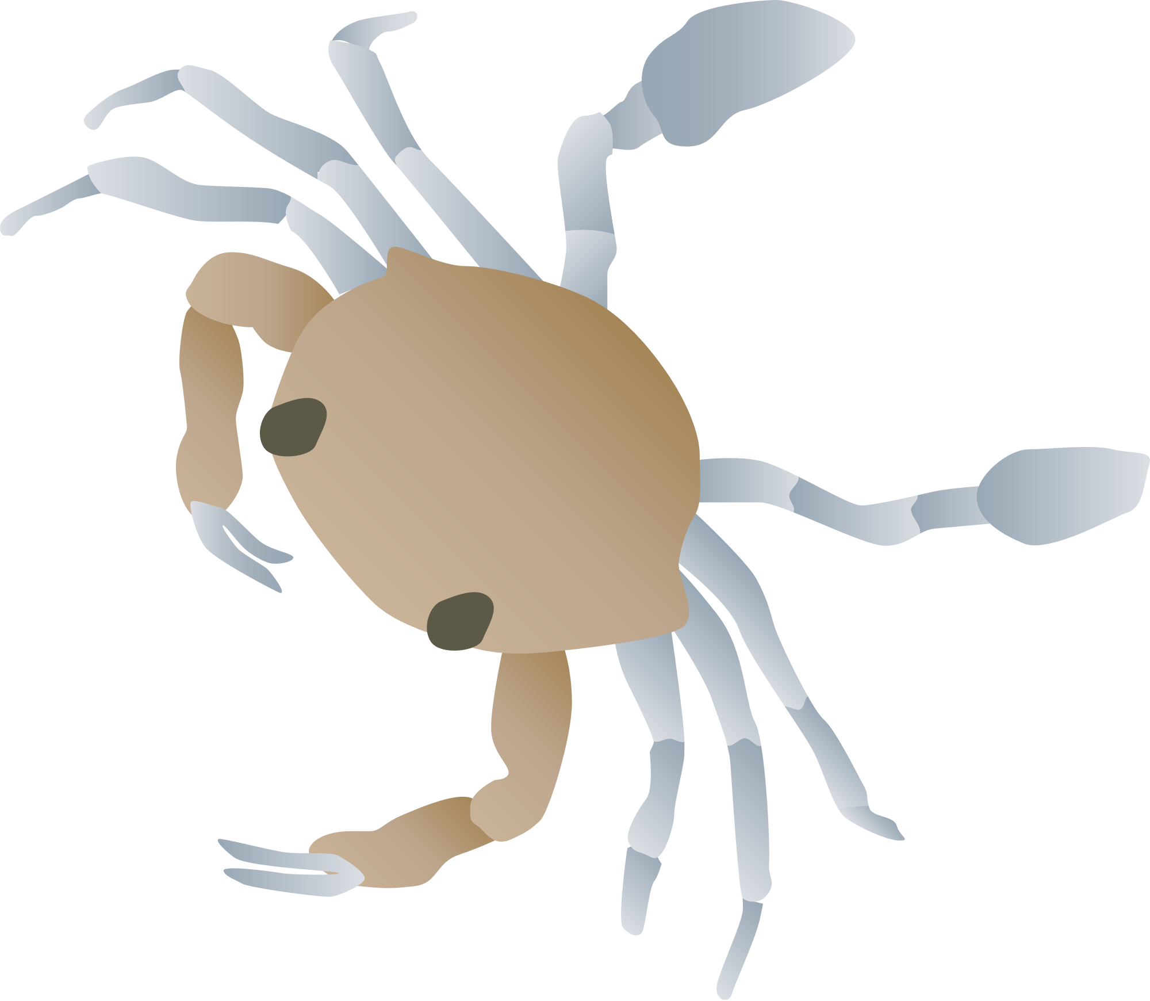
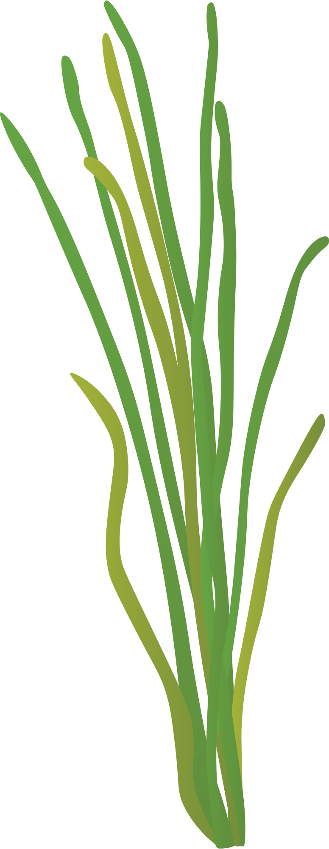
Blue crabs are cannibals
Opportunistic omnivores: They eat EVERYTHING!
Juvenile blue crabs LOVE to hangout in seagrass underwater where they seek refuge from predators and have plenty of food sources to grow big!
Prey can be found at MANY different densities
Mmm, they look yummy
Notes:
Cannibalism happens a lot in aquatic ecosystems!
Refuge is a situation where prey can avoid predators and get to safety. Seagrass is thick and long, so it allows the baby crabs (the juvenile prey) to hide so much better from predators than if they were just swimming around in the water with nowhere to hide. However, we can find these juvenile blue crabs at different amounts. Some seagrass areas might have a ton of animals while another seagrass area might have no one there! This leads us to the concept of density → (next slide)

Slide 5
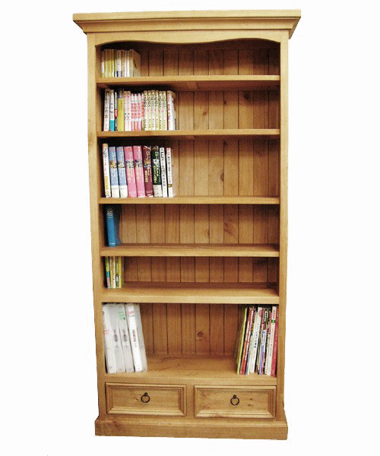
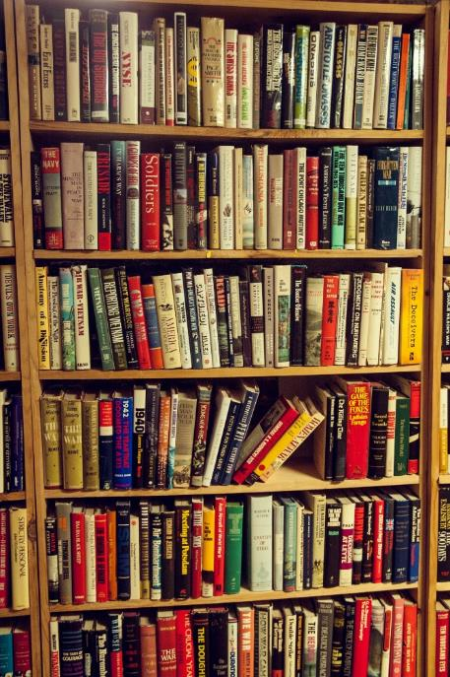



Density
LOW
HIGH
This Photo by Unknown Author is licensed under CC BY-NC
Notes:
Blue crabs in these seagrass patches can be found at many different densites, but first, what is density? Imagine a scenario with a forest. We can have few trees in a forest which means the trees are at a low density. OR we can have many trees in the forest and it’s very thick and “dense” which is a high density of trees. Same thing with a book shelf. We can have a low density of books where it’s empty, or we can have a high density of books where there’s barely any space!

Slide 6
Competition and Resource limitation
As more and more juvenile blue crabs come into seagrass patches, aka their homes, we get closer to carrying capacity → space and food decrease leading to…competition!
Which of the two following scenarios would carrying capacity be reached?
Low
Notes:
Now that we’ve learned about density, let’s talk about it with blue crabs. In these seagrass patches, as density increases, we get closer and closer to the carrying capacity, or the maximum number of crabs that can live in that seagrass area! This leads to more and more competition because now there’s less space for everyone to live in the seagrass and less food to eat since there’s too many hungry crabs. This means blue crabs will start to cannibalize each other as they fight for space and food to make more room for themselves. But it’s not just the itty-bitty crabs that live here…Adults love to come to these seagrass patches because they know there’s food here. Since they are much bigger than their prey, they need more space than the juveniles and will definitely rely on cannibalism to make sure they don’t miss out on dinner.
Now which of the two will carrying capacity be reached…is it a high density? Or…

Slide 7
Competition and Resource limitation
As more and more juvenile blue crabs come into seagrass patches, aka their homes, we get closer to carrying capacity → space and food decrease leading to…competition!
Which of the two following scenarios would carrying capacity be reached?
High
Notes:
Is it a low density?

Slide 8
Competition and Resource limitation
As more and more juvenile blue crabs come into seagrass patches, aka their homes, we get closer to carrying capacity → space and food decrease leading to…competition!
Which of the two following scenarios would carrying capacity be reached?
YES! The high density!
How do they compete? *drum roll*
High
Notes:
That’s correct! A high density means way more crowding and a higher chance that the crabs have reached their carrying capacity. Considering the video we watched earlier… how do we think crabs compete and get rid of each other in the habitat to make more food and space (resources) available?

Slide 9
Yup, you guessed it cannibalism!
We can explain how much cannibalism (how many blue crabs are eaten), by using a model
What’s a model?
A MODEL is a way to visualize a concept or scenario so others can better understand what is happening
Number of Students
Classroom Size
Notes:
Yup, you guessed it! Cannibalism! They will eat each other like we mentioned before SO we can represent how MUCH cannibalism happens using a model. Anyone know what a model is? *let students attempt to answer if models have been taught before in their education* Otherwise, go straight to definition. Show them the example that with increasing class size, we have increased number of students in the class. After having the students draw on the board, explain how blue crabs achieve satiation (fullness). The line eventually goes flat because blue crabs, just like us, get full after a meal! Think of a buffet, you can only eat so much before your tummy starts to feel too full! Blue crabs also have a maximum number of blue crabs they can eat/cannibalize so that’s why the line doesn’t go on forever and ever and ever. Otherwise, there would never be any blue crabs left in the wild.

Slide 10
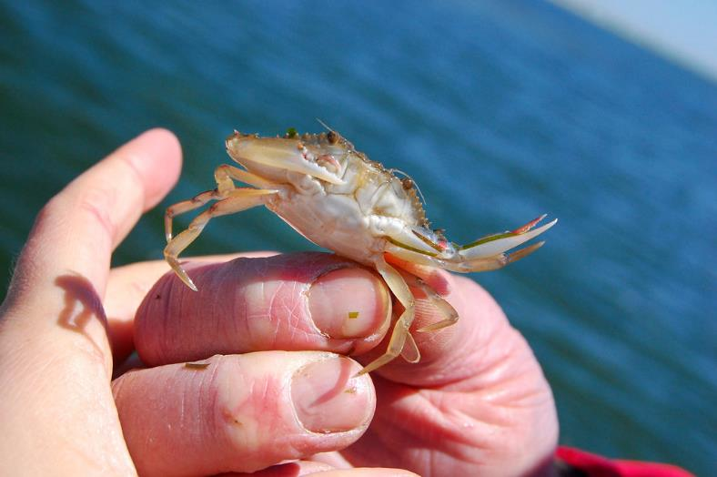
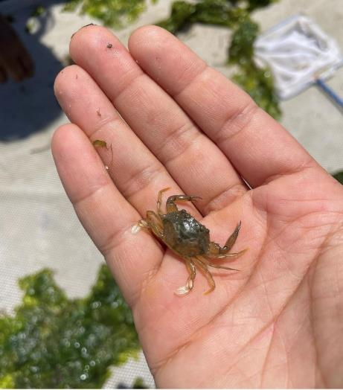
Now its your turn!
Reenact scenarios of low and high density and see how many juvenile blue crabs (prey) you can catch!
I’m gonna get ya!
Noooo!
This Photo by Unknown Author is licensed under CC BY-NC-ND
Nihal Guennouni

Slide 11
Scenario 1: High
Scenario 2: Low
Prey blue crabs scatter as many cutouts as you can around the classroom!!
Adult cannibals, time starts NOW!
When time is up:
RECORD the number of cutouts you caught.
SWITCH! Prey blue crabs scatter your cutouts around the classroom!
Adult cannibals, time starts NOW!
Time’s up! RECORD YOUR DATA

Slide 12
Your calculations:
Amount of Cannibalism Percent (%) = # of prey (tokens) you can catch ÷ by the total number of tokens around the classroom
Example:
I am in the HIGH-DENSITY scenario. There are a total of 30 tokens scattered across the classroom and I collect 20 in the time I have.
20÷30 = 0.66 x 100 = 66% amount of cannibalism
Now, calculate MEAN (average) amount of cannibalism with the entire class!
i.e. add all densities in the LOW scenario together and divide by how many groups there were to get the MEAN LOW DENSITY amount of cannibalism!

Slide 13
Expected Blue crab model
Cannibalism (%)
Notes:
We can expect that blue crabs will cannibalize (or eat) more prey when there are more prey available. When there are few prey available then they will not eat as many because they cannot find them.

Slide 14
Was it harder or easier to catch prey at low densities?
This is because prey have a low-density refuge and use it as a way to avoid getting eaten!
It’s harder to find them if you’re a big blue crab because you have to spend more time searching for them
Notes:
After they’ve filled out the worksheets

Slide 15
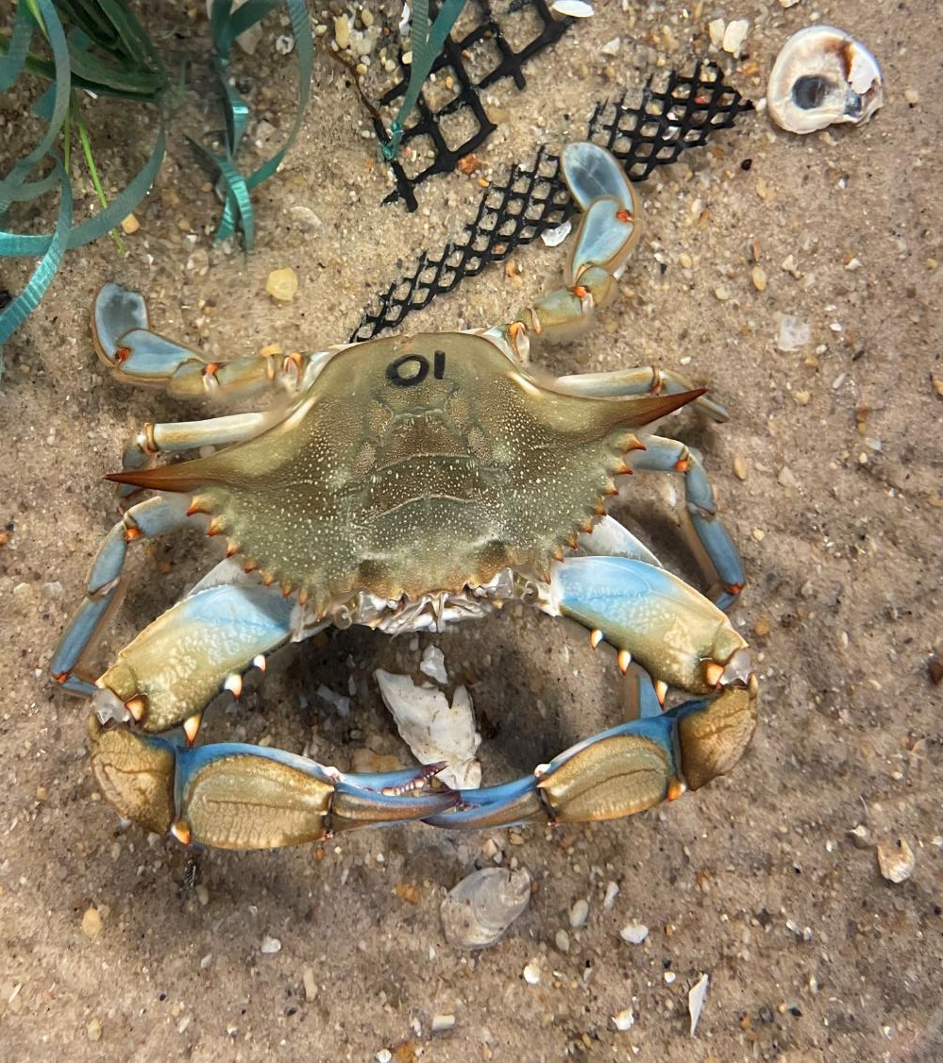
conclusions
Prey avoid predators by using their habitat and low density as refuge
Ecosystems rely on competition to remain balanced otherwise all resources will be used up and individuals within a population will not survive.
Models can help us better understand the natural world that we cannot otherwise sea ;)
Easy snack!
No, please don’t eat us!
Nihal Guennouni

