Slide 1
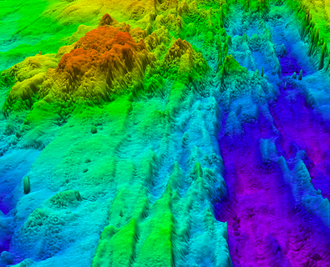
Deeper and Deeper
Learning about the seafloor!
Notes:
Source: NOAA Flickr
Here is where students can be introduced to the topic. The picture posted here is of a map of the seafloor, with different colors representing different depths.

Slide 2
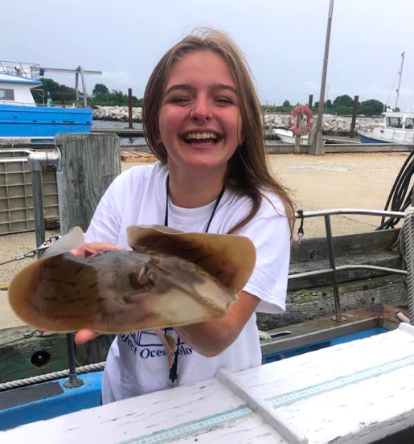
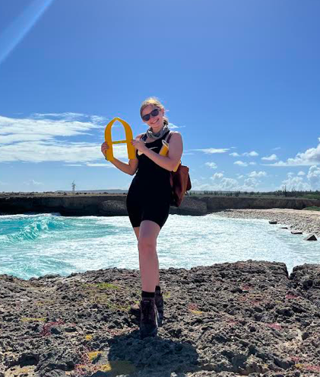
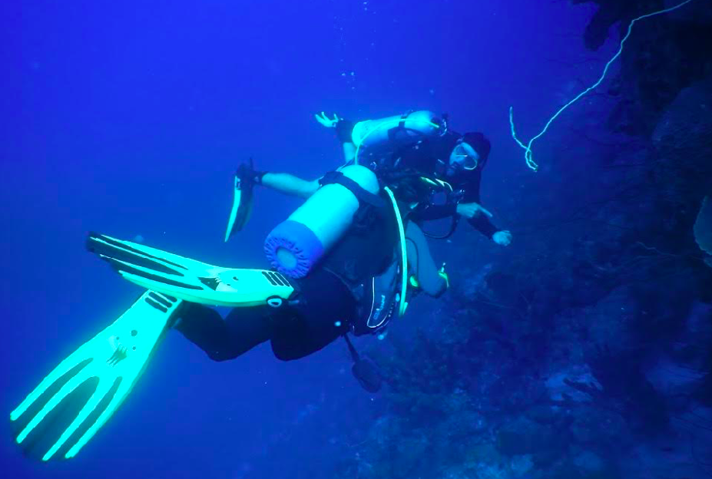
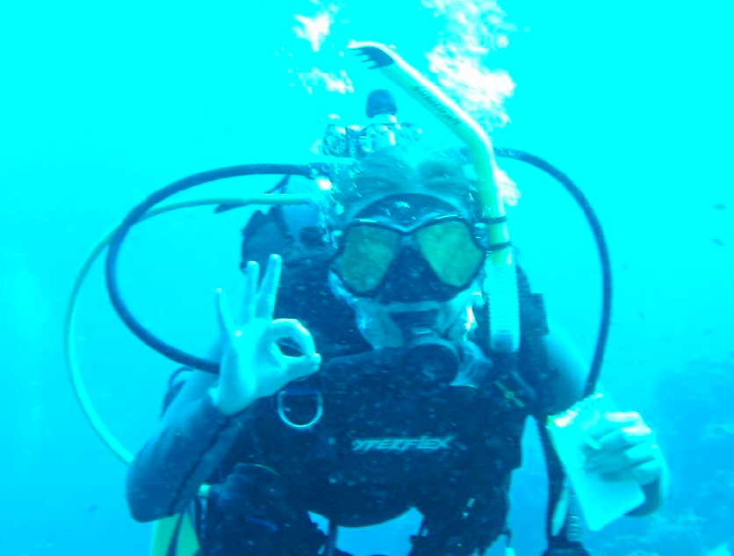
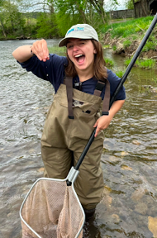
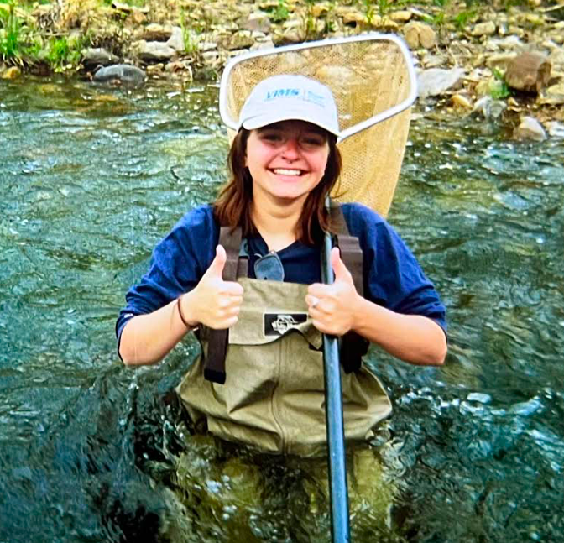
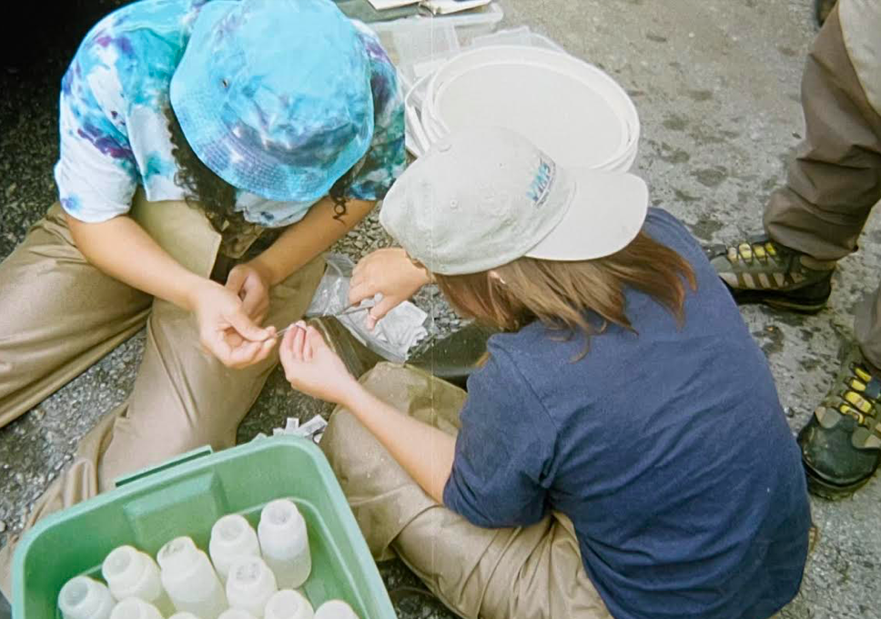
Meet the Scientist!
Amy Nicholson is a graduate student at the Virginia Institute of Marine Science. She is focusing her studies on marine science education, so her job is to learn as much about marine science as she can! She has a background in geology which is what inspired this lesson plan in particular.
Notes:
Image sources: Amy Nicholson
This is where you can talk briefly about who made the lesson plan and explain that it was made by a real marine scientist!

Slide 3
What do you think the very bottom of the ocean looks like?
Dark?
Slimy?
Muddy?
Flat?
Mountains?
Notes:
Here you can begin to have students think about the topic at hand. Ask them what they think the bottom of the ocean looks like. Is it dark, slimy, muddy, flat, mountainous, etc? Students may have other ideas for what it looks like also. (Spoiler alert, the ocean floor is actually all of these things!)

Slide 4
What do you think causes change to the seafloor?
Notes:
The seafloor, just like land above the sea, also can change over time. What do you think may cause changes to the seafloor? Think about things that may change our land above water as well.

Slide 5
What do you think causes change to the seafloor?
Volcanoes
Earthquakes
Spreading centers
Shipwrecks
Notes:
There are actually a lot of ways that the deep deep sea floor may change over time. Things like volcanoes can add cooled magma to the seafloor, earthquakes may cause a change in depth, spreading centers where the earth’s plates moves apart or pushes together may create new features, and even shipwrecks that sink to the bottom may change the seafloor!

Slide 6
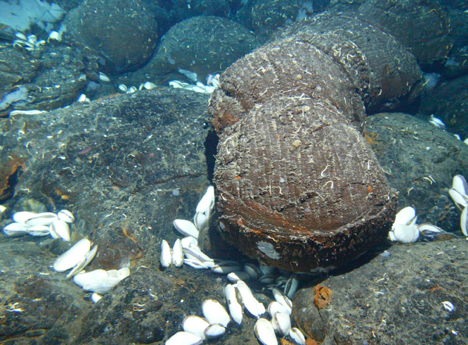
The bottom of the ocean is…
Dark
Cold
Has peaks
Valleys
And more!
Notes:
Image source: NOAA Flickr
If students said any of the above things, they are correct. The ocean floor is an incredibly diverse environment that is full of different features, very much like the land that we have around us.

Slide 7
The study of the seafloor is called:
Bathymetry!
Because the seafloor can be so deep and unknown, people spend their whole careers studying it
  Long ropes that go to the very bottom
  Special technology to map the seafloor
  Submarines that go all the way to the deepest parts
Notes:
Bathymetry is a big word that may be intimidating to younger students. Students can learn that bathymetry, even though they’ve likely never heard of it before, is a study just like marine science, biology, geology, or any other relevant fields of study they may have already learned about throughout the year. Scientists first studied the ocean floor by using really long ropes that they would drop to the bottom of the ocean and then measure them afterwards. Then, technology got better and they use special gear to get a picture of the ocean floor. Today, some people can even go all the way down to the ocean floor in a submarine and see the very deepest parts themselves!

Slide 8
How can we see what the seafloor looks like?
There is a lot of technology to map the seafloor…
BUT!
We can also use graphs of the seafloor to visualize the bottom
Notes:
Like we talked about, there are technologies that do this really well now. But let’s go back to the basics. Using graphs to visualize the seafloor is a really fun way to be a geologist for a day!

Slide 9
These graphs are called profiles!
These profiles can seem scary at first but really you are just taking a slice of the seafloor to look at!
Notes:
So let’s take a slice of our own…

Slide 10
Silly example…
Let’s say you have a supreme pizza slice. You know the surface of a pizza isn’t completely flat… right? There’s lots of toppings that may make it bumpy.
Notes:
Here you can compare a bathymetric profile to a slice of pizza. This analogy works really well when trying to conceptualize how to read a bathymetric profile and understand what you are asking them to do.

Slide 11
Profile for a supreme pizza…
Distance
Pepperoni
Sausage
Crust
Olive
Distance
Notes:
Image source: Amy Nicholson
If you took a slice of that pizza and looked at it from the side, you could see all of the bumps on the top! That is what a profile does, it looks at the seafloor as if you picked it up and looked at it from the side. On the x axis, or the bottom part of the graph, we have distance. This is distance from a certain point, which really is just the stretch of what you want to look at. Think of distance in this case as the tip of the pizza to the crust. On the y axis, or on the left of the graph, we have depth. This is how deep down we are going in the profile. Think of this from the very tippy top of the tallest topping to all the way to the bottom crust of the pizza. Here we are identifying different “key features” of the pizza. Maybe there is a small lump from an olive, a long skinny lump from the pepperoni, and a large lump from the sausage before we get to where the crust is. This is exactly what scientists are doing with the seafloor. They are looking at these profiles and trying to identify “key features” that they find just like we did with the pizza! (for added affect, you can model this pizza profile with the play doh here)

Slide 12
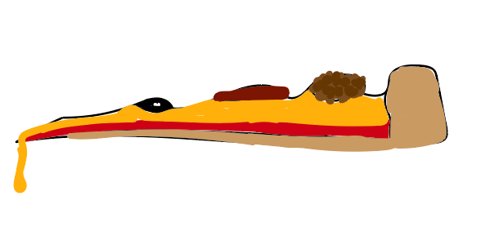
Pepperoni
Sausage
Crust
Olive
Notes:
Image source: Amy Nicholson
If you took a slice of that pizza and looked at it from the side, you could see all of the bumps on the top! That is what a profile does, it looks at the seafloor as if you picked it up and looked at it from the side. On the x axis, or the bottom part of the graph, we have distance. This is distance from a certain point, which really is just the stretch of what you want to look at. Think of distance in this case as the tip of the pizza to the crust. On the y axis, or on the left of the graph, we have depth. This is how deep down we are going in the profile. Think of this from the very tippy top of the tallest topping to all the way to the bottom crust of the pizza. Here we are identifying different “key features” of the pizza. Maybe there is a small lump from an olive, a long skinny lump from the pepperoni, and a large lump from the sausage before we get to where the crust is. This is exactly what scientists are doing with the seafloor. They are looking at these profiles and trying to identify “key features” that they find just like we did with the pizza!

Slide 13
Let’s look at some key features in the seafloor…
Notes:
Now that we have an idea of how to read a profile, let’s start being like scientists

Slide 14
Key Features in the Deep Deep Ocean
Trench:
Depth
Distance
Notes:
Students will learn that today we will be working with a special kind of line graph called a bathymetric profile. This graph would be like if you took a slice of the seafloor and got to look at it from the side. The x axis is distance away from a point, and the y axis is the depth. The first feature they will learn about is a trench. Just like on land, a trench is a deep depression in the seafloor that is very similar to a valley or a canyon. You can see a trench in a bathymetric profile by seeing a large dip in the graph like you see here. The deepest trench in the world, Mariana’s Trench, is actually the deepest point we know exists on Earth!

Slide 15
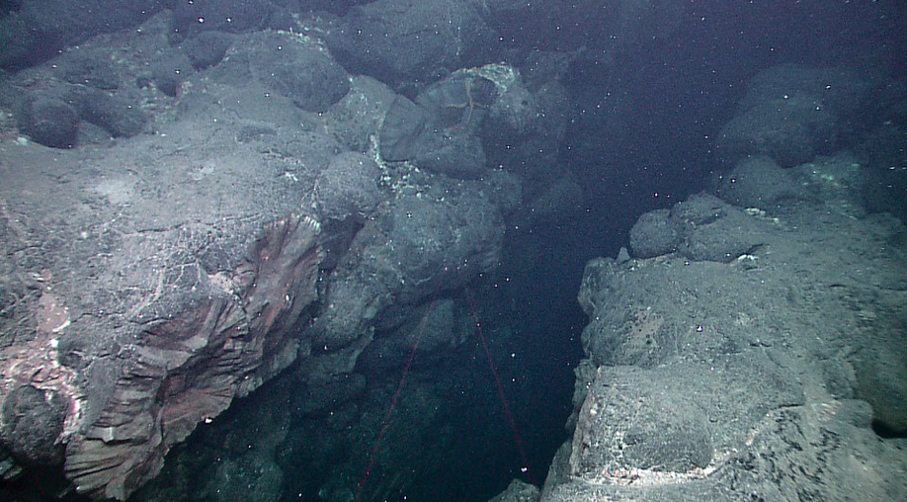
Key Features in the Deep Deep Ocean
Trench:
Depth
Distance
Notes:
Image source: NOAA Flickr
Here is a picture example of what a trench may look like - a deep valley in the ocean floor.

Slide 16
Key Features in the Deep Deep Ocean
Ridge:
Depth
Distance
Notes:
The next feature students will learn about is a ridge. A ridge is like a very steep mountain deep deep in the ocean. You can see a ridge on a bathymetric profile when there is a large spike in the graph. Sometimes, these ridges are actually active underwater volcanoes as well!

Slide 17
Key Features in the Deep Deep Ocean
Slope:
Depth
Depth
Distance
Distance
Notes:
The last feature we will learn about today is a slope. A slope is a gradual decrease in the water, like one half of a hill or something like a really big skateboard ramp! In a bathymetric profile, you can tell there is a slope when there is a diagonal line going either way like you see above. Slopes are oftentimes very close to our shorelines and a lot of the life in the ocean lives here. I could not find a good picture for this, but I believe the easiest way to imagine a slope is a hillside but underwater.

Slide 18
Now, you get to create your own seafloor!
Notes:
Students will now get their own bathymetric profile. It is a good idea to refresh how to read a bathymetric profile.

