Slide 1
Plants, Animals, and Others, Oh My!
Notes:
Here you can introduce the topic at hand - we are going to be talking about what makes plants plants and animals animals!

Slide 2
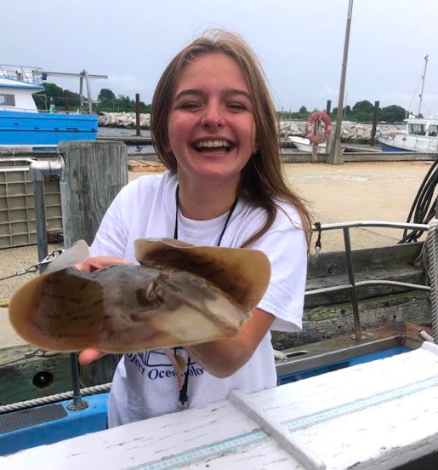
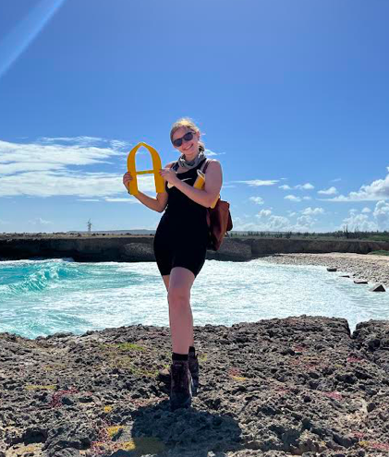
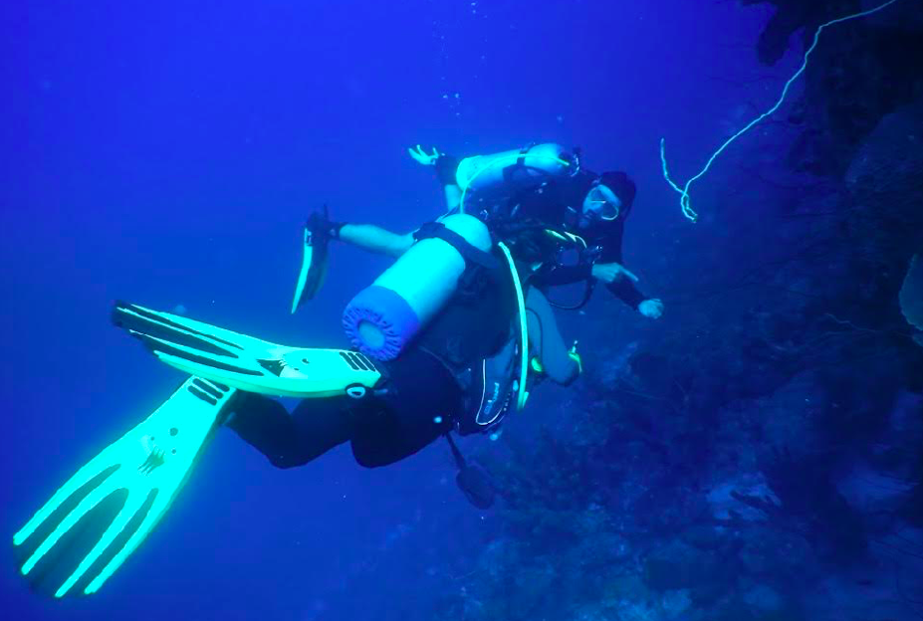
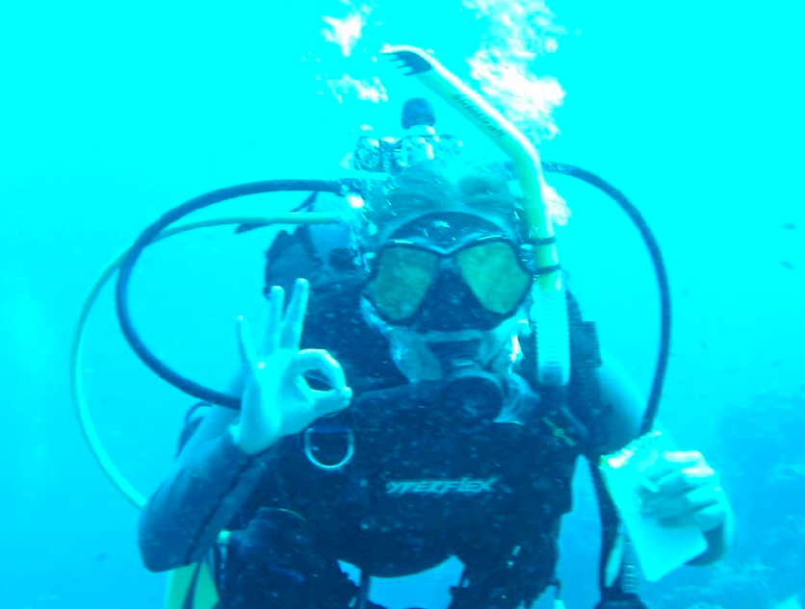
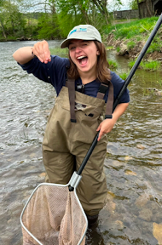
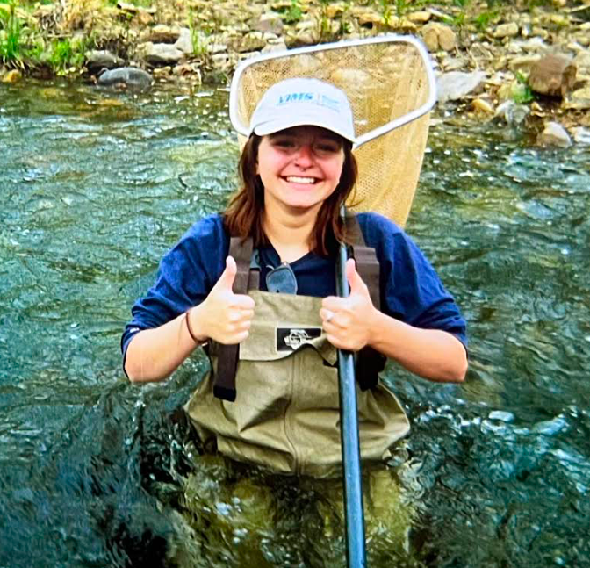
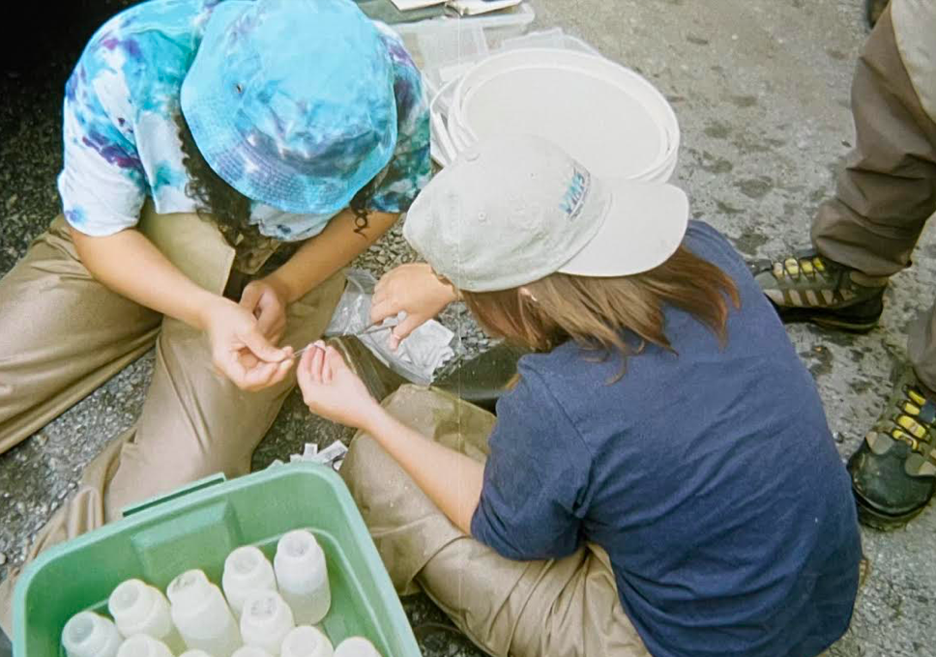
Meet the Scientist!
Amy Nicholson is a graduate student at the Virginia Institute of Marine Science. She is focusing her studies on marine science education, so her job is to learn as much about marine science as she can! She has a love for all things in the ocean and hope that this topic will help you understand and love our oceans too.
Notes:
This is where you can talk briefly about who made the lesson plan and explain that it was made by a real marine scientist!

Slide 3
What do you think of when you think of a plant?
Notes:
Here you can introduce a leading question - what is the first thing that comes to mind when students think of a plant? Are they leafy? Colorful? Big? Small? There are a lot of correct answers here for students. This will help lead into the rest of the activity.

Slide 4
What about an animal?
Notes:
You can ask the same question about animals. What do you think of when you think of animals? Are they big? Small? Furry? Rough? Again, this is a very broad question with a lot of correct answers. This will help lead into the content of the activity.

Slide 5
What is the difference between a plant and animal?
Animals can move whenever they want! Plants can not
  This means animals need a way to move (usually legs!)
Plants can make their own food and usually don’t have to eat like we do
Usually, animals have features like mouths to help eat and eyes to help them see while plants don’t
Notes:
Introduce the ideas that animals have limbs or things to help us move. What helps us move? Students can have fun with this and move around with their very own limbs. The last bullet point is also a great place to talk about our five senses, which other animals may have but plants will not. At the end, be sure to ask students if they have any questions and ask them to think if they have any other ideas of what makes plants different from animals in their eyes.

Slide 6
What is similar between plants and animals?
They are both living things
They both breathe
They both have some senses
Notes:
A lot of times, students think that plants are not alive but really they are! They are alive and “breathing” like we are. But they do not breathe using their mouths! Instead, the sun and water that they need is what helps them survive. Additionally, plants, although they do not have all senses, do have some senses like us in different special ways. This is a complicated concept, but it is good to introduce to help students understand the similarities between plants and animals.

Slide 7
What about things that are non-living?
Now we know about plants and animals and how they are both living
Non-living things do not breathe
Do not move on their own
And do not have any senses
Can someone give me an example?
Notes:
Non-living things are things that are all around us, students can use the classroom to think about non-living things as usually non living things are everywhere. Non-living things do have a lot of traits - but some things may look like non living things but really are. For example, something like an oyster also doesn’t move on its own but it does breathe and have some senses so therefore it would be living.

Slide 8
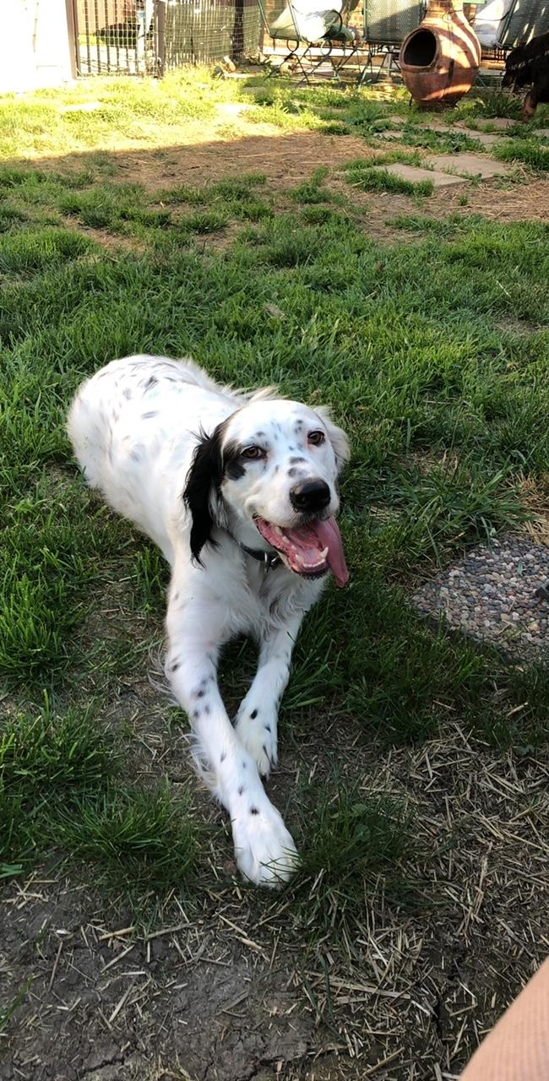
Let’s try!
Notes:
3,176 × 2,117
This is an image of an animal, a dog! Notice the mouth and limbs.

Slide 9
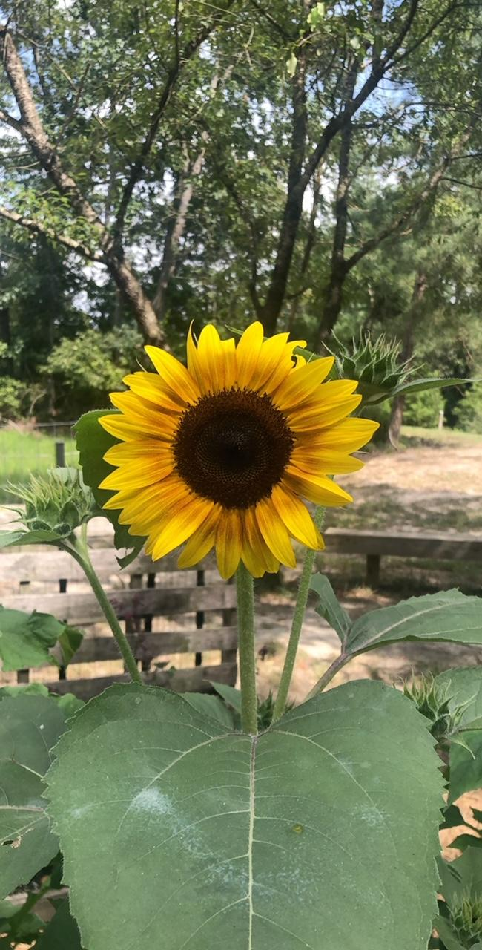
Let’s try!
Notes:
3,482 × 2,321
This is an image of a plant, a sunflower! Notice its petals, leafy appearance, and that there is no mouth. Plants are also oftentimes green, which you can see here.

Slide 10
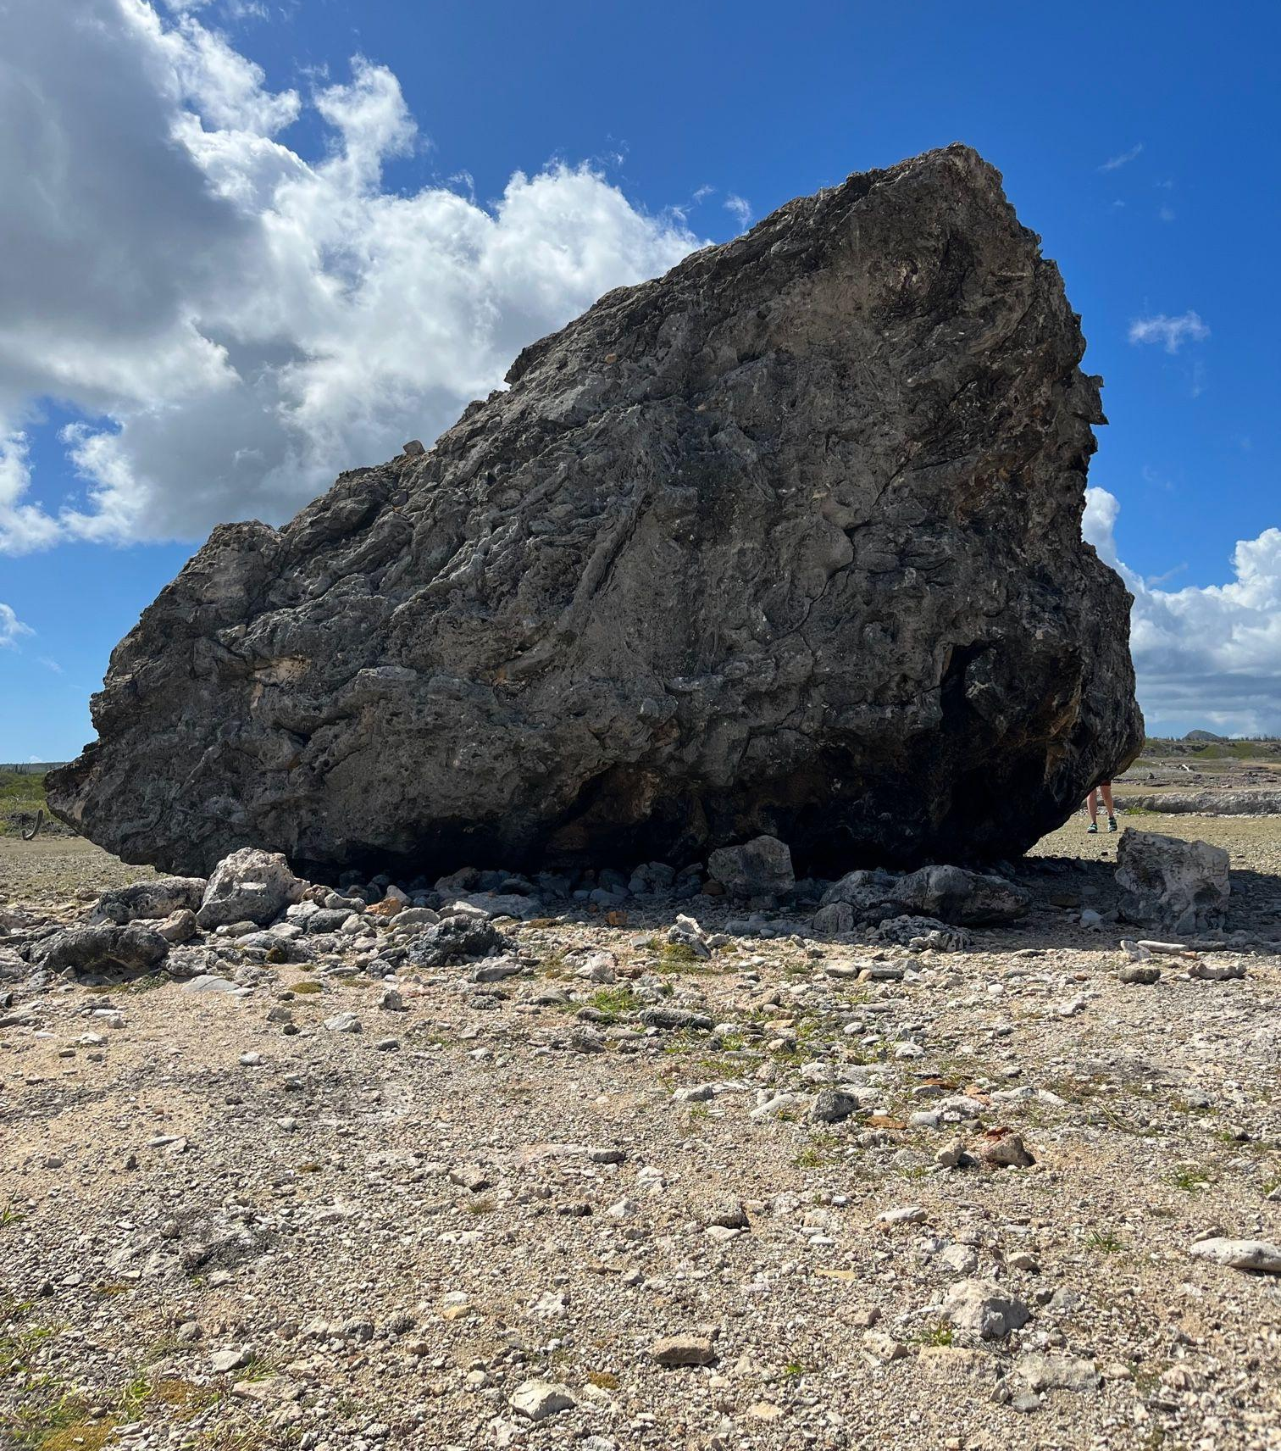
Let’s try!
Notes:
1,500 × 1,000
This is an image of a non-living object, a rock! Notice that it would not move on its own and has no limbs, senses, mouth, etc.

Slide 11
Alright, we did great with land plants and animals… but what about plants and animals under the water?
What makes them different?
Notes:
Things underwater can be very different from on land. This is because they cannot breathe are like we can, they have to move through water and swim all day long, and they also may live in the dark and cold for their whole lives. This makes them very different than us and our land friends much of the time! But students still should still be able to use the things we talked about to identify underwater plants, animals, and non-livings.

Slide 12
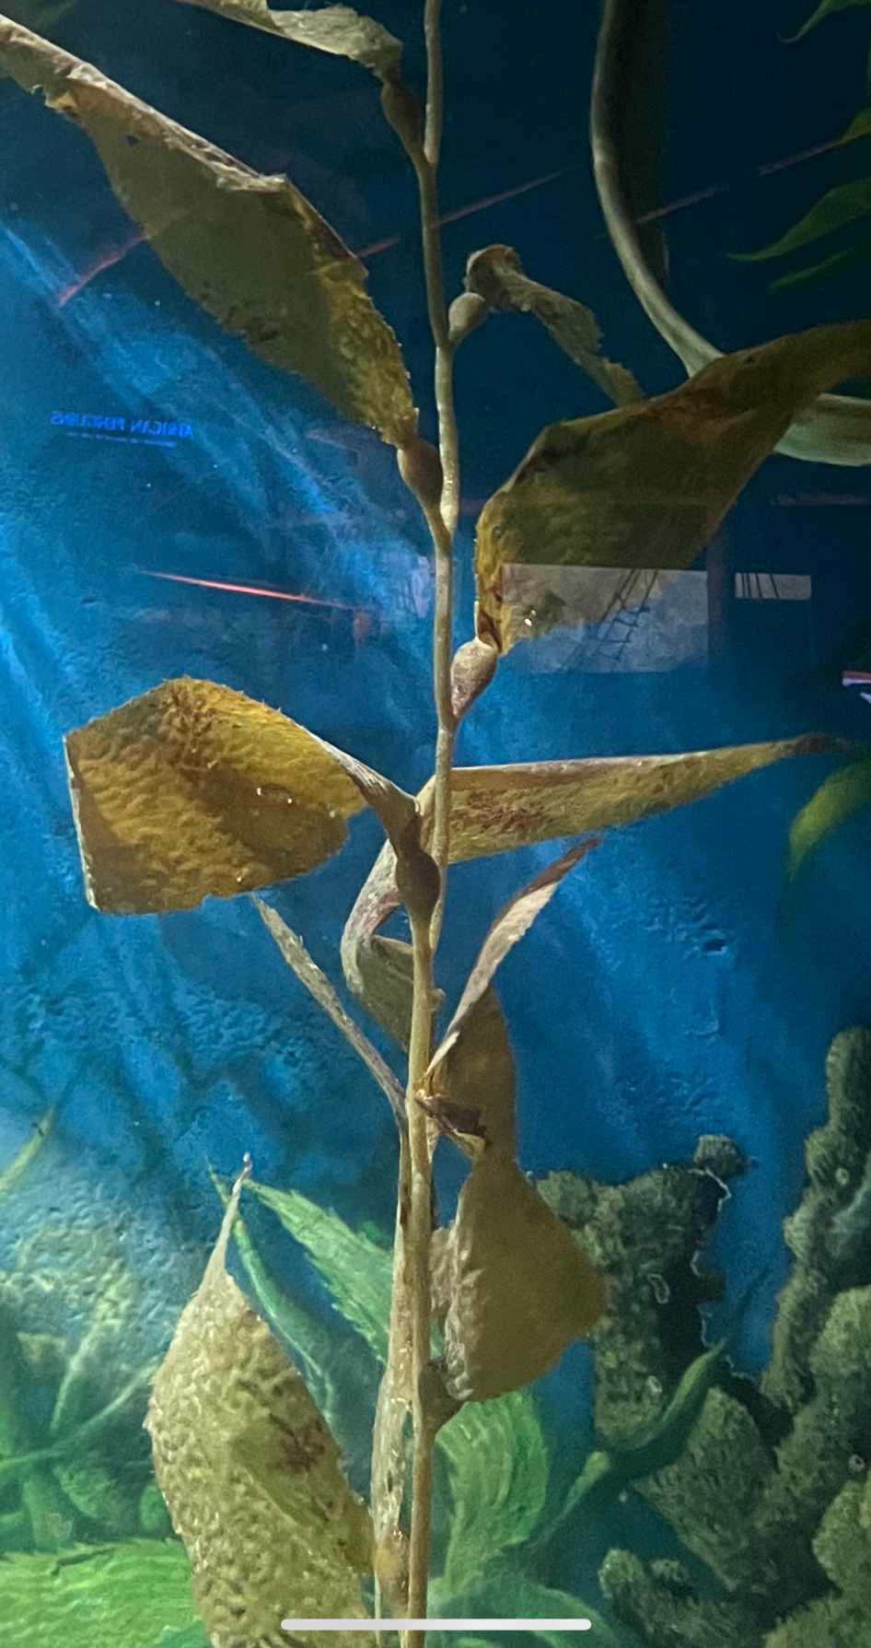
Let’s try again!
Notes:
728 × 971
This is an image of a plant, kelp. This underwater plant still looks pretty similar to its on land friend with its slight green color and leafy appearance.

Slide 13
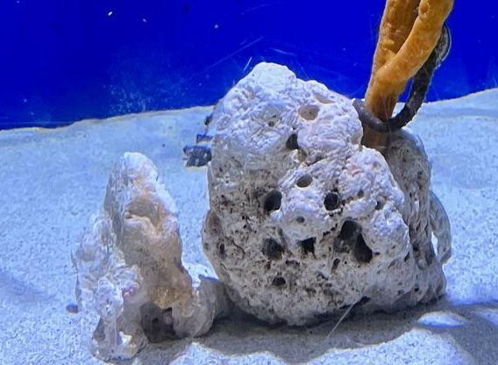
Let’s try again!
Notes:
2,560 × 1,600
This is an example of non-living. Again, this is very similar to its on land friend.

Slide 14
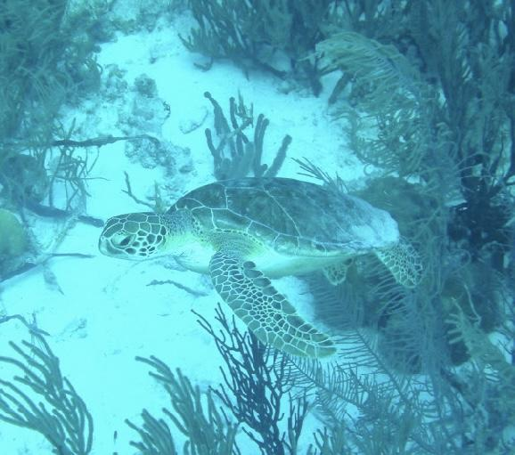
Let’s try again!
Notes:
3,268 × 2,179
This is an example of an underwater animal, a sea turtle! Notice that it looks very different from its on land friend. Because it is in water, it needs different limbs to move around through the water and also is not furry like the dog we saw earlier. Animals can take lots of forms.

Slide 15
What did you notice?
Notes:
Here you can practice observation with the students and ask them what they noticed about the differences between on land and in water and also what they noticed between the plants, animals, and nonliving things. They may notice the flippers on the turtle, the colors of things being different, the texture of the plants and animals, etc.

Slide 16
What is a pictograph?
Weather in a Week
3
2
1
Notes:
This slide can be used to briefly introduce a pictograph. Feel free to add more slides to this presentation if you feel that students would need more of an introduction to the topic. This is a simple example of a pictograph using weather. On the x axis is the symbols, which is this case are types of weather (sunny, storms, and cloudy) and on the y-axis we have the count of occurrences. In this pictograph, it was sunny three days in a week, storming one, and cloudy two. You may also explain to students the layout of the pictograph for this activity as well at this point.

Slide 17
Now you try!
Notes:
This is where you will begin to introduce the activity. Explain that now, the students are going to get a chance to sort through some pictures of their own and determine whether or not they think it is an animal, plant, or non living object. Once they think they get it, they can come up to the board and place it above the category on the pictogram that they think it belongs in

