Slide 1
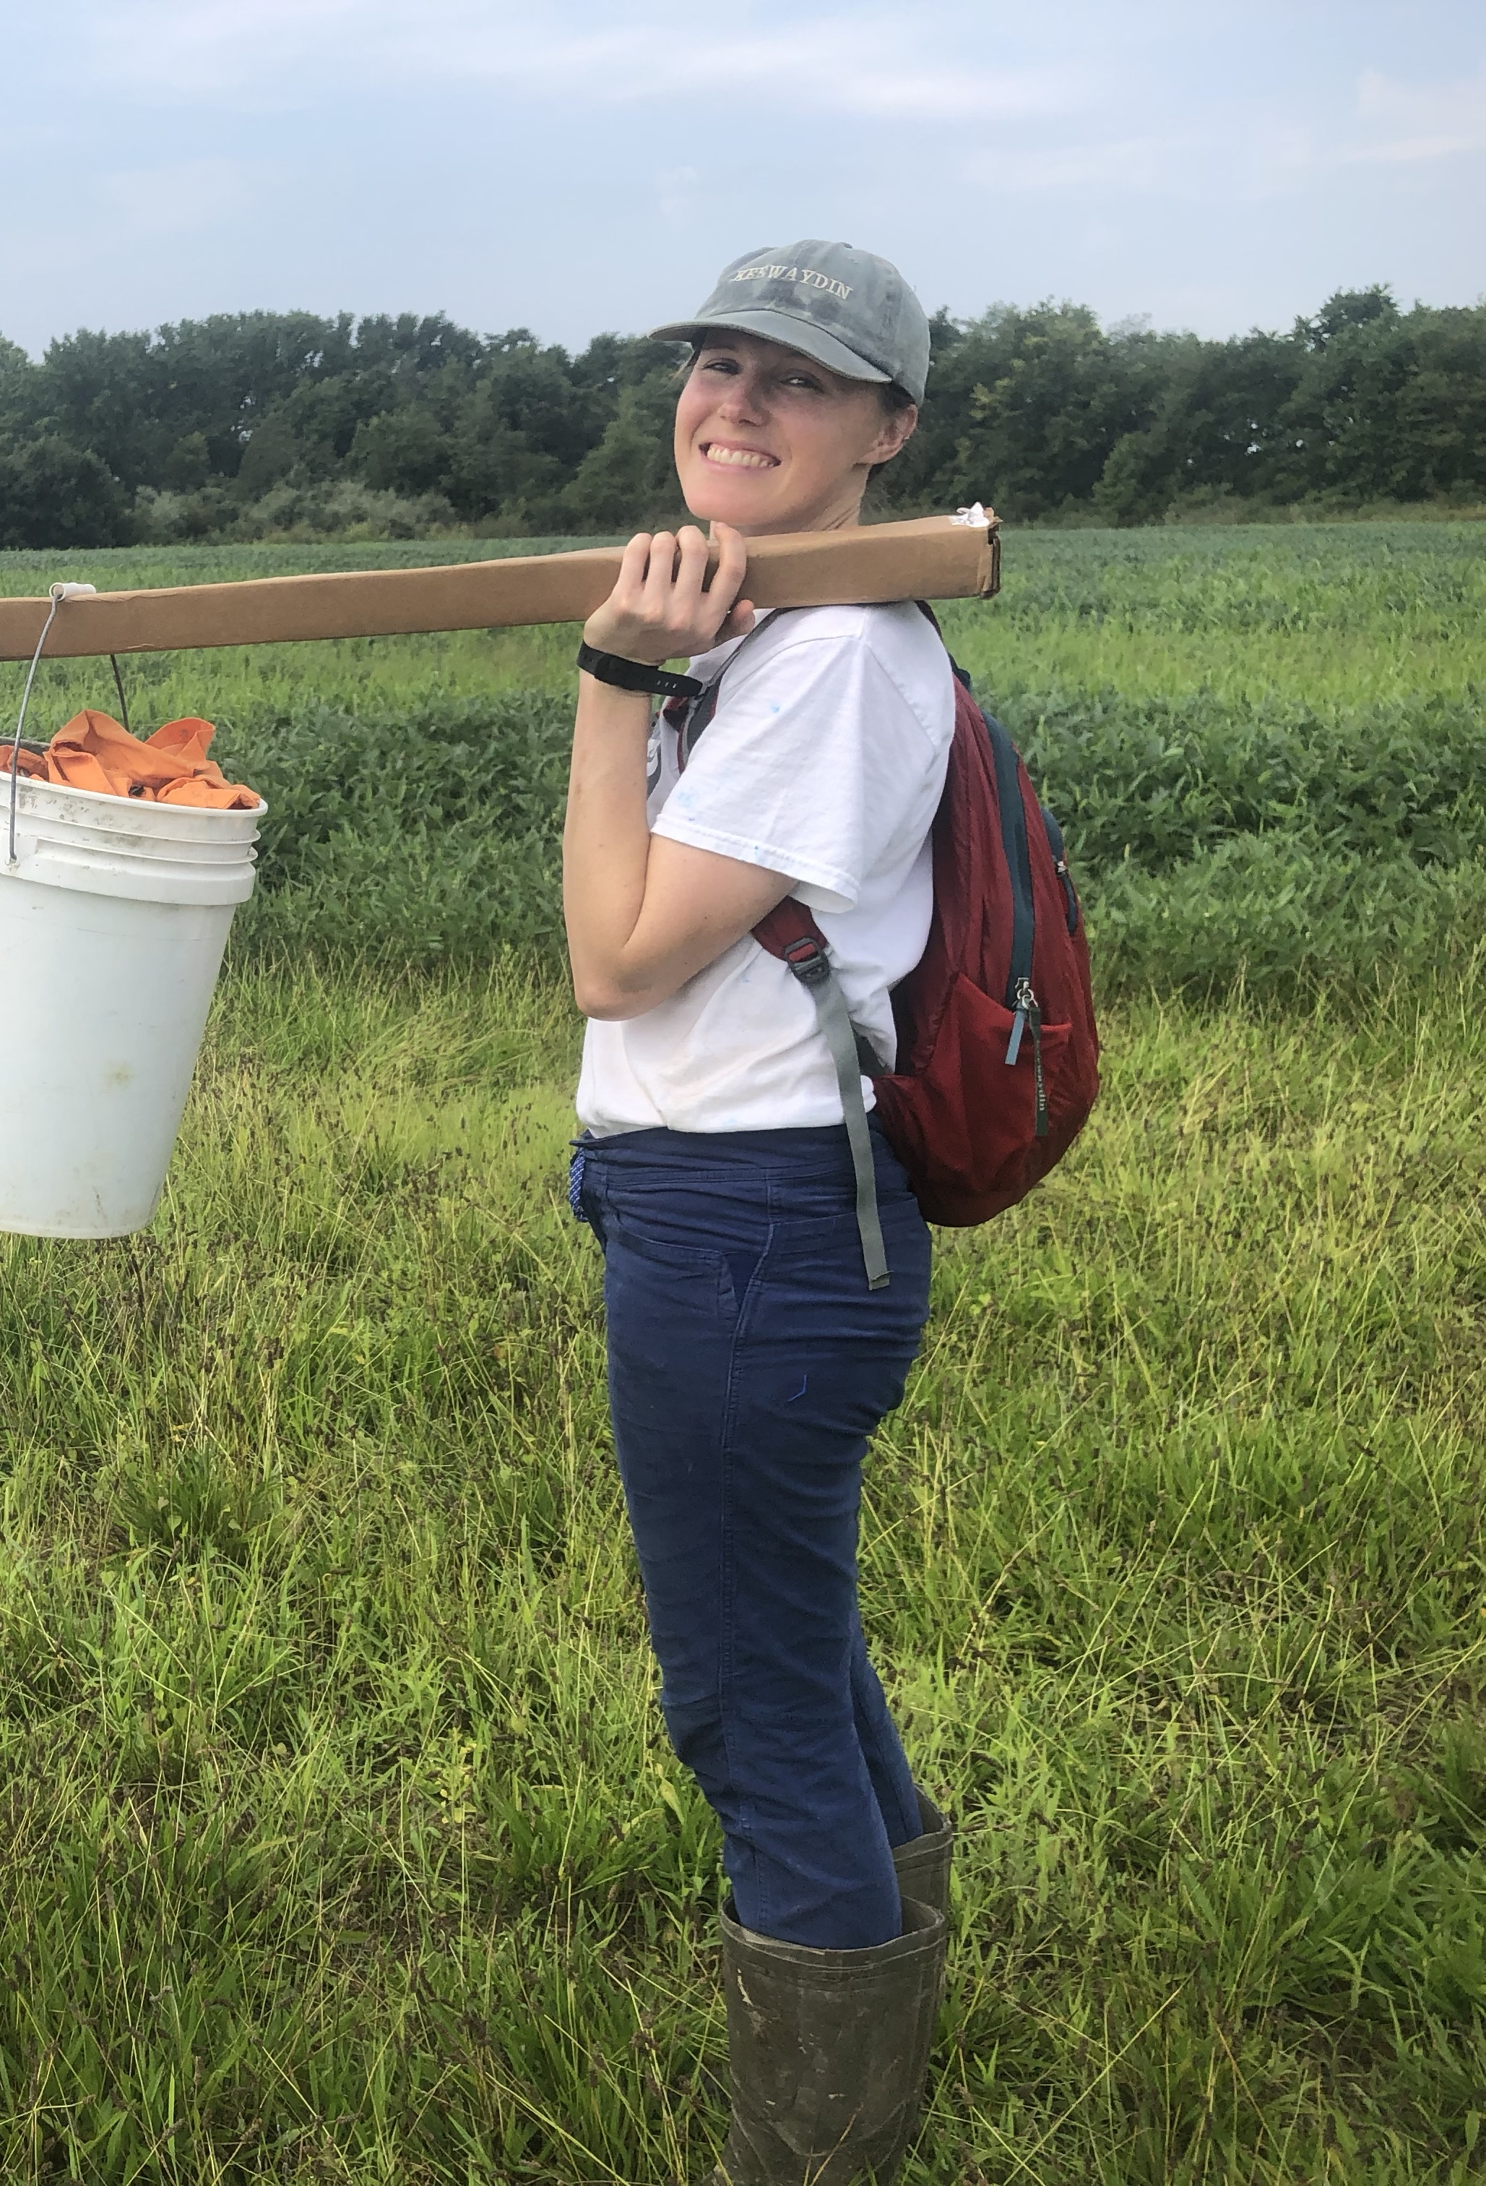
Name: Mary Bryan Barksdale
Hometown: Oxford, Mississippi
College: Bowdoin College in Brunswick, Maine
Science interests: Science has been my favorite subject since I was in the 3rd grade! As a 3rd year Ph.D. student at the Virginia Institute of Marine Science, I study coastal ecosystems like salt marshes and barrier islands by using sediment cores and computer models. Because of the pressing issue of climate change, driven by CO₂ emissions, I am most interested in figuring out how much carbon these coastal systems can hold (in soils & plants) into the future.
The focus of this lesson plan is based on the research I am doing on the effects of sea-level rise on salt marsh functions, like plant productivity and carbon storage. I hope you enjoy!
Photo credit: Alex Smith

Slide 2
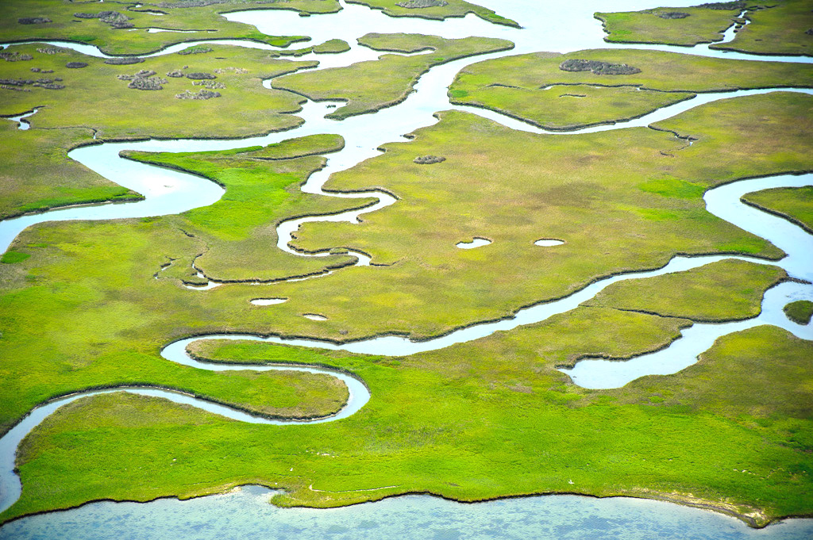
A Manager’s Dilemma: Defending salt marshes against rising seas
Photo information: Core Banks, NC; taken by John Buie, under Creative Commons Attribution 2.0 Generic license.

Slide 3
First, a definition:
Ecosystem service: goods and services provided by ecosystems to support people
Now, some examples of beautiful ecosystems and some of their services…
Photo information: Core Banks, NC; taken by John Buie, under Creative Commons Attribution 2.0 Generic license.

Slide 4

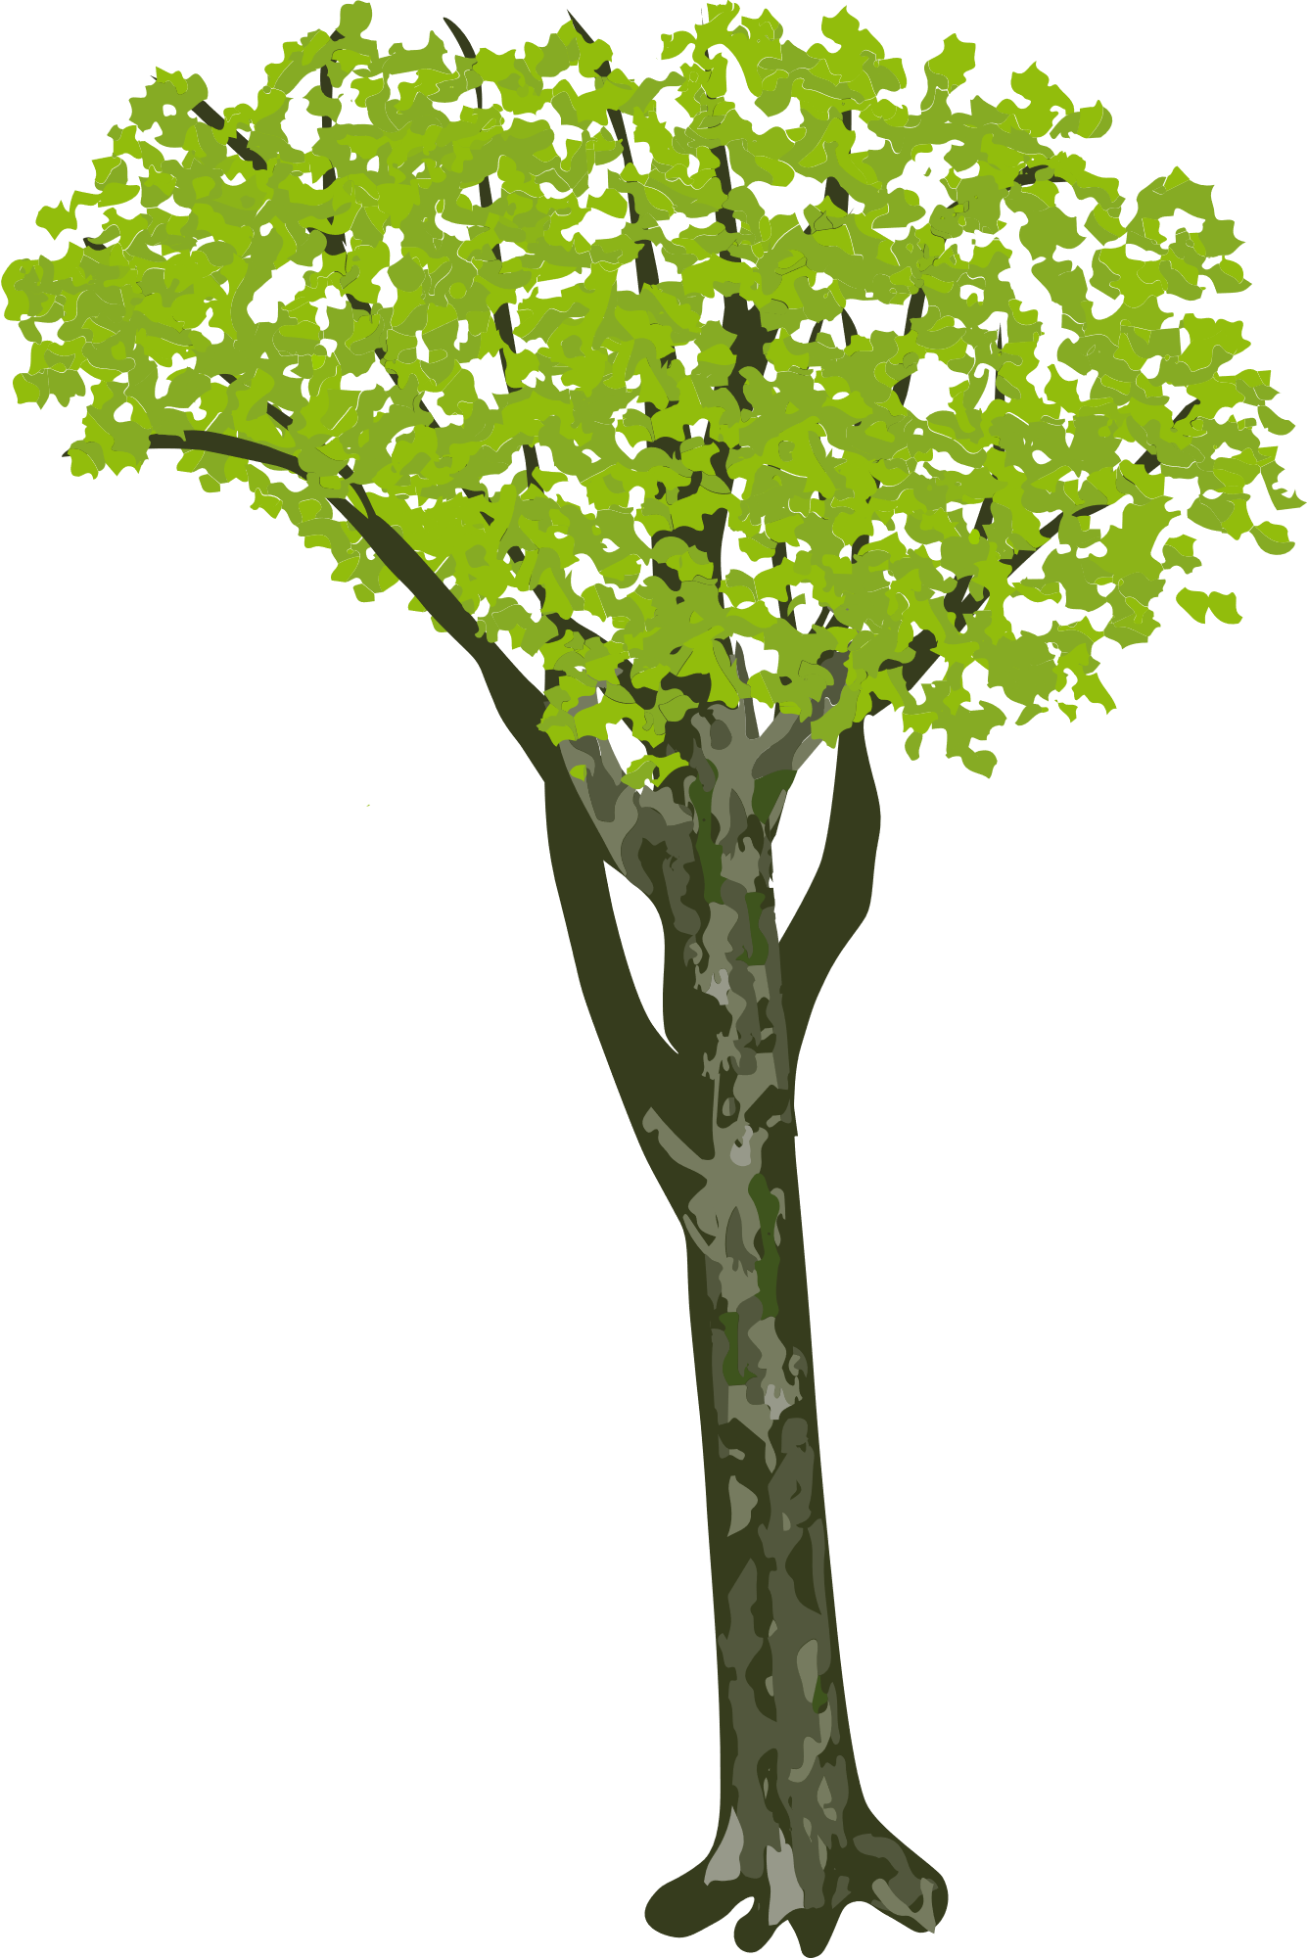
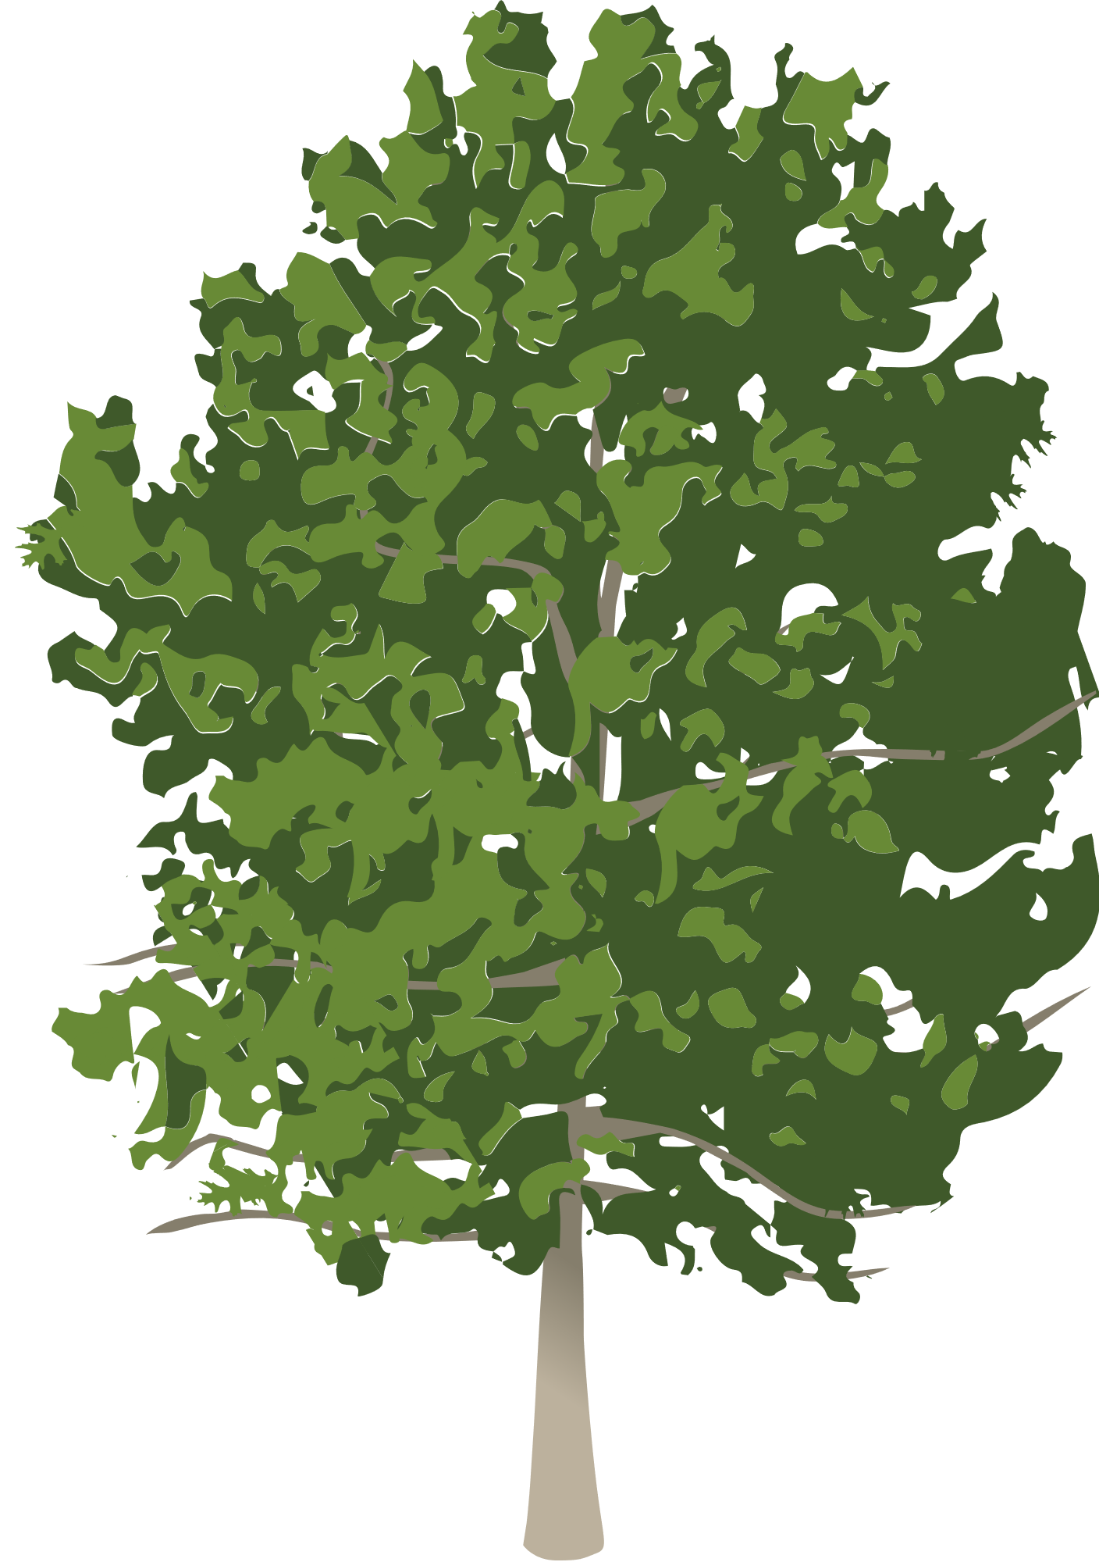



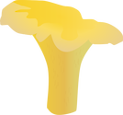
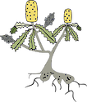
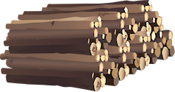
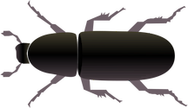
Ecosystem service: goods and services provided by ecosystems to support people
----------------------------------
What ecosystem services does a forest provide?
All symbols are from University of Maryland Center for Environmental Science Integration and Application Network (UMCES) and made available via Attribution-ShareAlike 4.0 International (CC BY-SA 4.0). See more information in notes below.
Notes:
White ash (light and dark green leaves) Joanna Woerner, Integration and Application Network (ian.umces.edu/media-library)
Man with plant: Tracey Saxby, Integration and Application Network (ian.umces.edu/media-library)
Platanus occidentalis (American sycamore) (light green leaves): Dylan Taillie, Integration and Application Network (ian.umces.edu/media-library)
Pinus echinate (shortleaf pine) (tall and straight): Dylan Taillie, Integration and Application Network (ian.umces.edu/media-library)
Scarlet oak (bushy): Dylan Taillie, Integration and Application Network (ian.umces.edu/media-library)
Lumber pile: Tracey Saxby, Integration and Application Network (ian.umces.edu/media-library)
Vermivora chrysoptera (Golden-winged warbler): Dylan Taillie, Integration and Application Network (ian.umces.edu/media-library)
Cantharellus cibarius (Golden Chanterelle) (mushroom): Tracey Saxby, Integration and Application Network (ian.umces.edu/media-library)
Dendroctonus ponderosae (Mountain Pine Beetle): Jane Thomas, Integration and Application Network (ian.umces.edu/media-library)
Banksia spp. (Banksia) (yellow rooted plant): Diana Kleine, Marine Botany UQ (ian.umces.edu/media-library)

Slide 5
Ecosystem service: goods and services provided by ecosystems to support people
----------------------------------
What ecosystem services does a forest provide?
Food (deer, fruits, herbs, seeds, honey) and medicine
Water filtration and storage
Habitats for flora and fauna
Soil formation
Carbon storage
Climate regulation/control
Protection against erosion & storms
Recreation and education
Any other ideas?
All symbols are from University of Maryland Center for Environmental Science Integration and Application Network (UMCES) and made available via Attribution-ShareAlike 4.0 International (CC BY-SA 4.0). See more information in notes below.
Notes:
White ash (light and dark green leaves) Joanna Woerner, Integration and Application Network (ian.umces.edu/media-library)
Man with plant: Tracey Saxby, Integration and Application Network (ian.umces.edu/media-library)
Platanus occidentalis (American sycamore) (light green leaves): Dylan Taillie, Integration and Application Network (ian.umces.edu/media-library)
Pinus echinate (shortleaf pine) (tall and straight): Dylan Taillie, Integration and Application Network (ian.umces.edu/media-library)
Scarlet oak (bushy): Dylan Taillie, Integration and Application Network (ian.umces.edu/media-library)
Lumber pile: Tracey Saxby, Integration and Application Network (ian.umces.edu/media-library)
Vermivora chrysoptera (Golden-winged warbler): Dylan Taillie, Integration and Application Network (ian.umces.edu/media-library)
Cantharellus cibarius (Golden Chanterelle) (mushroom): Tracey Saxby, Integration and Application Network (ian.umces.edu/media-library)
Dendroctonus ponderosae (Mountain Pine Beetle): Jane Thomas, Integration and Application Network (ian.umces.edu/media-library)
Banksia spp. (Banksia) (yellow rooted plant): Diana Kleine, Marine Botany UQ (ian.umces.edu/media-library)

Slide 6
Ecosystem Services
Threats to Salt Marshes
Marsh Restorations
Computer Modeling
Your Job
Today, you will take on the job of a salt marsh manager. To do your job and save your marsh, you need a crash course on the following
Photo information: Core Banks, NC; taken by John Buie, under Creative Commons Attribution 2.0 Generic license.

Slide 7
Ecosystem Services
Threats to Salt Marshes
Marsh Restorations
Computer Modeling
Your Job
Today, you will take on the job of a salt marsh manager. To do your job and save your marsh, you need a crash course on the following
Photo information: Core Banks, NC; taken by John Buie, under Creative Commons Attribution 2.0 Generic license.

Slide 8
Ecosystem Services
Threats to Salt Marshes
Marsh Restorations
Computer Modeling
Your Job
Today, you will take on the job of a salt marsh manager. To do your job and save your marsh, you need a crash course on the following
Track your progress by watching the yellow box
Photo information: Core Banks, NC; taken by John Buie, under Creative Commons Attribution 2.0 Generic license.

Slide 9
Ecosystem Services
Threats to Salt Marshes
Marsh Restorations
Computer Modeling
Your Job
Salt marshes, coastal ecosystems with salt & water-tolerant plants (shown in this background image) provide numerous ecosystem services.
Photo information: Core Banks, NC; taken by John Buie, under Creative Commons Attribution 2.0 Generic license.

Slide 10
Ecosystem Services
Threats to Salt Marshes
Marsh Restorations
Computer Modeling
Your Job
Salt marshes, coastal ecosystems with salt & water-tolerant plants (shown in this background image) provide numerous ecosystem services.
To understand salt marsh ecosystem services, we first must know about salt marshes and tides.
Photo information: Core Banks, NC; taken by John Buie, under Creative Commons Attribution 2.0 Generic license.

Slide 11
Ecosystem Services
Threats to Salt Marshes
Marsh Restorations
Computer Modeling
Your Job
Salt marshes, coastal ecosystems with salt & water-tolerant plants (shown in this background image) provide numerous ecosystem services.
To understand salt marsh ecosystem services, we first must know about salt marshes and tides.
First, we will watch a salt marsh during a complete tidal cycle, as water rises and falls with the tide.
Photo information: Core Banks, NC; taken by John Buie, under Creative Commons Attribution 2.0 Generic license.

Slide 12
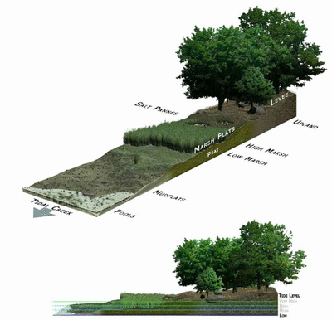
Ecosystem Services
Threats to Salt Marshes
Marsh Restorations
Computer Modeling
Your Job
Photo information: animation showing a mudflat, salt marsh, and forest during a tidal cycle; GIF provided by the National Oceanic and Atmospheric Administration (NOAA)—Ocean Service Education, available under the public domain

Slide 13
Ecosystem Services
Threats to Salt Marshes
Marsh Restorations
Computer Modeling
Your Job
Next to #1 and #2 on your handout, write the answers to:
1) Looking at the GIF on the right, describe what happens to a salt marsh during the high tide and during the low tide.
2) Make a hypothesis about what the incoming water (during high tide) delivers to a salt marsh.
Photo information: animation showing a mudflat, salt marsh, and forest during a tidal cycle; GIF provided by the National Oceanic and Atmospheric Administration (NOAA)—Ocean Service Education, available under the public domain

Slide 14
Ecosystem Services
Threats to Salt Marshes
Marsh Restorations
Computer Modeling
Your Job
1) Looking at the GIF on the right, describe what happens to a salt marsh during the high tide and during the low tide.
Salt marshes are flooded during high tide (when water levels are high), and are dry during low tide.
2) Make a hypothesis about what the incoming water (during high tide) delivers to a salt marsh.
Photo information: animation showing a mudflat, salt marsh, and forest during a tidal cycle; GIF provided by the National Oceanic and Atmospheric Administration (NOAA)—Ocean Service Education, available under the public domain

Slide 15
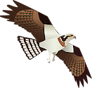


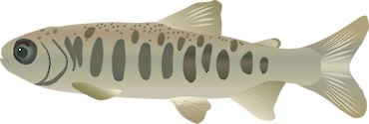

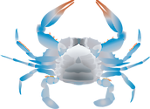
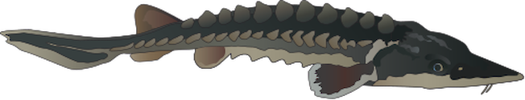

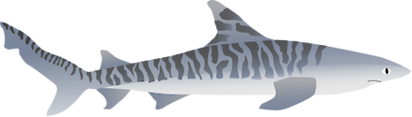



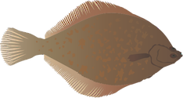
Ecosystem Services
Threats to Salt Marshes
Marsh Restorations
Computer Modeling
Your Job
1) Looking at the GIF on the right, describe what happens to a salt marsh during the high tide and during the low tide.
Salt marshes are flooded during high tide (when water levels are high), and are dry during low tide.
2) Make a hypothesis about what the incoming water (during high tide) delivers to a salt marsh.
Nutrients like nitrogen and phosphorus
Animals
Sediment
Other answers?
Photo information: animation showing a mudflat, salt marsh, and forest during a tidal cycle; GIF provided by the National Oceanic and Atmospheric Administration (NOAA)—Ocean Service Education, available under the public domain; all symbols are from UMCES (more info in notes)
Notes:
All symbols are from University of Maryland Center for Environmental Science Integration and Application Network (UMCES) and made available via Attribution-ShareAlike 4.0 International (CC BY-SA 4.0).
Osprey: Jane Hawkey, Integration and Application Network (ian.umces.edu/media-library)
Fisherperson in blue shirt: Tracey Saxby, Integration and Application Network (ian.umces.edu/media-library)
Salt marsh nekton surveyer: Jane Hawkey, Integration and Application Network (ian.umces.edu/media-library)
Blue crab: Jane Thomas, Integration and Application Network (ian.umces.edu/media-library)
Sturgeon: Tracey Saxby, Integration and Application Network (ian.umces.edu/media-library)
Salmo salar (Atlantic Salmon) parr: Claire Sbardella, Integration and Application Network (ian.umces.edu/media-library)
Salmo salar (Atlantic Salmon) eggs: Claire Sbardella, Integration and Application Network (ian.umces.edu/media-library)
Shark: Joanna Woerner, Integration and Application Network (ian.umces.edu/media-library)
Nutrients arrow: Tracey Saxby, Integration and Application Network (ian.umces.edu/media-library)
Sediment arrow: Tracey Saxby, Integration and Application Network (ian.umces.edu/media-library)
Sediment symbol: Jane Hawkey, Integration and Application Network (ian.umces.edu/media-library)
Seiners: Kim Kraeer, Lucy Van Essen-Fishman, Integration and Application Network (ian.umces.edu/media-library)
Flounder: Tracey Saxby, Integration and Application Network (ian.umces.edu/media-library)

Slide 16
Ecosystem Services
Threats to Salt Marshes
Marsh Restorations
Computer Modeling
Your Job
3) Identify at least two salt marsh ecosystem services based on the diagram.
Photo information: animation showing a mudflat, salt marsh, and forest during a tidal cycle; GIF provided by the National Oceanic and Atmospheric Administration (NOAA)—Ocean Service Education, available under the public domain; all symbols are from UMCES (more info in notes)
Notes:
All symbols are from University of Maryland Center for Environmental Science Integration and Application Network (UMCES) and made available via Attribution-ShareAlike 4.0 International (CC BY-SA 4.0).
Osprey: Jane Hawkey, Integration and Application Network (ian.umces.edu/media-library)
Fisherperson in blue shirt: Tracey Saxby, Integration and Application Network (ian.umces.edu/media-library)
Salt marsh nekton surveyer: Jane Hawkey, Integration and Application Network (ian.umces.edu/media-library)
Blue crab: Jane Thomas, Integration and Application Network (ian.umces.edu/media-library)
Sturgeon: Tracey Saxby, Integration and Application Network (ian.umces.edu/media-library)
Salmo salar (Atlantic Salmon) parr: Claire Sbardella, Integration and Application Network (ian.umces.edu/media-library)
Salmo salar (Atlantic Salmon) eggs: Claire Sbardella, Integration and Application Network (ian.umces.edu/media-library)
Shark: Joanna Woerner, Integration and Application Network (ian.umces.edu/media-library)
Nutrients arrow: Tracey Saxby, Integration and Application Network (ian.umces.edu/media-library)
Sediment arrow: Tracey Saxby, Integration and Application Network (ian.umces.edu/media-library)
Sediment symbol: Jane Hawkey, Integration and Application Network (ian.umces.edu/media-library)
Seiners: Kim Kraeer, Lucy Van Essen-Fishman, Integration and Application Network (ian.umces.edu/media-library)
Flounder: Tracey Saxby, Integration and Application Network (ian.umces.edu/media-library)

Slide 17
3) Identify at least two ecosystem services you think a salt marsh provides.
Absorb nutrients →
Photo information: animation showing a mudflat, salt marsh, and forest during a tidal cycle; GIF provided by the National Oceanic and Atmospheric Administration (NOAA)—Ocean Service Education, available under the public domain; all symbols are from UMCES (more info in notes)
Notes:
All symbols are from University of Maryland Center for Environmental Science Integration and Application Network (UMCES) and made available via Attribution-ShareAlike 4.0 International (CC BY-SA 4.0).
Osprey: Jane Hawkey, Integration and Application Network (ian.umces.edu/media-library)
Fisherperson in blue shirt: Tracey Saxby, Integration and Application Network (ian.umces.edu/media-library)
Salt marsh nekton surveyer: Jane Hawkey, Integration and Application Network (ian.umces.edu/media-library)
Blue crab: Jane Thomas, Integration and Application Network (ian.umces.edu/media-library)
Sturgeon: Tracey Saxby, Integration and Application Network (ian.umces.edu/media-library)
Salmo salar (Atlantic Salmon) parr: Claire Sbardella, Integration and Application Network (ian.umces.edu/media-library)
Salmo salar (Atlantic Salmon) eggs: Claire Sbardella, Integration and Application Network (ian.umces.edu/media-library)
Shark: Joanna Woerner, Integration and Application Network (ian.umces.edu/media-library)
Nutrients arrow: Tracey Saxby, Integration and Application Network (ian.umces.edu/media-library)
Sediment arrow: Tracey Saxby, Integration and Application Network (ian.umces.edu/media-library)
Sediment symbol: Jane Hawkey, Integration and Application Network (ian.umces.edu/media-library)
Seiners: Kim Kraeer, Lucy Van Essen-Fishman, Integration and Application Network (ian.umces.edu/media-library)
Flounder: Tracey Saxby, Integration and Application Network (ian.umces.edu/media-library)

Slide 18
3) Identify at least two ecosystem services you think a salt marsh provides.
Absorb nutrients → improve water quality
Photo information: animation showing a mudflat, salt marsh, and forest during a tidal cycle; GIF provided by the National Oceanic and Atmospheric Administration (NOAA)—Ocean Service Education, available under the public domain; all symbols are from UMCES (more info in notes)
Notes:
All symbols are from University of Maryland Center for Environmental Science Integration and Application Network (UMCES) and made available via Attribution-ShareAlike 4.0 International (CC BY-SA 4.0).
Osprey: Jane Hawkey, Integration and Application Network (ian.umces.edu/media-library)
Fisherperson in blue shirt: Tracey Saxby, Integration and Application Network (ian.umces.edu/media-library)
Salt marsh nekton surveyer: Jane Hawkey, Integration and Application Network (ian.umces.edu/media-library)
Blue crab: Jane Thomas, Integration and Application Network (ian.umces.edu/media-library)
Sturgeon: Tracey Saxby, Integration and Application Network (ian.umces.edu/media-library)
Salmo salar (Atlantic Salmon) parr: Claire Sbardella, Integration and Application Network (ian.umces.edu/media-library)
Salmo salar (Atlantic Salmon) eggs: Claire Sbardella, Integration and Application Network (ian.umces.edu/media-library)
Shark: Joanna Woerner, Integration and Application Network (ian.umces.edu/media-library)
Nutrients arrow: Tracey Saxby, Integration and Application Network (ian.umces.edu/media-library)
Sediment arrow: Tracey Saxby, Integration and Application Network (ian.umces.edu/media-library)
Sediment symbol: Jane Hawkey, Integration and Application Network (ian.umces.edu/media-library)
Seiners: Kim Kraeer, Lucy Van Essen-Fishman, Integration and Application Network (ian.umces.edu/media-library)
Flounder: Tracey Saxby, Integration and Application Network (ian.umces.edu/media-library)

Slide 19
3) Identify at least two ecosystem services you think a salt marsh provides.
Absorb nutrients → improve water quality
Provide habitat for fish & birds →
Photo information: animation showing a mudflat, salt marsh, and forest during a tidal cycle; GIF provided by the National Oceanic and Atmospheric Administration (NOAA)—Ocean Service Education, available under the public domain; all symbols are from UMCES (more info in notes)
Notes:
All symbols are from University of Maryland Center for Environmental Science Integration and Application Network (UMCES) and made available via Attribution-ShareAlike 4.0 International (CC BY-SA 4.0).
Osprey: Jane Hawkey, Integration and Application Network (ian.umces.edu/media-library)
Fisherperson in blue shirt: Tracey Saxby, Integration and Application Network (ian.umces.edu/media-library)
Salt marsh nekton surveyer: Jane Hawkey, Integration and Application Network (ian.umces.edu/media-library)
Blue crab: Jane Thomas, Integration and Application Network (ian.umces.edu/media-library)
Sturgeon: Tracey Saxby, Integration and Application Network (ian.umces.edu/media-library)
Salmo salar (Atlantic Salmon) parr: Claire Sbardella, Integration and Application Network (ian.umces.edu/media-library)
Salmo salar (Atlantic Salmon) eggs: Claire Sbardella, Integration and Application Network (ian.umces.edu/media-library)
Shark: Joanna Woerner, Integration and Application Network (ian.umces.edu/media-library)
Nutrients arrow: Tracey Saxby, Integration and Application Network (ian.umces.edu/media-library)
Sediment arrow: Tracey Saxby, Integration and Application Network (ian.umces.edu/media-library)
Sediment symbol: Jane Hawkey, Integration and Application Network (ian.umces.edu/media-library)
Seiners: Kim Kraeer, Lucy Van Essen-Fishman, Integration and Application Network (ian.umces.edu/media-library)
Flounder: Tracey Saxby, Integration and Application Network (ian.umces.edu/media-library)

Slide 20
3) Identify at least two ecosystem services you think a salt marsh provides.
Absorb nutrients → improve water quality
Provide habitat for fish & birds → food & raise young
Photo information: animation showing a mudflat, salt marsh, and forest during a tidal cycle; GIF provided by the National Oceanic and Atmospheric Administration (NOAA)—Ocean Service Education, available under the public domain; all symbols are from UMCES (more info in notes)
Notes:
All symbols are from University of Maryland Center for Environmental Science Integration and Application Network (UMCES) and made available via Attribution-ShareAlike 4.0 International (CC BY-SA 4.0).
Osprey: Jane Hawkey, Integration and Application Network (ian.umces.edu/media-library)
Fisherperson in blue shirt: Tracey Saxby, Integration and Application Network (ian.umces.edu/media-library)
Salt marsh nekton surveyer: Jane Hawkey, Integration and Application Network (ian.umces.edu/media-library)
Blue crab: Jane Thomas, Integration and Application Network (ian.umces.edu/media-library)
Sturgeon: Tracey Saxby, Integration and Application Network (ian.umces.edu/media-library)
Salmo salar (Atlantic Salmon) parr: Claire Sbardella, Integration and Application Network (ian.umces.edu/media-library)
Salmo salar (Atlantic Salmon) eggs: Claire Sbardella, Integration and Application Network (ian.umces.edu/media-library)
Shark: Joanna Woerner, Integration and Application Network (ian.umces.edu/media-library)
Nutrients arrow: Tracey Saxby, Integration and Application Network (ian.umces.edu/media-library)
Sediment arrow: Tracey Saxby, Integration and Application Network (ian.umces.edu/media-library)
Sediment symbol: Jane Hawkey, Integration and Application Network (ian.umces.edu/media-library)
Seiners: Kim Kraeer, Lucy Van Essen-Fishman, Integration and Application Network (ian.umces.edu/media-library)
Flounder: Tracey Saxby, Integration and Application Network (ian.umces.edu/media-library)

Slide 21
3) Identify at least two ecosystem services you think a salt marsh provides.
Absorb nutrients → improve water quality
Provide habitat for fish & birds → food & raise young
Store carbon →
Photo information: animation showing a mudflat, salt marsh, and forest during a tidal cycle; GIF provided by the National Oceanic and Atmospheric Administration (NOAA)—Ocean Service Education, available under the public domain ; all symbols are from UMCES (more info in notes)
Notes:
All symbols are from University of Maryland Center for Environmental Science Integration and Application Network (UMCES) and made available via Attribution-ShareAlike 4.0 International (CC BY-SA 4.0).
Osprey: Jane Hawkey, Integration and Application Network (ian.umces.edu/media-library)
Fisherperson in blue shirt: Tracey Saxby, Integration and Application Network (ian.umces.edu/media-library)
Salt marsh nekton surveyer: Jane Hawkey, Integration and Application Network (ian.umces.edu/media-library)
Blue crab: Jane Thomas, Integration and Application Network (ian.umces.edu/media-library)
Sturgeon: Tracey Saxby, Integration and Application Network (ian.umces.edu/media-library)
Salmo salar (Atlantic Salmon) parr: Claire Sbardella, Integration and Application Network (ian.umces.edu/media-library)
Salmo salar (Atlantic Salmon) eggs: Claire Sbardella, Integration and Application Network (ian.umces.edu/media-library)
Shark: Joanna Woerner, Integration and Application Network (ian.umces.edu/media-library)
Nutrients arrow: Tracey Saxby, Integration and Application Network (ian.umces.edu/media-library)
Sediment arrow: Tracey Saxby, Integration and Application Network (ian.umces.edu/media-library)
Sediment symbol: Jane Hawkey, Integration and Application Network (ian.umces.edu/media-library)
Seiners: Kim Kraeer, Lucy Van Essen-Fishman, Integration and Application Network (ian.umces.edu/media-library)
Flounder: Tracey Saxby, Integration and Application Network (ian.umces.edu/media-library)

Slide 22
3) Identify at least two ecosystem services you think a salt marsh provides.
Absorb nutrients → improve water quality
Provide habitat for fish & birds → food & raise young
Store carbon → limit climate change
Photo information: animation showing a mudflat, salt marsh, and forest during a tidal cycle; GIF provided by the National Oceanic and Atmospheric Administration (NOAA)—Ocean Service Education, available under the public domain; all symbols are from UMCES (more info in notes)
Notes:
All symbols are from University of Maryland Center for Environmental Science Integration and Application Network (UMCES) and made available via Attribution-ShareAlike 4.0 International (CC BY-SA 4.0).
Osprey: Jane Hawkey, Integration and Application Network (ian.umces.edu/media-library)
Fisherperson in blue shirt: Tracey Saxby, Integration and Application Network (ian.umces.edu/media-library)
Salt marsh nekton surveyer: Jane Hawkey, Integration and Application Network (ian.umces.edu/media-library)
Blue crab: Jane Thomas, Integration and Application Network (ian.umces.edu/media-library)
Sturgeon: Tracey Saxby, Integration and Application Network (ian.umces.edu/media-library)
Salmo salar (Atlantic Salmon) parr: Claire Sbardella, Integration and Application Network (ian.umces.edu/media-library)
Salmo salar (Atlantic Salmon) eggs: Claire Sbardella, Integration and Application Network (ian.umces.edu/media-library)
Shark: Joanna Woerner, Integration and Application Network (ian.umces.edu/media-library)
Nutrients arrow: Tracey Saxby, Integration and Application Network (ian.umces.edu/media-library)
Sediment arrow: Tracey Saxby, Integration and Application Network (ian.umces.edu/media-library)
Sediment symbol: Jane Hawkey, Integration and Application Network (ian.umces.edu/media-library)
Seiners: Kim Kraeer, Lucy Van Essen-Fishman, Integration and Application Network (ian.umces.edu/media-library)
Flounder: Tracey Saxby, Integration and Application Network (ian.umces.edu/media-library)

Slide 23
3) Identify at least two ecosystem services you think a salt marsh provides.
Absorb nutrients → improve water quality
Provide habitat for fish & birds → food & raise young
Store carbon → limit climate change
Provide recreation (kayaking, hunting, bird watching) opportunities
Photo information: animation showing a mudflat, salt marsh, and forest during a tidal cycle; GIF provided by the National Oceanic and Atmospheric Administration (NOAA)—Ocean Service Education, available under the public domain; all symbols are from UMCES (more info in notes)
Notes:
All symbols are from University of Maryland Center for Environmental Science Integration and Application Network (UMCES) and made available via Attribution-ShareAlike 4.0 International (CC BY-SA 4.0).
Osprey: Jane Hawkey, Integration and Application Network (ian.umces.edu/media-library)
Fisherperson in blue shirt: Tracey Saxby, Integration and Application Network (ian.umces.edu/media-library)
Salt marsh nekton surveyer: Jane Hawkey, Integration and Application Network (ian.umces.edu/media-library)
Blue crab: Jane Thomas, Integration and Application Network (ian.umces.edu/media-library)
Sturgeon: Tracey Saxby, Integration and Application Network (ian.umces.edu/media-library)
Salmo salar (Atlantic Salmon) parr: Claire Sbardella, Integration and Application Network (ian.umces.edu/media-library)
Salmo salar (Atlantic Salmon) eggs: Claire Sbardella, Integration and Application Network (ian.umces.edu/media-library)
Shark: Joanna Woerner, Integration and Application Network (ian.umces.edu/media-library)
Nutrients arrow: Tracey Saxby, Integration and Application Network (ian.umces.edu/media-library)
Sediment arrow: Tracey Saxby, Integration and Application Network (ian.umces.edu/media-library)
Sediment symbol: Jane Hawkey, Integration and Application Network (ian.umces.edu/media-library)
Seiners: Kim Kraeer, Lucy Van Essen-Fishman, Integration and Application Network (ian.umces.edu/media-library)
Flounder: Tracey Saxby, Integration and Application Network (ian.umces.edu/media-library)

Slide 24
3) Identify at least two ecosystem services you think a salt marsh provides.
Absorb nutrients → improve water quality
Provide habitat for fish & birds → food & raise young
Store carbon → limit climate change
Provide recreation (kayaking, hunting, bird watching) opportunities
Slow waves →
Photo information: animation showing a mudflat, salt marsh, and forest during a tidal cycle; GIF provided by the National Oceanic and Atmospheric Administration (NOAA)—Ocean Service Education, available under the public domain; all symbols are from UMCES (more info in notes)
Notes:
All symbols are from University of Maryland Center for Environmental Science Integration and Application Network (UMCES) and made available via Attribution-ShareAlike 4.0 International (CC BY-SA 4.0).
Osprey: Jane Hawkey, Integration and Application Network (ian.umces.edu/media-library)
Fisherperson in blue shirt: Tracey Saxby, Integration and Application Network (ian.umces.edu/media-library)
Salt marsh nekton surveyer: Jane Hawkey, Integration and Application Network (ian.umces.edu/media-library)
Blue crab: Jane Thomas, Integration and Application Network (ian.umces.edu/media-library)
Sturgeon: Tracey Saxby, Integration and Application Network (ian.umces.edu/media-library)
Salmo salar (Atlantic Salmon) parr: Claire Sbardella, Integration and Application Network (ian.umces.edu/media-library)
Salmo salar (Atlantic Salmon) eggs: Claire Sbardella, Integration and Application Network (ian.umces.edu/media-library)
Shark: Joanna Woerner, Integration and Application Network (ian.umces.edu/media-library)
Nutrients arrow: Tracey Saxby, Integration and Application Network (ian.umces.edu/media-library)
Sediment arrow: Tracey Saxby, Integration and Application Network (ian.umces.edu/media-library)
Sediment symbol: Jane Hawkey, Integration and Application Network (ian.umces.edu/media-library)
Seiners: Kim Kraeer, Lucy Van Essen-Fishman, Integration and Application Network (ian.umces.edu/media-library)
Flounder: Tracey Saxby, Integration and Application Network (ian.umces.edu/media-library)

Slide 25
3) Identify at least two ecosystem services you think a salt marsh provides.
Absorb nutrients → improve water quality
Provide habitat for fish & birds → food & raise young
Store carbon → limit climate change
Provide recreation (kayaking, hunting, bird watching) opportunities
Slow waves → protect coastal areas from storms
Photo information: animation showing a mudflat, salt marsh, and forest during a tidal cycle; GIF provided by the National Oceanic and Atmospheric Administration (NOAA)—Ocean Service Education, available under the public domain; all symbols are from UMCES (more info in notes)
Notes:
All symbols are from University of Maryland Center for Environmental Science Integration and Application Network (UMCES) and made available via Attribution-ShareAlike 4.0 International (CC BY-SA 4.0).
Osprey: Jane Hawkey, Integration and Application Network (ian.umces.edu/media-library)
Fisherperson in blue shirt: Tracey Saxby, Integration and Application Network (ian.umces.edu/media-library)
Salt marsh nekton surveyer: Jane Hawkey, Integration and Application Network (ian.umces.edu/media-library)
Blue crab: Jane Thomas, Integration and Application Network (ian.umces.edu/media-library)
Sturgeon: Tracey Saxby, Integration and Application Network (ian.umces.edu/media-library)
Salmo salar (Atlantic Salmon) parr: Claire Sbardella, Integration and Application Network (ian.umces.edu/media-library)
Salmo salar (Atlantic Salmon) eggs: Claire Sbardella, Integration and Application Network (ian.umces.edu/media-library)
Shark: Joanna Woerner, Integration and Application Network (ian.umces.edu/media-library)
Nutrients arrow: Tracey Saxby, Integration and Application Network (ian.umces.edu/media-library)
Sediment arrow: Tracey Saxby, Integration and Application Network (ian.umces.edu/media-library)
Sediment symbol: Jane Hawkey, Integration and Application Network (ian.umces.edu/media-library)
Seiners: Kim Kraeer, Lucy Van Essen-Fishman, Integration and Application Network (ian.umces.edu/media-library)
Flounder: Tracey Saxby, Integration and Application Network (ian.umces.edu/media-library)

Slide 26
3) Identify at least two ecosystem services you think a salt marsh provides.
Absorb nutrients → improve water quality
Provide habitat for fish & birds → food & raise young
Store carbon → limit climate change
Provide recreation (kayaking, hunting, bird watching) opportunities
Slow waves → protect coastal areas from storms
Any other ideas?
Photo information: animation showing a mudflat, salt marsh, and forest during a tidal cycle; GIF provided by the National Oceanic and Atmospheric Administration (NOAA)—Ocean Service Education, available under the public domain; all symbols are from UMCES (more info in notes)
Notes:
All symbols are from University of Maryland Center for Environmental Science Integration and Application Network (UMCES) and made available via Attribution-ShareAlike 4.0 International (CC BY-SA 4.0).
Osprey: Jane Hawkey, Integration and Application Network (ian.umces.edu/media-library)
Fisherperson in blue shirt: Tracey Saxby, Integration and Application Network (ian.umces.edu/media-library)
Salt marsh nekton surveyer: Jane Hawkey, Integration and Application Network (ian.umces.edu/media-library)
Blue crab: Jane Thomas, Integration and Application Network (ian.umces.edu/media-library)
Sturgeon: Tracey Saxby, Integration and Application Network (ian.umces.edu/media-library)
Salmo salar (Atlantic Salmon) parr: Claire Sbardella, Integration and Application Network (ian.umces.edu/media-library)
Salmo salar (Atlantic Salmon) eggs: Claire Sbardella, Integration and Application Network (ian.umces.edu/media-library)
Shark: Joanna Woerner, Integration and Application Network (ian.umces.edu/media-library)
Nutrients arrow: Tracey Saxby, Integration and Application Network (ian.umces.edu/media-library)
Sediment arrow: Tracey Saxby, Integration and Application Network (ian.umces.edu/media-library)
Sediment symbol: Jane Hawkey, Integration and Application Network (ian.umces.edu/media-library)
Seiners: Kim Kraeer, Lucy Van Essen-Fishman, Integration and Application Network (ian.umces.edu/media-library)
Flounder: Tracey Saxby, Integration and Application Network (ian.umces.edu/media-library)

Slide 27
Ecosystem Services
Threats to Salt Marshes
Marsh Restorations
Computer Modeling
Your Job
Ecosystem services can be hard to measure, so we have to get creative with how we measure these.
Photo information: animation showing a mudflat, salt marsh, and forest during a tidal cycle; GIF provided by the National Oceanic and Atmospheric Administration (NOAA)—Ocean Service Education, available under the public domain; all symbols are from UMCES (more info in notes)
Notes:
All symbols are from University of Maryland Center for Environmental Science Integration and Application Network (UMCES) and made available via Attribution-ShareAlike 4.0 International (CC BY-SA 4.0).
Osprey: Jane Hawkey, Integration and Application Network (ian.umces.edu/media-library)
Fisherperson in blue shirt: Tracey Saxby, Integration and Application Network (ian.umces.edu/media-library)
Salt marsh nekton surveyer: Jane Hawkey, Integration and Application Network (ian.umces.edu/media-library)
Blue crab: Jane Thomas, Integration and Application Network (ian.umces.edu/media-library)
Sturgeon: Tracey Saxby, Integration and Application Network (ian.umces.edu/media-library)
Salmo salar (Atlantic Salmon) parr: Claire Sbardella, Integration and Application Network (ian.umces.edu/media-library)
Salmo salar (Atlantic Salmon) eggs: Claire Sbardella, Integration and Application Network (ian.umces.edu/media-library)
Shark: Joanna Woerner, Integration and Application Network (ian.umces.edu/media-library)
Nutrients arrow: Tracey Saxby, Integration and Application Network (ian.umces.edu/media-library)
Sediment arrow: Tracey Saxby, Integration and Application Network (ian.umces.edu/media-library)
Sediment symbol: Jane Hawkey, Integration and Application Network (ian.umces.edu/media-library)
Seiners: Kim Kraeer, Lucy Van Essen-Fishman, Integration and Application Network (ian.umces.edu/media-library)
Flounder: Tracey Saxby, Integration and Application Network (ian.umces.edu/media-library)

Slide 28
Ecosystem Services
Threats to Salt Marshes
Marsh Restorations
Computer Modeling
Your Job
Ecosystem services can be hard to measure, so we have to get creative with how we measure these.
For example, how much a salt marsh improves water quality (by absorbing nutrients) can be measured by how much nitrogen the marsh plants use (because too much nitrogen can lower water quality).
Photo information: animation showing a mudflat, salt marsh, and forest during a tidal cycle; GIF provided by the National Oceanic and Atmospheric Administration (NOAA)—Ocean Service Education, available under the public domain; all symbols are from UMCES (more info in notes)
Notes:
All symbols are from University of Maryland Center for Environmental Science Integration and Application Network (UMCES) and made available via Attribution-ShareAlike 4.0 International (CC BY-SA 4.0).
Osprey: Jane Hawkey, Integration and Application Network (ian.umces.edu/media-library)
Fisherperson in blue shirt: Tracey Saxby, Integration and Application Network (ian.umces.edu/media-library)
Salt marsh nekton surveyer: Jane Hawkey, Integration and Application Network (ian.umces.edu/media-library)
Blue crab: Jane Thomas, Integration and Application Network (ian.umces.edu/media-library)
Sturgeon: Tracey Saxby, Integration and Application Network (ian.umces.edu/media-library)
Salmo salar (Atlantic Salmon) parr: Claire Sbardella, Integration and Application Network (ian.umces.edu/media-library)
Salmo salar (Atlantic Salmon) eggs: Claire Sbardella, Integration and Application Network (ian.umces.edu/media-library)
Shark: Joanna Woerner, Integration and Application Network (ian.umces.edu/media-library)
Nutrients arrow: Tracey Saxby, Integration and Application Network (ian.umces.edu/media-library)
Sediment arrow: Tracey Saxby, Integration and Application Network (ian.umces.edu/media-library)
Sediment symbol: Jane Hawkey, Integration and Application Network (ian.umces.edu/media-library)
Seiners: Kim Kraeer, Lucy Van Essen-Fishman, Integration and Application Network (ian.umces.edu/media-library)
Flounder: Tracey Saxby, Integration and Application Network (ian.umces.edu/media-library)

Slide 29
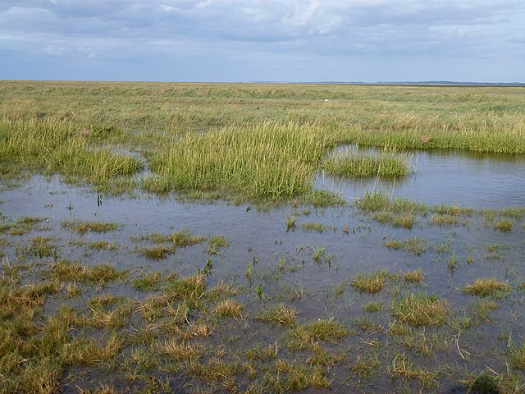
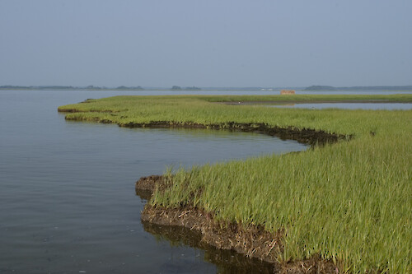
Ecosystem Services
Threats to Salt Marshes
Marsh Restorations
Computer Modeling
Your Job
We know salt marshes are important based on all the ecosystem services they provide.
Photo information: flooded salt marsh in Ireland; taken by Richard Humphrey, shared under Creative Commons Attribution-Share Alike 2.0 Generic license.
Photo information: eroding salt marsh in Maryland; taken by Adrian Jones, Integration and Application Network (ian.umces.edu/media-library), shared under Creative Commons Attribution-Share Alike 4.0 International (CC BY-SA 4.0).

Slide 30
Ecosystem Services
Threats to Salt Marshes
Marsh Restorations
Computer Modeling
Your Job
We know salt marshes are important based on all the ecosystem services they provide.
However, both sea-level rise and erosion currently threaten marshes.
Photo information: flooded salt marsh in Ireland; taken by Richard Humphrey, shared under Creative Commons Attribution-Share Alike 2.0 Generic license.
Photo information: eroding salt marsh in Maryland; taken by Adrian Jones, Integration and Application Network (ian.umces.edu/media-library), shared under Creative Commons Attribution-Share Alike 4.0 International (CC BY-SA 4.0).

Slide 31
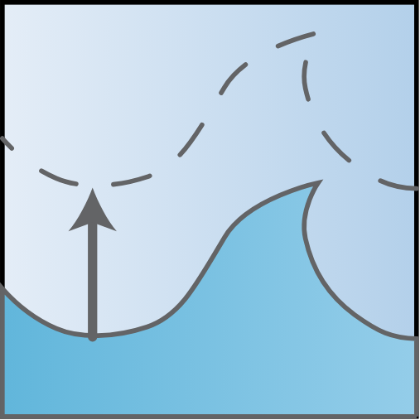
Ecosystem Services
Threats to Salt Marshes
Marsh Restorations
Computer Modeling
Your Job
We know salt marshes are important based on all the ecosystem services they provide.
However, both sea-level rise and erosion currently threaten marshes.
Sea-level rise: the increase in average water level → marsh drowning
Photo information: flooded salt marsh in Ireland; taken by Richard Humphrey, shared under Creative Commons Attribution-Share Alike 2.0 Generic license.
Photo information: eroding salt marsh in Maryland; taken by Adrian Jones, Integration and Application Network (ian.umces.edu/media-library), shared under Creative Commons Attribution-Share Alike 4.0 International (CC BY-SA 4.0).
sea-level rise
Notes:
Sea-level rise graphic: from University of Maryland Center for Environmental Science Integration and Application Network (UMCES) and made available via Attribution-ShareAlike 4.0 International (CC BY-SA 4.0). Tracey Saxby, Integration and Application Network (ian.umces.edu/media-library)

Slide 32

Ecosystem Services
Threats to Salt Marshes
Marsh Restorations
Computer Modeling
Your Job
We know salt marshes are important based on all the ecosystem services they provide.
However, both sea-level rise and erosion currently threaten marshes.
Sea-level rise: increase in average water level → marsh drowning
Marsh erosion: removal of plants & sediment by waves → marsh narrowing
Photo information: flooded salt marsh in Ireland; taken by Richard Humphrey, shared under Creative Commons Attribution-Share Alike 2.0 Generic license.
Photo information: eroding salt marsh in Maryland; taken by Adrian Jones, Integration and Application Network (ian.umces.edu/media-library), shared under Creative Commons Attribution-Share Alike 4.0 International (CC BY-SA 4.0).
sea-level rise
Notes:
Sea-level rise and erosion graphics: from University of Maryland Center for Environmental Science Integration and Application Network (UMCES) and made available via Attribution-ShareAlike 4.0 International (CC BY-SA 4.0). Tracey Saxby, Integration and Application Network (ian.umces.edu/media-library)

Slide 33
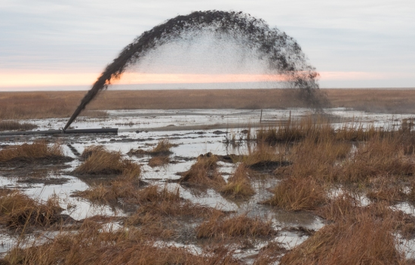
Ecosystem Services
Threats to Salt Marshes
Marsh Restorations
Computer Modeling
Your Job
Salt marsh restorations help support marshes
Thin layer placements (TLP): sediment is added to a marsh in a thin layer.
Thin-layer placement
Photo credit: Dave Harpe, U.S. Fish & Wildlife Service

Slide 34
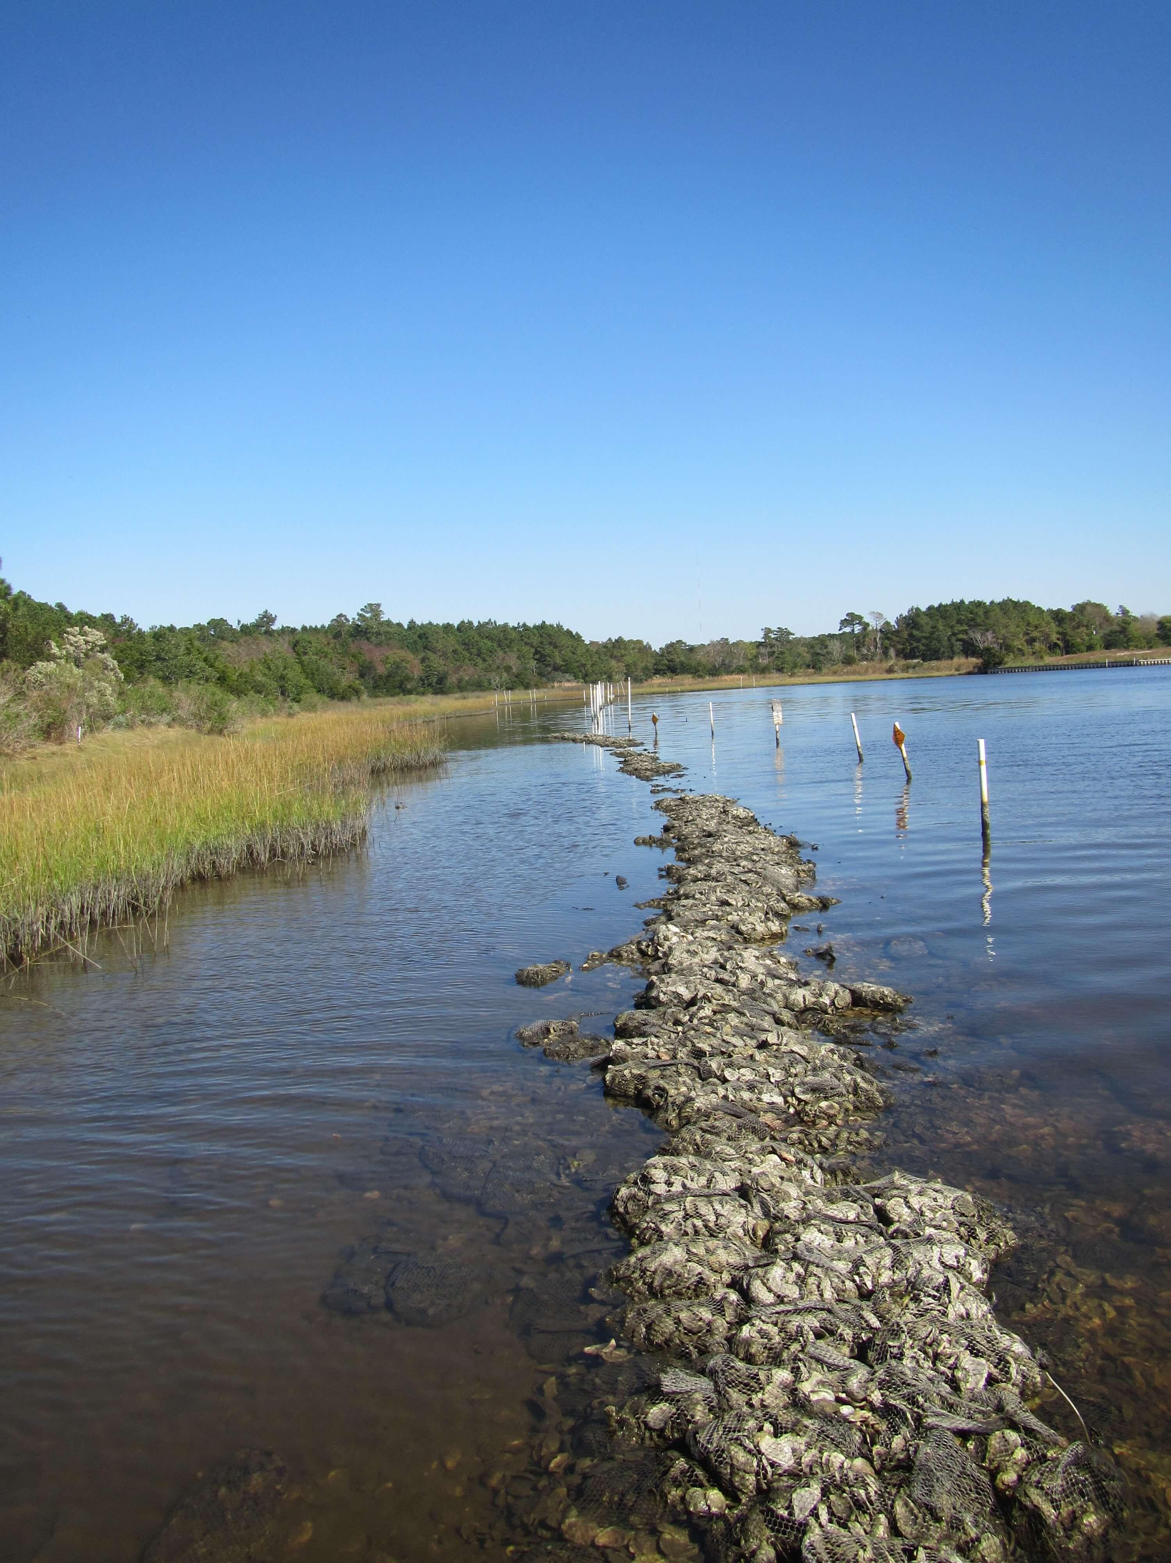
Ecosystem Services
Threats to Salt Marshes
Marsh Restorations
Computer Modeling
Your Job
Salt marsh restorations help support marshes
Thin layer placements (TLP): sediment is added to a marsh in a thin layer.
Sills: structures close to land that slow incoming waves and protect the marsh
Thin-layer placement
Sill
Photo credit: Dave Harpe, U.S. Fish & Wildlife Service
Photo credit: Carter Smith, NC Sea Grant

Slide 35
Ecosystem Services
Threats to Salt Marshes
Marsh Restorations
Computer Modeling
Your Job
Salt marsh restorations help support marshes
ANSWER ON YOUR HANDOUT:
4) Imagine the marsh that you are trying to save is being eroded quickly because of high wave energy. Which restoration strategy do you think would be better at protecting your marsh: thin-layer placements every 15 years OR a sill?
Thin layer placements (TLP): sediment is added to a marsh in a thin layer.
Sills: structures close to land that slow incoming waves and protect the marsh
Thin-layer placement
Sill
Photo credit: Dave Harpe, U.S. Fish & Wildlife Service
Photo credit: Carter Smith, NC Sea Grant

Slide 36
Ecosystem Services
Threats to Salt Marshes
Marsh Restorations
Computer Modeling
Your Job
Today, you will explore how these salt marshes restorations affect a marsh experiencing sea-level rise and erosion.
Photo information: Core Banks, NC; taken by John Buie, under Creative Commons Attribution 2.0 Generic license.

Slide 37
Ecosystem Services
Threats to Salt Marshes
Marsh Restorations
Computer Modeling
Your Job
Today, you will explore how these salt marshes restorations affect a marsh experiencing sea-level rise and erosion.
To do this you will use a numerical model
Numerical model:
a simplification of a real-world system
uses equations to simulate a response to changing conditions
Photo information: Core Banks, NC; taken by John Buie, under Creative Commons Attribution 2.0 Generic license.

Slide 38
Ecosystem Services
Threats to Salt Marshes
Marsh Restorations
Computer Modeling
Your Job
Model inputs are what you control
  Model inputs ≈ independent variables or the constants in a modeling experiment.

Slide 39
Ecosystem Services
Threats to Salt Marshes
Marsh Restorations
Computer Modeling
Your Job
Model inputs are what you control
  Model inputs ≈ independent variables or the constants in a modeling experiment.
  Site conditions are the constants for these experiments
Site conditions:
Rate of local sea-level rise: 2 mm yr⁻¹
Rate of marsh edge erosion: 1 m yr⁻¹
Suspended sediment concentration in the incoming tidal water: 20 mg L⁻¹

Slide 40
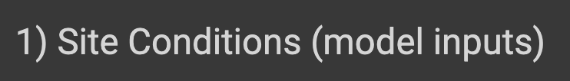
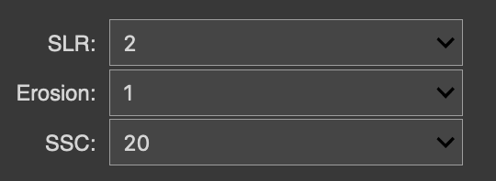
Ecosystem Services
Threats to Salt Marshes
Marsh Restorations
Computer Modeling
Your Job
Model inputs are what you control
  Model inputs ≈ independent variables or the constants in a modeling experiment.
  Site conditions are the constants for these experiments
Site conditions:
Rate of local sea-level rise: 2 mm yr⁻¹
Rate of marsh edge erosion: 1 m yr⁻¹
Suspended sediment concentration in the incoming tidal water: 20 mg L⁻¹
This is what your model input options will look like!

Slide 41
Ecosystem Services
Threats to Salt Marshes
Marsh Restorations
Computer Modeling
Your Job
Model inputs are what you control
  Model inputs ≈ independent variables or the constants in a modeling experiment.
  Site conditions are the constants for these experiments
  Restoration type is the independent variable
Site conditions:
Rate of local sea-level rise: 2 mm yr⁻¹
Rate of marsh edge erosion: 1 m yr⁻¹
Suspended sediment concentration in the incoming tidal water: 20 mg L⁻¹
This is what your model input options will look like!

Slide 42
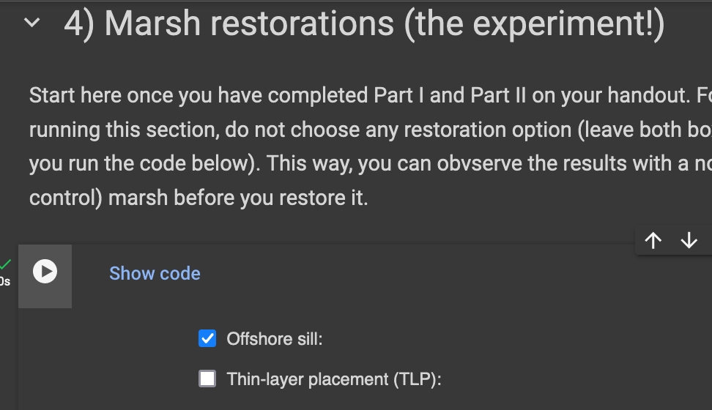
Ecosystem Services
Threats to Salt Marshes
Marsh Restorations
Computer Modeling
Your Job
Model inputs are what you control
  Model inputs ≈ independent variables or the constants in a modeling experiment.
  Site conditions are the constants for these experiments
  Restoration type is the independent variable
Site conditions:
Rate of local sea-level rise: 2 mm yr⁻¹
Rate of marsh edge erosion: 1 m yr⁻¹
Suspended sediment concentration in the incoming tidal water: 20 mg L⁻¹
This is what your model input options will look like!

Slide 43
Ecosystem Services
Threats to Salt Marshes
Marsh Restorations
Computer Modeling
Your Job
Model inputs are what you control
  Model inputs ≈ independent variables or the constants in a modeling experiment.
  Site conditions are the constants for these experiments
  Restoration type is the independent variable
Site conditions:
Rate of local sea-level rise: 2 mm yr⁻¹
Rate of marsh edge erosion: 1 m yr⁻¹
Suspended sediment concentration in the incoming tidal water: 20 mg L⁻¹
  Given these site conditions, which of these will save the marsh’s ecosystem services the best?

Slide 44
Ecosystem Services
Threats to Salt Marshes
Marsh Restorations
Computer Modeling
Your Job
Model inputs are what you control
  Model inputs ≈ independent variables or the constants in a modeling experiment.
  Site conditions are the constants for these experiments
  Restoration type is the independent variable
Site conditions:
Rate of local sea-level rise: 2 mm yr⁻¹
Rate of marsh edge erosion: 1 m yr⁻¹
Suspended sediment concentration in the incoming tidal water: 20 mg L⁻¹
  Given these site conditions, which of these will save the marsh’s ecosystem services the best?

Slide 45
Ecosystem Services
Threats to Salt Marshes
Marsh Restorations
Computer Modeling
Your Job
Model inputs are what you control
  Model inputs ≈ independent variables or the constants in a modeling experiment.
  Site conditions are the constants for these experiments
  Restoration type is the independent variable
Site conditions:
Rate of local sea-level rise: 2 mm yr⁻¹
Rate of marsh edge erosion: 1 m yr⁻¹
Suspended sediment concentration in the incoming tidal water: 20 mg L⁻¹
  Given these site conditions, which of these will save the marsh’s ecosystem services the best?

Slide 46
Ecosystem Services
Threats to Salt Marshes
Marsh Restorations
Computer Modeling
Your Job
Model inputs are what you control
  Model inputs ≈ independent variables or the constants in a modeling experiment.
  Site conditions are the constants for these experiments
  Restoration type is the independent variable
Site conditions:
Rate of local sea-level rise: 2 mm yr⁻¹
Rate of marsh edge erosion: 1 m yr⁻¹
Suspended sediment concentration in the incoming tidal water: 20 mg L⁻¹
You an use both restoration strategies at the same time
  Given these site conditions, which of these will save the marsh’s ecosystem services the best?

Slide 47
Ecosystem Services
Threats to Salt Marshes
Marsh Restorations
Computer Modeling
Your Job
Model inputs are what you control
Model outputs are based on a system of equations that uses your inputs.
  They are equivalent to the dependent variables of an experiment!

Slide 48
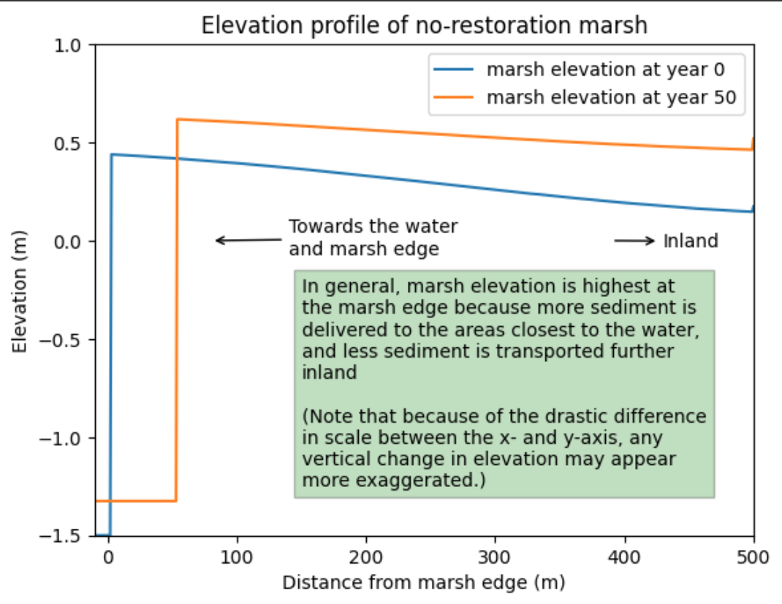
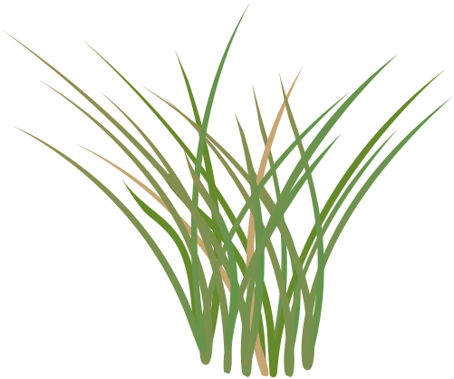
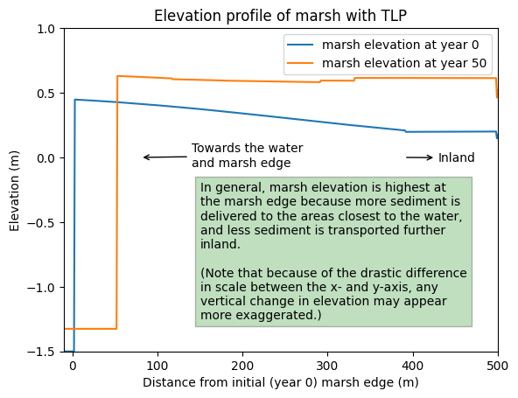
Ecosystem Services
Threats to Salt Marshes
Marsh Restorations
Computer Modeling
Your Job
Model inputs are what you control
Model outputs are based on a system of equations that uses your inputs.
  They are equivalent to the dependent variables of an experiment!
Notes:
This is an example of how the marsh elevation changes over the first 50 years of the marsh, that if you read the graph title, has not received any restoration. The blue line shows the initial elevation profile, and the orange line shows the elevation at year 50.
Salt marsh plant symbol from University of Maryland Center for Environmental Science Integration and Application Network (UMCES) and made available via Attribution-ShareAlike 4.0 International (CC BY-SA 4.0). Made byTracey Saxby, Integration and Application Network (ian.umces.edu/media-library)

Slide 49
Ecosystem Services
Threats to Salt Marshes
Marsh Restorations
Computer Modeling
Your Job
Model inputs are what you control
Model outputs are based on a system of equations that uses your inputs.
  They are equivalent to the dependent variables of an experiment!
How has the salt marsh elevation profile changed over 50 years?
Notes:
You will be asked a question like this when looking at these elevation profiles.
Salt marsh plant symbol from University of Maryland Center for Environmental Science Integration and Application Network (UMCES) and made available via Attribution-ShareAlike 4.0 International (CC BY-SA 4.0). Made byTracey Saxby, Integration and Application Network (ian.umces.edu/media-library)

Slide 50
Ecosystem Services
Threats to Salt Marshes
Marsh Restorations
Computer Modeling
Your Job
Model inputs are what you control
Model outputs are based on a system of equations that uses your inputs.
  They are equivalent to the dependent variables of an experiment!
How has the salt marsh elevation profile changed over 50 years?
It has been eroded (its edge has moved inland and the marsh has narrowed) AND it has grown taller AND it has flattened.
Notes:
You will be asked a question like this when looking at these elevation profiles.
Salt marsh plant symbol from University of Maryland Center for Environmental Science Integration and Application Network (UMCES) and made available via Attribution-ShareAlike 4.0 International (CC BY-SA 4.0). Made byTracey Saxby, Integration and Application Network (ian.umces.edu/media-library)

Slide 51
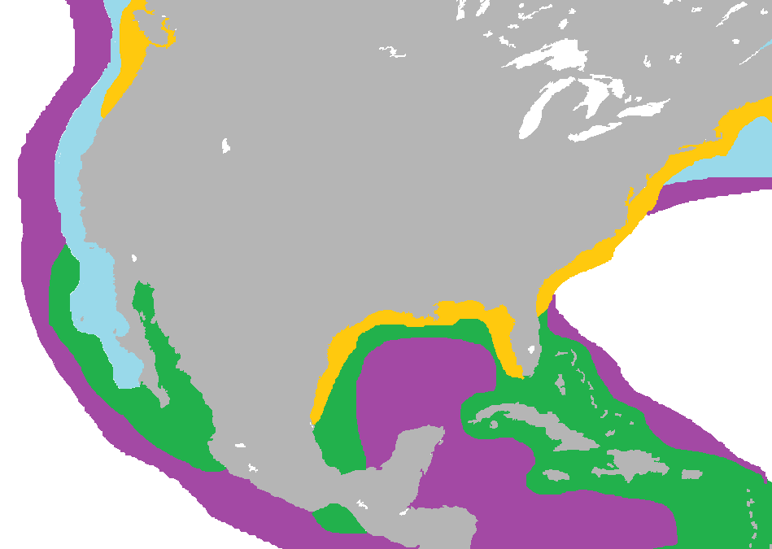

Ecosystem Services
Threats to Salt Marshes
Marsh Restorations
Computer Modeling
Your Job
The United States is home to extensive coastal vegetation!
1
4
UNITED STATES
3
2
Kelps
Mangroves
Salt Marshes
Seagrasses
Kelps
Mangroves
Salt Marshes
Seagrasses
Image credit: modified from Kiss Veronica, under Creative Commons Attribution-Share Alike 4.0 International license

Slide 52
Ecosystem Services
Threats to Salt Marshes
Marsh Restorations
Computer Modeling
Your Job
You are a marsh manager! But where? Be thinking about which of these marsh sites (1-4) you want to manage…
1
4
UNITED STATES
3
2
Kelps
Mangroves
Salt Marshes
Seagrasses
Kelps
Mangroves
Salt Marshes
Seagrasses
Image credit: modified from Kiss Veronica, under Creative Commons Attribution-Share Alike 4.0 International license

Slide 53
Ecosystem Services
Threats to Salt Marshes
Marsh Restorations
Computer Modeling
Your Job
You are a marsh manager! But where? Be thinking about which of these marsh sites (1-4) you want to manage…
Your task? Figure out how to save your struggling marsh’s ecosystem services
  given site conditions, which restoration(s) will save your marsh?
1
4
UNITED STATES
3
2
Kelps
Mangroves
Salt Marshes
Seagrasses
Image credit: modified from Kiss Veronica, under Creative Commons Attribution-Share Alike 4.0 International license

Slide 54
Ecosystem Services
Threats to Salt Marshes
Marsh Restorations
Computer Modeling
Your Job
For example, you are a manager in North Carolina’s Outer Banks:
1
4
UNITED STATES
3
0
2
Image credit: modified from Kiss Veronica, under Creative Commons Attribution-Share Alike 4.0 International license
1) You’ll get a handout for your marsh site that looks like this

Slide 55
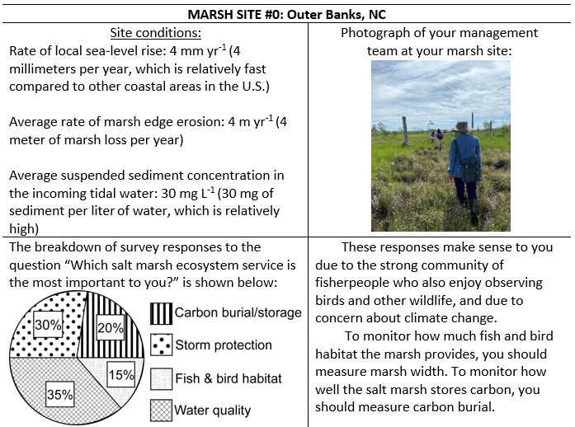
Ecosystem Services
Threats to Salt Marshes
Marsh Restorations
Computer Modeling
Your Job
For example, you are a manager in North Carolina’s Outer Banks:
1
4
UNITED STATES
3
0
2
Photo credit: Mary Bryan Barksdale
Image credit: modified from Kiss Veronica, under Creative Commons Attribution-Share Alike 4.0 International license
1) You’ll get a handout for your marsh site that looks like this

Slide 56
Ecosystem Services
Threats to Salt Marshes
Marsh Restorations
Computer Modeling
Your Job
For example, you are a manager in North Carolina’s Outer Banks:
1
4
UNITED STATES
3
2
Photo credit: Mary Bryan Barksdale
Image credit: modified from Kiss Veronica, under Creative Commons Attribution-Share Alike 4.0 International license
2) Update your site conditions (model inputs) for your new marsh site

Slide 57
Ecosystem Services
Threats to Salt Marshes
Marsh Restorations
Computer Modeling
Your Job
For example, you are a manager in North Carolina’s Outer Banks:
1
4
UNITED STATES
3
2
Photo credit: Mary Bryan Barksdale
Image credit: modified from Kiss Veronica, under Creative Commons Attribution-Share Alike 4.0 International license
3) Use the pie chart to learn which TWO marsh ecosystem services your local community values the most

Slide 58
Ecosystem Services
Threats to Salt Marshes
Marsh Restorations
Computer Modeling
Your Job
For example, you are a manager in North Carolina’s Outer Banks:
1
4
UNITED STATES
3
2
Photo credit: Mary Bryan Barksdale
Image credit: modified from Kiss Veronica, under Creative Commons Attribution-Share Alike 4.0 International license
4) Read this section to know which TWO model outputs you should monitor based on the pie chart

Slide 59
Ecosystem Services
Threats to Salt Marshes
Marsh Restorations
Computer Modeling
Your Job
We need to work one final example together before you and your partner(s) are on your own! This will prepare you for the last answers to your handout and the ultimate goal of figuring out the best way to save your marsh.

Slide 60
Ecosystem Services
Threats to Salt Marshes
Marsh Restorations
Computer Modeling
Your Job
Imagine this is your pie chart for your salt marsh.

Slide 61
Ecosystem Services
Threats to Salt Marshes
Marsh Restorations
Computer Modeling
Your Job
In this case, your first priority ecosystem service is __________

Slide 62
Ecosystem Services
Threats to Salt Marshes
Marsh Restorations
Computer Modeling
Your Job
In this case, your first priority ecosystem service is ___________
water quality

Slide 63
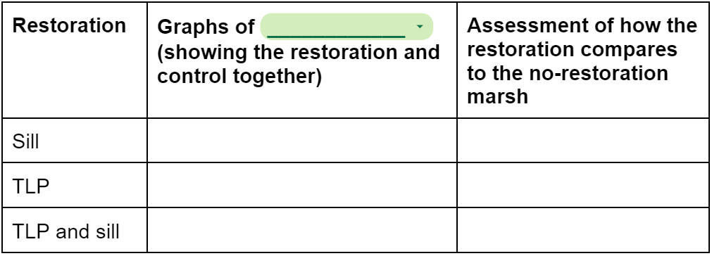
Ecosystem Services
Threats to Salt Marshes
Marsh Restorations
Computer Modeling
Your Job
Water quality can be monitored by how much ______ the plants take up

Slide 64
Ecosystem Services
Threats to Salt Marshes
Marsh Restorations
Computer Modeling
Your Job
nitrogen
Water quality can be monitored by how much ______ the plants take up

Slide 65
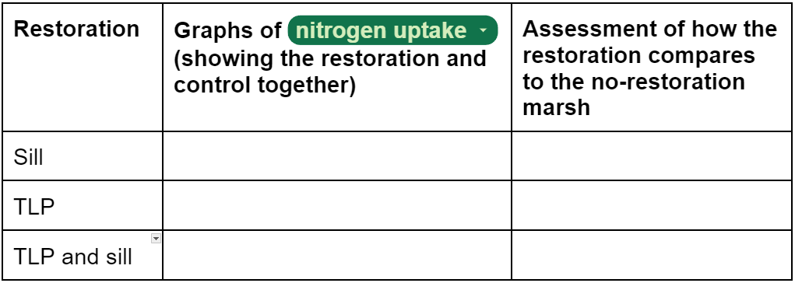
Ecosystem Services
Threats to Salt Marshes
Marsh Restorations
Computer Modeling
Your Job
nitrogen
Water quality can be monitored by how much ______ the plants take up

Slide 66
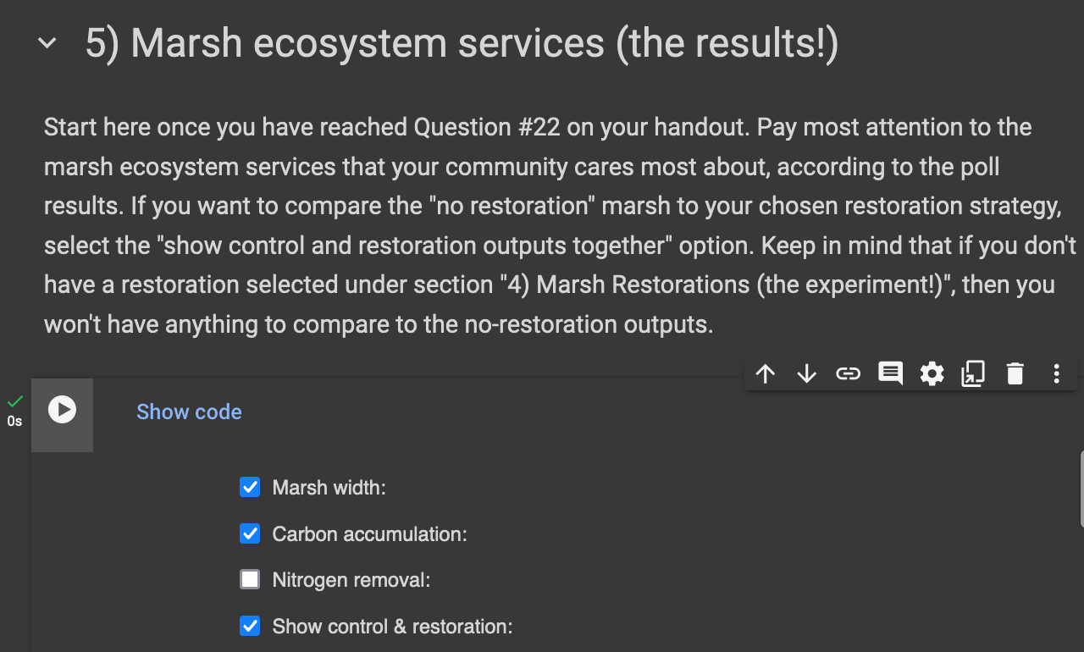

Ecosystem Services
Threats to Salt Marshes
Marsh Restorations
Computer Modeling
Your Job
nitrogen
Water quality can be monitored by how much ______ the plants take up
Now, run the model with ‘sill’, ‘N removal’, and ‘show together’ checked

Slide 67
Ecosystem Services
Threats to Salt Marshes
Marsh Restorations
Computer Modeling
Your Job

Slide 68
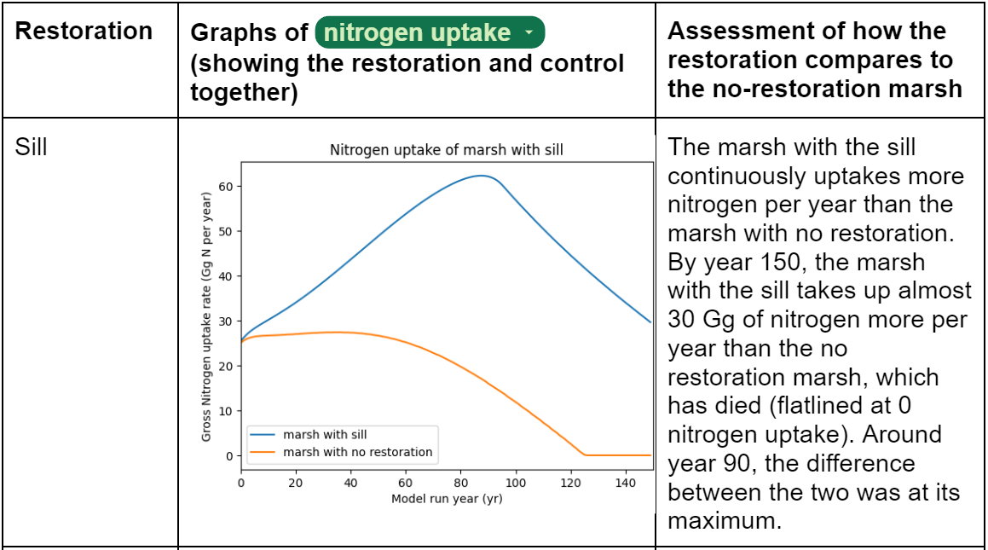
Ecosystem Services
Threats to Salt Marshes
Marsh Restorations
Computer Modeling
Your Job
*With these graphs that track marsh ecosystem services, the model run year is on the x-axis and the ecosystem service is mapped on the y-axis. So you’re looking at how the ecosystem service changes over time.

Slide 69
Ecosystem Services
Threats to Salt Marshes
Marsh Restorations
Computer Modeling
Your Job
*In this column, you should write out your assessment of how the 2 marshes (restored vs unrestored) compare through time!

Slide 70
Ecosystem Services
Threats to Salt Marshes
Marsh Restorations
Computer Modeling
Your Job

Slide 71
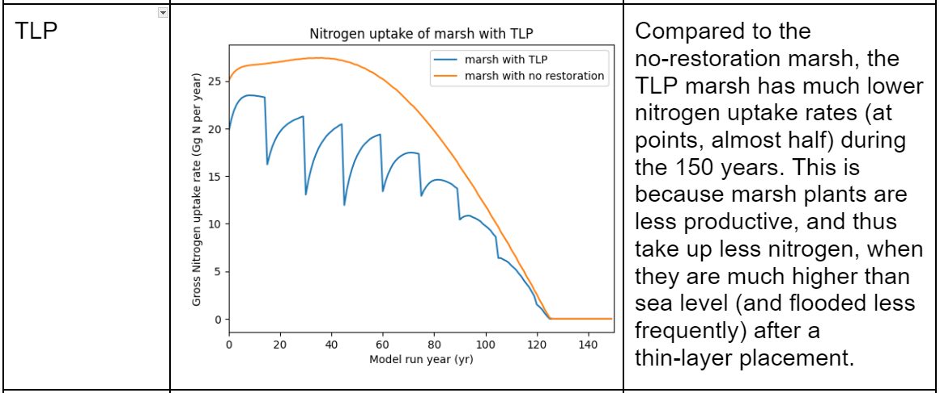
Ecosystem Services
Threats to Salt Marshes
Marsh Restorations
Computer Modeling
Your Job

Slide 72
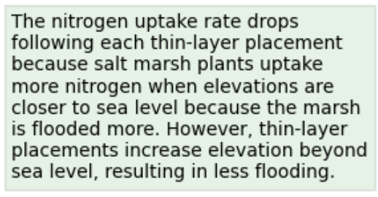
Ecosystem Services
Threats to Salt Marshes
Marsh Restorations
Computer Modeling
Your Job

Slide 73
Ecosystem Services
Threats to Salt Marshes
Marsh Restorations
Computer Modeling
Your Job

Slide 74
Ecosystem Services
Threats to Salt Marshes
Marsh Restorations
Computer Modeling
Your Job
If this was your marsh AND you were only deciding between sill vs TLP AND you were only managing for water quality (no other ecosystem services), which restoration would you ultimately recommend?

Slide 75
Ecosystem Services
Threats to Salt Marshes
Marsh Restorations
Computer Modeling
Your Job
If this was your marsh AND you were only deciding between sill vs TLP AND you were only managing for water quality (no other ecosystem services), which restoration would you ultimately recommend?
You should recommend the sill because it improves water quality more than the no restoration marsh and the TLP marsh

Slide 76
Ecosystem Services
Threats to Salt Marshes
Marsh Restorations
Computer Modeling
Your Job
Numerical model:
a simplification of a real-world system
uses equations to simulate a response to changing conditions
Link to model, https://tinyurl.com/yc533cj6, so we can review the format and instructions together.
*Read all the instructions in your instruction guide!
Photo information: Core Banks, NC; taken by John Buie, under Creative Commons Attribution 2.0 Generic license.

Slide 77
Ecosystem Services
Threats to Salt Marshes
Marsh Restorations
Computer Modeling
Your Job
Fill out #5–9 on your handout
You are a marsh manager! But where? Choose your marsh…
  Discuss with your partner which marsh you want to manage (using the map). Once decided, raise your hand and your teacher will bring around a handout to learn about your marsh.
Your task? Figure out how to save your struggling marsh’s ecosystem services
1
4
UNITED STATES
3
2
Kelps
Mangroves
Salt Marshes
Seagrasses
Image credit: modified from Kiss Veronica, under Creative Commons Attribution-Share Alike 4.0 International license
given site conditions, which restoration(s) will save your marsh?

