Slide 1
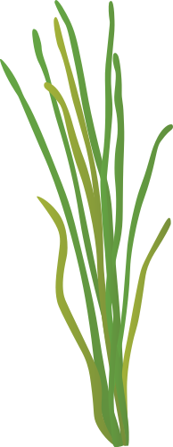
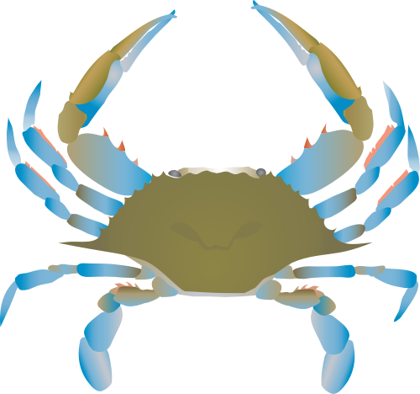
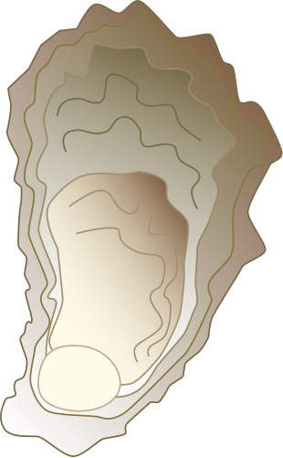
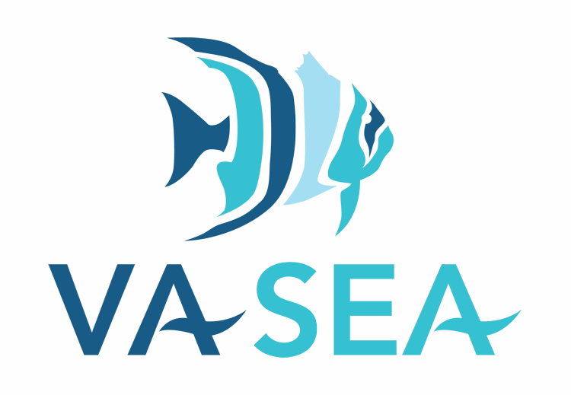

Chesapeake Bay Life Cycles

Slide 2
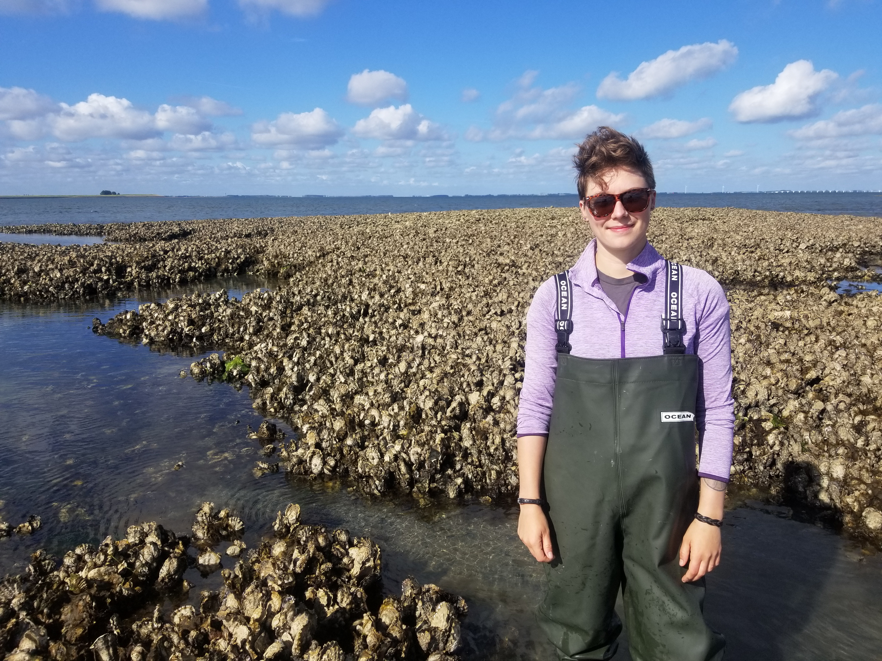
Meet the Scientist!
Hi! My name is Alex!
I am an invertebrate ecologist at the Virginia Institute of Marine Science.
I study invertebrates, like oysters and clams, in the Chesapeake Bay.
Notes:
Suggested Narration:
- Alex is originally from Seattle, WA . She went to college in Oregon and is now getting her PhD at Virginia Institute of Marine Science.
-Invertebrate ecologists study how animals without bones live and interact with their environment. Alex currently studies oyster in the Chesapeake Bay.
-This photo is Alex standing next to an oyster reef in Europe!
Image credit:
Alex Marquardt

Slide 3
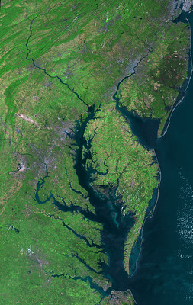
Chesapeake Bay
Biggest estuary in the United States
Many places for plants and animals to live
Ecosystems are the living and non-living things
Notes:
Suggested Narration:
- The Chesapeake Bay is the largest estuary in the United States. Do you know what an estuary is?
[Pause for students to answer]
- An estuary is where fresh water from rivers and salty water from oceans mix
-The mixing creates many places for plants and animals to live because it is very salty near the ocean and very fresh in the upper rivers
-Ecosystems are all the living and non living things in an area. So that’s all the plants, animals, and the conditions in the Chesapeake Bay estuary
Image credit:
NASA/USGS/Landsat 5

Slide 4
What plants and animals live in the Chesapeake Bay?
Notes:
Suggested Narration:
What plants and animals do you know that live in the Chesapeake Bay?
[Allow students to come up with a few ideas]

Slide 5
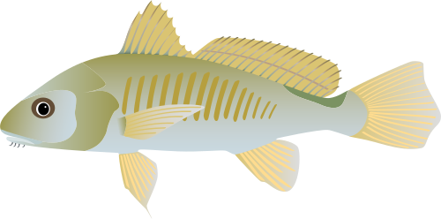
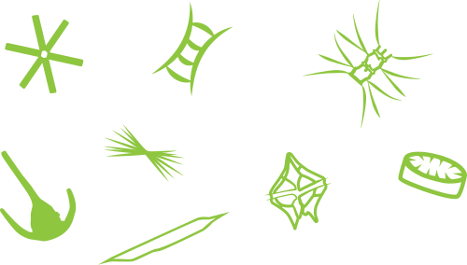
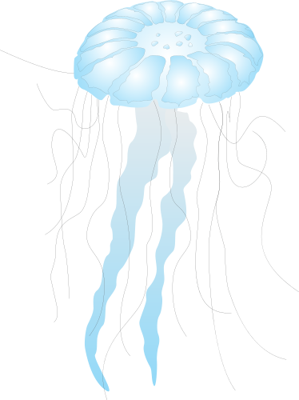
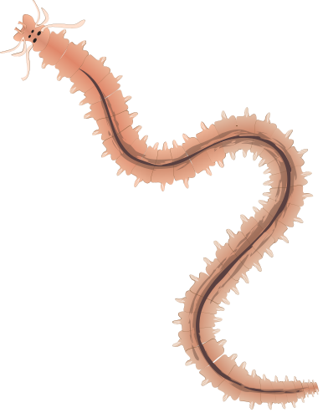
What plants and animals live in the Chesapeake Bay?
Fish
Algae
Oysters
Eelgrass
Blue crab
Jellyfish
Worms
Notes:
Suggested Narration:
-Excellent ideas!!
-Many plants and animals live in the Bay. Some neat examples include:
-For animals:
Fish that swim
Worms that live in or on the bottom of the river
Jellyfish that float in the water
Oysters that grow on top of each other in clumps
and Blue crabs which live in many places in the estuary
-For plants:
Eelgrass which grows in beautiful meadows, like a big lawn of grass
Algae which like plants, but are teeny, tiny and float in the water. Algae are very important as food for many animals
-Today we are going to learn about the how some of these plants and animals live in the Chesapeake Bay.
Image Credit:
Oyster, phytoplankton community: Tracey Saxby, Integration and Application Network (ian.umces.edu/media-library)
Blue crab: Jane Thomas, Integration and Application Network (ian.umces.edu/media-library)
Jelly fish, polychaete: Dieter Tracey, Marine Botany UQ (ian.umces.edu/media-library)
Eelgrass: Annie Carew, Integration and Application Network (ian.umces.edu/media-library)
Fish: Jane Thomas, Integration and Application Network (ian.umces.edu/media-library)

Slide 6
What plants and animals live in the Chesapeake Bay?
Fish
Algae
Oysters
Eelgrass
Blue crab
Jellyfish
Worms
Notes:
Suggested Narration:
-We will focus on the eelgrass, oysters, and blue crabs!
Image Credit:
Oyster, phytoplankton community: Tracey Saxby, Integration and Application Network (ian.umces.edu/media-library)
Blue crab: Jane Thomas, Integration and Application Network (ian.umces.edu/media-library)
Jelly fish, polychaete: Dieter Tracey, Marine Botany UQ (ian.umces.edu/media-library)
Eelgrass: Annie Carew, Integration and Application Network (ian.umces.edu/media-library)
Fish: Jane Thomas, Integration and Application Network (ian.umces.edu/media-library)

Slide 7
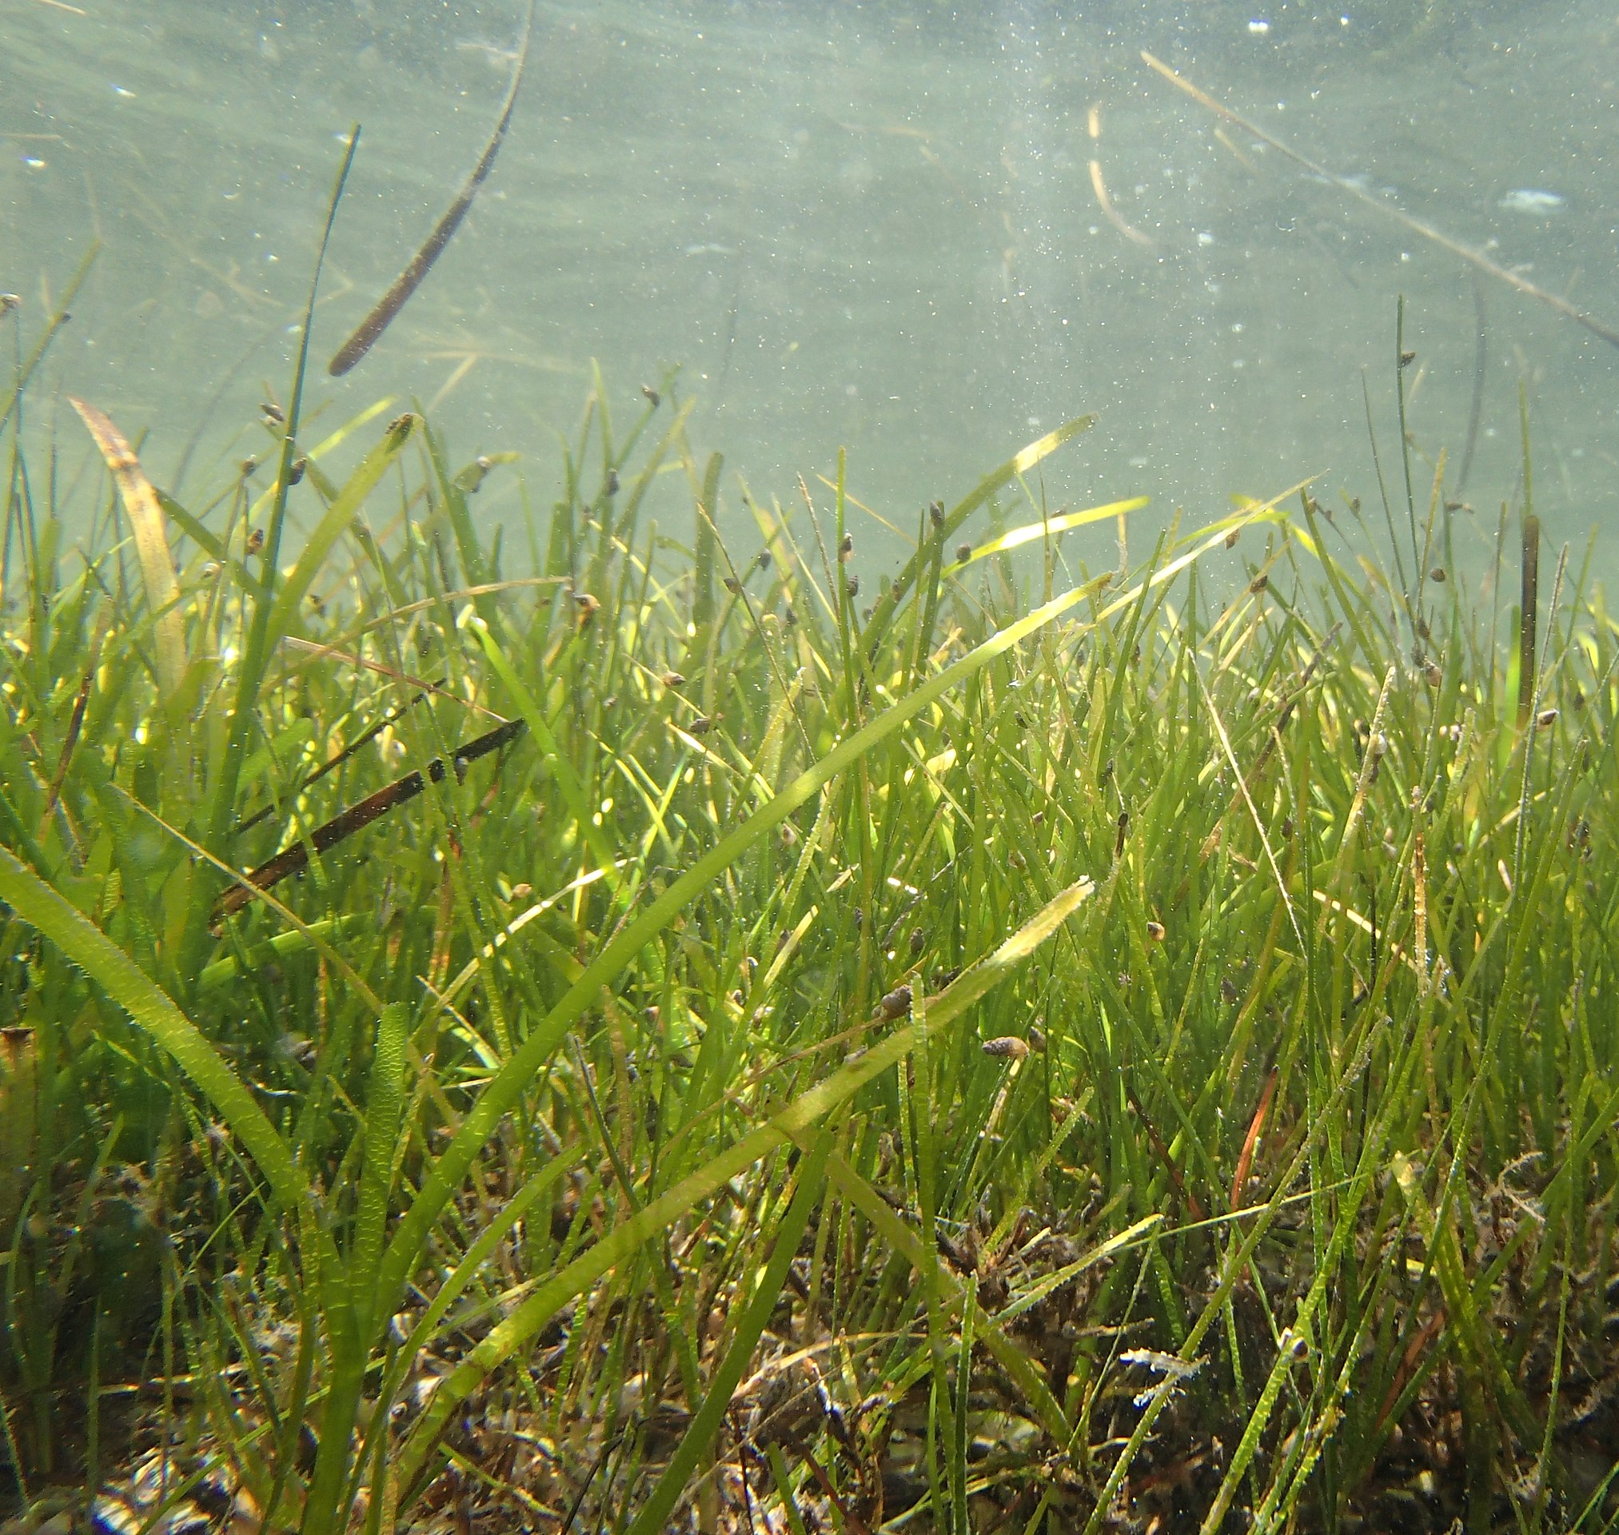
Eelgrass
Plant in Chesapeake Bay
Gains energy from sunlight
Grows in a meadow under water
Provides habitat for other animals
Notes:
Suggested Narration:
-Starting with eelgrass…
-Eelgrass is a plant found in the Chesapeake Bay.
-Like other plants, they get their energy from the sun
-They will grow in meadows, just like grasses on land (just like grass on the playground)
-They are important habitat for many animals in the Bay, including blue crabs
Image Credit:
Eelgrass: Sofia Sadogurska, Creative Commons 4.0 2020

Slide 8
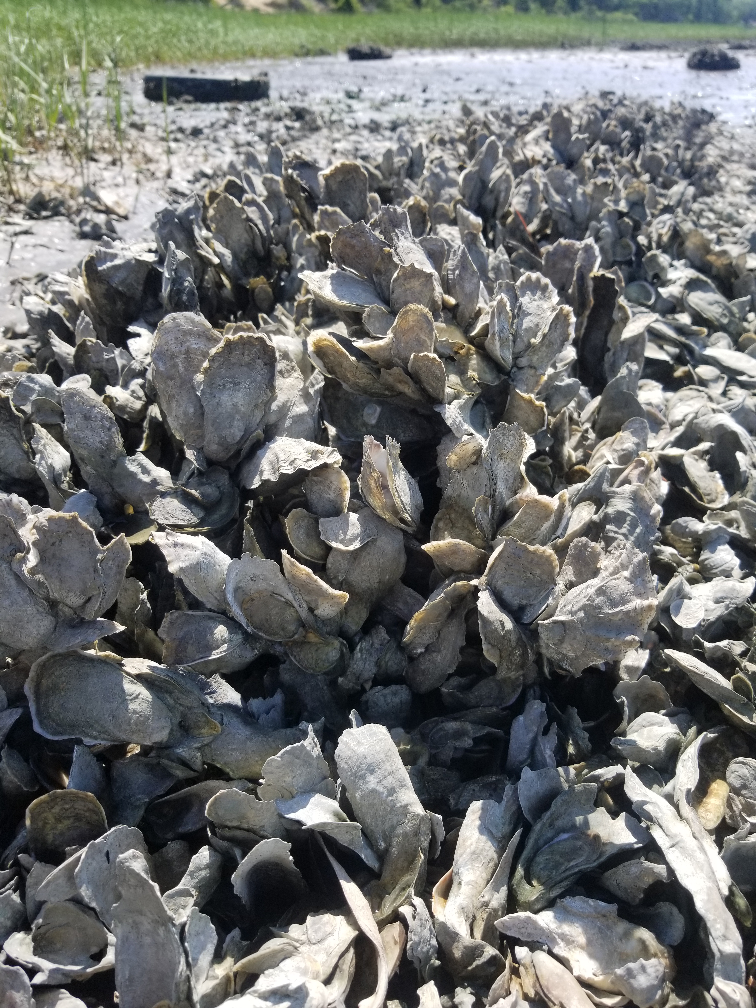
Oyster
Invertebrate in Chesapeake Bay
Attach to each other to make oyster reefs
Filters water, protects shore, and is prey for animals (humans too!)
Provides habitat for other animals
Notes:
Suggested Narration:
-Next up is oysters!
-Oysters are a type of invertebrate. As we talked about earlier, invertebrates are animals that don’t have bones
-Oysters attach to each other and grow in clumps like you see in the photo
Groups of oysters living together are called oyster reefs
-Oysters do many things in the Chesapeake Bay
Help keep the bay clean by filtering water
Help protect the shore and beaches by slowing down waves
They are important food sources for many animals – including humans
And they create habitat by growing in clumps – you can see there are lots of spaces for other animals to hide between them
Blue crabs will use oyster reefs as adults to look for things to eat
Image Credit:
Oyster cluster: Alex Marquardt

Slide 9
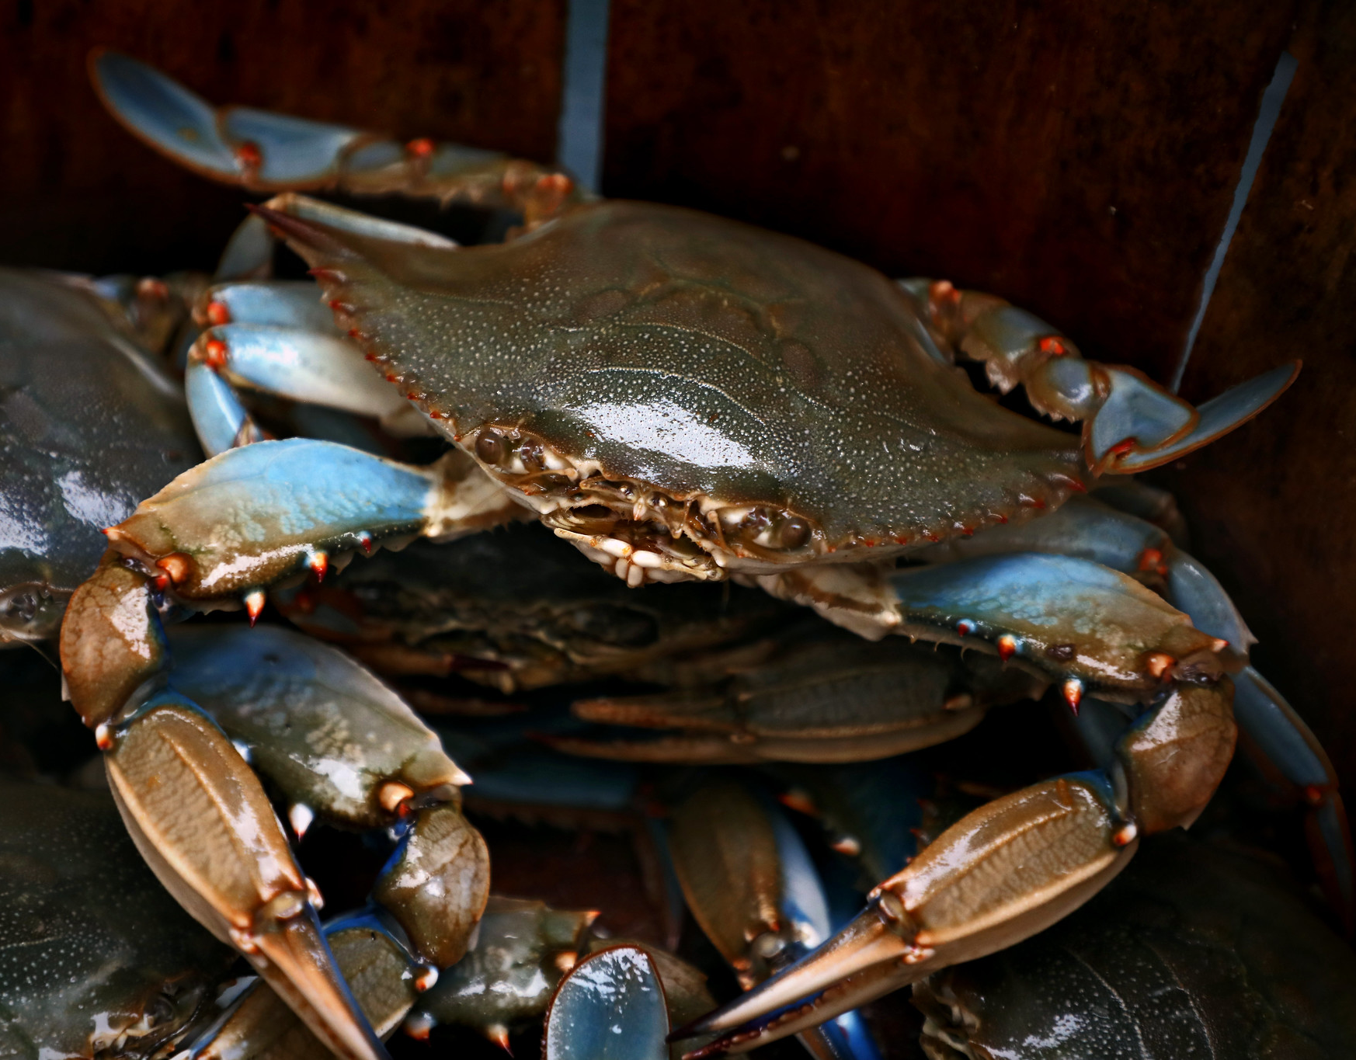
Blue Crab
Invertebrate in Chesapeake Bay
Uses many habitat types
Important predator
Eaten by humans
Notes:
Suggested Narration:
-Last is the blue crab!
-Blue crabs are also invertebrates in the Chesapeake Bay
-To grow, crabs have to shed their shell. This action is called molting.
-They are important predators in the Bay and eat many kinds of animals
-Humans fish for blue crabs to eat them
[next slide]
Image Credit:
Blue crab: Aileen Devlin, Virginia Sea Grant

Slide 10
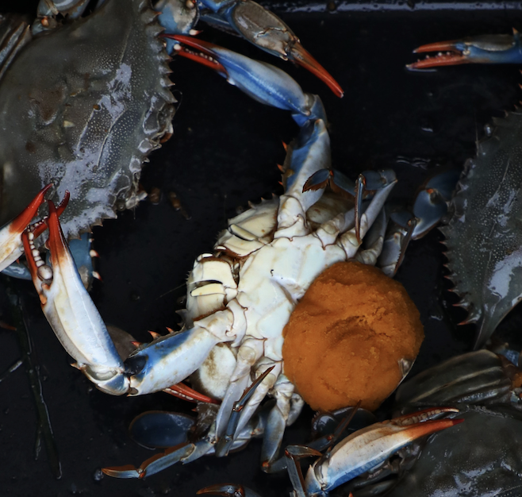
Blue Crab
Invertebrate in Chesapeake Bay
Uses many habitat types
Important predator
Eaten by humans
Notes:
Suggested Narration:
-Female blue crabs carry eggs on the underside
-Kind of looks like a big orange sponge doesn’t it?
-Our class activity will explore the life cycle of eelgrass, oysters, and blue crabs
Image Credit:
Blue crab: Aileen Devlin, Virginia Sea Grant

Slide 11

Activity 1: Life cycles
You will read about plant and animal life cycles
Use the readings to create the life cycle for eelgrass, oysters, and blue crab
Label the life stages
Notes:
Teacher may choose to have students work independently or in groups of 3.
Provide eat group (or student) with a set of life cycle stories (eelgrass, oyster, and blue crab), three blank life cycle worksheets, a set of life cycle stage sheets. Life stage sheets should be cut in half by the teacher, but students can cut out the individual stages.
Groups will use the readings to build the life cycles and learn new vocabulary.
Image credit:
Book graphic: Boca Tutor 2016

Slide 12
Activity 1: Discussion
How does eelgrass gain energy? Does that change through the life cycle?
How do oysters gain energy? Does what they eat change over their life cycle?
How do blue crabs gain energy? Does what they eat change over their life cycle?
Notes:
Key to discussion questions:
How does eelgrass gain energy? Does that change through the life cycle?
Answer: Eelgrass uses photosynthesis throughout the life cycle to gain energy from sunlight
How do oysters gain energy? Does what they eat change over their life cycle?
Answer: Oysters gain energy by filtering and consuming algae. They eat algae throughout the life cycle.
How do blue crabs gain energy? Does what they eat change over their lifetime?
Answer: Blue crabs gain energy by eating a variety of food items. During the larval stage, they will eat algae. When they grow to young or adult crabs, they transition to eating plants and other animals, such as fish, clams, oysters, and more.

Slide 13
Activity 1: Discussion
What would a general life cycle look like?
Notes:
Key to discussion questions:
If we were to make a general life cycle, what would it look like?
Answer: Teacher should walk students through creating a ‘model life cycle’ with stages for birth, growth, and reproduction. Death may happen at any time in the life cycle. Example below, but teachers may modify.

Slide 14
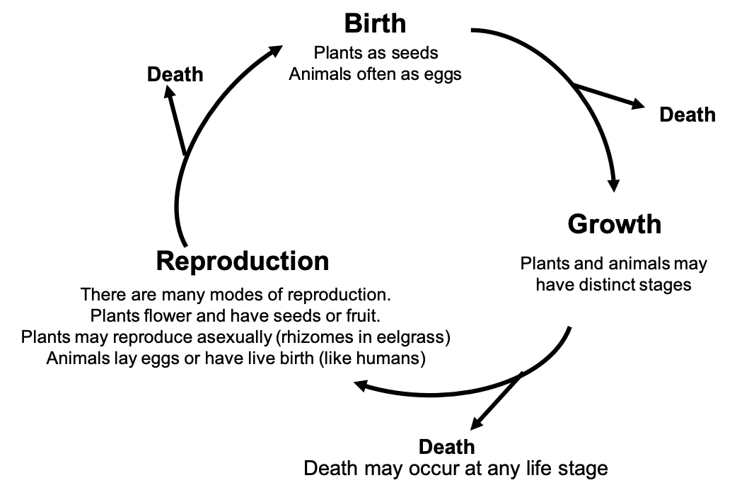
Instructor Reference
Notes:
Walk the class through creating a “model life cycle” with stages for birth, growth, and reproduction. Death may happen at any point in life cycle. Teachers may modify as needed
Image credit:
Model life cycle: Alex Marquardt

Slide 15
Blue Crab
Invertebrate in Chesapeake Bay
Important predator in the Bay and eaten by humans
Uses many habitats
Where do blue crabs live?
Notes:
Suggested Narration:
Let’s review blue crabs!
Blue crabs are an invertebrate and don’t have bones.
They are important predators in the bay and eat many different things.
Humans love to eat them too!
Blue crabs use many habitats in the Chesapeake Bay
Can anyone tell me where blue crabs live?
[If activity 1 was completed, students should know the answer. If not, they may not know and you can proceed to the next slide]
Image Credit:
Blue crab: Aileen Devlin, Virginia Sea Grant

Slide 16
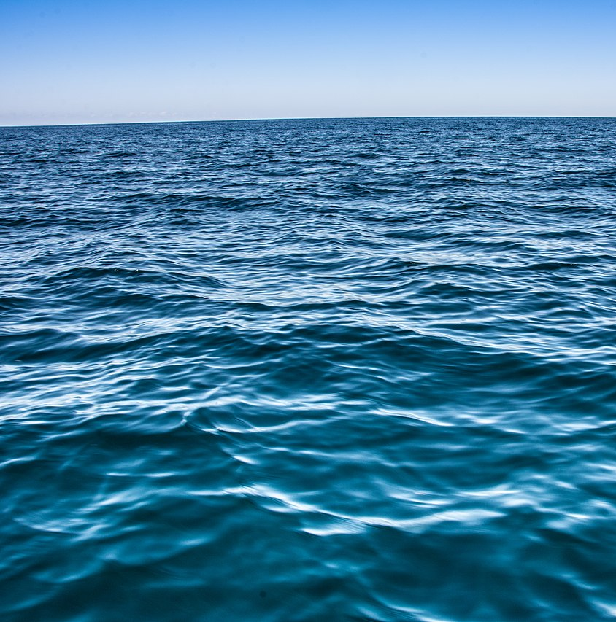
Eelgrass
Oyster reefs
Ocean
Notes:
Suggested Narration:
Blue crabs will use many habitats, but some are extra important.
Eelgrasses are habitats used by young crabs
Oyster reefs are habitats used by adults to look for food
Oceans are used for young larval crabs to grow
Image Credit:
Eelgrass: Sofia Sadogurska, Creative Commons 4.0 2020
Oyster cluster: Alex Marquardt
Ocean: apasciuto Creative Commons 2.0 2021

Slide 17
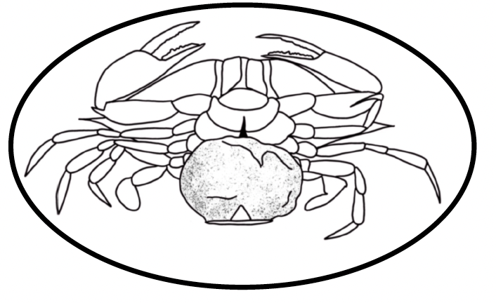
Blue Crab Life Cycle
Adult
Notes:
Suggested Narration:
Female blue crabs carry eggs to saltier water near the ocean.
Image Credit:
Oyster stages: Alex Marquardt

Slide 18
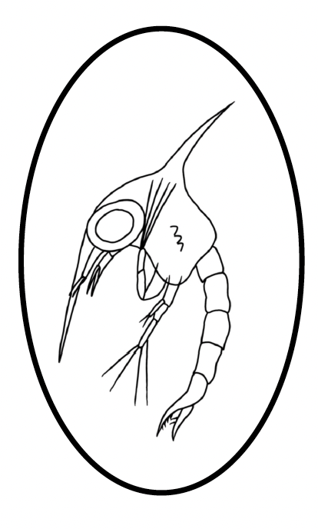
Blue Crab Life Cycle
Zoeae
Adult
Notes:
Suggested Narration:
When the eggs are ready, they hatch a zoeae.
Zoeae grow in the ocean and feed on algae. (Algae which like plants, but are teeny, tiny and float in the water.)
To grow, they have to shed their shell (also called molting)
Image Credit:
Oyster stages: Alex Marquardt

Slide 19
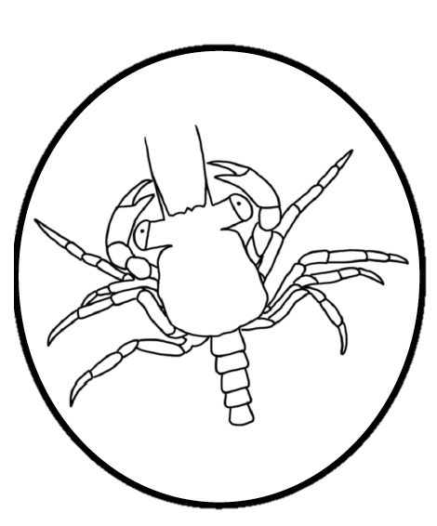
Blue Crab Life Cycle
Zoeae
Adult
Megalope
Notes:
Suggested Narration:
The ocean will carry the crab back to the estuary.
They change to megalope, which look more like a crab
Image Credit:
Oyster stages: Alex Marquardt

Slide 20
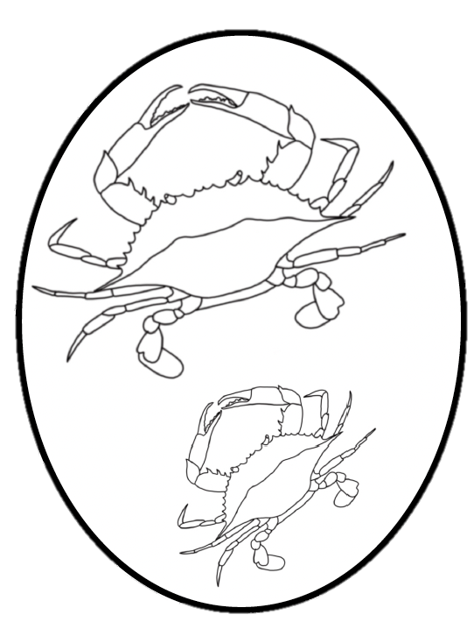
Blue Crab Life Cycle
Zoeae
Adult
Young
Megalope
Notes:
Suggested Narration:
They will eat, molt, and grow in eelgrass habitats while young crabs
Once they are large adults, they will move into other areas of the estuary
Eventually, females will bring their own eggs back to the ocean
Image Credit:
Oyster stages: Alex Marquardt

Slide 21
Blue crab population
Notes:
Suggested Narration:
One thing we notice is that blue crabs use habitats that are other living plants and animals.
All the blue crabs in an area are a population
Image Credit:
Blue crab: Jane Thomas, Integration and Application Network (ian.umces.edu/media-library)

Slide 22
Eelgrass population
Blue crab population
Oyster population
Notes:
Suggested Narration:
There are also populations of oysters and eelgrass in the ecosystem
Image Credit:
Oyster: Tracey Saxby, Integration and Application Network (ian.umces.edu/media-library)
Blue crab: Jane Thomas, Integration and Application Network (ian.umces.edu/media-library)
Eelgrass: Annie Carew, Integration and Application Network (ian.umces.edu/media-library)

Slide 23
Community
Notes:
Suggested Narration:
All of these together are called a community
Image Credit:
Oyster: Tracey Saxby, Integration and Application Network (ian.umces.edu/media-library)
Blue crab: Jane Thomas, Integration and Application Network (ian.umces.edu/media-library)
Eelgrass: Annie Carew, Integration and Application Network (ian.umces.edu/media-library)

Slide 24

Ecosystem
Notes:
Suggested Narration:
An ecosystem includes all the living things and non living conditions, such as temperature, how salty the water is, how clear the water is
Image Credit:
Oyster: Tracey Saxby, Integration and Application Network (ian.umces.edu/media-library)
Blue crab: Jane Thomas, Integration and Application Network (ian.umces.edu/media-library)
Eelgrass: Annie Carew, Integration and Application Network (ian.umces.edu/media-library)
Salt shaker clip art: Smart Servier, Creative Commons 3.0 2018
Thermometer: Powerpoint clip art

Slide 25
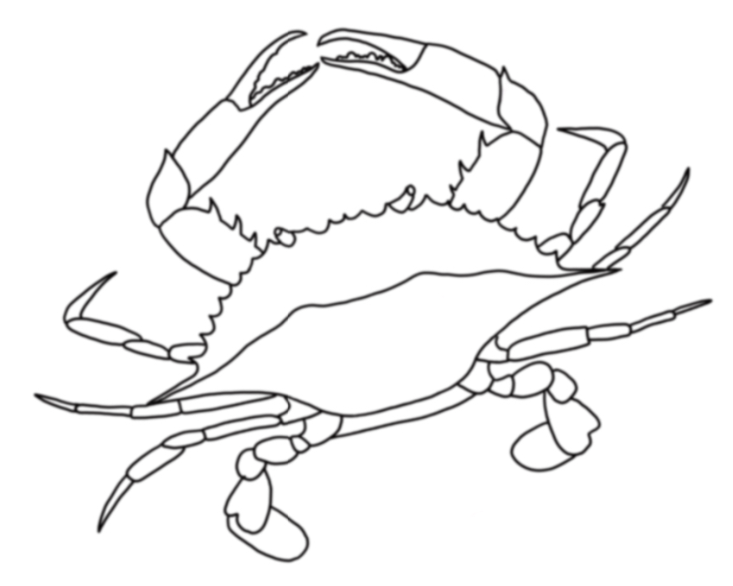
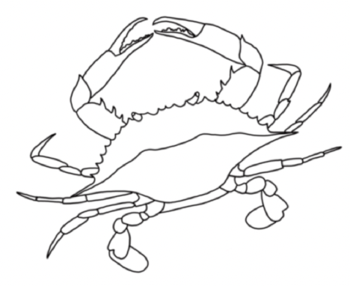
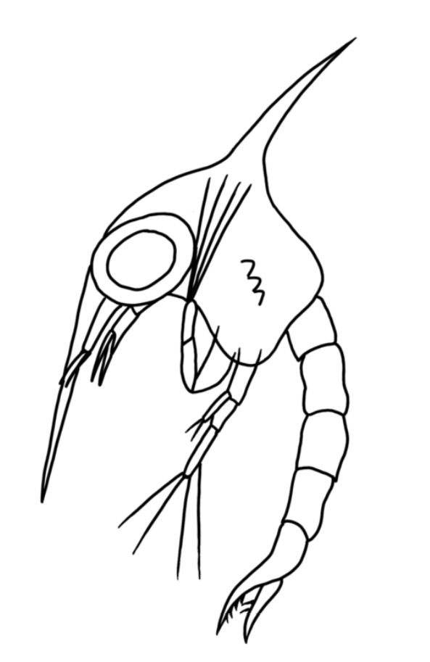
Activity 2: Blue crab game
Act as a blue crab population
Complete the life cycle without getting eaten!
See how population changes
Notes:
Suggested Narration:
Now that we reviewed the life cycle, we are all going to become blue crabs!
Your goal will be to complete the life cycle without getting eaten and we’ll see how the population changes
[next slides are optional to introduce the game mechanics before leaving the classroom. Instructor may go over this in the game space if they’d prefer]
Image credit:
Crab stages: Alex Marquardt

Slide 26
Activity 2: Blue crab game
Eelgrass
Oyster
Ocean
Everyone starts here
as a zoeae!
Notes:
Suggested Narration:
We’re going to go outside/to the gym. There will be there different habitats – ocean, eelgrass, and oyster
Everyone will start as a zoeae in the ocean. The goal is to get through the entire life cycle and grow the crab population

Slide 27
Activity 2: Blue crab game
Eelgrass
Oyster
Get to eelgrass to become a young crab
Ocean
Everyone starts here
as a zoeae!
Notes:
Suggested Narration:
You’ll need to safely make it to the eelgrass habitat first

Slide 28
Activity 2: Blue crab game
Eelgrass
Oyster
Get to eelgrass to become a young crab
Get to oyster reef to become an adult crab
Ocean
Everyone starts here
as a zoeae!
Notes:
Suggested Narration:
Then you’ll need to make it to the oyster reef to eat and grow as an adult

Slide 29
Activity 2: Blue crab game
Eelgrass
Oyster
Get to eelgrass to become a young crab
Get to oyster reef to become an adult crab
Ocean
Everyone starts here
as a zoeae!
Notes:
Suggested Narration:
Then you need to make it to the ocean to tag in two people to join the crab population.
They will need to go to the eelgrass, but you will have to go back and forth between the oyster and ocean habitat to make more crabs

Slide 30
Activity 2: Blue crab game
Eelgrass
Oyster
Get to eelgrass to become a young crab
Get to oyster reef to become an adult crab
Don’t get eaten!
Ocean
Everyone starts here
as a zoeae!
Notes:
Suggested Narration:
BUT! You need to avoid being eaten. There will be a predator running around tagging (eating) crabs.
If you get eaten, you go back to the ocean.
There will limited spaces in each habitat!
Okay let’s go!
[Class questions for between each round of the game are included in the lesson plan. The next slide has bigger picture discussion questions that can be completed either in the game space or back in the classroom]

Slide 31
Activity 2: Discussion
What do we need for healthy blue crab populations?
How do eelgrass populations interact with blue crabs?
How do oyster populations interact with blue crabs?
Notes:
Key to discussion questions:
What do we need for healthy blue crab populations in the Chesapeake Bay?
Answer: A healthy ecosystem, which includes abundant habitat, food, and good environmental conditions!
How do eelgrass populations interact with blue crabs?
Answer: Eelgrasses are plants that provide important habitat for juvenile blue crabs. The grasses provide abundant food and protection from predators.
How do oyster populations interact with blue crabs?
Answer: Oysters are animals that build reefs. The reefs provide habitat for adult blue crabs and abundant food for adults.

