Slide 1


Food Webs – here, there, and everywhere!
Comparing Arctic and Virginian Coastal Food Webs
Ellie Gellerson: efgellerson@vims.edu
VA SEA Lesson Plan
4th Grade Life Science

Slide 2
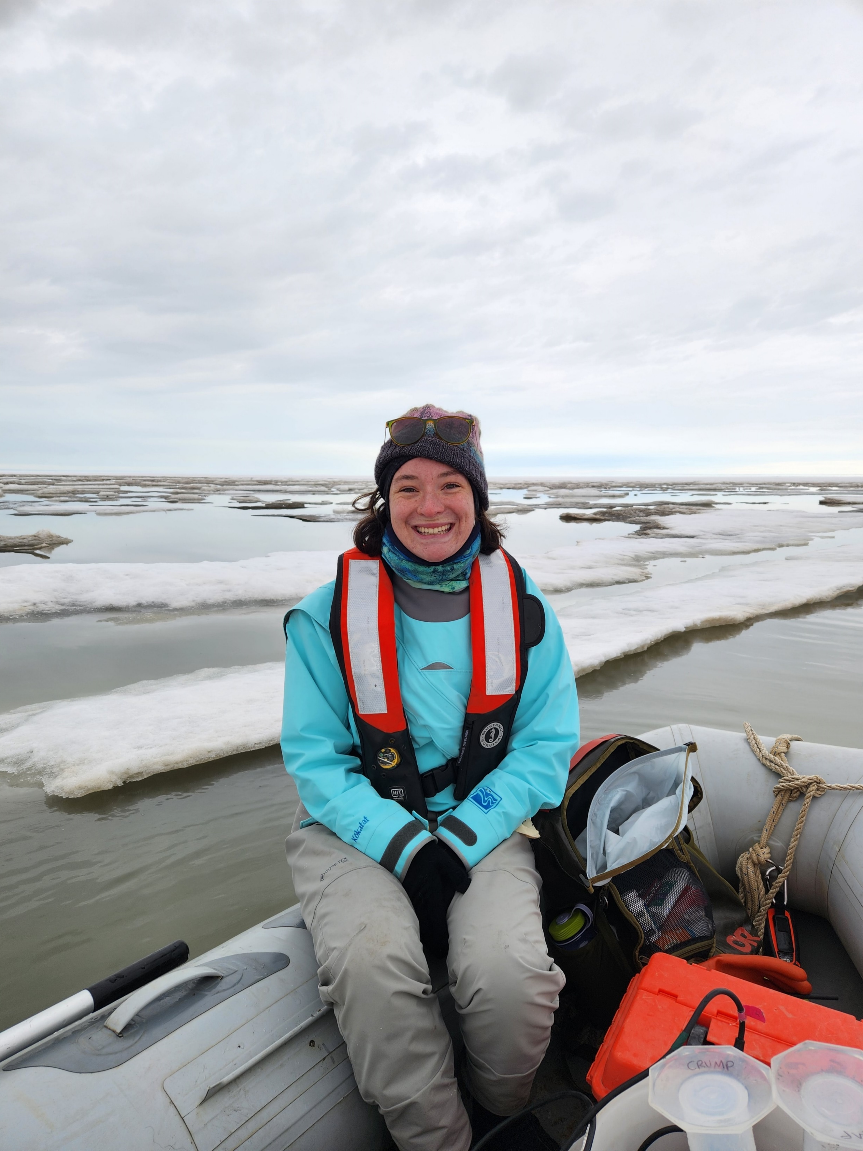
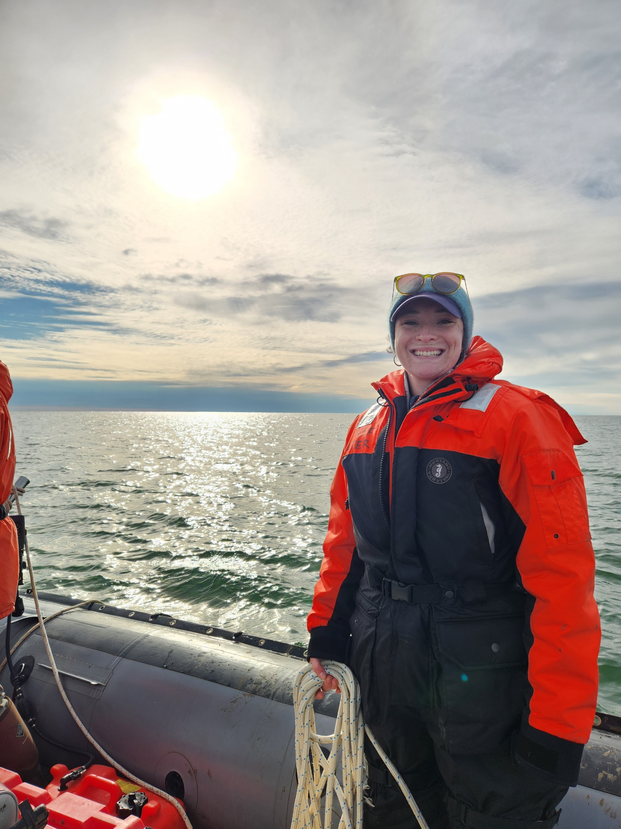
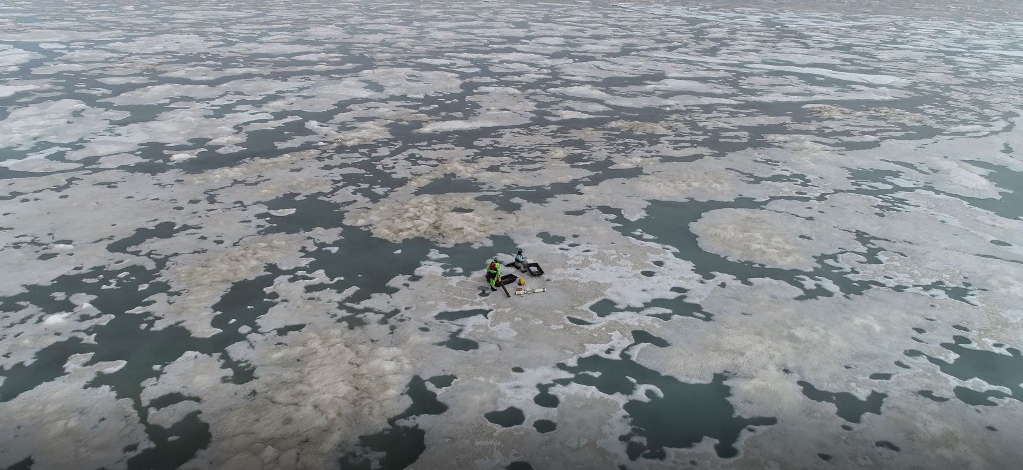
Meet the scientist!
My name is Ellie! I am from Maine.
I am a marine scientist who studies the Arctic. I really love the cold!
I ask questions about sea ice and how the Arctic changes in each season.
I also study phytoplankton – they are very important for food webs!
I love the ocean, and being a scientist, and am excited to share my knowledge with you!
That’s me collecting sea ice!
Image Credits: Ellie Gellerson

Slide 3
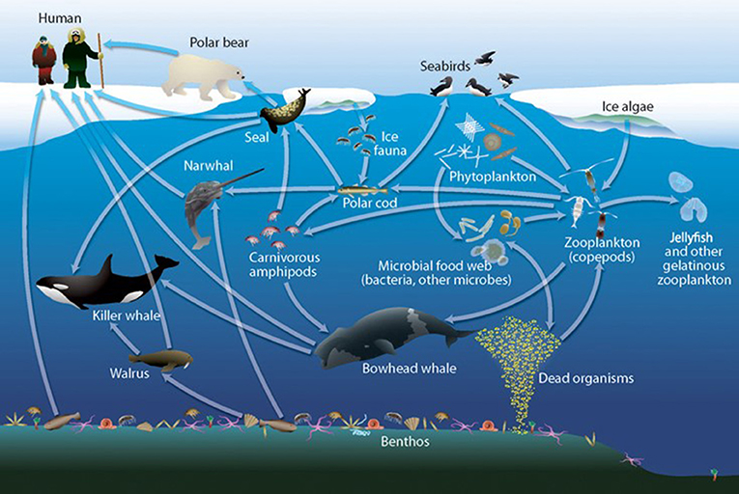
This picture is of a general Arctic food web – what does it make you think of?
I see, I think, I wonder
Take a minute or two to look at the picture
( I SEE….)
2) What does this picture make you think of?
(I THINK….)
3) What questions does it give you? (I WONDER….)
Image Credits: Darnis et al. (2012)
Notes:
Arctic food web, image credit: Darnis et al. (2012)

Slide 4
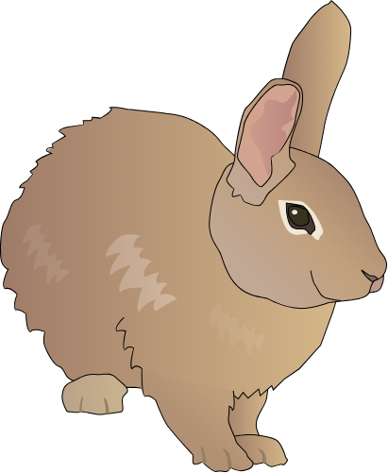
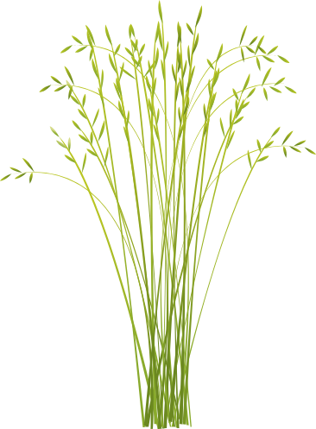
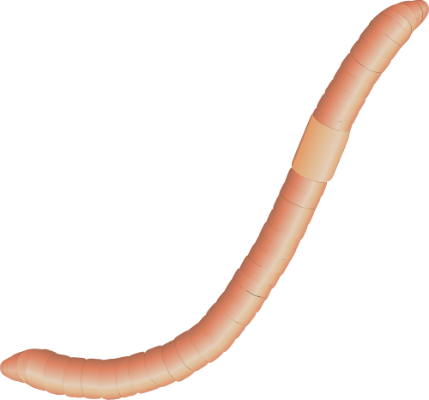
Food webs are made of three groups of organisms
Producers – create their own energy from sunlight.
Consumers – get their energy from eating living plants and animals.
Decomposers – get their energy from dead plants and animals.
Consumer
Food Web Groups
Producer
Decomposer
Image Credits: UMCES Integration and Application Network
Notes:
Ask students if they can think of other examples of each category
Earthworm – Sara Klips, Integration and Application Network, UMCES, Sharealike

Slide 5
The picture you just saw show’s an Arctic marine food web!
Today we’re going to be learning what a food web is, what the parts of a food web are, and how to build our own.

Slide 6
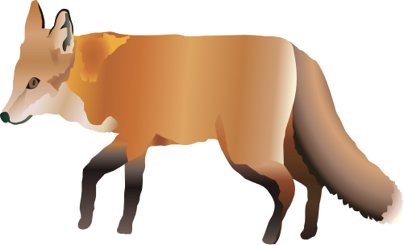

Food webs show the flow of energy through an ecosystem
When one organism consumes another organism, this is a transfer of energy (E)
Bigger consumers typically eat smaller consumers
Arrows show which way energy is moving
E
Consumer
Consumer
E
E
Producer
Image Credits: UMCES Integration and Application Network
Notes:
Grass – Sidney Anderson, Integration and Application Network, UMCES - Sharealike
Rabbit – Tracey Saxby, Integration and Application Network, UMCES – Sharealike
Fox – Kim Kraeer, Lucy Van Essen-Fishman. Integration and Application Network , UMCES - Sharealike
Sun – Jane Thomas, Integration and Application Network, UMCEs, Sharealike

Slide 7
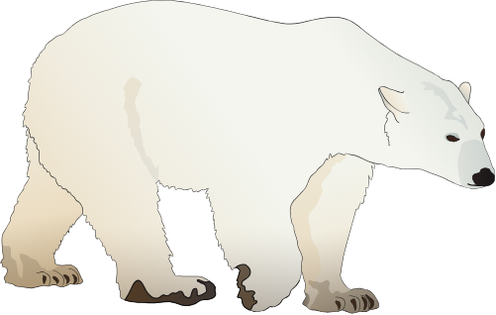
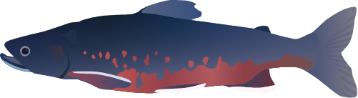
We can also think of food webs as showing predator and prey relationships
Prey – a plant or animal that is eaten by another animal
Predator- an animal that eats or hunts another living thing to get energy
Apex Predator – a consumer that has no predators and is at the top of the food web
Prey
Predator
Prey
Predator
Image Credits: UMCES Integration and Application Network
Notes:
Ask students if they can think of an example other than the examples given on the slide.
Polar Bear – Tracey Saxby, Integration and Application Network, UMCES, Sharealike

Slide 8
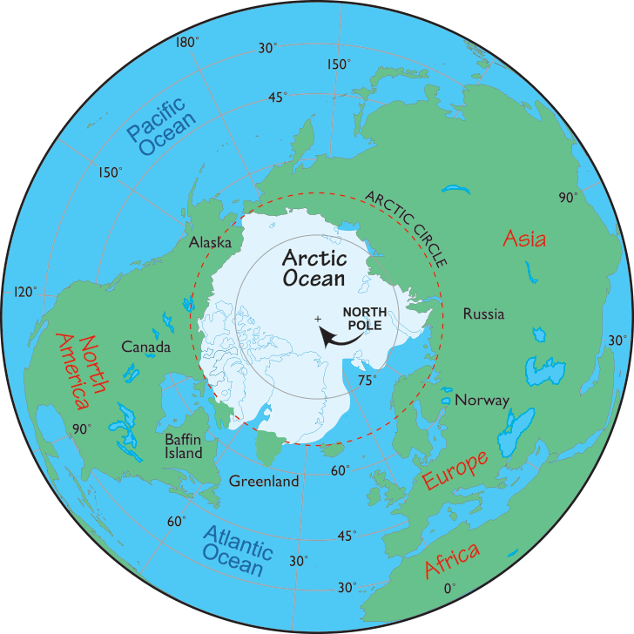
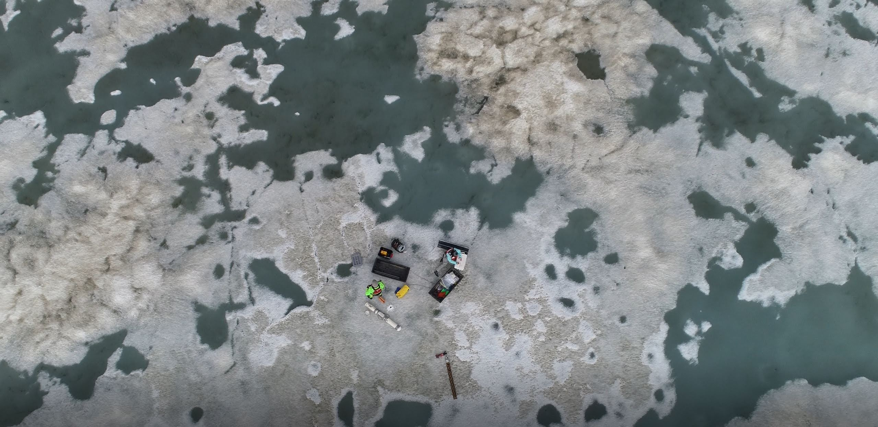
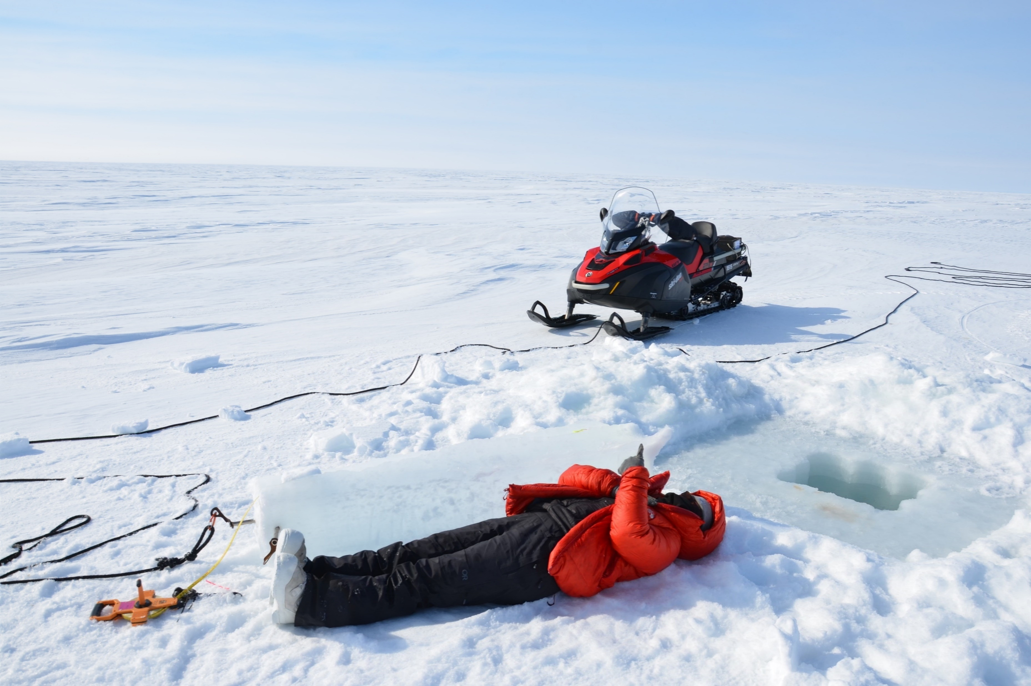
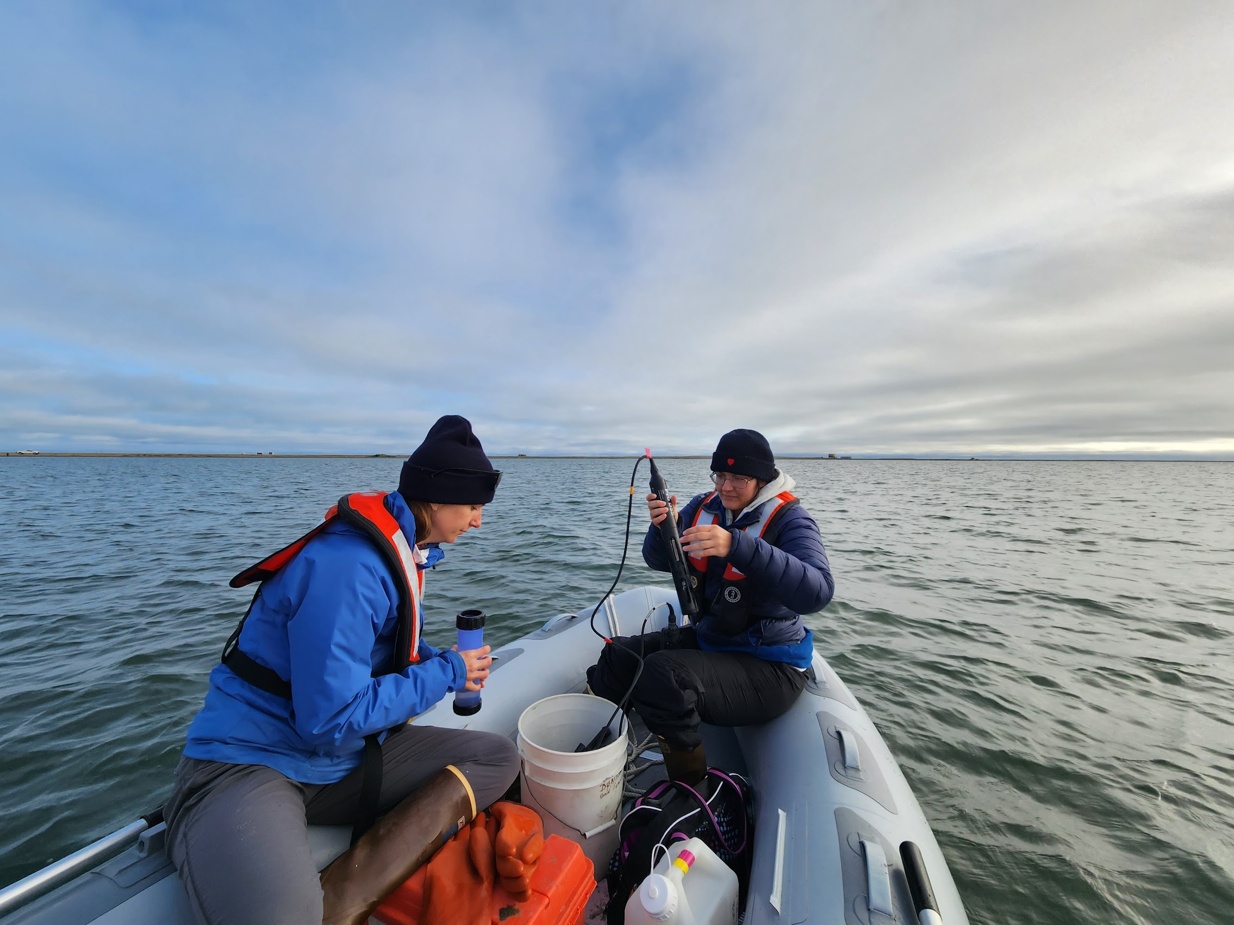
We are going to look at the Arctic coastal food web
Arctic -area around the north pole that is very, very, cold. So cold that sea ice forms in winter!
Spring
Virginia
Winter
Summer
Image Credits: Worldatlas.com, Kenneth Dunton, Ellie Gellerson
Notes:
Ask students if they can think of an example other than the examples given on the slide.
Arctic Map, worldatlas.com, creative commons
SnowMobile- Ken Dunton, BLE-LTER, Personal PermissionBoat Shot – Ellie Gellerson

Slide 9
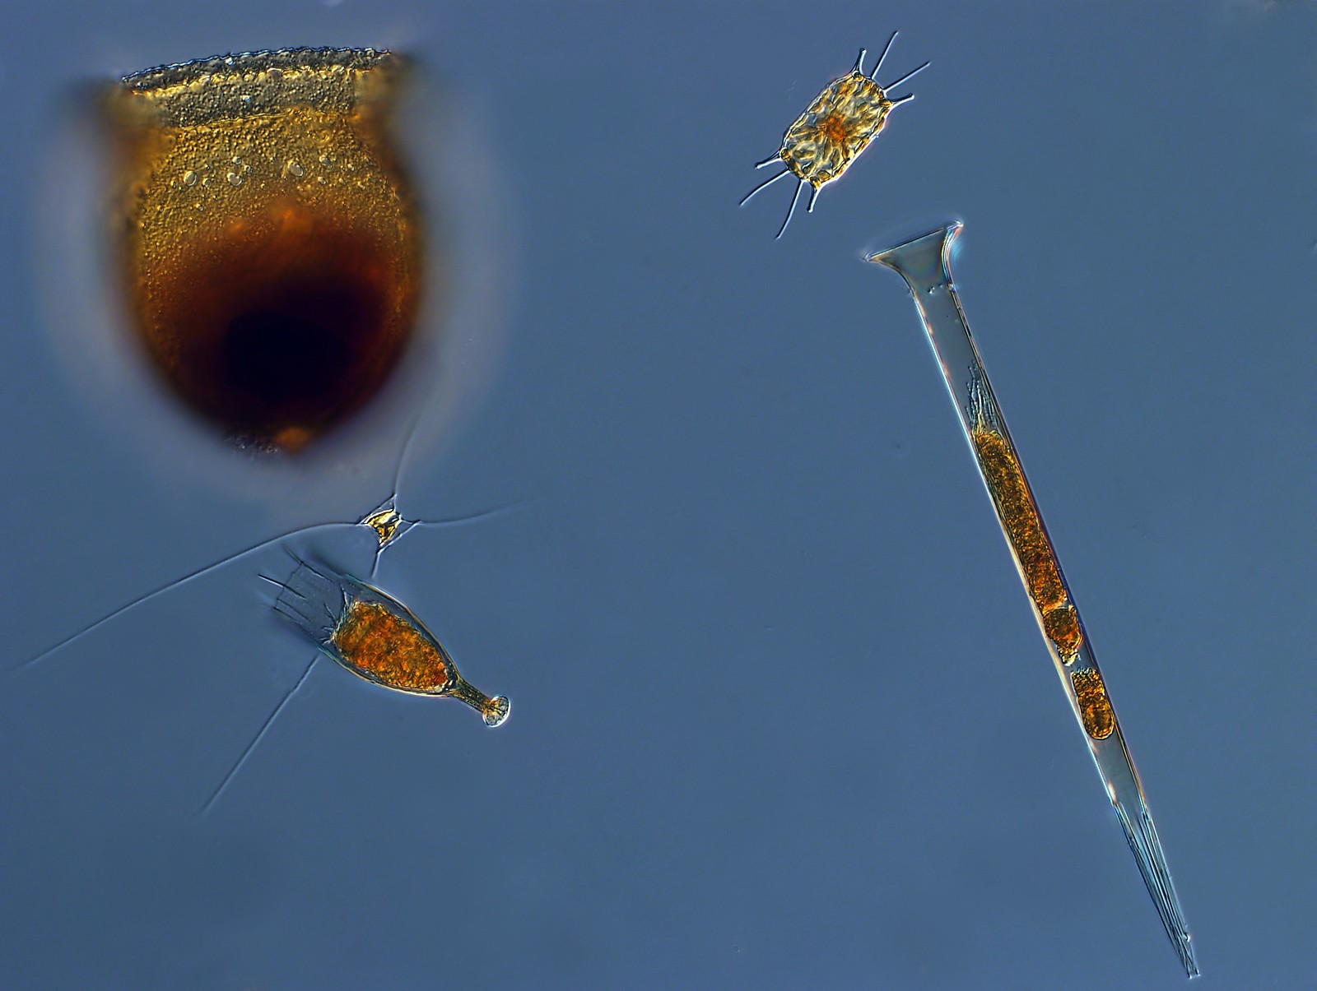
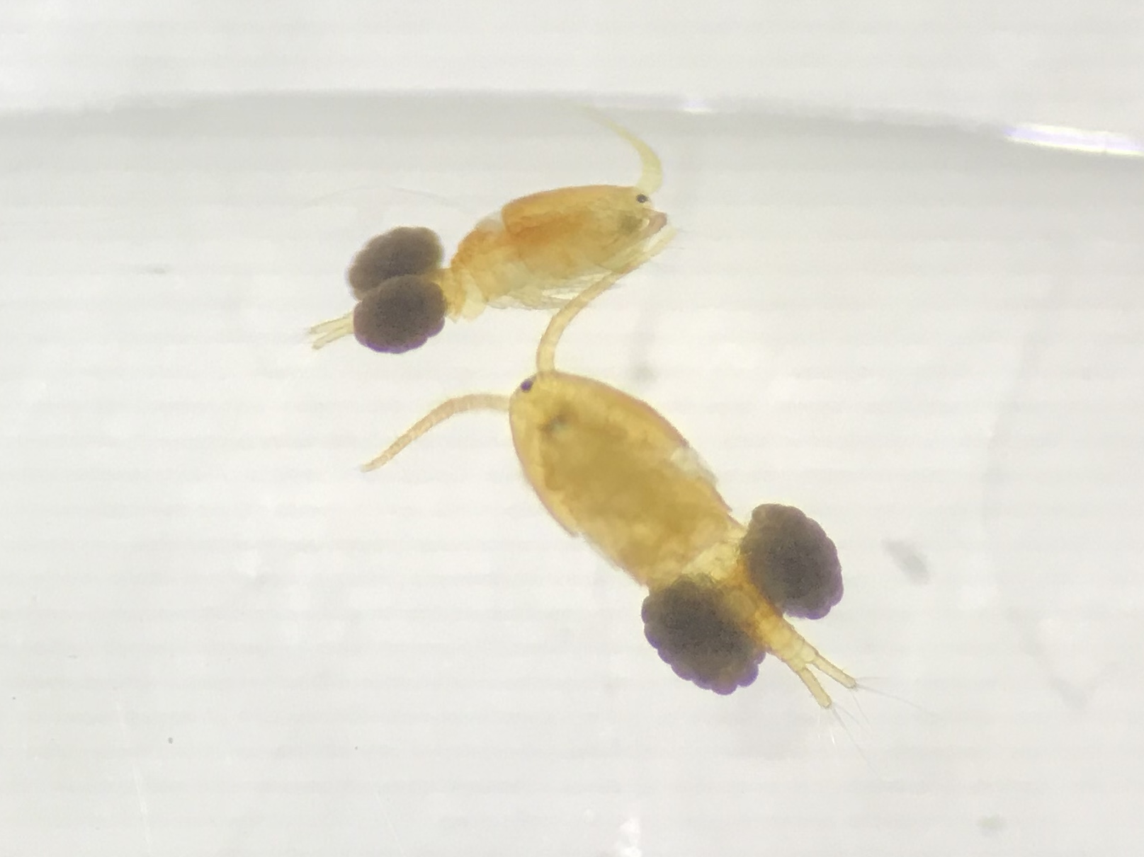
Some producers and consumers are found in all water-based ecosystems
Phytoplankton – microscopic organisms that drift through water and use light and nutrients to create energy
Zooplankton- very small, sometime microscopic, animals that drift through water and consume phytoplankton
Image Credits: Dr. John R. Dolan & Daniel Frasier
Notes:
Ask students if they can think of an example other than the examples given on the slide.
Phytoplankton – Dr. John R. Dolan, Laboratoire d’Oceanographique e Villefranche; Observatoire Oceanologique de Villefrance-sur-Mer, Creative Commons, Attribution 2.0 Generic
Zooplankton – Daniel Fraser, BLE LTER, Personal Permission

Slide 10
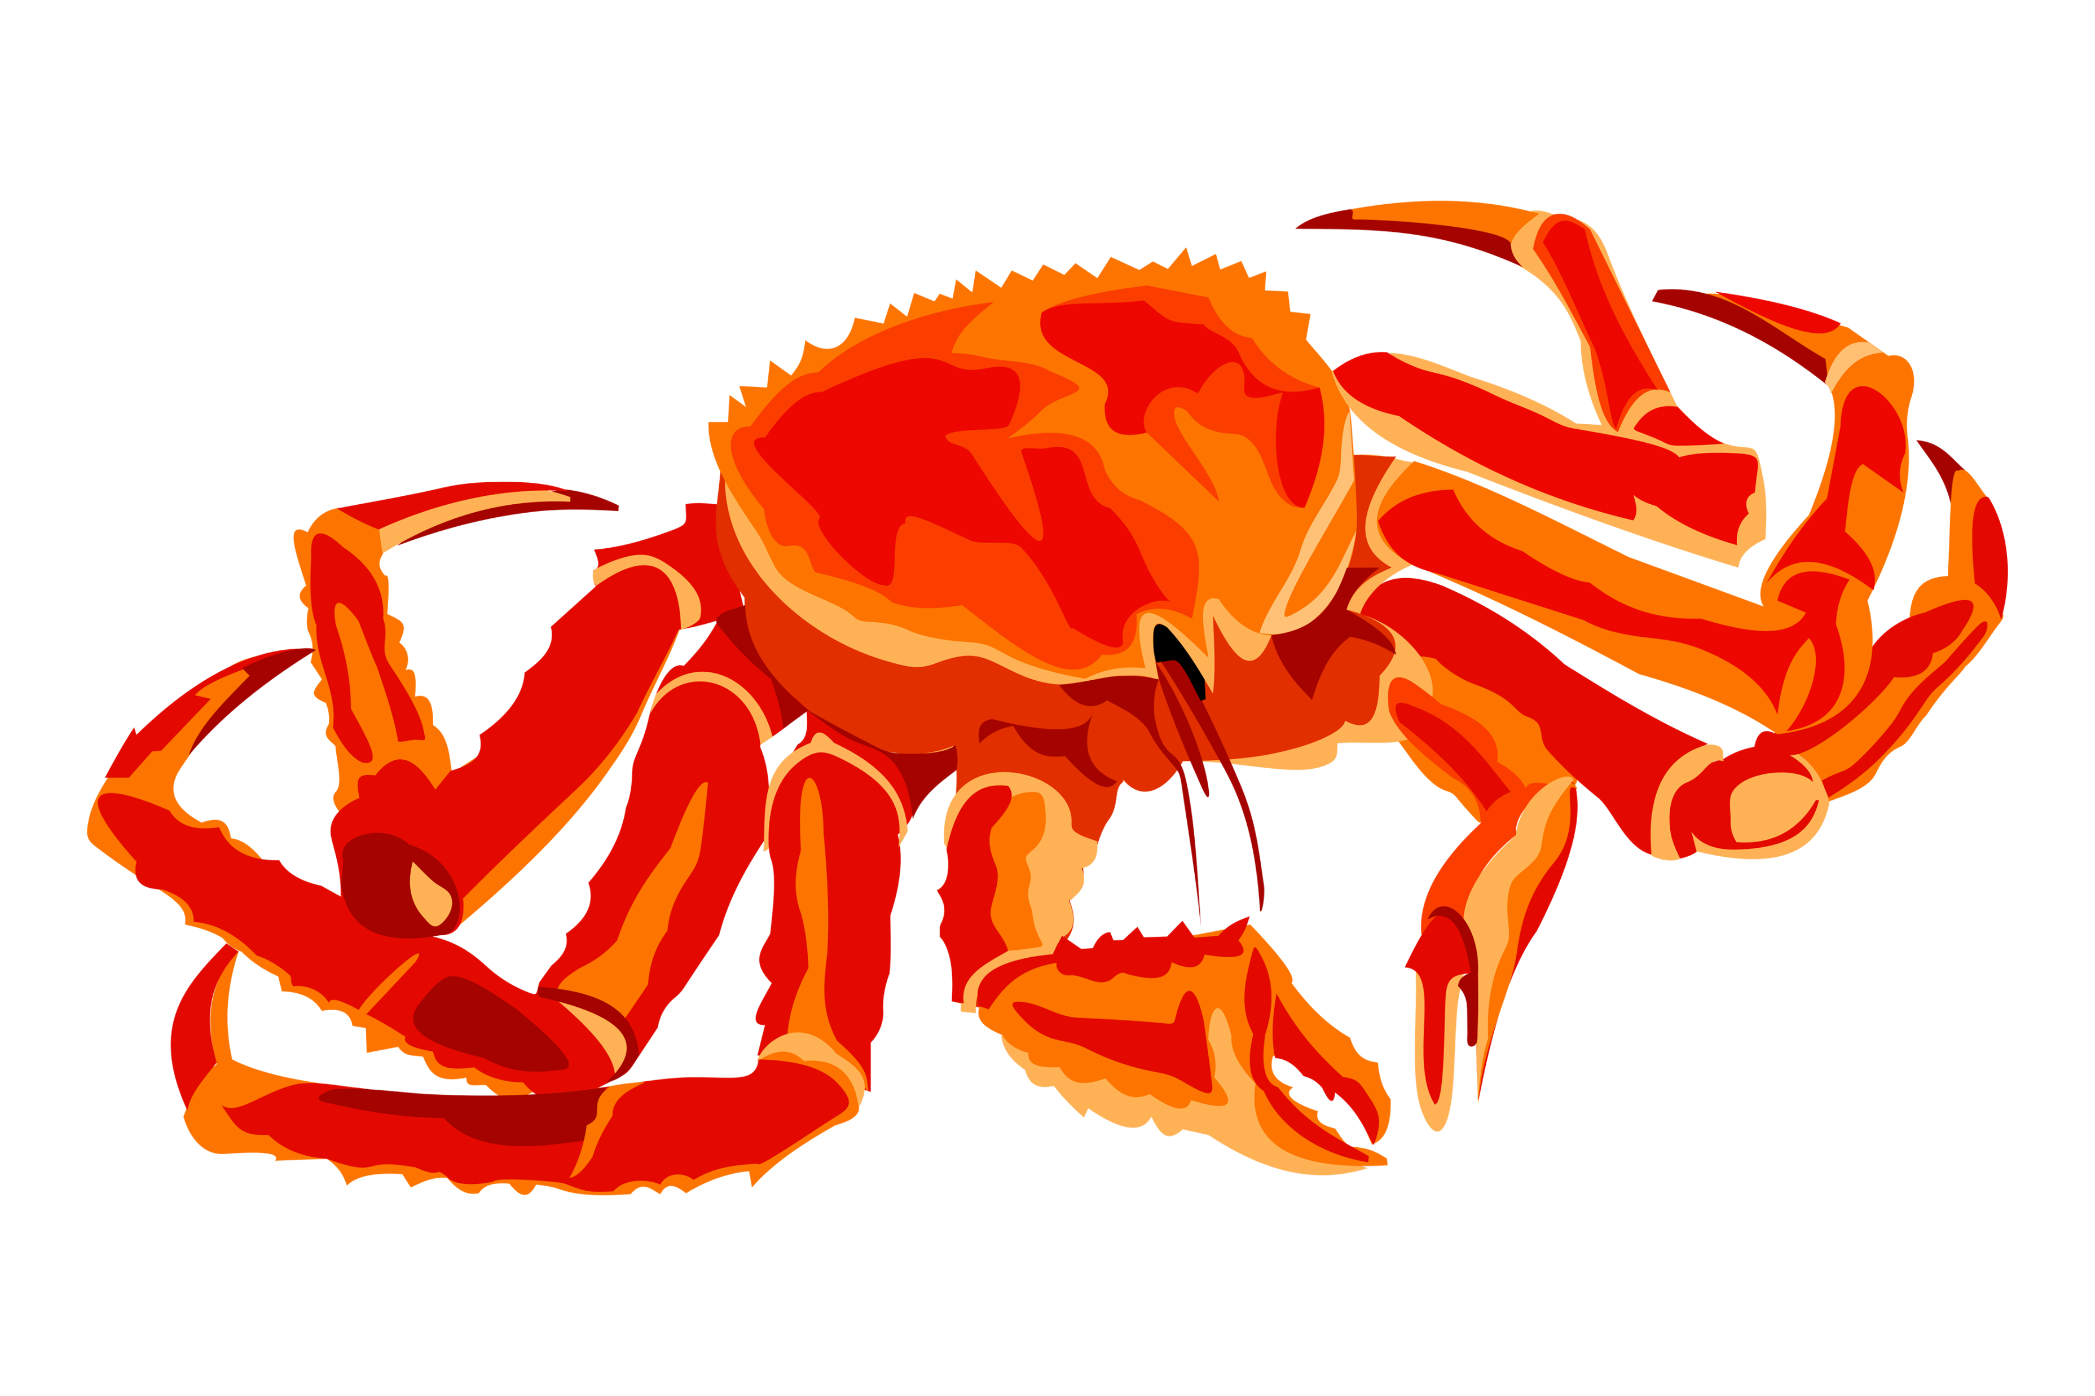
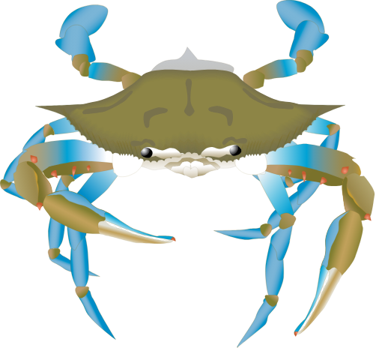
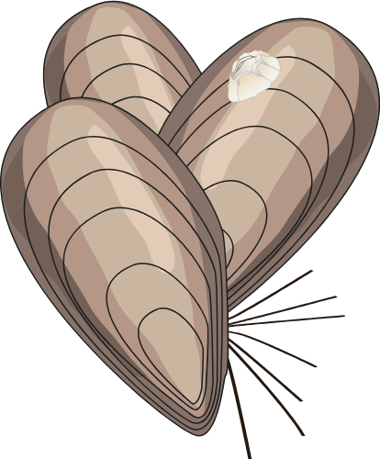
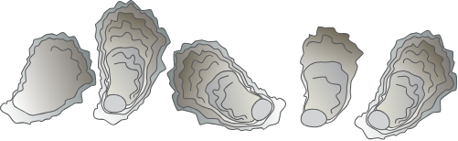
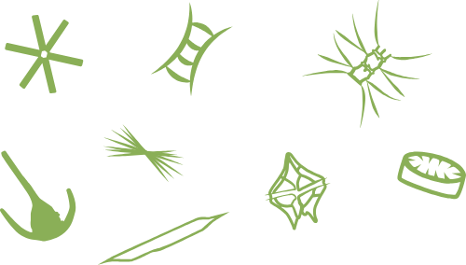
Food webs are structured similarly even in different ecosystems
Arctic
Virginia
Producers are at the bottom of the food chain
Larger organisms consume smaller organisms
Ecosystems have similar, but not the exact same, animals that are in similar spots in food webs.
Snow Crab
Blue Crab
E
E
Blue Mussel
Easter Oyster
E
E
Phytoplankton
Phytoplankton
Image Credits: UMCES Integration and Application Network

Slide 11
Coastal Arctic Food Web
Ice
Water
Sediment
Notes:
Explain that things can live in and on the ice, in the water, and in the sediment

Slide 12
Coastal Arctic Producers
Ice
Phytoplankton
Water
Producers here are phytoplankton that live in the ice, water, and sediment.
They get their energy from __________
Phytoplankton
Sediment
Phytoplankton
Notes:
Explain that things can live in and on the ice, in the water, and in the sediment

Slide 13
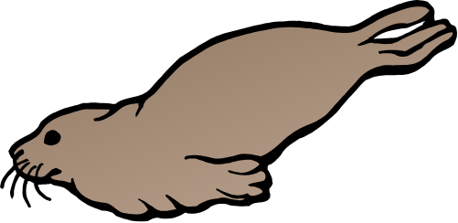

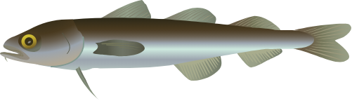
Coastal Arctic Consumers
Polar Bear
Ice
Ice Seals
Water
Zooplankton
Consumers here come in all sorts of shapes and sizes. They live in all 3 habitats.
Arctic Char
Arctic Cod
Sediment
Blue Mussels
Snow Crabs
Notes:
Explain that things can live in and on the ice, in the water, and in the sediment

Slide 14

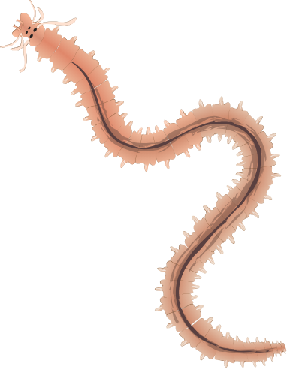
Coastal Arctic Decomposers
Ice
Water
Decomposers live in the water and the sediment.
They turn all the dead organisms back into nutrients and sediment for producers.
Bacteria
Sediment
Bacteria
Marine Worms
Notes:
Explain that things can live in and on the ice, in the water, and in the sediment
Bacteria – Ann Food, Integration and Application Network, UMCES, Sharealike

Slide 15
Coastal Arctic Food Web
Polar Bear
Ice
Ice Seals
Phytoplankton
Water
Zooplankton
Phytoplankton
Arctic Char
Bacteria
Arctic Cod
Sediment
Blue Mussels
Marine Worms
Snow Crabs
Notes:
If you have an interactive white board, have students draw the arrows themselves.

Slide 16
Polar Bear
Ice
Ice Seals
Phytoplankton
Water
Let’s draw all the food web relationships!
Zooplankton
Phytoplankton
Arctic Char
Bacteria
Arctic Cod
Sediment
Blue Mussels
Marine Worms
Snow Crabs
Notes:
If you have an interactive white board, have students draw the arrows themselves.

Slide 17
Coastal Arctic Food Web
Polar Bear
Ice
Ice Seals
Phytoplankton
Water
Zooplankton
Phytoplankton
Arctic Char
Bacteria
Arctic Cod
Sediment
Blue Mussels
Marine Worms
Snow Crabs
Notes:
Option to draw arrows yourself or with students if you have an interactive white board.

Slide 18
Coastal Arctic Food Web
Polar Bear
Ice
Ice Seals
Phytoplankton
Water
Zooplankton
Phytoplankton
Arctic Char
Bacteria
Arctic Cod
Sediment
Blue Mussels
Marine Worms
Snow Crabs
Notes:
If you have an interactive white board, have students draw the arrows themselves.

Slide 19
Now that we’ve practiced making a food web, lets make your own Coastal Virginia Food Web!
Label your habitats
Place your organisms in their correct habitat
Draw lines indicating the flow of energy between organisms
Hints:
Arrows should go from the prey to the predator!
Remember, different ecosystems have similar organisms that are in the similar spots in the food web.
E

Slide 20
Coastal Arctic Food Web
Polar Bear
Ice
Ice Seals
Phytoplankton
Water
Zooplankton
Phytoplankton
Arctic Char
Bacteria
Arctic Cod
Sediment
Blue Mussels
Marine Worms
Snow Crabs
Notes:
If you have an interactive white board, have students draw the arrows themselves.

Slide 21
Class Discussion Questions
Food web changes!

Slide 22
OH NO! A chemical spill kills all the phytoplankton in your food web. What organisms would no longer have food?
You can remove your phytoplankton organism card from habitat diagram to help think of an answer!

Slide 23
This time a chemical spill kills all the apex predators! Look at all the organisms that it consumes.
Do you think the number of organisms your apex predator eats would increase or decrease?

Slide 24
What organisms do you think would be the WORST to remove from your Virginia Coastal Ecosystem?

Slide 25
Classroom discussion KEY
Food Web Changes
Let’s pretend that something wipes out all the phytoplankton in your food web. Remove your phytoplankton card or erase all the lines branching out from them. What organisms would no longer have food?
Zooplankton, Oysters
Something wipes out the population of your apex predator. Look at all the organisms that it consumes. Do you think their population would increase or decrease?
Ex: Ospreys eat bay anchovies and striped bass. The fishes’ populations would likely increase since there is nothing to eat them.
What organisms do you think would be the WORST to remove from your Virginia Coastal Ecosystem?
Opinion/Critical Thinking answer: Any organism that is removed from the food chain will have severe consequences for population dynamics. This question is meant to get kids thinking!
These are not the only things to consider, but just examples!

Slide 26
Virtual Activity Option
Building the VA Coastal Food Web as a class, or students can follow along with their own printouts

Slide 27
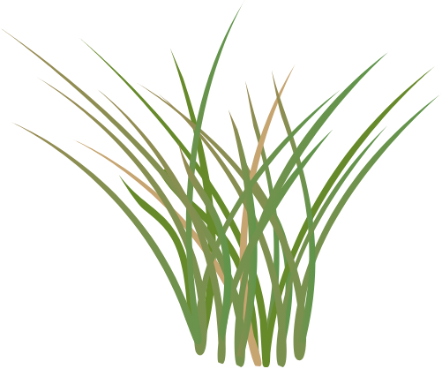

Slide 28
Label your habitats.
Notes:
Label your

Slide 29
Marsh
Water
Label your habitats.
Sediment
Notes:
Label your

Slide 30
Marsh
Water
Place your producers.
Sediment
Notes:
Label your

Slide 31
Marsh grass
Marsh
Water
Phytoplankton
Place your producers.
Sediment
Notes:
Label your

Slide 32
Marsh grass
Marsh
Water
Phytoplankton
Place your consumers.
Sediment
Notes:
Label your

Slide 33
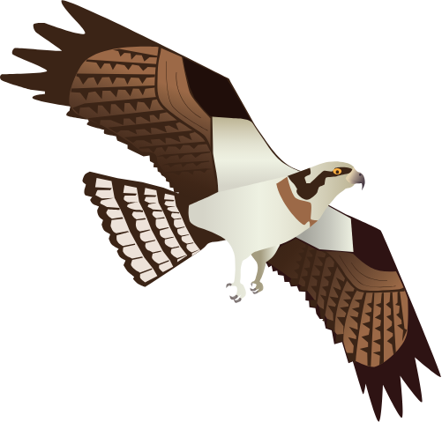
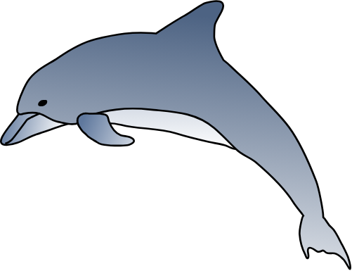
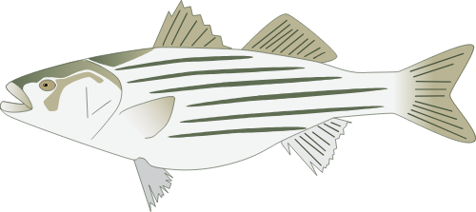
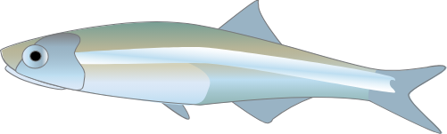
Marsh grass
Marsh
Osprey
Bottlenose Dolphin
Water
Zooplankton
Phytoplankton
Striped Bass
Bay Anchovy
Blue Crab
Eastern Oyster
Sediment

Slide 34
What eats phytoplankton?
Marsh grass
Marsh
Osprey
Bottlenose Dolphin
Water
Zooplankton
Phytoplankton
Striped Bass
Bay Anchovy
Blue Crab
Eastern Oyster
Sediment

Slide 35
What eats phytoplankton?
Marsh grass
Marsh
Osprey
Bottlenose Dolphin
Water
Zooplankton
Phytoplankton
Striped Bass
Bay Anchovy
Blue Crab
Eastern Oyster
Sediment

Slide 36
What eats zooplankton?
Marsh grass
Marsh
Osprey
Bottlenose Dolphin
Water
Zooplankton
Phytoplankton
Striped Bass
Bay Anchovy
Blue Crab
Eastern Oyster
Sediment

Slide 37
What eats zooplankton?
Marsh grass
Marsh
Osprey
Bottlenose Dolphin
Water
Zooplankton
Phytoplankton
Striped Bass
Bay Anchovy
Blue Crab
Eastern Oyster
Sediment

Slide 38
Draw all the arrows of your food web!
Marsh grass
Marsh
Osprey
Bottlenose Dolphin
Water
Zooplankton
Phytoplankton
Striped Bass
Bay Anchovy
Blue Crab
Eastern Oyster
Sediment

Slide 39
Marsh grass
Marsh
Osprey
Bottlenose Dolphin
Water
Zooplankton
Phytoplankton
Striped Bass
Bay Anchovy
Blue Crab
Eastern Oyster
Sediment

