Slide 1

Fish Detectives: Identifying and Classifying Fishes Using a Dichotomous Key
Kaitlyn (Kaite) Cisz
VIMS 2023
Notes:
Lesson plan overview. Can be used for teacher review of the material ahead of the lesson and/or to introduce the lesson to class. May be helpful for the younger grade levels in this range. Just a note – this PowerPoint has some animations so a PDF would not work unless the animations are cut out first. I hope this helps!

Slide 2
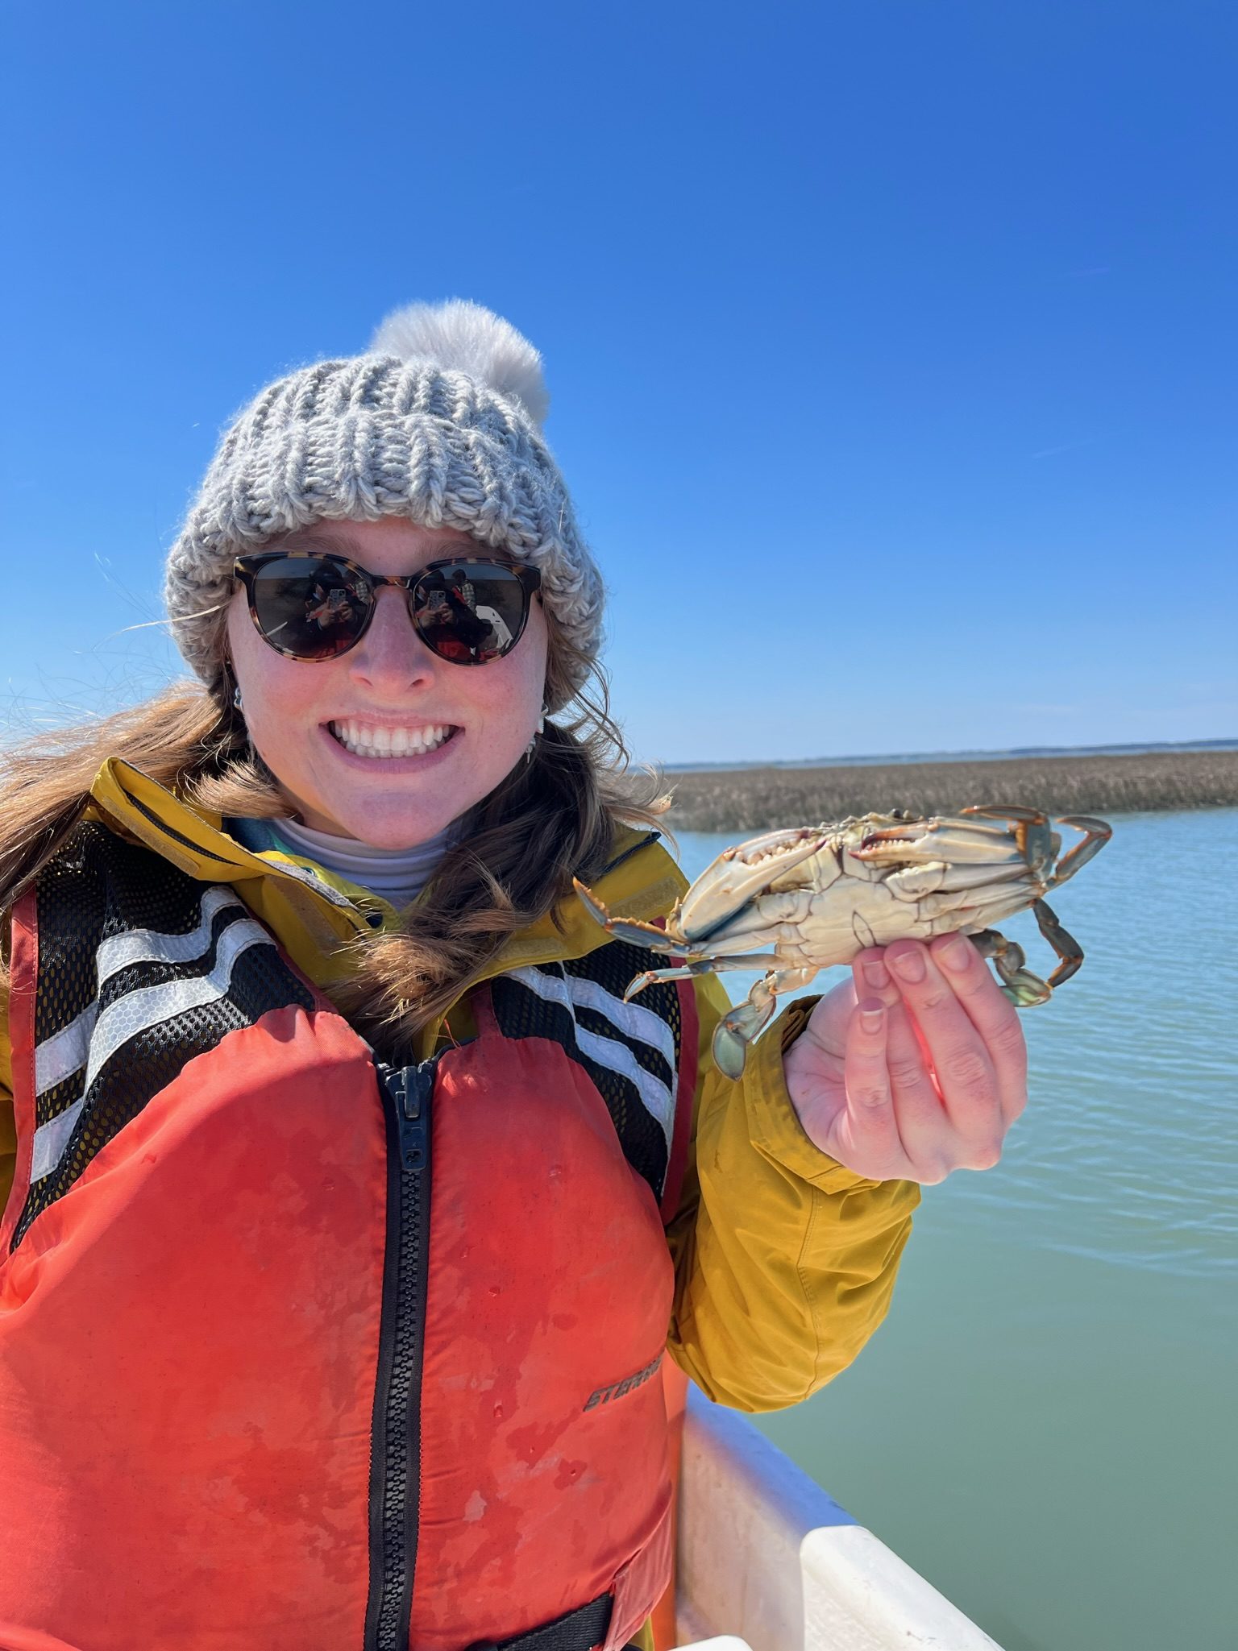
About the Author: Kaitlyn
My name is Kaitlyn but I go by Kaite
I am originally from New York and moved to Virginia in August of 2022 to start my graduate program at the Virginia Institute of Marine Science (VIMS)
I study skates (a cousin to a shark) and an animal you will learn a little bit more about with this lesson plan
I study morphology and genetics; think bones and DNA
Notes:
A little bit about the author of this lesson plan! My name is Kaite (rhymes with eight).

Slide 3

Fish Detectives: Identifying and Classifying Fishes Using a Dichotomous Key
Understanding how a dichotomous key can be utilized to explore how to identify and a group of fishes based on their physical characteristics.
What is a dichotomous key?
Notes:
Dichotomous key: An identification method based on a series on grouped categories.

Slide 4
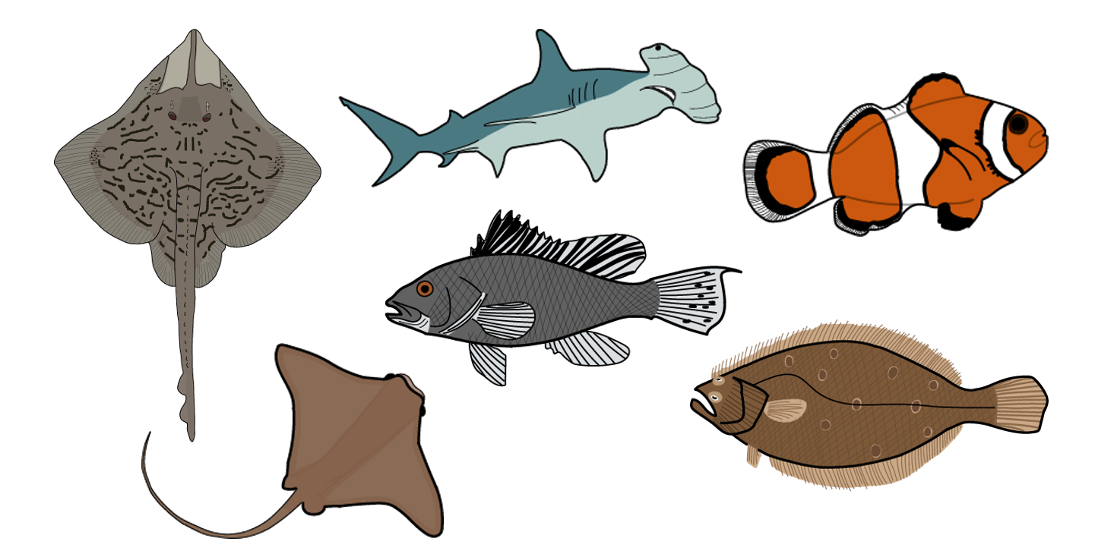
Ahoy mateys! Welcome aboard the S.S. Fish…
  Fish detectives are needed to figure out, classify and name the fish caught on the boat today. The catch:
Notes:
Introduction to the lesson and the “catch” of the day! Just introducing students to the fish they “caught.”

Slide 5
Activity 1: ~20 minutes
Learning how to classify animals based on observations we make about what they look like, where they live, and even their similarities and differences!
Key Vocabulary:
Common Name:
Teleost fish:
Cartilaginous fish:
Notes:
Let’s go through vocabulary starting with common name.

Slide 6
Activity 1: ~20 minutes
Learning how to classify animals based on observations we make about what they look like, where they live, and even their similarities and differences!
Key Vocabulary:
Common Name: The specific name given to an animal species to help with its classification.
Teleost fish:
Cartilaginous fish:
Think about names like a “cat” and “dog.”

Slide 7
Activity 1: ~20 minutes
Learning how to classify animals based on observations we make about what they look like, where they live, and even their similarities and differences!
Key Vocabulary:
Common Name: The specific name given to an animal species to help with its classification.
Teleost fish:
Cartilaginous fish:
Notes:
Next vocabulary word to know: teleost fish.

Slide 8
Activity 1: ~20 minutes
Learning how to classify animals based on observations we make about what they look like, where they live, and even their similarities and differences!
Key Vocabulary:
Common Name: The specific name given to an animal species to help with its classification.
Teleost fish: A fish with a skeleton made out of bones.
Cartilaginous fish:
Think about the bones in your arm!

Slide 9
Activity 1: ~20 minutes
Learning how to classify animals based on observations we make about what they look like, where they live, and even their similarities and differences!
Key Vocabulary:
Common Name: The specific name given to an animal species to help with its classification.
Teleost fish: A fish with a skeleton made out of bones.
Cartilaginous fish:
Notes:
Final vocabulary word to know: cartilaginous fish.

Slide 10
Activity 1: ~20 minutes
Learning how to classify animals based on observations we make about what they look like, where they live, and even their similarities and differences!
Key Vocabulary:
Common Name: The specific name given to an animal species to help with its classification.
Teleost fish: A fish with a skeleton made out of bones.
Cartilaginous fish: A fish with a skeleton made out of cartilage, no bones.
Wiggle your nose… that is cartilage!

Slide 11
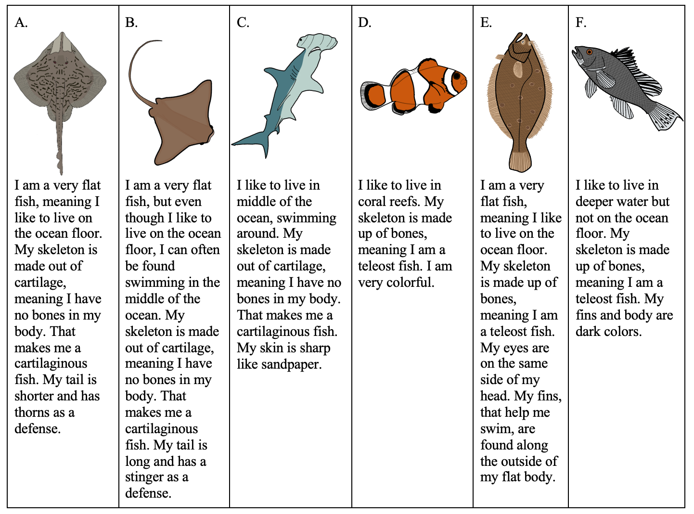
Descriptions of our catch:
Notes:
Review this with students. Especially if lesson activities one and two are done on two separate days. Feel free to click through the next few slides with students as needed and break these descriptions down further (i.e., flat body, bones, etc.). If not needed “hide” (block viewing or delete) these slides and move on.

Slide 12
Notes:
Review this with students. Especially if lesson activities one and two are done on two separate days.

Slide 13
Notes:
Review this with students. Especially if lesson activities one and two are done on two separate days.

Slide 14
Notes:
Review this with students. Especially if lesson activities one and two are done on two separate days.

Slide 15
Notes:
Review this with students. Especially if lesson activities one and two are done on two separate days.

Slide 16
Notes:
Review this with students. Especially if lesson activities one and two are done on two separate days.

Slide 17
Notes:
Review this with students. Especially if lesson activities one and two are done on two separate days.

Slide 18
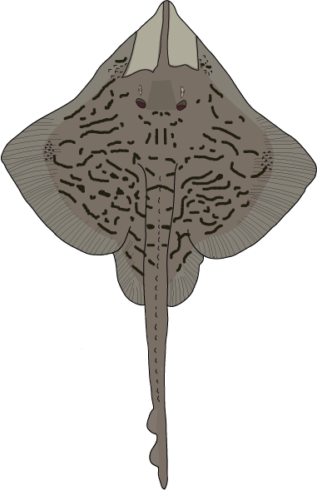
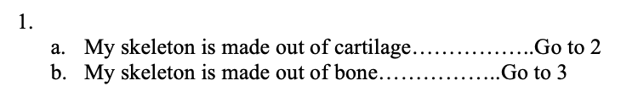


Activity 2: ~35 minutes
Following a dichotomous key to name animals caught down to species by their common name and then reflecting on what was learned during the lesson.
Let’s walk through a section together as an example:
Thorns
Notes:
Can be done a separate day from Activity 1 if needed but would need a review if so because knowledge is built off of one another.
Remember: Dichotomous key: An identification method based on a series on grouped categories.
Walk through this example of how to use/review use of a dichotomous key!

Slide 19
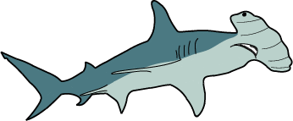
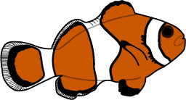

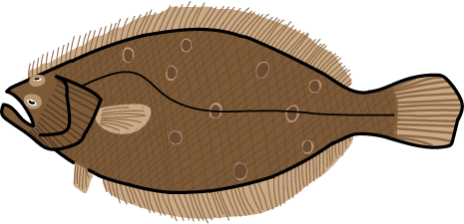
Thank you!
If you have any questions, please feel free to contact me, Kaite Cisz, at krcisz@vims.edu
Notes:
Let’s get started! Remember, you can do individual packets or have the kids work in a group. Printed or computer-based lessons are both okay, but circling the key and walking through it may be easier with a physical packet. Black and white or colored printing are both acceptable and work for this lesson. Have fun and please reach out if you have any issues! Happy sleuthing ☺

