Slide 1
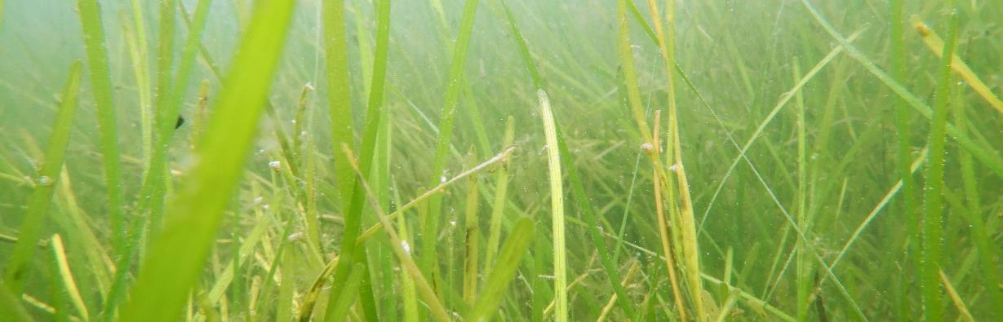
Watching Seagrass Breathe
VASEA Alyson Hall Seventh Grade Science
Notes:
Change to High School Biology if you are using the extension with Worksheet 2!

Slide 2
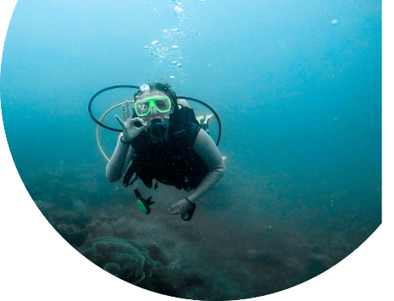
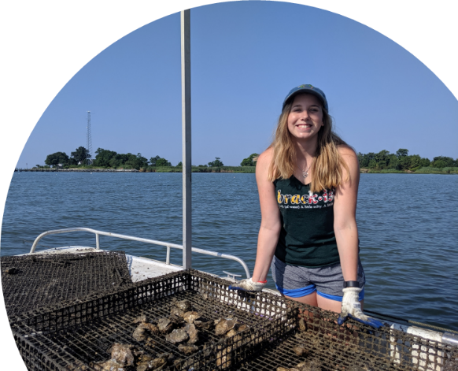
Meet the Scientist
That’s me!
Hello! My name is Aly
I am a marine biologist, I study living things on the coast and in the ocean.
I like to scuba dive and work with plants and animals that live in the ocean
Ever since I was little, I wanted to work on the ocean
Photos by Alyson Hall

Slide 3
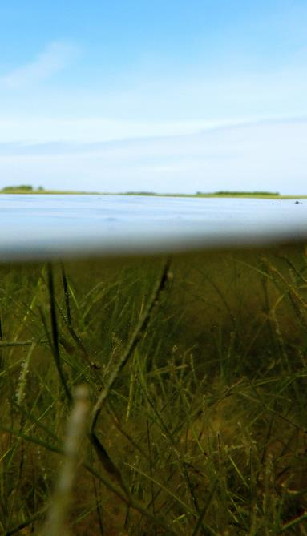
Goals for Today
Marine scientists measure the primary production of seagrass to help understand if seagrass meadows are putting energy and oxygen into the system.
To do this we have two main goals:
Survey the seagrass and collect data on the dissolved oxygen
Use that data to calculate rates of respiration and primary production
Photo by Alyson Hall

Slide 4


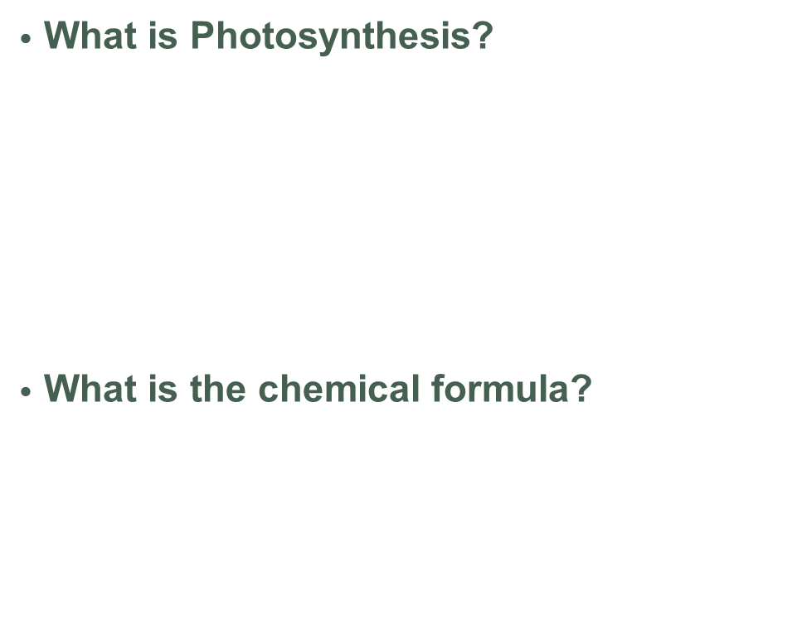
Primary Production of Plants is Driven by Photosynthesis!
What are the components of photosynthesis?
What is Photosynthesis?
  chemical reaction in which sugar and oxygen are produced from light, water and carbon dioxide.
  arbon di
  oxide + Water → Sugar + Oxygen
What is the chemical formula?
$$6{CO}_{2}+6H_{2}O \overset{→}{} C_{6}H_{12}O_{6}+{6O}_{2}$$
Tracey Saxby, Integration and Application Network (ian.umces.edu/media-library)
Notes:
This is an optional slide for a quick activity about labeling important parts of photosynthesis if you don’t want to jump straight into the lesson

Slide 5



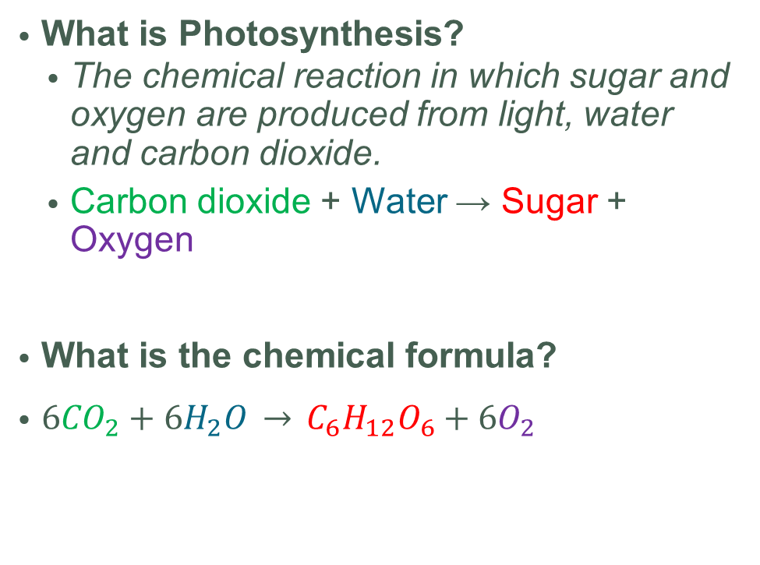
Primary Production of Plants is Driven by Photosynthesis!
What is Photosynthesis?
  The chemical reaction in which sugar and oxygen are produced from light, water and carbon dioxide.
  Carbon dioxide + Water → Sugar + Oxygen
What is the chemical formula?
$6{CO}_{2}+6H_{2}O \overset{→}{} C_{6}H_{12}O_{6}+{6O}_{2}$
Light
Carbon Dioxide
Water
Oxygen
Sugar
Tracey Saxby, Integration and Application Network (ian.umces.edu/media-library)
Notes:
This is an optional slide for a quick activity about labeling important parts of photosynthesis.

Slide 6
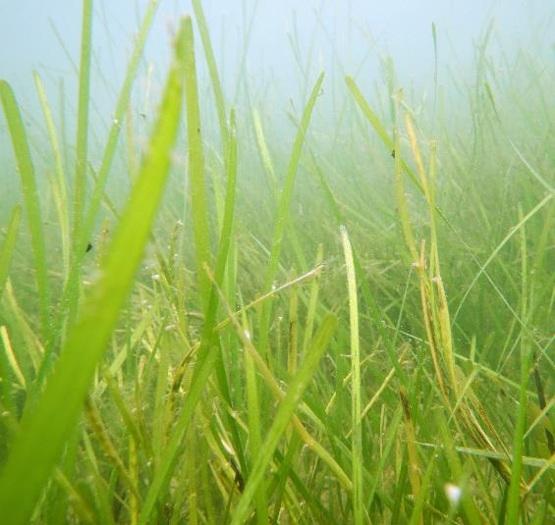
What are Seagrasses?
Seagrasses are marine angiosperms.
  Marine means they live in saltwater, like the ocean or estuaries
  Angiosperms is a word for “flowering plants” like fruit trees or flowers!
There are many species of seagrasses that are the ancestors of different plants on land that moved in the ocean.
Can you think of some green things that live in the ocean?
  Are these seagrasses?
Photo by Alyson Hall

Slide 7
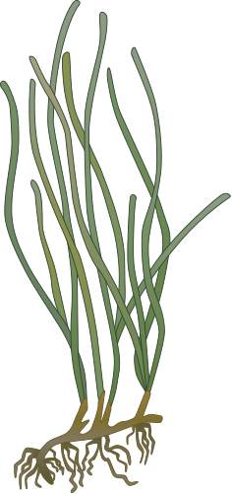
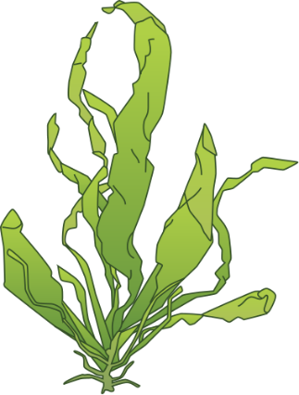
Seagrasses vs Seaweeds
Seagrasses and Seaweeds may look similar, but they are different!
Seagrasses have true leaves, but seaweeds have blades
Seagrasses reproduce with seeds, but seaweeds reproduce with microscopic spores
Seagrasses have roots that go in the sediment, but seaweeds have “holdfasts” to hold onto rocks
But BOTH photosynthesize!
Tracey Saxby, Integration and Application Network (ian.umces.edu/media-library)

Slide 8

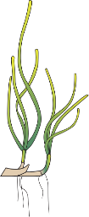
The Chesapeake Bay Has Two Species of Seagrass
The Chesapeake Bay has two species of seagrass:
  Eelgrass – Zostera marina
  Widgeon Grass – Ruppia maritima
These two species differ in size and shape
  Eelgrass is taller with thicker leaves
  Widgeon grass is usually shorter with thin, branching leaves
Eelgrass
Widgeon Grass
Tracey Saxby and Jane Thomas, Integration and Application Network (ian.umces.edu/media-library)

Slide 9
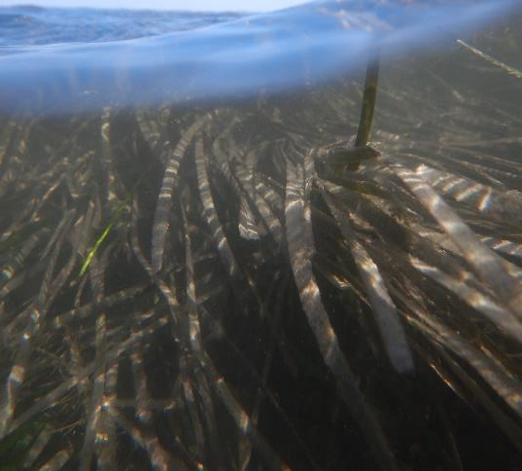
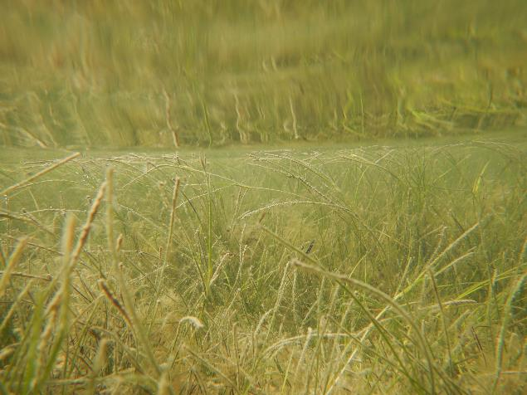
Can You Guess Which Picture is Each Species?
Photos by Alyson Hall

Slide 10
Can You Guess Which Picture is Each Species?
Eelgrass!
Widgeon Grass!
Photos by Alyson Hall

Slide 11
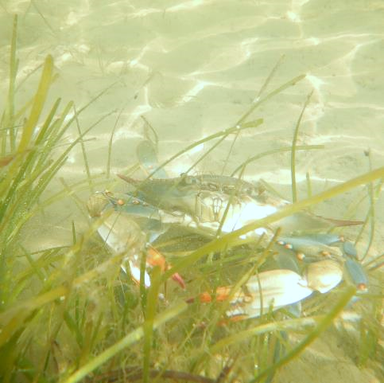
Why Care About Seagrasses?
Seagrasses form seagrass meadows, which are important ecosystems!
Seagrass meadows:
  Provide homes for many animals
  Keep sediment in place from waves
  Provide food for the rest of the food web
  Put oxygen into the water in many areas!
Photo by Alyson Hall

Slide 12
Why Care About Seagrasses?
Seagrasses form seagrass meadows, which are important ecosystems!
Seagrass meadows:
  Provide homes for many animals
  Keep sediment in place from waves
  Provide food for the rest of the food web
  Put oxygen into the water in many areas!
We are going to focus on their ability to put oxygen in the water through primary production!
Photo by Alyson Hall

Slide 13
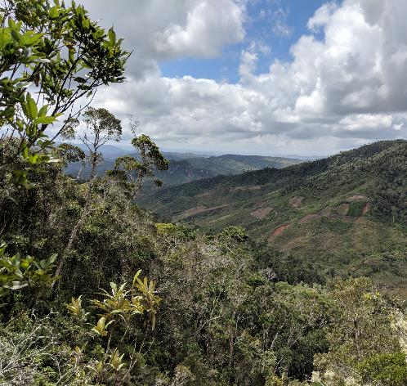
Primary Production and Respiration
Plants are primary producers!
  Plants create their own food (sugars) from:
    Energy from sunlight
    Water
    Carbon
    Minerals.
  We and other animals are consumers.
    We eat other organisms (like plants or animals) for energy
Photo by Alyson Hall
Notes:
Skip if your class doesn’t need a review of primary production and respiration!

Slide 14
Primary Production and Respiration
Plants are primary producers!
  Plants create their own food (sugars) from:
    Energy from sunlight
    Water
    Carbon
    Minerals.
  We and other animals are consumers.
    We eat other organisms (like plants or animals) for energy
But just like us, plants don’t only make food, but they use food for energy => Respiration
Photo by Alyson Hall
Notes:
Skip if your class doesn’t need a review of primary production and respiration!

Slide 15
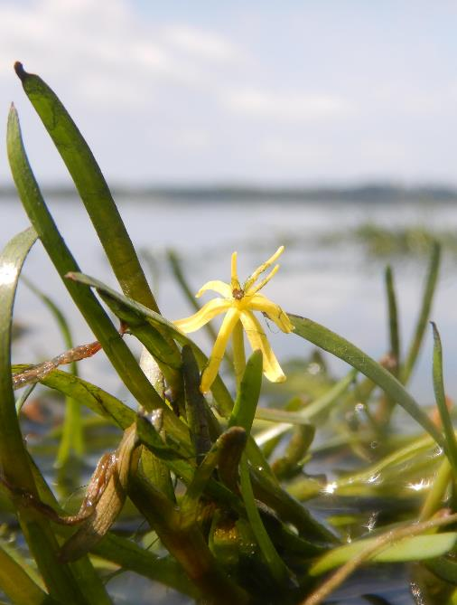
Why Do Scientists Want to Measure Primary Production?
All organisms need to use energy from food to live
  We get energy from cellular respiration
    Using food to create energy needed for living
Primary producers like plants in ecosystems such as forests or seagrass meadows are the start of food for whole food web
By knowing how productive an ecosystem is, we learn a lot about everything that lives in that ecosystem.
Photo by Alyson Hall

Slide 16

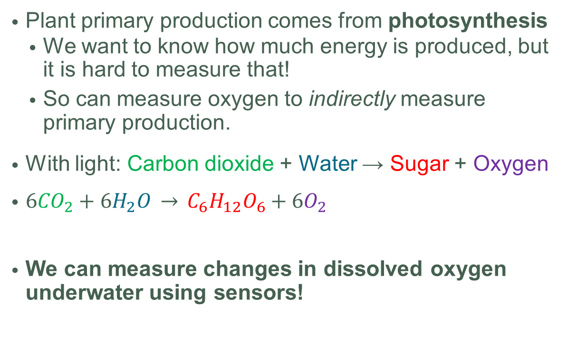
How Do Scientists Measure Primary Production?
Plant primary production comes from photosynthesis
  We want to know how much energy is produced, but it is hard to measure that!
  So can measure oxygen to indirectly measure primary production.
With light: Carbon dioxide + Water → Sugar + Oxygen
$6{CO}_{2}+6H_{2}O \overset{→}{} C_{6}H_{12}O_{6}+{6O}_{2}$
We can measure changes in dissolved oxygen underwater using sensors!
Light
Carbon Dioxide
Water
Oxygen
Sugar
Tracey Saxby, Integration and Application Network (ian.umces.edu/media-library)

Slide 17
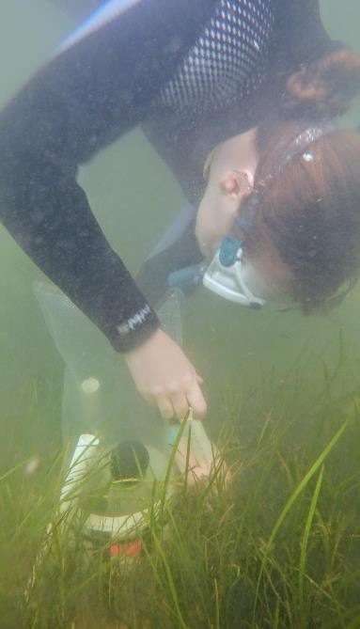
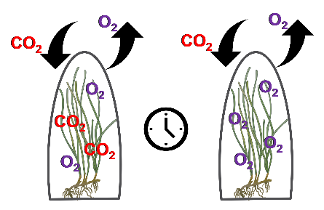
Scientists in Benthic Chambers to Measure Primary Production
Photo by Alyson Hall
We put an oxygen sensor in the benthic chamber and let the chamber run an incubation (time it measures).
Benthic chambers trap the water so we can measure chnages in oxygen in a certain spot!
This is me setting up one of my chambers!
Tracey Saxby, Integration and Application Network (ian.umces.edu/media-library)

Slide 18
Scientists in Benthic Chambers to Measure Primary Production
Photo by Alyson Hall
We put an oxygen sensor in the benthic chamber and let the chamber run an incubation (time it measures).
Benthic chambers trap the water so we can measure chnages in oxygen in a certain spot!
But what about respiration? Plants undergo aerobic respiration, meaning they use oxygen for respiration like we do!
This is me setting up one of my chambers!
Tracey Saxby, Integration and Application Network (ian.umces.edu/media-library)

Slide 19
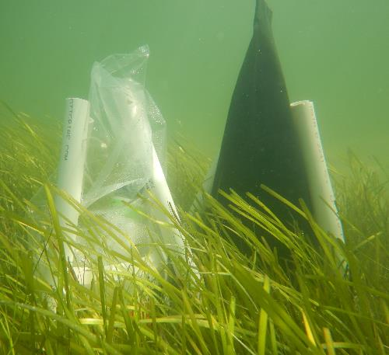
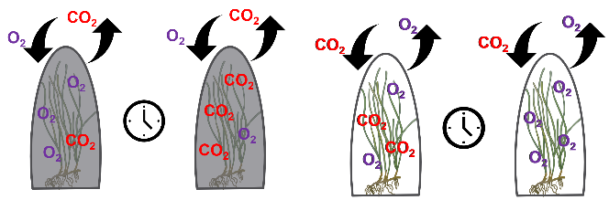
We Use Dark and Light Chambers to Measure Respiration and Net Primary Production
The light chambers allow in light so they measure Net Primary Production!
  The seagrasses are both respiring ( - oxygen) and photosynthesizing ( + oxygen)
  The black chambers block out light so they measure respiration only (- oxygen)
Tracey Saxby, Integration and Application Network (ian.umces.edu/media-library)
Photo by Alyson Hall

Slide 20
We Use Dark and Light Chambers to Measure Respiration and Net Primary Production
The light chambers allow in light so they measure Net Primary Production!
  The seagrasses are both respiring ( - oxygen) and photosynthesizing ( + oxygen)
  The black chambers block out light so they measure respiration only (- oxygen)
If we subtract these two rates we can estimate the Gross Primary Production*.
*This is the total amount of primary production before the plants respire and use energy and oxygen!
Tracey Saxby, Integration and Application Network (ian.umces.edu/media-library)

Slide 21
We Use Dark and Light Chambers to Measure Respiration and Net Primary Production
The light chambers allow in light so they measure Net Primary Production!
  The seagrasses are both respiring ( - oxygen) and photosynthesizing ( + oxygen)
  The black chambers block out light so they measure respiration only (- oxygen)
If we subtract these two rates we can estimate the Gross Primary Production*.
*This is the total amount of primary production before the plants respire and use energy and oxygen!
Tracey Saxby, Integration and Application Network (ian.umces.edu/media-library)
Photo by Alyson Hall

Slide 22
Calculating Gross Primary Production (GPP)
Photosynthesis produces oxygen
  The concentration of oxygen in the light chambers will increase*
  => A positive rate (Ex: 20 units of Oxygen per minute)!
    *But light chambers are also measuring respiration because the plants don’t stop respiring.
Respiration uses oxygen
  The concentration of oxygen in dark chambers will go down
  => A negative rate (Ex: -10 units of Oxygen per minute)!
=> (Rate from Light Chambers) – (Rate from Dark Chambers) = Gross Primary Production!
=> (+20 units per minute) – (-10 units per minute) = 30 units per minute!
Remember subtracting a negative will cancel out the negative and minus!
Notes:
This is a clarifying slide for calculating GPP if you feel it is needed!

Slide 23
Gross Primary Production can tell us if seagrass meadows are putting extra energy and oxygen into the system.
What does a positive rate of GPP mean?
What does a negative rate of GPP mean?
Photo by Alyson Hall

Slide 24
Gross Primary Production can tell us if seagrass meadows are putting extra energy and oxygen into the system.
What does a positive rate of GPP mean?
=> that photosynthesis is creating more energy and oxygen than the plant uses from respiration.
  This means the seagrass meadow is Net Autotrophic = makes extra energy
What does a negative rate of GPP mean?
=> that photosynthesis is not creating enough energy and oxygen for the plant.
  This means the seagrass meadow is Net Heterotrophic = uses more energy than it makes!
Photo by Alyson Hall

Slide 25
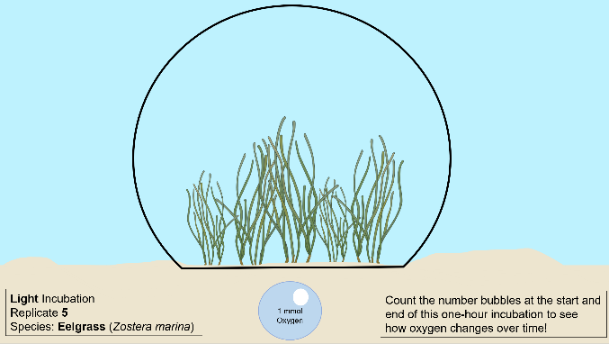
Now Its Your Turn!
1. You are going to count oxygen bubbles just like the oxygen sensors do for both light and dark chambers.
2. Then you will calculate rates of respiration and net primary production (NPP)
3. You will use those rates to estimate the rate of Gross Primary Production (GPP) for seagrasses in the Chesapeake Bay!
Tracey Saxby, Integration and Application Network (ian.umces.edu/media-library)

Slide 26
Now Its Your Turn!
1. You are going to count oxygen bubbles just like the oxygen sensors do for both light and dark chambers.
2. Then you will calculate rates of respiration and net primary production (NPP)
3. You will use those rates to estimate the rate of Gross Primary Production (GPP) for seagrasses in the Chesapeake Bay!
Remember!
You are measuring rates because it is a change in oxygen over a time period (the chamber incubation!)
Tracey Saxby, Integration and Application Network (ian.umces.edu/media-library)
Notes:
Have the students complete Worksheet One, section A at this time. You may choose to do one video together before breaking into groups!

Slide 27
Species Don’t Always Behave the Same!
Remember that the Chesapeake Bay has two species of seagrass!
These species differ in shape and size
These species have different communities of animals that live in them too
Will they have the same rate of NPP, respiration, and GPP?
Eelgrass
Widgeon Grass
Tracey Saxby and Jane Thomas, Integration and Application Network (ian.umces.edu/media-library)
Notes:
Feel free to check in about section A now to make sure they are on the right track. After reminding students there are two species have the students complete section B.

Slide 28
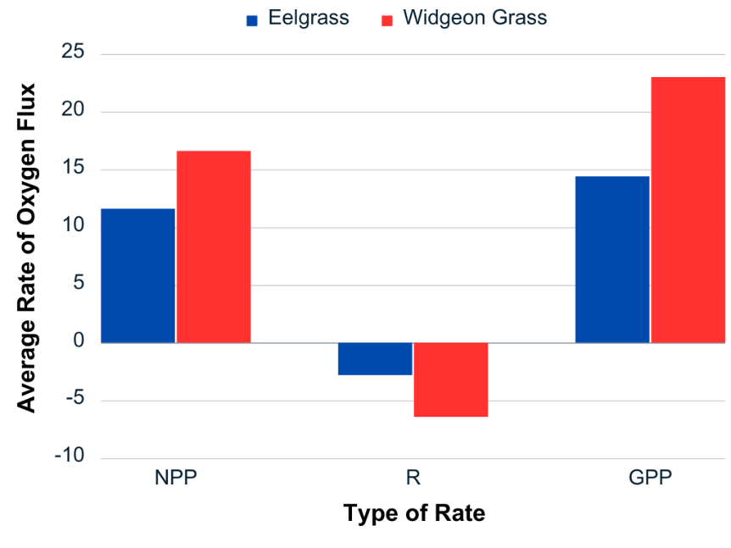
Notes:
This is an example of the finished bar graph from Worksheet 1. You can pull this up or ask a student to present theirs while talking about what they notice from this!

Slide 29
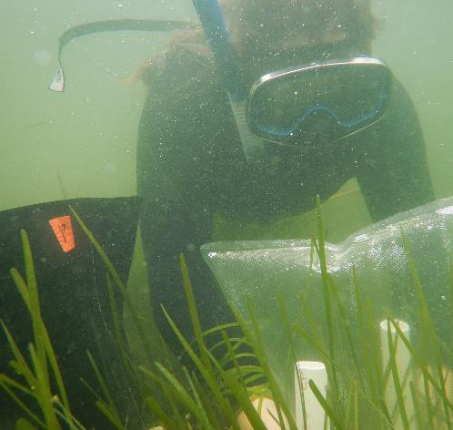
Scientists Often Scale Up Measurements to Estimate Whole Ecosystems
Our chambers only ran for 1 hour and covered about one square foot of bottom.
Scientists want to know about how entire seagrass meadows or entire estuaries function for whole days, weeks, or years.
How can we scale up our small samples to make these estimates?
Photo by Alyson Hall
Notes:
Complete Worksheet 1, section C now

Slide 30
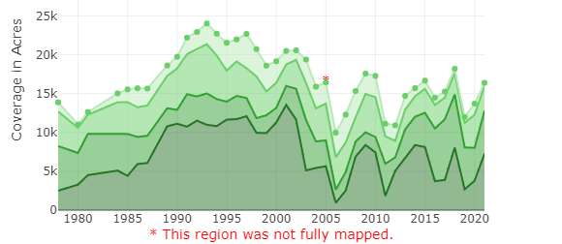
The Amount of Seagrass in the Chesapeake Bay Changes Yearly
The shades of green show how dense the seagrass is from sparse (light green) to very dense (dark green)
Graph from the Virginia Institute of Marine Science
Notes:
Optional Slide for Worksheet 2. Discuss and have students complete Worksheet 2 now. OR Supplemental slide to show how total seagrass coverage in the Lower Chesapeake Bay is changing per year (Widgeon Grass is found in all parts of the Bay!)
Feel free to update the graph for later years at https://www.vims.edu/research/units/programs/sav/access/charts/zones/index.php

Slide 31
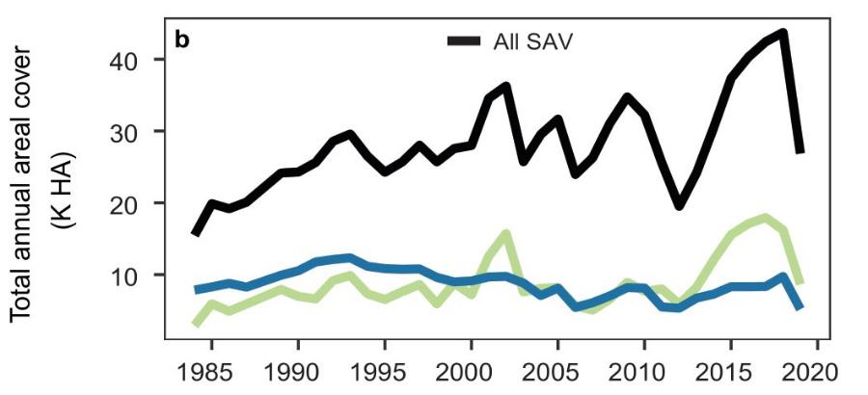
The Amount of Each Species is Also Changing in the Chesapeake Bay Yearly
Black = All Aquatic Plants
Green = Widgeon Grass
Blue = Eelgrass
Graph from the Virginia Institute of Marine Science
Notes:
This graph shows how the two seagrass species are not changing in the same way year to year

Slide 32

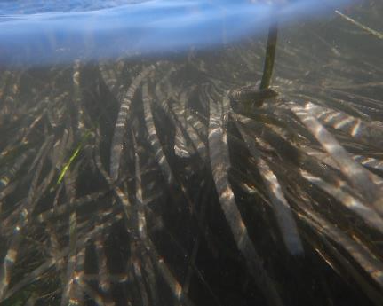
Why Does Seagrass Coverage Change Yearly?
Why Do Species Change Differently?
Photos by Alyson Hall
Notes:
Optional slide for Worksheet 2 (includes answers to final discussions)

Slide 33
Why Does Seagrass Coverage Change Yearly?
=> Seagrass coverage can be impacted by many factors:
  Things that affect production and respiration
    Temperature, light, carbon dioxide concentrations
  Humans
    Boat scaring from propellers
    Aquaculture
  Harmful Algae Blooms, more herbivores, and more!
Why Do Species Change Differently?
  => Different species will react to each of these factors differently, leading to different coverages.
  For example, Eelgrass is less heat tolerant than Widgeon Grass which has lead to it’s decline!
Photos by Alyson Hall
Notes:
Optional slide for Worksheet 2 (includes answers to final discussions)

Slide 34
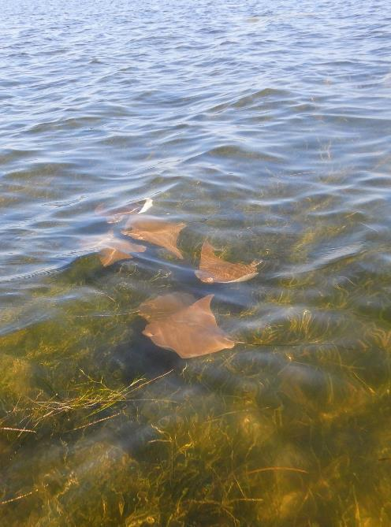
What Did We Learn Today?
Seagrasses are really important primary producers in the Chesapeake Bay
The two species of seagrass do not have the same rates of NPP, respiration, and GPP
Scientists use small chambers as a sample to estimate processes for much larger areas and time
Seagrasses and the GPP they provide is decreasing in the Chesapeake Bay and the dominance of species is changing!
Photo by Alyson Hall
Notes:
Use this slide to recap discussion (remove last bullet point if you don’t use Worksheet 2)

