Slide 1
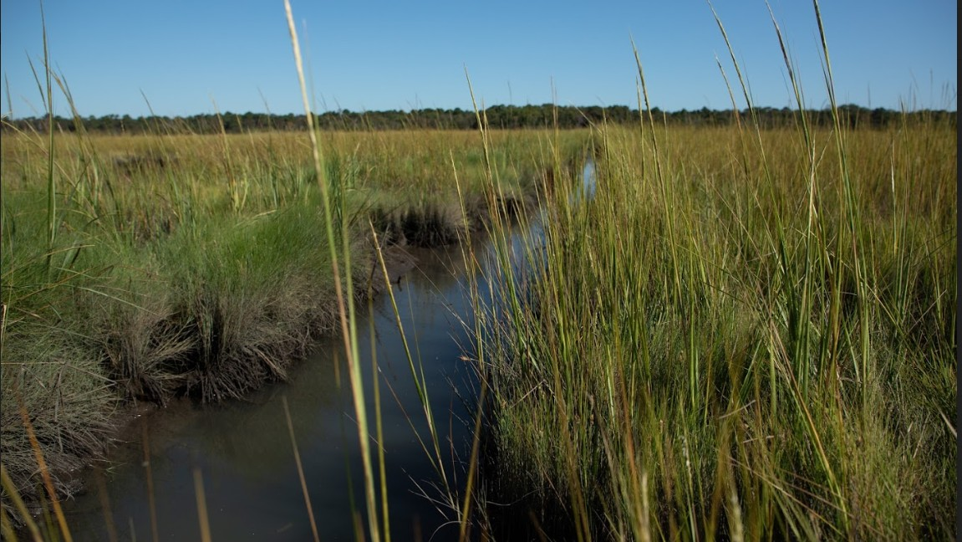
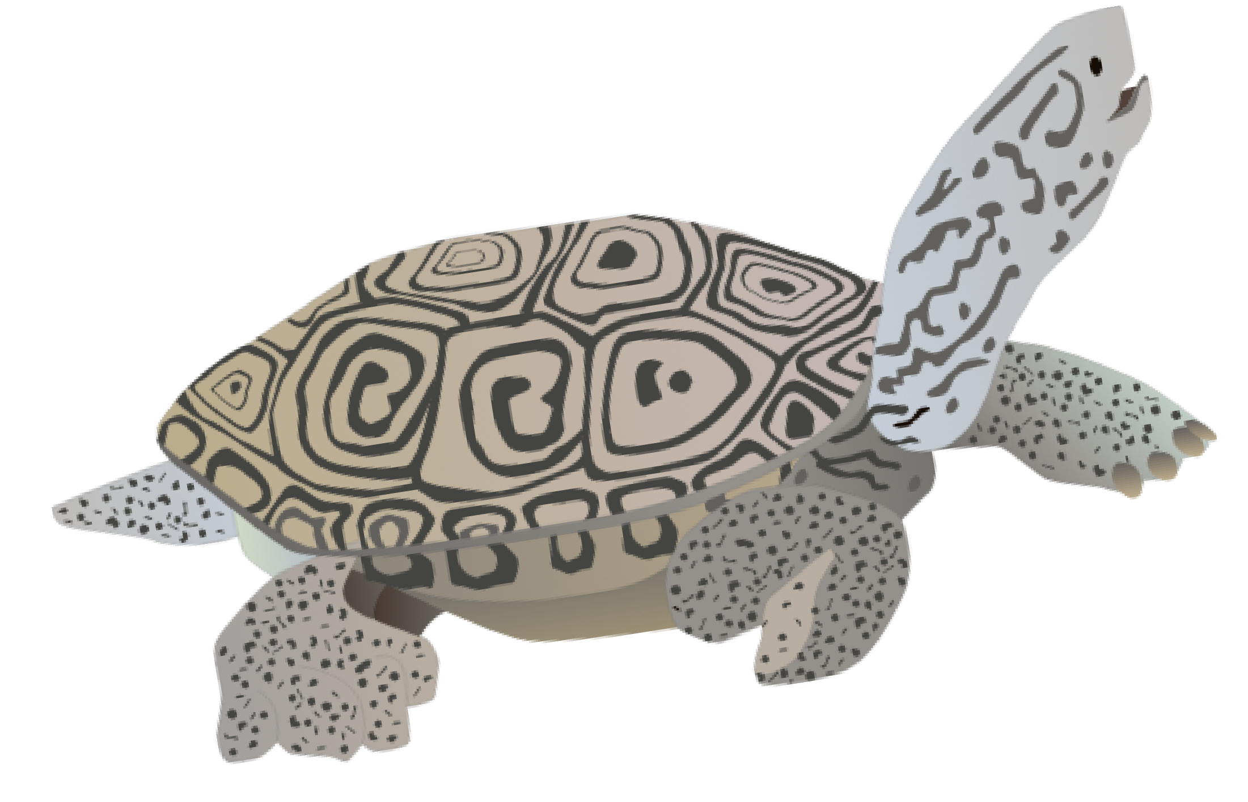
Terrapin Town
an activity on the conservation and management of the Diamondback Terrapin by Anna Caputo

Slide 2
Outline
1
T urtle biology (general)
2
T errapin ecology
3
T hreats
4
Conservation
5
Playing the game

Slide 3
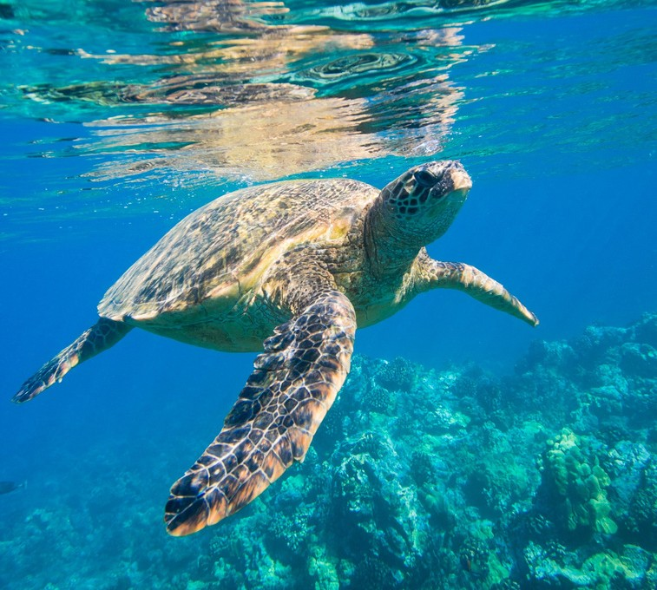
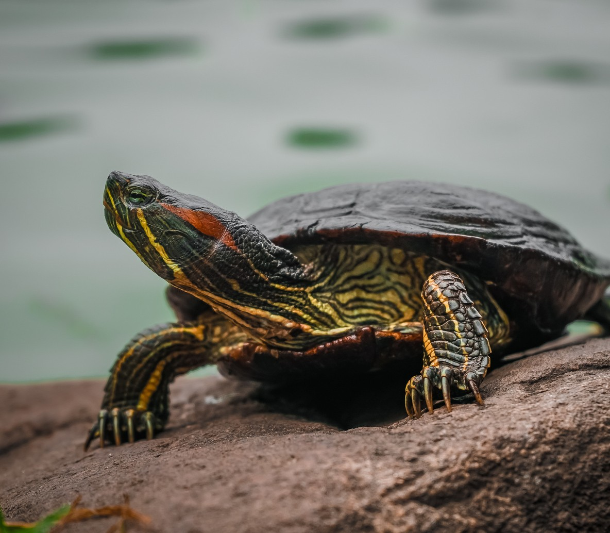
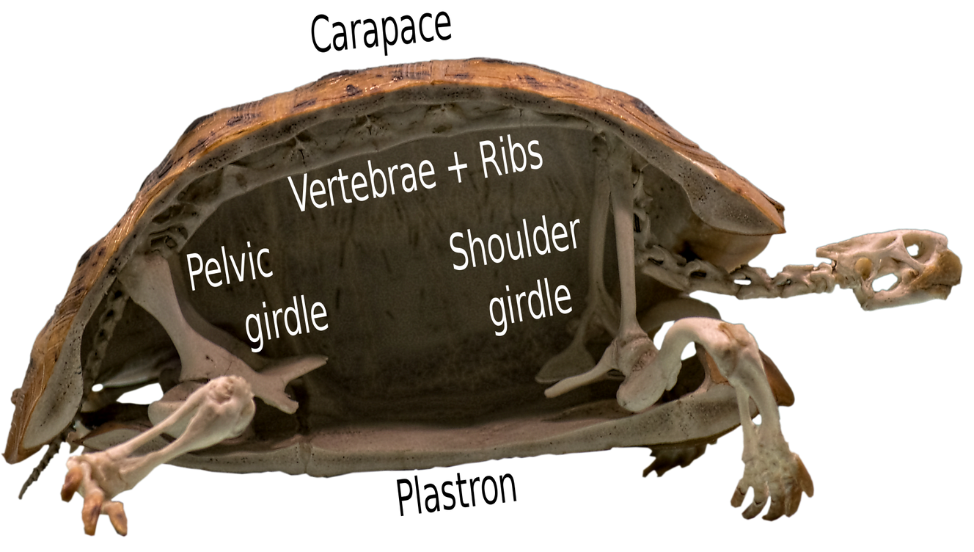
Lets Talk Turtles
Turtles are reptiles that have a spine and ribs that are attached to a shell. All turtles:
breathe air with lungs
are cold-blooded (ectothermic) lay eggs and bury them
Turtles are semi-aquatic and mostly in freshwater
Sea turtles are fully marine (saltwater) and only leave the water to nest
Tortoises are fully on land (terrestrial) though they sometimes like to forge streams
image credits: Ian Alexander -Tortoise skeleton cross-section, labeled as infographic; Natural History Museum, London

Slide 4
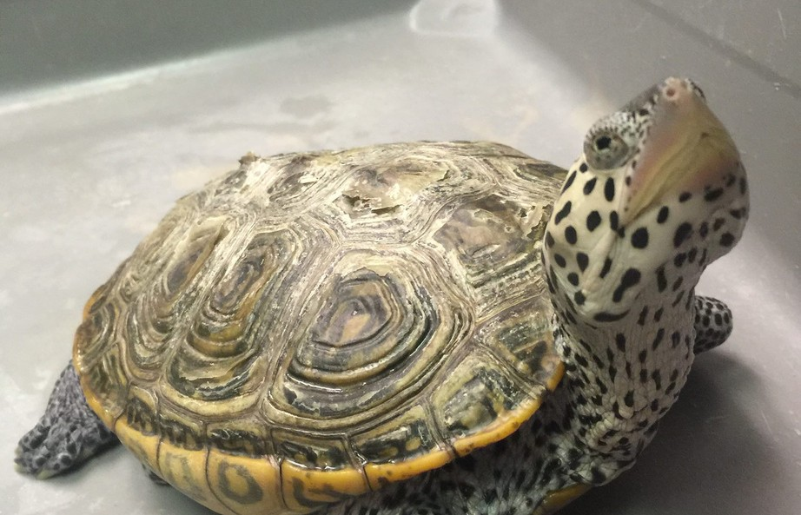
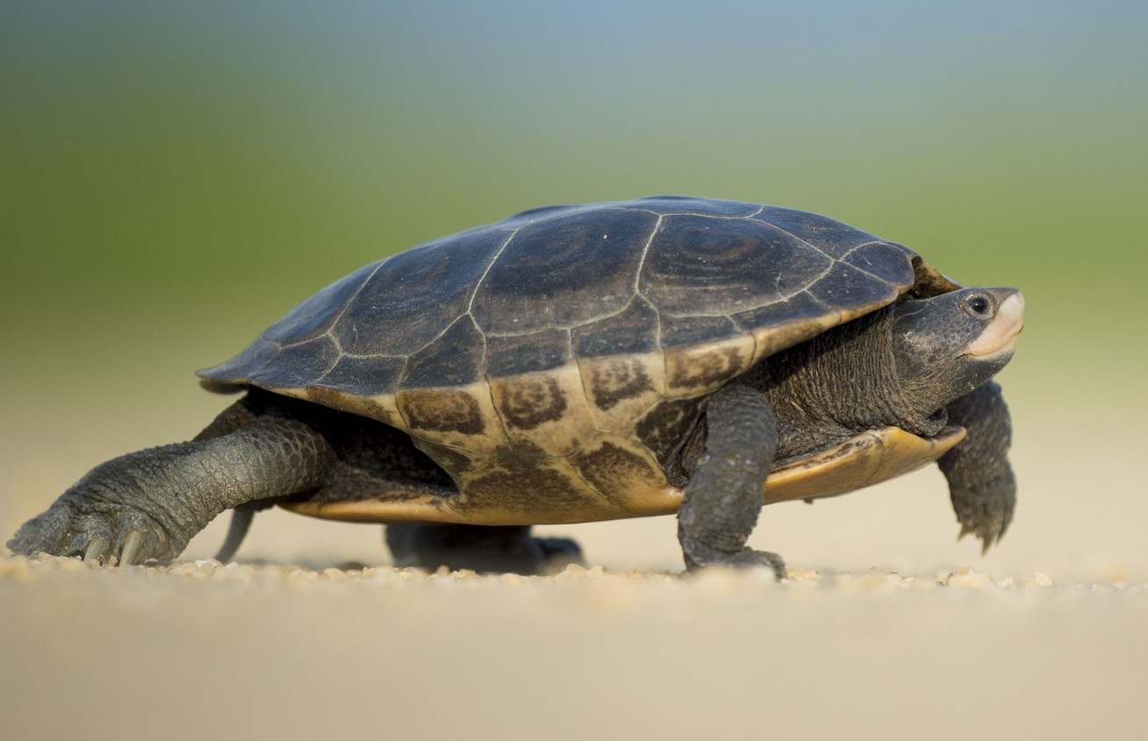
This is the Northern Diamondback Terrapin
(Malaclemys terrapin)
In the US, the word "terrapin" is used to describe turtles that live in brackish water, which is a mix of fresh and salt water.
Diamondback terrapins range from coastal Massachusettes to coastal Texas. They are the only brackish water turtle in the country.
They come in a variety of colors and patterns. Notice how different the 2 terrapins in the pictures look.
image credits: "Diamondback" by USFWS Headquarters is licensed under CC BY 2.0.; top photo: Allison Anholt - personal photo

Slide 5
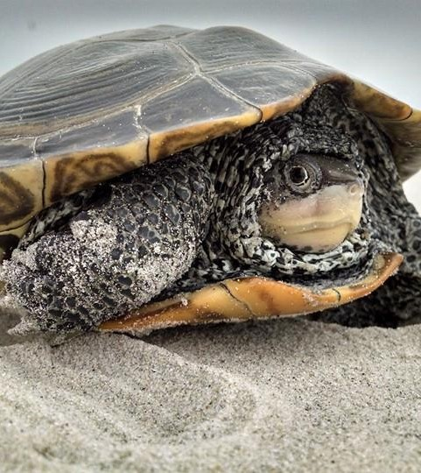
1
Terrapin ecology
Why are terrapins worth talking about?
Photo credit: Allison Anholt - personal photo

Slide 6
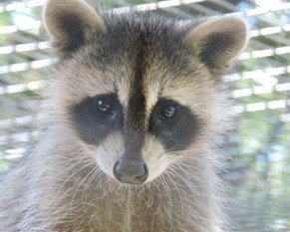
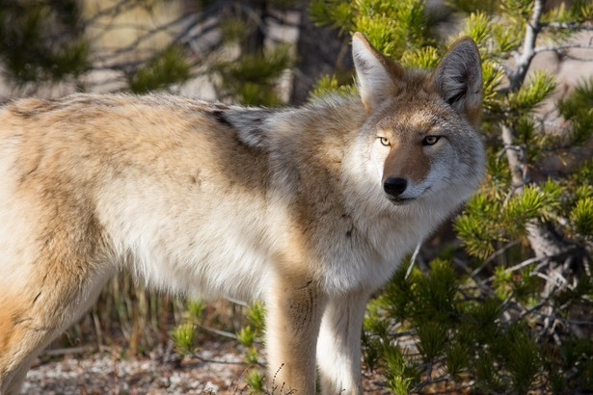
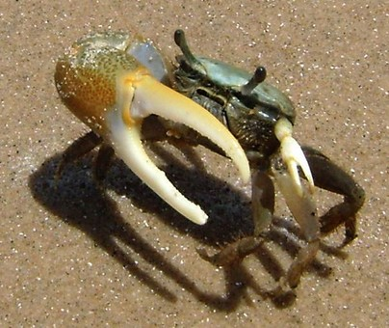
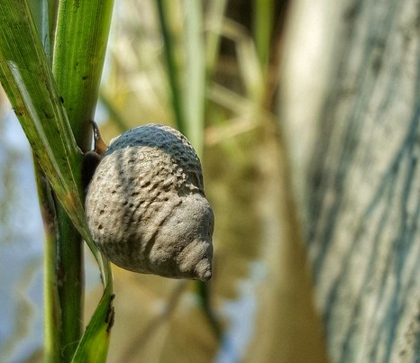
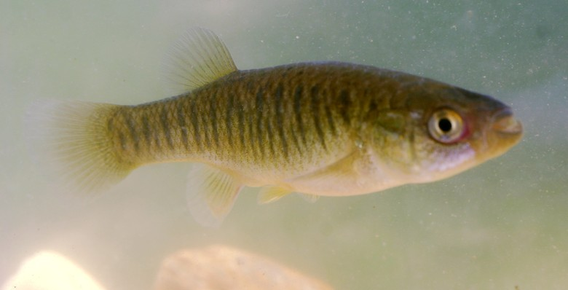
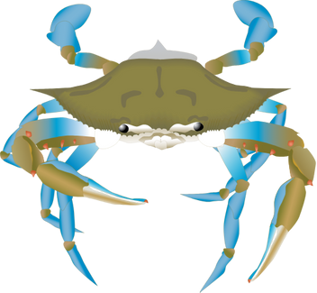
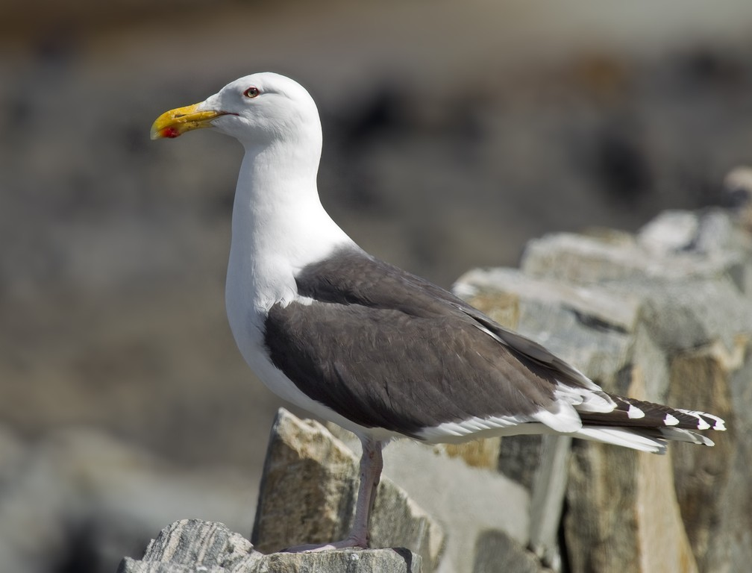
Life History
Life span: 20 to 40 years Prey Species: crabs, snails, clams, mussels, and small fish
Preferred habitat: Salt marsh
Predators: Racoons, birds, coyotes
image credits: Racoon by Grae O'Toole - personal photo; "Great Black-backed Gull" -Andreas Trepte, licensed under CC BY-SA 2.5.; "Male Fiddler Crab" by Patrick Feller, licensed under CC BY 2.0.; "Belle Isle State Park" - vastateparksstaff licensed under CC BY 2.0.

Slide 7
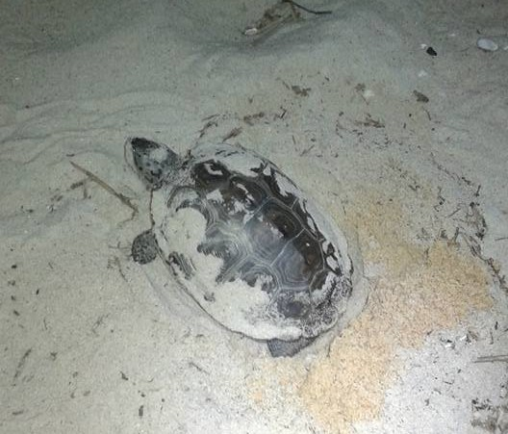
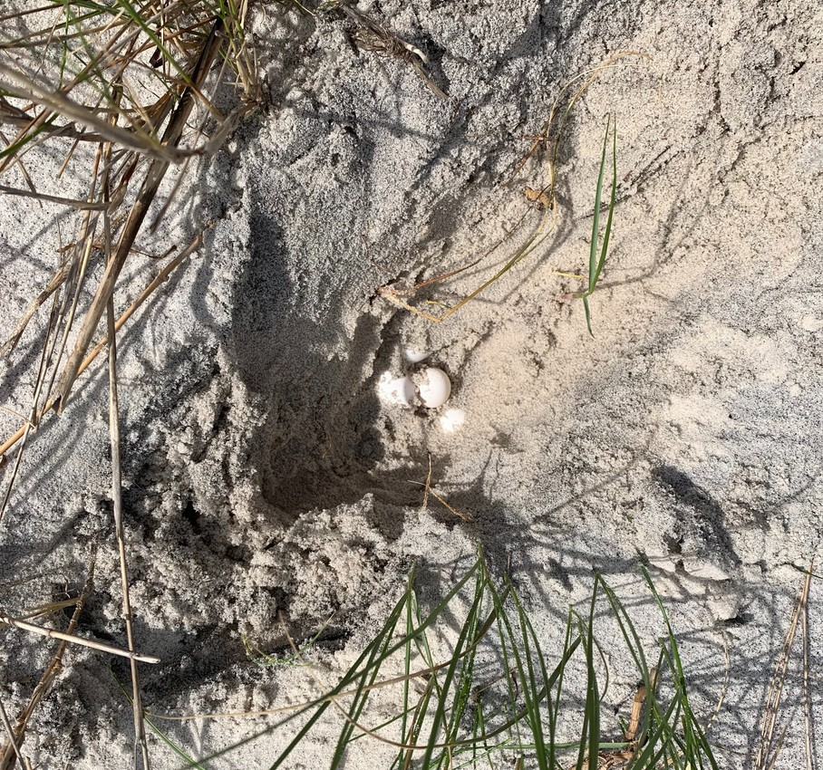
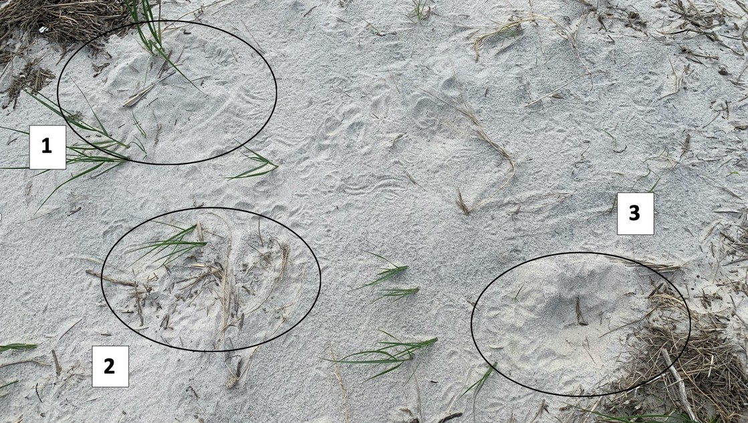
Nesting
Nest habitat: sandy beach or dunes Nesting season: early spring to mid summer
A feamle can lay 3 clutches of 8 to 20 eggs each nesting season.
Like sea turtles, hatchlings have a low survival rate. Nest and young terrapins often get eaten by predators.
Photo credit: Tara Rudo - personal photos

Slide 8
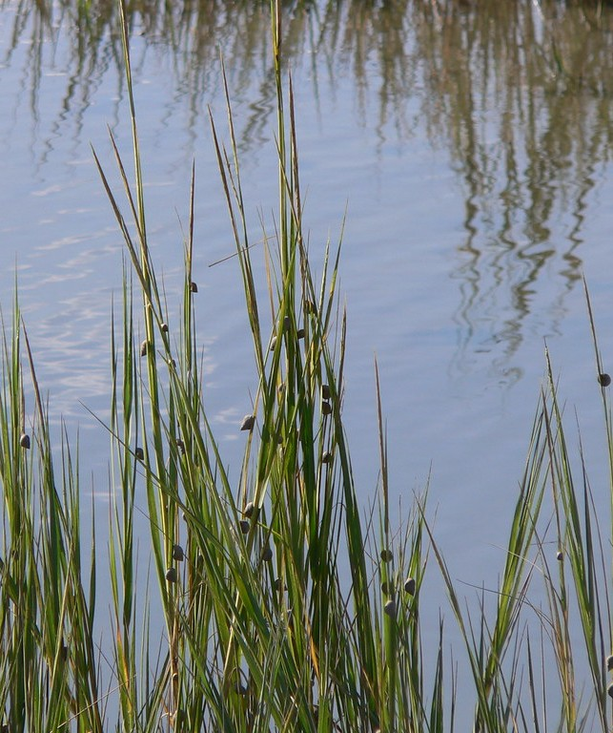
Keystone Species
Keystone species- an organism that has an effect on all other species living in an ecosystem, keeping it stable and functioning.
Terrapins primarily eat marsh periwinkle snails, which eat the algae off of salt marsh cordgrass. The snails can be harmful to the grass. Terrapins keep the snail population in check so that the marsh stays healthy.
Look at how many snails are on those grass blades in the photo.
"Snails climbing grass on Pinckney Island" by Lee Edwin Coursey is licensed under CC BY 2.0.

Slide 9
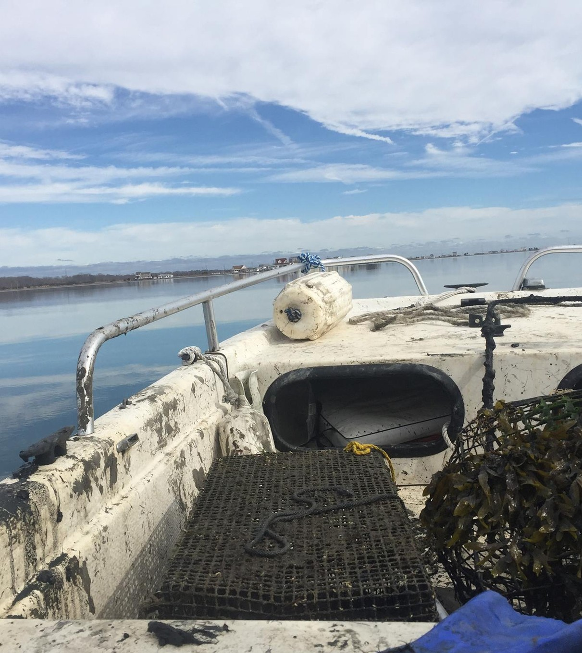
2
Threats to terrapins
According to the IUCN RedList Terrapins have been listed as "vulnerable" since 2018 and their population is in decline.

Slide 10
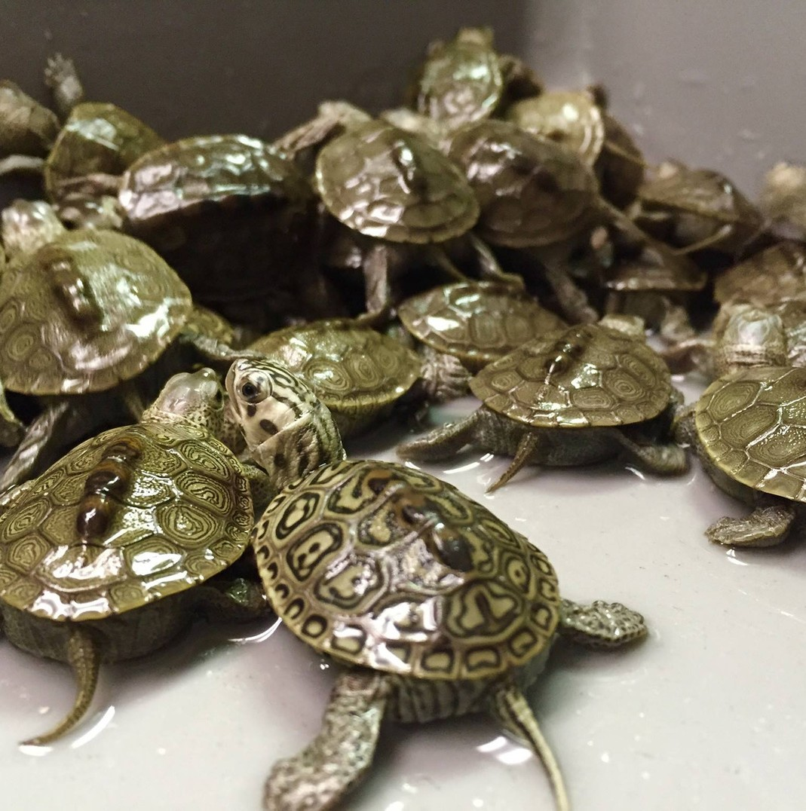
Over-harvesting and poaching
In the 1 800s terrapins were harvested for food, used as a main ingredient in turtle soup. By the early 1900s the population was nearly depleted.
In many states including VA, MD, and NJ it is now Illegal to harvest terrapins.
Another issue is poaching, for the pet trade or for food. Adult terrapins can be easily taken from the wild or clutches of hatchlings are collected by poachers to sell.
Photo credit: Allison Anholt- personal photos

Slide 11
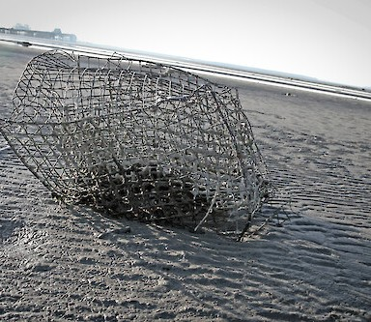
Ghost Fishing
Ghost fishing: a term that describes what happens when abandoned fishing gear 'continues to fish'.
Ghost crab pots in tidal salt marsh creeks, continue to collect crabs. Terrapins will go into the pots to eat the crabs and get trapped inside and drown.
This issue effects male turtles more than females because they tend to be smaller and can fit into the crab pot openings.
Photo crdit: Ghost pot by Melissa Jo Keever Bridges Licenced, Attribution-ShareAlike 4.0 International (CC BY-SA 4.0)

Slide 12
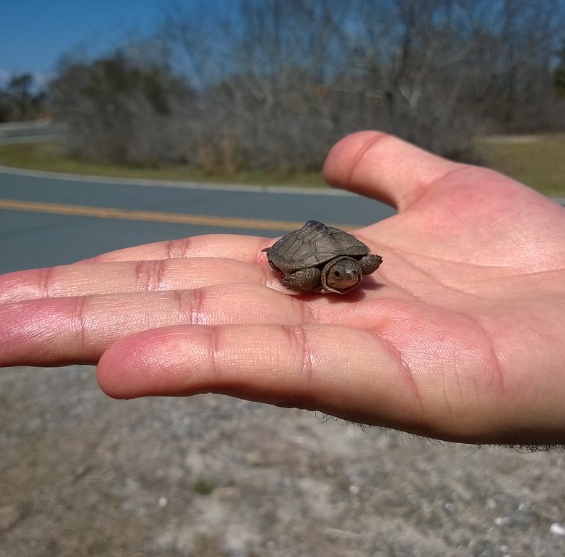
Habitat Loss and Road Mortalities
Terrapins are losing nest habitat as humans develop in coastal areas.
Roadways in coastal areas separate available nest habitat and marshes. Terrapins will often venture across roadways in search of a place to lay eggs, where they can be struck by vehicles.
Hatchling may also cross roadways and be runover or washed down stormdrains during heavy rain.
Photo credit: Baby diamondback terrapin by N8ure Lover is licensed under CC BY-NC-ND 2.0.

Slide 13
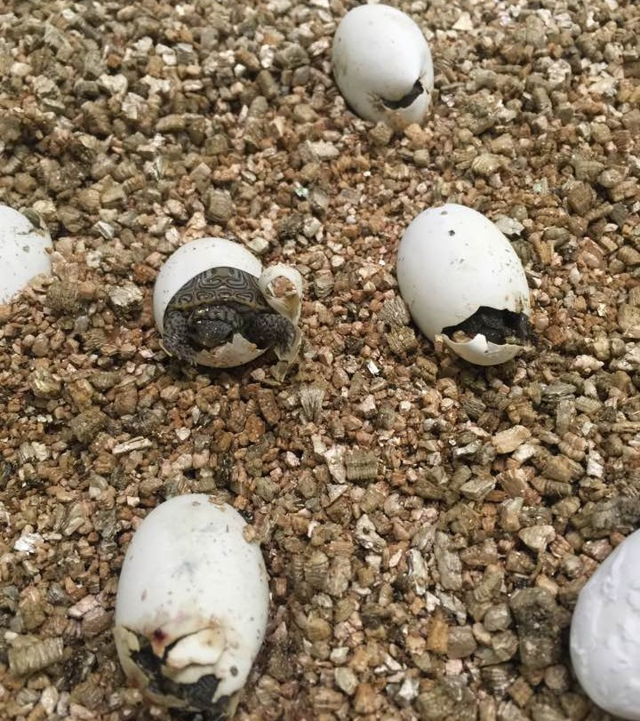
Terrapin Conservation
2
Photo Credit: Sue Slotterback- personal photol

Slide 14
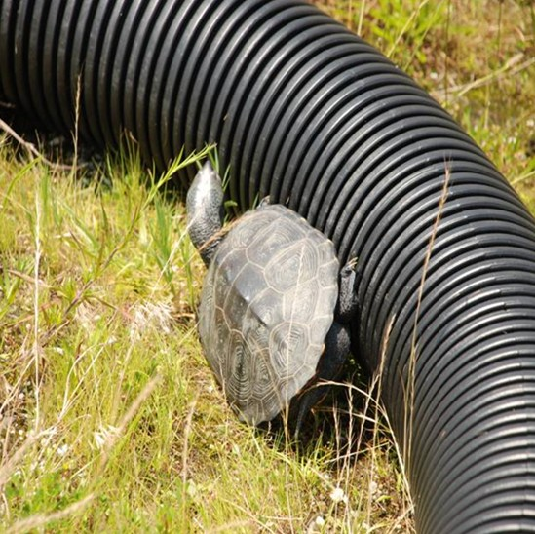
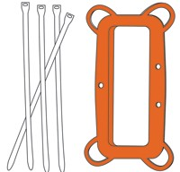
Solutions
There are several ways to reduce terrapin mortalities:
Predator exclusion- cadges that are placed over nest to protect them from predators
Turtle Exclusion Devices (TEDs)- narrow the openings of crab pots so that terrapins cannot get inside
Ghost pot removal
Barrier fencing- can be placed along roads sides where terrapins may cross, forcing them to find another path
Wildlife road crossings - areas that provide a safe bridge or tunnel for animals to cross roads
Photo credit: top- terrapin barrier by the Wetlands Institute.
Bottom- TED diagram by VIMS

Slide 15
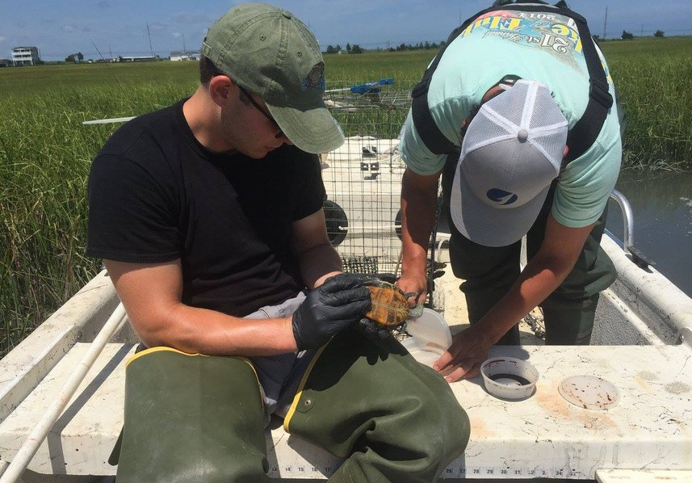
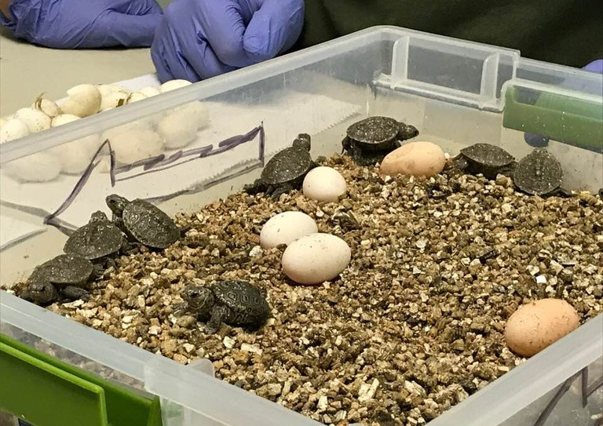
Science and Monitoring
Knowing more about terrapins will help conservation scientists protect them.
Tagging - tracking individuals
Road monitoring - finding where terrapins get struck by vehicles the most and rehabilitating any injured animals
Head starting- incubating eggs and releasing the hatchlings when they get old enough
Photo credit: Wolf Trumbauer- personal photos

Slide 16
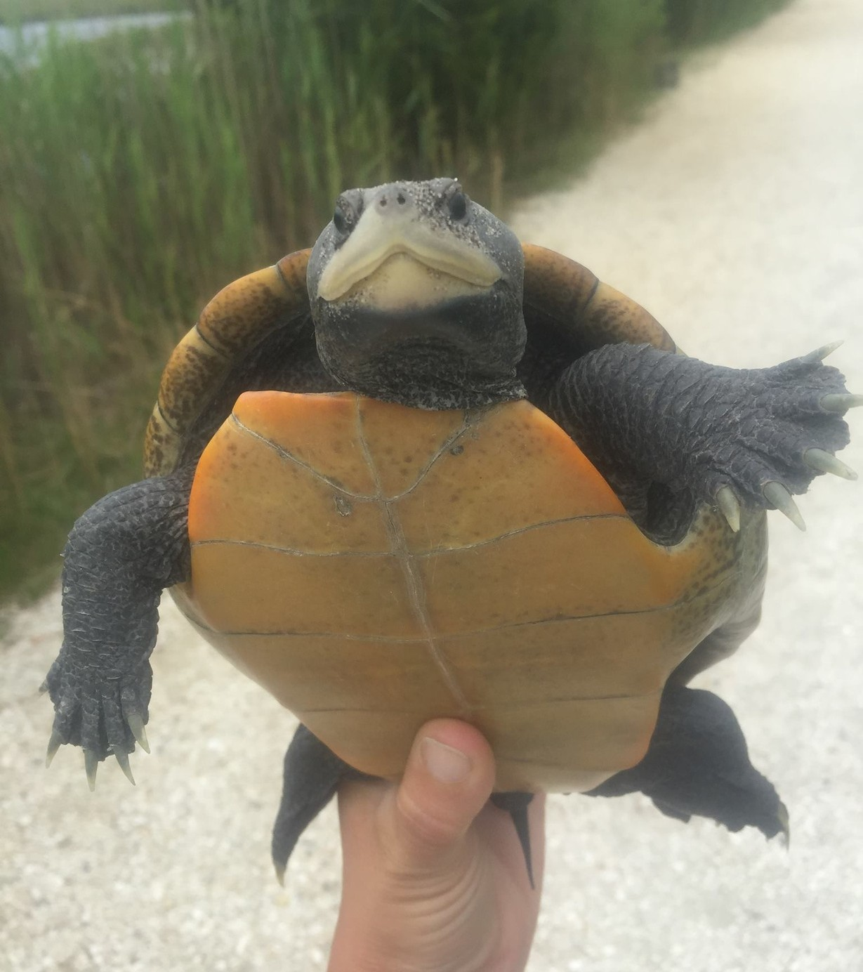
Play the Game

Slide 17
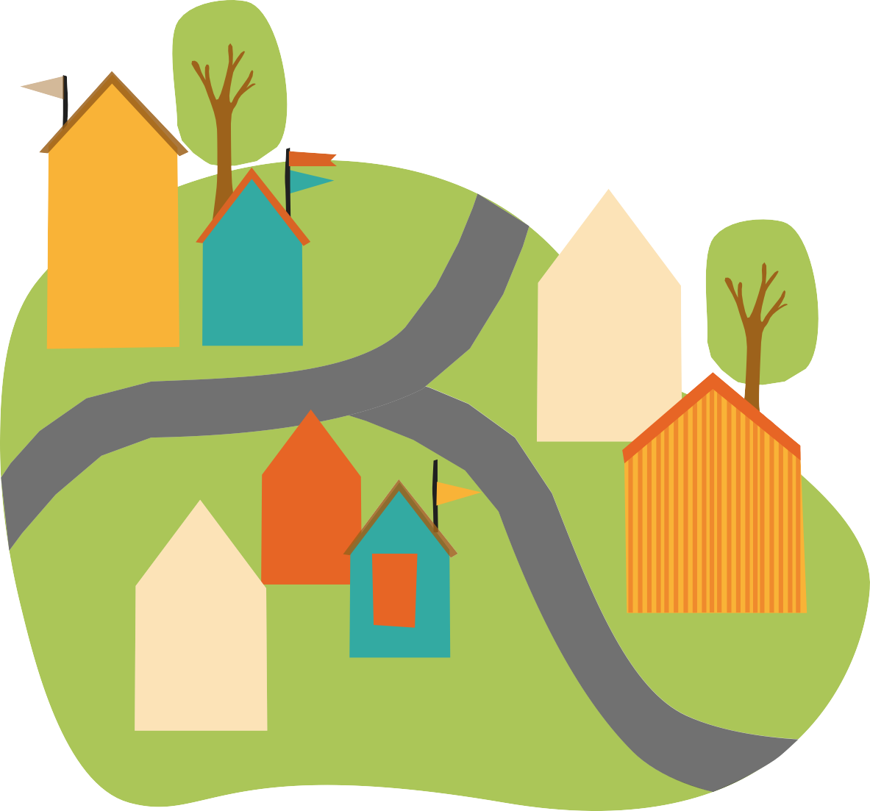


Terrapin Town:
Goal: Have the largest viable population of terrapins at the end of the game while also having an appealing town that people will want to move to.

Slide 18
Steps:
This activity has 5 rounds. Each round consists of the following:
Develop your town
Spend your tokens on conservation
An event will occur
Calculate your terrapin population
Collect tokens

Slide 19
Right now:
1. Use a pencil to mark each square that is an ideal nest habitat for terrapins in an "N". These should be sand squares adjacent to marsh and water.
2. Check your Maximum Population (MP). Each marsh square has enough space and resources to support 4 terrapins. MP= marsh squares X 4
EX: MP= 3 marsh squares X 4
MP=12
3. Write down that your Minimum Viable Population is 8 terrapins. Any population lower than 8 can not survive without threat of extinction from genetic issues or natural disasters

Slide 20
Step 1 : Develop
Draw 4 development cards and plan out where they should go on your map.

Slide 21
Step 2: Spending Action
Spend any number of tokens on the conservation actions on your spending sheet.

Slide 22
Step 3: Event
Your teacher will now roll to see what will happen.

Slide 23
Event Table
1 | Poaching | Terrapins were harvested from the marsh and sold as pets. | -35 terrapins
2 | Storm Drain | A storm came through and washed baby terrapins down the storm drain. | -3 nest
3 | Predation | Predators, such as raccoons or coyotes, dug up terrapin nests and ate the eggs. | -4 nest
4 | Ghost Pots | Place 2 ghost pot icons in the water. They will remain there until removed. | -10 terrapins (per pot per round they're on the board)
5 | Habitat Loss | A landowner has accidentally built on a nest site. | -1 nest square (color this in as a house)
6 | Road Mortality | Female terrapins were stuck by cars while trying to cross roadways. | -7 per road adjacent to marsh, water, or beach

Slide 24

Step 4: Population
Estimate and record the terrapin population change: Nest squares remaining
MP = number of marsh squares remaining X 4
Terrapins lost = number lost from the event - any offset from your conservation efforts
Terrapins gained = +1 terrapin per nest
T otal population = total population from last round - terrapins lost + terrapins gained. Can not be above the MVP. Any extra cannot survive.

Slide 25
Step 5: Collect 2 Tokens
(start the next round at step 1)

Slide 26
Vocabulary
Population - the number of organisms of the same species that live in a particular geographic area at the same time.
Individual - one organism of a single species
Keystone Species - an organism that influences all other species living in an ecosystem, keeping it stable and functioning.
Minimum Viable Population - the smallest number of individuals in a population capable of living within a habitat without threat of extinction from natural disasters, demographic, or genetic issues.

Slide 27
Vocabulary
Land-use - the human use of land for economic and cultural purposes
Ghost fishing - abandoned fishing equipment which continues to catch organisms
Poaching - the illegal removal of a managed species from its natural habitat
Conservation Plan - a document that outlines how a site will be managed to decrease or avoid potential negative environmental impacts; can be specific to a population or community.

