Slide 1
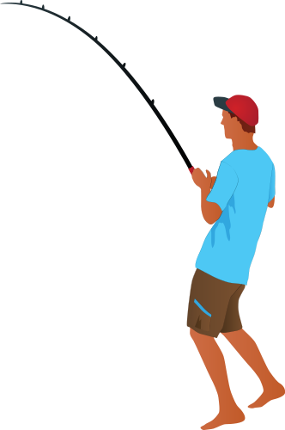
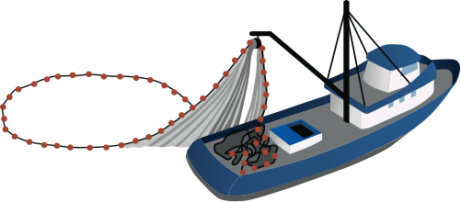
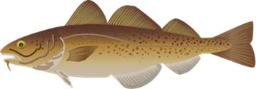
Going Fishing in the Classroom
Will Shoup
VA SEA Lesson Plan, 2022

Slide 2
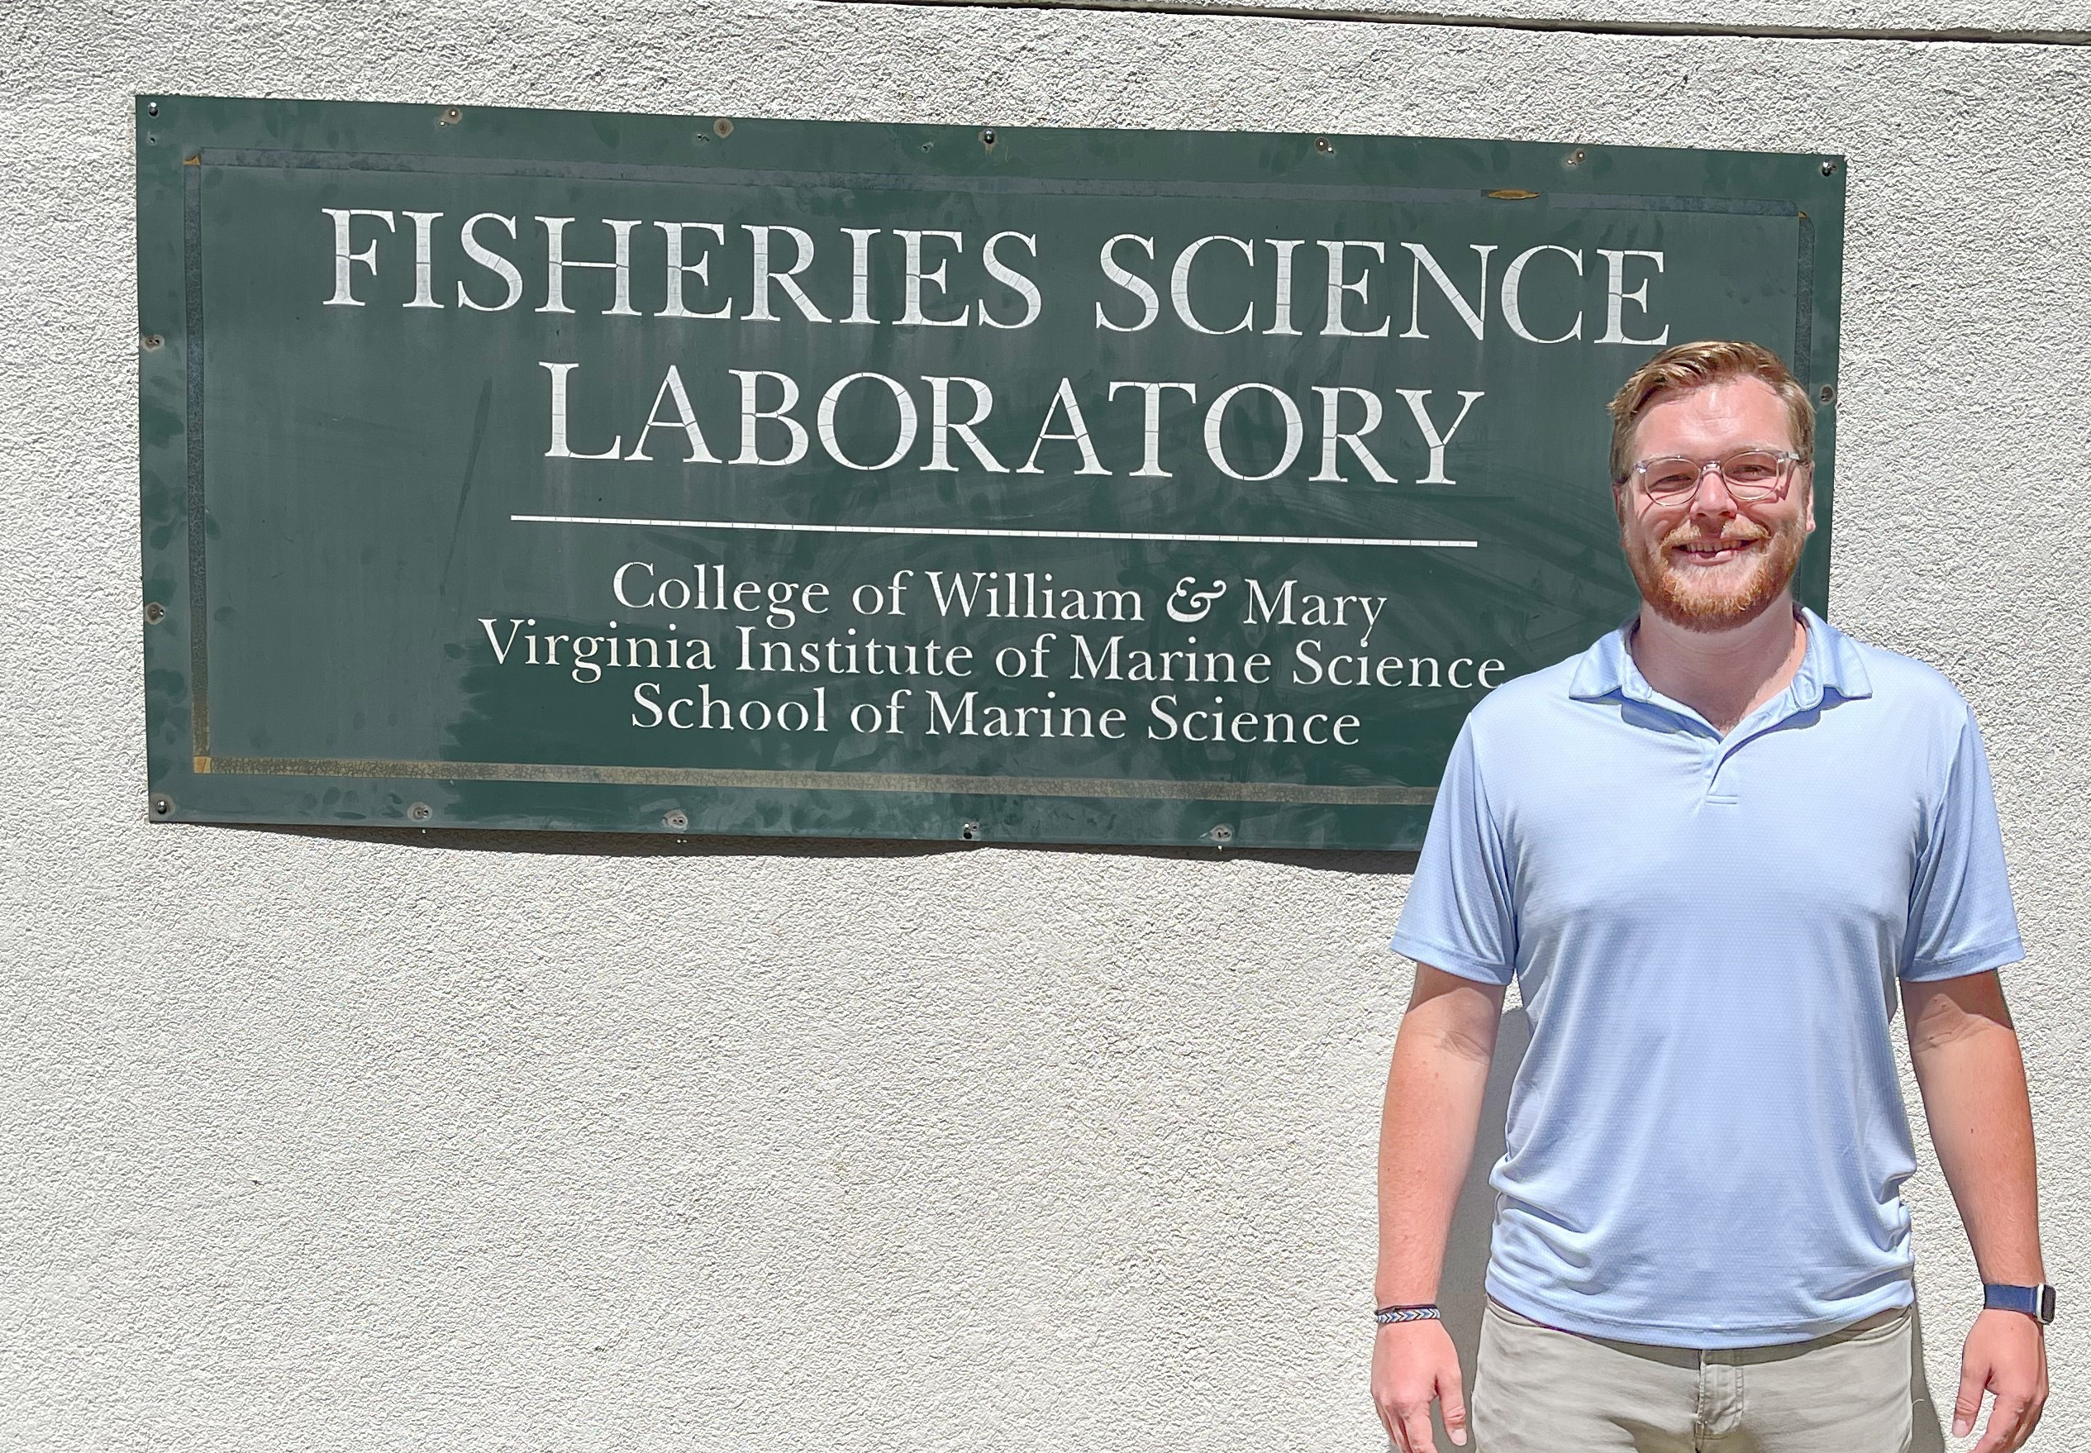
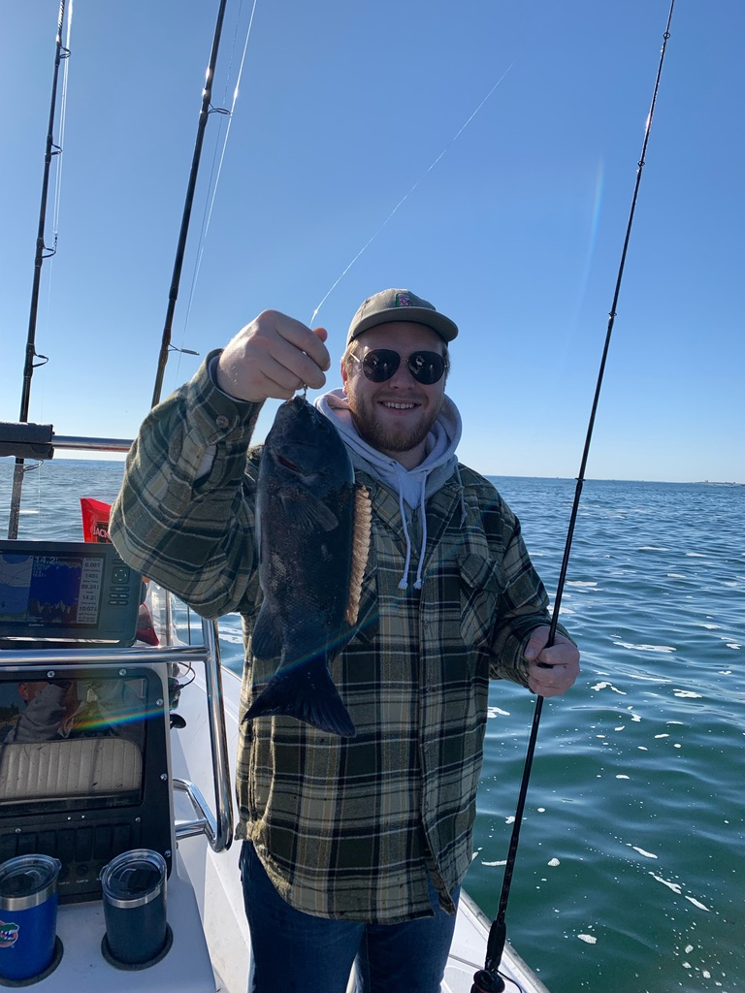
Meet the Scientist
Hi! I’m Will and I’m a graduate student at the Virginia Institute of Marine Science. I’m interested in helping fishermen to do their job in a sustainable way.

Slide 3
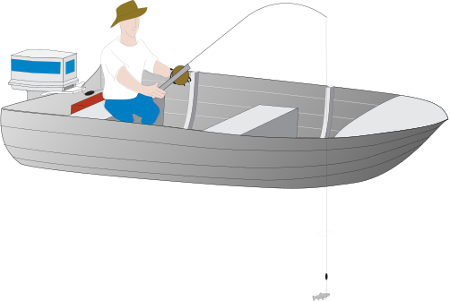
What does a fisherman look like?
  Did you think of somebody with a rod and reel on the beach or in a small boat?
  You’re probably thinking of a recreational fisherman. Somebody who catches fish for fun!

Slide 4
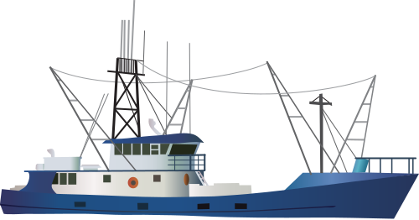
Did you know about commercial fishermen?
Commercial fishermen catch fish for their job
  They use boats, nets, and lots of hooks
That means that they can catch lots of fish at once

Slide 5
Today’s activity
Everybody gets a chance to be a commercial fisherman and a recreational fisherman
We’re fishing for Atlantic Cod, which look like this:
Whoever catches the most fish is the winner!

Slide 6
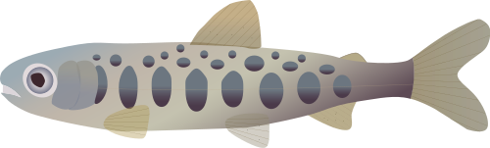
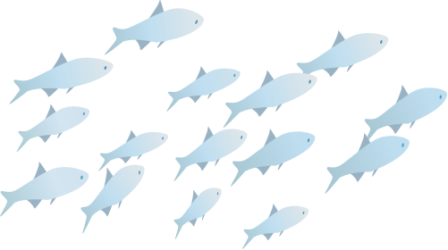
Vocabulary Check-in
Fish Stock: The number of fish in a population
Fishery: An area where fish are caught for commercial or recreational purposes
Overfishing: Taking more fish than we should. This means the fish stock will get smaller over time.

Slide 7
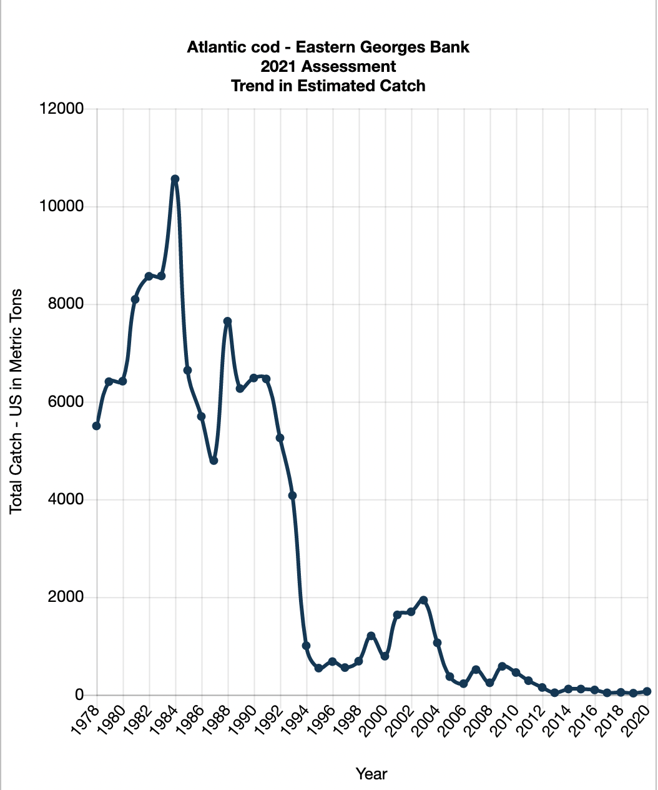
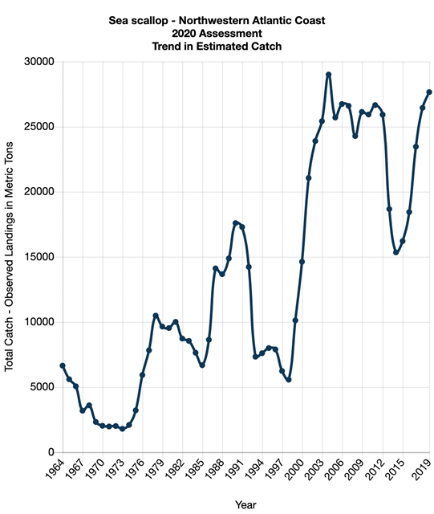
What did we learn?

Slide 8


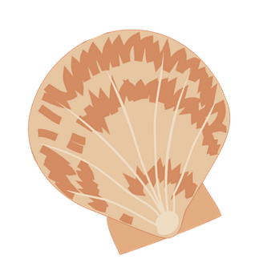
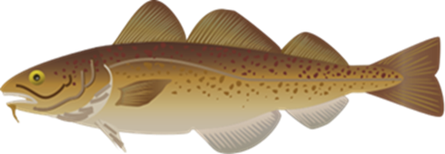
What did we learn?
When we fished for cod today, we started to run out!
Does that mean commercial fishermen are bad?
No! But it means that we should have rules about how many fish we catch at once. Scientists, fishermen, and lawmakers need to work together to make sure there are enough fish for everybody.
Without rules, the cod stock went and when we added them, the scallop stock went

Slide 9
Photo Attributions
Slide 1 –
  Purse Seine: Tracey Saxby, Integration and Application Network (ian.umces.edu/media-library) (also featured on slides 4, 6).
  Surf fisherman: Tracey Saxby, Integration and Application Network (ian.umces.edu/media-library) (also featured on slide 3).
  Atlantic cod: Kim Kraeer, Lucy Van Essen-Fishman, Integration and Application Network (ian.umces.edu/media-library) (also featured on slides 5,6, 9)
Slide 2 –
  Will next to sign: Laura Patrick/VIMS
  Will with fish: John Marcin
Slide 3 -
  Fisherman in boat: Diana Kleine, Marine Botany UQ (ian.umces.edu/media-library)
  Will: John Marcin
Slide 4 –
  Tuna Boat: Kim Kraeer, Lucy Van Essen-Fishman, Integration and Application Network (ian.umces.edu/media-library)
Slide 6 –
  Salmon: Joe Edgerton, Integration and Application Network (ian.umces.edu/media-library)
  Fish School: Tracey Saxby, Integration and Application Network (ian.umces.edu/media-library)
Slide 7 –
  NOAA Stock SMART database
Slide 8 –
  Scallop: Dieter Tracey, Water and Rivers Commission (ian.umces.edu/media-library)

