Slide 1
Shark Sanctuaries: Identifying Suitable Habitat for Small and Large Coastal Sharks
An exploration of where different sharks may live along the US Atlantic Coast and how changes in the environment may impact their distributions
Prepared By: Kaitlyn O’Brien in 2022
Virginia Institute of Marine Science

Slide 2
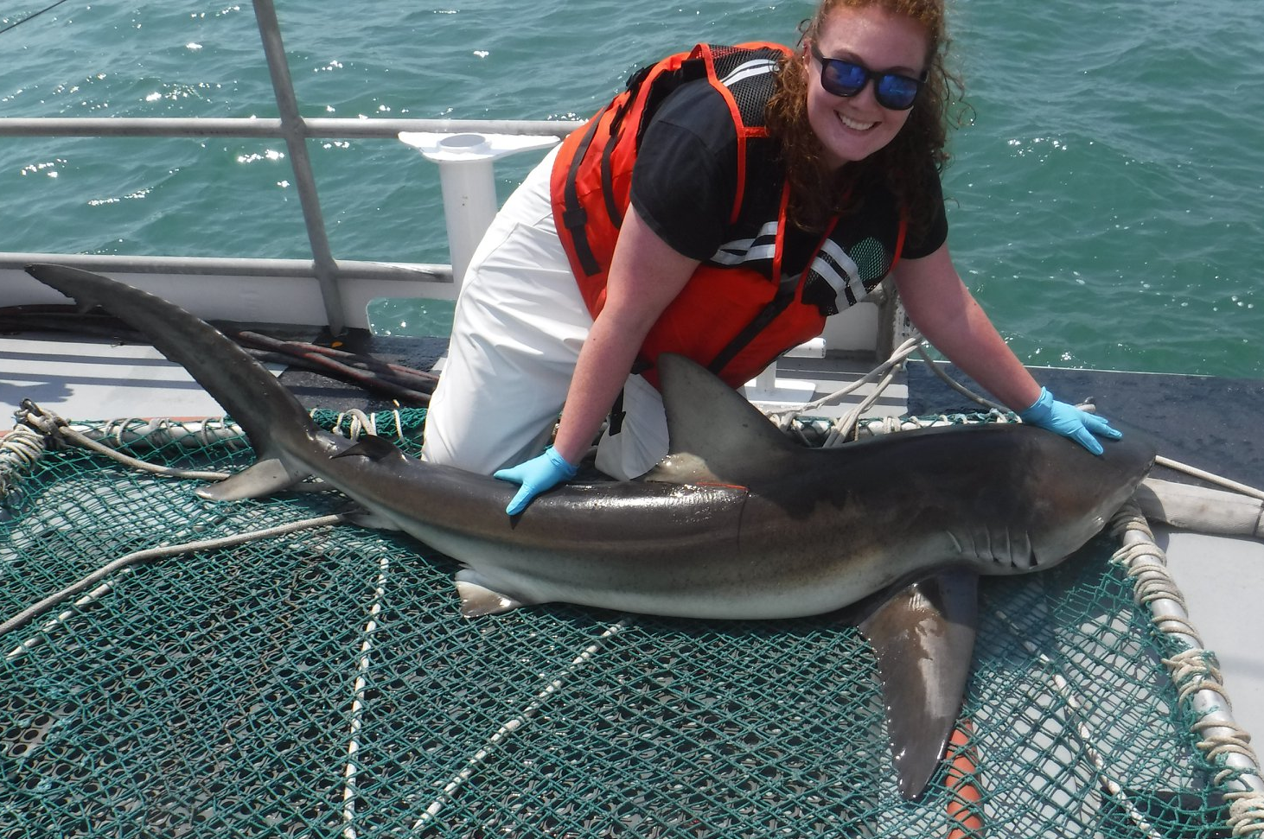
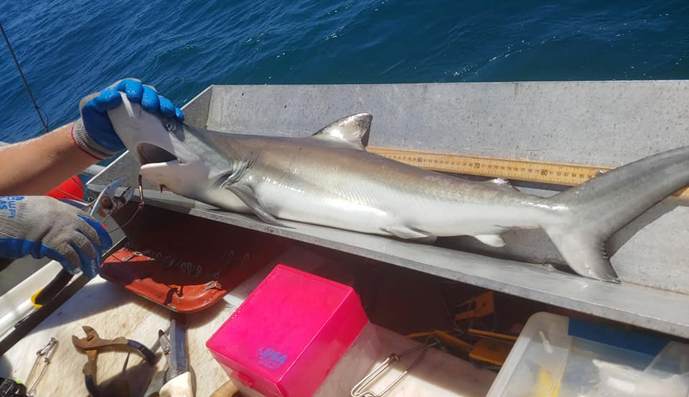
Kaitlyn O’Brien
Ph.D. Candidate at the Virginia Institute of Marine Science (VIMS)
I am a fisheries scientist-in-training!
I study how changes in the environment impact small and large coastal shark populations – like sandbar sharks
Photo Credit: Kaitlyn O’Brien
Photo Credit: Kaitlyn O’Brien
Notes:
Photo Credit: K. O’Brien
----
Species of sharks in photos: top – dusky shark, bottom – silky shark

Slide 3
Research Briefing
“Sharks are beautiful animals, and if you're lucky enough to see lots of them, that means that you're in a healthy ocean. You should be afraid if you are in the ocean and don't see sharks.”
- Sylvia Earle, Marine Biologist
Sharks are vital for healthy ecosystems, so it is critical to monitor their populations. This includes studying where sharks live and how many there are.
Notes:
Photo Credit: Left-NOAA FLICKR, Right-K. O’Brien
----
This slide summarizes the main goal to be answered by this lesson

Slide 4
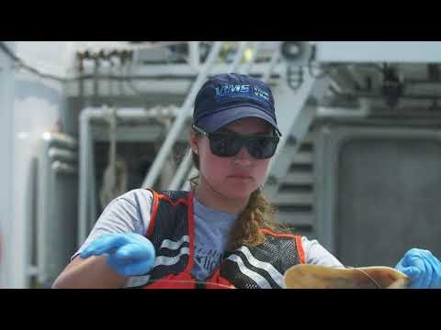

Slide 5
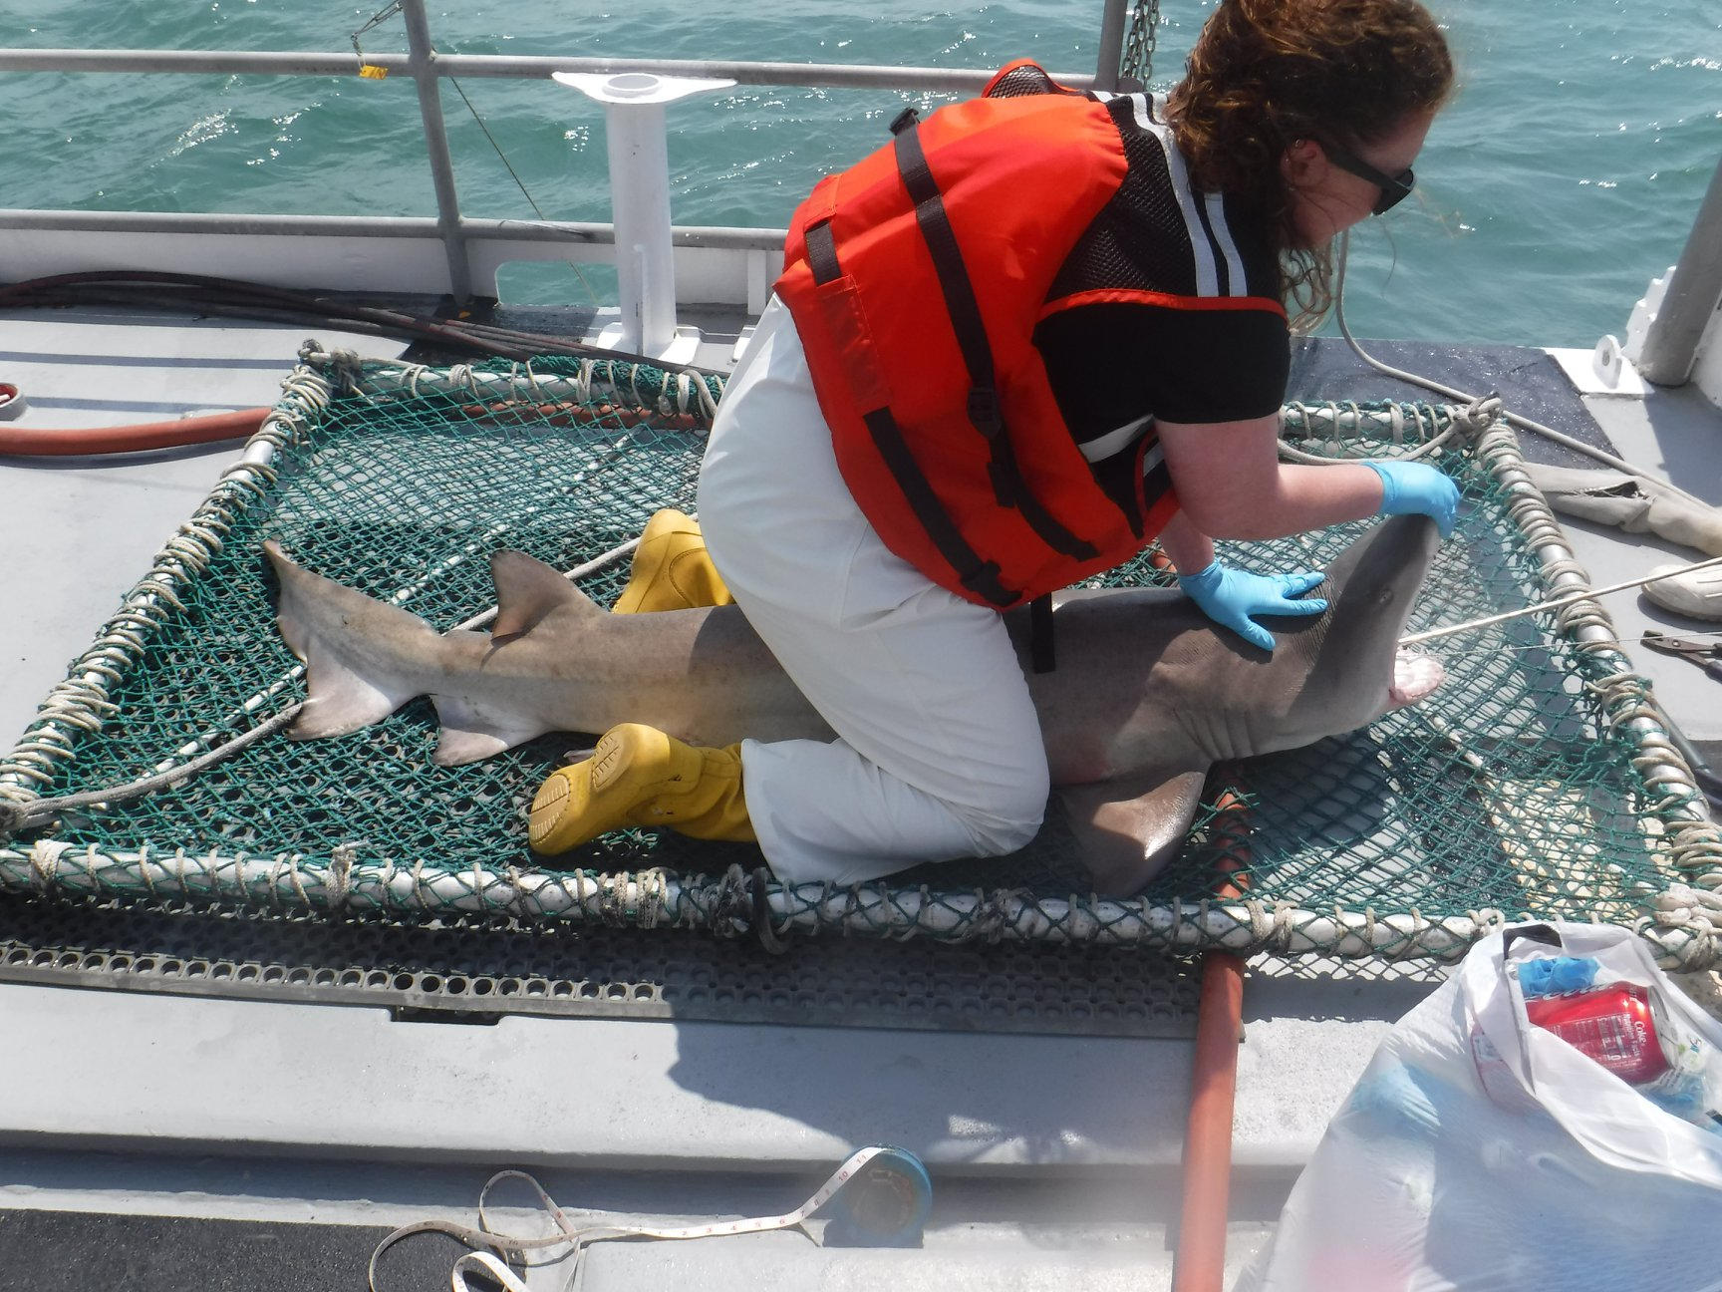
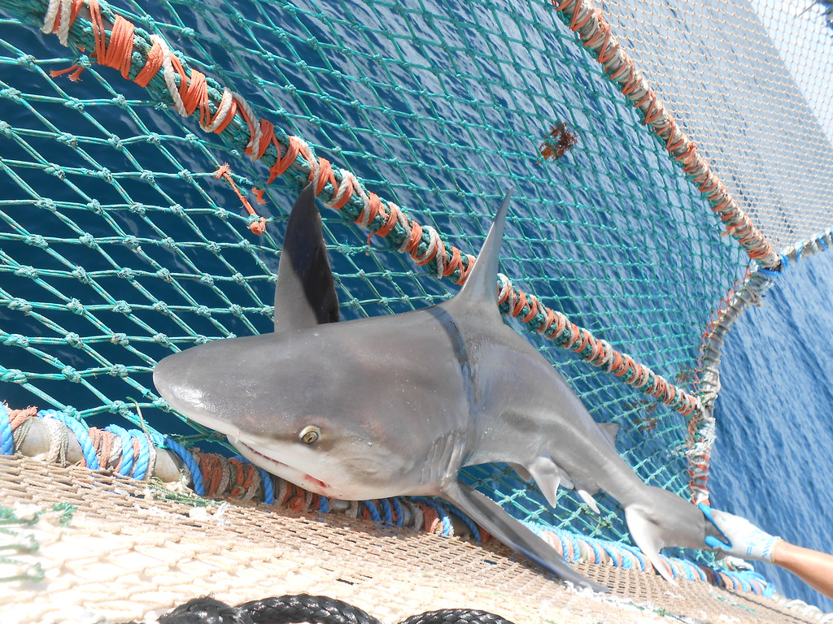
Your Task
Learn about five shark species common to the US Atlantic Coast
Explore how abiotic factors can impact the distribution and abundance of sharks
Simulate a shark survey and make hypotheses from the gathered information
Hypothesize how shark distributions may change over time
Photo Credit: K. O’Brien
Photo Credit: NOAA Flickr
Notes:
Photo Credit: Left-NOAA Flickr, Right-K. O’Brien
----
This slide summarizes the study objectives of the lesson

Slide 6
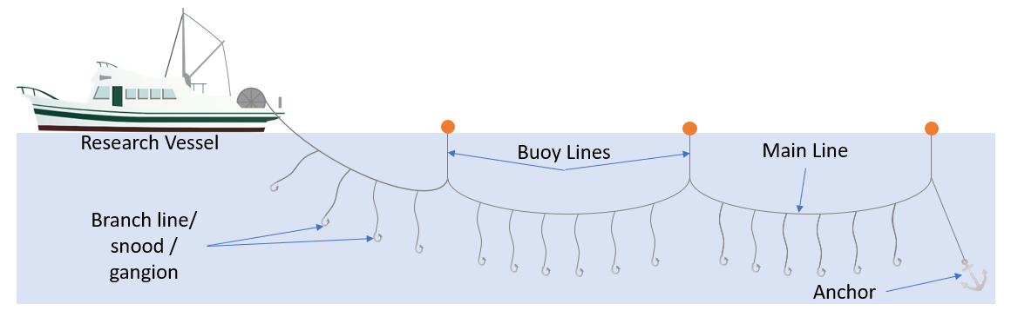
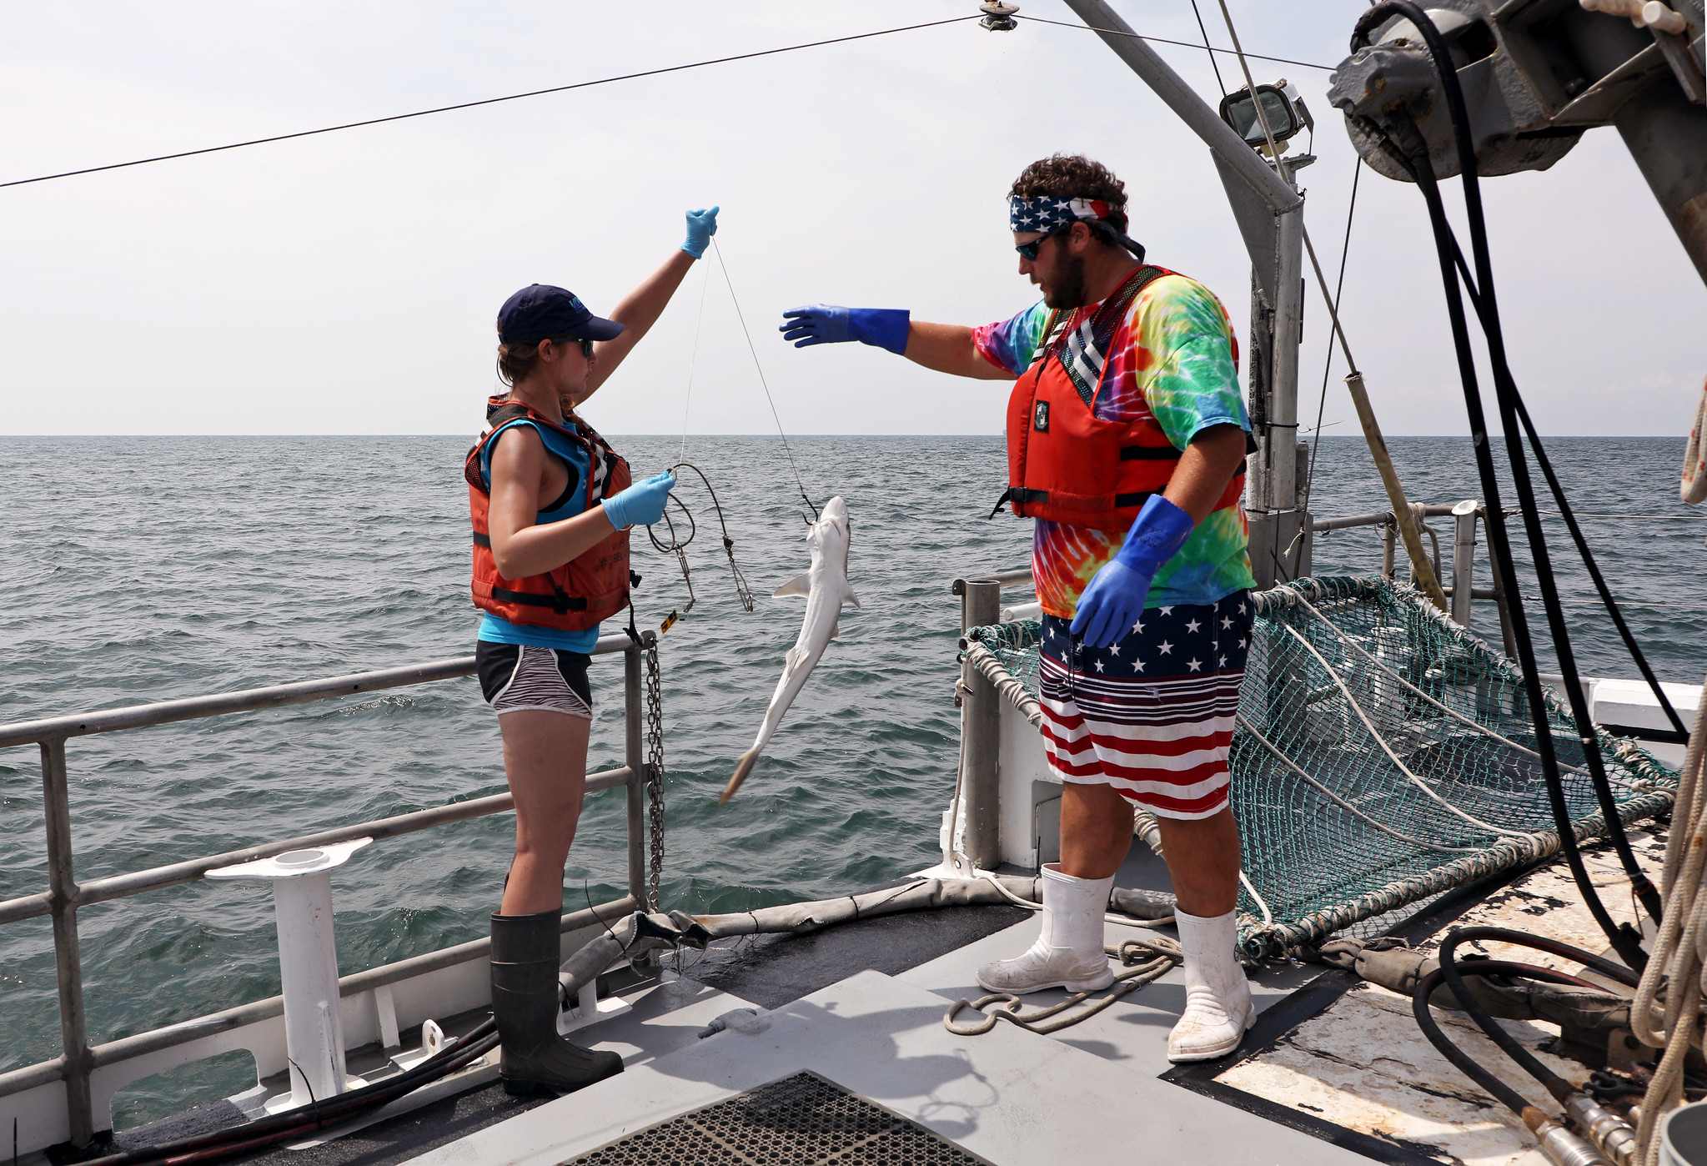
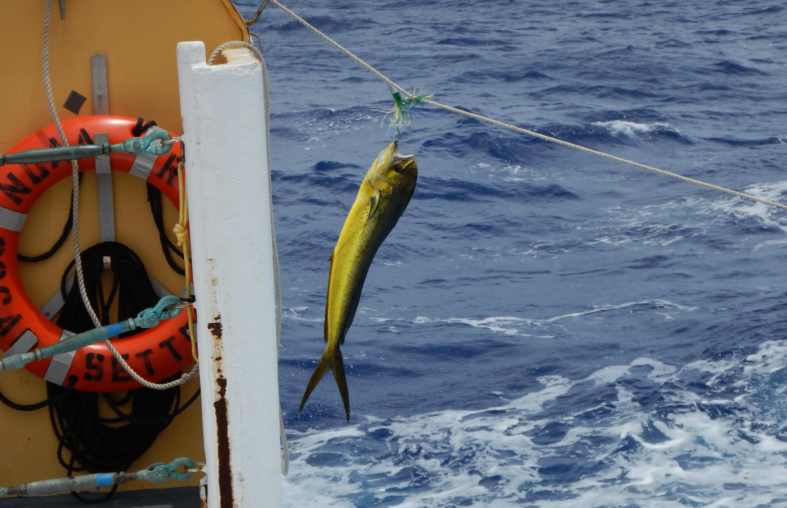
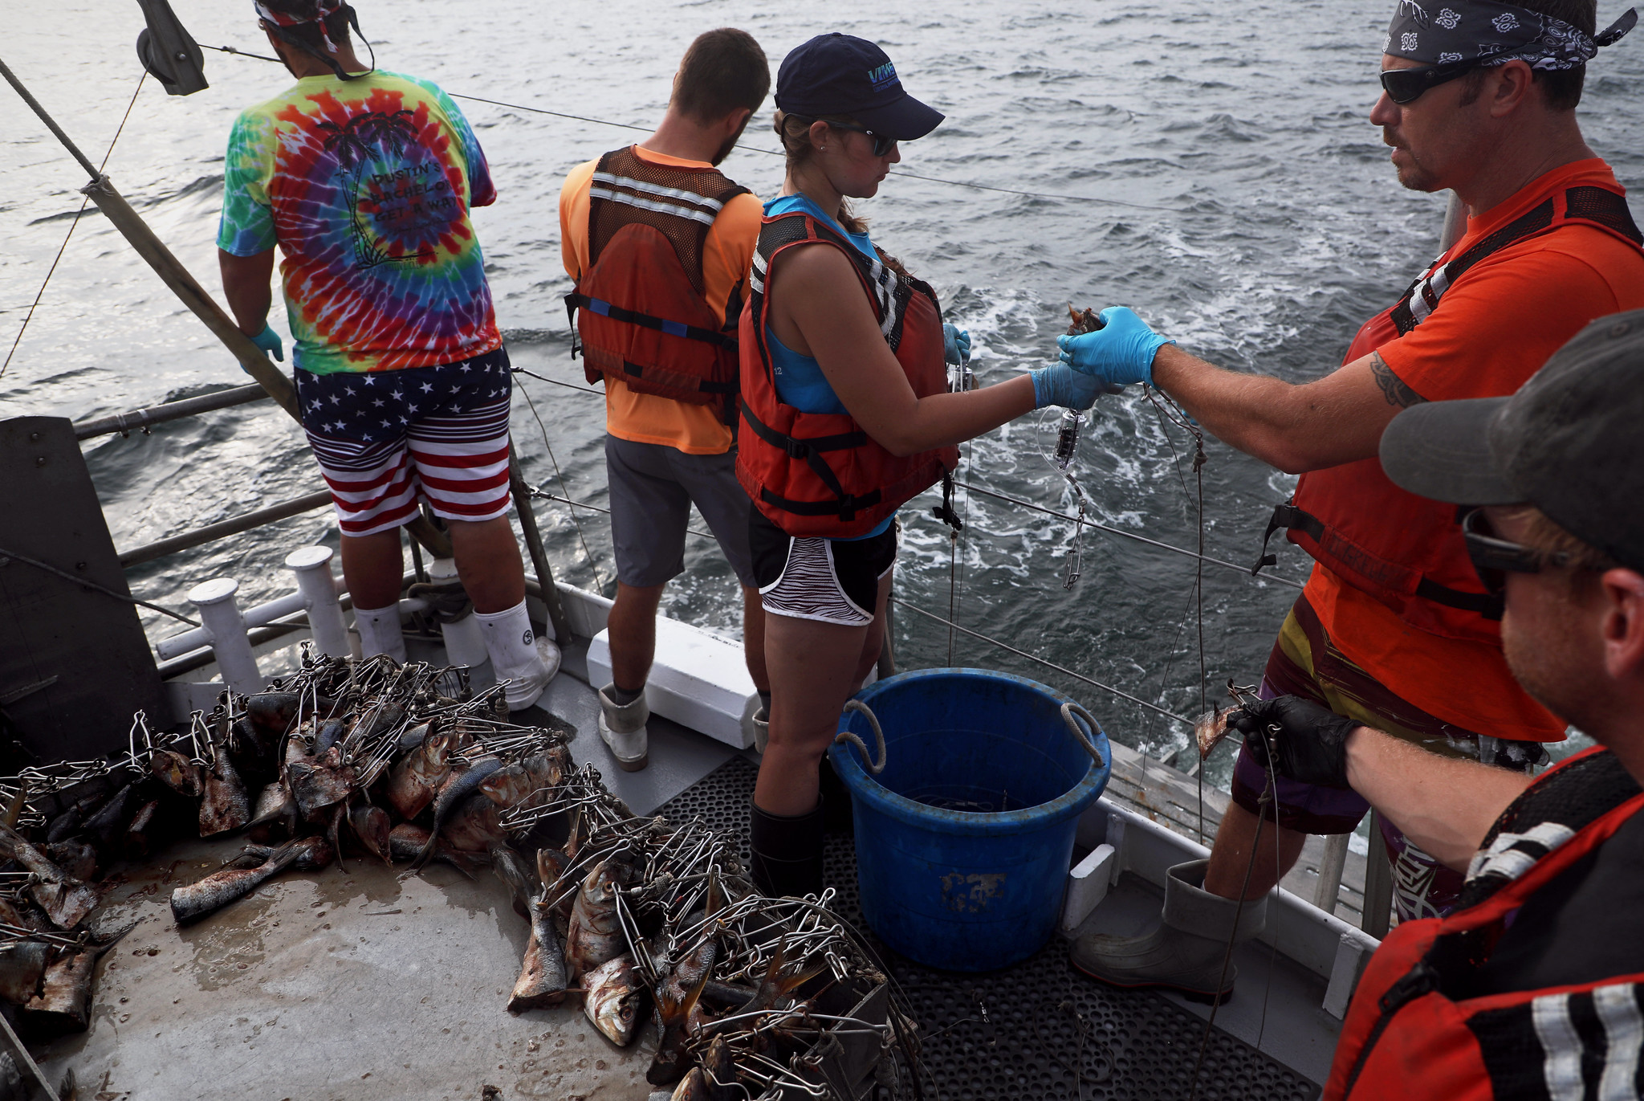
How do we sample sharks?
Shark populations are often sampled using Longlines
Photo Credits: Longline: UMCES IAN, Mahi: NOAA Flickr, Longline Deployment: VA Sea Grant Flickr
Notes:
Photo Credits: Longline: UMCES IAN, Mahi: NOAA Flickr, Longline Deployment: VA Sea Grant Flickr
----
Scientists monitor shark populations using fishery-independent surveys – which are standardized long-term monitoring projects to collect important information. By standardizing this information we can limit the amount of uncertainty or error incorporated into the study.
The major gear type used to sample sharks is a longline
Longlines consist of a long mainline, that can range from 100 meters to several thousand. Along the mainline are buoys to keep it floating and gangions. Gangions are what the baited hooks are attached to. For a bottom longline, both ends have anchors to keep the line grounded. The gear soaks for hours, ranging from 30 minutes to 4+ hours.
Once the longline has soaked for a decent amount of time the line is slowly brought back in and animals are identified, measured, and tagged. Environmental conditions are also collected during each longline
These longlines are repeated for every year, during different months, and over multiple locations
BUT! Even thought longlines are the best method for sampling sharks it is still very common to catch NO SHARKS – so how do scientists deal with this? That is something else we will explore in this activity

Slide 7
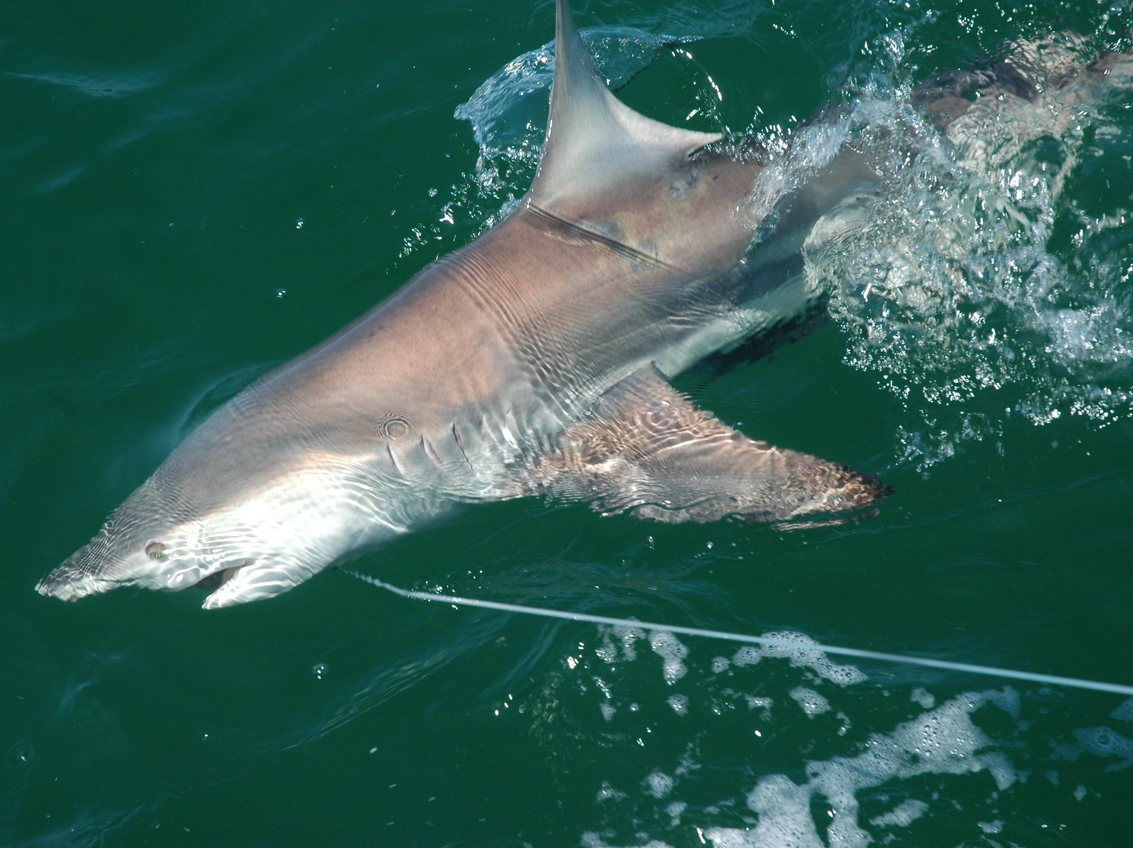
What do we use this data for?
Data can be used to:
Determine how a species is doing over time
Photo Credit: NOAA FLICKR
Notes:
Photo credit: NOAA FLICKR
----
The data that is collected from scientific surveys can be used in a variety of ways. One major use is to evaluate how different shark populations are changing from year to year, but another use is to examine suitable habitat for different species – specifically the abiotic factors. For this exercise we will be looking into how this data can be used to estimate a species ecological niche
Talk about what makes a suitable habitat
There are three major parts of an animals habitat; the accessibility, biotic factors (living parts of the ecosystem), and abiotic factors (non-living parts of the ecosystem)
This data can be used to evaluate the abiotic factors by comparing catch rates to collected environmental information
Consider asking the students for some examples of abiotic factors.
Common metrics that are sampled includes water temperature, salinity, depth, distance from shore, and dissolved oxygen

Slide 8
What do we use this data for?
Abiotic Factors
Data can be used to:
Determine how a species is doing over time
Examine suitable habitat
Migratory Accessibility
Biotic Factor
D
Photo Credit: Kaitlyn O’Brien
Notes:
----
The data that is collected from scientific surveys can be used in a variety of ways. One major use is to evaluate how different shark populations are changing from year to year, but another use is to examine suitable habitat for different species – specifically the abiotic factors. For this exercise we will be looking into how this data can be used to estimate a species ecological niche
Talk about what makes a suitable habitat
There are three major parts of an animals habitat; the accessibility, biotic factors (living parts of the ecosystem), and abiotic factors (non-living parts of the ecosystem)
This data can be used to evaluate the abiotic factors by comparing catch rates to collected environmental information
Consider asking the students for some examples of abiotic factors.
Common metrics that are sampled includes water temperature, salinity, depth, distance from shore, and dissolved oxygen

Slide 9
What do we use this data for?
Abiotic Factors
Data can be used to:
Determine how a species is doing over time
Examine suitable habitat
By comparing catch rates to collected environmental information scientists can use this data to evaluate ideal abiotic factors
Migratory Accessibility
Biotic Factor
D
Photo Credit: Kaitlyn O’Brien
Notes:
----
The data that is collected from scientific surveys can be used in a variety of ways. One major use is to evaluate how different shark populations are changing from year to year, but another use is to examine suitable habitat for different species – specifically the abiotic factors. For this exercise we will be looking into how this data can be used to estimate a species ecological niche
Talk about what makes a suitable habitat
There are three major parts of an animals habitat; the accessibility, biotic factors (living parts of the ecosystem), and abiotic factors (non-living parts of the ecosystem)
This data can be used to evaluate the abiotic factors by comparing catch rates to collected environmental information
Consider asking the students for some examples of abiotic factors.
Common metrics that are sampled includes water temperature, salinity, depth, distance from shore, and dissolved oxygen
How do they think these metrics could impact animals?
Ex: Warm waters lead to increased metabolic rates – which may not be sustainable for animals for long periods of time

Slide 10
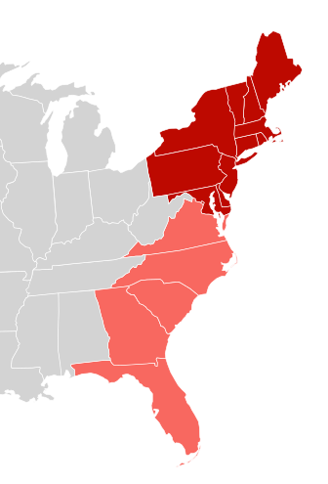
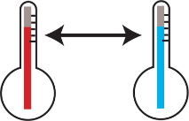
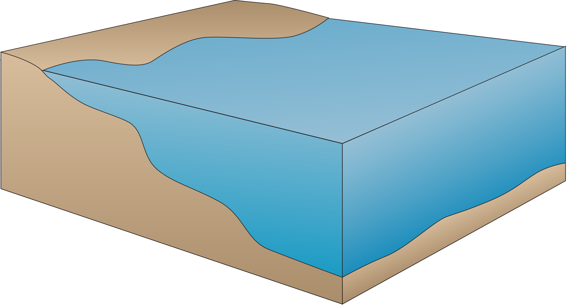


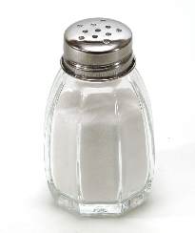
What do we use this data for?
By sampling at a variety of locations, scientists can understand what factors are important for different species and different ages
Photo Credit: UMCES IAN and Wikipedia Commons
Notes:
Photo Credits: Map: Wikipedia Commons, House and other: UMCES IAN
----
The data that is collected from scientific surveys can be used in a variety of ways. One major use is to evaluate how different shark populations are changing from year to year, but another use is to examine suitable habitat for different species – specifically the abiotic factors.
Stress the importance of multiple samples
By sampling multiple locations and environments we gather more information to better our predictions.
When thinking about samples, it is important to be familiarize with the Coastal Atlantic environment
Abiotic factors can follow some simple trends depending on the locations – talk to the students about some of these trends
Examples include water being warmer in the south and closer to shore, salinity being lower closer to shore (due to fresh water input), Depth gets deeper the farther offshore, Dissolved oxygen is lower closer to shore and increases in colder water.
Give a brief overview over some of these patterns

Slide 11
What do we use this data for?
What are some common trends?
Water temperature
Photo Credit: UMCES IAN and Wikipedia Commons
Notes:
Photo Credits: Map: Wikipedia Commons, House and other: UMCES IAN
----
The data that is collected from scientific surveys can be used in a variety of ways. One major use is to evaluate how different shark populations are changing from year to year, but another use is to examine suitable habitat for different species – specifically the abiotic factors.
Stress the importance of multiple samples
By sampling multiple locations and environments we gather more information to better our predictions.
When thinking about samples, it is important to be familiarize with the Coastal Atlantic environment
Abiotic factors can follow some simple trends depending on the locations – talk to the students about some of these trends
Examples include water being warmer in the south and closer to shore
Salinity is lower closer to shore (due to fresh water input)
Depth gets deeper the farther offshore
Dissolved oxygen is lower closer to shore and increases in colder water.
Give a brief overview over some of these patterns

Slide 12
What do we use this data for?
What are some common trends?
Water temperature
Salinity
Photo Credit: UMCES IAN and Wikipedia Commons
Notes:
Photo Credits: Map: Wikipedia Commons, House and other: UMCES IAN
----
The data that is collected from scientific surveys can be used in a variety of ways. One major use is to evaluate how different shark populations are changing from year to year, but another use is to examine suitable habitat for different species – specifically the abiotic factors.
Stress the importance of multiple samples
By sampling multiple locations and environments we gather more information to better our predictions.
When thinking about samples, it is important to be familiarize with the Coastal Atlantic environment
Abiotic factors can follow some simple trends depending on the locations – talk to the students about some of these trends
Examples include water being warmer in the south and closer to shore
Salinity is lower closer to shore (due to fresh water input)
Depth gets deeper the farther offshore
Dissolved oxygen is lower closer to shore and increases in colder water.
Give a brief overview over some of these patterns

Slide 13
What do we use this data for?
What are some common trends?
Water temperature
Salinity
Depth
Photo Credit: UMCES IAN and Wikipedia Commons
Notes:
Photo Credits: Map: Wikipedia Commons, House and other: UMCES IAN
----
The data that is collected from scientific surveys can be used in a variety of ways. One major use is to evaluate how different shark populations are changing from year to year, but another use is to examine suitable habitat for different species – specifically the abiotic factors.
Stress the importance of multiple samples
By sampling multiple locations and environments we gather more information to better our predictions.
When thinking about samples, it is important to be familiarize with the Coastal Atlantic environment
Abiotic factors can follow some simple trends depending on the locations – talk to the students about some of these trends
Examples include water being warmer in the south and closer to shore
Salinity is lower closer to shore (due to fresh water input)
Depth gets deeper the farther offshore
Dissolved oxygen is lower closer to shore and increases in colder water.
Give a brief overview over some of these patterns

Slide 14
What do we use this data for?
What are some common trends?
Water temperature
Salinity
Depth
Dissolved Oxygen
Photo Credit: UMCES IAN and Wikipedia Commons
Notes:
Photo Credits: Map: Wikipedia Commons, House and other: UMCES IAN
----
The data that is collected from scientific surveys can be used in a variety of ways. One major use is to evaluate how different shark populations are changing from year to year, but another use is to examine suitable habitat for different species – specifically the abiotic factors.
Stress the importance of multiple samples
By sampling multiple locations and environments we gather more information to better our predictions.
When thinking about samples, it is important to be familiarize with the Coastal Atlantic environment
Abiotic factors can follow some simple trends depending on the locations – talk to the students about some of these trends
Examples include water being warmer in the south and closer to shore
Salinity is lower closer to shore (due to fresh water input)
Depth gets deeper the farther offshore
Dissolved oxygen is lower closer to shore and increases in colder water.
Give a brief overview over some of these patterns

Slide 15
What do we use this data for?
What are some common trends?
Water temperature
Salinity
Depth
Dissolved Oxygen
Distance from shore
Photo Credit: UMCES IAN and Wikipedia Commons
Notes:
Photo Credits: Map: Wikipedia Commons, House and other: UMCES IAN
----
The data that is collected from scientific surveys can be used in a variety of ways. One major use is to evaluate how different shark populations are changing from year to year, but another use is to examine suitable habitat for different species – specifically the abiotic factors.
Stress the importance of multiple samples
By sampling multiple locations and environments we gather more information to better our predictions.
When thinking about samples, it is important to be familiarize with the Coastal Atlantic environment
Abiotic factors can follow some simple trends depending on the locations – talk to the students about some of these trends
Examples include water being warmer in the south and closer to shore
Salinity is lower closer to shore (due to fresh water input)
Depth gets deeper the farther offshore
Dissolved oxygen is lower closer to shore and increases in colder water.
Give a brief overview over some of these patterns

Slide 16
Questions to consider:
Do you think different species live in the same habitats?
Do you think sharks live in different habitats throughout their life cycle?
Do conditions in the environment stays the same or changes over time? If not, what are some hypothesized changes?
Notes:
---
1a. Ask students if different species can live in the same habitat. Answer: It depends on the ecology of an individual species – where they can find enough food, mates for reproduction, and optimal physical conditions for their species (for example, are they a more coastal or offshore species). Emphasize to students that while all fish have the same basic needs (ample prey, protection from predators, etc.), different species live in different habitats. Just like different people live in different places.
This activity focuses on the distinction between different habitat types.
1b. Ask students if they think fish might live in different habitats throughout their life cycle? Answer: Yes. For many species, juveniles and adults live in different habitats, but others live in the same habitat throughout their lives. It all depends on their ecology
2. Ask students if they think these conditions always stay the same or if they change over time. They should understand that environmental conditions can change from season to season, and year to year. Examples: Water temperature changes with the season; salinity can change after a heavy rain event.
Takeaway: The distribution and abundance of a particular species can vary over time in response to changes in the ecosystem. Define these terms if students are not familiar – definitions are included in the lesson plan.

Slide 17
What makes sharks different from other fish?
Chondrichthyes
  Includes sharks, skates, and rays
  Chondr – cartilage
  K-selected life-history strategy
    Long lived, slow growing, low fecundity, late maturity
Osteichthyes
  Includes bony fishes – ex: Salmon
  Osteo – Bony
  r-selected life-history strategy (mainly)
    Short lived, fast growing, high fecundity, quick to mature
Notes:
----
Explain the difference between sharks and other bony fish
Sharks are part of the group Chondrichthyes – which in latin can be broken down into chondr (cartilage) and ichthyes (fish) – referencing their cartilaginous skeleton. In contrast osteo means bones in Latin. Osteichthyes breaks down to bony fish – referencing their bony skeletons.
Some examples of common characteristics among Chondrichthyes includes the cartilaginous skeleton, internal fertilization, and five gill slits - > but there are many more!
Some examples of common characteristics among Osteichthyes is bony skeleton, external fertilization (mainly), and one gill slit
Stress the difference between K-selected and r-selected life history strategies
K-selected species are similar to humans meaning that they are long lived, slow growing, low fecundity (or few number of pups per year) and late maturity.
One example of this is the sand tiger shark (pictured) which reaches sexual maturity for females around 9-10 years and males in 6-7 years, only has 2 pups every 2-3 years, and lives around 40 years
R-Selected species are very different with short lives, fast growing, high fecundity, and quick to mature.
An example of this is the Bay anchovy. The bay anchovy matures within months of hatching, rarely live longer than two years, and spawn 50 times each mating season – releasing more than 1000 eggs each time
The few number of pups per year and the late maturity of animals can lead to quick stock collapses and a long recovery period for over fished animals
How does the difference between K and r-selected life histories impact fisheries
K-selected species are highly vulnerable to overfishing and fishing pressure.
This is due to the length of generation time (often greater than 10 years) in comparison to r selected species where the generation time can be less than a year
The number of animals in a single spawning event is also very small in K-selected species compared to r-selected species

Slide 18
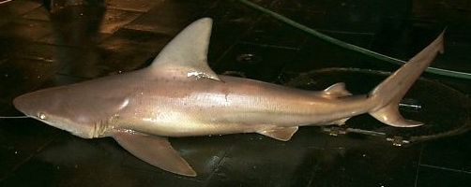
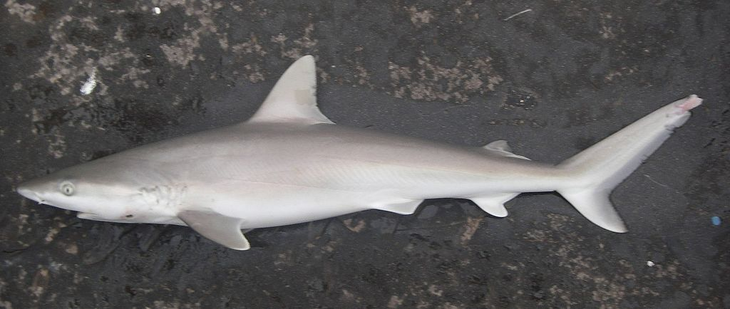
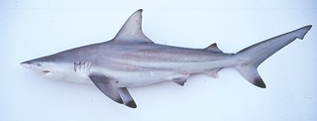
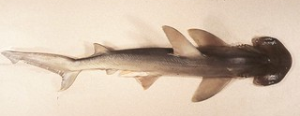
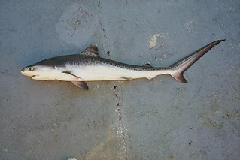
Species of consideration
Large Coastal Sharks
Small Coastal Sharks
Sandbar Shark
Blacknose Shark
Photo Credit: NOAA Flickr
Blacktip Shark
Photo Credit: Wikipedia Commons
Bonnethead Shark
Photo Credit: Florida Fish and Wildlife
Tiger Shark
Photo Credit: Florida Fish and Wildlife
Photo Credit: Florida Fish and Wildlife
Photo Credit: Wikipedia Commons, Kaitlyn O’Brien, Florida Museum of Natural History
Notes:
Photo Credit: Blacktip, Tiger, Bonnethead –Florida Fish and Wildlife, Blacknose – Wikipedia commons, Sandbar – NOAA Flickr
----
There are two major groupings of sharks - large coastal and small coastal
This breakdown is for management purposes, but also relates slightly to their ecology
But each species is different! Be sure that each student reads about their assigned species

Slide 19
Sandbar shark
Photo Credit: NOAA Flickr
Habitat: temperate to sub-tropical, bottom dwelling, often found over muddy or sandy bottoms
Range: Florida to New York, Gulf of Mexico, Caribbean Sea
  Migrate north during summer months (This is when they are found off the coast of Virginia)
Maximum Size: Males – 2.3 meters, Females – 2.5 meters
Age of Maturity: 14-20 years
Fecundity: 8 pups every 2-3 years
Maximum age: Unknown – but may exceed 50 years
Notes:
Photo Credits: Sandbar: NOAA flickr
----
This is a quick debriefing on the basics of a Sandbar shark’s ecology and life history. This can be skipped for time.

Slide 20
Tiger shark
Photo Credit: Florida Fish and Wildlife
Habitat: Sub-tropical to tropical, extreme habitat generalist, generally offshore
Range: US East Coast, Gulf of Mexico, Caribbean Sea
  Migrate north during summer months
Maximum Size: Males – 3.7 meters, Females – 5.5 meters
Age of Maturity: 8-9 years
Fecundity: 41 pups every 2 years
Maximum age: ~29 years
Notes:
Photo Credits: Tiger: Florida Fish and Wildlife
----
This is a quick debriefing on the basics of a Tiger shark’s ecology and life history. This can be skipped for time.

Slide 21
Blacktip shark
Photo Credit: Florida Fish and Wildlife
Habitat: Sub-temperate to tropical, coastal species
Range: Florida to New England, Gulf of Mexico, Caribbean Sea
  Migrate north during summer months
Maximum Size: Males – 1.75 meters, Females – 1.93 meters
Age of Maturity: 5-7 years
Fecundity: 4-11 pups every 2 years
Maximum age: ~22 years (female)
Notes:
Photo Credits: Blacktip: Florida Fish and Wildlife
----
This is a quick debriefing on the basics of a Blacktip shark’s ecology and life history. This can be skipped for time.

Slide 22
Blacknose shark
Photo Credit: Wikipedia Commons
Habitat: Sub-tropical to tropical, inshore coastal species
Range: Brazil to North Carolina, Gulf of Mexico, Caribbean Sea
  Migrate north during summer months
Maximum Size: 2 meters (more commonly 1.25 meters)
Age of Maturity: 4.5 years
Fecundity: 6 pups every 2 years
Maximum age: ~19 years
Notes:
Photo Credits: Blacknose: Wikipedia Commons
----
This is a quick debriefing on the basics of a Blacknose shark’s ecology and life history. This can be skipped for time.

Slide 23
Bonnethead shark
Photo Credit: Florida Fish and Wildlife
Habitat: Sub-tropical to tropical, inshore coastal shark
Range: Brazil to North Carolina, Gulf of Mexico, Caribbean Sea
  Migrate north during summer months
Maximum Size: 1 meter total length
Age of Maturity: 7 years
Fecundity: 2 to 14 with mean of 7 pups every year
Maximum age: ~16-18 years
Notes:
Photo Credits: Bonnethead: Florida Fish and Wildlife
----
This is a quick debriefing on the basics of a Bonnethead shark’s ecology and life history. This can be skipped for time.

Slide 24
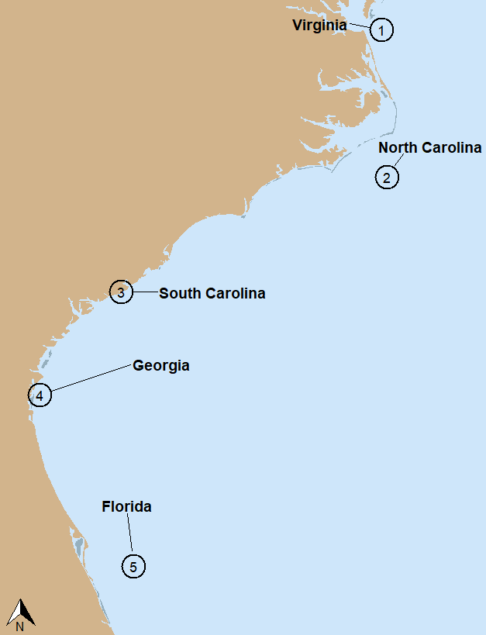
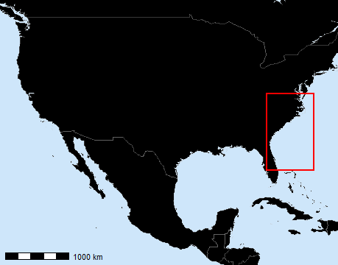
Shark Sampling Activity
We need to know:
  What abiotic factors are important for each species?
  How to deal with uncertainty in science?
Your task:
  Its field season! As scientists you will work together to sample five different surveyed locations along the US Atlantic Coast.
  At each station a scientist will be in charge of a species, but as a group you will sample your station. Sampling will involve collecting, identifying, and recording the information.
  At the end of sampling you will meet up with scientists from other stations that were in charge of the same species as you. Together, you will evaluate the ecological niche of your species
Photo Credit: K. O’Brien
Notes:
Photo Credit: Wikipedia Commons
----
This slide summarizes the questions that are to be answered during the activity.

Slide 25
Pre-Survey Questions – Station Specific
Is your sample station farther north or south along the Atlantic coast? Is your station closer to or farther from shore? How do you think the placement of your station affects the environmental conditions?
Develop a hypothesis for which shark species you think you will most likely sample at this station? What is your evidence for this?
Are there any species you do not expect to find at this site? Why or why not?
Notes:
This slide has a copy of the Pre-Survey questions #1, 2, and 3 on the Survey Data Worksheet. Students should answer these on their sheet with their STATION group and before sampling

Slide 26
Post-Survey Questions – Species Specific
Was there any particular station where your species was never caught? Do you have any hypotheses as to why?
Looking at your graphs describe what your species optimal environment is (ex: best water temperatures).
How often did you sample "No sharks"? Was this surprising? Do you think catching "No sharks" really means your species wasn't there, or did you just not sample any? Do you think there was a purpose to sampling your station multiple times?
How would you improve on your shark's estimated ecological niche?
Notes:
This slide has a copy of the Post-Survey questions #4, 5, 6, and 7 on the Survey Data Worksheet. Students should answer these with their SHARK group after surveying and graphing

Slide 27
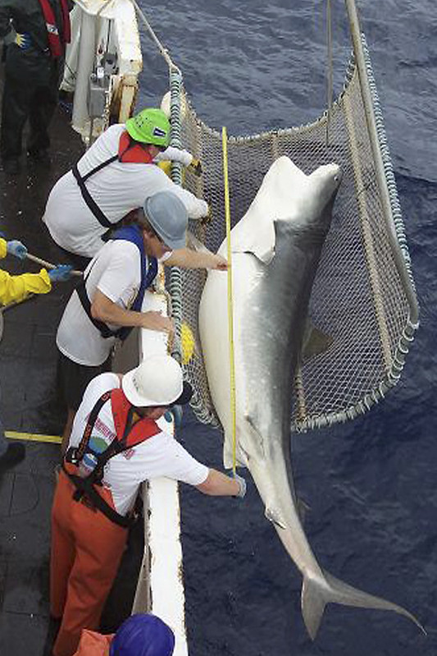
How is a species distribution expected to change?
The environment that sharks live in is expected to change due to climate change. This can lead to new interactions between species, changes in commercial fisheries, and new difficulties when it comes to assessing the health of shark populations.
In response to this, it is important to predict how a species distribution may change over time to prepare for the future.
Photo Credit: NOAA Flickr
Notes:
Photo Credit: NOAA Flickr
----
This slide summarizes the importance of the second part of the activity.

Slide 28
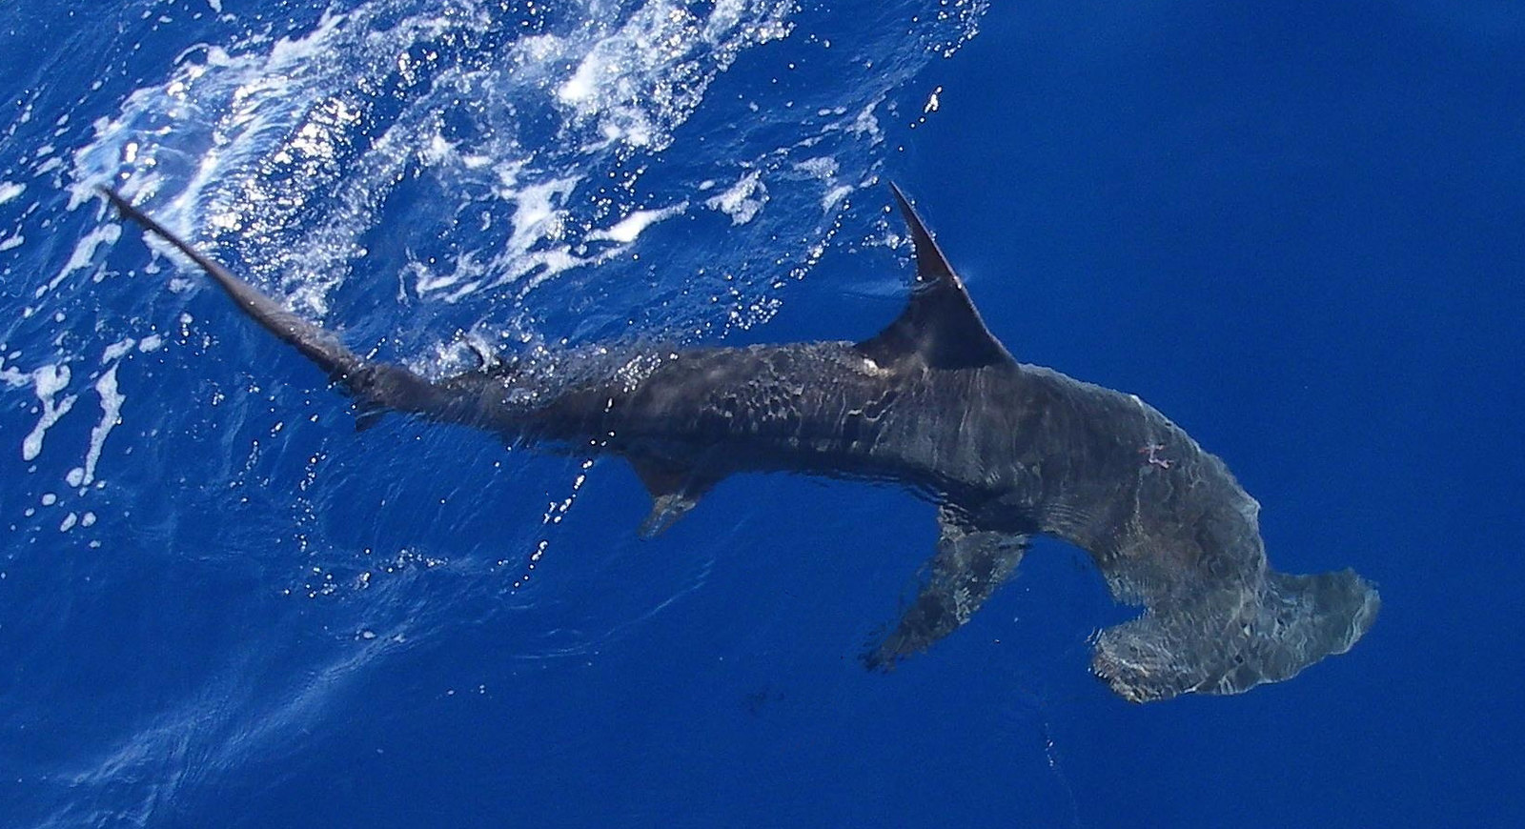
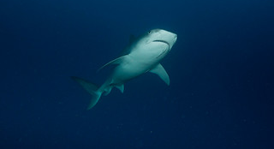
Shark Distribution Shifts
We need to know:
  What are the expected change in species distributions?
Your task:
  Scientists have continued your sampling work to create Ecological niche models (ENMs). Scientists have also predicted how different abiotic factors are expected to change due to climate change.
  Using both the maps of how abiotic factors are expect to change and scientists ecological niche models, your groups will predict changes in species distributions and present your findings to the class.
Photo Credit: NOAA Flickr
Photo Credit: NOAA Flickr
Notes:
Photo Credit: NOAA Flickr
----
This slide summarizes the questions that are to be answered during the activity.

Slide 29
How is your species suitable habitat changing
Increasing
Staying the same
Decreasing
Bonnethead Shark
Sandbar Shark
Photo Credit: Florida Fish and Wildlife
Tiger Shark
Blacktip Shark
Photo Credit: Florida Fish and Wildlife
Photo Credit: NOAA Flickr
Photo Credit: Florida Fish and Wildlife
Blacknose Shark
Photo Credit: Wikipedia Commons
Notes:
Photo Credit: Blacktip, Tiger, Bonnethead –Florida Fish and Wildlife, Blacknose – Wikipedia commons, Sandbar – NOAA Flickr
----
Overall, the more tropical species are expected to experience an increase in suitable habitat, where the temperate species (sandbar) is experiencing an decrease in habitat.
Is anyone surprised by this?
What do you all think scientists can use this information for?
Information like this is extremely useful for management purposes! Setting aside and protecting important habitat for sandbar sharks, adjusting catch levels, and determining regulations for new areas are all critical.

