Slide 1
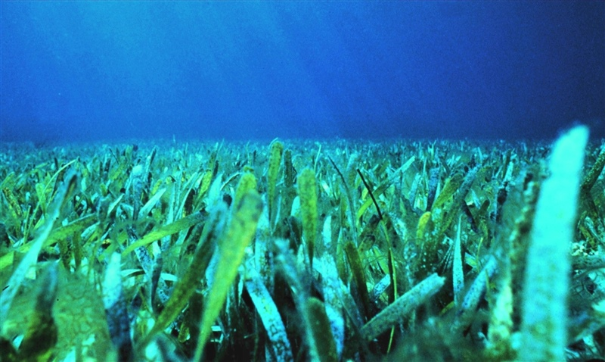
The Seagrass is Greener on the
Other Side
Prepared by Lauren Alvaro
Virginia Institute of Marine Science
Notes:
Learning Objectives:
Students will count animals collected in a seagrass epifauna sample, and graph their data
Students will identify if high, medium, or low seagrass cover attracts the most diversity and abundance of animals
Students will compare and contrast their results to those from other groups members
Students will calculate Simpson’s Diversity Index
Students will use data to develop a hypothesis about how climate change will affect diversity and abundance in seagrass meadows
Photo credit:
“Healthy seagrass” Photographer: Paige Gill Location: Florida Keys National Marine Sanctuary
(https://photolib.noaa.gov/Collections/Sanctuaries/Florida-Keys/emodule/848/eitem/36080)

Slide 2
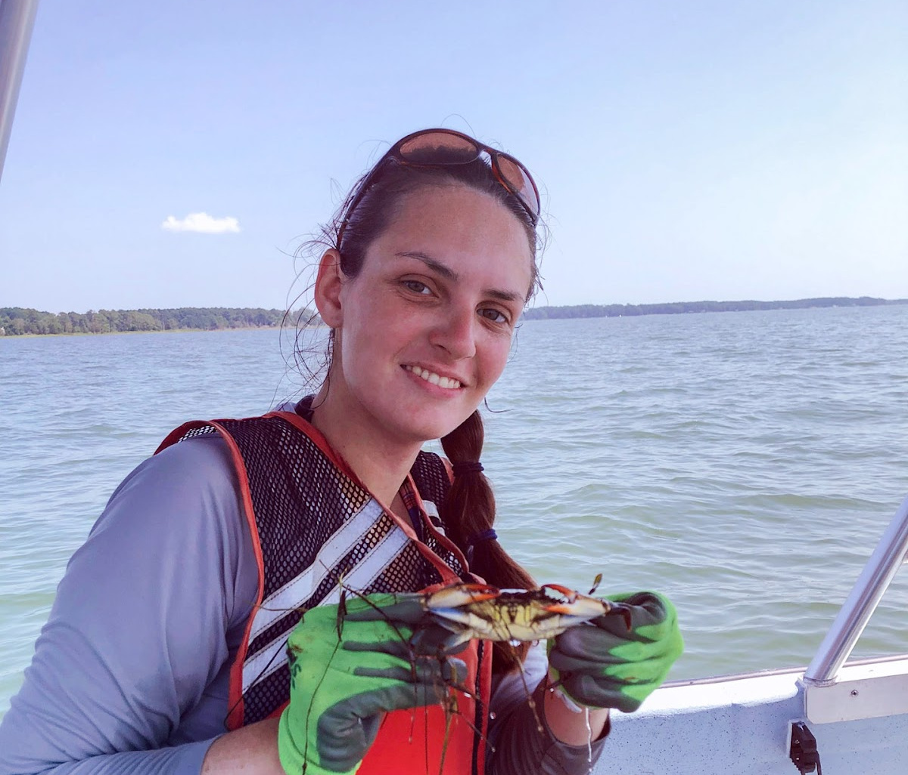
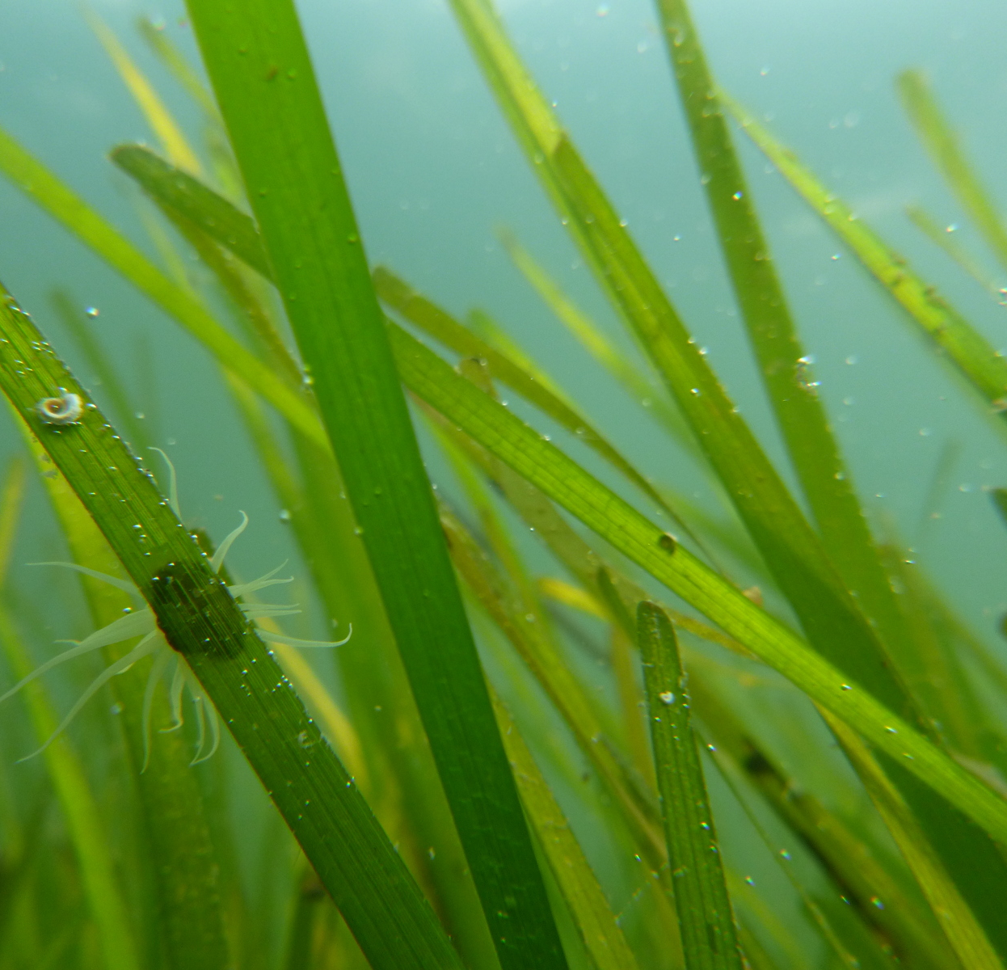
LAUREN ALVARO
  Master’s student at the Virginia Institute of Marine Science (VIMS)
  I work in a lab that studies coastal ecosystems and focuses on seagrass ecology and restoration
Notes:
Photo credit: Lauren Alvaro and VIMS Coastal & Estuarine Ecology Lab

Slide 3
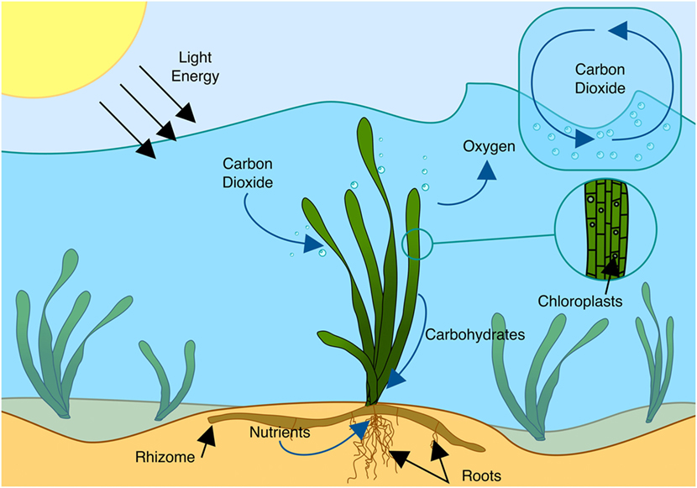
WHAT IS SEAGRASS?
Seagrasses are angiosperms that adapted to live underwater
Seagrass exchanges oxygen and carbon dioxide through its thin leaves
The roots and rhizomes absorb nutrients and anchor the plants in place
Notes:
Seagrasses are angiosperms, or flowering plants, that over time adapted to live underwater. They use their roots and rhizomes to absorb and store nutrients and to anchor themselves in the sediments. Just like land plants, seagrasses also perform photosynthesis and use energy from the sun to convert carbon dioxide and water into sugar and oxygen. Seagrasses exchange oxygen and carbon dioxide through their thin leaves.
Photo credit:
Cullen-Unsworth L, Jones B, Lilley R and Unsworth R (2018) Secret Gardens Under the Sea: What are Seagrass Meadows and Why are They Important?. Front. Young Minds. 6:2. doi: 10.3389/frym.2018.00002

Slide 4
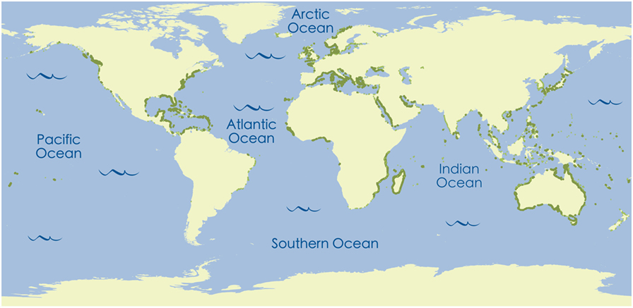
WHERE ARE SEAGRASSES FOUND?
Notes:
Seagrasses have a global distribution and can be found in the shallow coastal waters of all continents except Antarctica.
Photo credit:
Cullen-Unsworth L, Jones B, Lilley R and Unsworth R (2018) Secret Gardens Under the Sea: What are Seagrass Meadows and Why are They Important?. Front. Young Minds. 6:2. doi: 10.3389/frym.2018.00002

Slide 5
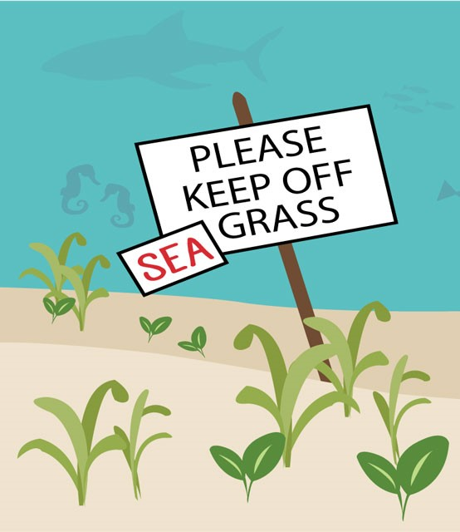
SEAGRASS IS AT RISK
Globally we are losing the equivalent of two football fields of seagrass meadows every hour per year
Threats to seagrass meadows include:
  Climate change
  Poor water quality and pollution
  Boating and destructive fishing methods
Notes:
Unfortunately, seagrasses are at risk. Globally we are losing the equivalent of two football fields of seagrass meadows every hour per year. Threats to seagrass meadows include: climate change, poor water quality from pollution, as well as boating and destructive fishing methods.
Photo credit:
Cullen-Unsworth L, Jones B, Lilley R and Unsworth R (2018) Secret Gardens Under the Sea: What are Seagrass Meadows and Why are They Important?. Front. Young Minds. 6:2. doi: 10.3389/frym.2018.00002

Slide 6
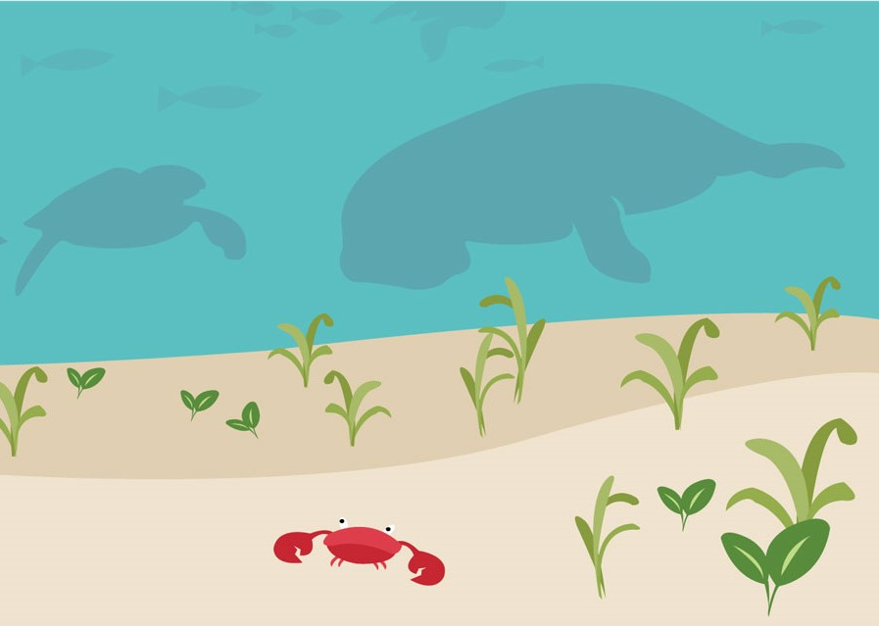
WHY IS SEAGRASS IMPORTANT?
Seagrass meadows have high biodiversity
They are a source of food and habitat for many marine animals especially juveniles
Seagrass absorbs the carbon dioxide that is dissolved in the ocean
They protect the coasts from the impacts of storms by stopping coastal erosion
Notes:
Seagrass meadows are an important marine ecosystem for a variety of reasons. For example, seagrass meadows have high biodiversity and are a vital source of food and habitat for many marine animals, especially juveniles. Seagrass meadows can be home to many fishes that humans eat and to other species like seahorses, manatees, and sea turtles. Seagrasses absorb the carbon dioxide that is dissolved in the ocean and store it in their tissues or in the sediment. They also protect the coasts from the impacts of storms by stopping coastal erosion.
Why is it important that seagrass absorbs carbon dioxide in the ocean? Answer: Carbon dioxide contributes to global warming and by absorbing the carbon dioxide dissolved in the ocean, seagrasses prevent it from escaping back into the atmosphere.
Photo credit:
Cullen-Unsworth L, Jones B, Lilley R and Unsworth R (2018) Secret Gardens Under the Sea: What are Seagrass Meadows and Why are They Important?. Front. Young Minds. 6:2. doi: 10.3389/frym.2018.00002

Slide 7
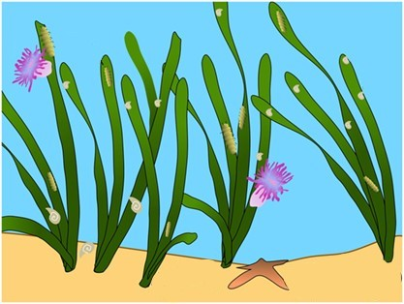
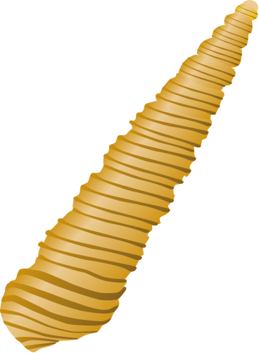
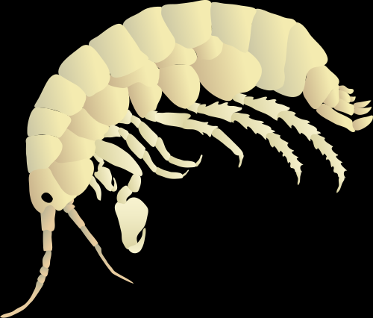
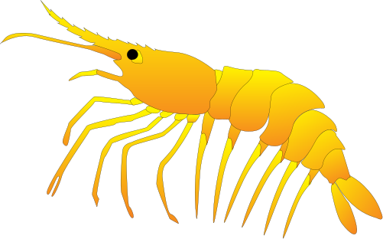
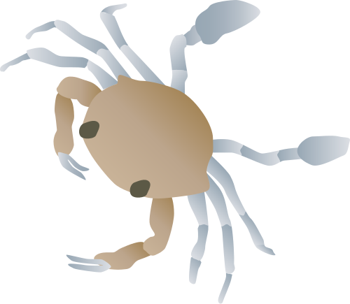
WHAT ARE EPIFAUNA?
Epifauna are aquatic animals, like amphipods, that live on the surface of seagrass
These small animals are sources of food for many fish and are a key link in the food web
They remove algae which would otherwise overgrow the seagrass
Higher seagrass percent cover correlates with increases in diversity and density of epifauna
Notes:
Epifauna are aquatic animals, such as amphipods, that live on the surface of the sediment or on the surface of a substrate, like rocks or plants and are vital to the maintenance of seagrass ecosystems. (Amphipods are invertebrates and a type of crustacean whose Latin name means “different-footed” because they have multiple types of legs.) These invertebrates remove fouling algae which would otherwise overgrow the seagrass. They also act as an important link in the food web between primary producers and animals higher in the food chain.
Photo credit:
Cullen-Unsworth L, Jones B, Lilley R and Unsworth R (2018) Secret Gardens Under the Sea: What are Seagrass Meadows and Why are They Important?. Front. Young Minds. 6:2. doi: 10.3389/frym.2018.00002
Tracey Saxby, Integration and Application Network (ian.umces.edu/media-library)
Dieter Tracey, Water and Rivers Commission (ian.umces.edu/media-library)

Slide 8
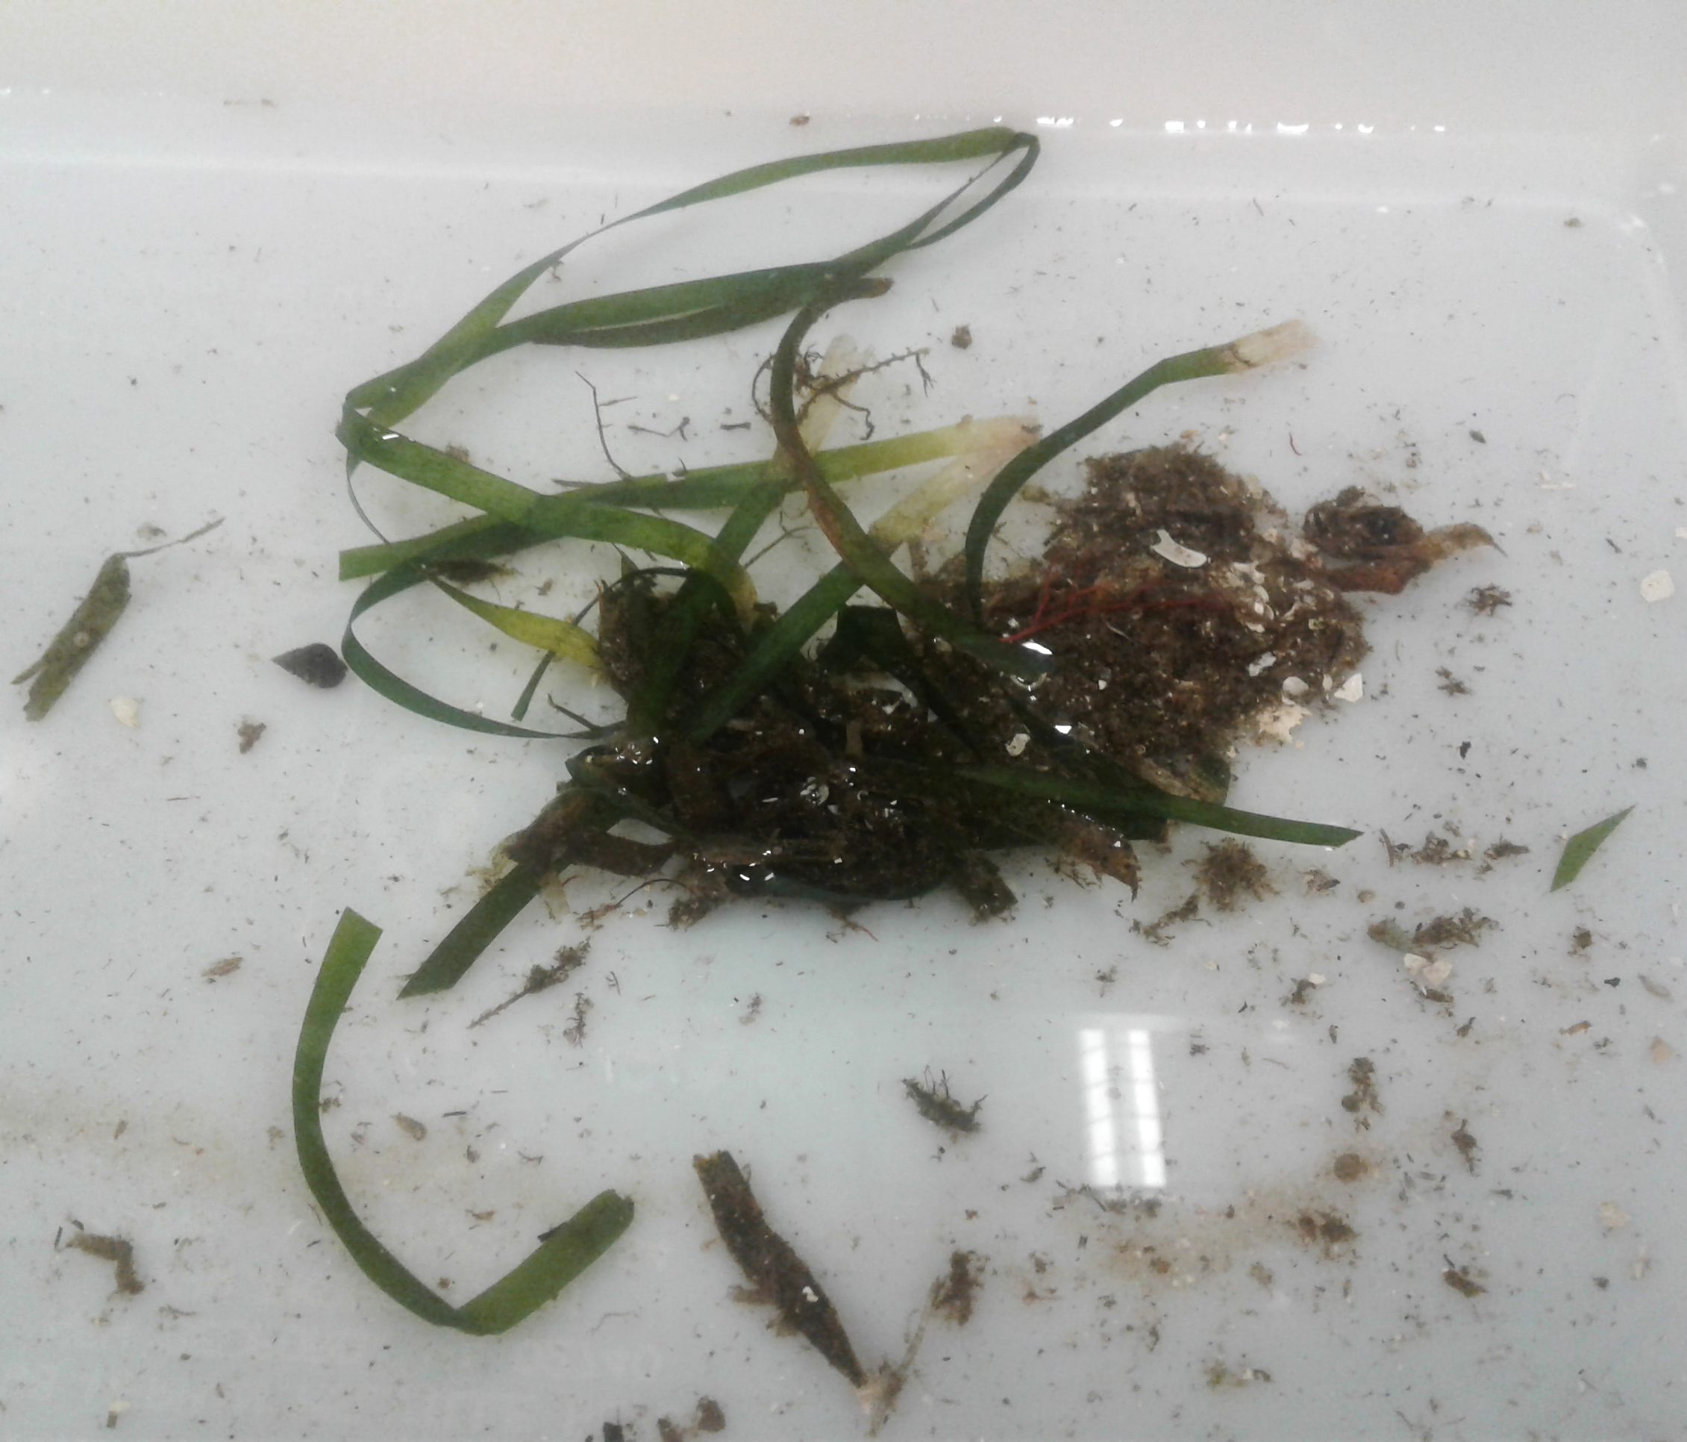
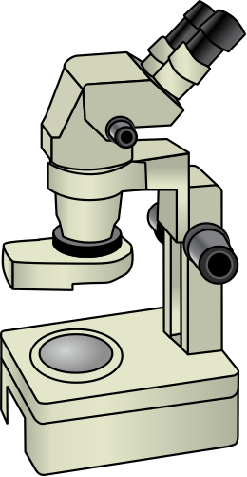
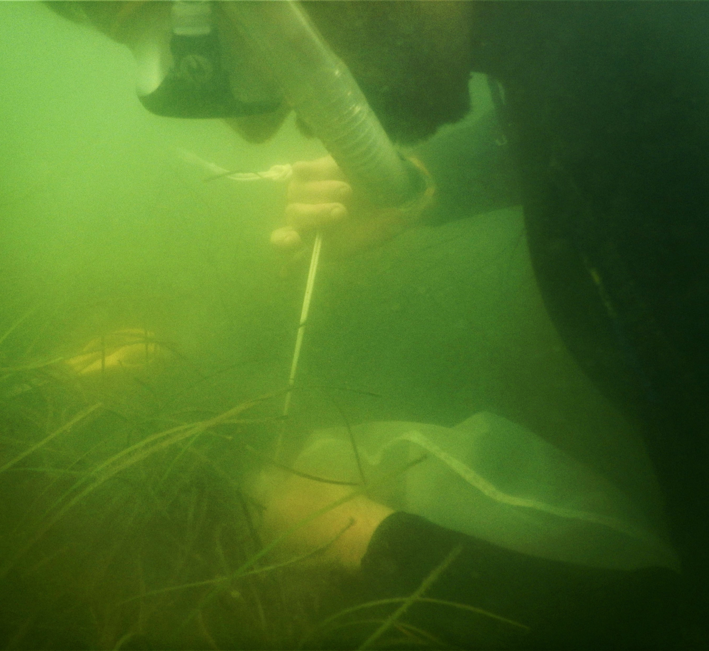
HOW DO SCIENTISTS SAMPLE EPIFAUNA IN SEAGRASS MEADOWS?
Mesh grab bags are lowered over a section of seagrass to capture the epifauna living on the plants
Samples are then processed and epifauna are identified under a microscope
Notes:
The key roles that epifauna play in seagrass ecosystems mean that sampling the epifauna community helps scientists understand the health and function of seagrass meadows. One-way scientists collect epifauna is by using mesh grab bags. After lowering a bag over a section of seagrass and closing it, the samples are then processed by adding water, separating out the grass to weigh, and putting the remaining water through different sieves to sort the epifauna into size classes. Next, epifauna are identified under a microscope.
Photo credit:
Epifauna collection: VIMS Coastal & Estuarine Ecology Lab
Seagrass sample: Lauren Alvaro
Microscope: Tracey Saxby, Integration and Application Network (ian.umces.edu/media-library)

Slide 9
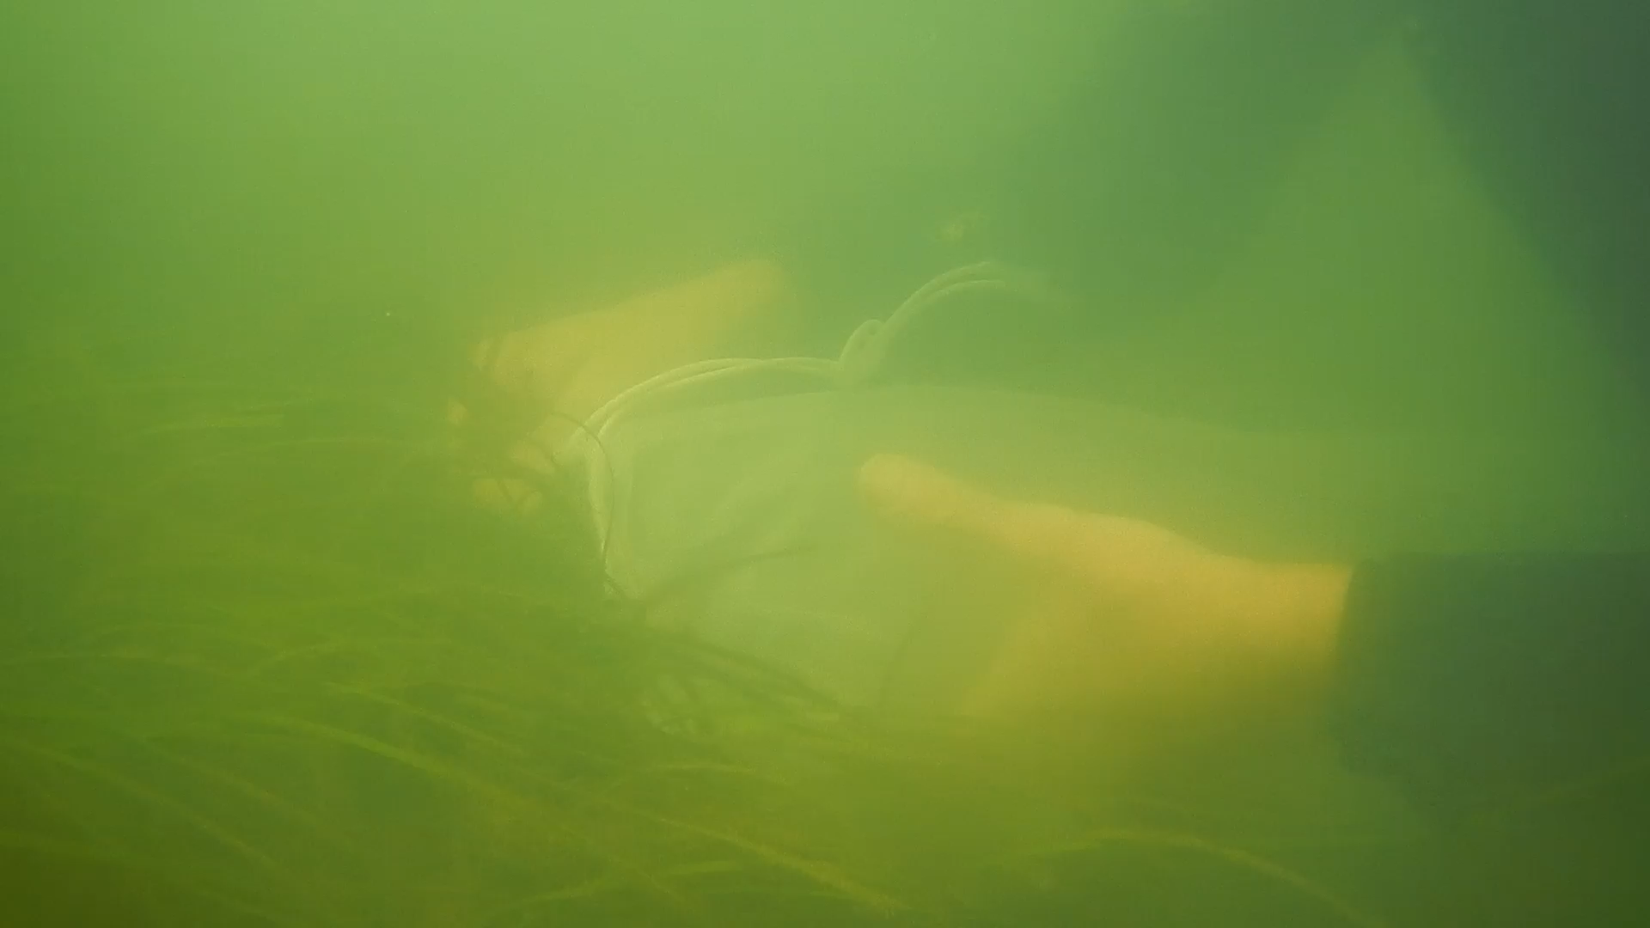
Notes:
Here is a short video showing how a mesh grab bag is used to collect seagrass and epifauna.
Video credit: VIMS Coastal & Estuarine Ecology Lab

Slide 10
EPIFAUNA: SMALL BUT MIGHTY
Bittium Snail
Juvenile Blue Crab
Hippolyte Shrimp
White Amphipod
Bead Color: “Insert here”
Bead Color: “Insert here”
Bead Color: “Insert here”
Bead Color: “Insert here”
Notes:
These are some common species of epifauna that we will find in our samples
Photo credit:
Bittium snail, Juvenile blue crab, Amphipod: Tracey Saxby, Integration and Application Network (ian.umces.edu/media-library)
Shrimp: Dieter Tracey, Water and Rivers Commission (ian.umces.edu/media-library)

Slide 11
Simpson’s Diversity Index (D)
Simpson's Diversity Index is a measure of biodiversity
The value of D can range between 0 and 1
A value of 1 represents high diversity and a value of 0 indicates no diversity
$$D=1− \frac{n_{1}\left(n_{1}−1\right)+n_{2}\left(n_{2}−1\right)+n_{3}\left(n_{3}−1\right)+…+n_{s}\left(n_{s}−1\right)}{N\left(N−1\right)}$$
Species | Species Count
Species 1 | n₁
Species 2 | n₂
Species 3 | n₃
… | …
Species S | n_{s}
Total Individuals | N
Notes:
Simpson's Diversity Index is a measure of biodiversity that considers the number of species present and the abundance of each species. The value of Simpson's Diversity Index (D) can range between 0 and 1. A value of 1 represents high diversity and a value of 0 indicates no diversity.

Slide 12
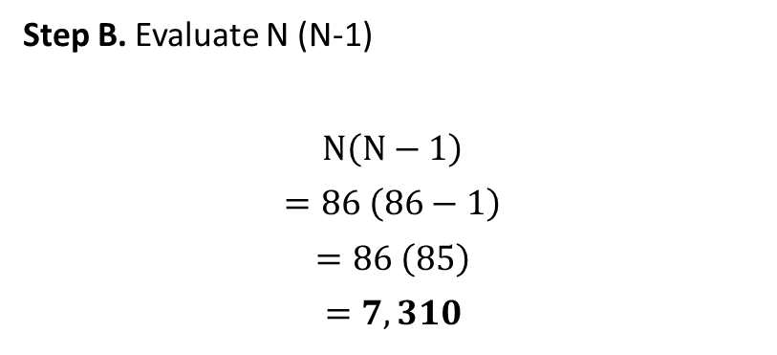
Example 1
$$D=1− \frac{n_{1}\left(n_{1}−1\right)+n_{2}\left(n_{2}−1\right)+n_{3}\left(n_{3}−1\right)+…+n_{s}\left(n_{s}−1\right)}{N\left(N−1\right)}$$
Species | Epifauna Count
Species 1 | n₁ =11
Species 2 | n₂ = 11
Species 3 | n₃ = 5
Species 4 | n₄ = 3
Species 5 | n₅ = 20
Species 6 | n₆ = 36
Total Individuals | N = 86
Step A. Add up the total number of individual species in your sample to get the total number of observations or N
${N= n}_{1}+n_{2}+n_{3}+n_{4}$ $+n_{5}+n_{6}$
N = 11 + 11 + 5 + 3 + 20 + 36 = 86
Step B. Evaluate N (N-1)
$$N\left(N−1\right)$$
$$=86 \left(86−1\right)$$
$$=86 \left(85\right)$$
$$=7,310$$

Slide 13
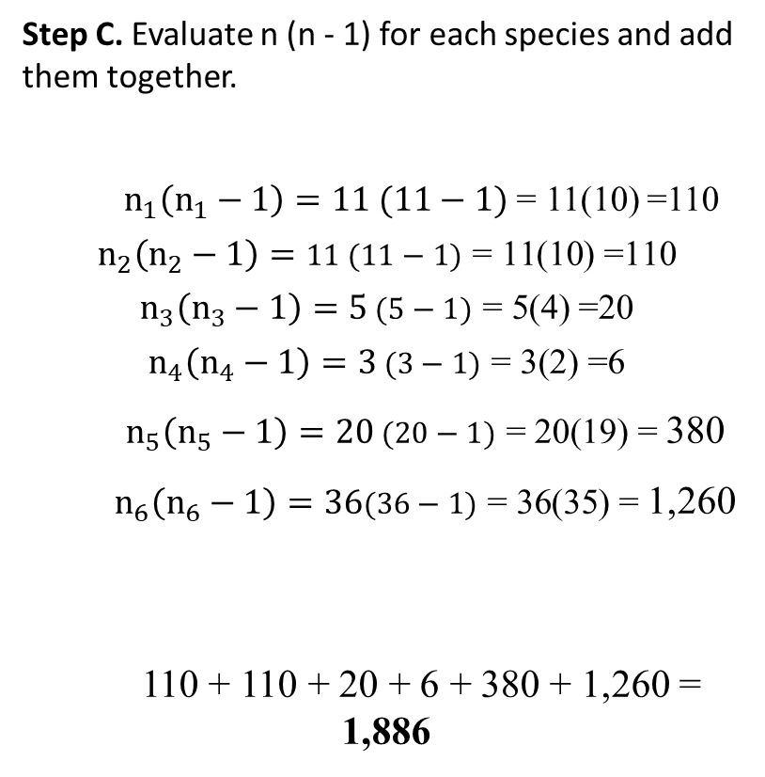
Example 1
$$D=1− \frac{n_{1}\left(n_{1}−1\right)+n_{2}\left(n_{2}−1\right)+n_{3}\left(n_{3}−1\right)+…+n_{s}\left(n_{s}−1\right)}{N\left(N−1\right)}$$
Species | Epifauna Count
Species 1 | n₁ =11
Species 2 | n₂ = 11
Species 3 | n₃ = 5
Species 4 | n₄ = 3
Species 5 | n₅ = 20
Species 6 | n₆ = 36
Total Individuals | N = 86
Step C. Evaluate n (n - 1) for each species and add them together.
${ n}_{1}\left(n_{1}−1\right)=11 (11−1)$ = 11(10) =110
$$n_{2}\left(n_{2}−1\right)=11 (11−1)\text{ = 11(10) =110}$$
$$n_{3}\left(n_{3}−1\right)=5 (5−1)\text{ = }\text{5}\text{(}\text{4}\text{) =}\text{20}$$
$$n_{4}\left(n_{4}−1\right)=3 (3−1)\text{ = }\text{3}\text{(}\text{2}\text{) =}\text{6}$$
${ n}_{5}\left(n_{5}−1\right)=20 (20−1)\text{ = }\text{20}\text{(1}\text{9}\text{) =}$ 380
${ n}_{6}\left(n_{6}−1\right)=36(36−1)\text{ =}\text{ 36}\text{(}\text{35}\text{) =}$ 1,260
110 + 110 + 20 + 6 + 380 + 1,260 = 1,886

Slide 14
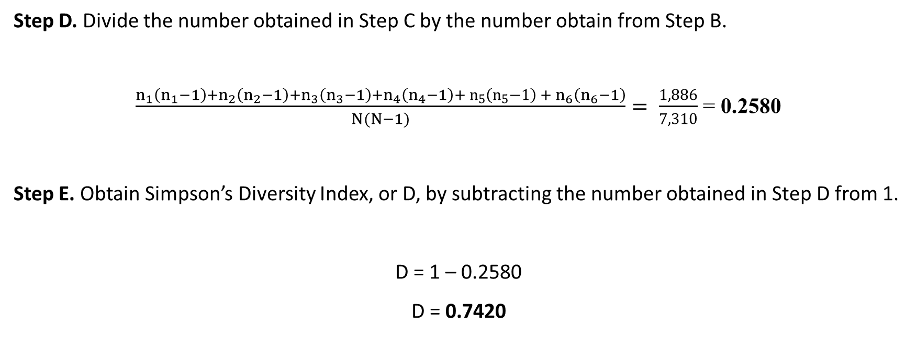
Example 1
$$D=1− \frac{n_{1}\left(n_{1}−1\right)+n_{2}\left(n_{2}−1\right)+n_{3}\left(n_{3}−1\right)+…+n_{s}\left(n_{s}−1\right)}{N\left(N−1\right)}$$
Step D. Divide the number obtained in Step C by the number obtain from Step B.
$\frac{n_{1}\left(n_{1}−1\right)+n_{2}\left(n_{2}−1\right)+n_{3}\left(n_{3}−1\right)+n_{4}\left(n_{4}−1\right)+{{ n}_{5}\left(n_{5}−1\right) + n}_{6}\left(n_{6}−1\right)}{N(N−1)}= \frac{1,886}{7,310}$ = 0.2580
Step E. Obtain Simpson’s Diversity Index, or D, by subtracting the number obtained in Step D from 1.
D = 1 – 0.2580
D = 0.7420

Slide 15
Notes:
Photo credit:
“Healthy seagrass” Photographer: Paige Gill Location: Florida Keys National Marine Sanctuary
(https://photolib.noaa.gov/Collections/Sanctuaries/Florida-Keys/emodule/848/eitem/36080)

