Slide 1
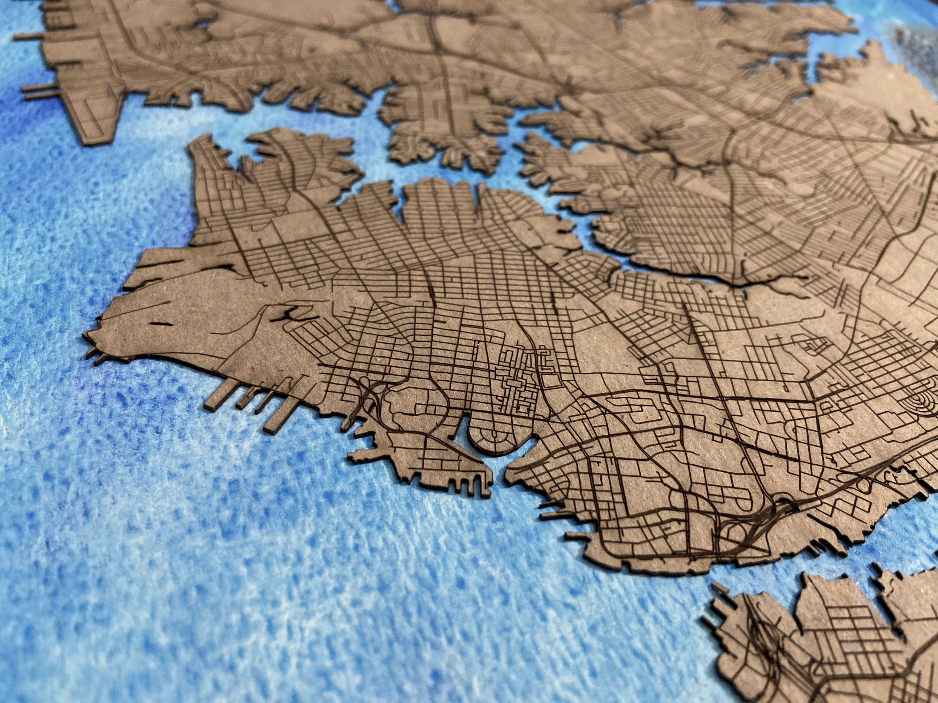


Virginia Scientists & Educators Alliance
How Resilient Is It?
The Resilience Quotient Zoning Ordinance
Lesson for High School
Created by: Qiong Wang
& Yao Wang
2021-2022
Notes:
Introduction – 15 minutes
Slide 1: Introduce students to the topic by asking:
If students have known, seen or experienced flooding in coastal areas.
Note: It’s normal for people to notice flooding issues in coastal areas.
How could flooding happen?
Possible answers: sea level rise, storm, precipitation, rainfall, etc.
If students know any methods or strategies to address flooding issues.
Possible answers: wetlands, levees, Low Impact Development, etc.
Today, we are going to learn about one way to mitigate flooding issues for coastal communities. It’s the Resilience Quotient system which is an innovative zoning ordinance.

Slide 2



Resilience Quotient System
Meet the Researchers
Qiong Wang
Graduate student at Virginia Tech
Research interests: Disaster resilience, hazard mitigation policy, and floodplain management
Yao Wang
Graduate student at the State University of New York College of Environmental Science and Forestry (SUNY-ESF)
Research interests: Disaster resilience, hazard mitigation planning, community engagement, floodplain management, and visualization
2
Notes:
Slide 2 (Optional): Meet the Researchers
Qiong Wang: Today’s lesson is based on ongoing research at Virginia Tech conducted by Qiong Wang (pronounced “Chung”), a graduate student. She is interested in studying hazard mitigation because it is an important component for disaster resilience. Currently, she studies the modifications of the Resilience Quotient system for the City of Norfolk.
Yao Wang: Qiong invited Yao Wang, who is a graduate student at the State University of New York College of Environmental Science and Forestry (SUNY-ESF), to produce 3D documents for the activity. Yao Wang studies community engagement in the climate change adaptation process. She is also a teaching assistant at the Digital Fabrication lab and has many experiences of utilizing laser cutters, 3D printers, CNC, and other 3D model machines and programs.

Slide 3

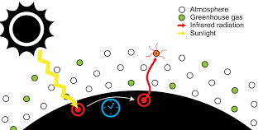

Resilience Quotient System
Climate Change
Climate change refers to significant changes in global temperature, precipitation, wind patterns and other measures that have occurred over several decades.
The world is experiencing climate change in diverse ways
  Global temperature rises (global warming) which leads to sea level rise, drought, etc.
What causes global warming?
  Greenhouse gases
Figure 1. Greenhouse effect
(via a Creative Commons license)
Source: https://commons.wikimedia.org/wiki/File:The_Greenhouse_Effect.svg
Figure 2. Greenhouse gas
(via a Creative Commons license)
Source: https://theconversation.com/epa-clean-power-plan-reenergizes-the-us-climate-policy-debate-43039
Figure 3. Global warming (via a Creative Commons license)
Source: https://freesvg.org/globalwarming-fire
3
Notes:
Slide 3: Climate Change
Ask students: What is climate change?
Climate change refers to significant changes in global temperature, precipitation, wind patterns and other measures that have occurred over several decades (UCDavis, 2021).
The world is experiencing climate change in diverse ways.
Sea-level rise and saltwater intrusion have advanced to the point where whole communities have had to relocate, and protracted droughts are putting people at risk of famine.
Ask students: What causes global warming?
Greenhouse gases
The Greenhouse Effect: some sunlight that hits earth is reflected back into space while the rest becomes heat. Greenhouse gases prevent heat from escaping into space, warming the planet.

Slide 4
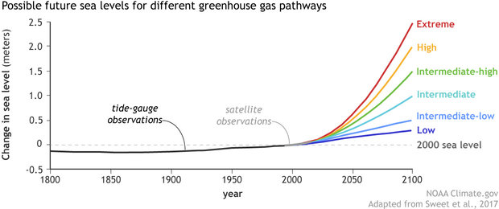
Resilience Quotient System
Sea Level Rise
Sea level heights
Since 1880, the sea level has increased 8–9 inches (21–24 cm).
In the scenario of a low greenhouse gas pathway (purple line), global sea level is expected to increase by at least 12 inches (30 cm) by 2100.
Figure 4. Past and future sea level heights (Lindsey, 2020)
4
Notes:
Slide 4: Sea level rise
Sea level rise is one indicator of climate change.
Figure 4 (Lindsey, 2020) shows the past and future sea level heights. Sea level observations were obtained from tide gauges (dark gray) and satellites (light gray) from 1800 to 2015. Since 1880, the sea level has increased 8–9 inches (21–24 cm).
Ask students: What is causing sea level to rise?
Answer: glaciers and ice sheets throughout the planet are melting and contributing water to the ocean caused by release of greenhouse gas that leads to global warming.
In Figure 4, it shows the projected sea level through 2100 under six different future scenarios (colored lines). The scenarios differ due to changes in the possible rates of glacier and ice sheet loss, as well as potential future rates of greenhouse gas emissions. In the scenario of a low greenhouse gas pathway, global sea level is expected to increase by at least 12 inches (30 cm) by 2100.
Ask students: why does sea level matter?
After listening to answers from students, show slide 5 to explain.

Slide 5
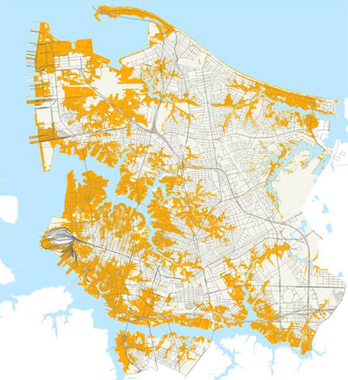
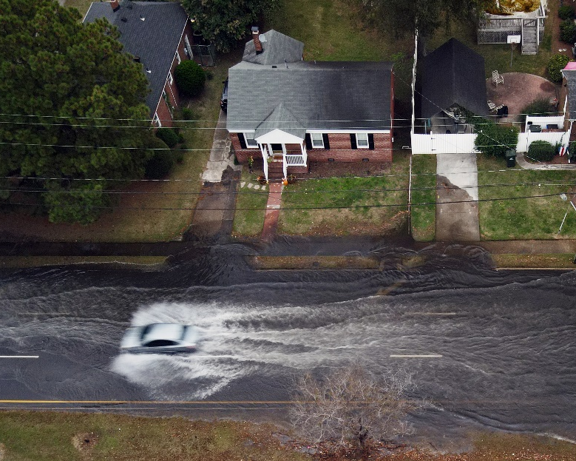
Resilience Quotient System
Flooding Problems in Coastal Areas
Why sea level matters?
40% of the population in the U.S. lives in a coastal area that may be at risk from sea level rise.
Norfolk is highly vulnerable to sea level rise.
  Coastal flooding risk
Figure 5. Norfolk flood zones with 2-3 feet of (relative) water rise in orange / Norfolk Vision 2100
Figure 6. During a King Tide weekend, water begins to creep into the roadways and residential areas of the Cambridge Crescent neighborhood of Norfolk, Va. on Nov 6, 2021. (Photo by Aileen Devlin | Virginia Sea Grant, via a Creative Commons license)
(Source: Building a better Norfolk: a zoning ordinance for the 21st century; https://www.flickr.com/photos/virginiaseagrant/51915364187/in/album-72157712985963002/)
5
Notes:
Slide 5: Flooding problems in coastal areas
40% of the population in the U.S. lives in a coastal area that may be vulnerable to sea level rise. Infrastructure (e.g., roads, subways, etc.) that are vital for local jobs and regional businesses are all threatened by rising seas in urban environments along coasts.
Norfolk is surrounded by water over 144 miles of shoreline, making it very vulnerable to sea level rise. It is home to the world's largest naval facility and is the second biggest city in Virginia. Norfolk has flood zones with 2-3 feet of (relative) water rise in orange by 2100. It means that Norfolk will have to face increasing rates of sea level rise and repetitive coastal flooding issues. Figure 5 and 6 show flooding problems in Norfolk.

Slide 6


Resilience Quotient System
Resilience Quotient System
Zoning Ordinance
A set of rules for land use
Zoning classifications
Resilience
Quotient
The first and most resilience-focused zoning ordinance in America
Community Resilience
A community's capacity to
  Continue key operations
  Recover rapidly
  Build more prosperous communities in times of disturbance
6
Notes:
Slide 6: Resilience Quotient System
Before we dive into the Resilience Quotient system, let’s talk about zoning ordinance and community resilience.
Ask students: What is a zoning ordinance?
Answer: A zoning ordinance is a set of rules that governs how individuals can utilize land and structures in a certain region (Kenton, 2021). For example, a zoning ordinance can define which particular areas are appropriate for residential or commercial use.
Zoning classifications include residential (single-family residential and multi-unit residential), industrial, commercial, agricultural, and other more specific designations (Kenton, 2021).
Ask students: What is community resilience?
Answer: Community resilience refers to a community's capacity to continue key operations, recover rapidly, and build more prosperous communities in times of disturbance (Wang et al., 2020). For example, when a hurricane attacks, a community can prepare (e.g., conduct evacuation plans) before the hurricane, maintain essential functions (e.g., keep the electricity system working and avoid power outages), recover quickly, and bounce forward toward an improved and stronger community.

Slide 7


Resilience Quotient System
Resilience Quotient System
What is the Resilience Quotient?
A point system
Points assigned to specific resilient actions
For developers and property owners to use
Resilience
Quotient
The first and most resilience-focused zoning ordinance in America
Three Components and Point Tables
Three Components
  Risk reduction
  Stormwater management
  Energy resilience
Point Tables
  Resilient interventions with assigned points
7
Notes:
Slide 7: Resilience Quotient System
Therefore, in order to better prepare for a changing future, the city of Norfolk adopted a new zoning ordinance that is the Resilience Quotient system (also referred to as the RQ) in 2018. RQ is the first and most resilience focused zoning ordinance in the country.
Resilience Quotient
What is the Resilience Quotient?
RQ is a point system, where credit is allocated for specific actions that developers and property owners can use to meet requirements in order to reduce coastal flooding risk and enhance community resilience (City of Norfolk, 2021).
Three components and point tables
RQ includes three components, including risk reduction, stormwater management, and energy resilience. In each component, there are several typical interventions with assigned points for developers or property owners to select.

Slide 8
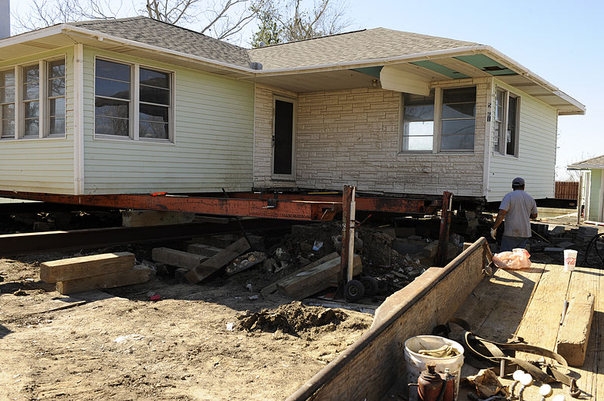
Resilience Quotient System
Resilience Quotient System-Three Components
1. Risk Reduction
  Risk reduction is decreasing the effects of floods by implementing measures within coastal areas.
    Example: for residential development, the lowest habitable floor and all significant electrical and mechanical equipment shall be elevated to at least 16 inches above the highest existing grade adjacent to the front façade of the structure.
    12 inches (global sea level in 2100) < 16 inches < 24 inches (Norfolk sea level in 2100)
    Benefit: avoid repetitive flooding loss.
Figure 7. Elevation
(Source: https://wetlandswatch.org/freeboard-requirement/)
8
Notes:
Slide 8: Risk Reduction
Ask students: What is risk reduction?
Risk reduction refers to flooding risk reduction, which is decreasing the effects of floods by implementing measures within coastal areas.
For example, in the city of Norfolk, the residential development projects are required to meet this minimum elevation standard. The lowest habitable floor and all significant electrical and mechanical equipment shall be elevated to at least 16 inches above the highest existing grade adjacent to the front façade of the structure.
Ask students: Why do planners in Norfolk choose 16 inches as a standard elevation?
Answer: 16 inches are larger than 12 inches, which is a projection of global sea level in 2100 but smaller than 24 inches, which is one projection of Norfolk sea level in 2100.
Ask students: what benefit does it have?
Answer: It can avoid repetitive flooding loss.
Optional examples: limiting enclosed areas below the floodplain to less than 70 square feet; prohibiting basements; and installing open carports instead of attached garages.

Slide 9
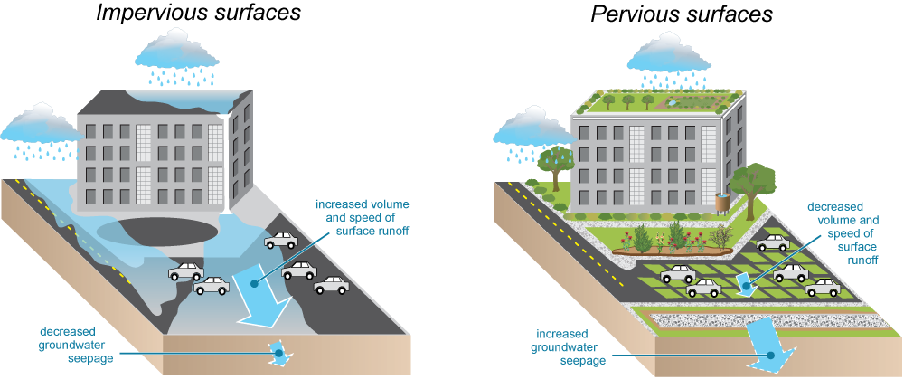
Resilience Quotient System
Resilience Quotient System-Three Components
2. Stormwater Management
  Stormwater management is the process of reducing the rainwater runoff from impermeable surfaces, such as parking lots and rooftops. It can control channel erosion and improve water quality.
    Example: 100% of the drainage from impervious surfaces on the site shall be captured and retained on site with sufficient storage to keep the first 1.25 inches of rainwater from an individual rain event on site.
    Benefit: avoid damages on infrastructure and provide recreational areas.
Figure 8. Stormwater management
(Source: https://www.georgetownclimate.org/adaptation/toolkits/green-infrastructure-toolkit/introduction.html?full)
9
Notes:
Slide 9: Stormwater Management
Ask students: what is stormwater management?
Stormwater management is the process of reducing the rainwater runoff from impermeable surfaces, such as parking lots and rooftops. It can control channel erosion and improve water quality (Environmental Protection Agency, n.d.).
Example: for all types of developments, 100% of the drainage from impervious surfaces on the site shall be captured and retained on site with sufficient storage to keep the first 1.25 inches of rainwater from an individual rain event on site.
Ask students: what benefit does it have?
Answer: It can avoid damages on infrastructure and provide recreational areas.
Optional examples: installing bioretention Best Management Practices (BMPs) in areas that are required to be landscaped above and beyond the minimum quantity requirement; installing stormwater management for water quantity that has capacity for an additional 1,000 square feet of impervious surface; installing grass or pervious pavers for parking areas; and capturing all roof drainage for rainwater harvesting.

Slide 10
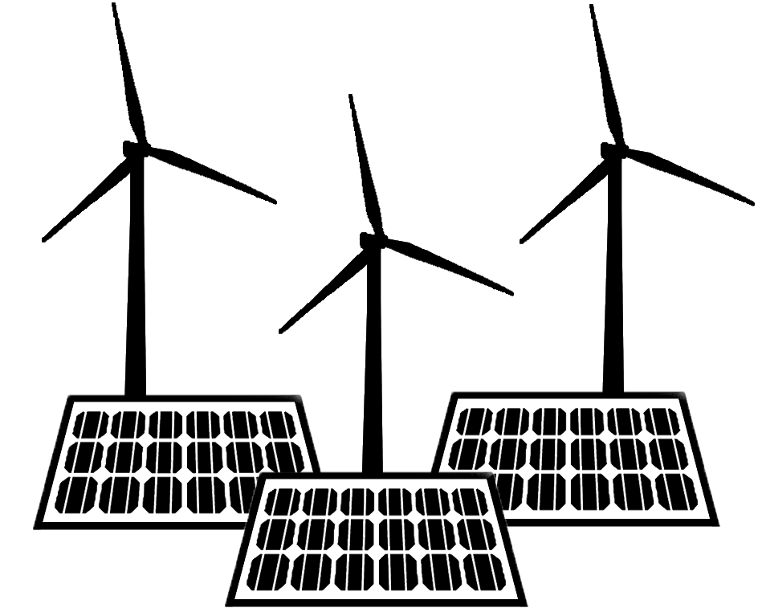
Resilience Quotient System
Resilience Quotient System-Three Components
3. Energy Resilience
  Energy resilience is decreasing the effects of floods by implementing measures within coastal areas.
    Example: for residential development, the electrical systems of the dwelling shall be designed with pre-installed wiring and connections to allow use of a generator during electricity outages and/or connection of solar, wind, or other locally-generated electricity.
    Benefit: reduce greenhouse gases.
Figure 9. Renewable energy
(Source: https://commons.wikimedia.org/wiki/File:Renewable_generators_-_wind_turbine_-_solar_panel_icon.png)
10
Notes:
Slide 10: Energy Resilience
Ask students: what is energy resilience?
Energy resilience is about ensuring users have a stable, consistent source of energy as well as a contingency method in the case of a power outage (Jasiūnas et al., 2021).
An example of this is installing renewable energy systems. For residential development, the electrical systems of the dwelling shall be designed with pre-installed wiring and connections to allow use of a generator during electricity outages and/or connection of solar, wind, or other locally-generated electricity.
Ask students: what benefit does it have?
Answer: It can be resistant to shocks and reduce greenhouse gas.
Optional examples: installing permanent backup generators; installing or maintaining large canopy trees; using non-traditional Heating, Ventilation, and Air Conditioning (HVAC) techniques such as geothermal systems and mini-splits; using conditioned crawl spaces; installing electric vehicle charging stations; and designing the development to provide maximum sunlight exposure to roof tops for possible renewable energy installation.

Slide 11
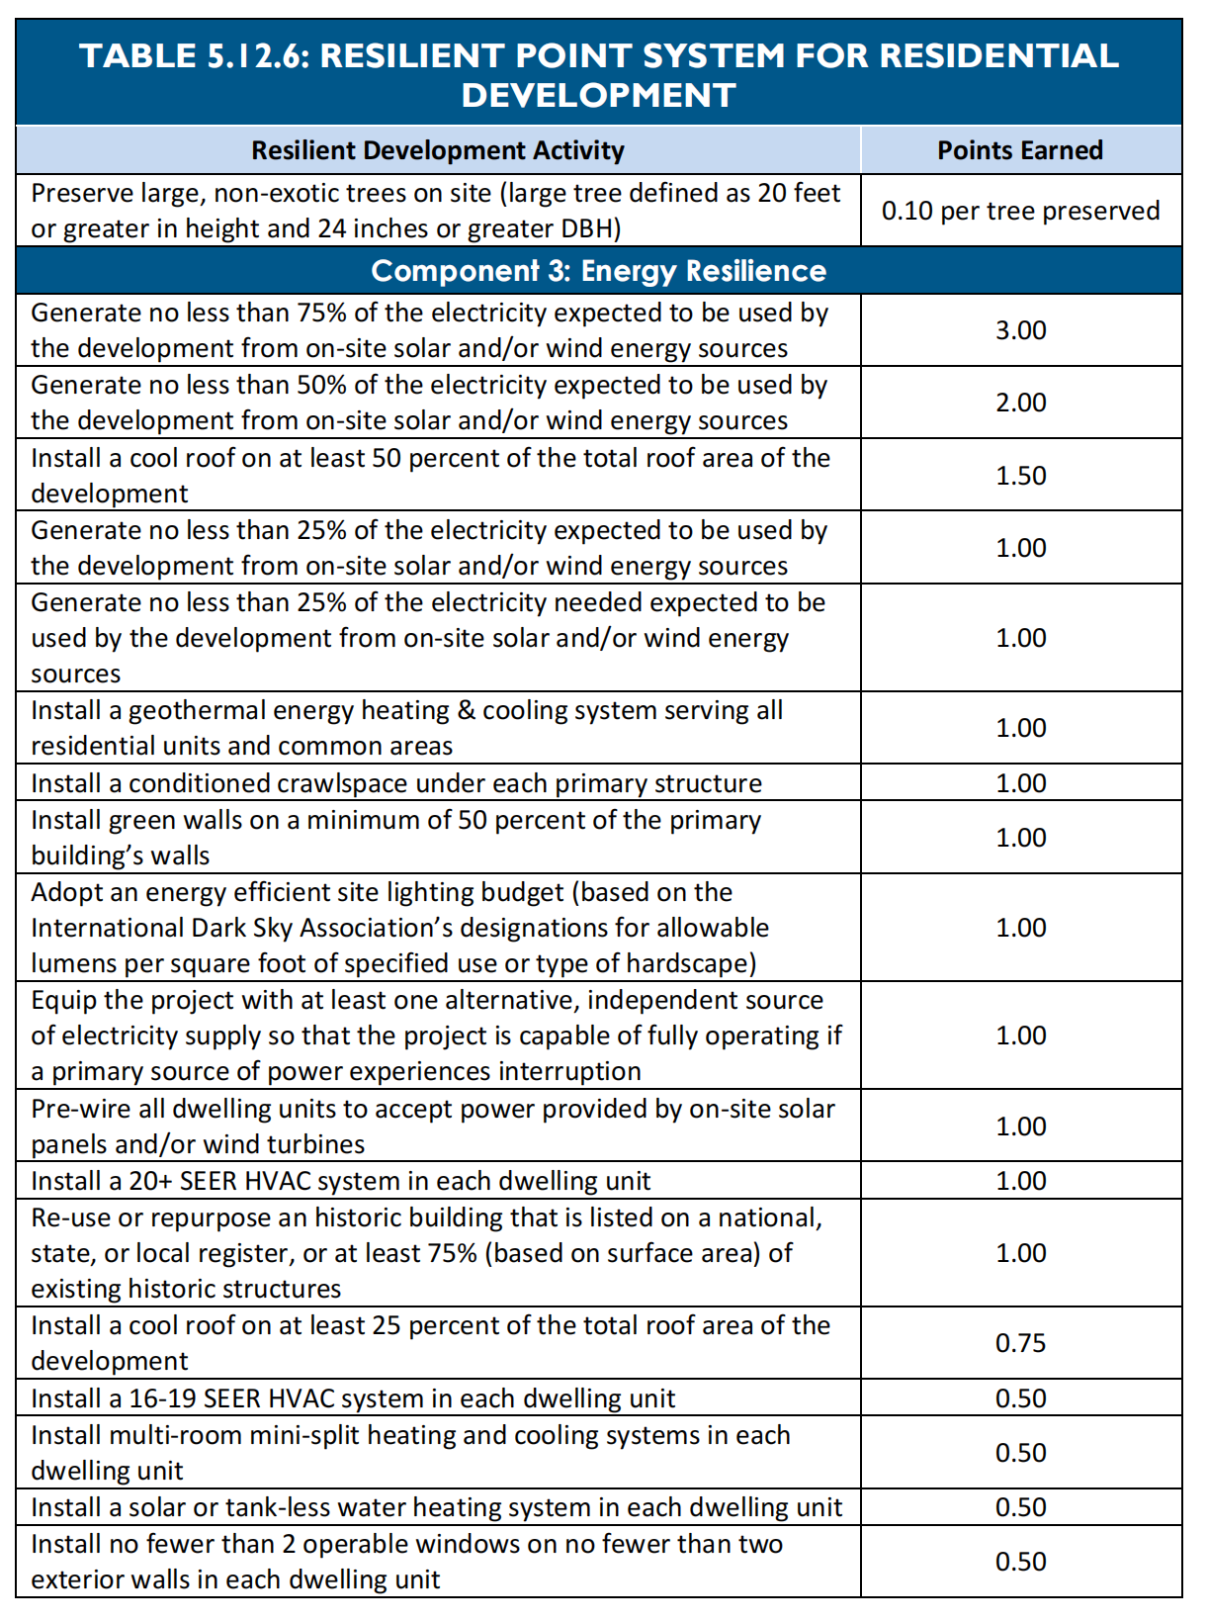
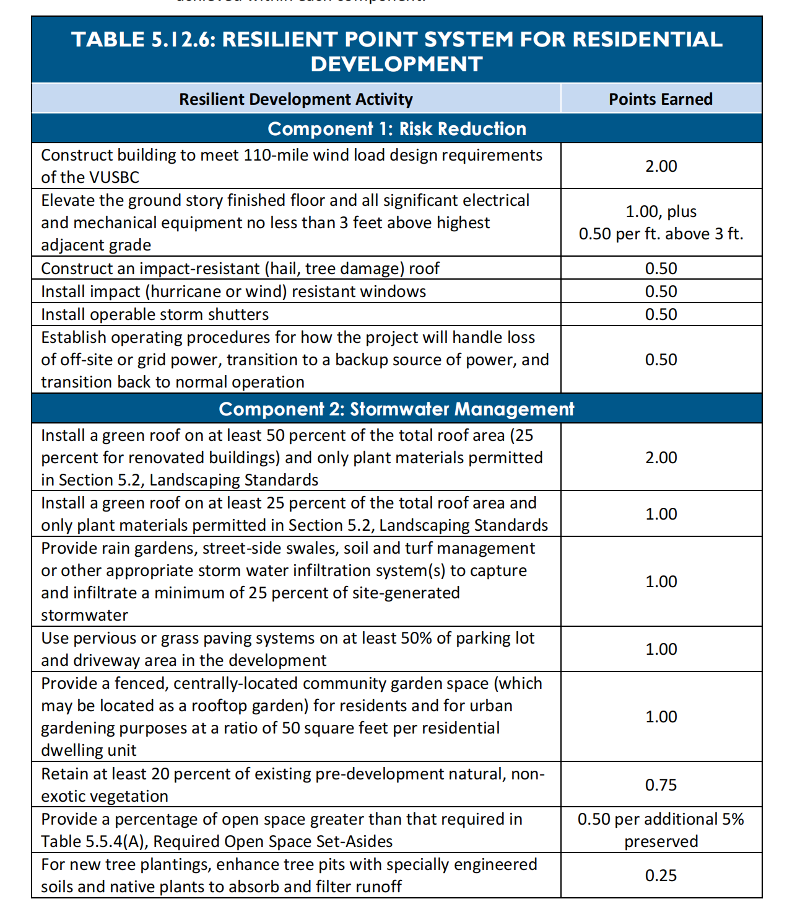
Resilience Quotient System
RQ-Point Tables
11
Notes:
Slide 11: Point tables
Here are the point tables of RQ. It shows three components and specific interventions in the tables. You will use these tables in the class activity.

Slide 12
Resilience Quotient System
In-Class Activity
Purpose
  Help students understand how to use the Resilience Quotient system in reality.
  Simulate how developers meet the requirements after they calculate the costs and points in three scenarios.
  Demonstrate what a zoning ordinance is and how the Resilience Quotient works to reduce risks and enhance community resilience.
Materials
  Each team gets a set of activity materials.
    Appendix A - Scenario handouts for groups (Resilience Quotient Compliance for Different Development Projects)
    Appendix B - Benefits of Resilience Quotient interventions
    Appendix C or E - Master plan of the city of Norfolk
    Appendix D - Illustration cards of resilient interventions
    Paper and pencils/pens
    Any calculators
12
Notes:
Background and Purpose
This activity is designed to help students understand how to use the Resilience Quotient system in reality. There are three scenarios for students to simulate how developers meet the requirements after they calculate the costs and consider the benefits of interventions. The goal of this activity is for students to demonstrate what a zoning ordinance is and how the Resilience Quotient works to reduce risks and enhance community resilience.
* Please go through the whole set of instructions to see what will work best for your class in terms of student separation and equipment needed. Moreover, some information on this worksheet, such as the examples given for the activity, should not be shared with students unless absolutely essential. If a student is having trouble, then the teacher may decide whether or not to provide some of these examples.*
Materials
Each team gets a set of activity materials.
Appendix A - Scenario handouts for groups (Resilience Quotient Compliance for Different Development Projects)
Appendix B - Benefits of Resilience Quotient interventions
Appendix C or E - Master plan of the city of Norfolk
Appendix D - Illustration cards of resilient interventions
Paper and pencils/pens
Any calculators

Slide 13
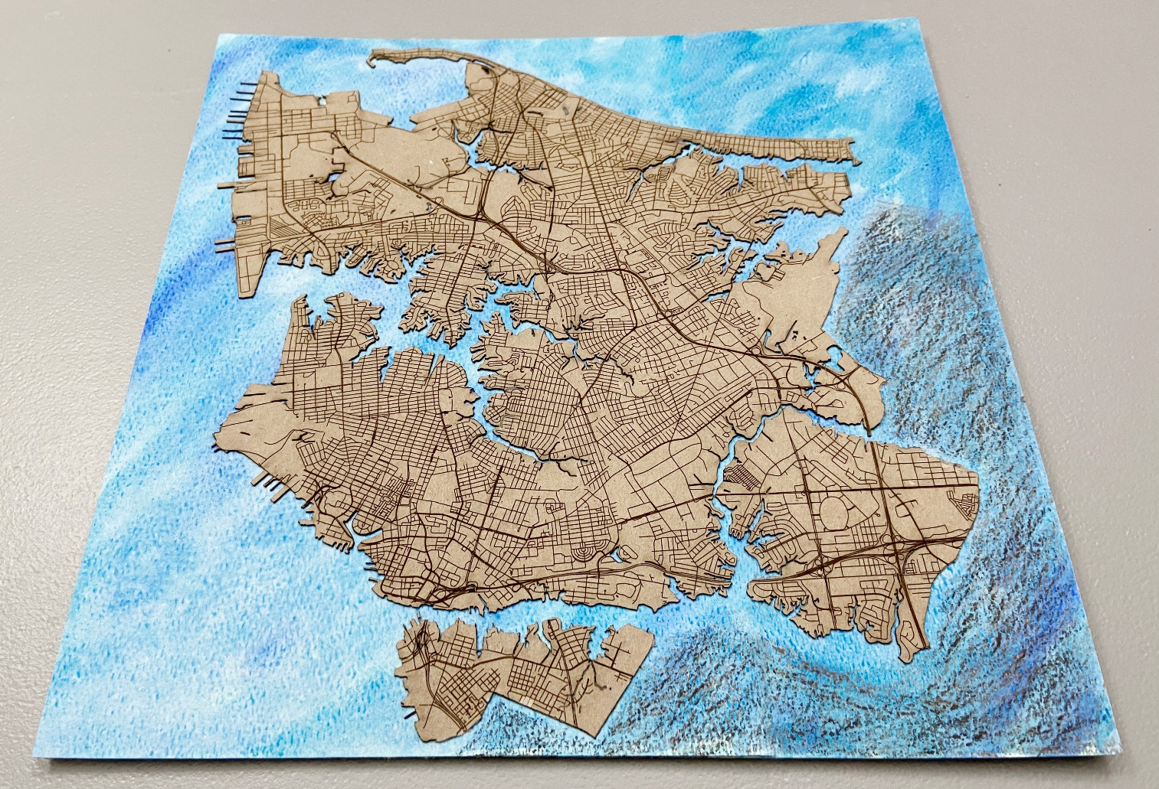
Resilience Quotient System
In-Class Activity
Three Groups
  Group A: Resilience Quotient Compliance for Single-Family Residential Development
  Group B: Resilience Quotient Compliance for Multi-Family Residential Development
  Group C: Resilience Quotient Compliance for Non-Residential Development
Chesapeake Bay
Site A
Site B
Site C
Elizabeth
River
City of Virginia Beach
Figure 10. Master plan of Norfolk, Virginia (using a laser cutter to print)
13
Notes:
Based on three scenarios, the class should be split into three groups (Group A, Group B, and Group C). The three scenarios are Resilience Quotient compliance for single-family development, multi-family residential development, and non-residential development. Each group will complete a full RQ Compliance plan for their scenario. Each group should get a set of activity materials.

Slide 14
Resilience Quotient System
In-Class Activity
Activity Procedure
  Read the instructions
  Pick interventions based on the points, costs, and benefits of the interventions in the table
    For example, capturing all roof drainage for rainwater harvesting
  Each item that is selected or not in the RQ point table must be recorded on the worksheet as follows (instructions also on worksheet)
Components | Interventions | Points | Prices | Costs | Benefits | Selection
Component 1: Risk Reduction | Construct building to meet 110-mile wind load design requirements of the Virginia Uniform Statewide Building Code | 2.00 | Engineered Wood Siding: $5 per square foot; Vinyl Siding: $3 per square foot |  | 1.1Ba, b, and c | /
 | Install impact (hurricane or wind) resistant windows | 0.50 | $50 per square foot |  | 1.1Ba | √
Total Points and Costs |  | 0.5
14
Notes:
Activity Procedure
The groups will simulate how developers use the Resilience Quotient to conduct development projects. They will be able to pick through all the interventions in the RQ point table to determine whether their selected interventions meet the requirements. Their reasoning for why the interventions were chosen must be explained.
Example: the benefits of their chosen interventions for community resilience
Each item that is selected or not in the RQ point table must be recorded on the worksheet as follows (instructions also on worksheet)
Actions for students in the activity
Select interventions
Calculate points and costs of each intervention
Write down benefits for the selected items
Calculate total points and costs of interventions to meet the required minimum points
Each group needs to choose the intervention cards for the project. It will be used for a group presentation.

Slide 15
Resilience Quotient System
In-Class Activity
Activity Procedure
  Presentation
    When each group is finished filling out their tables, they will be asked to choose one or more members to present their results.
    The presenters should introduce the background of their group project and the required minimum resilience points.
    The presenters should use the master plan with intervention cards to illustrate what resilient actions they selected for the project.
    The presenters should answer the questions in the summary section of the handout.
15
Notes:
Presentation
When each group is finished filling out their tables, they will be asked to choose one or more members to present their results.
The presenters should introduce the background of their group project and the required minimum resilience points.
The presenters should use the master plan with intervention cards to illustrate what resilient actions they selected for the project.
The presenters should answer the questions in the summary section of the handout. The questions were layered according to Bloom’s Taxonomy.
Could you define zoning ordinance and the Resilience Quotient system?
What risks does your area have?
Please describe how the Resilience Quotient works to reduce risks and enhance community resilience.
In the activity, you carried out the Resilience Quotient system for your project. How many points did you decide on earning? What is your total cost for all components?
Please interpret your selection of interventions in each component.
What are the requirements for your project?
What are the goals of your project in risk reduction, stormwater management, and energy resilience?
Why did you choose those interventions?
Please describe the points and costs for each component and in total.
Which component has the most points that you selected? Why did you choose them? Please describe the short-term and long-term benefits of these interventions, both for people who are going to live in your area and for the environment.
What were the most expensive and cheapest interventions that you selected? Why did you choose them? What are the benefits of the intervention in the short term and long term, both for people who are going to live in your area and for the environment?
Could you develop new interventions that are not included in the existing RQ table? If so, please provide pros and cons of the new interventions.

Slide 16
Resilience Quotient System
In-Class Activity
Activity Procedure
  Wrap-up Questions
    Do the three groups have the same intervention items?
    What are the differences of goals among the three projects? What risks does your area have? Could these strategies be used to help?
    How do the results in Group A compare with Group B? With Group C?
    What kinds of interventions have more benefits in the long term? Why?
    What are the new interventions for each group? Are there any differences between them?
  Exit Ticket
    Students will need to write a short paragraph (less than 500 words) to summarize their findings for the group scenario of the Resilience Quotient system.
16
Notes:
Wrap-up and Assessment
See slides for specific notes with suggested dialog and discussion. (Slide 16: wrap-up questions)
Some possible answers are listed with each question, but these are not the only answers possible.
Do the three groups have the same intervention items?
No. Since project types are different, the larger the project is, the more resilience responsibility it should have.
What are the differences of goals among the three projects? What risks does your area have? Could these strategies be used to help?
Since there is a limited budget for single-family development, Group A’s goal is to meet the point requirement and keep low-cost interventions. At the same time, they also need to consider the risks on the site.
The multi-family development group has sufficient money, and they prefer to provide more public open space for residents, so their goal is to meet the point requirement and create less risks, convenient, and comfortable community environments.
The industry project’s goal is to have a Leadership in Energy and Environmental Design (LEED) certificate and produce less pollution in order to take social responsibility to reduce risks and make more contributions to community resilience. Leadership in Energy and Environmental Design is a green building certification program used worldwide.
Higher or lower flooding risk on sites should be considered.
How do the results in Group A compare with Group B? With Group C?
Point amount
Focus components
Costs
Benefits
What kinds of interventions have more benefits for each group in the long term? Why?
There is no right or wrong answer.
What are the new interventions for each group? Are there any differences between them?
There is no right or wrong answer.
Exit Ticket
Students will need to write a short paragraph (less than 500 words) to summarize their findings for the group scenario of the Resilience Quotient system. This will allow for the individual to show their mastery of the material.
Optional Task
Students can also write a semi-technical paper on their findings for their group scenarios.

Slide 17
Virginia Scientists & Educators Alliance
The end

