Slide 1
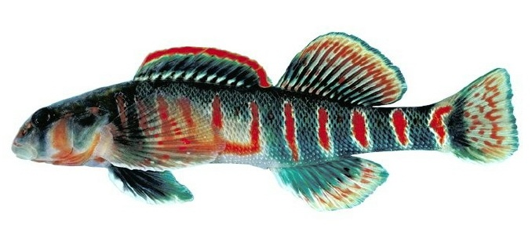
Find the Bullseye: Targeting Conservation of the Candy Darter
Determining an endemic species’ risk of extinction using available data and spreading awareness for conservation.
Prepared by: Jem Baldisimo

Slide 2
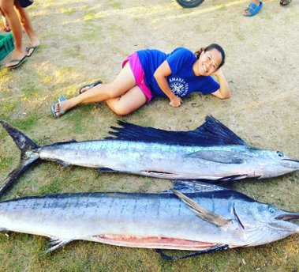

Jem Baldisimo
From the Philippines – country with the most types of marine fishes in the world!
PhD candidate at ODU
I study: Which aquarium fishes are more likely to be extinct in the future?
Notes:
My name is Jem Baldisimo. I grew up in the Philippines, the country with the most diverse marine fishes. I am a PhD candidate at ODU studying which aquarium fishes are more likely to disappear in the future.

Slide 3

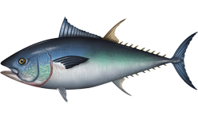
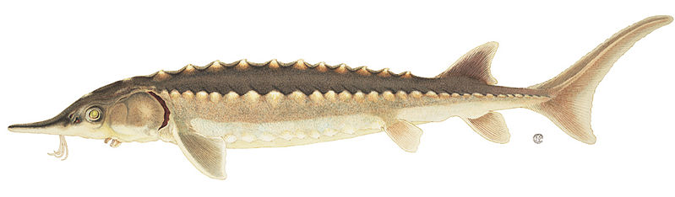
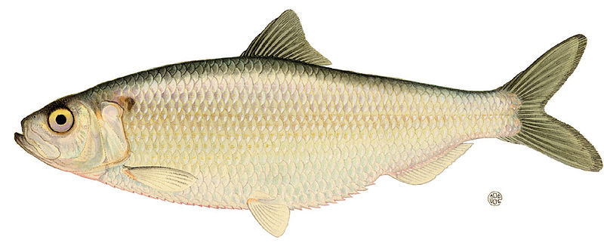
Lesson Overview
Extinction & Extinction Risk
IUCN Red List
Threatened Fishes in the Chesapeake Bay
Extinction Risk of the Candy Darter
Notes:
In this lesson, students will learn about extinction and extinction risk, the IUCN Red List, some threatened fishes in the Chesapeake Bay based on the IUCN Red List. We will try to see how the IUCN Red List process can be used to find out the extinction risk of the Candy Darter.

Slide 4
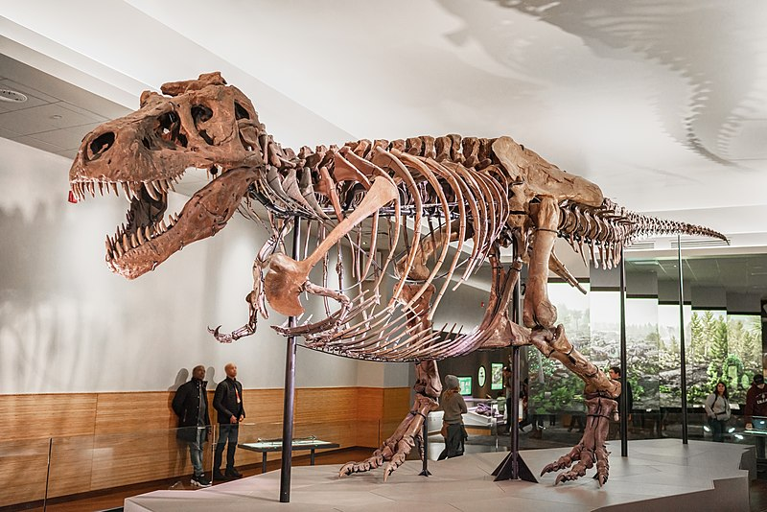
EXTINCTION
when the last individual of a species has died​
Why should we care about extinction?
Nature supports human well-being
Balanced Biodiversity = healthy ecosystems
All species have the right to exist
Notes:
Let's go right in and talk about extinction, which occurs when the last individual of a species has died. You may have heard about the dinosaurs that became extinct a long time ago. Extinction has been happening at a faster rate and is directly caused by human activity.
Why should we care about extinction?
First, nature provides humans with many things food, shelter, and other things that help us survive. We must take care of our environment as it takes care of us.
Second, a balanced biodiversity leads to health ecosystem. Everything is interconnected and if one species disappears, then the web of life will be disrupted.
Third, whether a species is valued by humans or not, they have a right to exist. If human activity is enough to cause a species to disappear, then that should be taken as a sign that the activity is too damaging

Slide 5
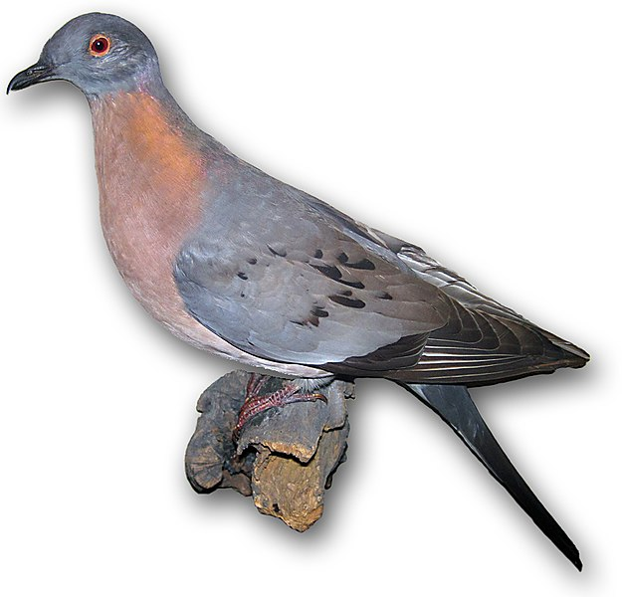
Passenger Pigeons: Once widespread, now extinct
Notes:
How the once widespread American Passenger Pigeon became extinct is one of the most dramatic stories of extinction.
Native to North America, it was once the most common bird in the world.
At one time, there were 5 billion passenger pigeons. There were enormous flocks of these birds. One flock would be 1 mi wide by 300 mi long and have about 2 billion birds.
Unfortunately, they were hunted to extinction. Many poor people in the US between the 17 to 1800s ate no other meat except the passenger pigeon.
In 1914, the last passenger pigeon died in the Cincinnati Zoo. She was named Marth after Martha Washington.

Slide 6

Estimating Extinction Risk
Notes:
One way to estimate the likelihood of extinction or extinction risk for a species is through the IUCN Red List of Threatened Species. Let's watch a video about the IUCN Red List.

Slide 7
Estimating Extinction Risk
Uses available data
Objective process
Quantitative approach
Uses of the Red List:
Raise awareness
Conservation planning & policy making
Environmental impact assessments
Monitor species populations
Notes:
The Red List uses available data on a species, follows an objective process and uses a quantitative approach to finding out the extinction risk of a species.
The Red list can raise awareness of the general public for the need to protect a species and the environment. It can be a reference for conservation planning, policy making, environmental impact assessments, and help monitor species populations through time.

Slide 8


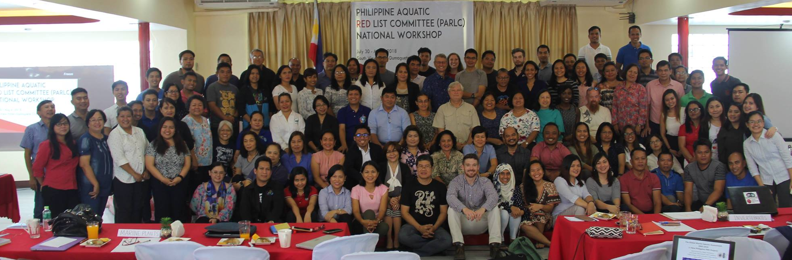
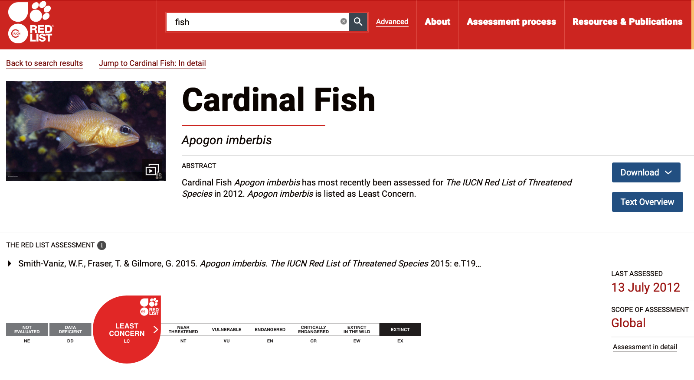
Estimating Extinction Risk
Data Collection
Assessment
Database entry
Final review & assessment
Publication
Red Listing process involves:
Notes:
Completing and publishing a Red List assessment takes a bit of time. The process involves collecting information from scientific literature, interviewing experts, holding workshops to conduct the assessment, entering information in a database, final review, and then publishing in the IUCN website.

Slide 9
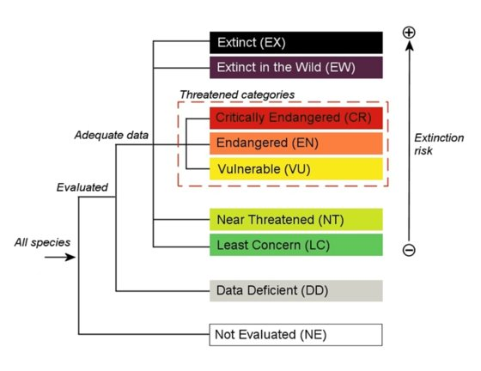
9 Categories
Notes:
There are 9 Red List categories that a species can be listed under. I will briefly describe the meaning of each one, but I want to draw your attention specifically to what we refer to as the ‘threatened’ categories in the red box here, which are Critically Endangered, Endangered and Vulnerable

Slide 10
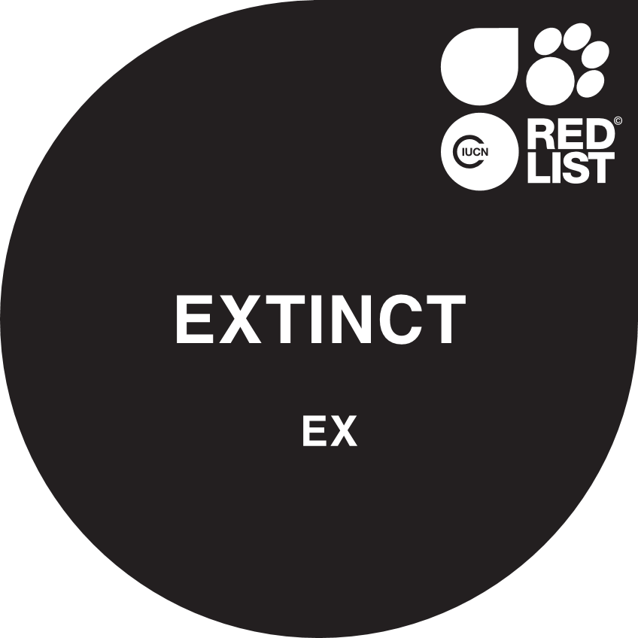
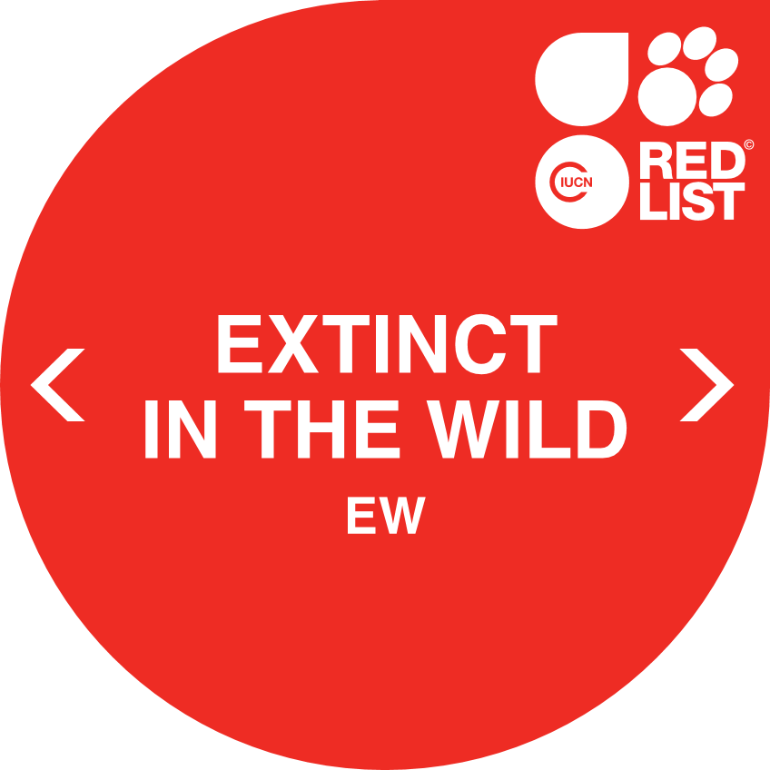
9 Categories
The last individual for a species has died
The species is known only to survive in cultivation, in captivity, or as a naturalized population (or populations) outside past its range

Slide 11
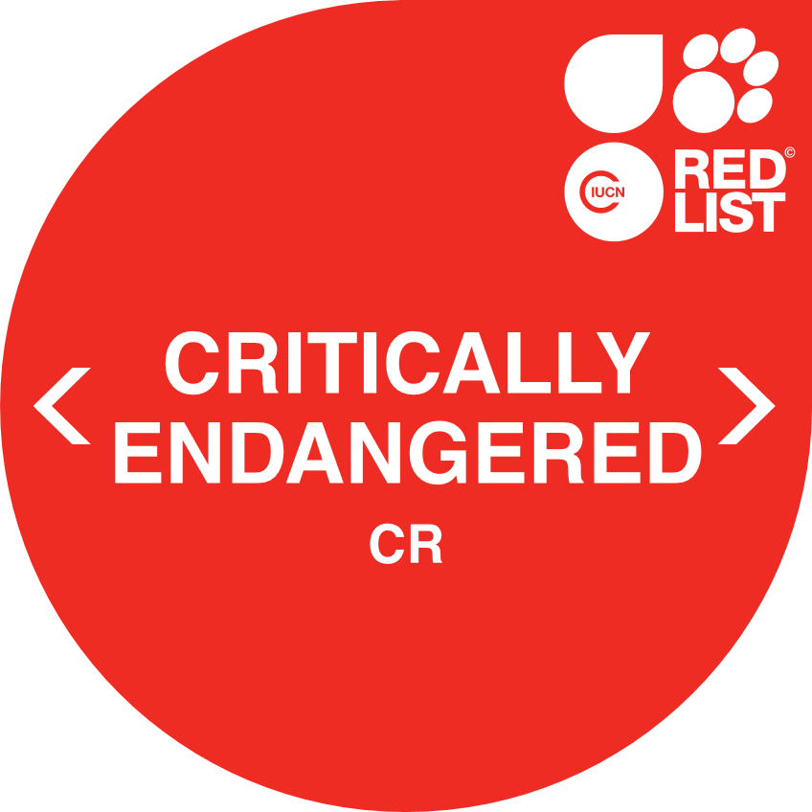


9 Categories
A species facing an extremely high risk of extinction in the wild
A species facing a very high risk of extinction in the wild
A species facing a high risk of extinction in the wild
Notes:
These three categories are the threatened categories.

Slide 12
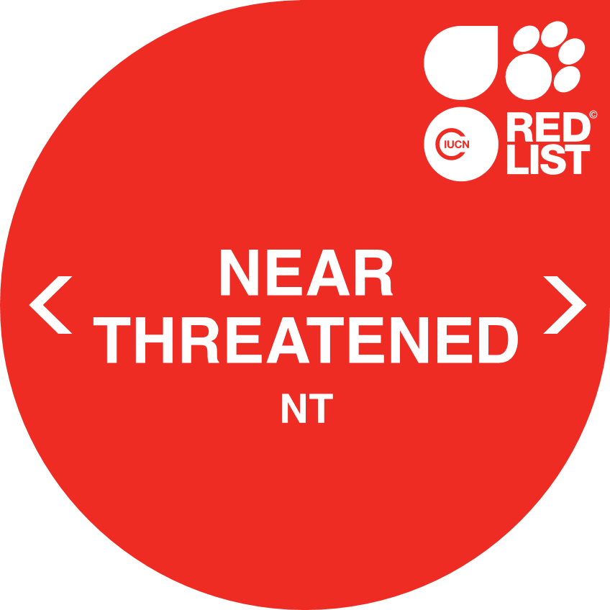

9 Categories
A species that does not qualify as threatened now, but is close to qualifying for a threatened category in the near future
A species that is not qualified as threatened or near threatened. Species that are LC are widespread and abundant.

Slide 13
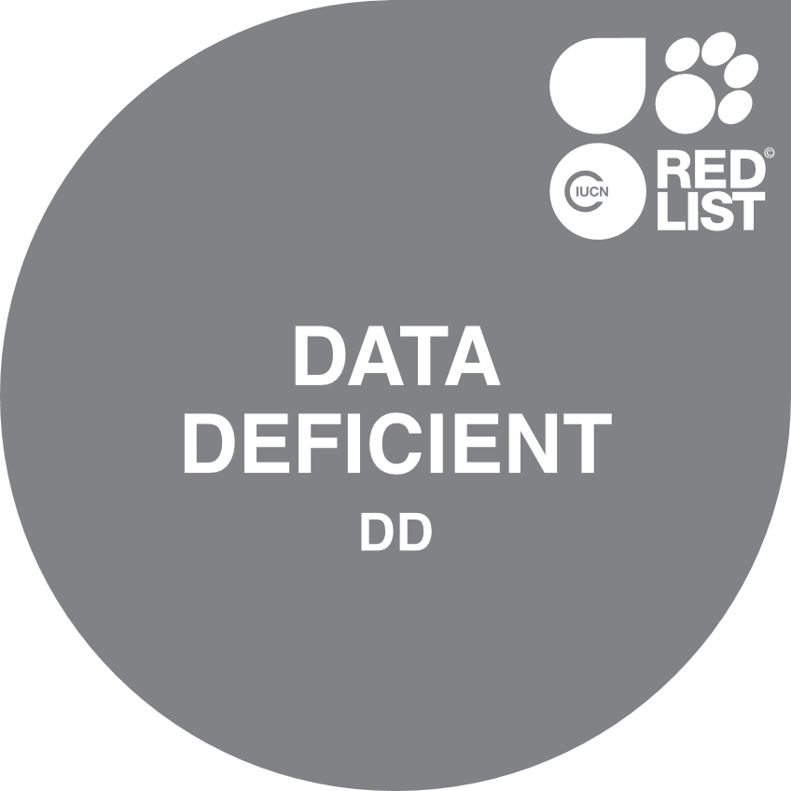
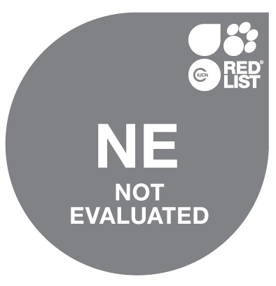
9 Categories
A species that does not have enough information to make a direct or indirect assessment of extinction risk.
A species that has not been evaluated using the IUCN criteria for extinction risk.
Notes:
If there isn't enough information to figure out a species' extinction risk, it can be tagged as Data Deficient. Species that have not been evaluated against the Red List Criteria are called NE or Not Evaluated.

Slide 14
Extinction Risk Theory
Two paradigms (Mace et al. 2006):
Small Population
Exposed to threats
Experiencing decline
Large population
Declining rate faster than reproductive recovery (more deaths than births)
Higher Extinction
Risk
Notes:
Before we talk about the criteria that is used, it is worth discussing the Extinction Risk Theory, which gives a prediction on which populations are more likely to become extinct. This theory is based on two paradigms: the small population paradigm and the declining population paradigm.
This theory says that if you have a small population that is exposed to threats and is experiencing a decline, then this population will have a higher risk of becoming extinct.
On the other hand, when you have a widespread or large population, but its population is declining faster than its capacity to recover, then it will have a higher extinction risk. If you think about it, this is what happened to the Passenger Pigeons!
The IUCN Extinction Risk criteria uses this concept when finding out Extinction Risk for a species.

Slide 15
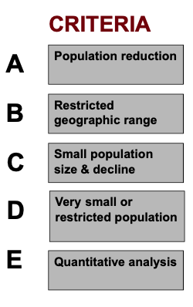
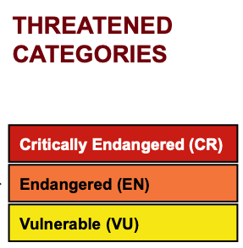
Red List Criteria
Notes:
There are five Red List Criteria (A-E), each of which are independent of each other and based on a different issue related to extinction risk.
Each criterion has a set of quantitative thresholds that determine which (if any) of the threatened categories a species qualifies for. Red List experts undergo a training to become Red List assessors. Later today, you will learn a simplified version of this so that you can get a glimpse of how the assessments are done.

Slide 16
Red Listed fishes in the Chesapeake Bay
Atlantic Bluefin Tuna (Thunnus thynnus)
Range: North Atlantic Ocean (Canada to Brazil, Mediterranean, West Africa)
Habitat: Oceanic, lives in open sea
Uses & Trade: Highly valued game fish, Japanese sashimi market
Threats: Overfishing, habitat loss, oil spills
Conservation measures: Fishery managed at international level, strict US fishing regulations since 2010
Notes:
Let's take a look at some fish species found in the Chesapeake Bay that have been tagged as Threatened in the IUCN Red List. The first one is the Atlantic Bluefin Tuna.
It is a highly valued game fish and caught for sashimi.
Its fishery is managed internationally and locally. Currently, it is Least Concern, although years ago, it was Endangered.

Slide 17
Red Listed fishes in the Chesapeake Bay
Atlantic Sturgeon (Acipenser oxyrinchus)
Largest native Chesapeake fish
Range: Canada to Florida
Habitat: Lives in ocean, spawns in rivers & estuaries
Uses & Trade: Food (flesh & caviar)
Threats: Harvesting (7 million tons taken in 1887), habitat degradation due to dams & other development, pollution
Conservation measures: Fishing ban, dam removal, listed in 2012 US Endangered Species Act
Notes:
The next one is the Atlantic Sturgeon, the largest Native Chesapeake fish. It used to be caught for its flesh & eggs (for caviar). It is currently Near Threatened and to prevent further declines, some conservation measures like fishing bans and dam removals have been done. It is listed under the US Endangered Species Act.

Slide 18

Red Listed fishes in the Chesapeake Bay
Blueback Herring (Alosa aestivalis)
Eaten by larger fish like Striped Bass
Range: Canada to Florida
Habitat: Schools in ocean, spawns in rivers & estuaries
Uses & Trade: Food, fish meal, fish oil
Threats: Harvesting, habitat degradation due to dams
Conservation measures: Fishing ban in VA since 2012
Notes:
The blueback herring is Vulnerable in the IUCN Red List. It was caught for food and used as fish meal and for making fish oil. Since 2012, fishing blueback herring in Virginia was banned.

Slide 19
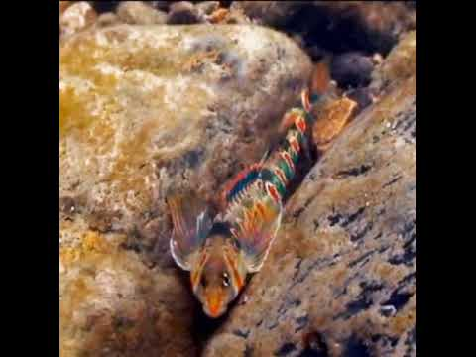
Activity:
Find the Bullseye: Targeting Conservation of the Candy Darter
Notes:
The candy darter is another interesting fish found only in West Virginia & Virginia. Here's a video of this colorful freshwater fish. The last IUCN Red List Assessment for this species was made in 2011. You have a task to help update the IUCN Red List Assessment for this fish since the last assessment was made 10 years ago.

Slide 20
Activity
Your task:
PART 1: Agree on the extinction risk of the Candy Darter (Etheostoma osburni)
PART 2: Create a media project to spread awareness & conservation of the Candy Darter
Notes:
Now that you've learned about the IUCN Red List, we you are going to try and assess its conservation status or extinction riskof the Candy darter and after that, create a media project to spread awareness & conserve the candy darter.

Slide 21
Activity
PART 1: Agree on the extinction risk of the Candy Darter
1. Read article & fill in Candy Darter Fact Sheet:
Geographic Range
Population
Habitat & Ecology
Uses
Threats
Existing conservation measures
Notes:
To find out the extinction risk of the Candy Darter, you will read an article and fill in the Candy Darter Fact Sheet for the following: Geographic range, population, habitat & ecology, uses, threats and existing conservation measures

Slide 22
Activity
PART 1: Agree on the extinction risk of Candy Darter
2. Each group be assigned one criteria to evaluate extinction risk:
Group 1 - Population Reduction
Group 2 – Restricted Geographic Range
Group 3 – Small population size & decline
Group 4 – Very small or restricted population
Group 5 – Quantitative Analysis
Note: If there is no data available for your criterion, it should be considered Data Deficient.
Notes:
After filling in the sheet, each group must evaluate extinction risk based on the Red List Criteria that will be assigned to them. Note that if in the article, you cannot find anything that relates to your criterion, then you can say that it is Data Deficient for your criterion.

Slide 23

Activity
PART 1: Agree on the extinction risk of the Candy Darter
2. After each group reports their findings, the class will agree on the which category the candy darter belongs to:
Criteria A: ?
Criteria B: ?
Criteria C: ?
Criteria D: ?
Criteria E: ?
Final Category: ???
Notes:
*Note: proceed with Part 1 activity after this slide*

Slide 24
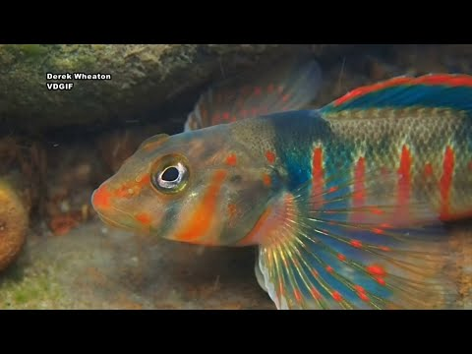
The Candy Darter
Notes:
Now that you've agreed on the Extinction Risk/Conservation Status of the Candy Darter, let's proceed to Part 2 of the activity. Let's watch this news segment on the Candy Darter.

Slide 25
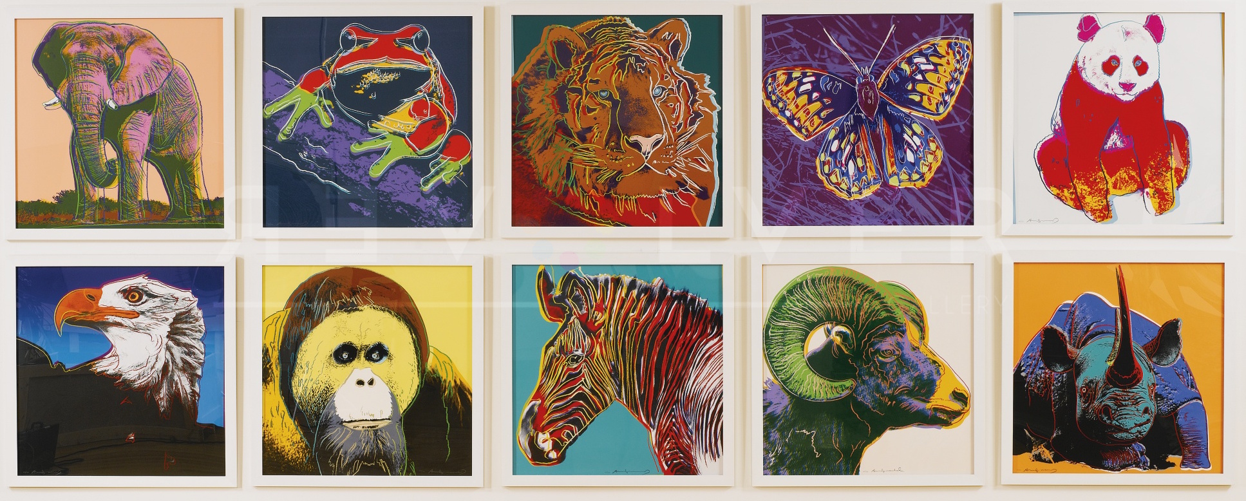
Activity
PART 2: Create a media project to spread awareness & promote conservation of the Candy Darter
Poster/artwork
Song
Video
Endangered Species by Andy Warhol
Notes:
Knowing the conservation status of the Candy Darter, you must create a media project that can spread awareness and promote its conservation. Here are some examples of posters, artwork, songs, and videos that raise awareness on endangered animals or threatened species.

Slide 26
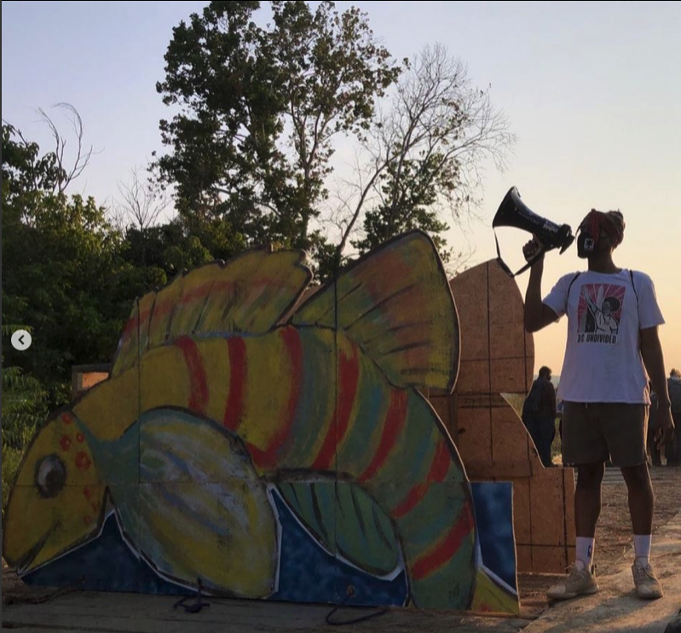
Activity
PART 2: Create a media project to spread awareness & promote conservation of the Candy Darter
Poster/artwork
Song
Video
Photo credit: Lynn Englum @vanishing places
Notes:
This is an outdoor installation featuring the Candy Darter.

Slide 27
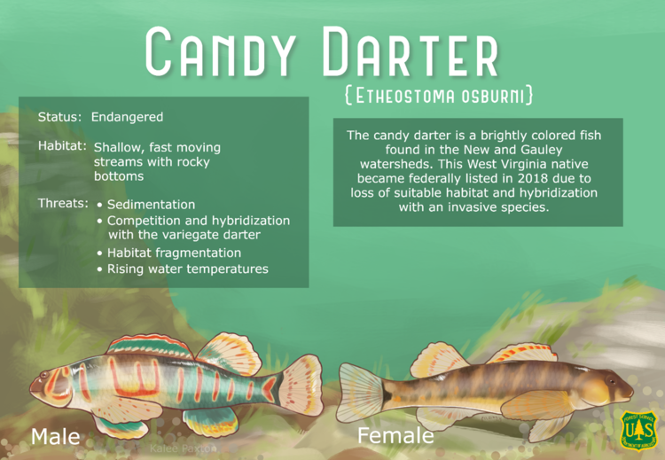
Activity
PART 2: Create a media project to spread awareness & conservation of the Candy Darter
Poster/artwork
Song
Video
Notes:
This is an example of an infographic about the Candy Darter

Slide 28
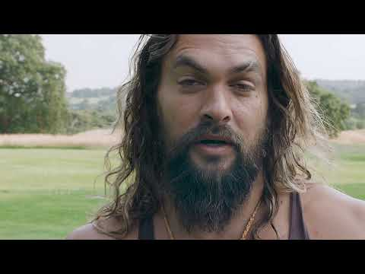
Activity
Notes:
Here's an example of a 1-minute video for raising awareness on wolves & encouraging its re-listing as endangered

Slide 29

Activity
Notes:
Here's a song promoting the protection of endangered animals

Slide 30
Reflection Questions:
What are important things to consider when finding out a species' extinction risk?
What difficulties did you encounter as you discussed the final Red List Category?
How did you go about choosing your creative media project?

Slide 31
What can you do for species conservation?
Spread awareness about the Candy Darter
Read about how to lessen your impact on the environment
Check out the IUCN Red List Website (http://iucnredlist.org)
Find ways to contribute to scientific research
Notes:
If the students have other ideas than what has been mentioned here, ask them to share them too!

