Slide 1
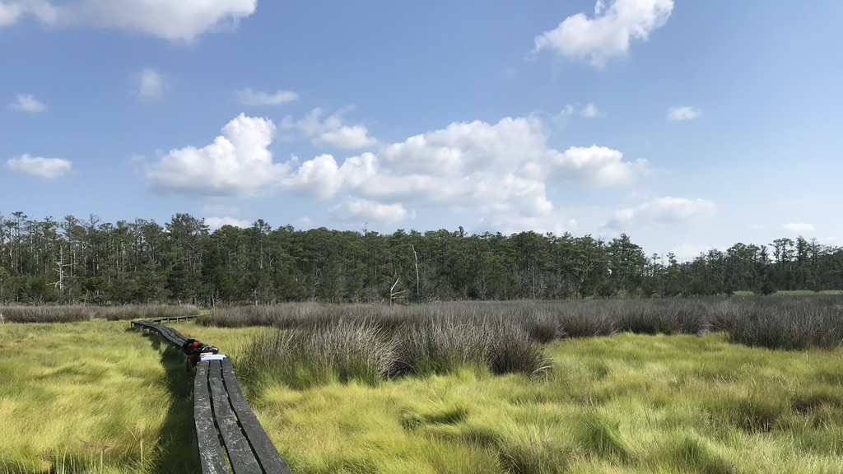
Marsh Migration Mania
Salt marsh invertebrates in the ghost forest
Photo: E. Goetz

Slide 2
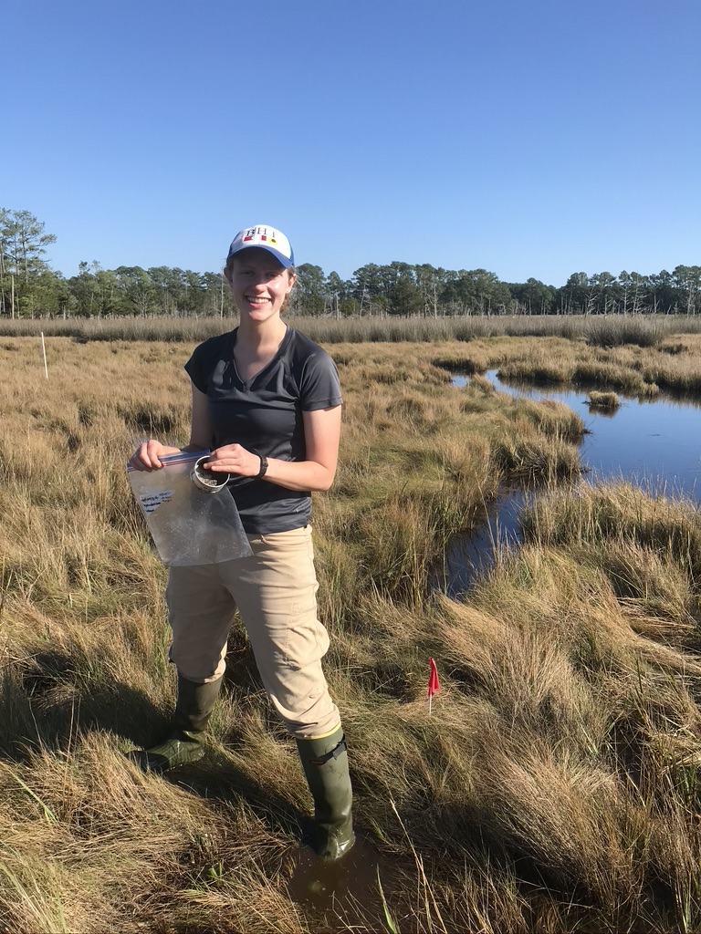
Meet the Marsh Researcher
Emily Goetz, graduate student at Virginia Institute of Marine Science
Research:
  Salt marsh and ghost forest invertebrate communities
  Changes to invertebrate habitat caused by sea-level rise
Photo: M. Goetz
Notes:
Today’s lesson is based on ongoing research at the Virginia Institute of Marine Science conducted by Emily Goetz (pronounced “Getz”), a graduate student. She studies how invertebrates in the salt marsh respond to sea-level rise and compares invertebrate communities in the salt marsh and ghost forest habitats.

Slide 3
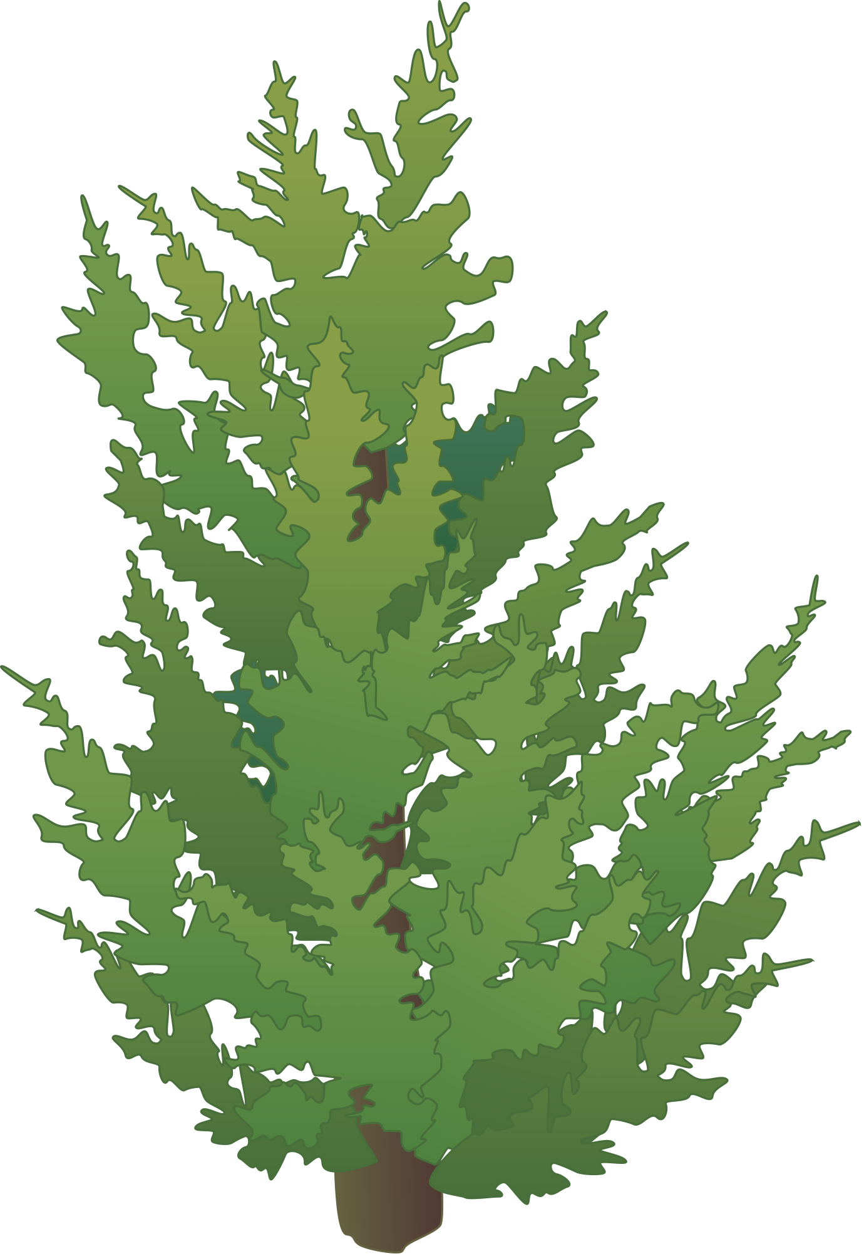
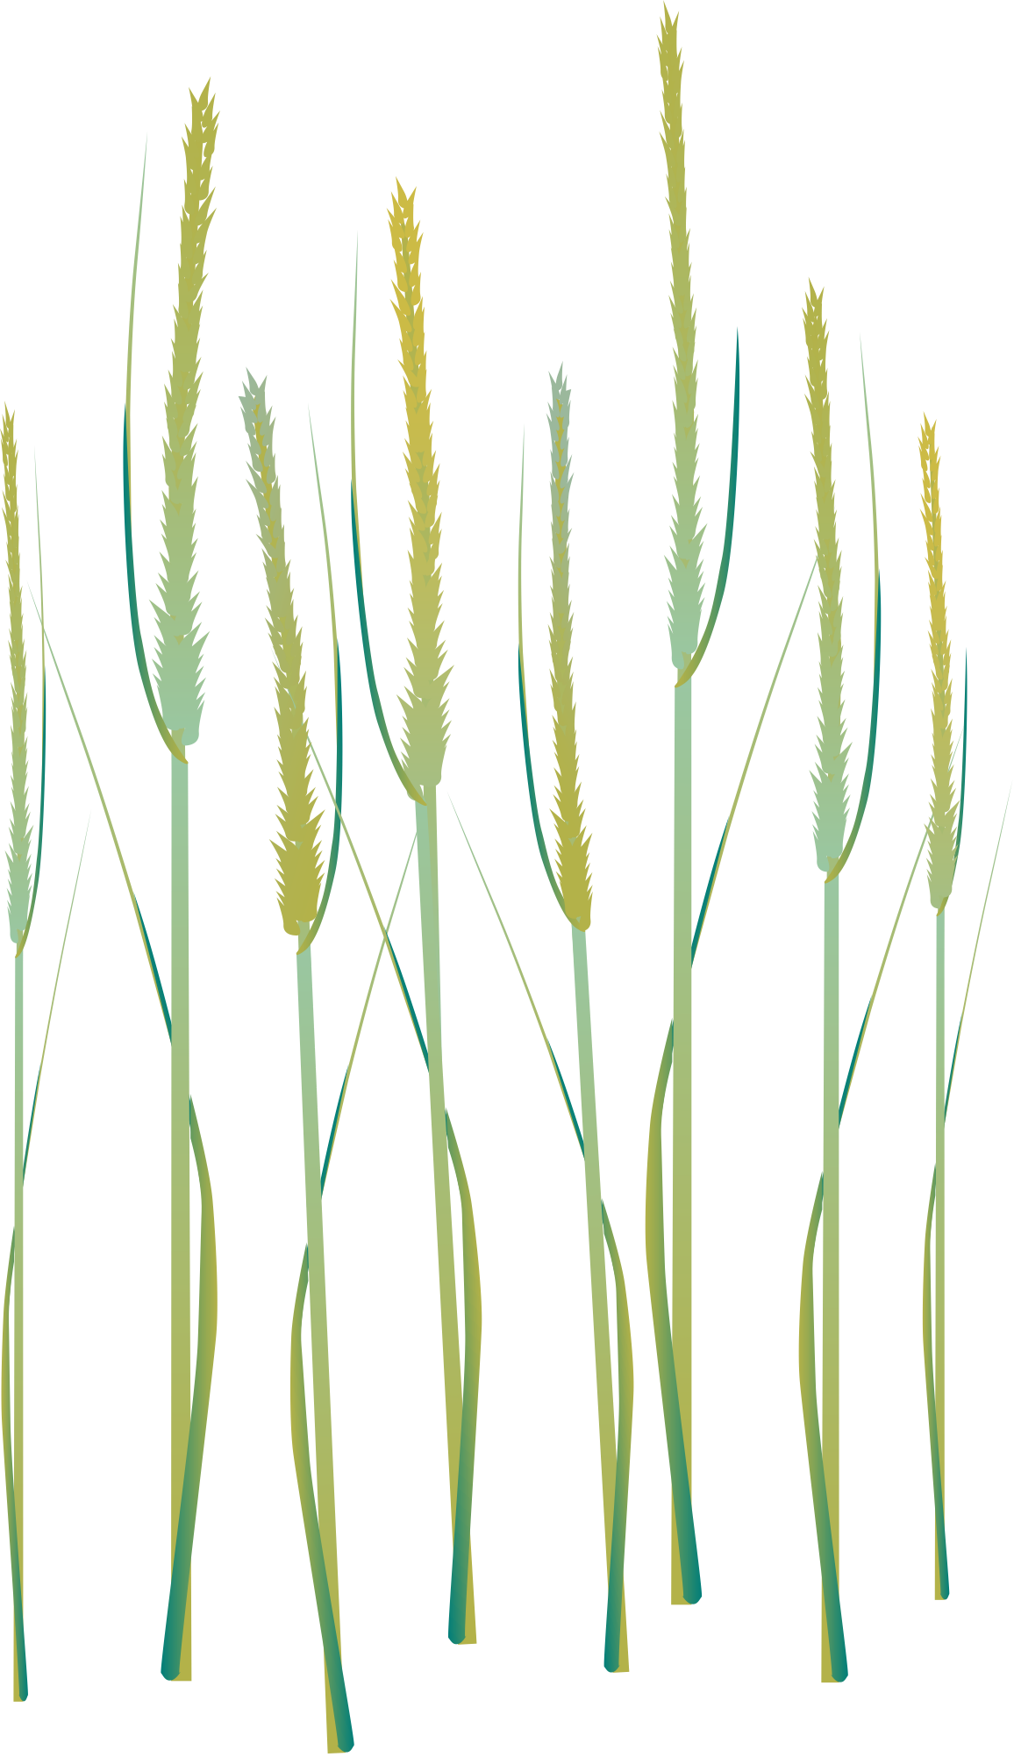
Salt marsh: intertidal
FOREST
OCEAN
Images c/o IAN
Notes:
Salt marshes are intertidal grasslands, meaning that they are flooded with salt water sometimes and exposed and dry at other times. When the tide comes in, it floods salt marsh grasses
(animation = water rising)

Slide 4
Salt marsh: intertidal
FOREST
OCEAN
Images c/o IAN
Notes:
When the tide goes out, it exposes salt marsh grasses (animation = water falling). Everything that lives in the salt marsh must be tough enough to survive being flooded at times and dry at times. Plants and animals must be able to tolerate salt water.
(Compare this to agricultural crops/house or garden plants the students might be familiar with – what would happen if you watered your plants with salt water? Plants would likely die)

Slide 5
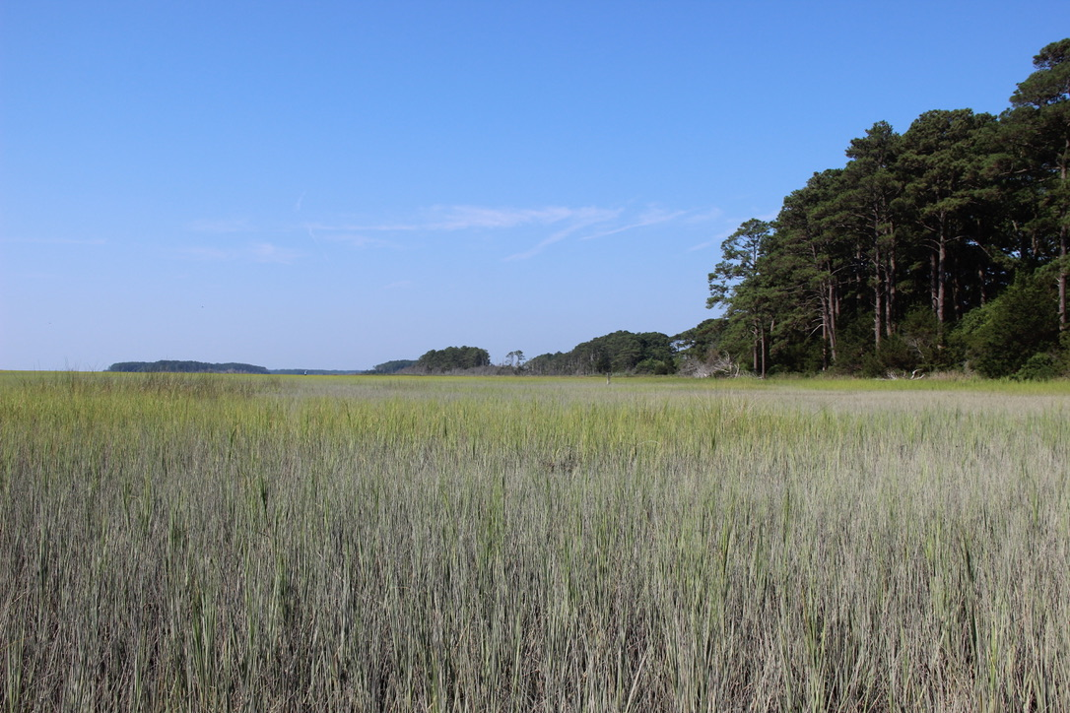
Who lives in the salt marsh?
Photo: E. Goetz
Notes:
This is a photo of a salt marsh on the Eastern Shore of VA. Has anyone ever seen a salt marsh?
(Animation=text)
It’s not just plants that live in the salt marsh! Ask students: what other organisms live in or use the salt marsh? (If no one answers, prompt with: does anybody like seafood?)
Possible answers: birds (egrets, herons), fish (mummichog), crabs (fiddler crabs, blue crabs), snails, mussels, oysters
Lots of invertebrates live in the salt marsh and are an important source of food for all of the other animals (and humans!) Can ask students to ID which of the animals they named was an invertebrate (crabs, snails, mussels, oysters)

Slide 6
Sea-level rise
FOREST
OCEAN
Images c/o IAN
Notes:
But the marsh is changing. Warming ocean waters and melting ice are causing sea levels to rise around the world, which can threaten salt marshes. With sea-level rise, high tides get higher
(animation = water rising)

Slide 7
Sea-level rise
FOREST
OCEAN
Images c/o IAN
Notes:
And low tides don't drain the entire marsh (animation = water falling), so that the lowest elevation marsh stays flooded. This will eventually cause the lowest elevation marsh to drown and die back (animation = grass disappears).
Ask students: what do you think will happen to the trees at the edge of the marsh if they are flooded by saltwater?
Answer: Trees will die if flooded with salt water. Only certain species can tolerate salt water, like marsh plants that are specially adapted for saltwater conditions

Slide 8
Sea-level rise
FOREST
OCEAN
Images c/o IAN
Notes:
We will likely see some of the forest found right at the edge of the marsh die, but the trees typically do not fall over.

Slide 9
Marsh migration
FOREST
OCEAN
Images c/o IAN
Notes:
However, we also see some plants that become MORE successful in areas that are flooded with rising sea levels. Forests might die back, but those areas become good habitat for marsh plants and animals. For example, we see marsh plants start growing in areas where they didn’t grow before. This expansion of the marsh to higher elevations is called marsh migration.
(Animation = text appears)
***PAUSE SLIDESHOW HERE FOR OPTIONAL CLAY MODEL DEMONSTRATION

Slide 10
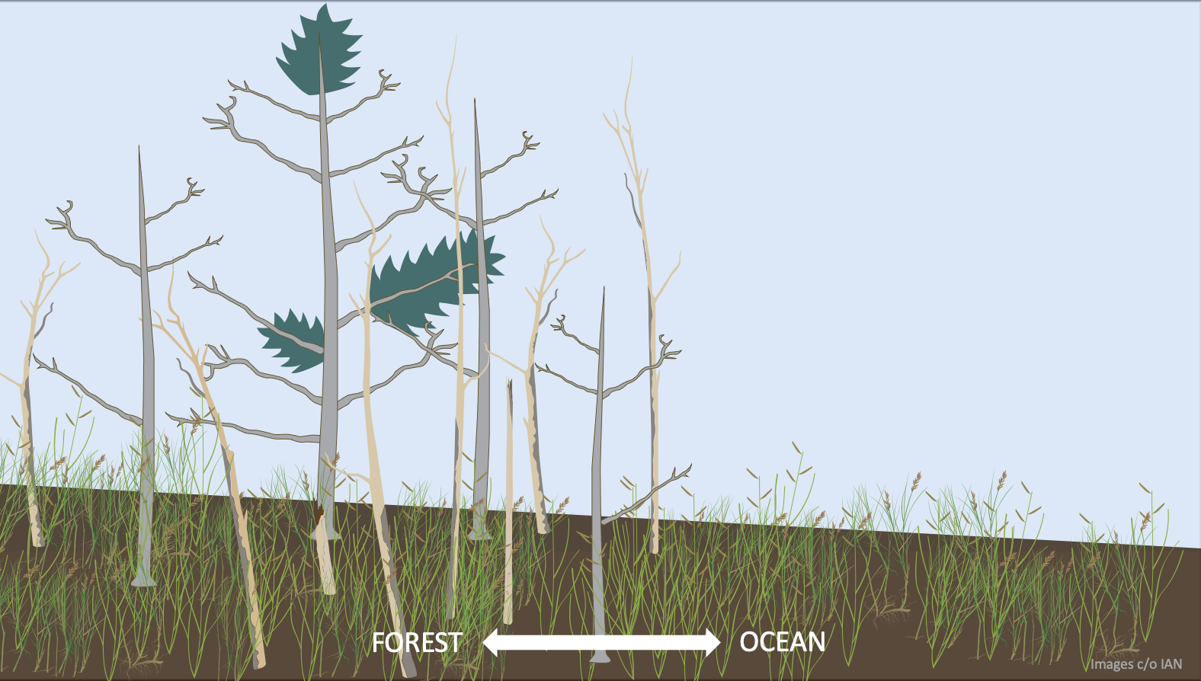
Ghost Forest
Salt Marsh
Notes:
When saltwater floods higher elevations, it kills trees and lets marsh plants grow. This forms a new habitat between the marsh and the forest: ghost forest. The ghost forest has standing dead trees with marsh grasses growing below them.
If sea level keeps rising and more forest dies back, marsh plants and animals will keep moving inland to higher elevations. Eventually, the dead trees will fall over and the ghost forest will start to look like the rest of the marsh. With faster and faster sea-level rise, we start to see more ghost forests because the marsh is migrating inland faster than the dead trees are falling over.

Slide 11
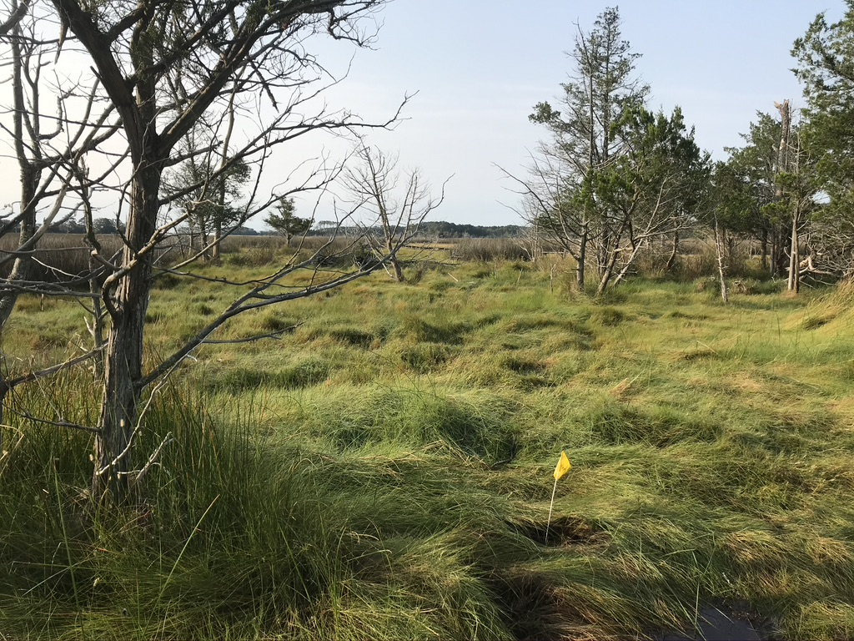
Who lives in the ghost forest?
Ghost Forest
VA Eastern Shore
Photo: E. Goetz
Notes:
In real life, the ghost forest might look something like this. This photo is from a ghost forest on the Eastern Shore of Virginia. We know that this area used to be forest because of the trees and tree trunks that are still there. We also know that the marsh is migrating in here because all of the ground plants are grass species that need salty soil. The rest of the living trees here will die soon and will eventually fall over.
(Animation = text appears)
Ask students: what kinds of plants and animals live in the ghost forest? Do you think they’re the same as the plants and animals in the marsh? Answer: as discussed on the next slide, scientists don’t know yet!

Slide 12
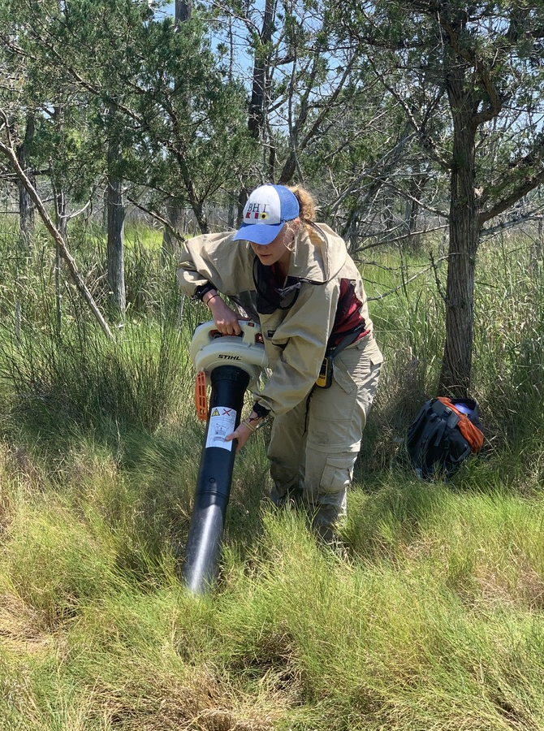
Scientists don’t know yet!
Scientists are doing surveys to learn what types of plants and animals live in the ghost forest.
Some animals might not use ghost forest right away because it doesn’t have the right food or conditions for them yet.
Other animals might be less sensitive and migrate into the ghost forest sooner.
Eventually, the ghost forest will turn into salt marsh and marsh animals will be able to live there.
Photo: SS Wittyngham
Notes:
We don’t yet know exactly which organisms are using the ghost forest, but scientists are collecting samples to determine how the salt marsh and ghost forest communities compare to each other. In this photo, the marsh researcher is using a leaf vacuum to suck up invertebrates in the marsh grasses so she can compare invertebrate communities between habitats.
Ask students: why might there be different plants or animals in the ghost forest, as compared to the salt marsh?
Possible answers: less sunlight because of the trees, less flooding/salinity because it is farther inland/higher elevation, different types of food available for animals
Eventually, the ghost forest will turn into a salt marsh. However, if marsh is lost to sea-level rise before the ghost forest has had enough time to become good habitat for marsh animals, these marsh organisms may not have enough habitat to survive.

