Slide 1
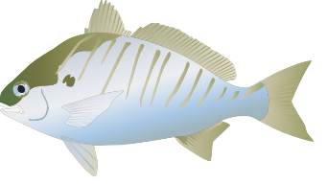
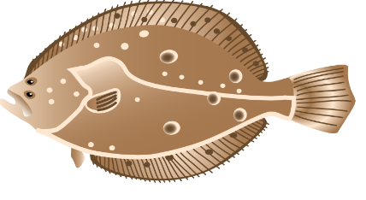
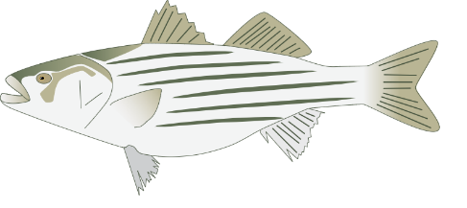
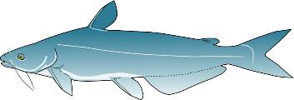

Fish Census: Monitoring Finfish Populations in Chesapeake Bay
An exploration of where fishes live in a coastal estuary and how their populations change through time
Prepared By: Rachel Dixon
Virginia Institute of Marine Science
Photo Credit: UMCES IAN and V. Nepal
Notes:
Photo Credits:
Spot, Summer Flounder, Bay Anchovy, Striped Bass: UMCES Integration & Application Network Image Library (ian.umces.edu/imagelibrary/)
Blue Catfish: Vaskar Nepal

Slide 2
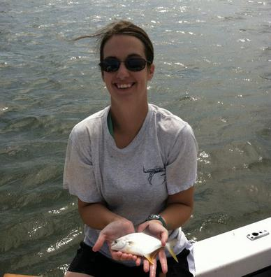
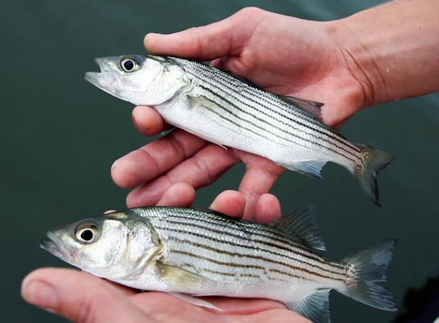
Rachel Dixon
Ph.D. Student at the Virginia Institute of Marine Science (VIMS)
I am a fisheries scientist-in-training!
I study how changes in the environment impact populations of fishes like Striped Bass
Photo Credit: R. Dixon
Photo Credit: VIMS Juvenile Fish Trawl Survey
Notes:
Photo Credit: R. Dixon and VIMS Juvenile Fish Trawl Survey (striped bass)

Slide 3
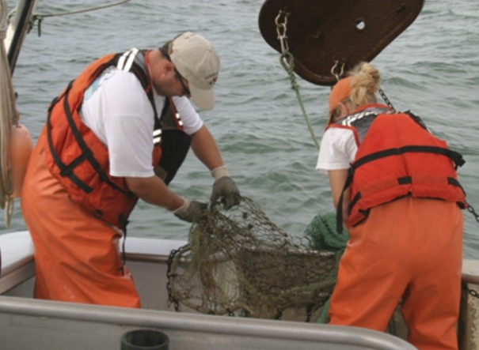
Research Briefing
Introduction - Background
“Counting fish is like counting trees, except they are invisible, and they keep moving” – John Shepherd, Fisheries Scientist
Scientists need to know which fishes live where, and how many there are. This helps scientists understand how populations are changing and learn about the health of the Bay.
Your task:
Learn about five fish species common to Chesapeake Bay
Learn about what factors can impact the distribution and abundance of fishes
Collect survey data and share your results
Determine how fish populations change over time
Photo Credit: VIMS Juvenile Fish Trawl Survey
Notes:
Photo Credit: VIMS Juvenile Fish Trawl Survey
----
This slide summarizes the main goal to be answered by this lesson and summarizes the study objectives

Slide 4
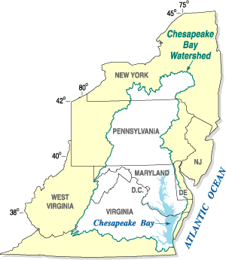
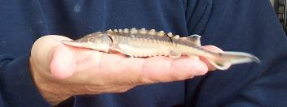
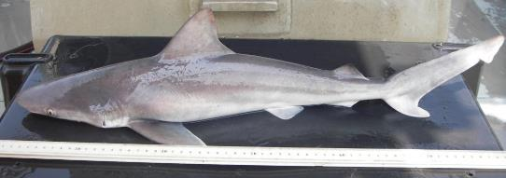
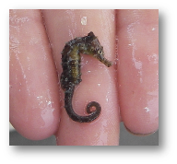
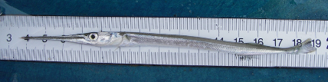
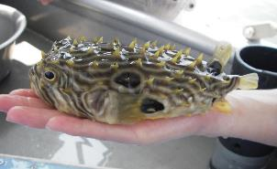
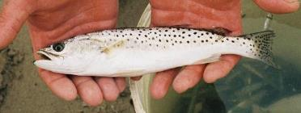
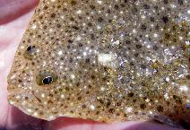
What fishes live in Chesapeake Bay?
Introduction - Background
This large coastal estuary is home to nearly
350 species of fish
How many can you name?
Photo Credits: VIMS Juvenile Fish Trawl Survey
Every year, scientists conduct a fish “census”:
They count the number of fish in different habitats around the
Bay to track how populations change
Photo Credit: USGS, Wikipedia Commons
Notes:
Photo Credits: Map: Wikipedia Commons, USGS. Fish photos: VIMS Juvenile Fish Trawl Survey
----
1. Familiarize students with the Chesapeake Bay if they aren’t already. The Chesapeake Bay is the largest estuary in the United States (and in North America) and the third largest in the world. Rivers from 6 states and Washington DC drain into the Bay (the watershed)
2. Define an estuary and its parts:
An estuary is a coastal ecosystem that is partially-enclosed, characterized by a mixing of freshwater from the land and saltwater from the ocean
The mouth of the Bay and the central “trunk” is referred to as the mainstem. The water at the mouth of the Bay is salty from the proximity to the Atlantic Ocean (salinity between 25-30 ppt) and becomes more fresh as you move toward the head (top) of the Bay.
The rivers that flow into the Bay, (the “branches”) are referred to at the tributaries. The water here is fresh, becoming slightly salty as you move downstream.
3. The watershed is home to 18.2 million people and nearly 350 species of fish. Ask students if they can name any, either the examples shown in the pictures or any others. Some of these fish species live in the Bay year-round, while others migrate into the Bay from the ocean to seek food, shelter, or reproduce.
Photo key: Top row – Atlantic sturgeon, sandbar shark. Middle row: Lined seahorse, Atlantic needlefish, striped burrfish. Bottom row: Spotted seatrout, windowpane flounder
A wide-diversity of fishes live in the Bay – scientists want to study what fishes live where, and how many there are. Make the connection to a human census – counting a state or country’s human population to see how it has changed over time.

Slide 5


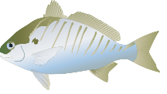
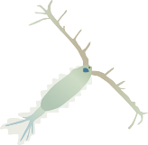
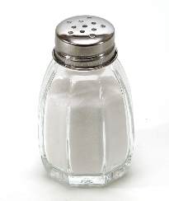
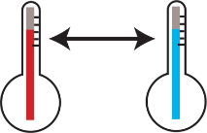

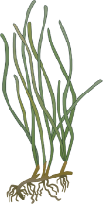

What factors determine where a fish lives?
Introduction - Background
Fish need access to healthy habitats that provide:
1. Plenty of food (prey)
3. Ideal environmental conditions: Temperature range
Salinity (fresh or salt water)
Do you think different species live in the same habitats?
Do you think fish live in different habitats throughout their life cycle?
2. Shelter
Do conditions in the environment stay the same or change over time?
Photo Credit: UMCES IAN and Wikipedia Commons
Notes:
Photo Credits: Diagram – UMCES IAN. Salt shaker – Wikipedia Commons, by Dubravko Sorić SoraZG on Flickr - https://www.flickr.com/photos/11939863@N08/3793288383/in/photostream/, CC BY 2.0, https://commons.wikimedia.org/w/index.php?curid=18125369
----
Continue to make the connection to a human census – Why do people live in certain neighborhoods? Some ideas students might have would be that people want to live near a grocery store, or close to a school.
1. A fish’s distribution – the specific habitats where a species lives – is determined by many factors. You might ask students to brainstorm ideas first.
2a. Ask students if different species can live in the same habitat. Answer: It depends on the ecology of an individual species – where they can find enough food, mates for reproduction, and optimal physical conditions for their species (for example, are they a fresh water or saltwater fish). Emphasize to students that while all fish have the same basic needs (ample prey, protection from predators, etc.), different species live in different habitats. Just like different people live in different places.
This activity focuses on the distinction between the freshwater tributaries of the Bay and the more saltwater mainstem, to allow students to see how fishes can be spatially distributed through an estuary.
2b. Ask students if they think fish might live in different habitats throughout their life cycle? Answer: Yes. For many species, juveniles and adults live in different habitats, but others live in the same habitat throughout their lives.
3. Ask students if they think these conditions always stay the same or if they change over time. They should understand that environmental conditions can change from season to season, and year to year. Examples: Water temperature changes with the season; salinity can change after a heavy rain event.
Takeaway: The distribution and abundance of a particular species can vary over time in response to changes in the ecosystem. Define these terms if students are not familiar – definitions are included in the lesson plan.

Slide 6
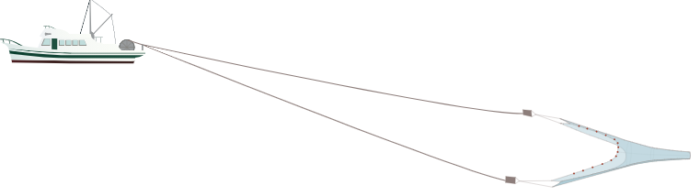


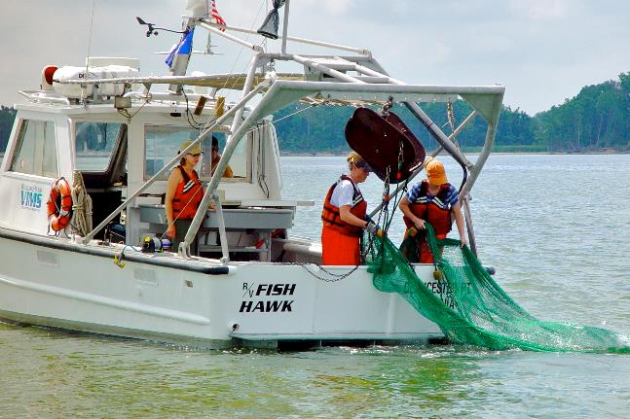
How do scientists sample fish in the Bay?
Introduction - Background
Research vessel
Float line helps keep
the net open
Fish are collected in
the cod-end
Bridles tow the net behind the vessel
Trawl doors help spread
the net wide
Scientists conduct surveys using a cone-shaped net called a trawl.
Scientists collect fish from different habitats to see how populations change from year to year.
Video on the parts of a trawl net
Photo Credit: VIMS Juvenile Fish Trawl Survey. Trawl Diagram: UMCES IAN
Notes:
Photo Credits: Trawl Diagram – UMCES IAN, Photo – VIMS Juvenile Fish Trawl Survey
----
Scientists monitor fish populations by conducting surveys – this ‘census’ shows us how many fishes are in the Bay and where they are living.
To study these fishes, scientists conduct surveys using a gear called a trawl net. A trawl net consists of a cone-shaped body that is extended at the opening by two doors and closed by a bag or “cod-end” where organisms are collected. The net can be towed by one or two boats and used to sample on the bottom or in the middle of the water column.
The net is lowered via a winch into the water. As the net extends behind the boat, two steel “doors” spread the opening wide and help it stay open. The top of the net has floats and the bottom is weighted. As the net is pulled behind the boat, fish are collected in the cod-end which has a finer mesh. After the net is towed for a set amount of time (ex. 5 minutes), the net is brought back up on deck and the fish are removed, sorted by species, measured, and counted.
These surveys play an important role in researching and monitoring the Bay’s fish populations. They help scientists track trends in seasonal distribution and the abundance of species that have ecological importance, but also those targeted by commercial and recreational fisheries. We sample different areas of the Bay to get a representative sample of the fishes in the Bay.
Like a census of people, you go to different “neighborhoods” to count people to know how many are in the whole town or state.
Optional video explaining the different parts of a trawl net (2:07): https://www.youtube.com/watch?v=R65g5o-5OdU

Slide 7
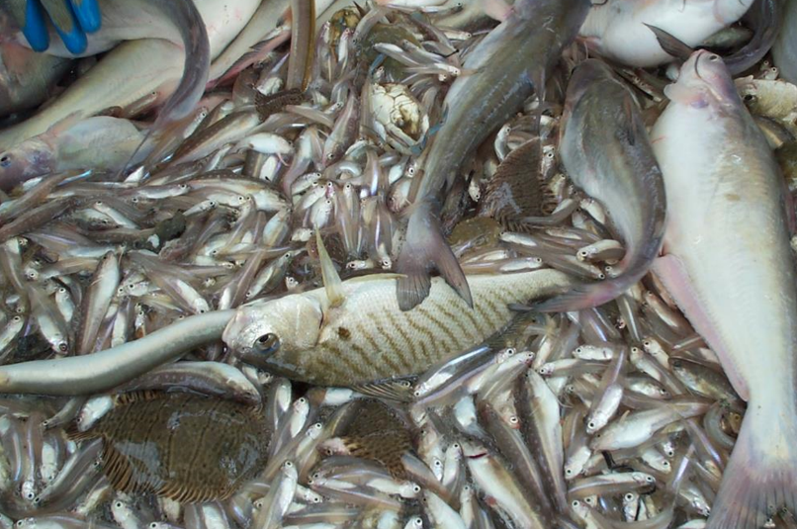
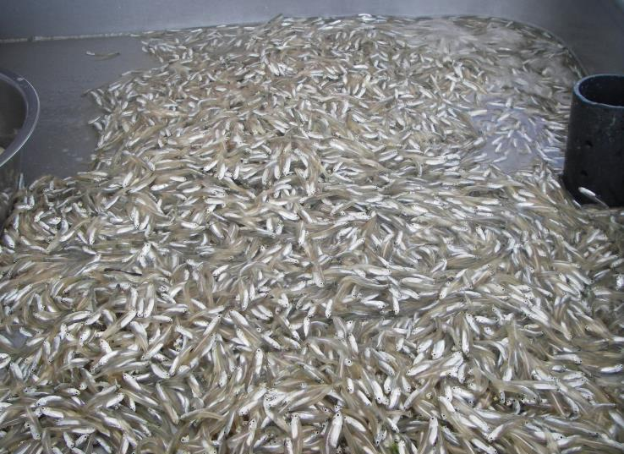
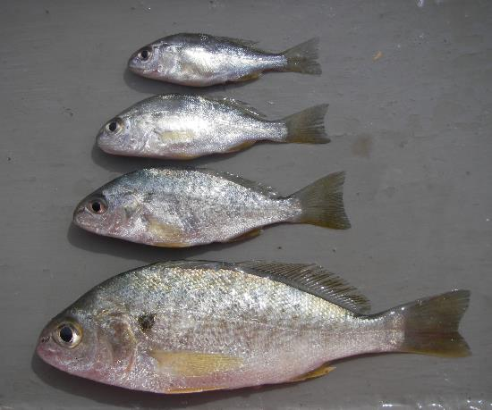
Introduction - Background
Sometimes we catch many species at once…
Or sometimes we catch many fish of just one species…
Often, we catch many sizes of the same species!
Photo Credits: VIMS Juvenile Fish Trawl Survey
Notes:
Photo Credits: VIMS Juvenile Fish Trawl Survey
----
These are some additional images to demonstrate that the diversity of species and overall numbers of fish can vary widely depending on where survey samples are collected

Slide 8


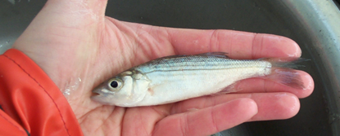
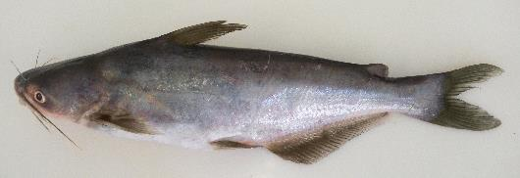

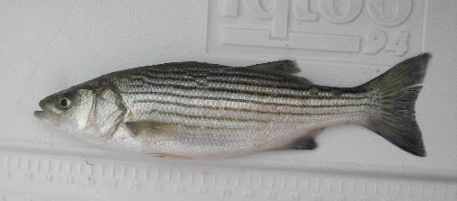
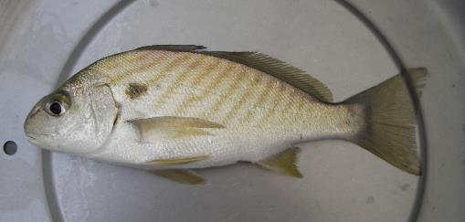


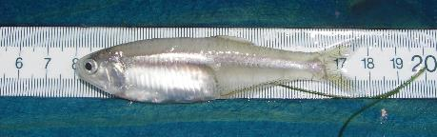
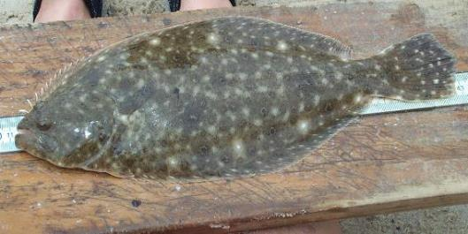
Today, we will observe 5 different fish species common to Chesapeake Bay:
Striped Bass
Blue Catfish
Juvenile
Spot
Adult
Bay Anchovy
Summer Flounder
Photo Credits: VIMS Juvenile Fish Trawl Survey
Notes:
Photo Credits: Photographs – VIMS Juvenile Fish Trawl Survey, Illustrations – UMCES IAN, Vaskar Nepal
----
This slide shows the 5 focal species we are going to “catch” in this activity. Ask whether students recognize any of these fishes - they might have caught some fishing or ate one at a restaurant.
Overall, these five fishes are examples of how different species not only play important ecological roles as key prey (ex. Bay Anchovy) or predators (ex. Striped Bass/Summer Flounder/Blue Catfish) in the food chain, but are important to humans as species that we fish for, either commercially or recreationally (ex. Striped Bass/Summer Flounder). The Blue Catfish has a unique role as one that has a negative impact on the ecosystem (as an invasive species), but is also an important sport/recreational species.
**NOTE** – The next 3 slides demonstrate some of the relationships between these species. These can be omitted or expanded on as time allows or based on student’s prior knowledge.

Slide 9
Live in the Bay year-round
Migrate in and out of the Bay
Striped Bass
Blue Catfish
Spot
Summer Flounder
Bay Anchovy
Notes:
Photo Credits: Photographs – VIMS Juvenile Fish Trawl Survey, Illustrations – UMCES IAN, Vaskar Nepal
----
Resident (BLUE) vs. Migratory (YELLOW). Two of these species (Blue Catfish and Bay Anchovy) are full time residents of the Bay, while the other three migrate in and out of the Bay at different points in their life cycle.

Slide 10
Striped Bass
Blue Catfish
Spot
Predator
Prey (especially when small)
Summer Flounder
Bay Anchovy
Prey
Predator
Notes:
Photo Credits: Photographs – VIMS Juvenile Fish Trawl Survey, Illustrations – UMCES IAN, Vaskar Nepal
----
Prey (ORANGE) vs. Predators (PURPLE): Bay Anchovy, especially, but spot as well are important prey fish for other larger fishes.
Blue catfish are omnivorous and generalist feeders – but important to note, they have very few natural predators due to the spines (barbels) located on their dorsal and pectoral fins/

Slide 11
Striped Bass
Blue Catfish
Spot
Summer Flounder
Bay Anchovy
Notes:
Photo Credits: Photographs – VIMS Juvenile Fish Trawl Survey, Illustrations – UMCES IAN, Vaskar Nepal
----
(GRAY) Striped Bass and Summer Flounder are two species in the Bay that are the focus of valuable commercial and recreational fisheries – people fish for them to sell, to eat, and for fun.

Slide 12
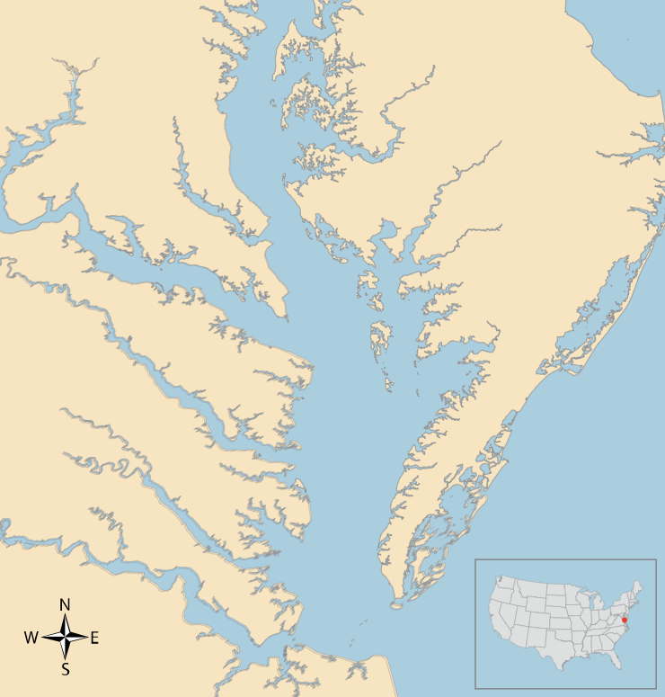
Activity
We need to know:
Where do different fish species live?
How many fishes are in different habitats?
Eastern
Shore
Your task:
It’s summer, and your class is going to collect survey data for the next fish census of Chesapeake Bay!
In groups, you will work as a crew of scientists to identify, sort, and count the fish you caught in your trawl net.
Potomac R.
5
Rappahannock R.
Chesapeake Bay
Piankatank R.
Atlantic Ocean
York R.
2
Mobjack
Bay
3
4
James R.
1
Notes:
Map Credit: UMCES IAN
----
This slide summarizes the questions to be answered and sets the stage for the activity and their objective. Students will count and sort fishes in their sample and should be able to draw conclusions about the differences in catch between sites.
This map and the instructions are included in the handouts for students, but this slide can be kept up for reference if its helpful.

Slide 13
Pre-Survey Questions
Is your sample site in the mainstem of the Bay or one of its tributaries? Do you think the habitats at this site will be mostly fresh or salt water?
Develop a hypothesis for which fish species you think you will catch the most of at this site. What evidence supports your hypothesis?
Are there any species you do not expect to find at this site? Why or why not?
Notes:
This slide has a copy of the Pre-Survey questions #1, 2, and 3 on the Survey Data Worksheet. Students should answer these on their sheet before sorting their “samples” and counting fish.

Slide 14
What did you catch?
What fishes did you catch at your site, and how many? Which species is most abundant? Least abundant?
How does your site compare to the other sites around the Bay? Did you catch more or less species, or more or less fish overall?
Do you think this survey was an accurate estimate of all the fish in Chesapeake Bay? Why or why not?
Notes:
This slide has a copy of the Post-Survey questions #4, 5, and 6 on the Survey Data Worksheet. Students should answer these on their sheet, then share with the class

Slide 15
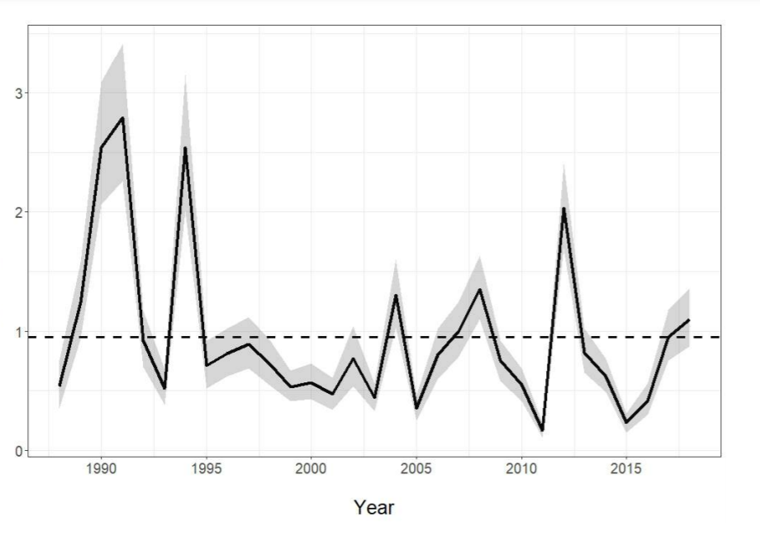
What are these data used for?
Fish populations change over time. Survey data can provide an estimate of how many fish of a species are present in the Bay that year. This is called an Index of Abundance.
This provides scientists with important knowledge on the health of the Bay’s ecosystems.
We need to know:
For each of our species, is the abundance increasing or decreasing?
Your task:
You will summarize the data you just collected for this “year” and conclude how the population is changing.
For some species, we want to make sure populations are healthy enough to fish from in the future.
Fish Abundance
Photo Credits: VIMS Juvenile Fish Trawl Survey, UMCES IAN
Notes:
Figure Credit: VIMS Juvenile Fish Trawl Survey; Flounder – UMCES IAN
----
1. Ask students to brainstorm why populations might fluctuate. Remind students that the distribution and abundance of a particular species can vary over time in response to (1) changes in environmental conditions, (2) changes in the abundance of their prey, and/or (3) fishing pressure.
- For species that people are interested in fishing and eating, like Striped Bass and Summer Flounder, we are especially interested in whether fishing regulations need to change to help conserve the population.
- It’s also important to monitor the populations of their prey, like Bay Anchovies (if prey numbers decline, there will be less food for predators).
- For an invasive species like Blue Catfish, we want to keep an eye on their numbers, as too many might have negative consequences for other fishes.
2. The main goal of these surveys is to develop indices of abundance (like the graph on the left) – which measures the relative size of the population each year. This lets researchers and fishery managers help predict whether the population size will be healthy enough to harvest fishes in the future. This figure is an example of an index of abundance for Summer Flounder – point out to students how much it changes over time. The dashed line indicates the average population size.
3. Now, inform the class that they have completed a years’ "census" of data, now let's see how this year's data compares to past census years to see how the population is changing through time for each species.

Slide 16

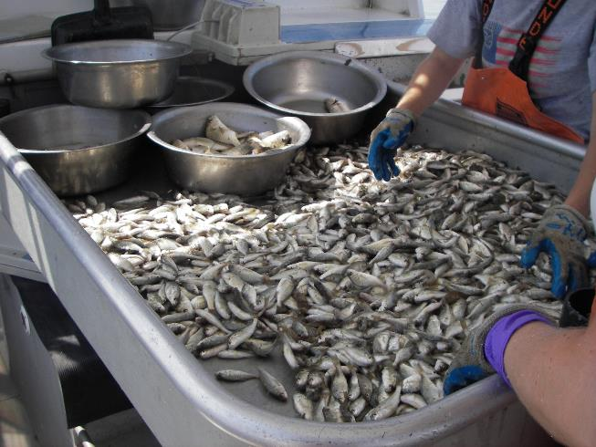
How is your population changing over time?
Compared to last year (Year 5), does your species population appear to increase, decrease, or stay about the same?
Over the past six years, what is the population doing?
Bay Anchovy
Spot
Photo Credits: VIMS Juvenile Fish Trawl Survey
Notes:
Photo Credits: Photographs – VIMS Juvenile Fish Trawl Survey, Illustrations – UMCES IAN
----
Overall, these five fishes are examples of how different species not only play important ecological roles as key prey (ex. Bay Anchovy) or predators (ex. Striped Bass/Summer Flounder/Blue Catfish) in the food chain, but are important to humans as species that we fish for, either commercially or recreationally.
For the forage/prey species like Bay Anchovy and Spot – the populations of these fishes might fluctuate more from year to year based on changes in environmental conditions, but we want to make sure their populations are large enough to provide enough food for larger fish species like Striped Bass and Summer Flounder.

Slide 17
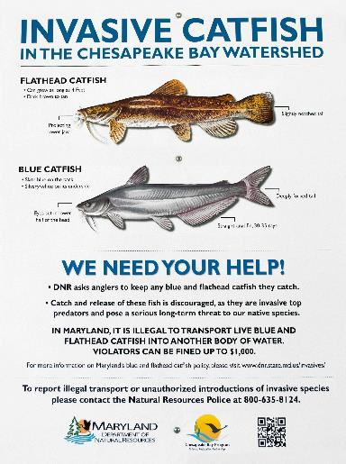
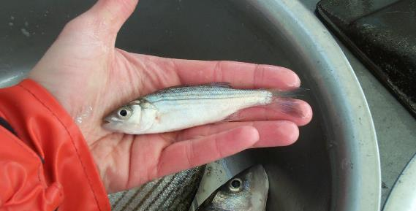
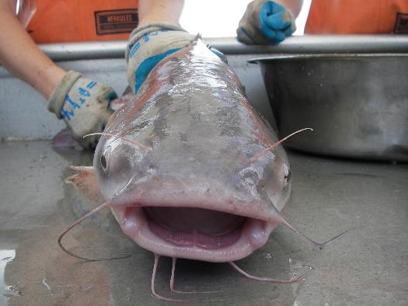
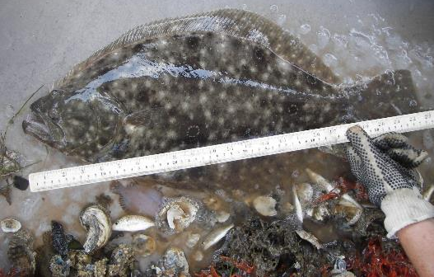
How is your population changing over time?
Compared to last year (Year 5), does your species population appear to increase, decrease, or stay about the same?
Over the past six years, what is the population doing?
Striped Bass
Blue Catfish
Summer Flounder
Photo Credits: VIMS Juvenile Fish Trawl Survey
Notes:
Photo Credits: Photographs – VIMS Juvenile Fish Trawl Survey, Illustrations – UMCES IAN
Blue Catfish poster: Chesapeake Bay Program Flickr
----
The Blue Catfish is an invasive species, and scientists are studying the negative impact their growing population is having on the ecosystem. Because these fish can grow so large, they are also an important sport/recreational species. Scientists are working with managers to see if we can find a balance between having enough Blue Catfish to fish for, but control their population from becoming too large.
Striped bass and Summer Flounder are important predators in the Bay’s ecosystem. Both species are also economically important, as the focus of both commercial and recreational fisheries in the region. Ensuring that their populations are large and stable enough helps fishery managers understand how much fishing can take place in the future.

