Slide 1

Dial C For Collaboration: Finding Unknowns with Your Fellow Scientists
Created By: Brianna Stanley for VA SEA
Notes:
Introduction (~15 minutes) – This PowerPoint may be utilized to introduce the idea of collaboration and standard curves. If students are unfamiliar with Excel or alternative programs such as Google Sheets, introduce students to the program.

Slide 2
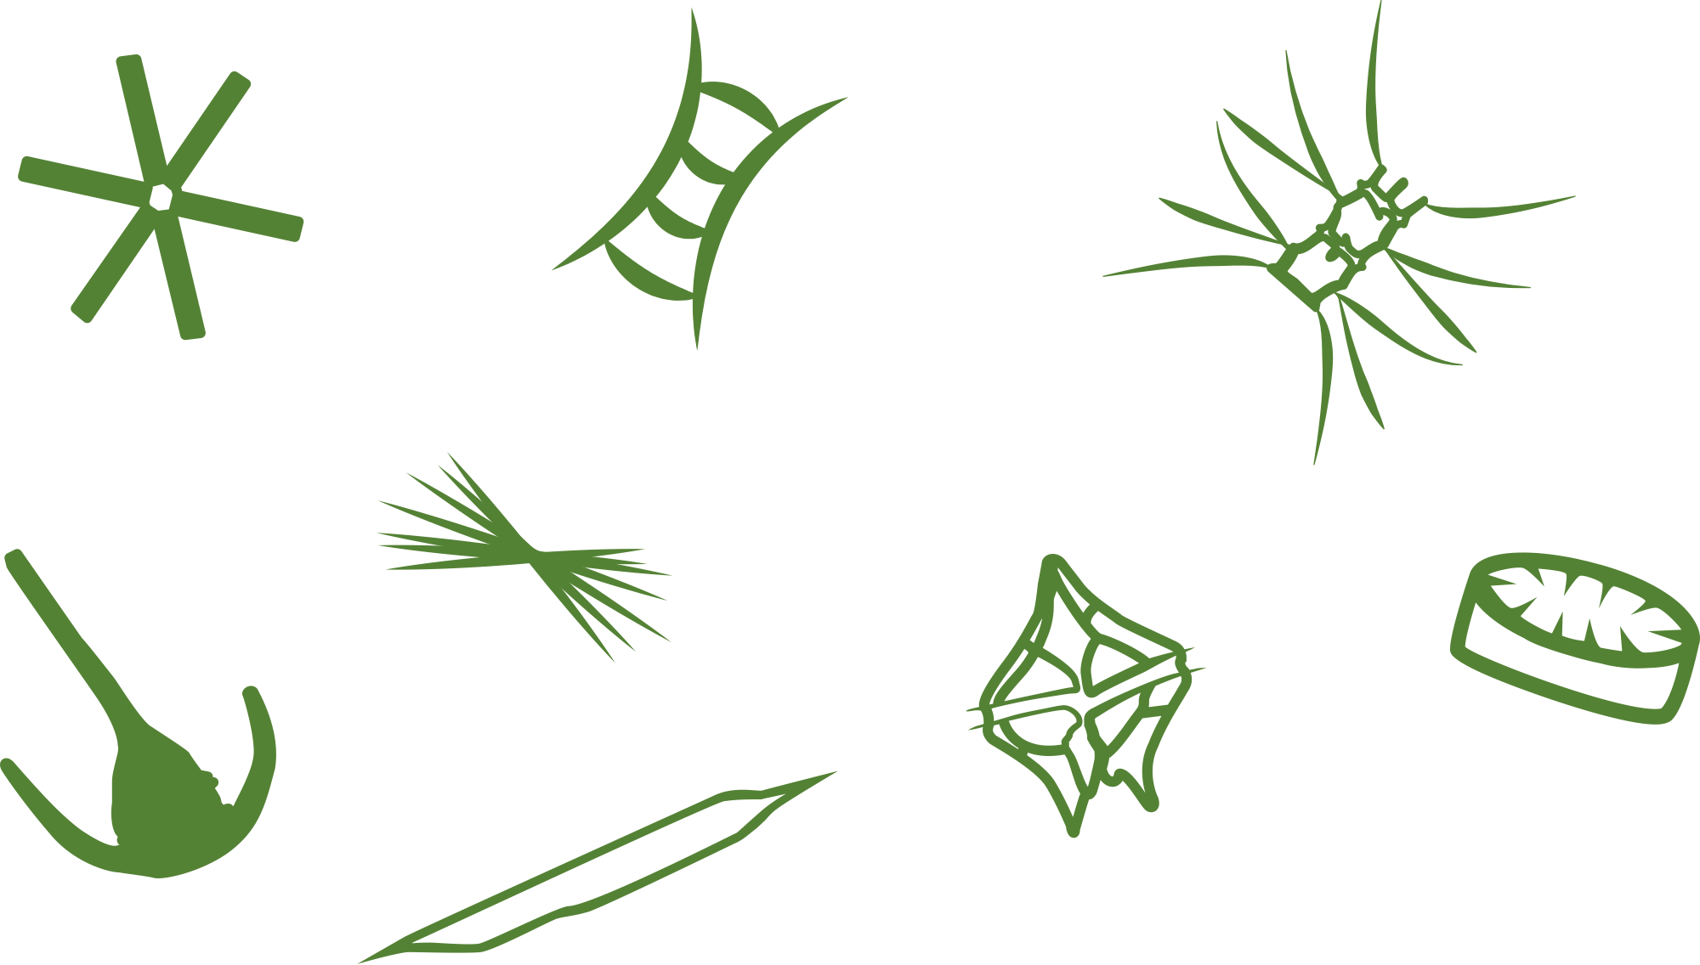
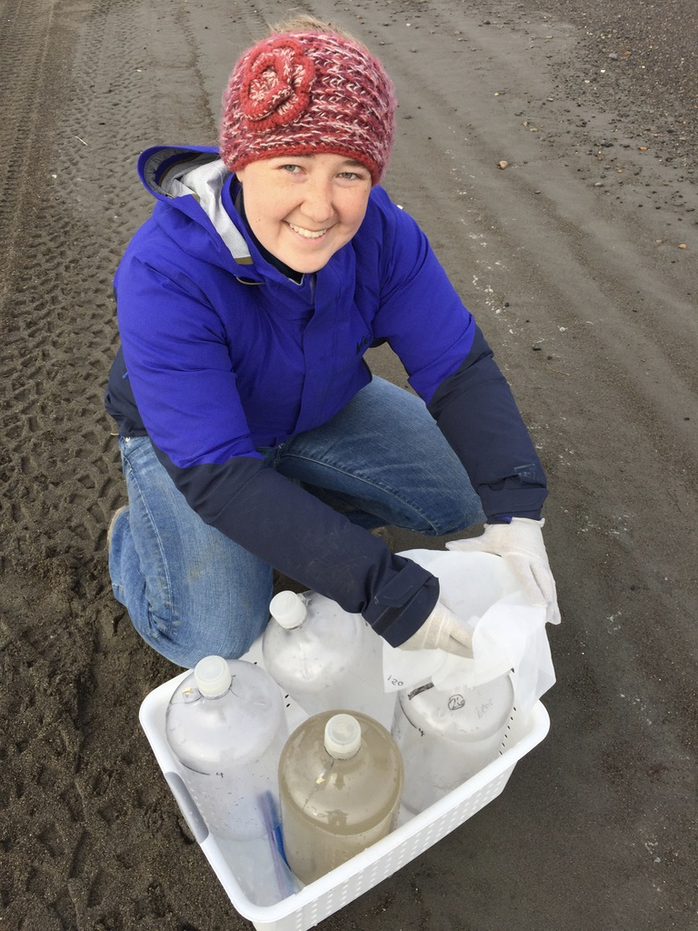
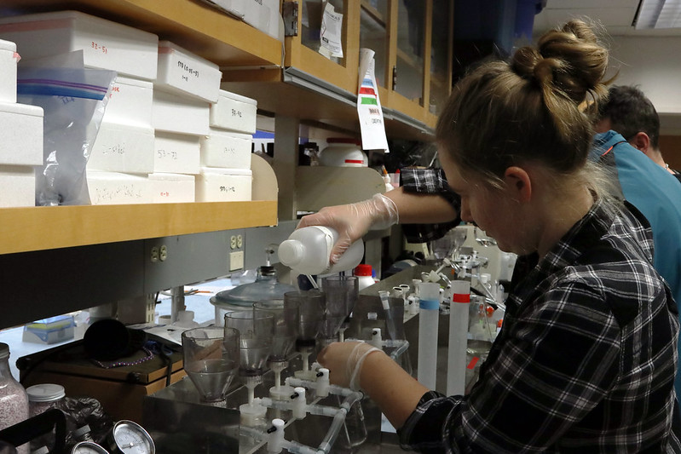
Brianna Stanley
I am a graduate student in Virginia studying nitrogen as a food source for phytoplankton.
Madeleine Jepsen for VA Sea Grant
Madeleine Jepsen for VA Sea Grant
Fun Fact! I decided I wanted to study nitrogen when I was a sophomore in high school!
Brianna Stanley
Symbols courtesy of the Integration and Application Network, University of Maryland Center for Environmental Science
Notes:
I am a graduate student in Virginia studying nitrogen and how it is used as a food source for phytoplankton. I am interested in how different phytoplankton use different types of nitrogen for food. The first picture shows me doing lab work in Virginia. I spend most of my time doing research in Virginia, but I also get to travel to do science. The second photo shows me on a beach in Alaska collecting water. I got to spend two summers in Alaska to study how nitrogen is changing in the Arctic.

Slide 3
Collaboration
Chief Investigators
Peers and Friends
Professor at university abroad
Is working together with your peers or fellow scientists to reach a common goal.
Goal
Scientist with cool idea from a science meeting
Professor at nearby university
Students
Notes:
Collaboration is a big part of science, Collaboration is working together with your peers or fellow scientists to reach a common goal. All scientists, even student scientists need to collaborate. Scientists collaborate with a lot of different people to reach their research goals. These can include a head scientist, called a chief investigator, students, friends, and many other professors. These scientists may be at the same school or from other universities all over the world! They can even be scientists they meet with a cool idea from a science meeting or members of the local indigenous community. For example, when I was in Alaska we worked with the local Inupiat tribe to coordinate our sampling with their summer hunting season.

Slide 4
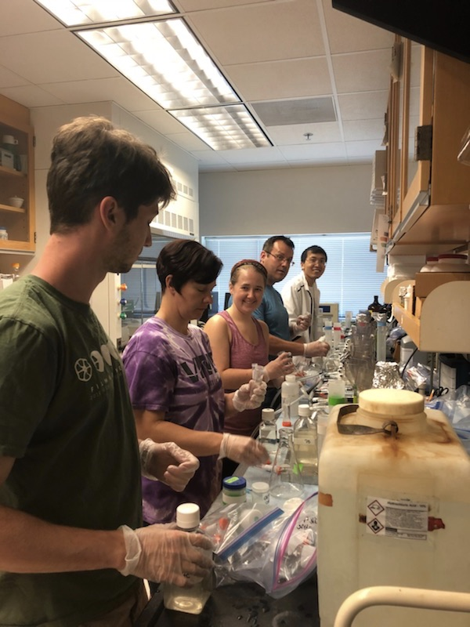
Collaboration
Science isn’t hard when you have collaborators to help you do your experiments and check your ideas!
Brianna with her collaborators working on an experiment in the York River, VA
Brianna Stanley
Notes:
This slide shows the author with some collaborators as an example. Brianna is shown her working with collaborators to do an experiment on phytoplankton in the York River in Virginia.

Slide 5
The Scientific Method
A way to gain scientific understanding that promotes thinking, experimentation, and collaboration
Research Question
Research and Create a Hypothesis
Do your results make sense? Perform quality control and reach out to collaborators
Experiment
Check Results/Make Conclusions
Report Results
Notes:
This slide can be used to introduce the scientific method that scientists use to ask questions. A scientist first comes up with a research question. Before designing an experiment to test that question, the scientists gather earlier research to create an informed hypothesis about their question. Once an experiment is well designed (often with collaborators) the scientist begins an experiment. Once the experiment is complete, a scientist assesses their data to check that the results make sense. If they don’t they may repeat or redesign their experiment. You can check your data by sending samples to collaborators or other researchers to also repeat your experiment. Once everything is verified then you can make conclusions. Finally, the results are reported and shared to other scientists.

Slide 6
Today’s Activity
Ammonium = type of nitrogen food for phytoplankton
Collaborate together to find the unknown concentration (or amount) of ammonium in a water sample!
Symbols courtesy of the Integration and Application Network, University of Maryland Center for Environmental Science
Notes:
In today’s activity you will collaborate with your fellow students to find the concentration of ammonium in an unknown water sample. Ammonium is a type of nitrogen that is used as food by phytoplankton. Phytoplankton are a type of autotroph that feed other marine creatures and help create the oxygen we breath!

Slide 7
How do you find an unknown?
Notes:
Ask the students how you find an unknown concentration.

Slide 8
How do you find an unknown?
Start with what you do know!
Scientists use a set of known samples (standards) to measure an unknown by making a standard curve
For ammonium this is a linear equation!
Standard Curve
Notes:
One way to find an unknown concentration is to start with what you do know. Scientists will create a set of samples that they know the concentrations of in order to measure an unknown by creating an equation based on their measurement and experiments with their knowns. These known samples are called standards and the graph/equation is called a standard curve. The standard curve for one ammonium method is linear and we are going to be using some standard data for ammonium provided by Brianna to create a standard curve graph, like the one on the right. Your samples with known concentration are graphed on the x-axis against a reading or collected measurement on the y-axis. A linear line and equation are then added in Excel or Google Sheets. That equation can then be used to back calculate your unknown.

Slide 9
How do you find an unknown?
Standard Curve
Use your known equation to solve for your unknown!!
Unknown Reading: 0.0553
Unknown
Notes:
As a further visualization, here is an unknown sample with a known Y-value or measurement, placed on your graphed known line as a star. You will use Excel or Google sheets and your equation to solve for the X-value or known concentration of your unknown sample. Today’s activity will use a graphing software program graph a standard curve to find the unknown concentration of ammonium in a water sample. This is a good time to break students into pairs or add an additional graphing tutorial.

Slide 10
Linear Equations Review
Standard Curve
y - axis
m – slope of a line (how steep it is)
y = mx + b
b – y-intercept
or what y equals when x =0
x - axis
Notes:
If students are unfamiliar or need a review of the equation of a straight line this slide will allow you to go over the components of y=mx+b. This will be helpful for the later worksheet activity. As a reminder: y is the point in the y-axis direction, x is the point in the x-axis direction, m is the slope of the line (how steep it is), and b is the y-intercept or what y equals when x is zero.

Slide 11
Linear Equation Practice
What is the slope and the y-intercept for the following equations?
Standard Curve
1. y = 3.5x + 2
2. y = 4x
3. y = 25
Notes:
Optional. Further in-class practice with the y=mx+b equation.

Slide 12
Linear Equation Practice
1. y = 3.5x + 2
y intercept = 2
Slope = 3.5
2. y = 4x
y intercept = 0
Slope = 4
3. y = 25
y intercept = 25
Slope = 0
Standard Curve
Notes:
Optional. Further in-class practice with the y=mx+b equation.

Slide 13
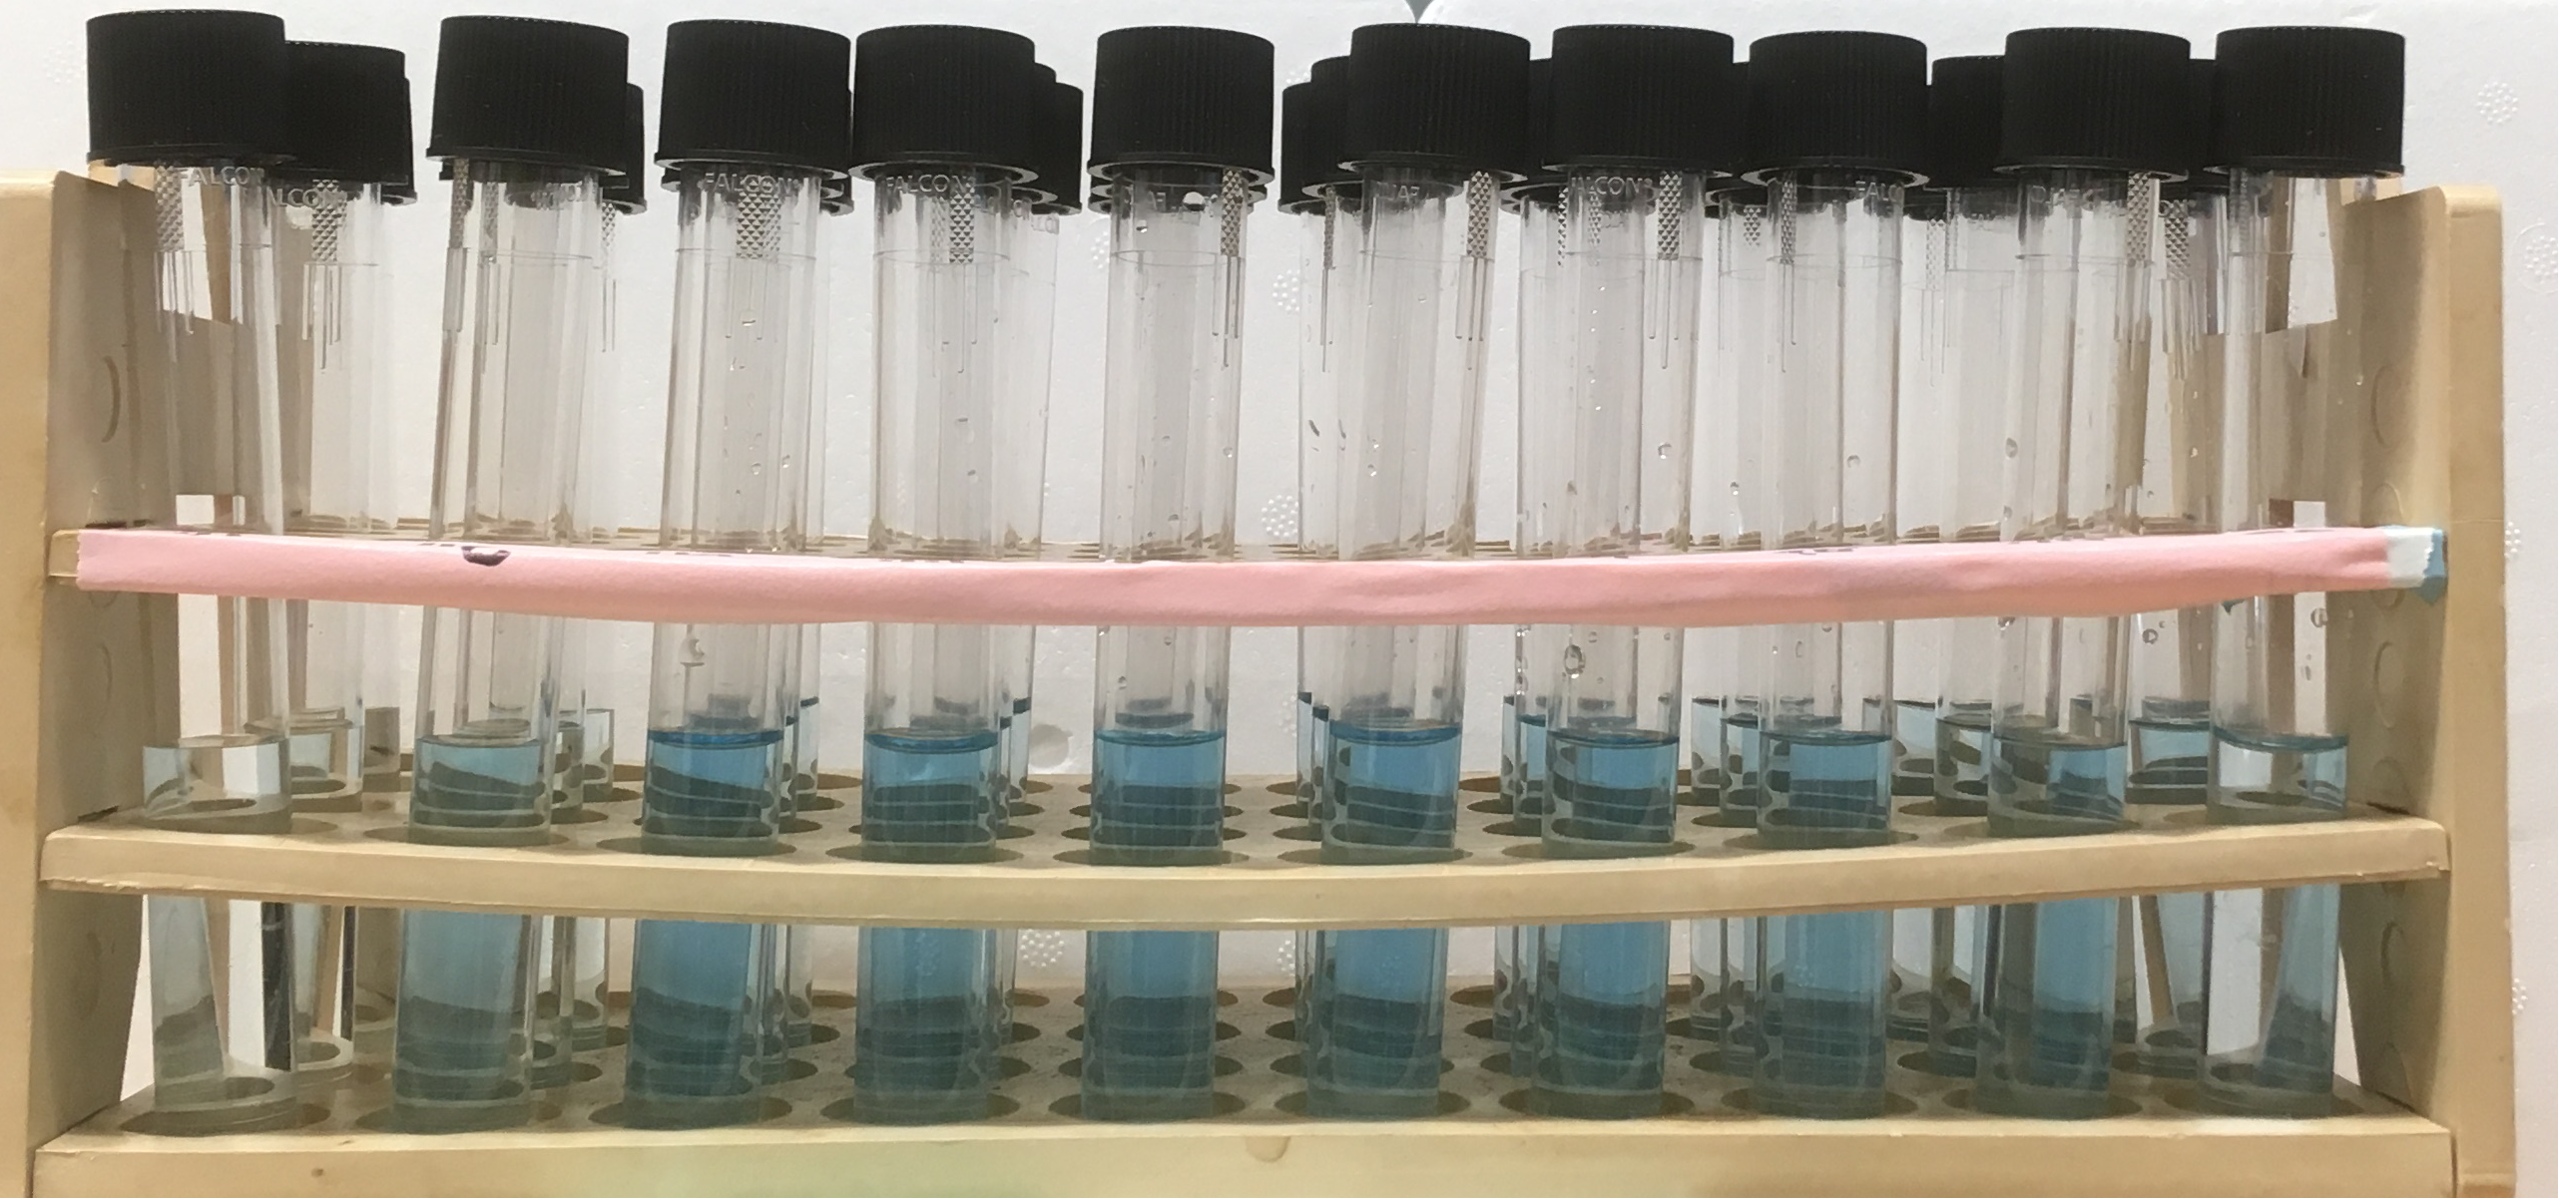
Measuring Ammonium in a Lab
You can’t see ammonium, so we change the structure with chemicals so that it becomes blue!
More blue = more ammonium
Blue ammonium samples are then processed on a spectrophotometer to measure absorbance of light
Jane Sedlak
Notes:
Optional. The activity is vague enough that you could apply this to a different type of measurement. The data used to create the activity is from running ammonium nutrient samples. Ammonium can be measured in the lab by adding chemicals to make a new chemical structure that appears blue. So, the more ammonium in the sample, the bluer the tube will appear. This liquid sample is then processed on a spectrophotometer to measure the absorbance of light.

Slide 14
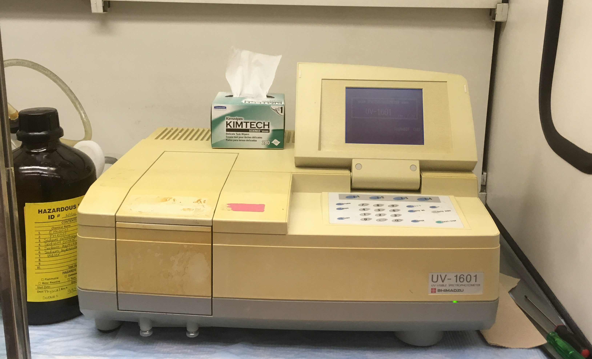
Measuring Ammonium in a Lab
We measure ammonium and create a standard curve graph based on Beer’s Law
y = mx + b
A - Absorbance
C - Concentration
A = ɛbC
b – length of light path
Spectrophotometer
ɛ – molar absorptivity
Jane Sedlak
Notes:
Optional. Continuing after Slide 13, ammonium is measured using a spectrophotometer and the concept of Beer’s Law. You do not need to go into the details of Beer’s Law, but it describes the attenuation of light through a material. Here it is the blue ammonium which is measured in a 1 cm quartz cell. The absorbance reading obtained from the spectrophotometer is then used to calculate concentration. Depending on students’ backgrounds this may be too much information. An alternative visual example that you may use to explain the standard curve is drops of food coloring in water.

Slide 15
Today’s Activity
Ammonium = type of nitrogen food for phytoplankton
Collaborate together to find the unknown concentration (or amount) of ammonium in a water sample!
Symbols courtesy of the Integration and Application Network, University of Maryland Center for Environmental Science
Notes:
Todays activity will use Excel to graph a standard curve to find the unknown concentration of ammonium in a water sample. This is a good time to break students into pairs or add an additional Excel tutorial.

Slide 16
Activity Results
Three different curves:
Version 1: x = (y – 0.0283)/0.0153
Version 2: x = (y – 0.0188)/0.0169
Version 3: x = (y – 0.0282)/0.016
Data Version | Concentration | % Difference from 1 | % Difference from 2 | % Difference from 3
1 | 1.76 | – | 22.4% | 4.2%
2 | 2.16 | 22.4% | – | 27.5%
3 | 1.69 | 4.2% | 27.5% | –
Notes:
Go over the equations and results for each of the three data versions. Ask the students which groups’ method/version looks right/wrong.

Slide 17
How do you verify which results are right?
Notes:
Ask students, how do you verify which results are right?

Slide 18
How do you verify which results are right?
More experimentation
OR
Reference material!
Standards measured by multiple scientists and produced by companies as an extra check
Notes:
There are lots of good answers to this. If they remember the earlier slides from the scientific method they might answer more experimentation. Another answer is to check results based on an agreed standard. This is called standard reference material and they are standards produced by companies that have been measured by multiple scientists. They are an agreed upon check that can be used to help verify your data and results.

Slide 19
Keep Collaborating!!
Notes:
Keep Collaborating! Science is about working together, it’s not just one scientist alone in a lab!

