Slide 1
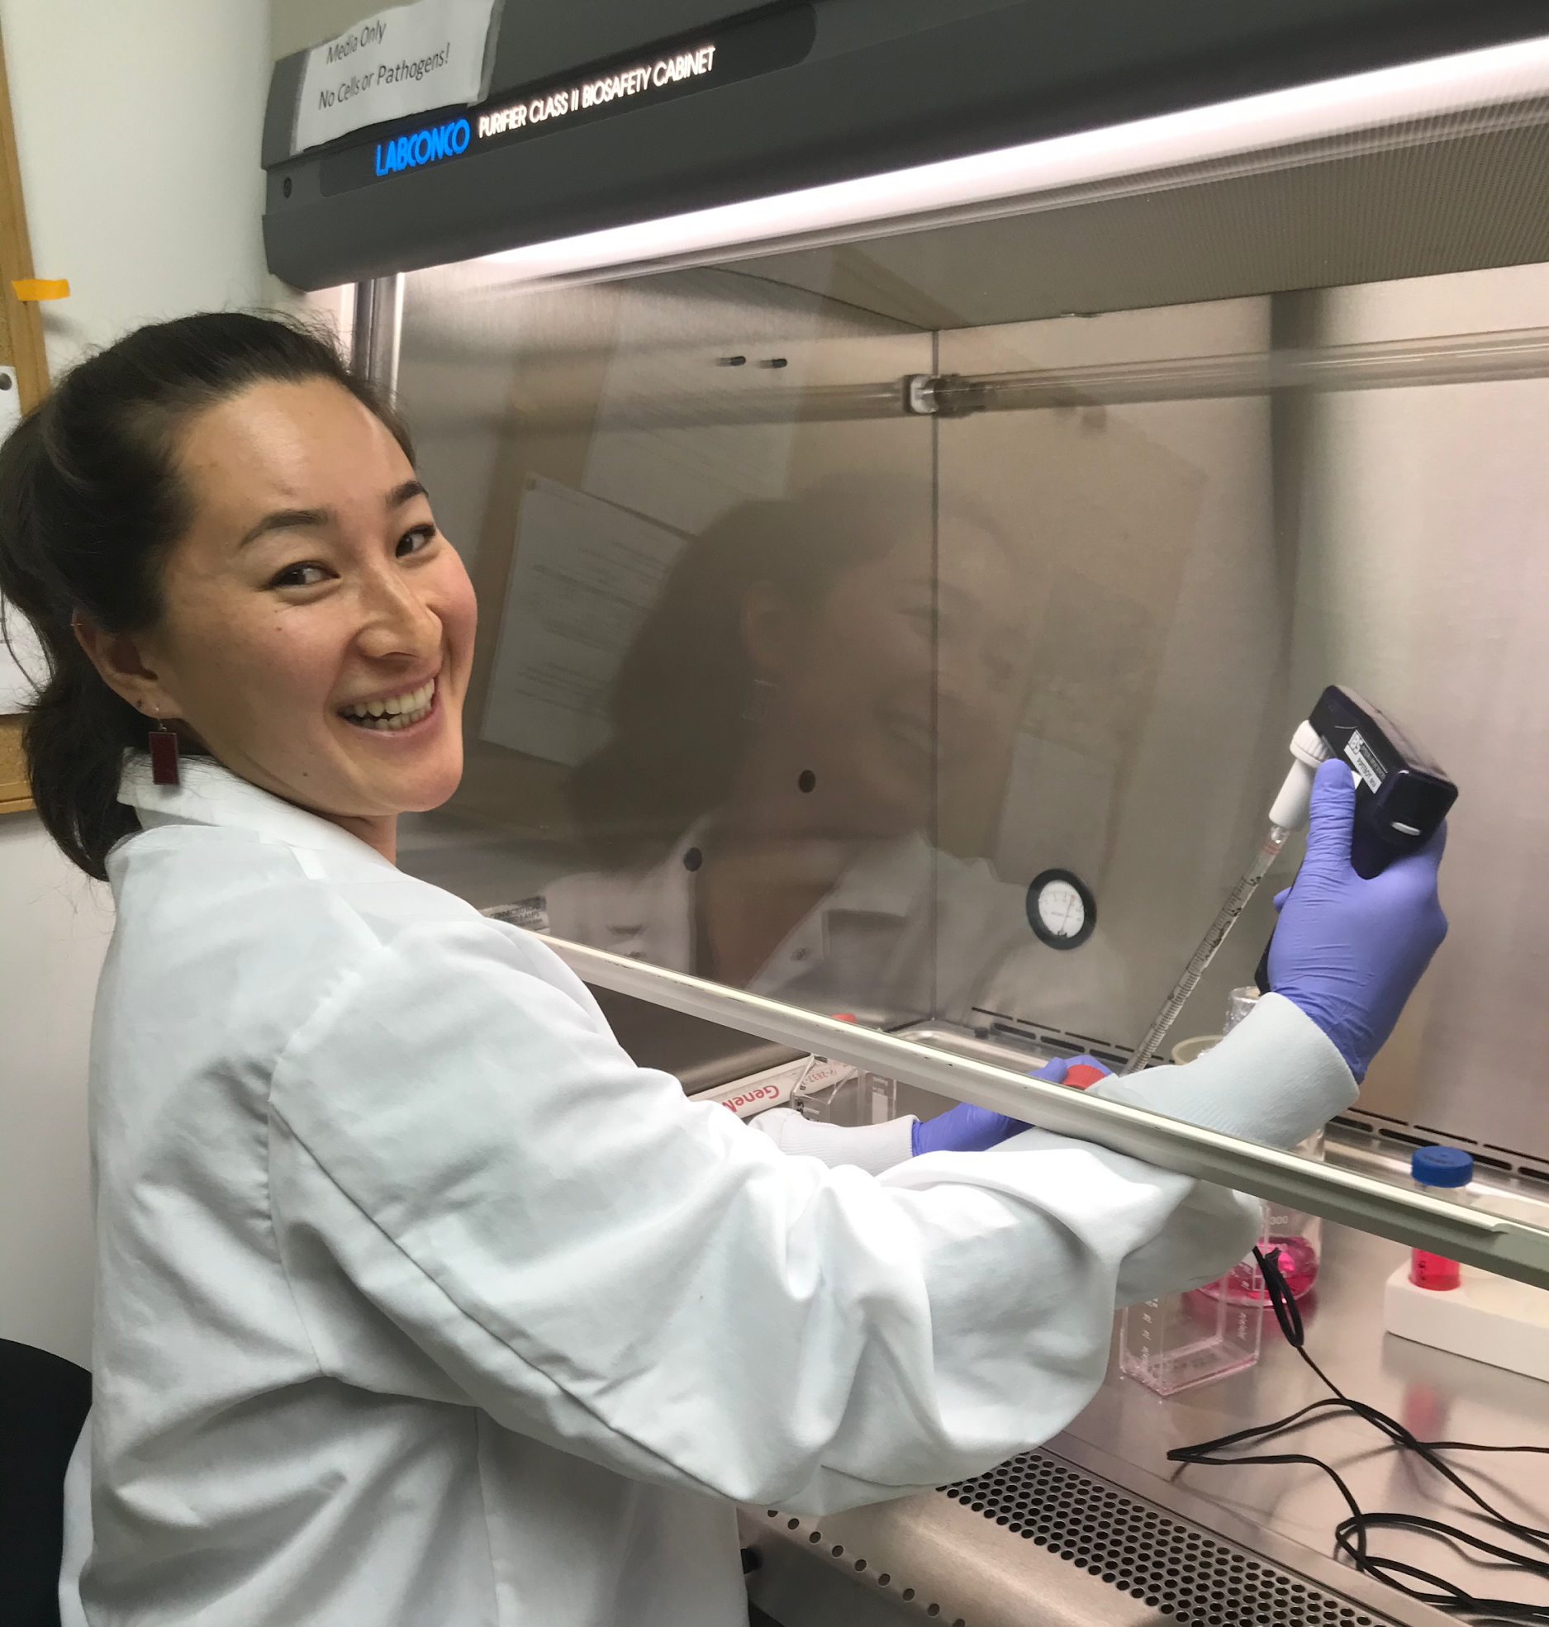
Hi, I’m Malina!
I am a graduate student in the Wargo Lab at the Virginia Institute of Marine Science, in southeast Virginia. Our lab studies emergent aquatic diseases and pathogen evolution.
I study a virus called Infectious Hematopoietic Necrosis Virus (IHNV), which affects fish in the salmon family. My work aims to identify the evolutionary path viruses will take after making a host jump from one species to another.
This research helps disease management in aquaculture and builds our understanding of virology and evolution.
Viruses are just one kind of pathogen that affect organism health. I hope this lesson gets you thinking about the same questions I think about in my daily work: Is a healthy-looking fish actually healthy? If it looks sick, what’s causing it? How will an infection progress in the individual, and in the population?
This is me, working in a laminar flow hood, which prevents contamination of samples. Here I’m dividing a flask of fish cells, which I use for diagnostic tests.
Notes:
(intro slide about Malina Loeher, a grad student at VIMS and the author of this VA SEA lesson plan.)

Slide 2

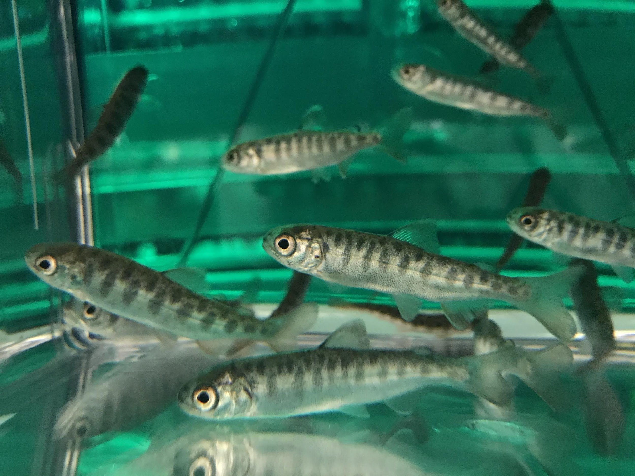

Farm Fresh Fish: what makes a healthy fish?
Image credit: Malina Loeher
Created for VA SEA 2020
Lesson Plan: “Etiology in action: identifying aquaculture disease threats through data analysis”
Malina M. Loeher
Notes:
This powerpoint is intended to give you background knowledge on disease ecology as a discipline, and consider how to ask questions about animal health and the environment.

Slide 3
Overview:
What is disease?
Host-pathogen system for IHNV
Etiology: What does IHNV do to trout?
Epidemiology: Where did IHNV come from, and what does it mean for aquaculture?
Notes:
We’ll go over a few slides that cover the following topics:
-What is disease?
-Host-pathogen system for IHNV
-Etiology: What does IHNV do to trout?
-Epidemiology: Where did it come from, and what does it mean for aquaculture?

Slide 4
What is disease?
“The Disease Triangle”
Pathogen
Disease is an outcome that only emerges with the right combination of pathogen, host, and environmental conditions.
E.g. You (a human host) may
encounter a flu virus (a pathogen)
at school, but disease (getting
sick) may not occur until winter,
when the environment is colder and
your immune system is naturally depressed.
Host
Disease
Environment
Notes:
The Disease Triangle is a base concept of disease ecology. It describes how disease only occurs at a particular intersection of concurrent conditions in the Host, Pathogen, and Environment.
It is important to differentiate between “disease” and “pathogen”:
DISEASE is an outcome, describing a set of adverse conditions experienced by a host AS RESULT of a pathogen and/or environment.
EXAMPLE: Flu is the disease experienced by a human host exposed to a pathogen (influenza virus). People often get the flu disease in the colder winter months, which provide environmental conditions (low temperatures, possibly reduced access to nutritious diet, possibly increased time spent indoors in contact with flu viruses, etc.) that tip the balance in favor of an infectious pathogen, away from the defensive immune system of the host.
Hosts may be infected benignly (without suffering disease, or sometimes even realizing they are infected at all). Pathogens may remain dormant until the ‘right’ conditions emerge in either the host or the environment. Perhaps the host’s immune system becomes compromised by another infection, or stressful conditions. Perhaps the environment in which the host lives becomes unhealthy (very high or low temperatures, poor air quality, polluted water, etc.). Environmental changes that benefit the pathogen, or detriment the host, can result in disease, when otherwise conditions do not favor disease.
EXAMPLE : We see pop culture references to ‘getting stressed’ = cold sores appearing. This is an example of host and/or environmental changes that produce a disease symptom. The host (a person) has been infected by a pathogen (herpes simplex virus), but if the person is in good living conditions, the host probably will not experience any disease despite being infected. Once something changes in their environment (e.g. a camping trip in rough weather, a natural disaster) that causes the host to experience a stress response, herpes simplex virus may ‘flare up’, producing a cold sore (disease).
Alternatively, the environment may remain the same, but the host conditions surrounding the infection may change. Perhaps a person infected with herpes simplex virus starts taking a new medication that produces a hormonal change, or other change in body chemistry. Anything the host perceives as stressful may also affect their internal body chemistry too (receiving bad news, mental exhaustion from exam week, etc). These are also opportunities for the herpes virus to take advantage and produce symptoms, “cold sores”.

Slide 5
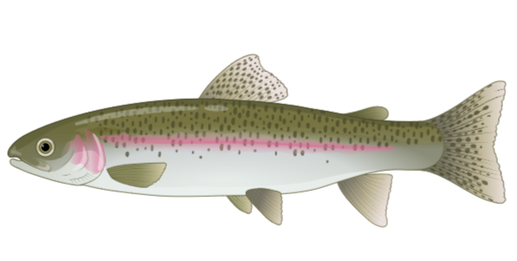
Describe the host-pathogen system:
Host: salmonid fish (salmon, trout)
Pathogen: infectious hematopoietic necrosis virus (IHNV)
Environment: freshwater streams and lakes in North America, and connecting waters (e.g. ocean for migrating fish)
Citation:
Juvenile chinook. Image credit: Malina Loeher
A typical rainbow trout. Image credit: Biorender.com
Notes:
Examples on the previous slide were in humans, but the same concept can apply to any host species.
The combination of a host and the pathogen that may infect it is called a “Host-Pathogen System”.
The system you’ll be using to investigate health questions in the lesson activity is a Rainbow Trout– IHNV system. Rainbow trout are the host species. IHNV is the pathogen that affects them.
Rainbow trout (Oncorhynchus mykiss) are native to North America. (Their close relatives, other trout species and salmon species, are also susceptible to IHNV, but you will be focusing on trout.) They live in freshwater streams and lakes, especially in the Western and Pacific Northwest states. Some populations of fish are anadromous, meaning they migrate to the ocean for their adult years (these are the same as steelhead trout), and return to their home river to spawn.

Slide 6
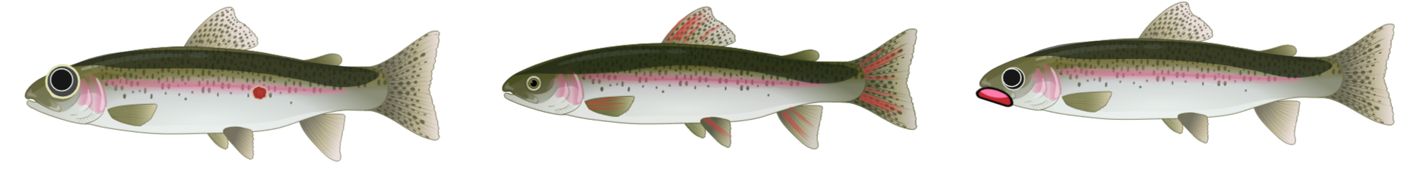
What does IHNV do to rainbow trout?
IHNV is a lethal viral disease that can kill >90% of juvenile fish if conditions are right (trout-specific strain of virus, rainbow trout species, stressful environmental conditions).
Transmission: IHNV is excreted from infected fish in fluids and transported through the water.
Clinical signs of IHNV include:
Erratic or lethargic swimming behavior
Bulging eyes (exophthalmia)
Bleeding in the fins or tail
Swollen belly
Discolored skin
Increased susceptibility to bacterial infections, which in turn cause:
    Skin lesions
    Bacterial growths on the skin or fins
    Tattered fin appearance
Citation:
Top: healthy trout. Two bottom: examples of IHNV clinical signs. Image credit: Biorender.com
Notes:
IHNV is a lethal viral disease that can kill >90% of juvenile fish if conditions are right.
Remember the disease triangle! 🡪 In this system, the ‘right conditions’ mean: trout-specific strain of virus, rainbow trout species, and stressful environmental conditions.
(Aquaculture can be inherently stressful, even with responsible farming practices: dense living conditions, variable water quality.)
Clinical signs (observable signs of illness) include:
Erratic or lethargic swimming behavior
Bulging eyes (exophthalmia) 🡪 depicted in middle fish
Bleeding in the fins or tail 🡪 depicted in bottom fish
Swollen belly
Discolored skin 🡪 depicted in middle and bottom fish
Increased susceptibility to bacterial infections, which in turn cause:
Skin lesions 🡪 depicted in middle fish
Bacterial growths on the skin or fins
Tattered fin appearance
Considering how a pathogen infects a host, what that infection looks like (clinical signs), and how the pathogen progresses, is within the study of ETIOLOGY.

Slide 7
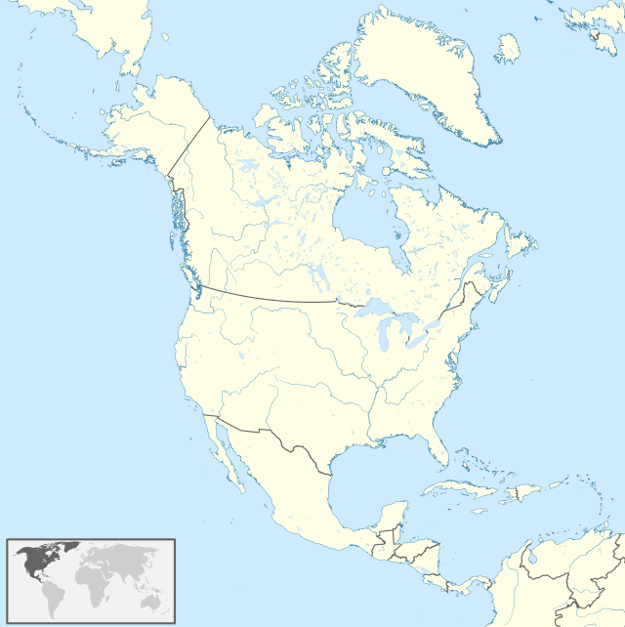
Where did IHNV come from?
IHNV is endemic to the Pacific Northwest region of North America.
It is theorized to have co-evolved in sockeye salmon (Oncorhyncus nerka).
It is considered a natural part of the environment in this region.
It was first observed in salmon aquaculture in the 1960’s.
Soon after, it was observed in rainbow trout aquaculture.
Successfully moving from one host species to another is called a “host jump”.
IHNV has diversified genetically in trout farms in North America since its discovery.
What does IHNV mean for aquaculture?
Some strains of IHNV are incredibly deadly to trout.
Aquaculture is an emerging industry with a small profit margin.
IHNV has potential for massive economic loss if uncontrolled in dense farm conditions.
Study system
Host: sockeye salmon, rainbow trout
Pathogen: IHNV
Approximate endemic range of IHNV
Clinical signs of IHNV
First emergence of IHNV in aquaculture (1950s)
Expansion of IHNV into rainbow trout farms (1960s)
Romero, et al. (2008) DAO 80(2):123-35
Image credit: Wikipedia Commons
Notes:
On the previous slide, you learned what IHNV does to trout (part of its ”etiology”, study of the cause of disease). Now let’s consider where the virus came from, and where it might be going (this is an example of “epidemiology”, the study of a disease’s spread and management.)
IHNV evolved with sockeye salmon (Oncorhyncus nerka) in the Pacific Northwest region of North America. It is likely hundreds or thousands of years old, and considered to be a natural part of the environment, much like the salmon and trout themselves.
In the 1960’s, high mortality rates (number of deaths) were recorded in salmon farms, and soon after, nearby trout farms. This is evidence of a ‘host jump’: a successful move of a pathogen from one host to another host species. Along with the host jump came a huge diversification: a few strains (it is impossible to know how many) from salmon evolved into many more strains (numbering in the hundreds!) adapted to trout.
Now, trout farming is a growing industry for land-based aquaculture, and IHNV poses a major health threat. Farms raise fish from egg 🡪 juvenile 🡪 adult. Juvenile fish are most likely to die from the virus. Fish are typically not big enough to sell until they are adult size. Farmers earn little per fish, so losing fish to disease is concerning both for the biological system and the business. Some mortality is natural (a few percent of the population, depending on the growth stage), but uncontrolled IHNV poses major longterm problems for trout farms. If all your baby fish die from disease, you will have no adult fish to sell and your business will fail.
In the lesson activity, you will examine mortality curves for IHN, and compare data to identify whether mortality is caused by IHNV or another unknown pathogen.

