Slide 1

Scientific Skills and Process
Gettin' Crabby
about
Parasites
Claire Adrian-Tucci and Luisa Hays

Slide 2
Dear Teachers,
Thank you so much for looking at this document and considering to use our lesson plan. We hope that you find it useful.
This presentation is what we have used for our classes, but with added instruction slides included.
Please read them and make whatever changes you think will work best for your class. Please feel free to reach out to use with questions, were happy to help.
Best,
Claire Adrian-Tucci (adriantucci@cbgs.k12.va.us ) and Luisa Hays (luisa.hays@frco.k12.va.us )

Slide 3
Teacher Instructions:
Our introduction slides are focused the Shield’s lab staff and objectives. We think its important to emphasize the people to explain to students that these are real, cool people, and not old, lonely people in lab coats and bubbling beakers. Feel free to adjust as needed.

Slide 4
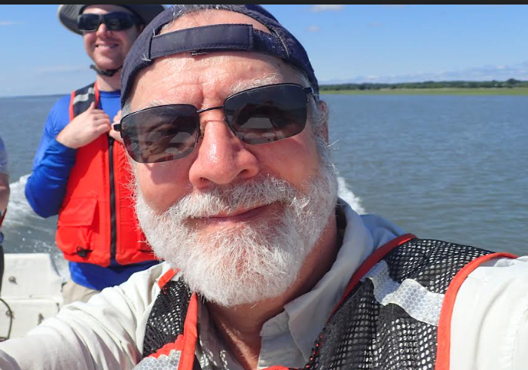
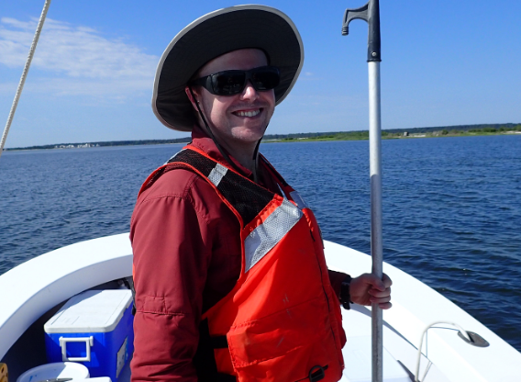
Introduction to Dr. Jeffrey D Shields Lab
Shields Lab has a number of different people that help make up his team through each ongoing project.
David Jones-
Lab Specialist
Jeff Shields-PI
Notes:
Dr. Jeffrey Shields is the PI on the Project. He is also a Professor at William and Mary college. He has numerous publications while being a research professor at VIMS. David Jones B.S. Biological Sciences from Old Dominion University- M.S. was in Marine Biology from the College of Charleston
David Jones-B.S. was in Biological Sciences from Old Dominion University M.S. was in Marine Biology from the College of Charleston . He is Dr. Shields Right hand Man
David Jones is Dr. Shields Lab Specialist. He is that and so much more, those duties range from Boat captain to babysitting Teacher Researcher interns.
He has a masters degree in Marine Biology from the College of Charleston.

Slide 5
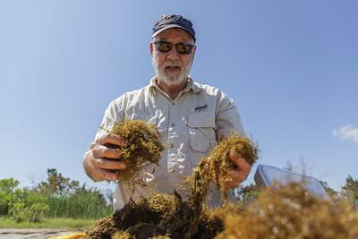
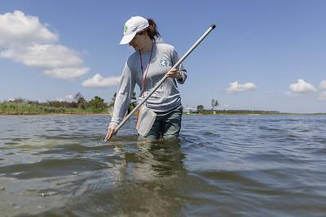
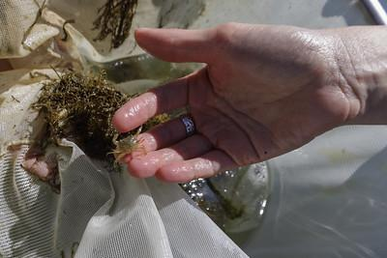
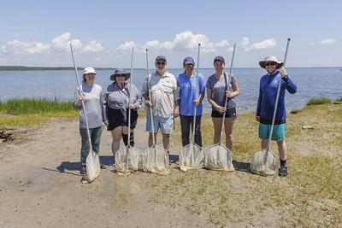
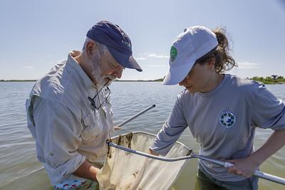
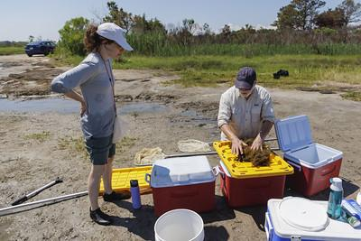
VIMS Teacher Research Internship, Summer 2024
Photo credit: Lathan Goumas, Virginia Sea Grant
Notes:
Photo credit all go to Nathan Goumas, Virginia Sea Grant.

Slide 6
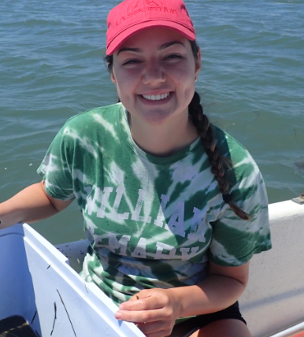
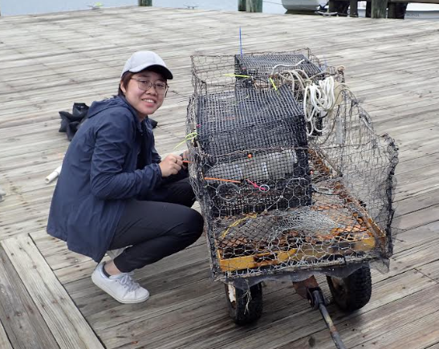
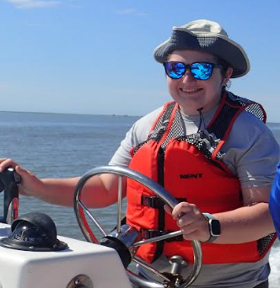
Shields Lab Group Continued
Ella Indseth
Undergraduate student
Xuqing Chen
Graduate student
Lindsey “Smitty” Smith
Laboratory Specialist
Notes:
Ella was an undergraduate student working on a moltening study of blue crab. She will be looking at if molting impacts the infection status in crabs. Xuqing (pronounced Sha-shing) is a PhD student that is working to understand the transmission pathway of the hematodinium. She has also looked into how different genes are expressed in infected and uninfected crabs. Smitty is a lab specialist. Like David, she is able to run all of the experiments in the lab and in the field!

Slide 7
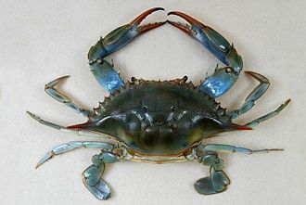
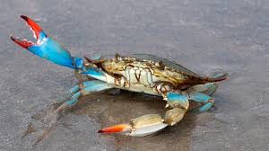
Meet Callinectes sapidus, the Atlantic Blue Crab
Notes:
Introduce students to the main star of the case study- the blue crab. Ask students if they are familiar with blue crabs and generate a list of what they have heard of before. Quick background information can be found at the wiki page: https://en.wikipedia.org/wiki/Callinectes_sapidus
Some things you may want to highlight include:
The blue crab's carapace (shell) varies in color from bluish to olive green.
It can reach up to 9 inches across.
The carapace has nine marginal teeth on each side.
Its claws are bright blue, and those of mature females feature red tips.
Blue crabs have three pairs of walking legs and paddle-shaped rear swimming legs.

Slide 8
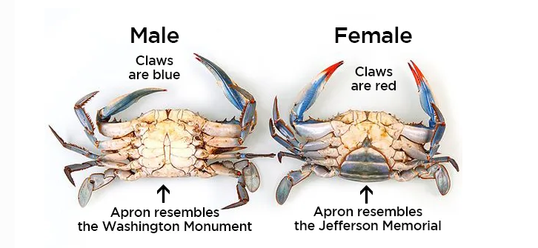
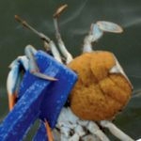
Blue Crab appearance and General Information
Feeding:
Crabs will eat anything from plants to other crabs.
Predators:
Drums, Birds, Croakers, Other Crab and turtles
Notes:
Male and female crabs look different (introduce term “sexually dimorphic” if appropriate for your class).Males have a strongly tapered abdomen, or "apron," that resembles an inverted T.
Mature females have a broad, rounded apron, and immature females have a triangular apron.

Slide 9
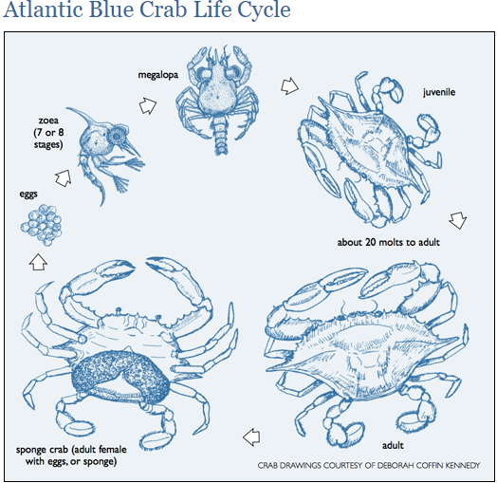
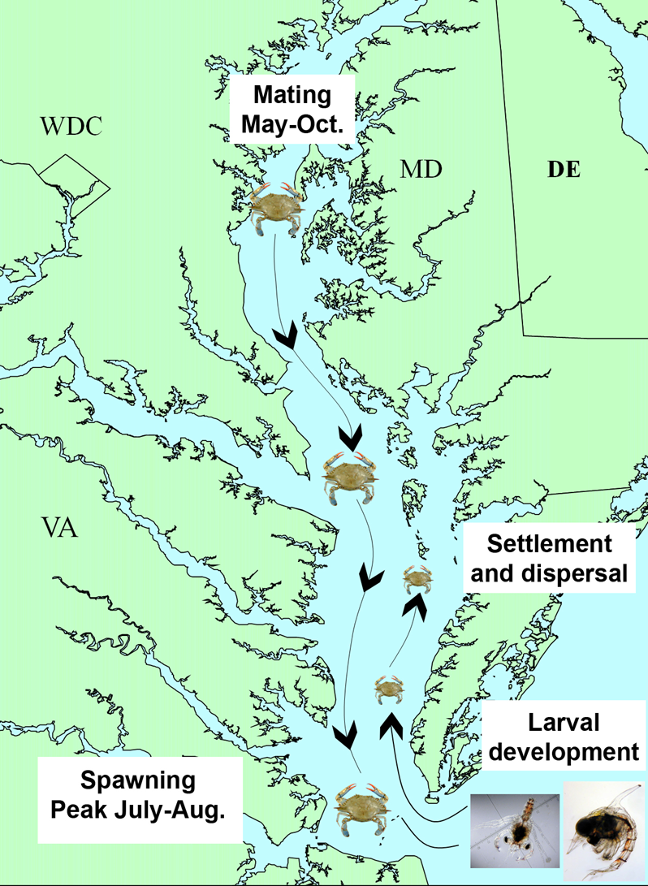
Notes:
Great background/explanation of the lifecycle can be found at : https://news.maryland.gov/dnr/2016/03/20/crab-lifecycle/ .
Important information is that the eggs/larvae need the salty water of the ocean to survive. Female crabs swim down to the lower, salty part of the bay, she then fertilizes the eggs (with sperms she is storing) and then this creates a large external egg mass. Larva develop in the saltier environment and then the zoea can move back to the less saltier parts of the bay.
Females develop an external egg mass, or sponge, beneath their aprons. Each bright orange egg mass may contain between 750,000 and two million eggs.
Blue crabs mate from May through October in the brackish waters of the Chesapeake Bay and migrate toward the mouth of the Bay.
In the Chesapeake Bay, blue crabs mate and spawn from spring to fall. Females migrate to the mouth of the Bay to spawn and can produce between 750,000 and 3,200,000 eggs per brood.
Eggs hatch into larvae and go through a series of molts in high-salinity coastal waters and then migrate back into the Bay.
Megalopae eventually metamorphose into immature crabs, which look like tiny adults.
Immature crabs molt several times before they reach maturity about 12 to 18 months after hatching.
Few blue crabs live longer than three years.
This information in video form can be found here: https://www.cbf.org/news-media/multimedia/video/animation-blue-crab-lifecycle.html

Slide 10
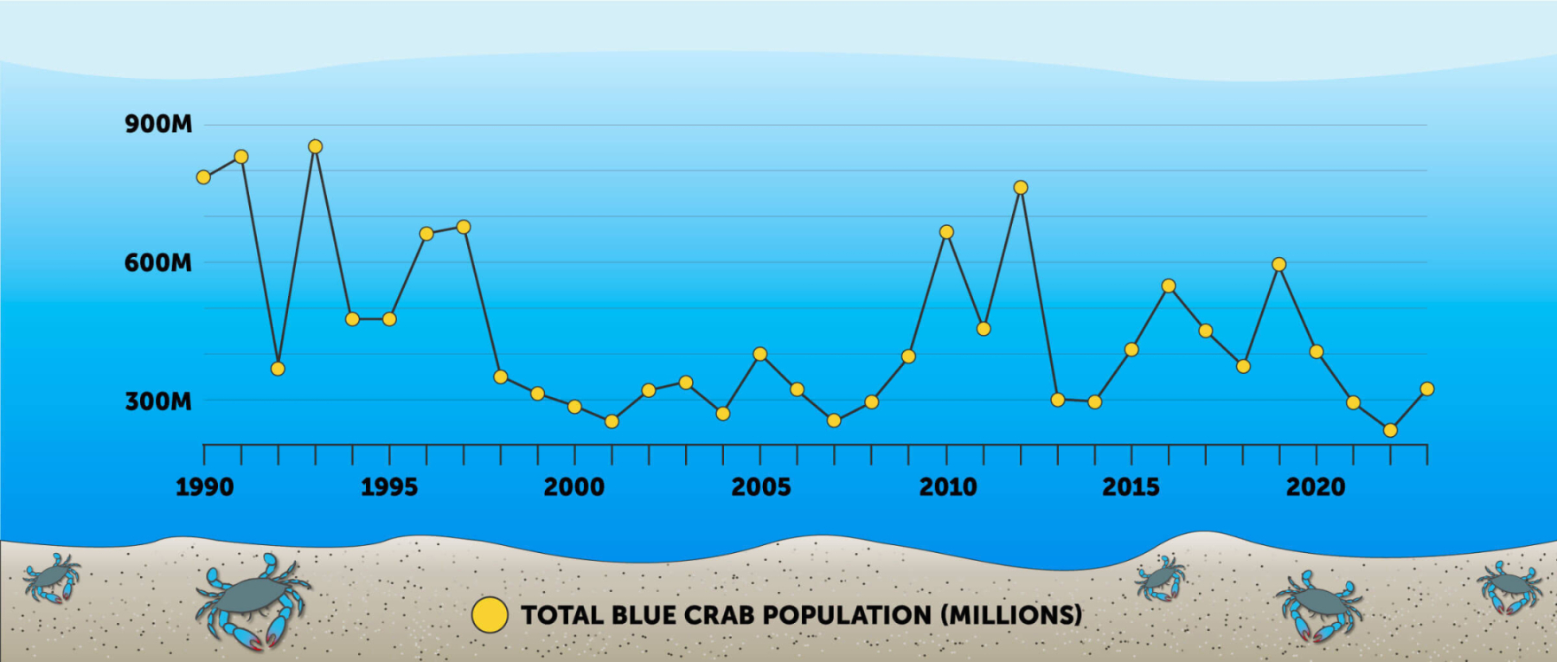
Blue Crab Population Over Time
Notes:
Graph from here: https://www.chesapeakebay.net/issues/whats-at-risk/blue-crabs#:~:text=Blue%20crabs%E2%80%94harvested%20as%20hard,dollars%20of%20revenue%20each%20year.

Slide 11
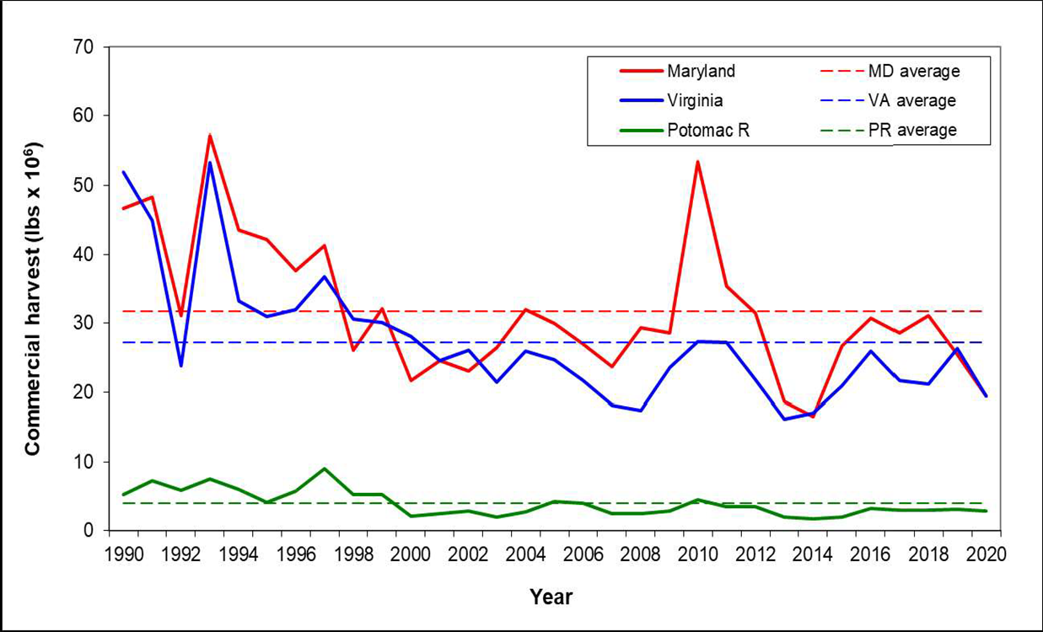
Chesapeake Bay Crab Fishery
Maryland, Virginia, and Potomac River commercial blue crab harvest in millions of pounds (all categories), 1990-2020.
https://www.chesapeakebay.net/who/group/chesapeake-bay-stock-assessment-committee

Slide 12
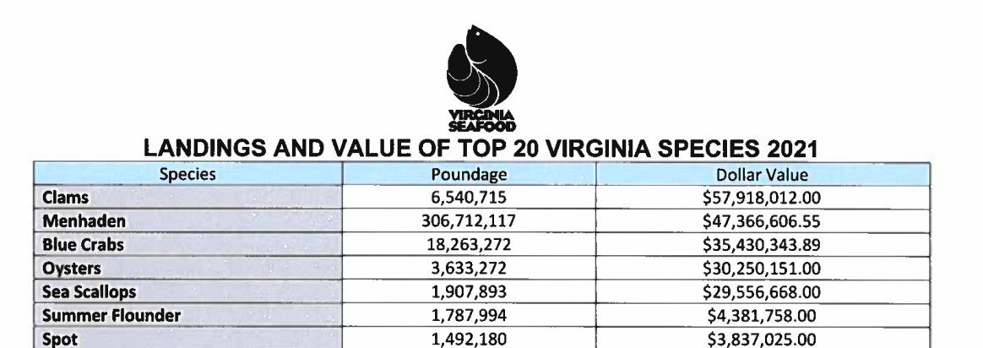
Virginia Landing and Value:
Notes:
Have students look at the chart in order to understand the impact of blue crabs.
Borrowed from here: https://www.virginiaseafood.org/wp-content/uploads/2024/01/2021-Landing-Figures-6.pdf.

Slide 13
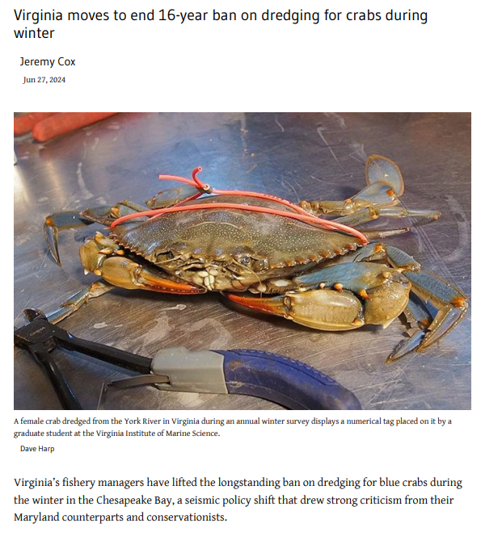
Blue Crabs in the news, June 2024
How do you think this might impact Blue Crab population?
Notes:
Full article here: https://www.bayjournal.com/news/fisheries/virginia-moves-to-end-16-year-ban-on-dredging-for-crabs-during-winter/article_b6d6f3e2-348f-11ef-a454-d3b0b7243a34.html

Slide 14
What are parasites?
Notes:
Ask students for a definition

Slide 15
Parasite:
A relationship between 2 species in which one species, the parasite, benefits from the other species, the host is harmed

Slide 16
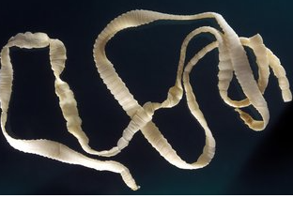
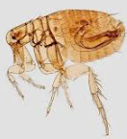
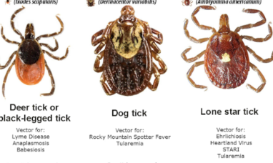
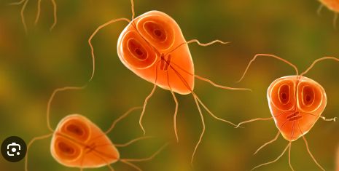
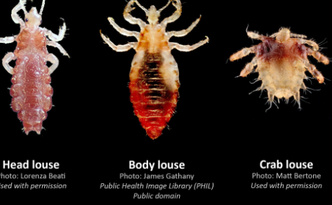
Examples of Parasites

Slide 17
Parasite Information
Examples internal:
Tape worms, Nematodes (roundworms), cestodes (tapeworms), and trematodes (flatworms)
Examples External:
Lice, flees, ticks, mites
It is estimated that there are between 75,000 and 300,000 helminth species parasitizing the vertebrates.

Slide 18
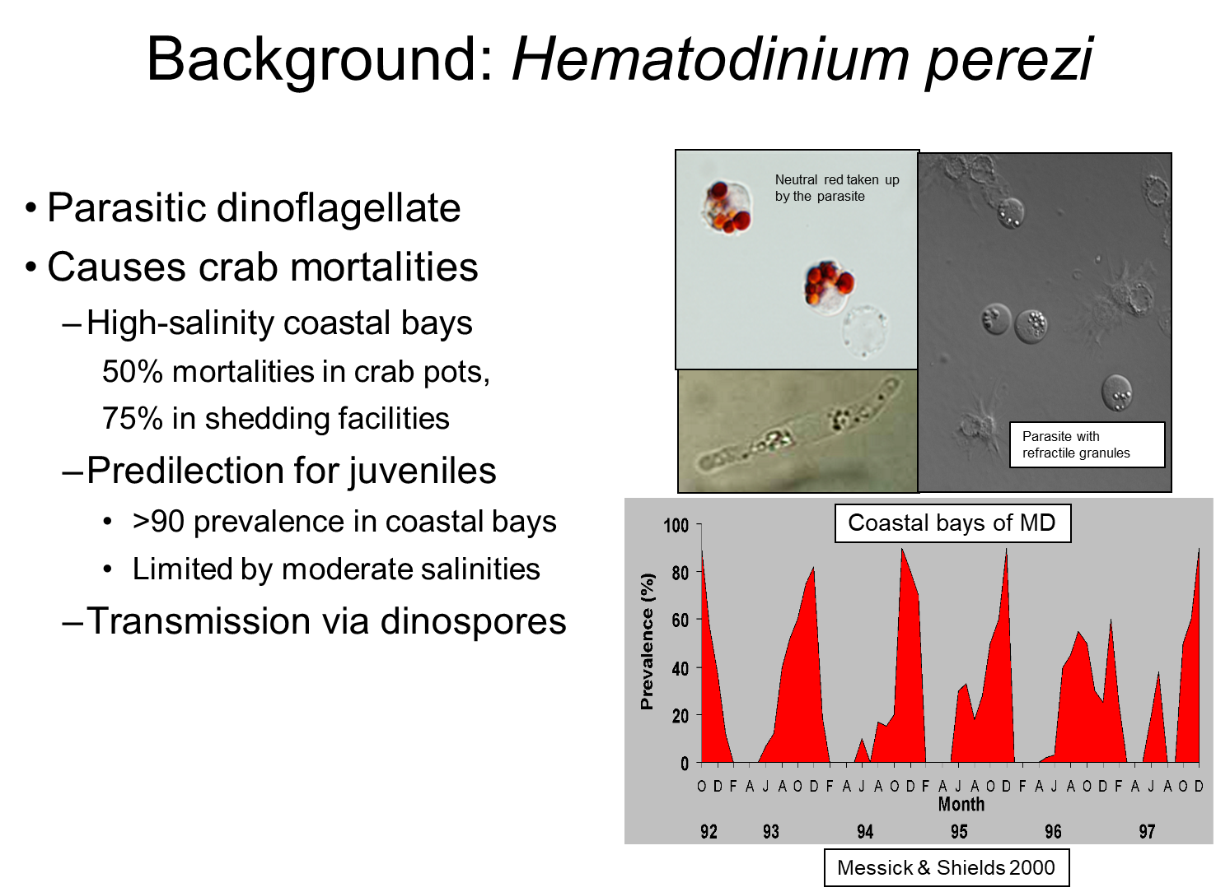

Slide 19
•Transmission
Transmission of the parasite occurs via the dinospores there are 2 types Micro and Macro spores
More specifically the Micro-spores appear to be the infectious spore
From crab to crab through water
Crabs release dinospores through their gills and this is usually fatal
Life cycle outside the crab is unknown

Slide 20
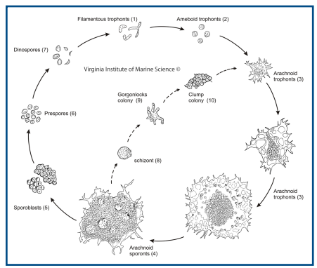
Hematodinium Has a complex Life cycle in the Blue Crab
Notes:
Dinospores ecology is complicated by the Production of 2 spore types- Micro and Macro—- The question that they are wondering at Shields lab is could they be gametes or something else?

Slide 21
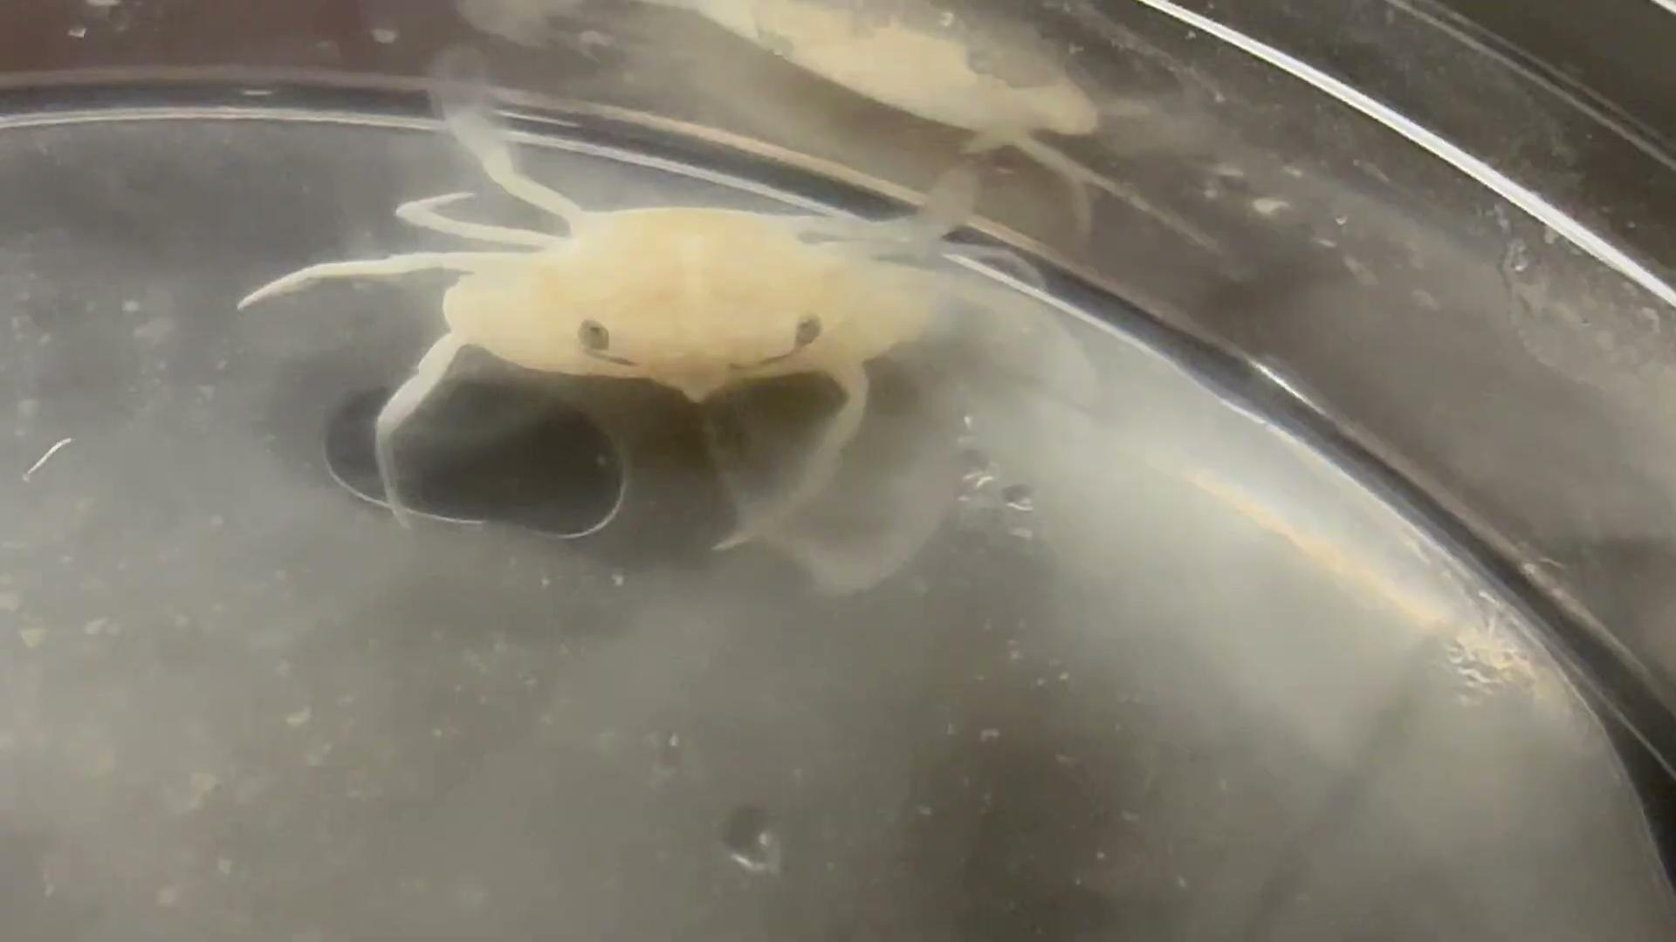
Juvenile Blue Crab with a Hematodinium Infection

Slide 22
We will be using the Shields Lab as a Case Study to understand how scientists actually carry out experiments in the lab & field

Slide 23
Teacher Instructions
The next slides are about science as a process. Please feel free to add/subtract as you see fit for your classroom.
We have included many slides with definitions, they might not be best leveled for upper level/advanced students
The section on peer review may not be needed for lower grade levels

Slide 24
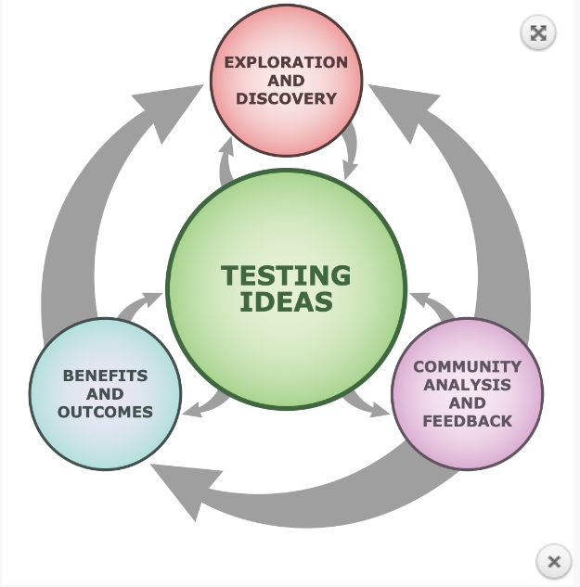
Nature of Science
Notes:
Insert/adapt/alter to whatever intro to the scientific process you think is important for your class. In my class, I think it's important to emphasize how fluid/dynamics the steps are and how things go back and forth between things. Rarely do experiments all follow the same, linear path.
Graphic adapted from here: https://undsci.berkeley.edu/for-educators/find-lessons-and-tools/understanding-science-infographics-and-tools/

Slide 25
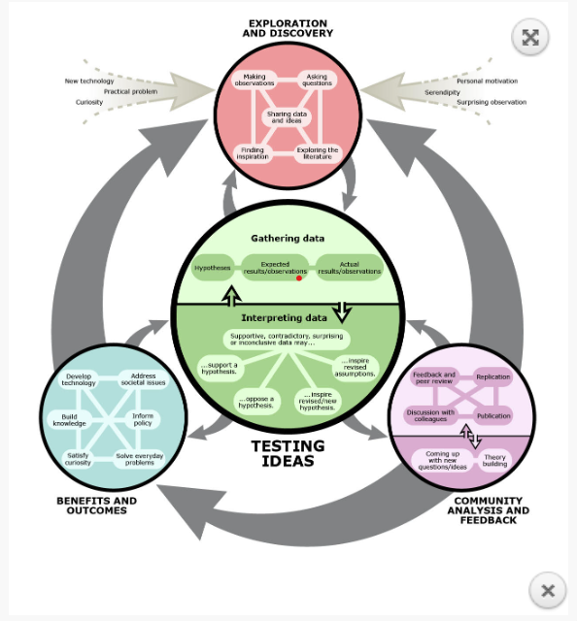
Notes:
More broken down components of this. Students can play with this graphic more through one og hhmi’s click and learn tools here: https://www.biointeractive.org/classroom-resources/how-science-works
Toe me, its important to introduce/note the concept of peer review in addition to the parts at the top about serendipity, curiosity, and wanting to solve a problem.

Slide 26
What are the key steps of a scientific experiment?

Slide 27
Steps of a Scientific Experiment
Ask a Question
Formulate a hypothesis
Design and implement the experiment
Collect data and analyse data
Formulate conclusion
Report findings
Notes:
General Steps/ you can use whichever model you like

Slide 28
Step 1: Make an Observation/Ask a Question
A testable problem or a question must first be identified.
What are some examples of testable questions?
What are some examples of untestable questions?
Notes:
Examples:
How much water can a root hair absorb?
Why does a plant stem bend toward the light?
What effect does temperature have on heart rate?

Slide 29
Step 2: Form a Hypothesis
A possible explanation to the question or problem
Often it is recommended to follow the ‘if-then’ structure
Notes:
Gather some ideas from students about what they know. Then introduce the null vs alternative structure

Slide 30
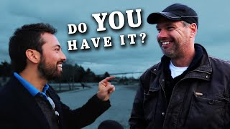
Science Does Not Prove Things!
Notes:
I like to show Veritasium’s video, “The most common cognitive bias” video to show this point. https://www.youtube.com/watch?v=vKA4w2O61Xo

Slide 31
Null vs Alternative Language
Null Hypothesis- There is no relationship between the variables
Alternative Hypothesis- There is a relationship between the variables
We need our experiments to disprove the null. When writing about our hypothesis, we either reject the null or fail to reject the null.

Slide 32
Step 3: Design a Controlled Experiment and Test It
What are the key parts of an experiment?
Notes:
Have kids brainstorm, and talk through them as a group

Slide 33
Step 3: Design a Controlled Experiment and Test It
Variables
The factors in an experiment that can be changed are called variables.
A controlled experiment works with one variable at a time. If several variables were changed at the same time, the scientist would not know which variable was responsible for the observed results.
Notes:
Have students list example

Slide 34
Step 3: Design a Controlled Experiment and Test It
Independent variable is the variable the researcher intentionally changes Examples: Temperature, light, heat, salinity, time
Dependent variable is the factor that the research measures. It changes in response to the independent variable; in other words, it depends on the “IV”

Slide 35
What is the difference between Constants and Controls?

Slide 36
Constants vs Controls
Constants- The factors that do not change during the experiment. Examples can be temperature, duration of time,
Control The control group serves as the comparison. It is the same as the experimental group, except that the one variable that is being tested is removed.

Slide 37
Can we run an experiment one time and make a conclusion?

Slide 38
Replicates/Trials
We need to run an experiment multiple times in order to determine if our result is accurate. These are called replicates or trials
This does not mean that scientists repeat things until the result turns out they way they want it to
If something went wrong during the experiment, then it would be repeated

Slide 39
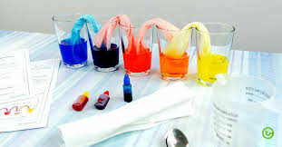
Stage 3 Implement the Experiments
You have your design, and supplies and you are ready to get started!
Notes:
Now that we have basic knowledge of how to Design the experiment this is the goal
Define the Problem/objective/goal
Conduct Research- on how you can accomplish your goal
Conceptualization- your product/project
Prototype Development- or dry run
Begin testing and Evaluation of your product or project
Make sure to have a timeline set for your goal/project be very specific with your design.

Slide 40
Step 4: Analysis and Recording of the Results
The data that has been collected must be organized and analyzed to determine whether it is reliable

Slide 41
Step 5: Drawing Conclusion
The evidence from the experiment is used to determine if the null hypothesis is rejected or not.
Once experiments have been repeated, the results should be consistent before a valid conclusion can be reached.

Slide 42
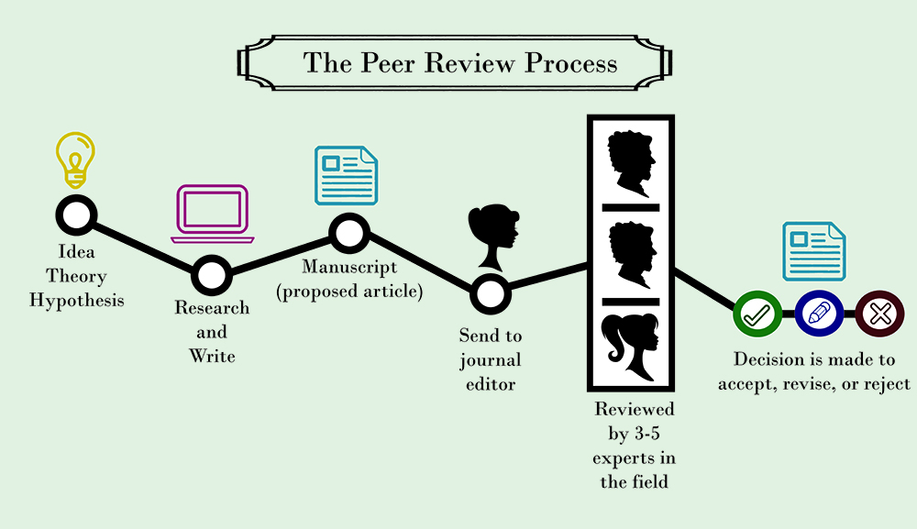
Step 6: Report Findings
Once conclusions have been drawn the findings should be reported.

Slide 43
Teacher Instructions
This is where the real magic happens! Students are asked to use the Shield’s lab framework to create an experiment.
We have a small activity for each each major component of an experiment. There are corresponding places on the student worksheets for students to write down their answers to these parts.

Slide 44
Shield’s Lab Connection: Generating Testable Questions
With your group, generate some testable questions that you could test in the Blue Crab/Hematodinium system
Consider biotic and abiotic factors
We wonder…?
How….?
Why…?
What would happen it….?
Each group should come up with 5 questions and be prepared to share them with the class
Notes:
Teacher may need to remind students that abiotic factors are nonliving. Guide students to think about climate, salinity, yearly cycles, nutrients, etc. Biotic factors are living things, guide students to think about predation and how different species interact with one another. Are there any organisms that can mediate crab infection with the parasite? Teacher should circulate the room as students are working and help hone questions. At this stage, all questions are good questions, as long as they are plausible and related to the system.

Slide 45
Shield’s Lab Connection: Comparing Testable Questions
Group members share their testable questions
Notes:
Teacher can have students share some of their questions. Teacher can engage in as much or as little discussion about the questions as they have time for. Some follow up questions for students might include how they would carry out the experiment for that question.

Slide 46
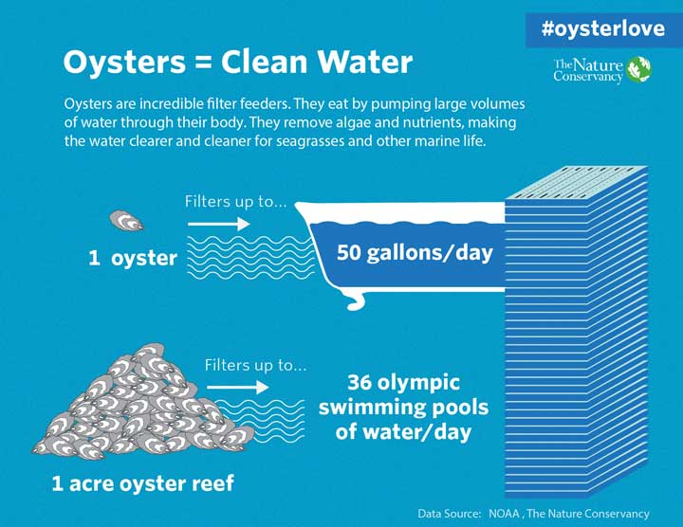
Unique to Aquatic Environments: Filter Feeders
Aquatic animals that acquire nutrients by feeding on organic matters, food particles or smaller organisms suspended in water, typically by having the water pass over or through a specialized filtering organ
Notes:
This is one element that we have not introduced yet… filter feeders. They play a big role in the environment, through filtering and removing things from the environment. At this point, introducing them and their role to students is enough… we want students independently make the connection between filter feeding and disease transmission.

Slide 47
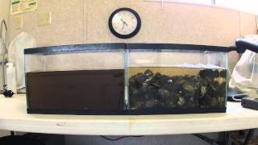
Oyster Filtration

Slide 48
Shield’s Lab Connection: Refining your Testable Question
Now that we know that filter feeders are important to the environment…
How could scientists study relationship between:
Blue crab populations
Hematodinium
Filter feeders
Notes:
After presenting this slide, give student groups the opportunity to generate a testable question. At this point, the questions should become pretty similar and result in students wanting to determine how does the presence of filter feeders impact the amount of hematodinium parasite present in the blue crabs.

Slide 49
Our Question: How do Oysters (filter feeders) impact the prevalence of Hematodinium in Blue Crabs?
Notes:
Important to mention that this is an actual study conducted by the shields lab.. All of the the data that students will examine in the following slides has been adapted from their real results.

Slide 50
Shield’s Lab Connection:
Design an Experiment to Answer our Question
Refer to your handout and develop your experiment with your partner(s).
Your experimental design should have all of the key components of an experiment that we have discussed.
Notes:
This part allows for a lot of flexibility for both the students and teacher. Students need to work together in order to develop the experiment and it needs to have all of the appropriate components. During this time, teacher can circulate the room to help students when they get stuck, this can be a lot of creative thinking. At this point, the experiments just need to be internally consistent and in a broad sense plausible. If there is enough time, teacher can have groups present their plans to each other and/or to the class. Students can serve as peer reviewers in order to ask questions about how things might work or “poke holes” in the plan. If of interest, teacher can collect these preliminary experimental designs in order to gauge how the students do with this at the beginning of the year. The next slide should be modified in order to reflect what you will be doing in your classroom… students can either diagram their work on paper, create a device (makerspace approach), or another method of your choice.

Slide 51
Teacher Instructions
The next slide is a placeholder for the many different ways that you can role this out to students. There could be a makerspace approach, plain paper for drawing, white boards, etc.
Depending on the level of your students, you might want to show them the “Crab Sandwich” creation first. Some students will be able to generate the idea independently for this device and others may not be able to.

Slide 52
To design your experiment you have access to…
Teacher could show students supplies for a makerspace type design where students are physically making their set up
Or students could have piece of paper/white board/etc to design their experiments.
Experiments should have all of the key components of a good experiment in their design

Slide 53
Shield’s Lab Connection:
Presenting our Experimental Designs
Students in each group will share their design with their peers.
Each group will have 3-5 mins
Notes:
Remind students that this is what actually happens in labs, different members work together to evaluate how to best set up experiments. Adjust this slide to reflect how you would like your students to share their work.

Slide 54
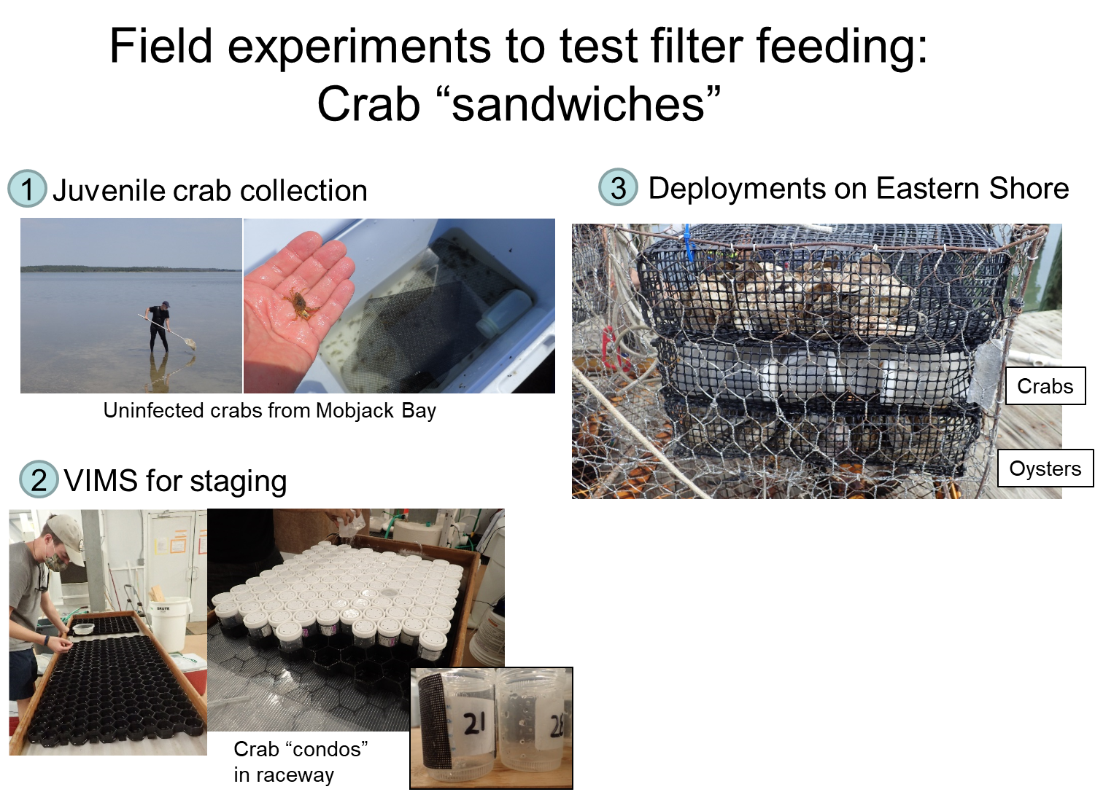
Shield’s Lab Design:
Notes:
Important to note that this is actually what the Shield’s Lab did to carry out this experiment. 1) The crabs were collected in mobjack bay (near VIMS in Gloucester, VA) because the parasite isn’t present there. This allows scientists to claim that any crab infected at the end of this study got it from the trial out on the Eastern Shore and wasn’t infected before the study began. Juveniles were selected because ..?? 2)Crabs were taken to the lab and sorted/ assembled into containers and ultimately the crab sandwiches. 3) This is what a fully assembled crab sandwich looks like. The the crabs are either “sandwiched” with oysters (the filter feeder), oyster shells, or nothing. You could have students think through why we need the shell group… but ultimately this is to allow scientists to determine if differences are the result of filter feeding or result of the oysters just being present and reducing flow/transmission of the pathogen. The shells and the empty sandwiches are both controls. Crab sandwich devices were all deployed in the eastern shore of virginia, near wachapreague, fro 10 days. After the 10 days, the devices were removed from the water and all crabs were dissected to determine infection status.
Also, the hematodinium parasites can not be grown in the lab well. This is why this experiment needs to be done outside in the areas where the parasite is endemic and not in a tank in a lab. This was a common question students ha

Slide 55
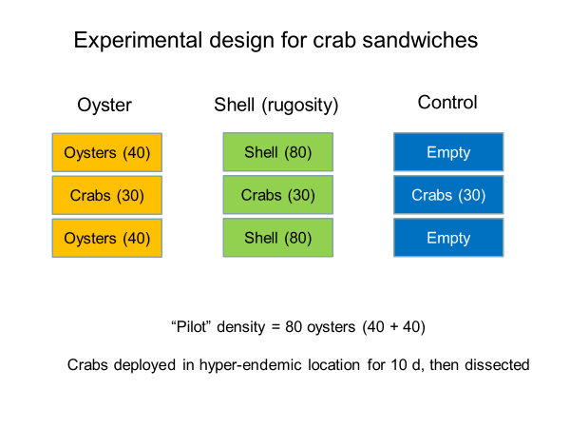
Notes:
This is a schematic for how the crab sandwiches were set up. In this study, there were 9 different deployment sites with three replicates of each treatment (control, shell, oyster) at each site, for a total of 27 sandwiches of each treatment total.

Slide 56
Section Two: Data Analysis
Now that we have established how the shield’s lab carries out this study, now we are going to play the role of the scientists to carry out the data collection and analysis, like they do in the lab.
Notes:
Again, emphasize that all of the data that they are analyzing came from the data collected from the crab sandwiches.

Slide 57
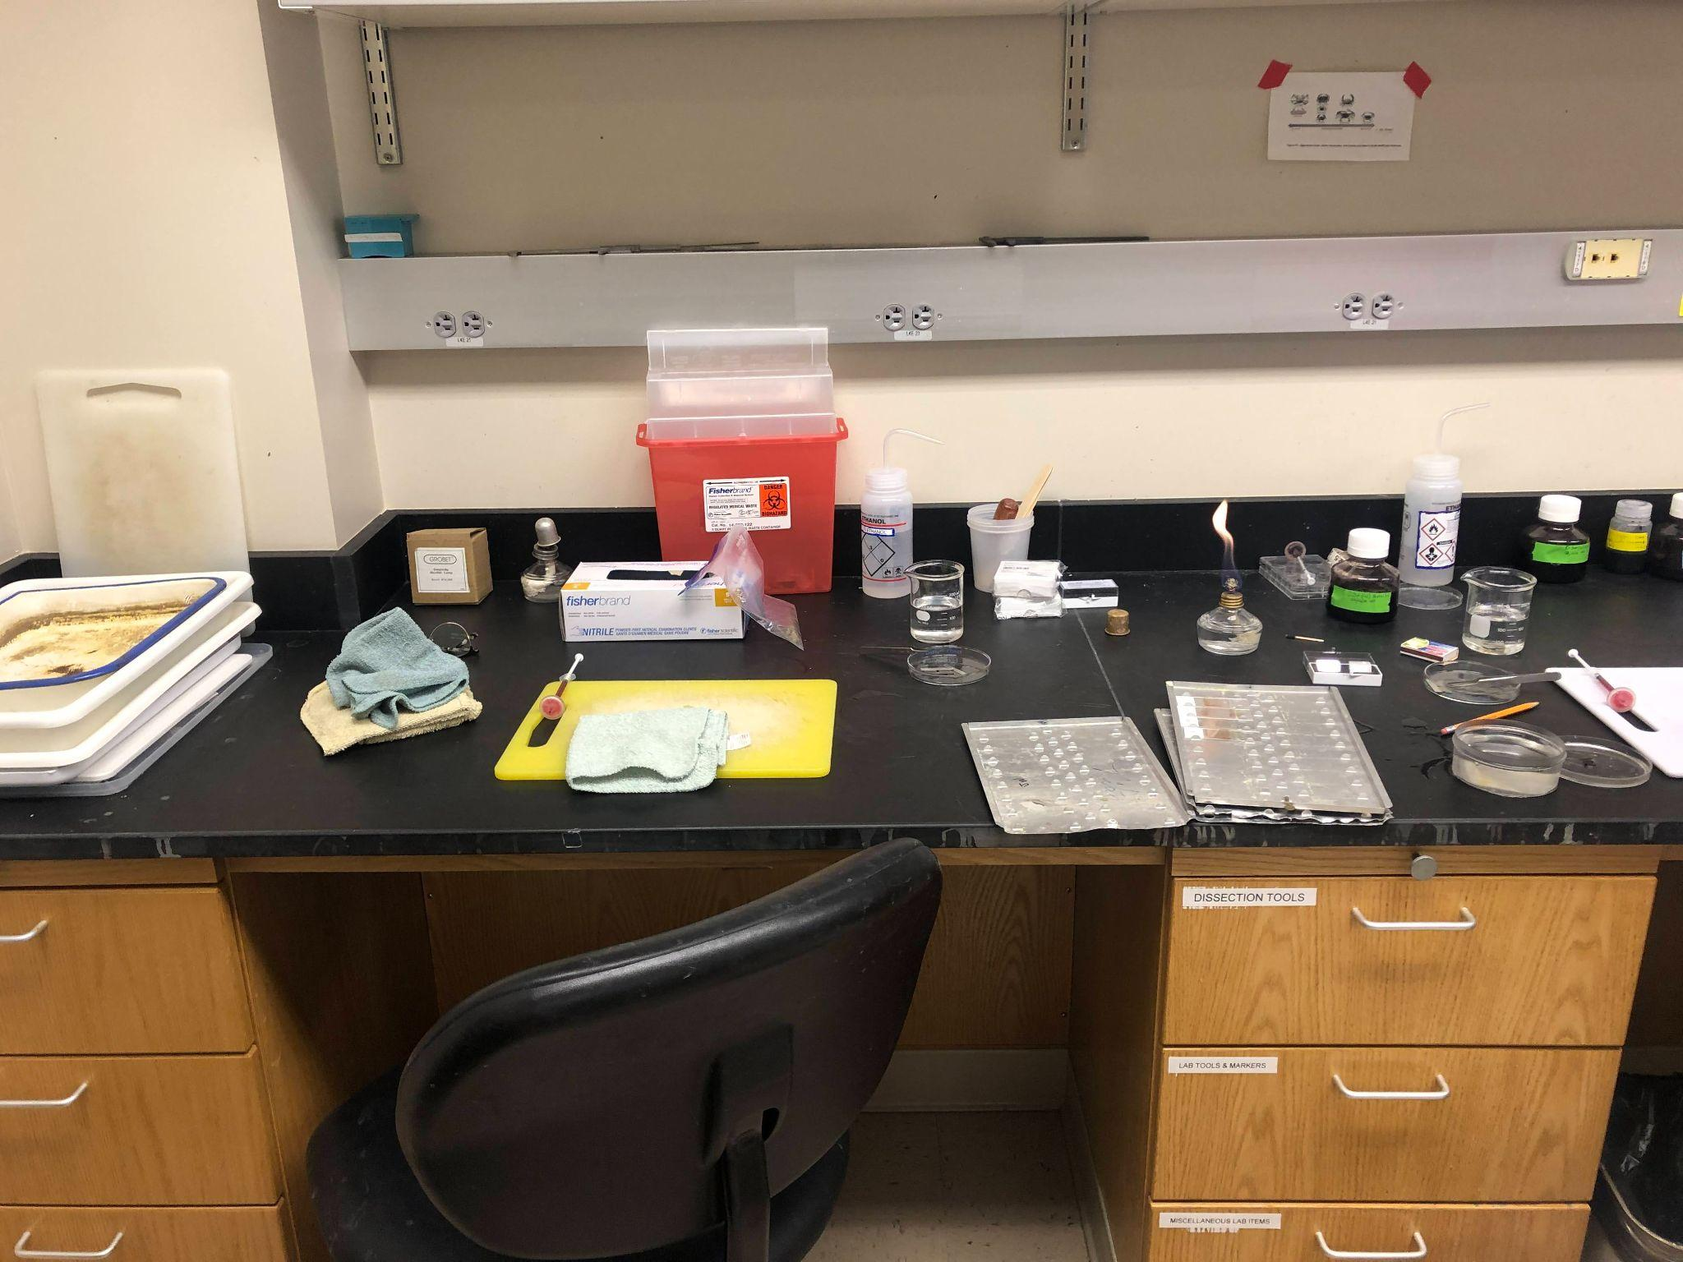
Data Analysis Activity One: Diagnostics
Photo Taken in Shield’s Lab, during a crab dissection
Notes:
In the lab, crabs are dissected and then hemolymph is placed on a microscope slide. Then we add 1 or 2 drops of neutral red, which binds to the hematodinium cells and not the crab cells. Scientists then look at the slides under the microscope and determine if they can see any of the parasite cells. Crab is cut on the yellow cutting board. There are small syringes that have the red dye. Students looking at this might ask where there is fire– all tools are dipped into alcohol and then flamed, so that there is no contamination. The red container in the back is for sharps, any sort of needle, blade or glass is discarded in this type of container.
** the dissection process does involve cutting a live crab in half. Students might have feelings about this, it is ok. There is a video of this process, starring lab tech David Jones, and iut starts after the crabs have been dissected. He talks about how there can be involuntary movement of the crab after they are cut. You decide if you want to show this for your class.

Slide 58
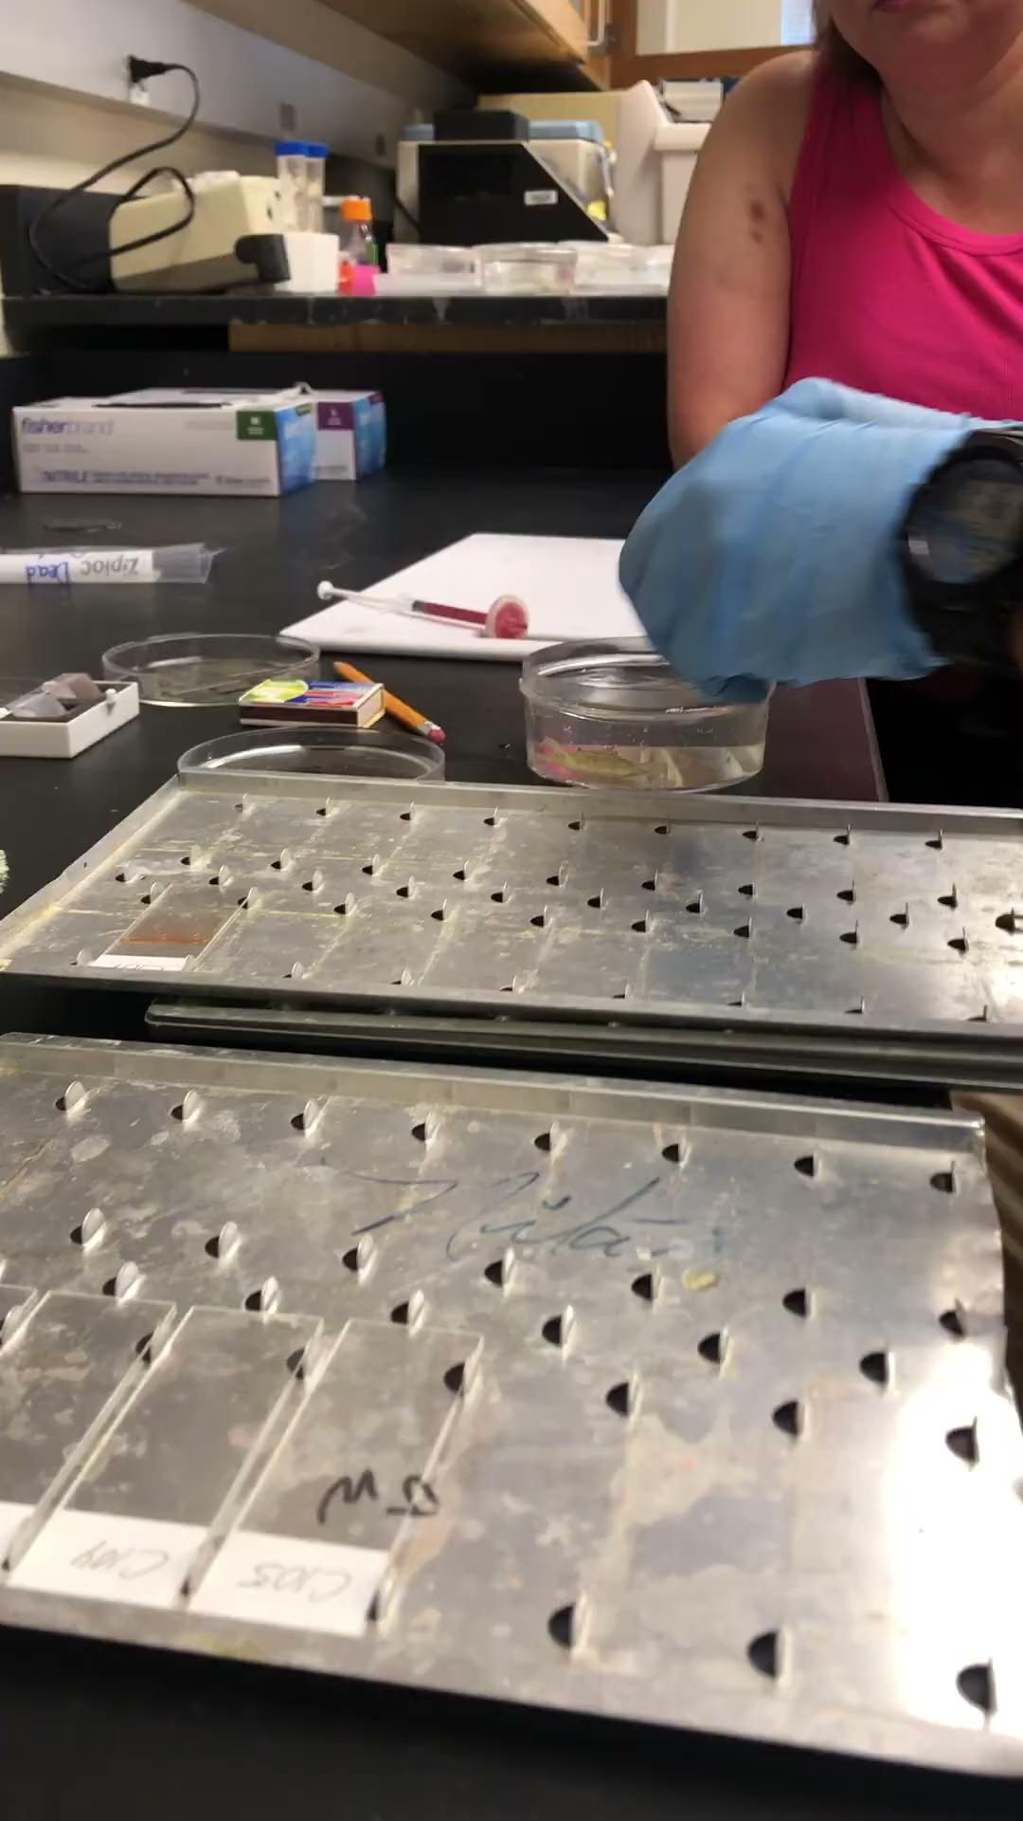
Notes:
This video is featuring David Jones, lab specialist in the Shields Lab. Luisa Hays, teacher intern, is in the background. Video taken by Claire Adrian-Tucci, teacher intern. Thi video shows the dissection of the crab, watch first and decide if this is appropriate for your classroom.

Slide 59
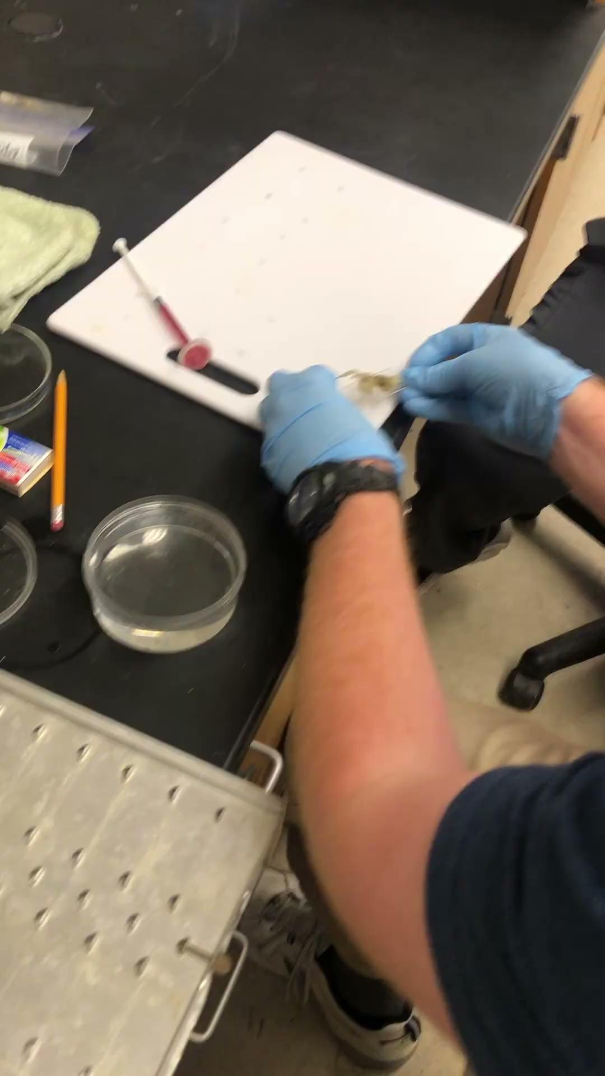
Notes:
This video is featuring David Jones, lab specialist in the Shields Lab. Luisa Hays, teacher intern, is in the background. Video taken by Claire Adrian-Tucci, teacher intern. Thi video shows the dissection of the crab, watch first and decide if this is appropriate for your classroom.

Slide 60
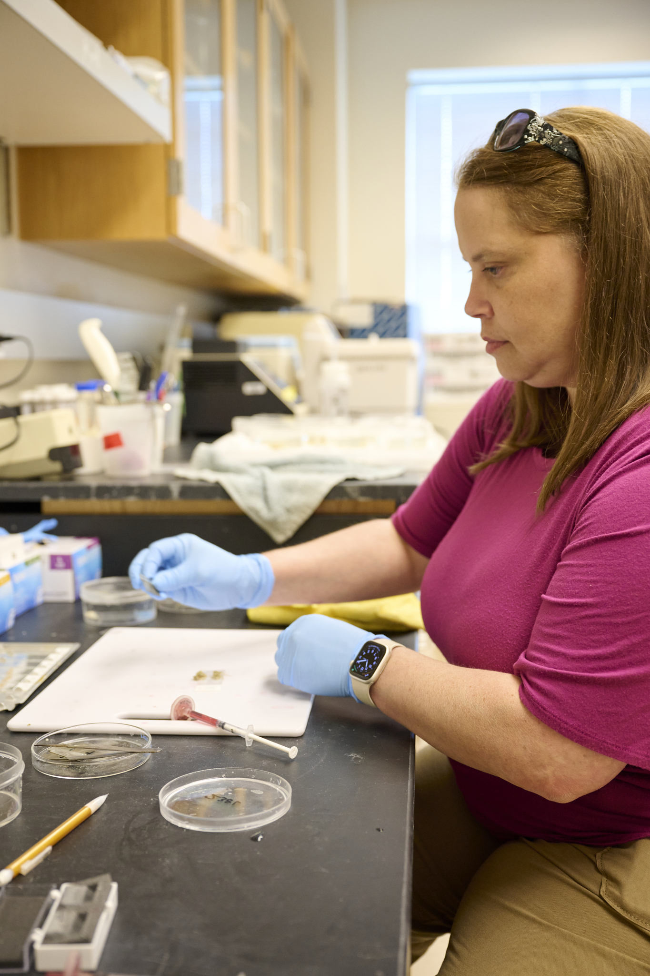
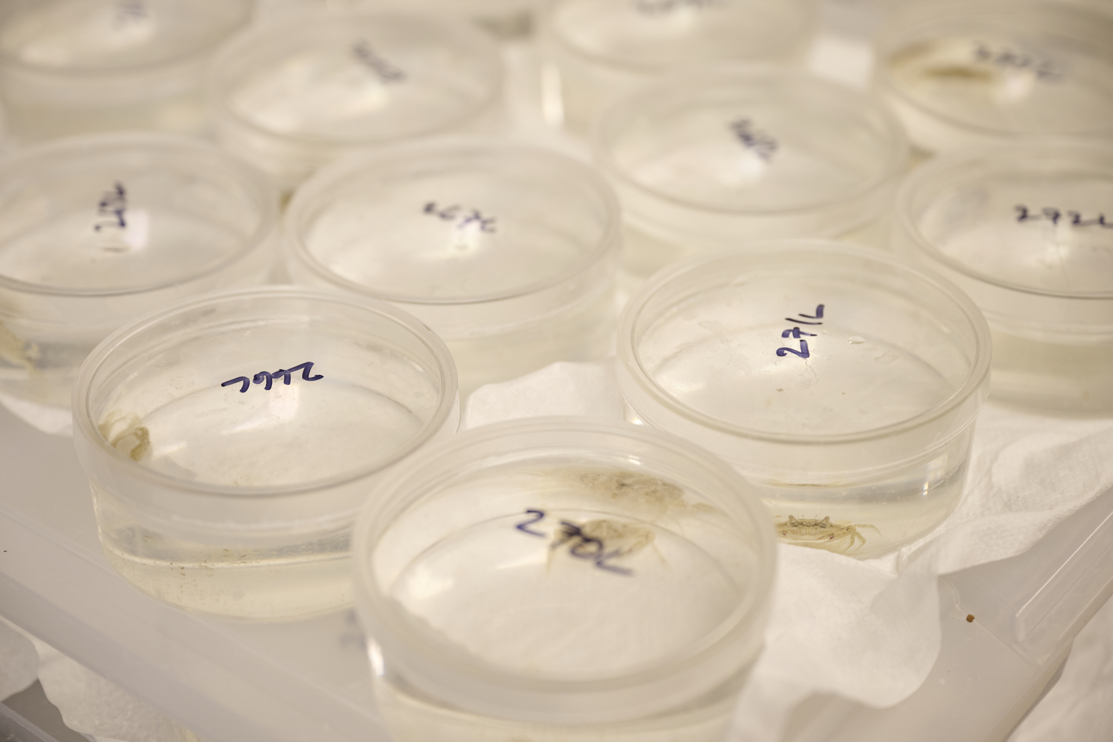
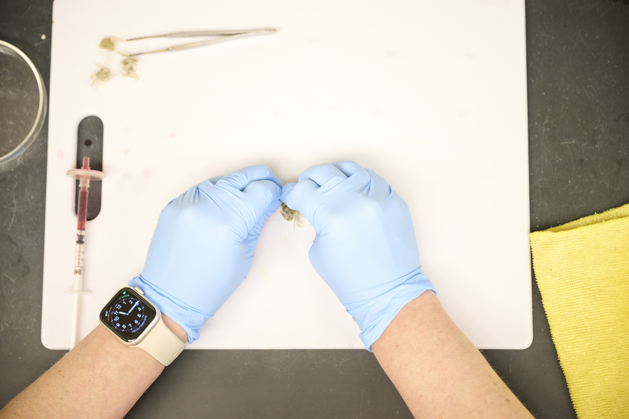
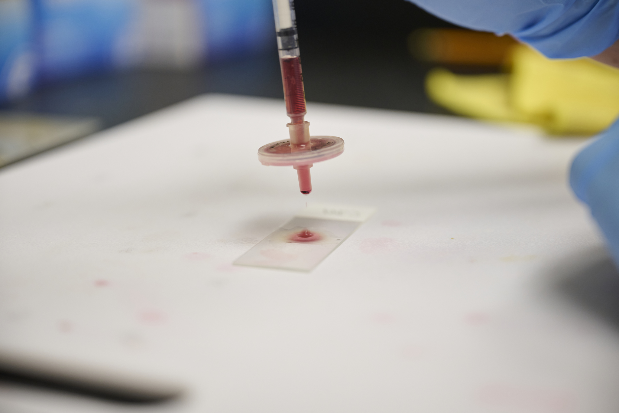
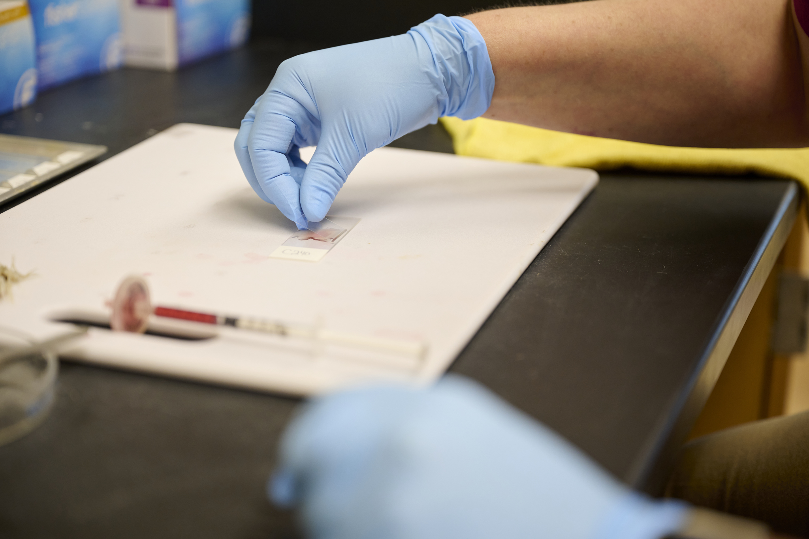
Crab Dissection Protocol
Photo Credit: James Loving
Notes:
All pictures by James Loving at VIMS. Luisa Hays is conducting the crab dissection and prep in all of the pictures. This covers all the information in the videos, but in still images. First, crabs removed from their homes (tall petri dishes). Crabs are dissected on cutting boards onto a microscope slide. Neutral Red dye applied and then cover slip added. After the tools are used, they are then dunked in alcohol and flamed to prevent contamination.

Slide 61
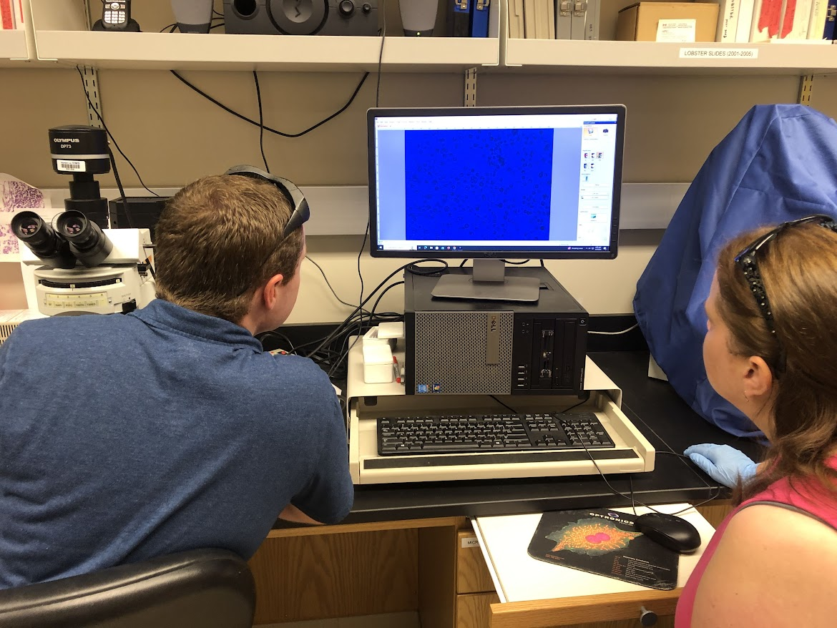
Analyzing microscope slides to see if parasites are present
Notes:
One could point out to students that this process is very similar in human diagnostics. In the picture is David Jones (left) and Luisa Hays (right).

Slide 62
Teacher Instructions
On the next slide, you need to determine how you want to split up the infection cards. Will there be stations? Or a jigsaw? Etc.
You can also have students graph their results on paper or on google sheets/excel.

Slide 63
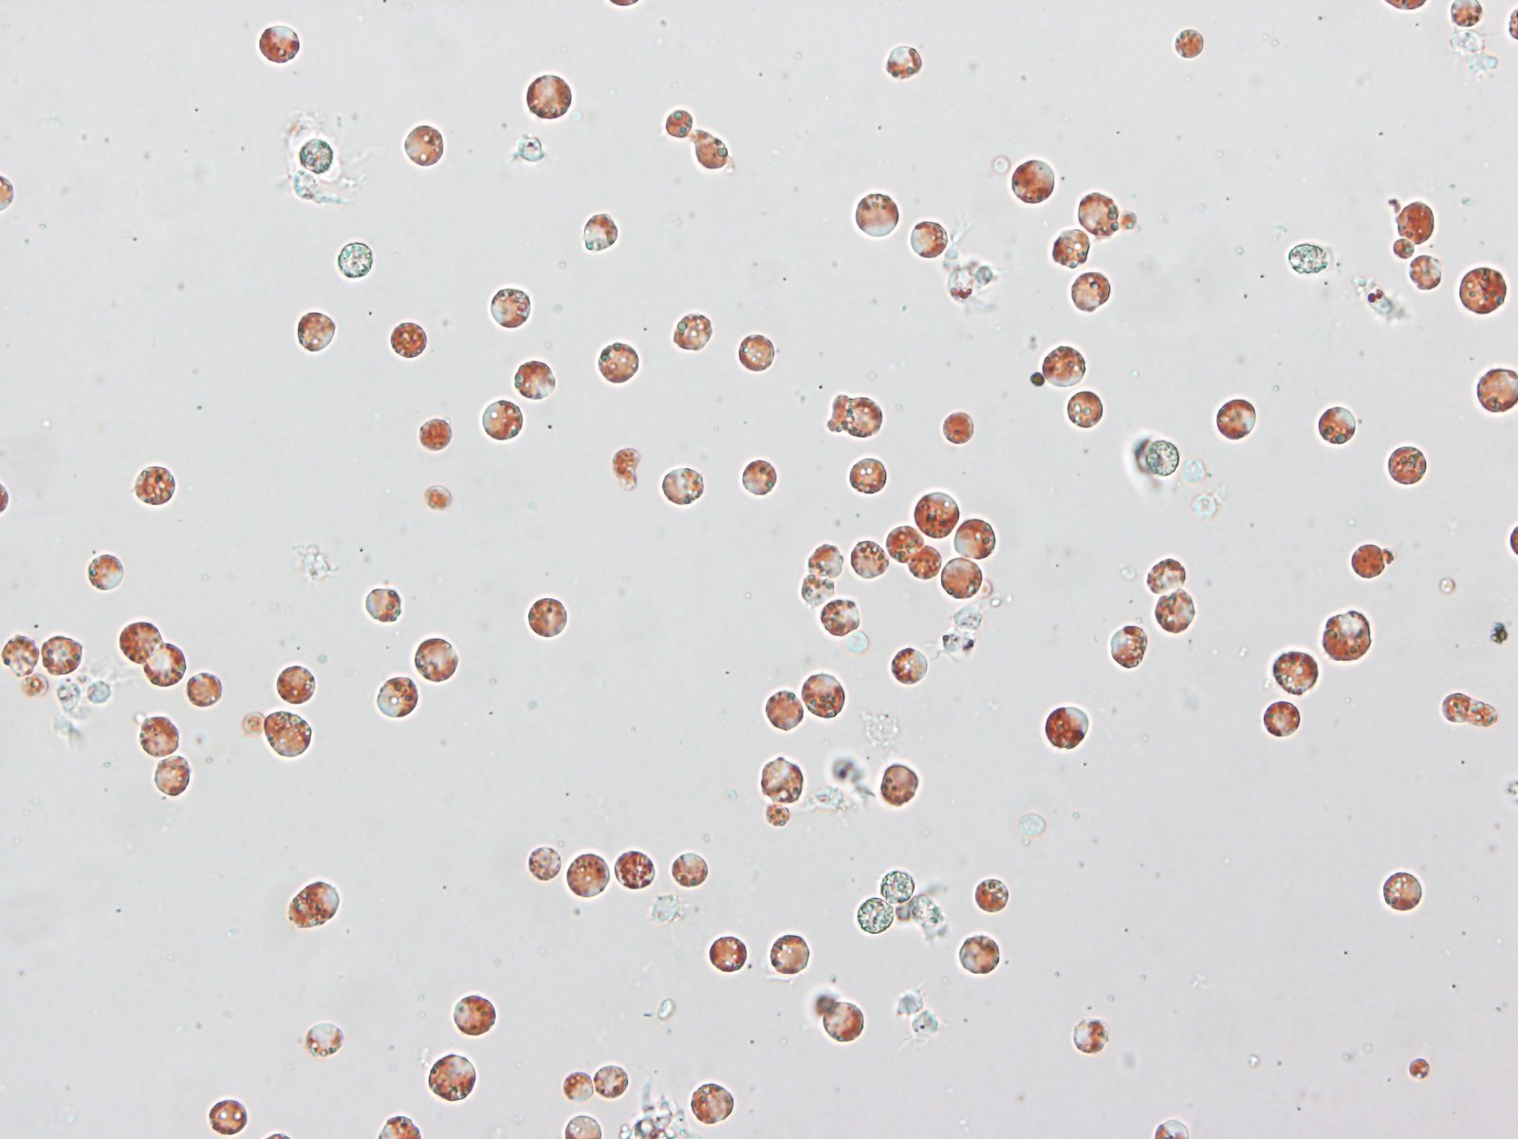
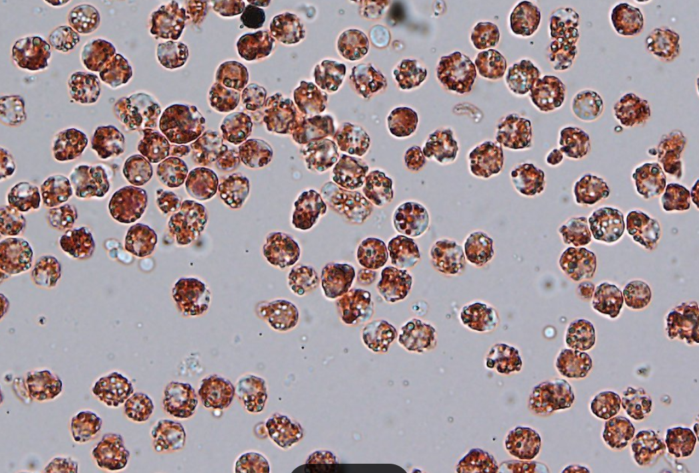
Data Analysis Activity One: Diagnostics
After crabs are dissected, scientists look at them under the microscope
An infected slide
An infected slide, zoomed in
Shield’s lab staff all agree- it is much easier when you have an infected sample. It takes a lot longer to identify an uninfected slide, because you need to look at the entire slide and not find any parasites.
Notes:
Have students look at their worksheet as you are going over this part.

Slide 64
Data Analysis Activity One: Diagnostics
Each group will be assigned *insert number here* of crab cards. On each card there is a picture of the crab and a picture of the micrograph demonstrating its infection status.
Be sure to record your results on your data table, be ready to share your findings with the class
Notes:
Up to teacher to determine how many images each group looks at

Slide 65
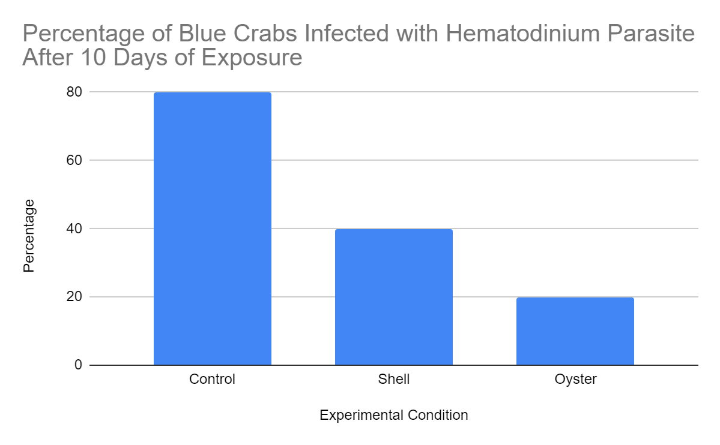
Data Analysis:
Our Results Infection Status across Treatments
Notes:
If you had students put the information into excel/sheets, it should look something like this.this is just looking at infection status broadly, without the size taken into account. Again,the results/ trends are consistent with what was found in the lab, we just reduced the number of crabs. Notice that the crabs sandwiched between oysters were half as likely to become infected than the ones with just shell. Also note that the shell still has less infection, which is consistent with the results,. The filter feeder does the most to reduce infection, but there still might be some protection from the shells.

Slide 66

Notes:
This slide is data from the shields lab, which shows the data for 6 of the 9 deployments (I am unsure why the other three are not included). Teacher can show this to students to have them evaluate or this can be removed.

Slide 67
Teacher Instructions
The next step is to interpret the crab images. There are multiple ways to do this. Students can either measure via imageJ (which is very technology heavy) or they can measure the pictures with rulers (no technology required)
For the ImageJ route, you need the internet to run the program and then a way to get pictures downloaded on student machines. Chromebooks don’t work well for this activity, unless you can get the pictures to the students on a flash drive
The specifics on how to use ImageJ are on the student worksheet

Slide 68
Data Analysis Activity Two: Measurement
Now, scientists wanted to determine if there was a relationship between the size of the crab and the level of infection.
To carry out the measurements, there is teacher choice:
ImageJ w crab pictures
Rulers/calipers with printed/laminated crab pics
Notes:
At this point, teachers need to decide if they want students to measure with Image J software or with rulers off of printed pictures In either case, one of the most important and difficult elements of this is correctly identifying the structures and where the measurements should be taken from. This is okay and happens to people in the lab too… it takes time to get good at this.
If using Image J:
please refer to the student direction sheet, and walk students through those steps. It might be helpful to do a test image or two at front of the classroom first. The images can be found HERE. Image J is free and can be run through a browser or downloaded, the program works the same way in both versions.
If using Paper:
DO NOT try to make the crab pictures bigger… it will ultimately distort the image and will mess up the size and characterization if the crab is large or small. You may want to laminate the pictures so that students can markn up the pictures to determine where they are measuring from.

Slide 69

Data Analysis Activity Two: Measurement
We will measure
Long Carapace Width (LCW), which is pointy spine to pointy spine &
Carapace Length (CL), which is front to back
Use your LCW measurement to determine if the crab is small, 0-15mm or large 16-30 mm
Notes:
We measure the crabs to see if there is a difference in infection status at different sizes/ages of crabs. This is an image from the lab, and shows all of the possible measurements that they use, for varying experiments,. Not all parameters are measured for every experiment, depends on what they are looking at. For the purpose of this case study, we will just have students measure the LCW (Long Carapave Width, which is pointy spine to pointy spine) and the CL (carapace length, front to back).
SCW is the short carapce length which is basically right before the spines poke out. This measurement is used because sometimes the points can be damaged or not present.
DL is the dactyl length or the length of the last paddle

Slide 70
What does our data tell us?

Slide 71

Notes:
Graphs should look something like this. According to the lab data, the smaller juveniles are half as likely to become infected than the larger juveniles. This is an interesting finding and isnt just reflective of the larger crabs being older- remember that all of the crabs were placed in the high endemic area for the same amount of time, 10 days, and would not have been exposed to the parasite prior. The lab is interested in understanding the mechanism for this, it is likely an effect of surface area to volume ratio- the small crabs being smaller allows for more of the pathogen to get in.

Slide 72

Data from Shields Lab
Notes:
Here is the data from the lab, but broken down into more categories. Same trend is true, the smaller ones are less likely to be infected. In the lab, they spoke about small crabs being 0-15 and then larger ones being anything greater than 15mm. This graph just breaks it down into more categories to see if there are any other trends going on. For this case study, we were certain to select crab images that were either very small or very large… so that the trend would remain the same even with student measurement errors. If your students’ trend do not look correct, it is possible that their calculation was correct, but they made mistakes while measuring the crabs. If this happens, remind students about the importance of accurate measurements and how new members of the Shields lab spend time taking measurements and comparing their measurements (via percent error calculations) to a more experienced member of the lab. Only when the percent error is very low (~3%) are new people allowed to take measurement and enter them into the labs official records.

Slide 73
Conclusions from the Case Study:
There are less infections in the crabs that were surrounded by oysters. This suggests that the filter feeding of the oyster reduces parasite infection.
Smaller crabs are less likely to be infected
Science is fun and creative!!
The Shields lab is currently submitting the finished article to journals for peer review.

Slide 74
References
https://www.chesapeakebay.net/discover/field-guide/entry/blue-crab

Slide 75
Blue Crab Fun Facts
The blue crab’s scientific name comes from the Greek words for “beautiful” and “swimmer.”
Male blue crabs are known as “jimmies,” while mature females are called "sooks."
Blue crabs are one of the most important commercial and recreational catches in the Chesapeake Bay.
The Chesapeake Bay blue crab population has not been overfished since female-specific management was implemented in 2008.

Slide 76

https://tinyurl.com/vimsesl
2025 ESL Course

