Slide 1
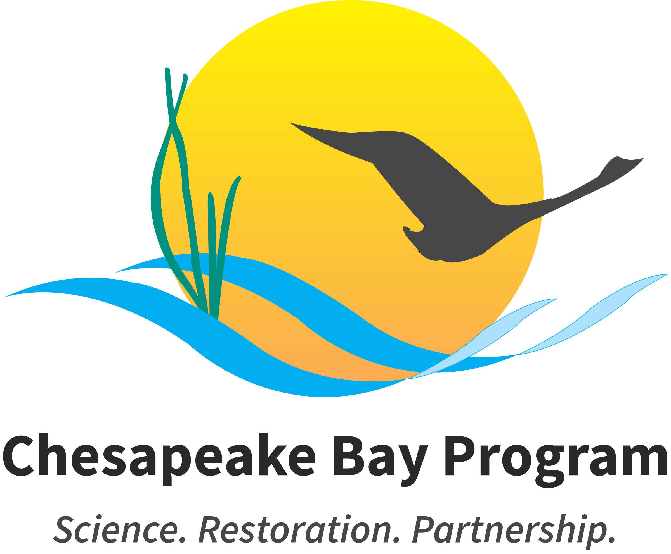
Chesapeake Bay Issue Cards
Developed by the Chesapeake Bay Program, the following issue cards can be used with students to explore key issues in the region and consider the human and natural systems connected to these issues.
Have students explore the issue cards and facilitate a group discussion considering the following questions:
● What issue(s) are particularly relevant to where you work/live?
● Were you surprised by any of the issues?
● Are there any major issues missing that are important in your community?
● How else might you identify locally relevant issues?
● Can you take a couple of the issues, natural systems, human systems, and values to create a driving question that is locally relevant?
If practical, note that environmental issues are often the result of tensions between groups and/or natural and human/social systems.
The Chesapeake Bay Program is a partnership among federal, state and local governments as well as non-governmental organizations (NGOs) that guides the restoration of the nation’s largest estuary and its watershed. The Chesapeake Bay Program works to address issues ranging from water quality to the ways in which society uses land throughout the watershed.

Slide 2
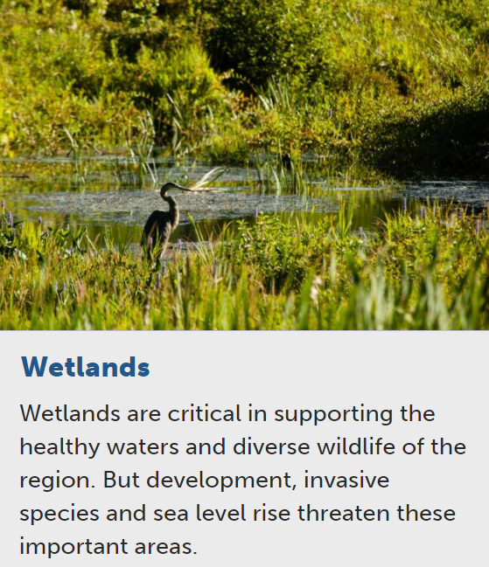
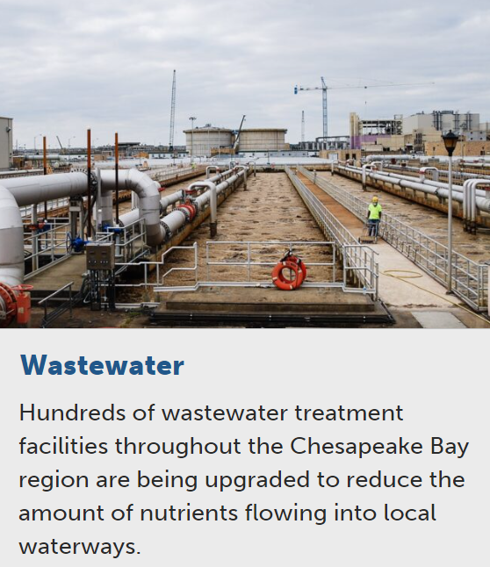
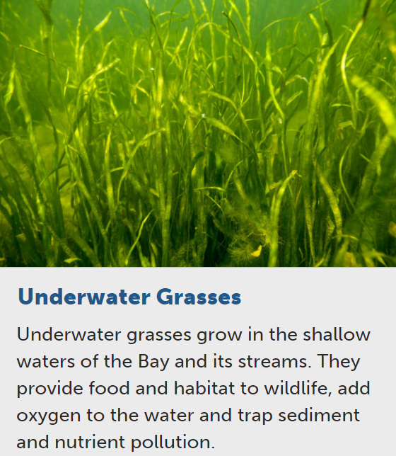
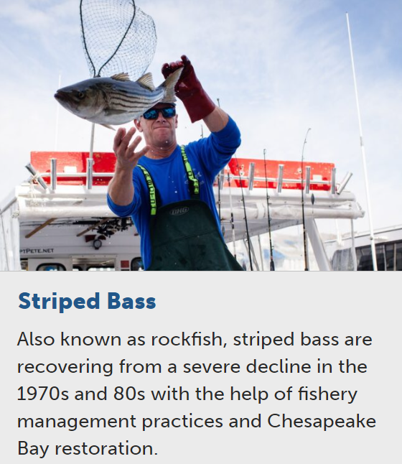

Slide 3
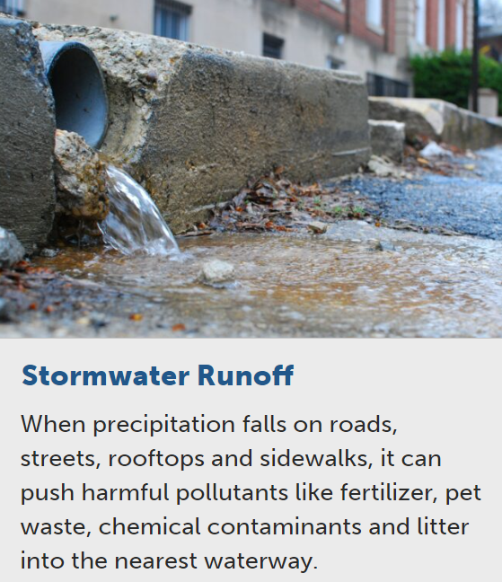
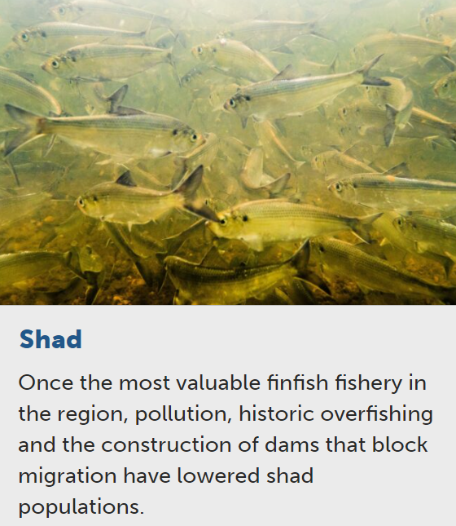
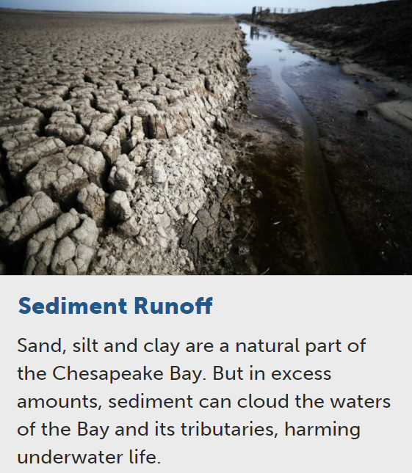
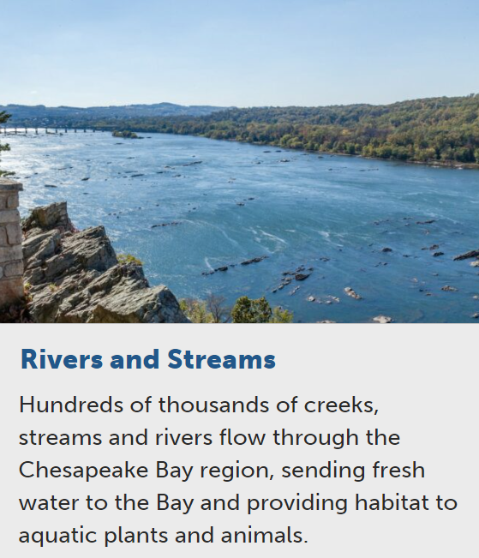

Slide 4
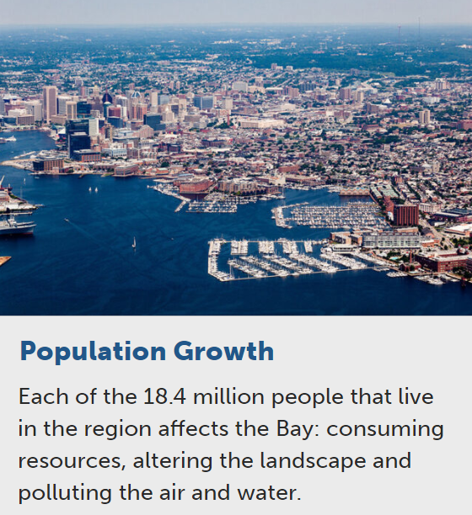
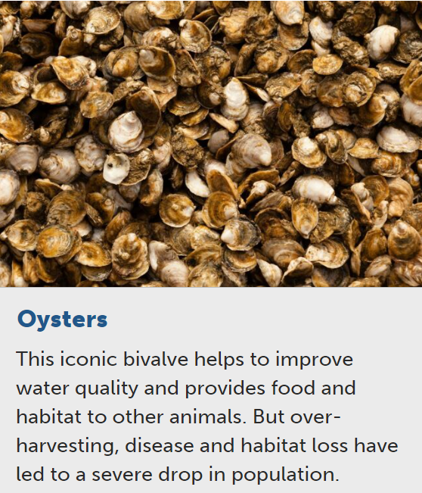
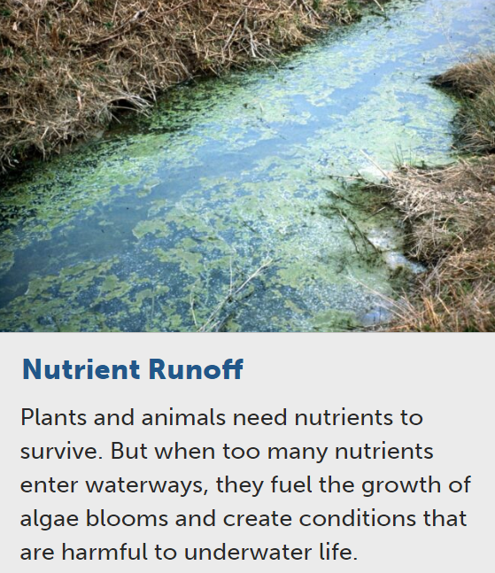
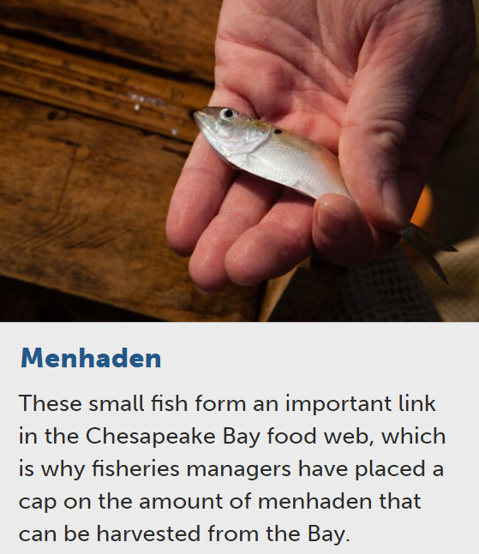

Slide 5
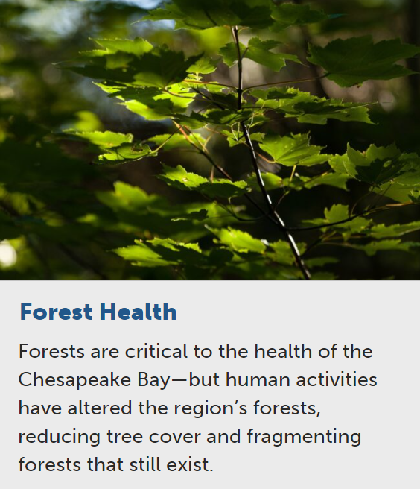
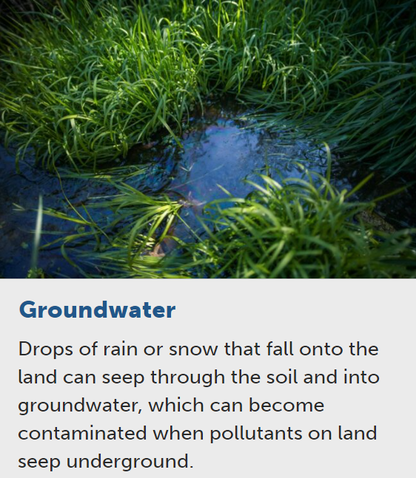
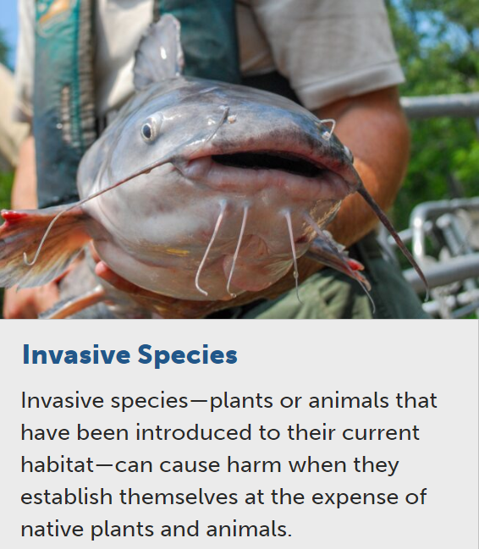
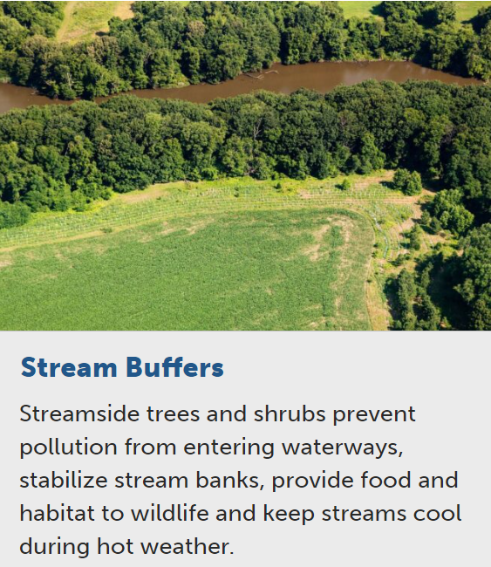

Slide 6
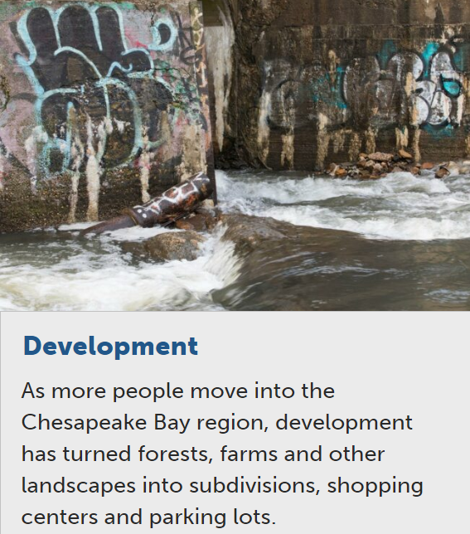
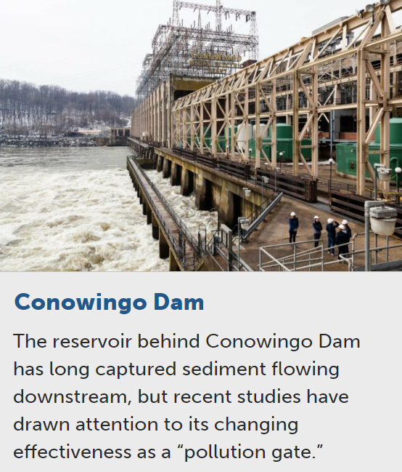
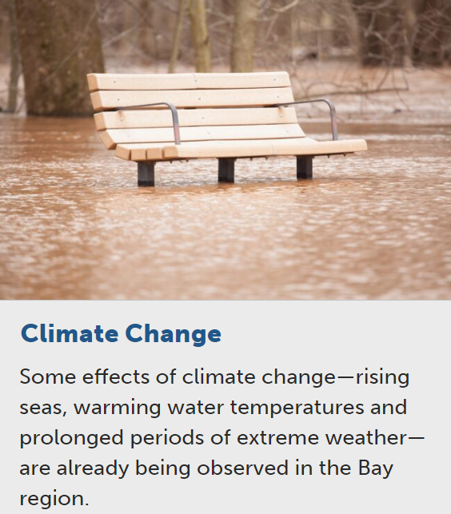
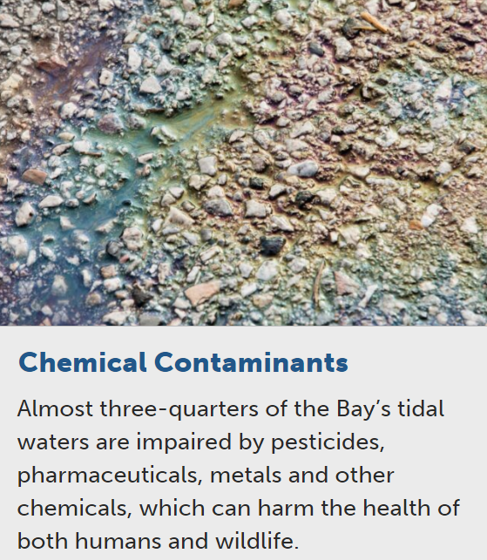

Slide 7
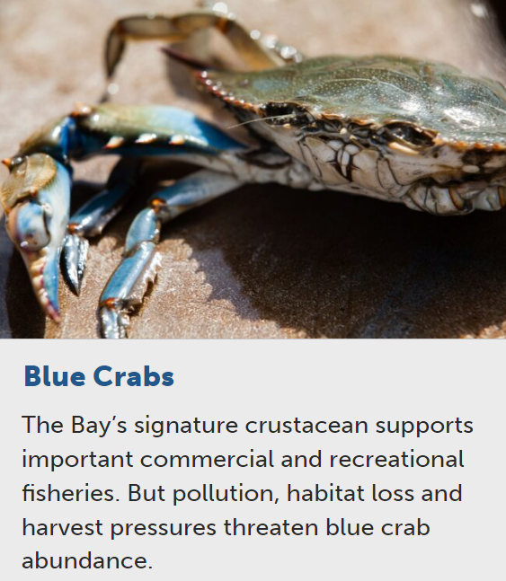
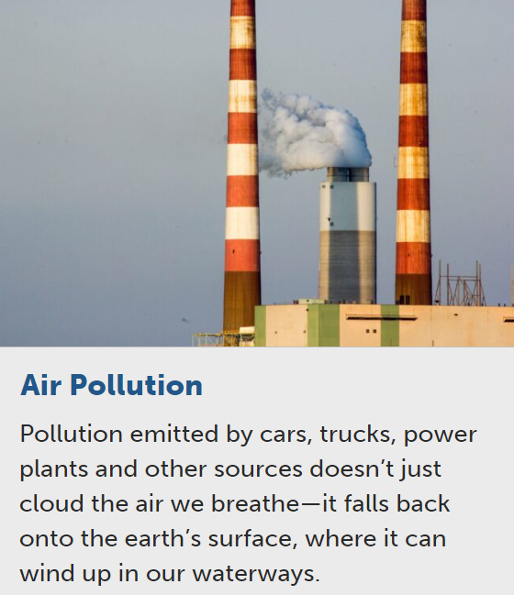
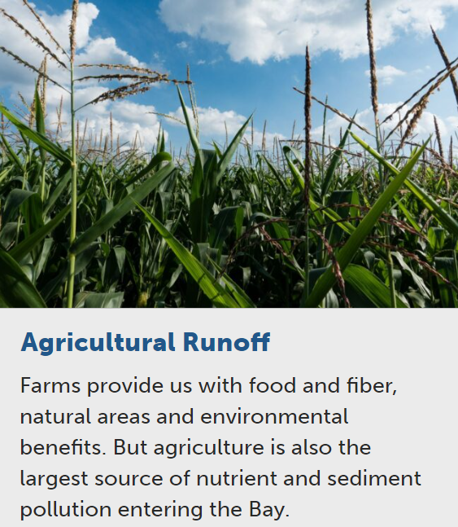
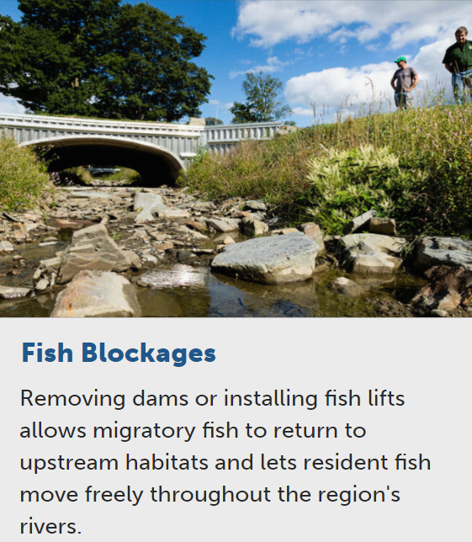

Slide 8
