Slide 1
Sediment Stories:
Exploring Carbon in Seagrass Ecosystems
Written by Alyson Hall
VA SEA

Slide 2
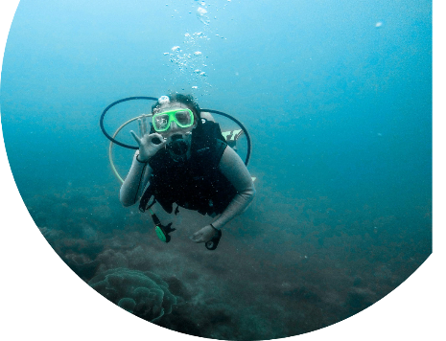
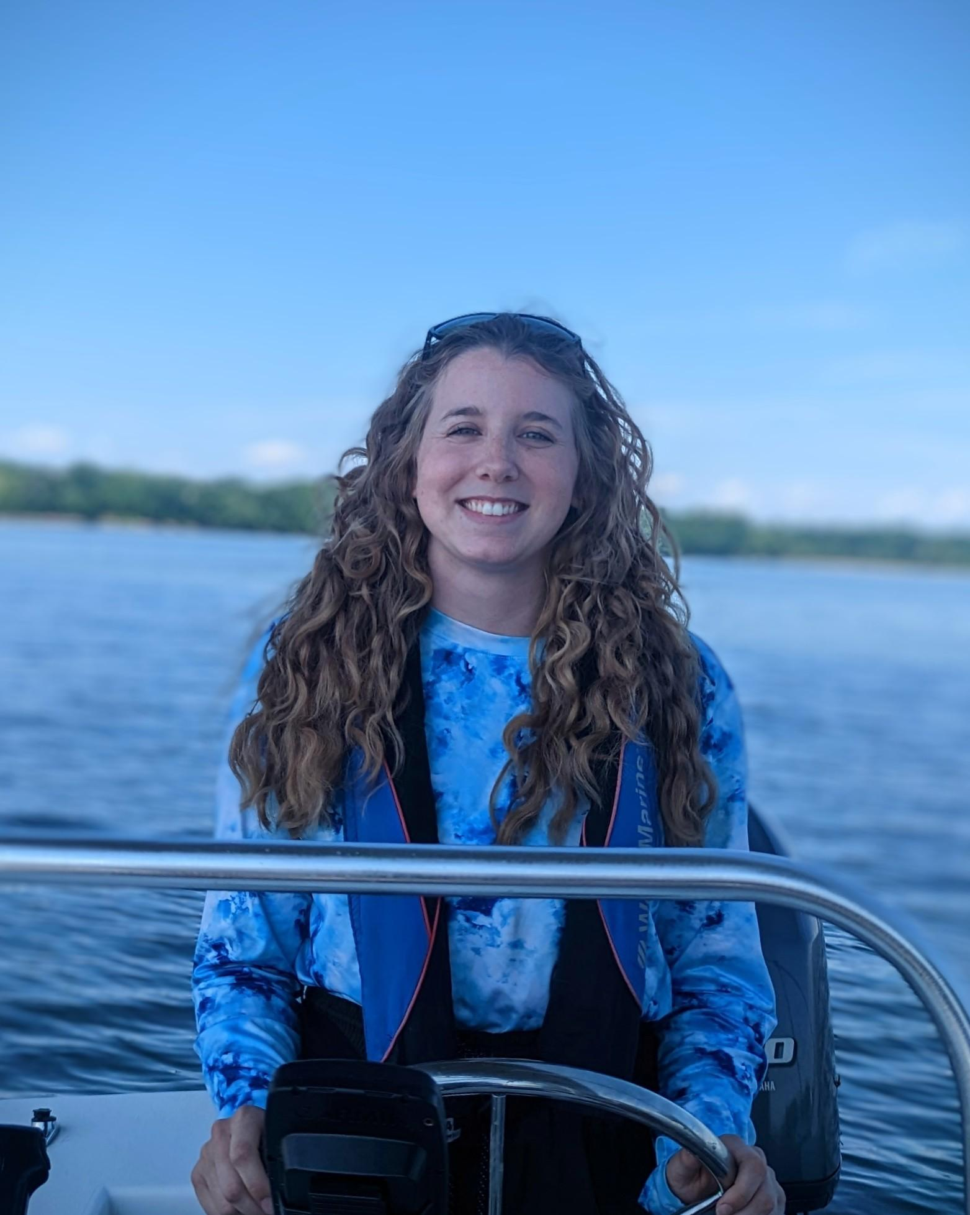
Meet the scientist
That’s me!
Hi, my name is Aly Hall
I am a marine biologist at the Virginia Institute of Marine Science
I am from Maryland and love the Chesapeake Bay!
I study seagrasses and how they are being affected by humans.
Photos by Alyson Hall

Slide 3
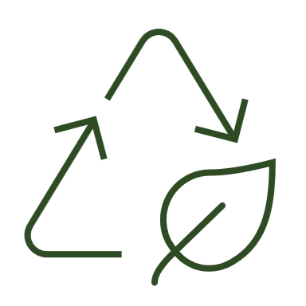
Think – Pair – Share: Climate change
Take 1 minute to think about what you know about climate change
Discuss with a partner what you brainstormed
Share with the class what you know about climate change and the effect it has on ecosystems

Slide 4
Climate change and excess carbon dioxide
C
C
O
O
O
O
Climate change is caused by extra carbon dioxide (CO2) in the atmosphere
Extra CO2 can cause:
Earth-wide warming temperatures
Worse and more frequent storms
More acidic oceans
All of these affect humans, plants, and animals across the planet
C
O
O
C
C
O
O
O
O

Slide 5
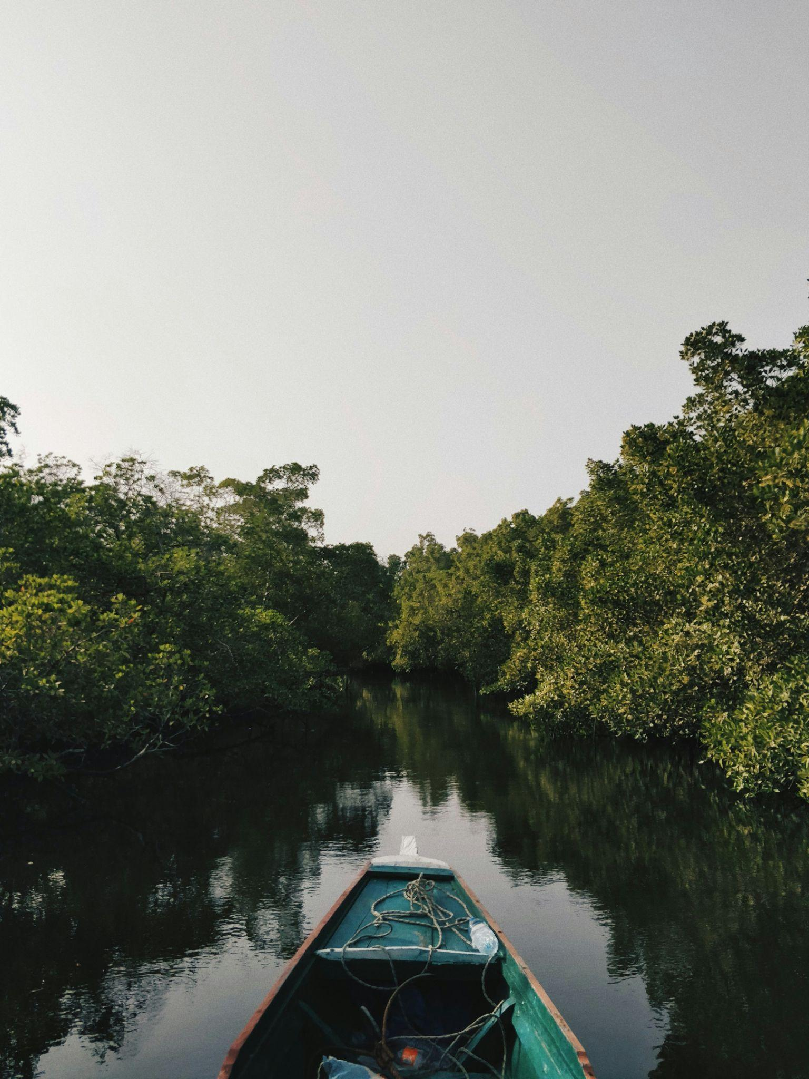
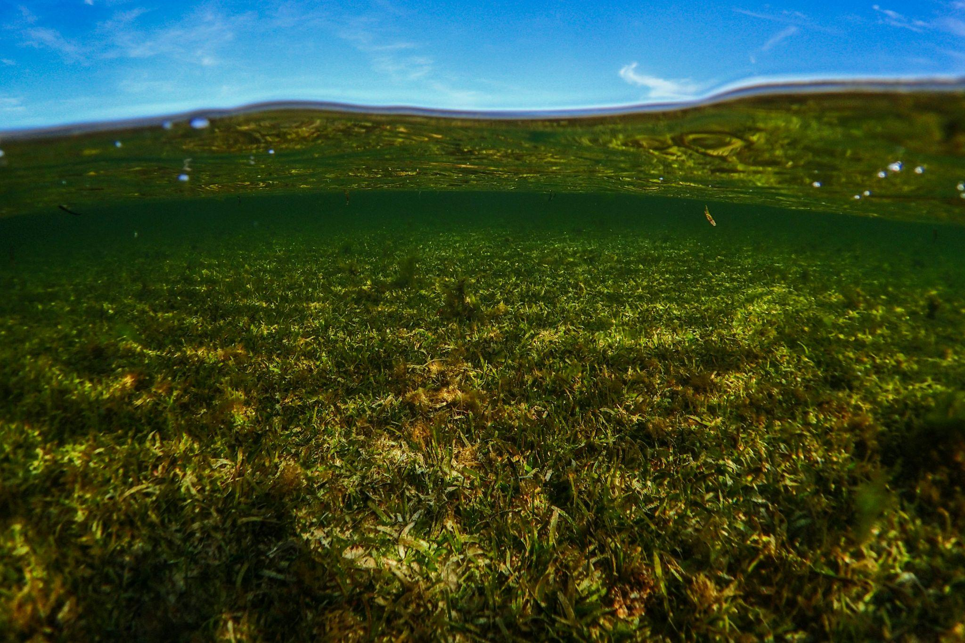
Coastal systems are powerful carbon sinks
Areas that store carbon (capture it and lock it away) are considered carbon sinks
Many habitats are powerful carbon sinks, such as:
Rainforests
Seagrass meadows
Salt marshes
Mangroves
Photo by Anton Lecock on Unsplash
Photo by Benjamin L. Jones on Unsplash

Slide 6
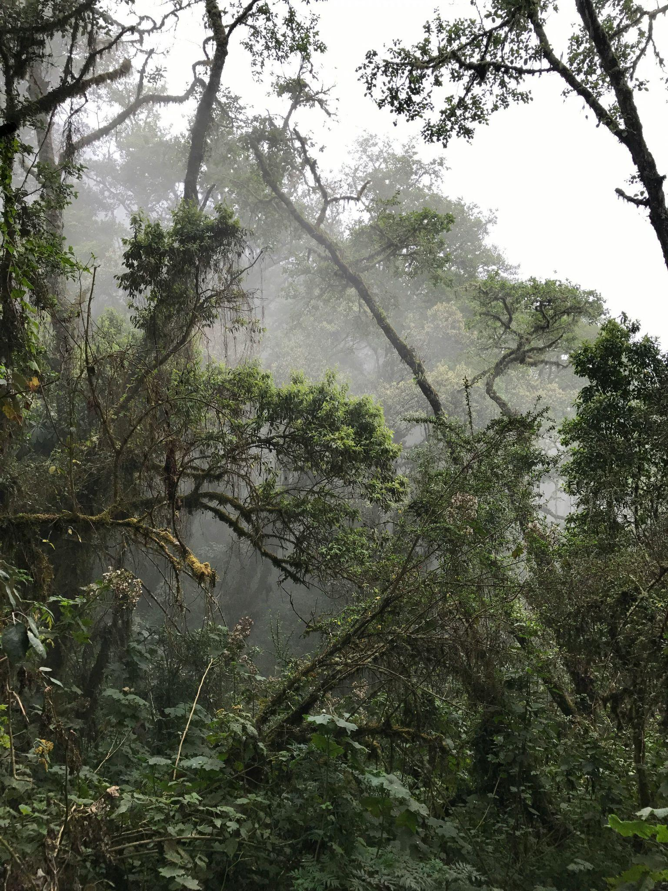
We want to protect ecosystems that are carbon sinks!
C
O
O
C
Ecosystems that store carbon are protected because:
1) they can store even more carbon (accumulation) and
2) if they disappear that stored carbon might get released!
O
O
Photo by Theodore Moore on Unsplash

Slide 7
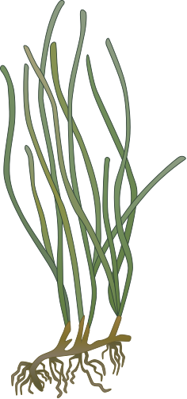
Long-term carbon storage is in sediment
Plant and animal tissue is made of carbon
However, for carbon to be stored for a long time, and help fight climate change, it must be “buried” in sediment!
C
O
O
Icon by Tracey Saxby, Integration and Application Network (ian.umces.edu/media-library)
Tracey Saxby and Jane Thomas, Integration and Application Network (ian.umces.edu/media-library)

Slide 8
Brainstorm: What might impact carbon storage of coastal habitats?
Hint: Think about
1) the abiotic factors (environment the ecosystem is in)
2) the bi0tic factors (species inside the ecosystem)

Slide 9
Almost everything about an ecosystem can impact how it stores carbon!
Abiotic
Temperature
Sunlight
Sediment characteristics
Depth of water
Wave action
2. Biotic
Species of plant,
Species of animals
Microbial community

Slide 10
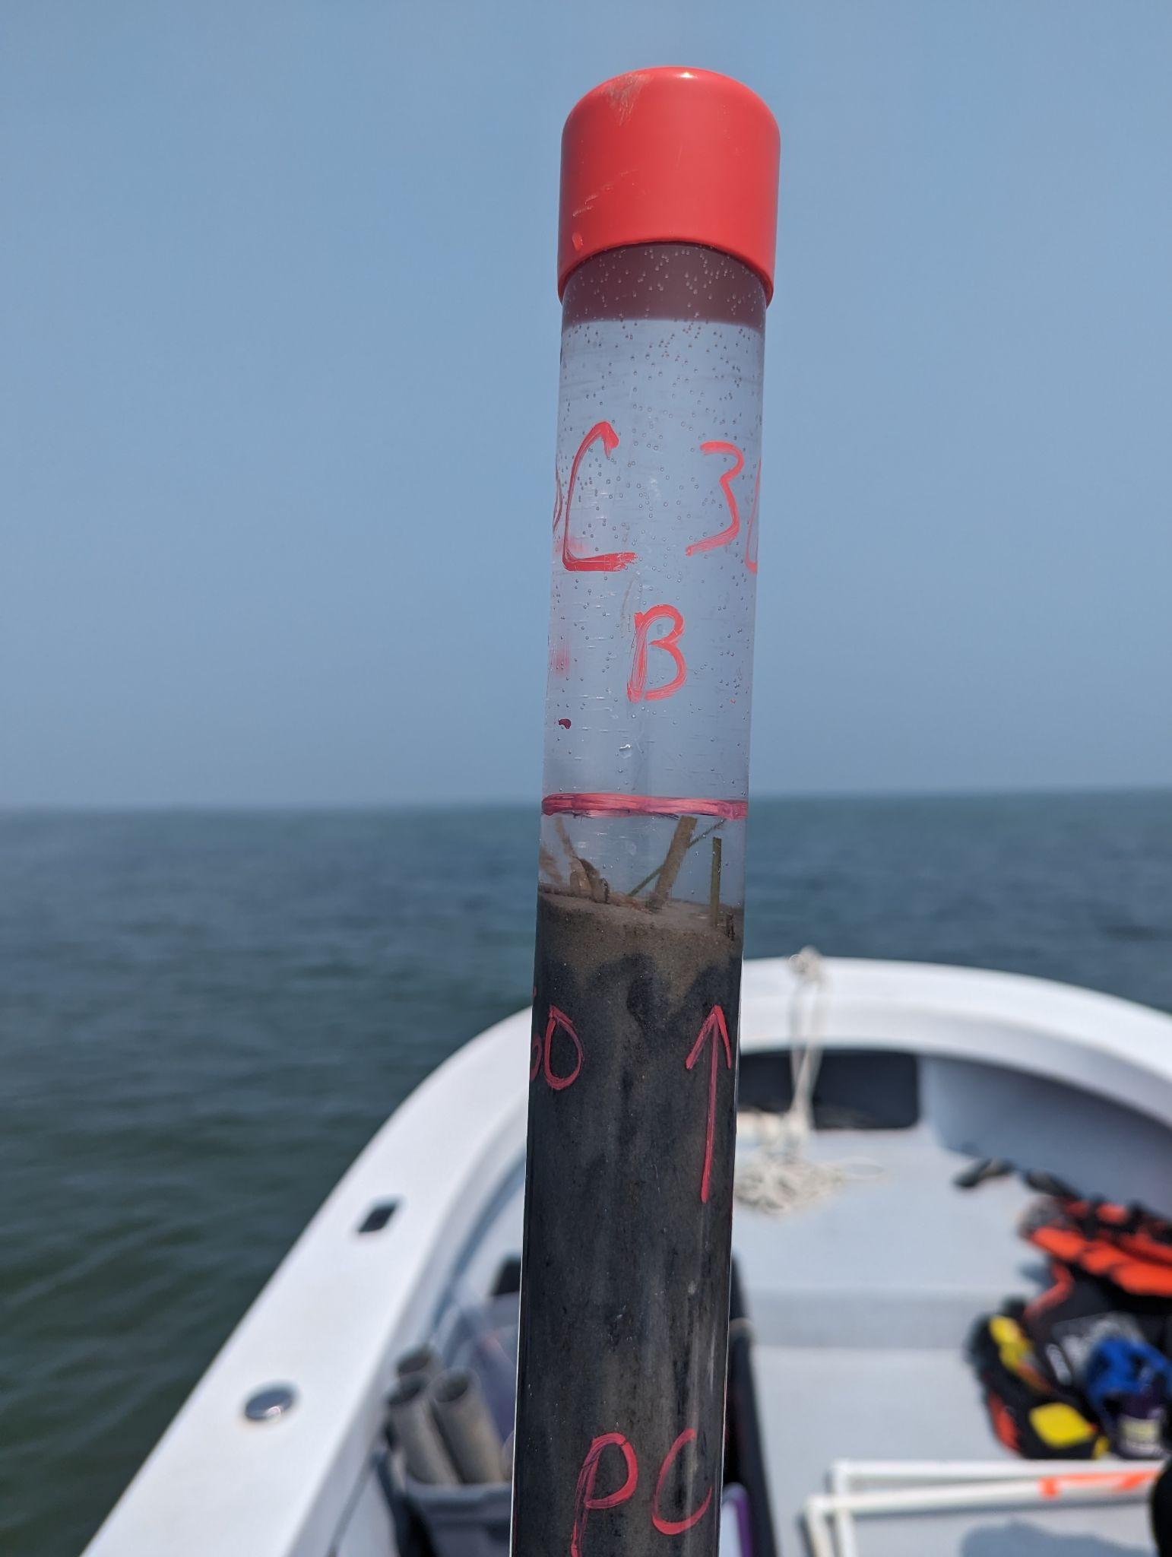
Scientists can measure carbon stocks using sediment cores
Scientists want to track the amount of carbon stored in ecosystems, or their carbon stocks
They can do this by taking sediment cores
Cores are little chunks taken out of the ground
We then measure the amount of sediment and carbon inside!
Photo by Alyson Hall

Slide 11
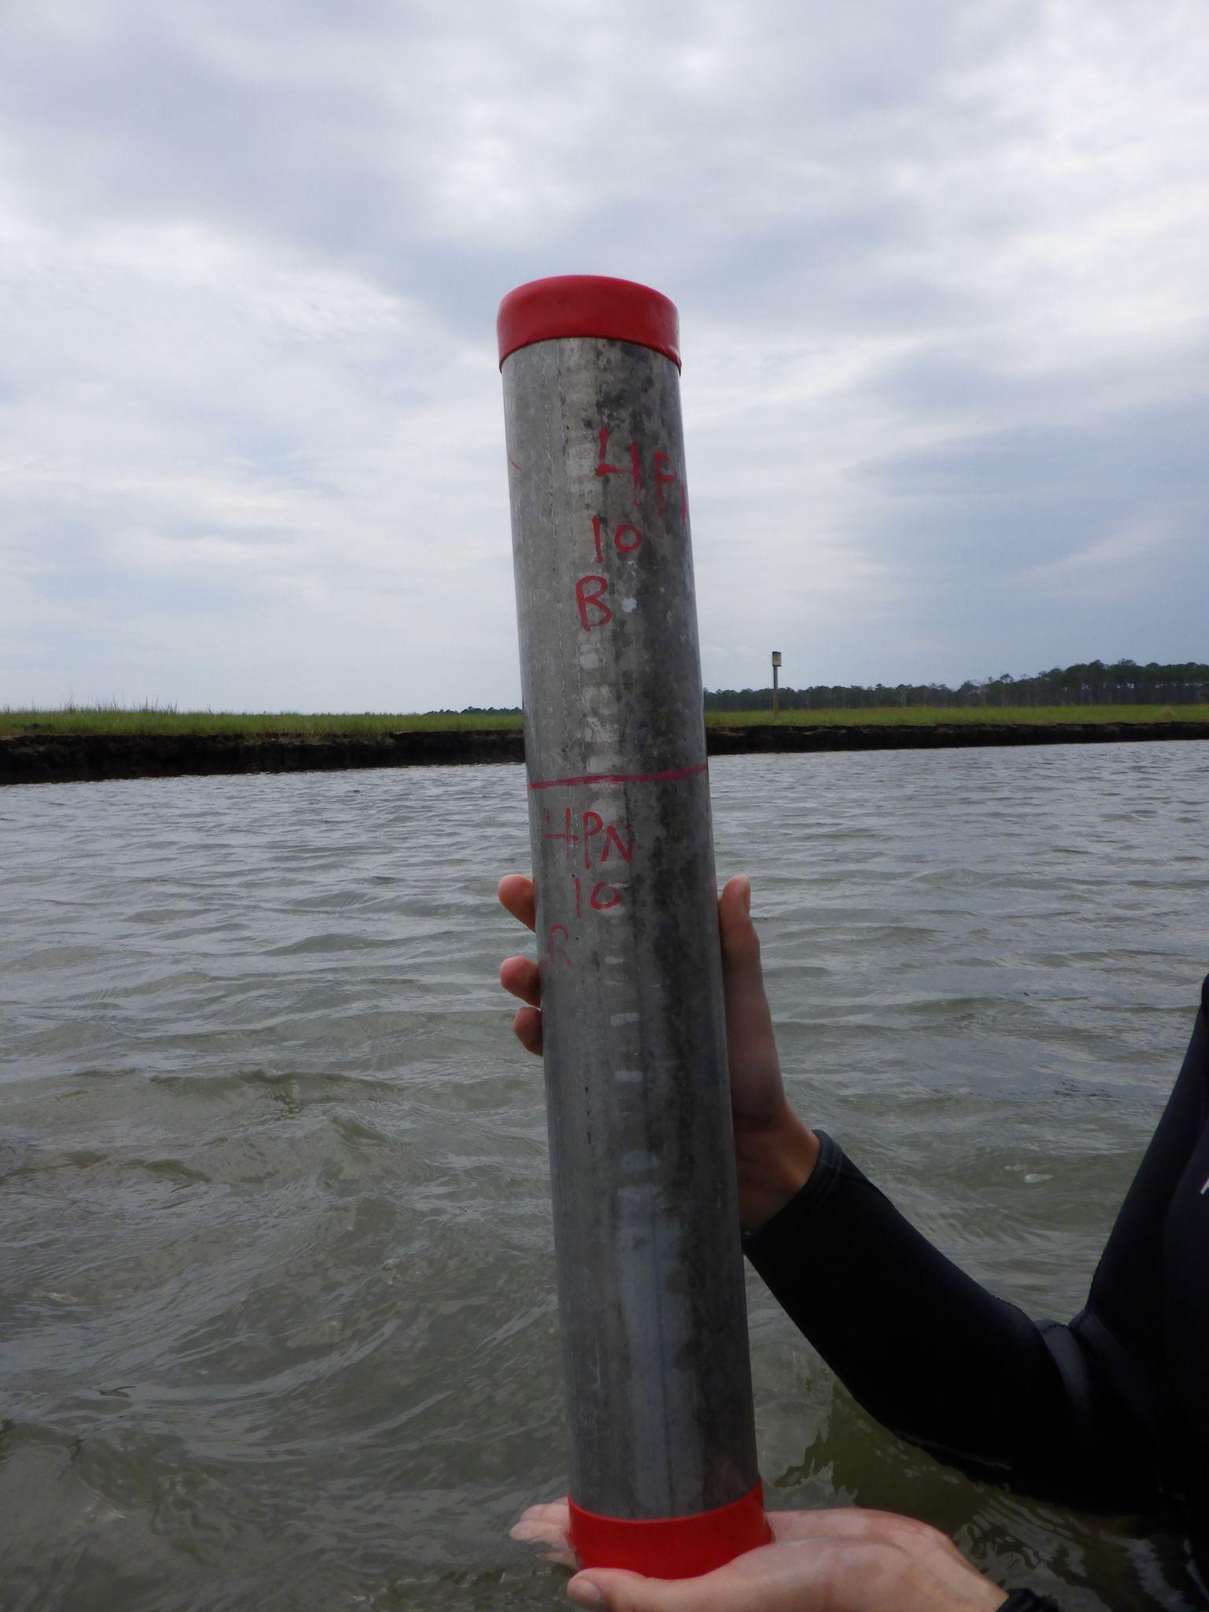
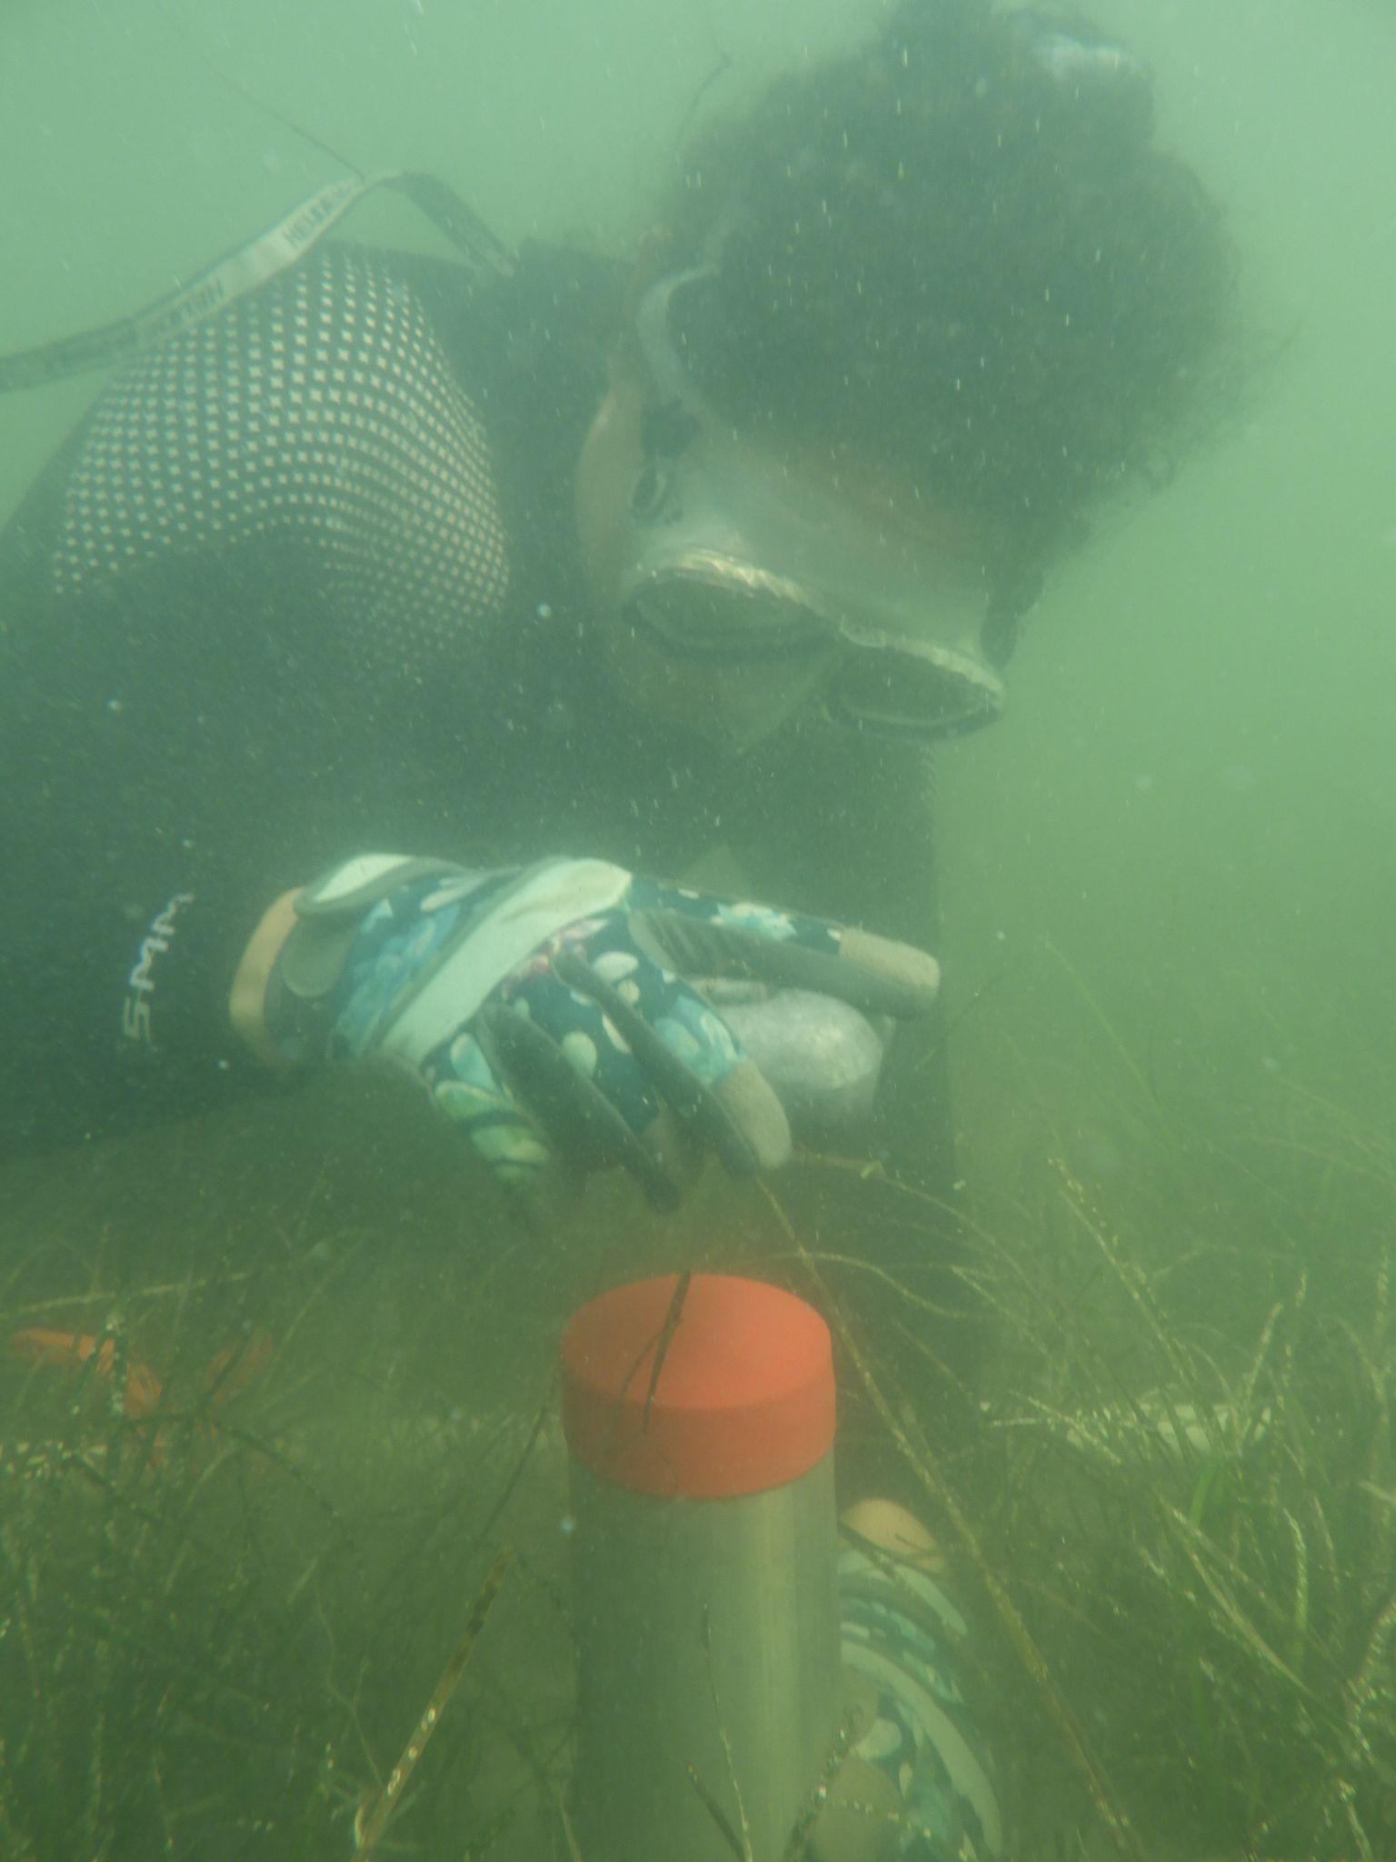
I study seagrasses, watch this to see how we core seagrass meadows!
This is hard to do underwater!
First we clip the aboveground biomass (seagrass leaves)
Then we hammer in the core
Then we cap it
The we dig under the core and pull it out of the water!
Photos and video by Alyson Hall
Notes:
Feel free to show the video in the first photo!

Slide 12
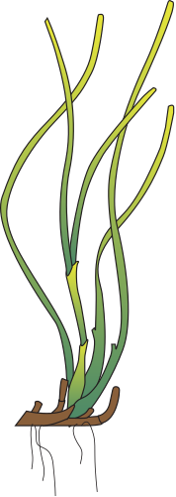
What are seagrasses?
Seagrasses are marine angiosperms.
Marine means they live in saltwater, like the ocean or estuaries
Angiosperms is a word for “flowering plants” like fruit trees or flowers!
Photo by Benjamin L. Jones on Unsplash
Icons by Catherine Collier, Integration and Application Network (ian.umces.edu/media-library)

Slide 13
What are seagrasses?
Seagrasses are marine angiosperms.
Marine means they live in saltwater, like the ocean or estuaries
Angiosperms is a word for “flowering plants” like fruit trees or flowers!
They perform many ecosystem services
Provide homes for many animals
Keep sediment in place from waves
Act as carbon sinks!
Photo by Benjamin L. Jones on Unsplash
Icons by Catherine Collier, Integration and Application Network (ian.umces.edu/media-library)

Slide 14
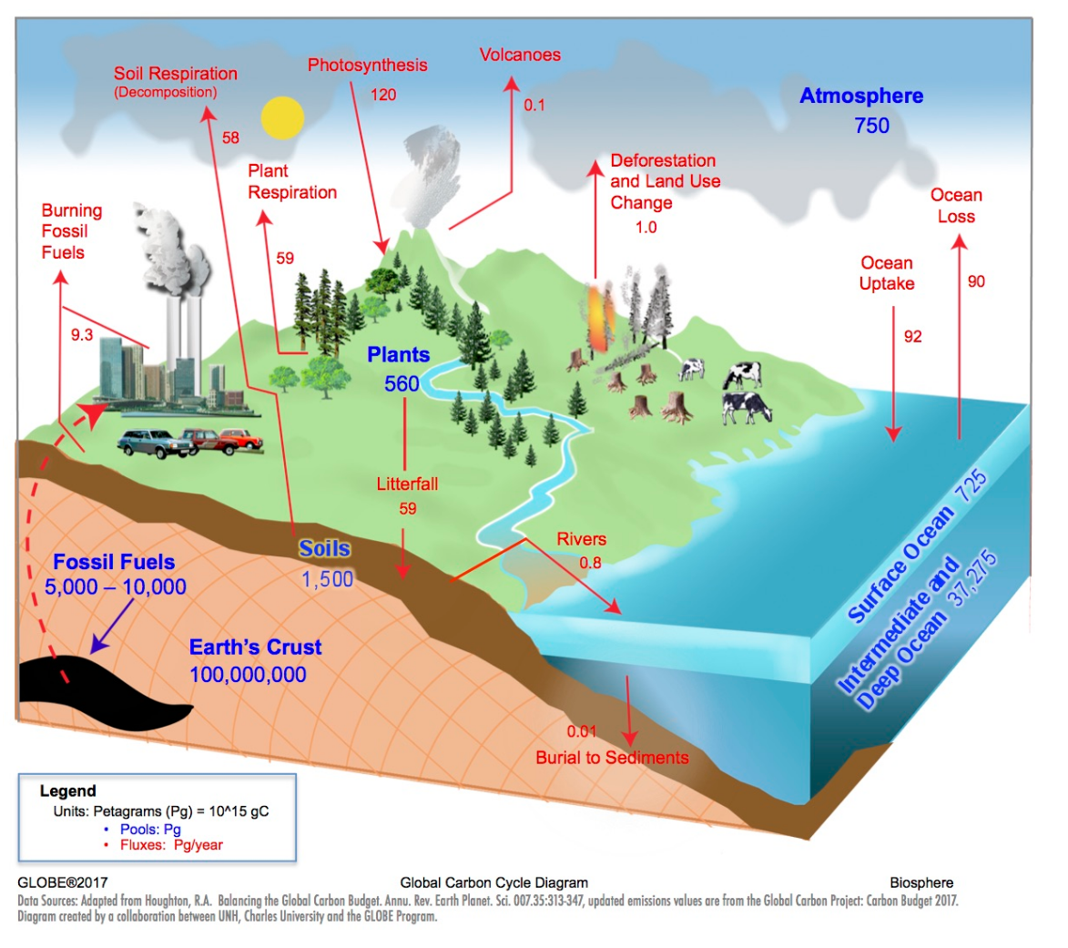
Global carbon cycle
Where would seagrasses fit in?
Notes:
Optional challenge for students

Slide 15
Global carbon cycle
Where would seagrasses fit in?
Between the coast and open ocean!
Seagrasses add to burial in ocean sediments as well as plant biomass
Notes:
Optional challenge for students

Slide 16
The Chesapeake Bay has two species of seagrasses
The Chesapeake Bay has two species of seagrass:
Eelgrass – Zostera marina
Widgeon Grass – Ruppia maritima
These two species differ in size and shape
Eelgrass is taller with thicker leaves
Widgeon grass is usually shorter with thin, branching leaves
Eelgrass
Widgeon Grass
Icons by Catherine Collier and Tracey Saxby, Integration and Application Network (ian.umces.edu/media-library)

Slide 17
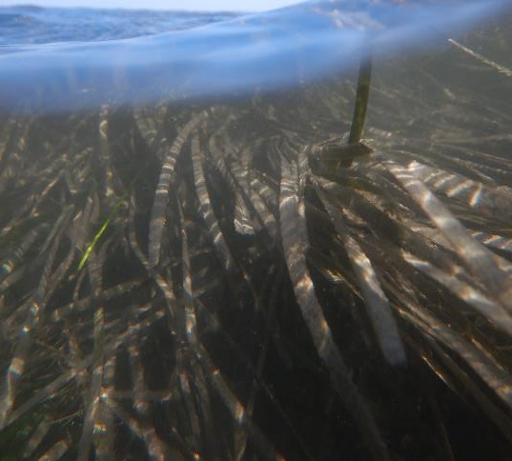
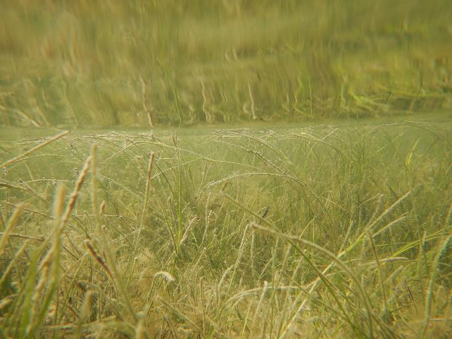
Can you guess which picture is each species?
Photos by Alyson Hall

Slide 18
Can you guess which picture is each species?
Eelgrass!
Widgeon Grass!
Photos by Alyson Hall

Slide 19
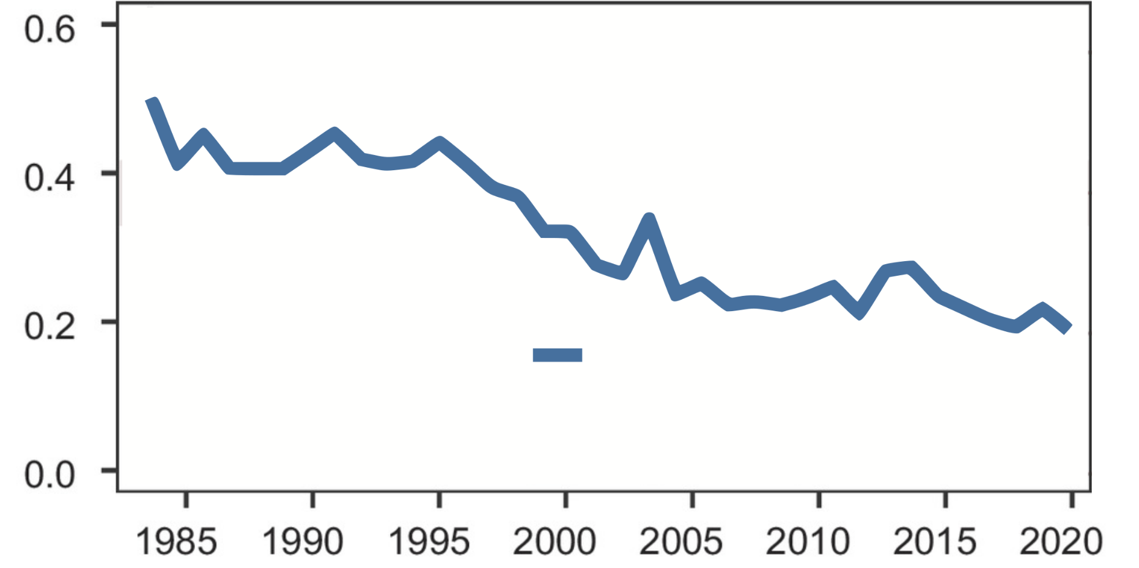
The Chesapeake Bay has a new dominant seagrass!
Most seagrass meadows in the Chesapeake Bay used to be formed by Eelgrass (dominant species)
Proportion of total seagrass area in the Chesapeake Bay
Eelgrass
(Adapted from Figure 2, Hensel et al., 2023; https://www.pnas.org/doi/10.1073/pnas.2220678120; Copyright (2023) National Academy of Sciences )
Notes:
This graph shows the amount (proportion) of seagrass area, or meadows, that was composed of each species (widgeon grass or eelgrass) in the Chesapeake Bay

Slide 20
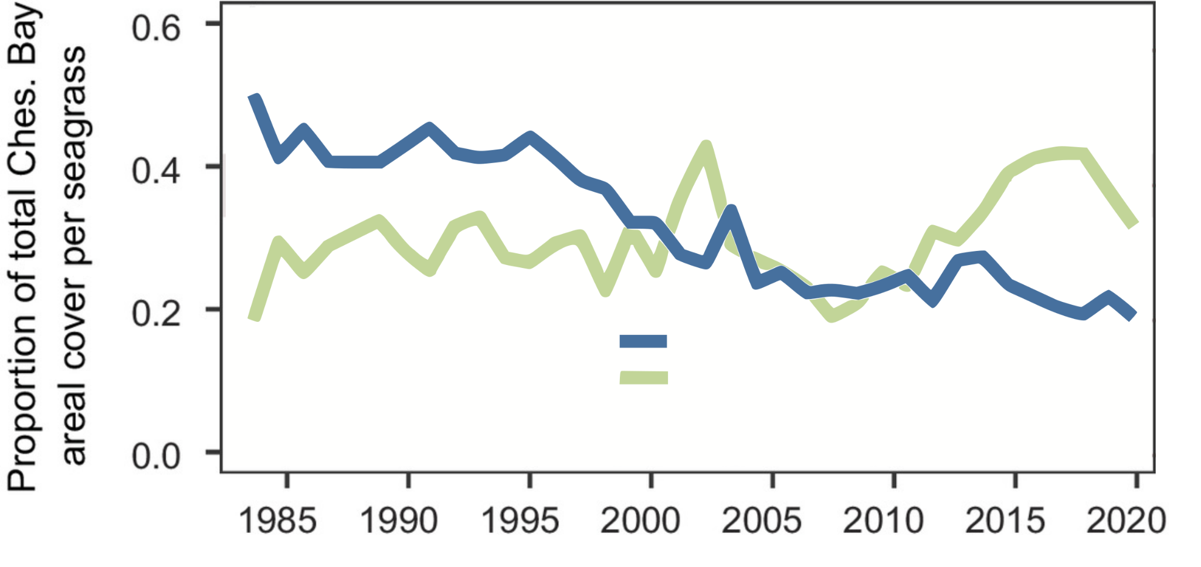
The Chesapeake Bay has a new dominant seagrass!
Most seagrass meadows in the Chesapeake Bay used to be formed by Eelgrass (dominant species), but due to rising summer temperatures, the new dominant species is Widgeon Grass
Proportion of total seagrass area in the Chesapeake Bay
Eelgrass
Widgeon Grass
(Adapted from Figure 2, Hensel et al., 2023; https://www.pnas.org/doi/10.1073/pnas.2220678120; Copyright (2023) National Academy of Sciences )
Notes:
This graph shows the amount (proportion) of seagrass area, or meadows, that was composed of each species (widgeon grass or eelgrass) in the Chesapeake Bay

Slide 21
The Chesapeake Bay has a new dominant seagrass!
What kind of effects does this shift hold?
That is a current topic of research at the Virginia Institute of Marine Science!
Most seagrass meadows in the Chesapeake Bay used to be formed by Eelgrass (dominant species), but due to rising summer temperatures, the new dominant species is Widgeon Grass
Proportion of total seagrass area in the Chesapeake Bay
Eelgrass
Widgeon Grass
(Adapted from Figure 2, Hensel et al., 2023; https://www.pnas.org/doi/10.1073/pnas.2220678120; Copyright (2023) National Academy of Sciences )

Slide 22
Our study: Seagrass sediment carbon by species
In order to investigate if carbon stock differed between seagrass species, we will core sediment in both Eelgrass and Widgeon grass meadows and compare them
C
O
O
Photo by Alyson Hall

Slide 23
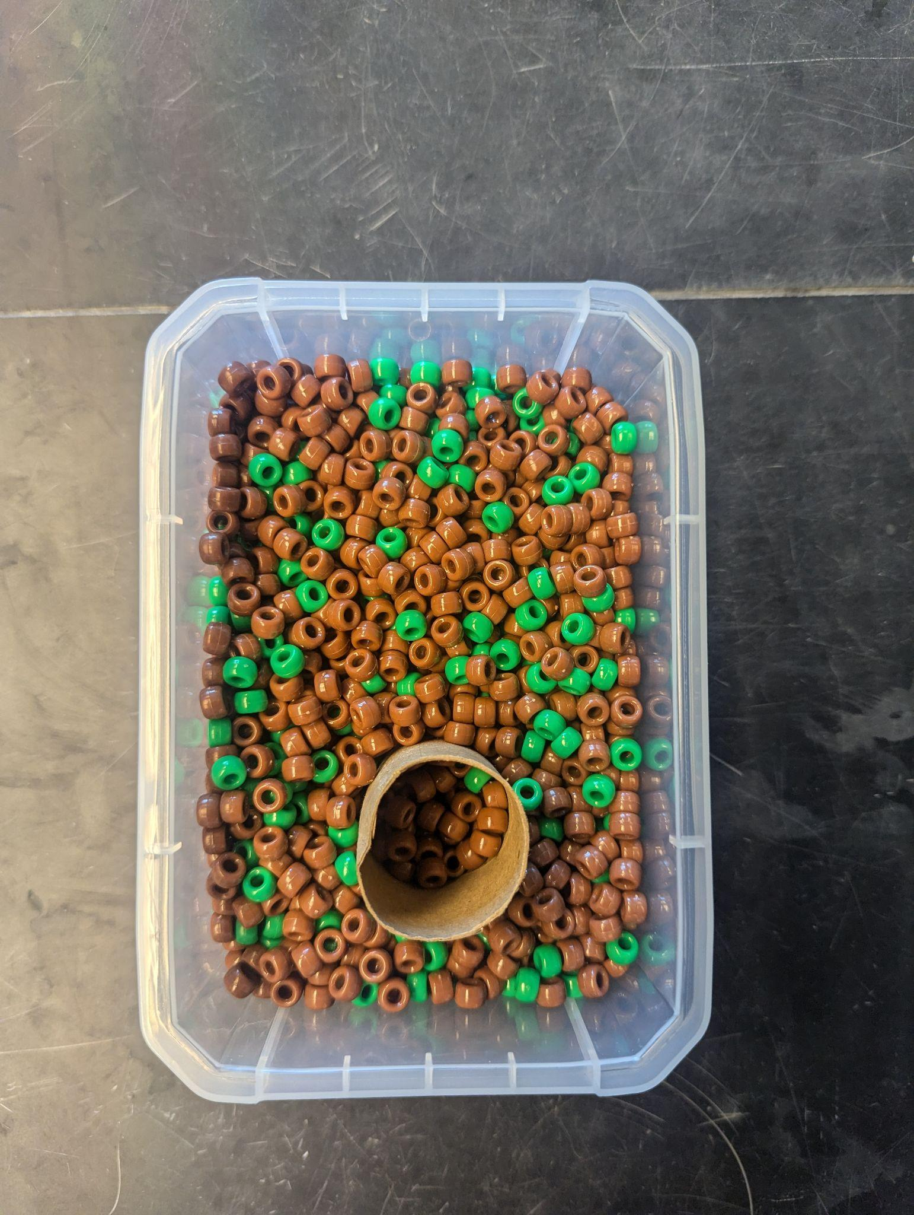
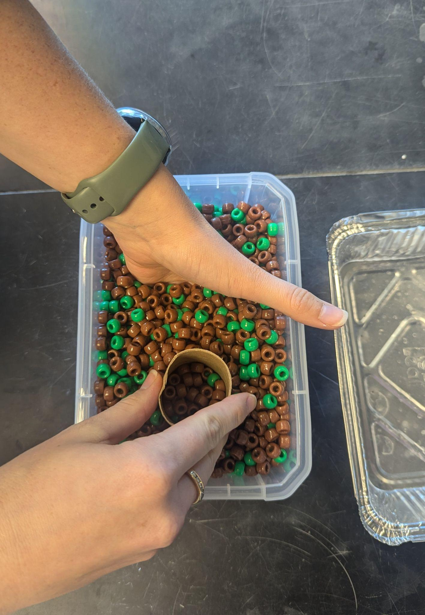
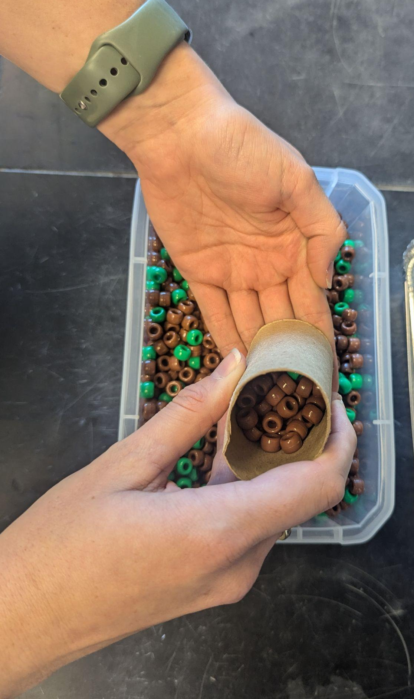
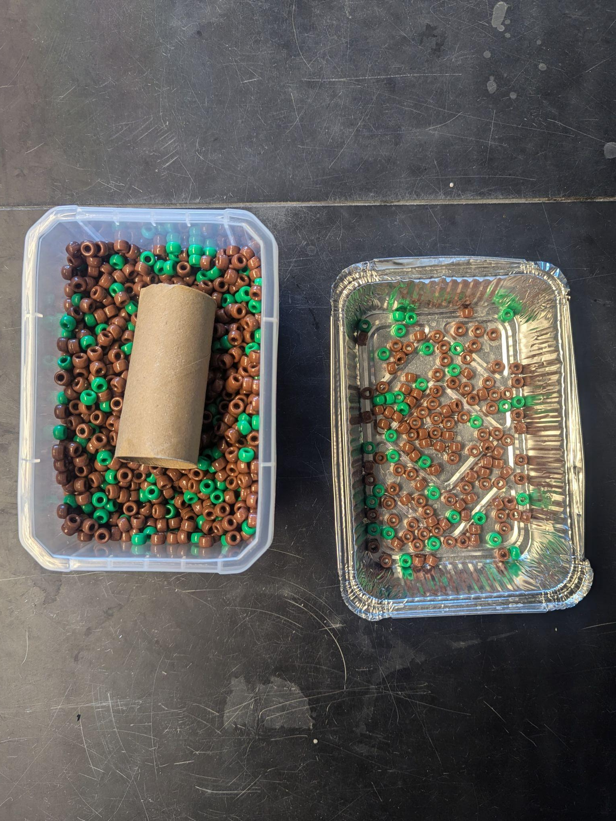
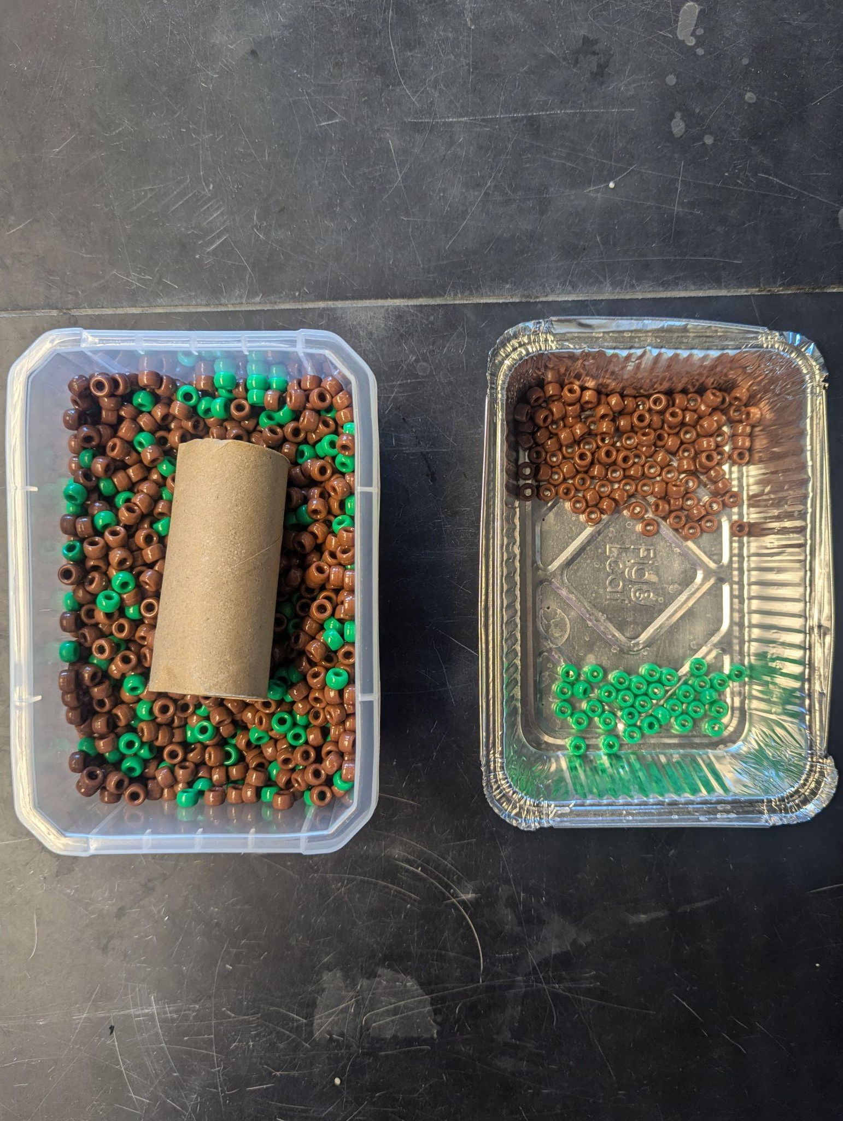
Now it is your turn to take cores and measure carbon!
Follow along the worksheet to take cores and calculate carbon stocks as a group
Share results and calculate an average carbon stock per species
Graph your results and draw conclusions
Photos by Alyson Hall

Slide 24
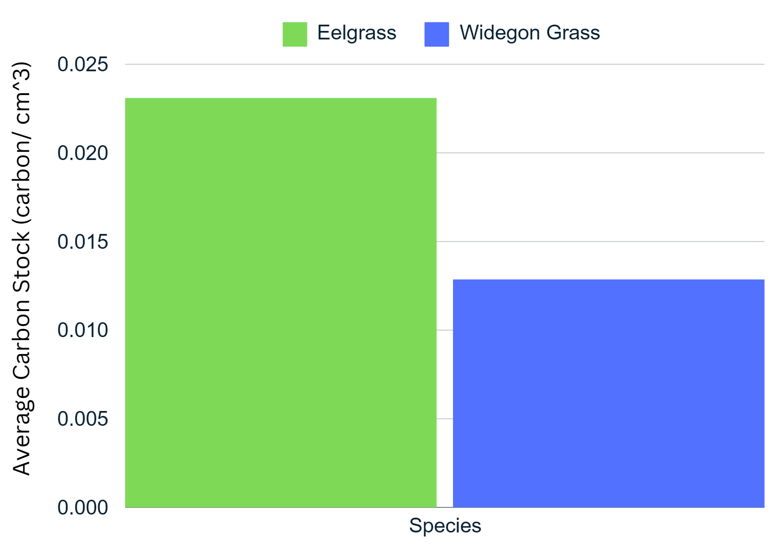
Core activity: results
Eelgrass meadows have a larger carbon stock!
Notes:
This graph is from the answer key, your students graph might look slightly different (average values might differ slightly). Every core will have slightly different amounts of carbon stock, just like in nature!

Slide 25
Core activity extension: carbon stocks over time
Seagrass coverage per species is not constant over time!
How do you think seagrass carbon stocks have changed over time?
Proportion of total seagrass area in the Chesapeake Bay
Eelgrass
Widgeon Grass
(Adapted from Figure 2, Hensel et al., 2023; https://www.pnas.org/doi/10.1073/pnas.2220678120; Copyright (2023) National Academy of Sciences )

Slide 26
What did we learn today?
Coastal habitats, like seagrass meadows, are important carbon sinks
Carbon stocks can be measured using carbon cores
Seagrass meadows of different species can have different carbon stocks
Photo by Benjamin L. Jones on Unsplash

